Slide 1
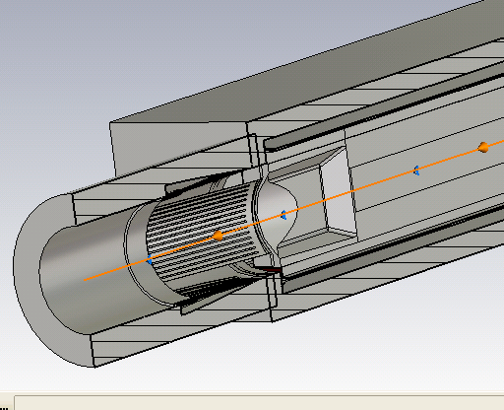
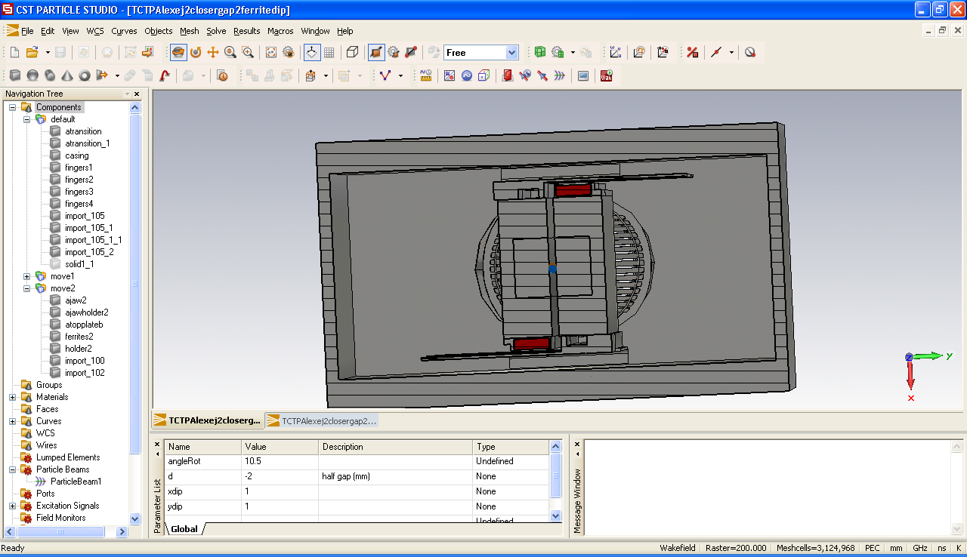
Collimator design with BPMs
(TCTP)
F. Caspers, H. Day, A. Grudiev, E. Métral, B. Salvant

Slide 2
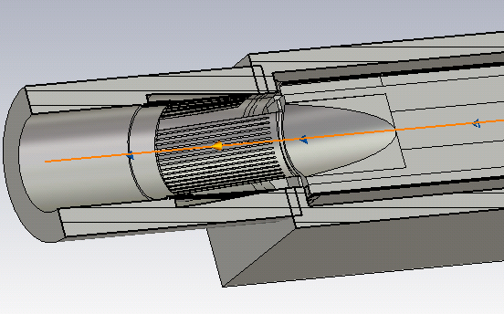
Main changes with current design from impedance point of view
Taper
Wish to suppress the contact fingers
(but adding ferrite)
new
current

Slide 3
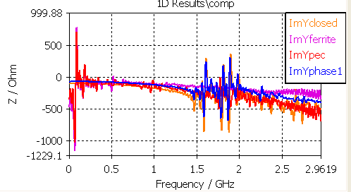
Preliminary simulations vertical imaginary impedance (in Ohm/mm) for 2mm half gap
→ Complicated model imported from CATIA (thanks to simplifications from Luca Gentini)
Absence of contact seems to lead to significant low frequency resonance
Phase 1 to new taper seems to lead to 20 to 30% broadband impedance increase
To be checked with more convergence studies

Slide 4
Next steps
Convergence studies
Compare with resistive wall impedance for these gaps
Look for recommendations to TS/MME and solutions to minimize the impedance
Dedicated impedance meeting this Friday?

