Slide 1
Preliminary analysis of the ADT data from LHC ecloud MD 26th August
H. Bartosik, G. Arduini, W. Höfle

Slide 2
Overview
Analysis of “2nd dump” of LHC 25ns injection MD
(after 12 bunches) B2 injection of 48 bunches with 25ns spacing with transverse dampers off
Protection dump due to losses after around 500 turns (previous injection with transverse dampers was dumped after around 1000 turns)
Injection itself looked clean
Around 30s before injection: perturbation on 3.3kV line
→ Cryo plant in point 2 lost around 30s after injection …
No particular observation on BBQ data
Probably due to fast time scale
Analysis of 73 turns before the dump from the ADT (damper) pickups of all bunches is presented

Slide 3
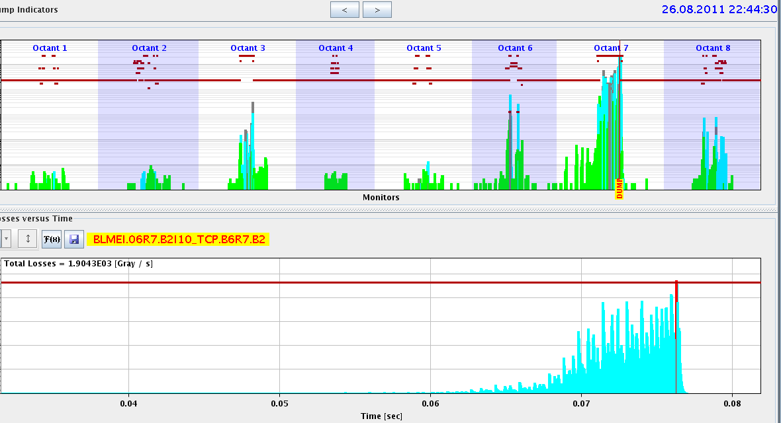
Losses in vertical plane → beam dump

Slide 4
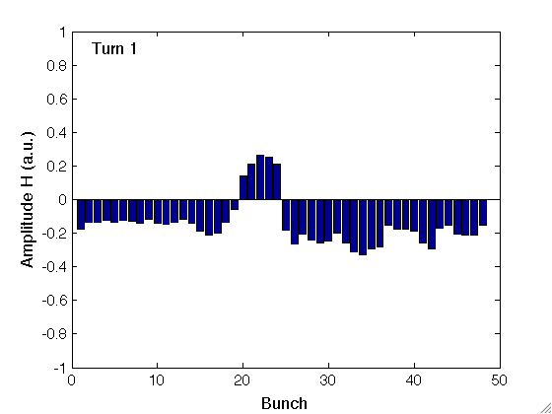
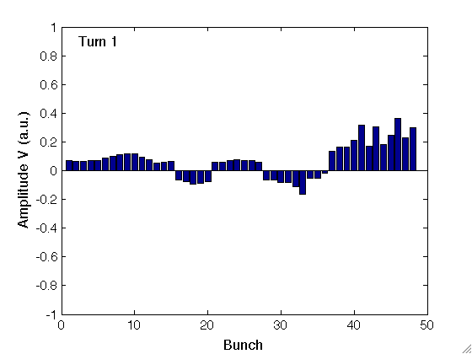
ADT pickup signals (Q9)
Increased coupled bunch motion after ~20 bunches …

Slide 5
SVD – pattern reconstruction

Slide 6
“Mountain range” of bunch motion

Slide 7
Single bunch FFTs
FFT of the 73 turns for each bunch

Slide 8
Tunes along the batch (with NAFF)
Ecloud saturation after ~28 bunches? …
Bunch intensities along the 73 turns probably not constant
Pickup signal maybe saturated (to be checked)

Slide 9
“Rise time” estimations
Estimating “rise time” from the 73 turns
Instability was already developped → not a real rise time
Losses probably during and before the 73 turns (ADT data is NOT just before the dump, but a little earlier)

Slide 10
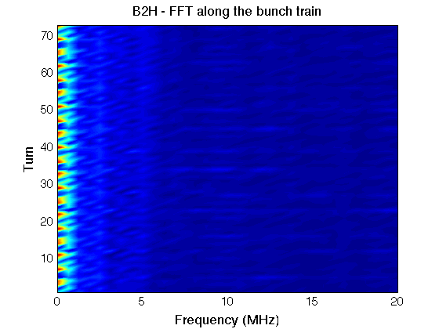
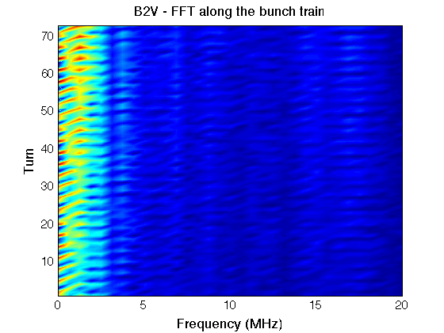
FFT along the bunch train for each turn

Slide 11
2D FFT

