Slide 1
HEADTAIL simulation studies of Landau damping through octupoles in the LHC.
E.Metral, N.Mounet, B.Salvant, R.Wasef
09/08/2011

Slide 2
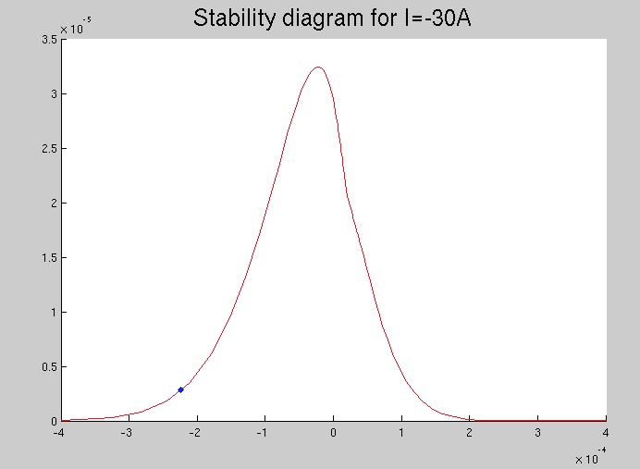
Objective
HEADTAIL
-> average position
-> tune-shift
-> stabilizing current
THEORY
-> tune-shift
-> stabilizing current
-> stability diagram
-Im(ΔQ)
Re(ΔQ)
Compare HEADTAIL and Theory and try to plot the stability
diagram using HEADTAIL

Slide 3
Main parameters
Single bunch
Energy: 3.5 TeV
Collimator settings: MD May 17th 2010
Impedance: Only dipolar component
Linear bucket
Intensity: 1.15e11 p/b
Horizontal chromaticity: 6

Slide 4
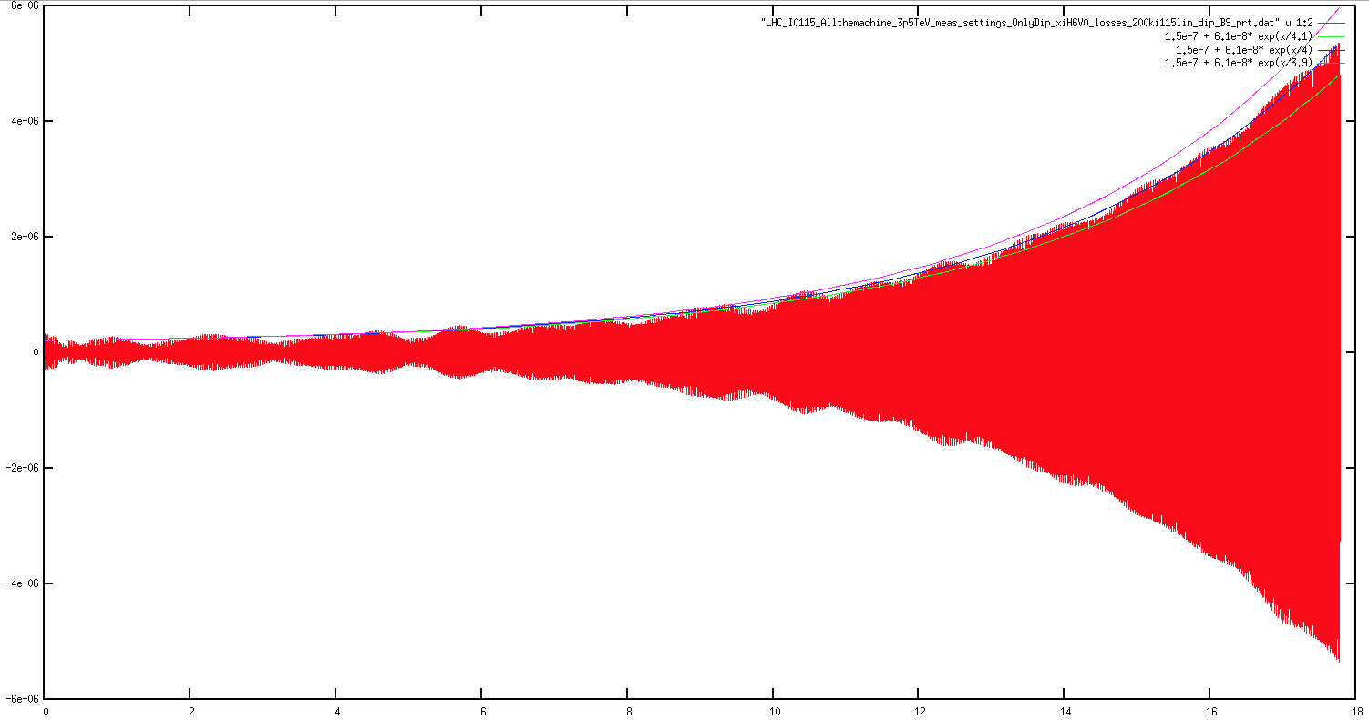
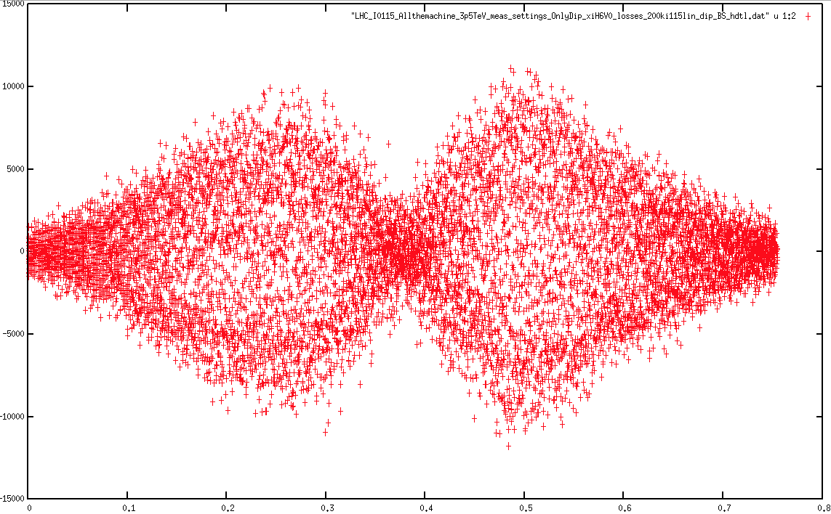
Average horizontal position & Imaginary tune-shift
3 different fits with 3.9 ; 4 and 4.1 as time constant
Mode 1
➔Rise-time = 4.02s which leads to Im(ΔQ)= -3.5 E-6

Slide 5
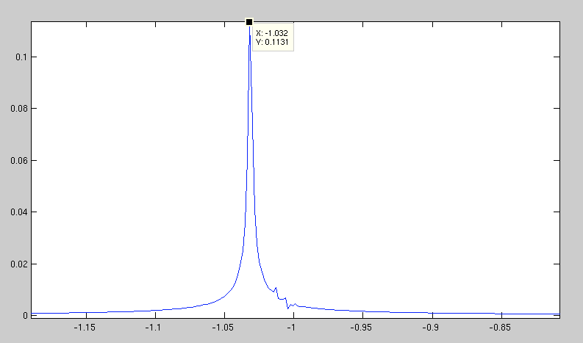
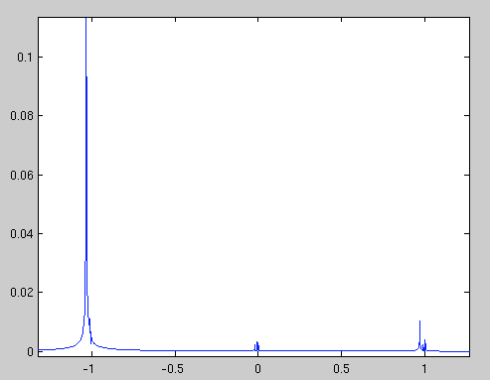
Real tune-shift
Obtained with an FFT of the average horizontal position
➔Re(ΔQ)= -9.28 E-5

Slide 6
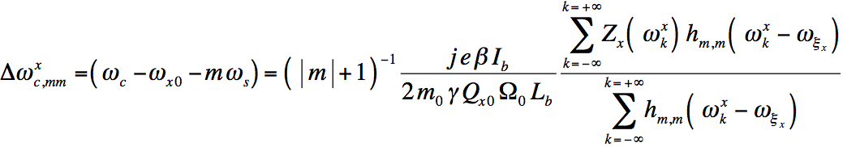
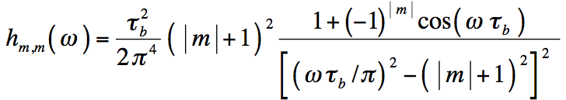
Sacherer's analysis
with
with
➔ΔQ= -1.64 E-4 – i 3.78E-6

Slide 7
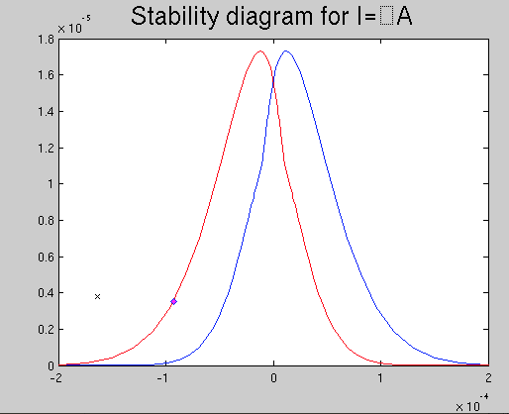
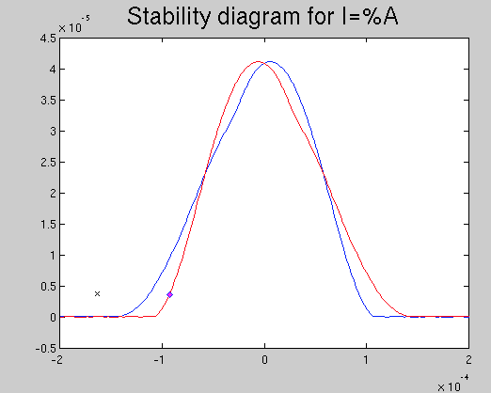
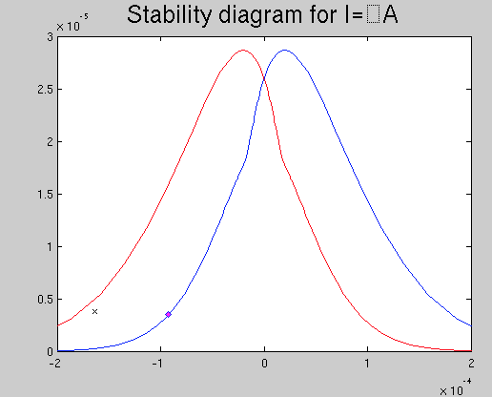
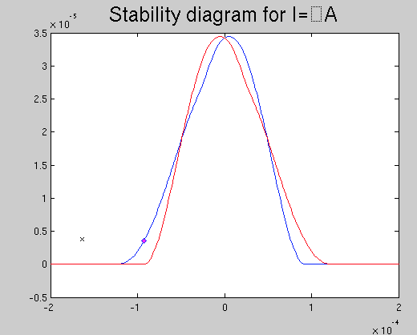
Stability diagrams
Gaussian distribution
Parabolic distribution
-Im(ΔQ)
-16 A
-Im(ΔQ)
-37 A
Sacherer tune-shift
HDTL tune-shift
Re(ΔQ)
Re(ΔQ)
HEADTAIL: between -5 and -10A
-Im(ΔQ)
+26.5A
-Im(ΔQ)
+31A
Re(ΔQ)
Re(ΔQ)
HEADTAIL: between +10 and +15A

Slide 8
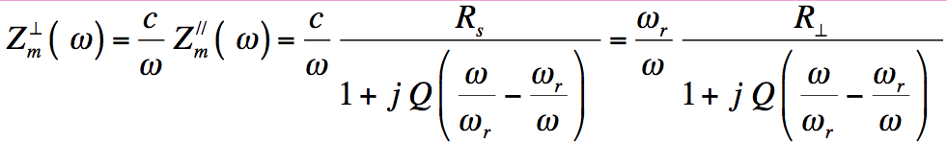


Resonator Impedance
To scan the curve of stability, a broad-band impedance model is used to obtain a second point on the curve
With:
The resonance angular frequency:
Quality factor:
Shunt Impedance:

Slide 9
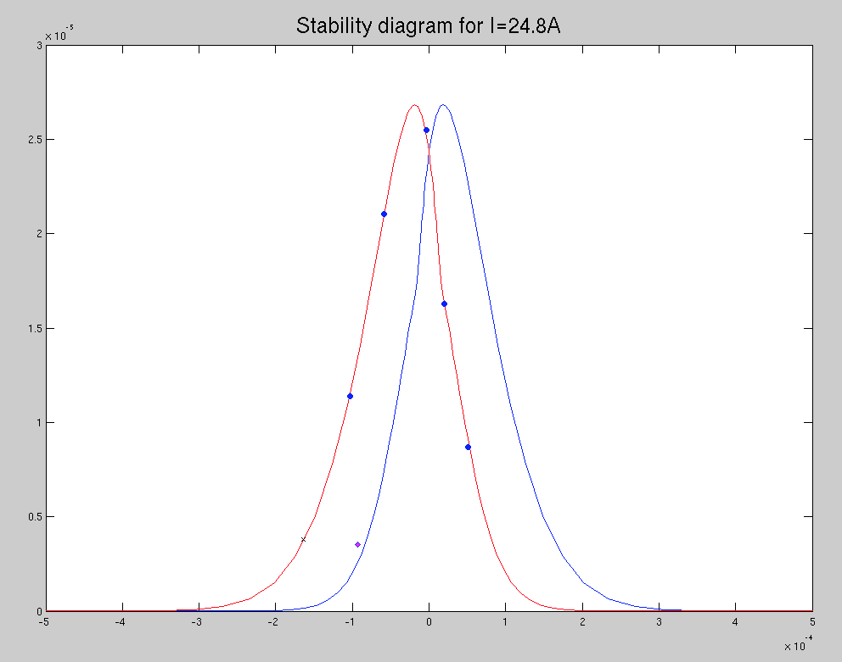
Resonator Impedance
-Im(ΔQ)
R=17.5MΩ/m, Q=1 f =0.6GHz
R=17.5MΩ/m, Q=1 f =0.64GHz
R=17.5MΩ/m, Q=2 f =0.6GHz
R=7.1MΩ/m, Q=0.5 f =0.75GHz
R=22.5MΩ/m, Q=1 f =0.1GHz
Sacherer for LHC_dipolar
Re(ΔQ)
HDTL for LHC_dipolar

Slide 10
Comparaison Sacherer/HDTL/MOSES
 | Rs (Mohm/m) | 7.1 | 17.5 | 17.5 | 17.5 | 22.5 | 7 | 9.86
 | Q | 0.5 | 1 | 1 | 2 | 1 | 0.5 | 0.5
 | f(GHz) | 0.75 | 0.64 | 0.6 | 0.6 | 0.1 | 0.75 | 1.5
Headtail | Re | 1.42E-05 | 5.28E-05 | 4.49E-05 | 4.11E-05 | 7.63E-06 | 1.11E-05 | -5.24E-05
 | Im | -1.12E-05 | -3.16E-05 | -3.06E-05 | -1.93E-05 | -2.95E-06 | -1.14E-05 | -0.000011619
MOSES | Re | 1.05E-05 | 3.23E-05 | 3.17E-05 | 2.25E-05 | 3.80E-06 | 1.03E-05 | -6.48E-05
 | Im | -1.14E-05 | -3.13E-05 | -3.10E-05 | -1.97E-05 | -3.89E-06 | -1.12E-05 | -7.82E-06
 | error RE | 26 | 39 | 29 | 45 | 50 | 7 | 24
 | error Im | 2 | 1 | 1 | 2 | 32 | 2 | 33
Sacherer | Re | 4.85E-06 | 3.09E-05 | 3.27E-05 | 2.57E-05 | 4.74E-06 | 4.78E-06 | -8.36E-05
 | Im | -1.72E-05 | -3.43E-05 | -3.39E-05 | -2.32E-05 | -3.67E-06 | -1.70E-05 | -5.29E-06
 | error Re | 66 | 41 | 27 | 38 | 38 | 57 | 60
 | error Im | 55 | 8 | 11 | 20 | 24 | 49 | 54

Slide 11
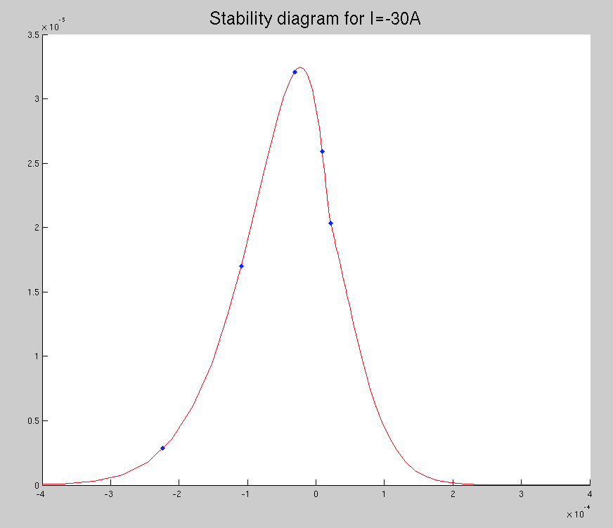
Scan at -30A
-Im(ΔQ)
R=27.67MΩ/m, Q=1 f =1GHz
R=25.415MΩ/m, Q=2 f =0.9GHz
R=12.89MΩ/m, Q=1.5 f =0.6GHz
R=18.9MΩ/m, Q=0.55 f =1.3GHz
R=24.5MΩ/m, Q=0.55 f =1.55GHz
Re(ΔQ)

Slide 12
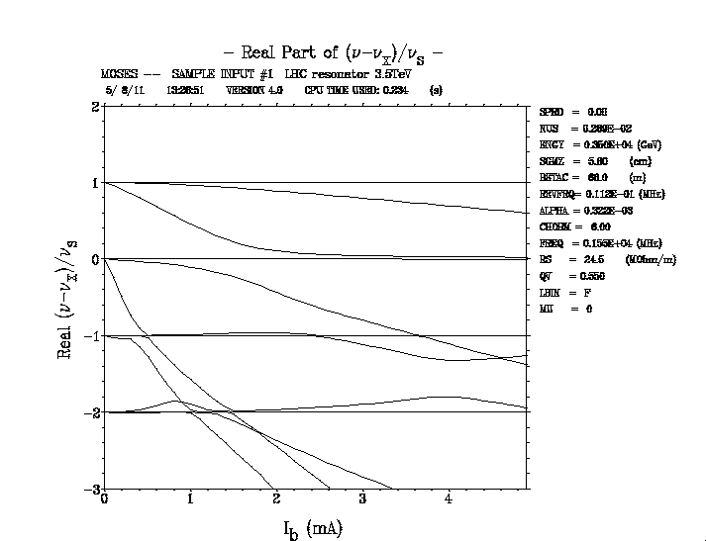
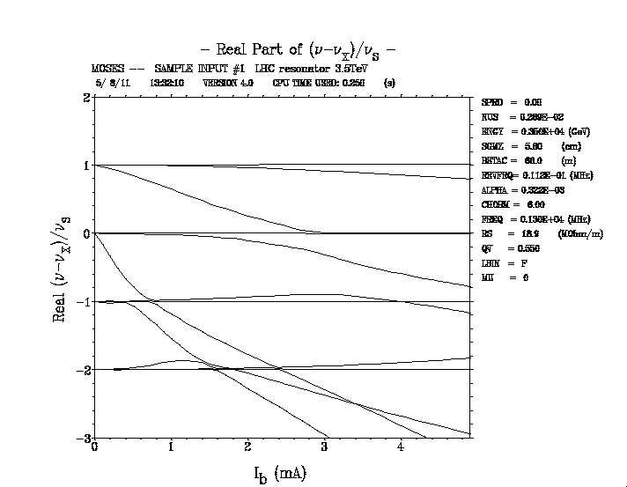
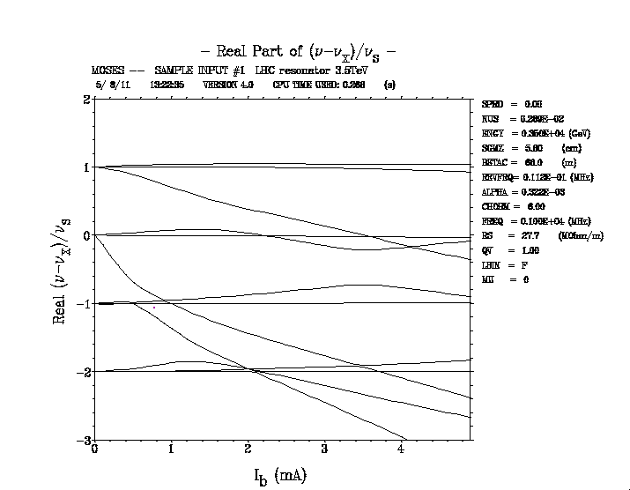
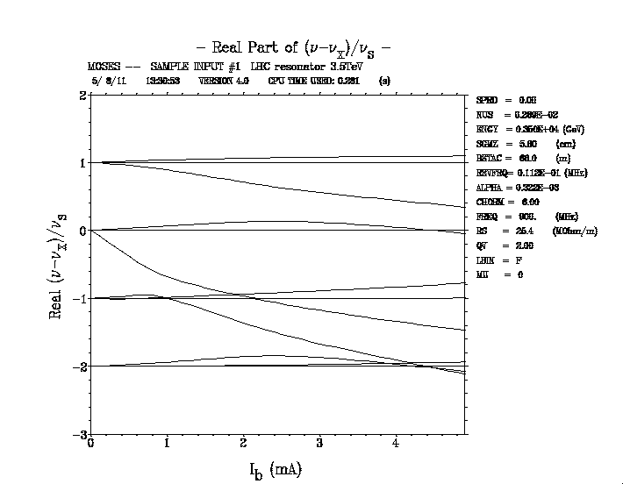
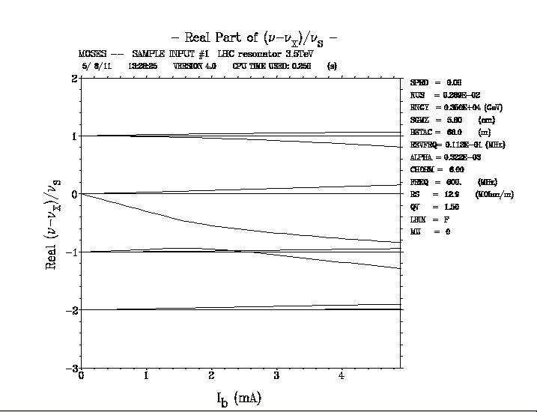
Head-Tail and not TMC

Slide 13
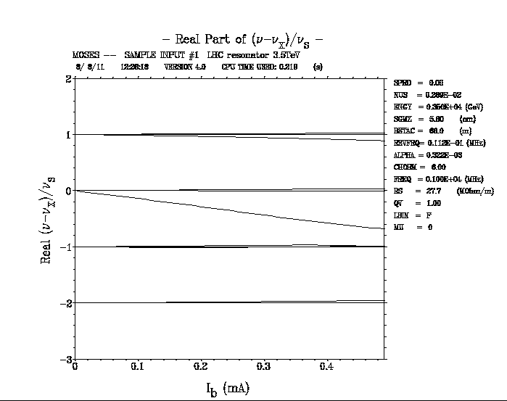
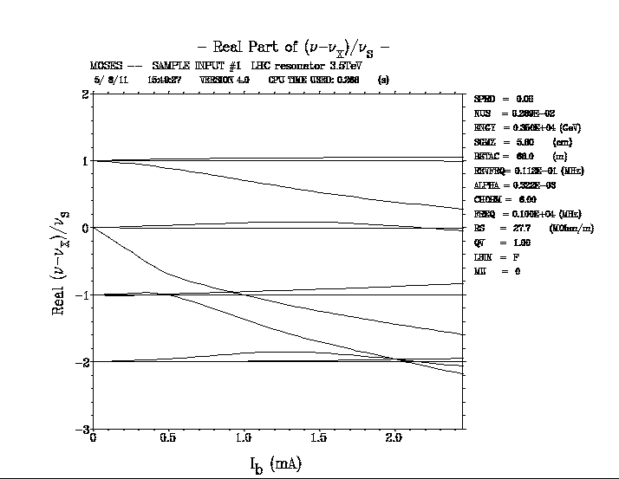
Head-Tail and not TMC

