Slide 1
Bench measurements of the PS fast wire scanner
Jean-Luc Nougaret, Olav Berrig and Hugo Day with special thanks to Benoit Salvant and William Andreazza

Slide 2
Forewarning
The stretched wire method should not be applied to this case because it is a cavity and not a long element (L<2d)
The wire forms a TEM line allowing for electromagnetic communication between the end plates of the cavity below waveguide cutoff or below the fundamental mode of the unperturbed cavity.
The presence of the wire reduces the unperturbed Q values of the longitudinal modes massively.
Instead Q measurement should be done using on axis probes for the longitudinal modes and probe pairs with 180 deg Hybrid for the transverse modes.
Notes:
We are still very thankful to Fritz and Vittorio in explaining why the stretched wire measurement method should not be applied in this case.
First the fast wire scanner is about 45 centimeters long and 45 cm centimeters wide. This means that the length is less than two times the diameter, which means the device should be analyzed according to the theory of cavities, which means it has a Q and loss-factor.
Essentially, the presence of the wire forms a TEM line which allows for electromagnetic communication between the end plates of the cavity, below waveguide cutoff or below the fundamental mode of the unperturbed cavity. This reduces the Q values massively.

Slide 3
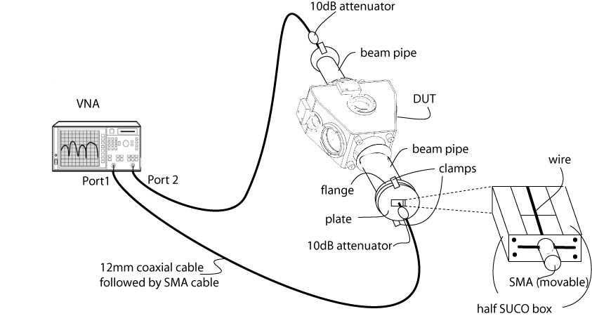
Setup for single wire measurement
Notes:
For longitudinal impedance measurements, we stretch the wire across the tank. The device under test consists of the tank and of the added beam pipe portions. The beam pipe is not expected to make significant changes to the real impedance and the modification of the imaginary impedance is taken into account through reference normalization.
The device under test is connected to the two ports of vector analyzer through 12 mm and SMA cables.
The ends of the cables are fitted with a 10dB attenuator.
Note that the wire is running across a split SUCO box without any shielding.

Slide 4
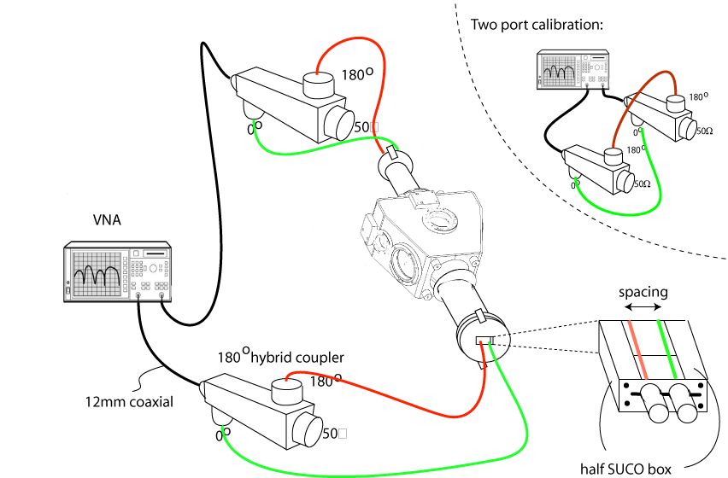
Setup for two wire measurement
Notes:
For transverse impedance measurements, we stretch two wires across the tank, with current flowing in the two opposite directions thanks to a 180 degrees hybrid coupler.

Slide 5
Settings
2000 points
Start frequency=1MHz
Stop frequency=2GHz
I/F bandwidth=1kHz
Averaging OFF
Frequency low-pass OFF
Preset power 0dBm=1mW
Notes:
The settings of the Vector Network Analyzer are as followed.
As far as I understand the I/F bandwidth should be as small as possible, but decreasing it increases the time required to get the measurements.

Slide 6
Calibration
Zg=50 Ω, ZL=50 Ω.
Cables on port 1 and port 2 fitted with 10dB attenuators (stay during measurements).
Open circuit reflection calibration of port 1.
Short circuit reflection calibration of port 1.
50 Ohm reflection calibration of port 1.
Repeat reflection calibration for port 2.
Transmission calibration with connection between port 1 and port 2, with 2x10dB attenuators.
Notes:
The calibration is performed in two stages.
First we calibrate individually ports 1 and 2 by terminating the cable with open, short and 50 ohm terminations.
Second we calibrate the transmission by connecting ports 1 and 2 through 2 10dB attenuators.

Slide 7
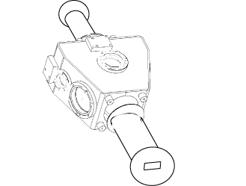
Transmission line
50 Ω
-10dB
Z0, k0
-10dB
50 Ω
50 Ω
50 Ω
Notes:
According to the wire method, the system behaves as a transmission line.
The transmission line is not matched as the characteristic impedance Z0 is different from the system’s 50 Ohm impedance.
We assume that the device under test adds a small homogeneously distributed impedance.

Slide 8
Multiple reflections
No matching network.
Initial attempt to rely on time gating to protect against multiple reflections.
But DUT still ringing after first reflection.
Finally removed gating by importing raw data without gating active.
Lots of reflections show up in the measurements.
Notes:
This has the consequence that multiple reflections occur on the transmission line created by the stretched wire.
We initially tried to get of such reflections by relying on time gating, but the device under test was still ringing.
Eventually we collected the raw data without gating.
But multiple reflections show up in the measurements.

Slide 9
Longitudinal impedance formula [1,2]
Without an actual reference, assume
Notes:
For a matched transmission line, there are two alternative formulae to compute the longitudinal impedance. The one on the left is the one from Vaccaro, the one on the right is the one due to Walling and reported by Fritz Casper. In appendix we derive these two formulae from the expression of the propagation constants.
As we do not have a reference consisting of a beam pipe of equal length, we assume the reference is a pure delay.
In this case, the longitudinal impedance is given by the following formula.

Slide 10
Determination of
Characteristic impedance of reference (no DUT)
From time domain transient 1st reflection step:
From an analytical model of the beam pipe [3]:
Very coarse approximation:
Notes:
In order to determine Z0, we can rely on measuring the coefficient of the first reflection.
Alternatively, we found a paper which provides a formula to compute the characteristic impedance for a coaxial cable with an inner circular conductor and an outer elliptic conductor, but it did not work too well.
Finally, a very coarse approximation of the characteristic impedance is given by the free space impedance.

Slide 11
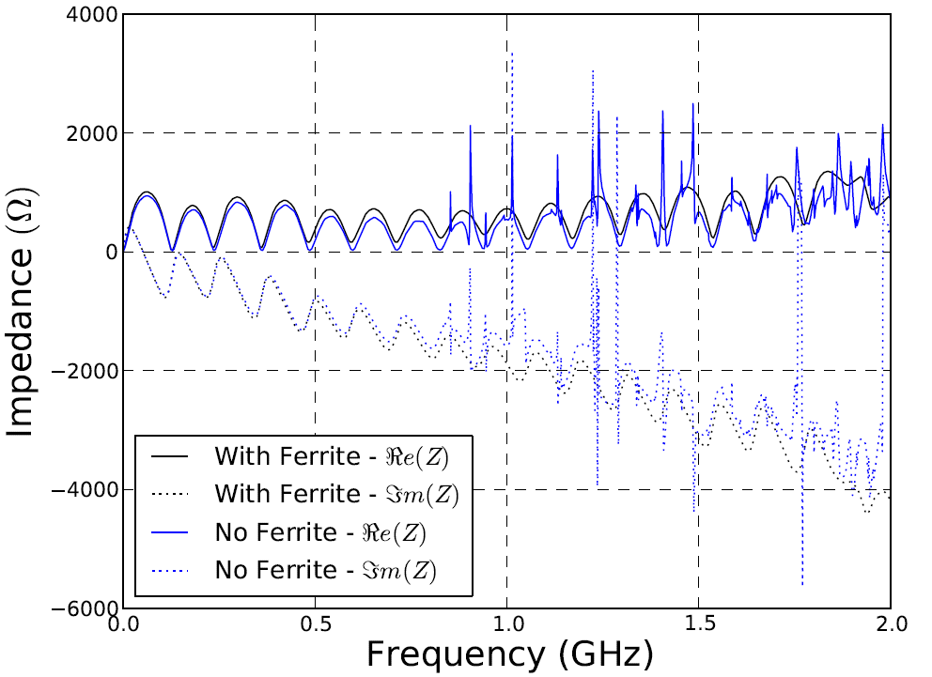
Results
Notes:
The signals exhibit multiple reflections but we can still see a few peaks in the real part of the impedance.
However, we cannot get accurate measurements of the Q values which are massively reduced by the presence of the stretched wire.
By comparison, we can see that the ferrites suppress the peaks.

Slide 12
Transverse impedance formula
From Panowski-Wentzel theorem and [1]:
Rotate the plate to have in both the vertical and horizontal planes.
Notes:
Similar formulae can be applied to derive the transverse impedance from two wire measurements, where delta refers to the spacing between the wires.

Slide 13
Cross-check between longitudinal and transverse impedances
Moving wire in x then y-plane [4]
Notes:
Finally, I recalled some formulae which can be applied to cross-check the values of the longitudinal and transverse impedances.
Don’t ask me what they mean because I won’t be able to answer.
I only understood that this is where the parabola fitting comes into play.

Slide 14
Issues
The stretched wire method should not apply
Validity of the log formula for mismatched DUT?
What about Vaccaro improved method?
Is the value plugged for correct?
Validity without an actual reference ?
Effect of naked wires in the two-parts split SUCO box?
Notes:
As pointed out at the beginning of the presentation, the device’s length is less than twice its diameter which means the device should be analyzed according to the theory of cavities, while the presence of the wire results in massive reduction of the Q values.
Even if one could rely on the stretched wire method, there is still the problem that the transmission line is mismatched, in which case the two standard log formulae do not hold.
In case of an impedance mismatch, Vaccaro suggested the improved wire method which is not detailed in this presentation.
We mentioned that the measured value for Z0 does not match the one obtained by theory.
Also we plugged a theoretical value for the reference which is not the same as the reference made of a beam pipe of equal length.
We are also wondering whether the wire running in between the two parts of the SUCO box can have antenna effects that would alter the measurements.
Finally we would like to point-out that the two probe method with weak coupling will now be applied to measure the Q more reliably.

Slide 15
References
Coupling impedance measurements: an improved wire method. INFN/TC-94/023. V.G. Vaccaro, 1994.
Impedance determination from bench measurements. CERN-PS/2000-004 (RF). F.Caspers, 2000.
Characteristic Impedance of a Coaxial System Consisting of Circular and Noncircular Conductor. IEEE transactions on microwave theory and techniques, vol. 36, no. 5, May 1988. S.H.Pan. 1988.
Longitudinal and transverse wire measurements for the evaluation of impedance reduction measures on the MKE extraction kickers. AB-Note-2007-028. T. Kroyers, F.Caspers, E. Gaxiola. 2007.

Slide 16
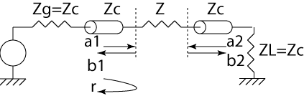
A. Lumped impedance formula
Notes:
The lumped impedance formula applies to situations where the element’s length is very small as compared to the wavelengths. It does not apply in this case.
But for completeness, I tried to explain where the formula comes from.
According to transmission line theory, the reflection coefficient is given by Zend-Zorigin/Zend+Zorigin.
We deduce the formula for Z.

Slide 17

B. Log formula [1]
Notes:
The log formula comes in two flavors.
The first one due to Vaccaro starts by expressing the propagation coefficient from transmission line theory.
The key assumption is that there is no reflection for a matched line.
In this case the transmission coefficients are simple exponentials of the propagation constant times the length of the device.
And we can the deduce the formula.

Slide 18

C. Log formula [2]
Notes:
The second version of the log formula is the one reported by Fritz Casper.
It makes the same assumption that the transmission line is matched so that the transmission coefficients are simple exponentials.
It takes the first term of the Taylor series of the square root, to deduce the longitudinal impedance.

Slide 19
D. Cutoff
B=70mm
a=146mm
No analytic formula of cutoff frequency of an elliptical beam pipe (?).
For a cylindrical beam pipe of radius r=(146/2)mm:
For a rectangular 146*70mm waveguide:
Notes:
There’s no analytic formula for the cutoff frequency of the elliptical beam pipe.
We can either rely on the formula for a cylindrical waveguide or use the formula for a rectangular waveguide.
For a cylindrical waveguide the first modes to propagate are the TE11 and TM01.
For a rectangular waveguide, the cutoff is given by the following formula for both TE and TM modes, but TM only arises for m and n >= 1.

