Slide 1
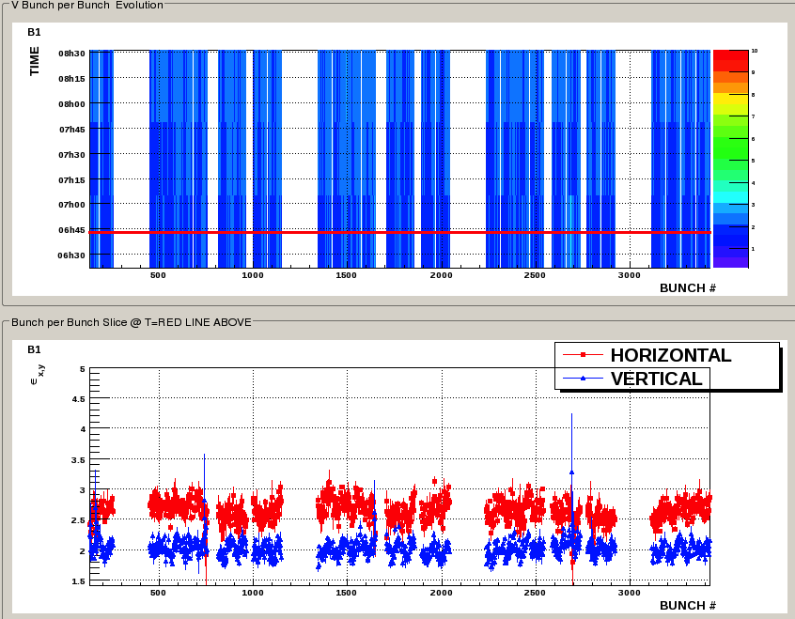
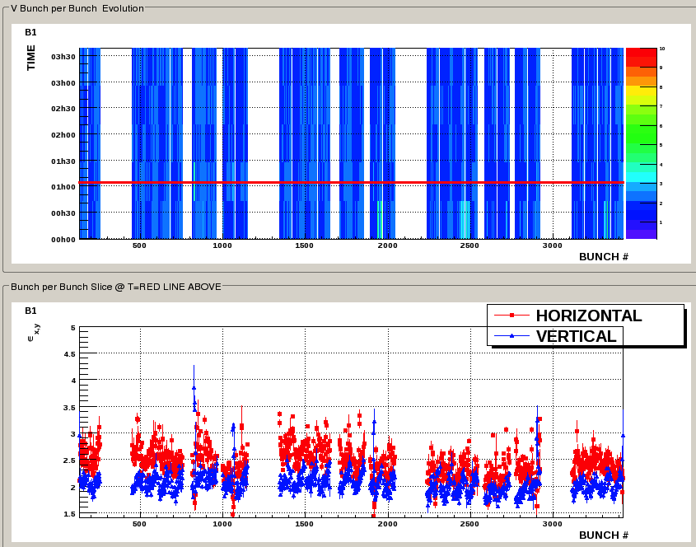
B1 beginning of flat top
FILL 1875
FILL 1883

Slide 2
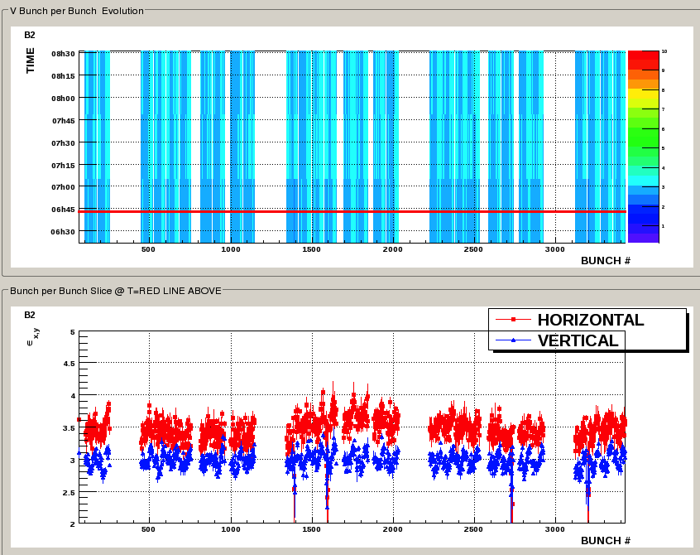
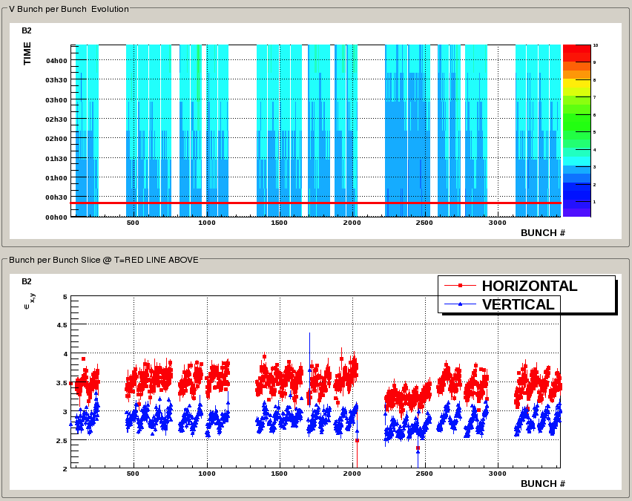
B2 beginning of flat top
FILL 1875
FILL 1883

Slide 3
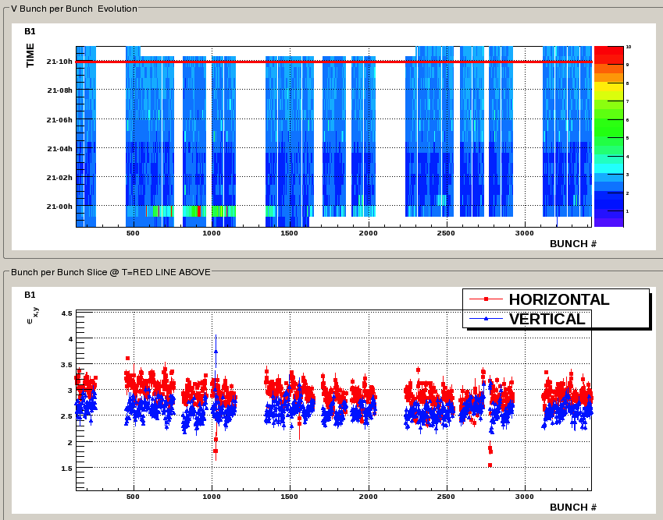
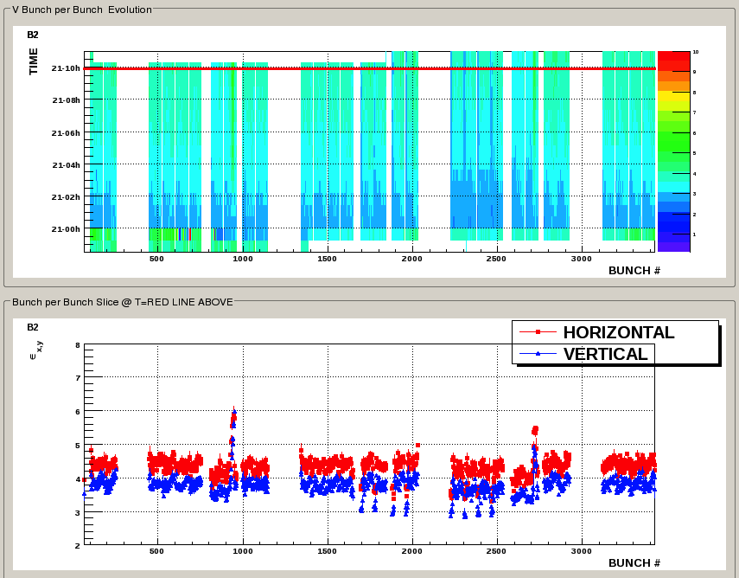
FILL 1883 @ ~ 10h
Non colliding bunches?

Slide 4
