Slide 1


The HEADTAIL Development Working Group (HDWG)
G. Rumolo
Wednesday 27.07.2011, in ABP-ICE Meeting
On behalf of the whole HDWG, i.e.
T. Argyropoulos, S. Aumon, H. Bartosik, E. Benedetto, N. Biancacci, H. Day, C. Hansen, E. Koukovini-Platia, K. Li, E. Métral, N. Mounet, B. Salvant, R. Wasef, C. Zannini
BE-ABP-ICE
BE-ABP-ICE

Slide 2
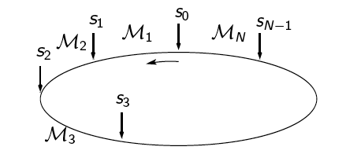
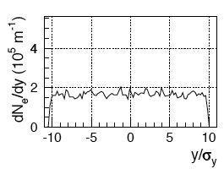
HEADTAIL_ecloud simulation general principle

Slide 3
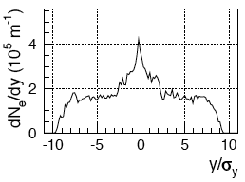
HEADTAIL_ecloud simulation general principle

Slide 4
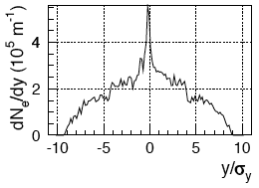
HEADTAIL_ecloud simulation general principle
Single bunch
Effect of the electron cloud on the bunch over many turns
Electron cloud refreshed at every interaction point and each turn
Bunch slicing renewed at every turn

Slide 5
HEADTAIL_impedance simulation general principle
Impedance source,
No e.m. field before the bunch starts going through it

Slide 6

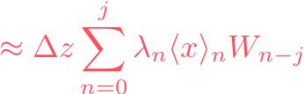
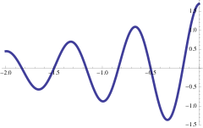
HEADTAIL_impedance simulation general principle
Multi-bunch
Multi-kick
Multi-turn (which means also that the wake memory has to be carried over turns!)
W(z)

Slide 7
Why a HEADTAIL Development
Working Group?
Over the years HEADTAIL has been used on a broad variety of machines and problems (single bunch)
  Electron cloud
    PS, SPS (different optics), LHC, SIS18, SIS100
    KEKB LER, DaΦne
    CLIC/ILC Damping Rings
    Studies of high-bandwidth transverse feedback system
  Impedance (transverse)
    SPS (TMCI at injection, headtail instabilities)
    PS (headtail instabilities at injection, TMCI at transition)
    ALBA, CLIC Damping Rings (impedance budget)
  Impedance (longitudinal)
    Potential well distortion (synchronous phase shift, bunch lengthening/shortening)
    Microwave instability threshold (above and below transition)
    Space charge vs. impedance effects over transition crossing

Slide 8
Why a HEADTAIL Development
Working Group?
Over the years HEADTAIL has been used on a broad variety of machines and problems (single bunch)
  Electron cloud
  Impedance (transverse)
  Impedance (longitudinal)
More recently
  Impedance localization techniques with a more refined optics description
  Multi-bunch simulations with wake fields
  Improvement of output data storage and development of off-line data analysis tools for studies of coherent modes and tune footprints

Slide 9
Why a HEADTAIL Development
Working Group?
Over the years HEADTAIL has been used on a broad variety of machines and problems (single bunch)
  Electron cloud
  Impedance (transverse)
  Impedance (longitudinal)
More recently
  Impedance localization techniques with a more refined optics description
  Multi-bunch simulations with wake fields
  Improvement of output data storage and development of off-line data analysis tools for studies of coherent modes and tune footprints
Lots of people have contributed to this development
  Elena, Diego, Benoit, Christian, Kevin, Nicolas, …
  But also lots of users and lots of different versions of HEADTAIL have started circulating … ☺

Slide 10
Mandate, goals and meeting schedule of the HDWG
Mandate → oversee and steer the use and further development of the HEADTAIL program for beam dynamics simulations including different classes of collective effects.
Goals:
  Converge to one single reliable version of the code, which can be freely distributed inside and outside CERN under request
  Report, follow up and possibly resolve specific issues encountered by users
  Propose and promote improvements and upgrades
  Discuss possible new applications and studies.
Meeting schedule:
  Meetings take place on Mondays @9h30 in 6/2-004 with biweekly frequency (or tentatively at least once a month)
  Each meeting has a ~1.5h duration (30’ devoted to follow-ups and up to 1h devoted to a specific subject)
  However meetings are also intended to be a platform for open discussion to ask questions, express doubts, look into details of both physical and numerical issues encountered in simulations!

Slide 11
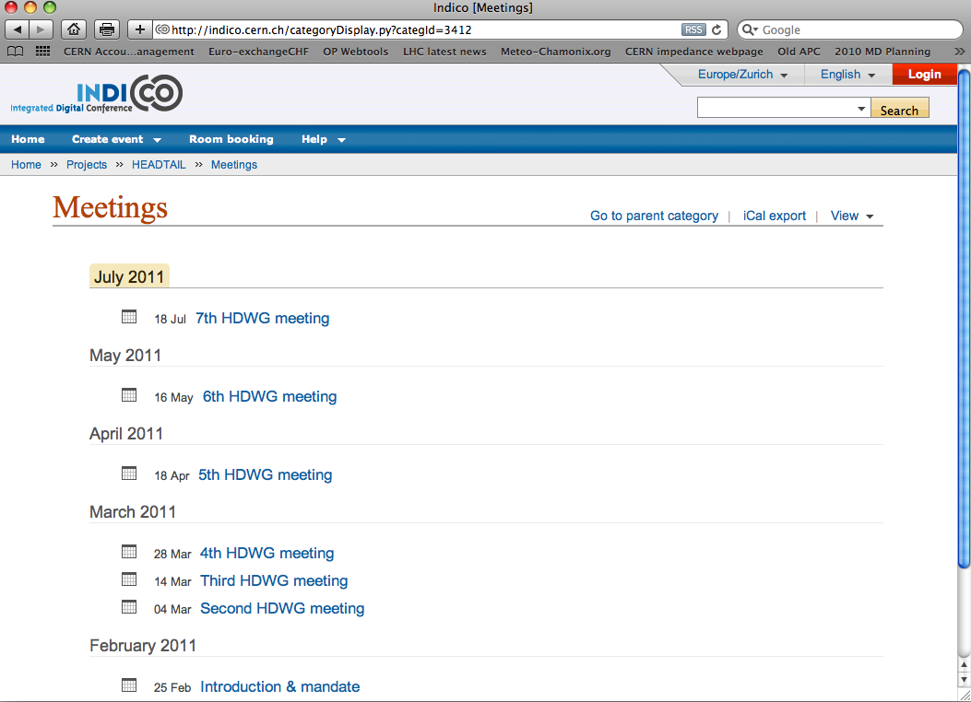
INDICO site under Projects → HEADTAIL

Slide 12
Special topics covered in the HDWG meetings
Past meetings:
  Intro
  Nonlinear matching in the longitudinal plane (Christian)
  Using CERN svn repositories to manage HeadTail versions (Kevin)
  HeadTail multi-bunch development (Nicolas)
  PS Simulations on the accelerating ramp (Sandra)
  Contributions of both constant and coupling terms to the wake fields (Carlo)
  Observations of emittance growth in the presence of dipolar wake fields (Nicolò)
  Electron cloud effects in the SPS at nominal (Q26) and large momentum compaction (Q20) optics (Hannes)
To come soon
  Octupole stabilization: theory vs. simulations (Raymond)
  The grand unification of the HEADTAIL_impedance existing subversions (Nicolas)
  Effects of constant wake field terms in HEADTAIL simulations: the “transverse potential well distortion” (Kevin)
  Interface of HEADTAIL with Zbase (Benoît)
  Is ECI a TMC-type instability? (Hannes)

Slide 13
Mandate, goals and meeting schedule of the HDWG
Mandate → oversee and steer the use and further development of the HEADTAIL program for beam dynamics simulations including different classes of collective effects.
Goals:
  Converge to one single reliable version of the code, which can be freely distributed inside and outside CERN under request
  Report, follow up and possibly resolve specific issues encountered by users
  Propose and promote improvements and upgrades
  Discuss possible new applications and studies.
Meeting schedule:
  Meetings take place on Mondays @9h30 in 6/2-004 with biweekly frequency (or tentatively at least once a month)
  Each meeting has a ~1.5h duration (30’ devoted to follow-ups and up to 1h devoted to a specific subject)
  However meetings are also intended to be a platform for open discussion to ask questions, express doubts, look into details of both physical and numerical issues encountered in simulations!

Slide 14
HEADTAIL
HEADTAIL_ecloud
HEADTAIL_impedance
Kevin Li
Nicolas Mounet
Single bunch
Multi-kick with different beta-function transport
Different electron cloud density at different kick points
Different magnetic field option at different kick points
Can import electron distribution file from ECLOUD
Multi-bunch, parallel
Multi-kick with different beta-function transport
Option to store the wake over several turns
Different analytical impedances in different kick points
Wake fields can be imported by Z-base (constant, dipolar, quadrupolar, coupling)
Several applications

Slide 15
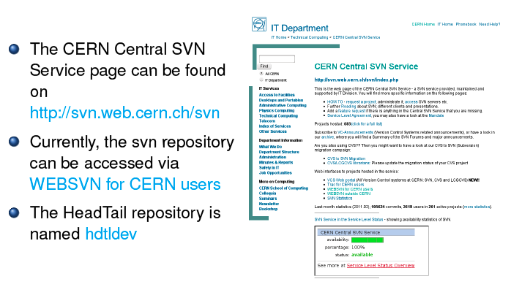
Here the code can be downloaded. Any HDWG member can then modify it and upload it.
The code will be then assigned a new version number and all changes are tracked.
Hdtl-ecld is the repository for HEADTAIL_ecloud
Kevin Li

Slide 16
Mandate, goals and meeting schedule of the HDWG
Mandate → oversee and steer the use and further development of the HEADTAIL program for beam dynamics simulations including different classes of collective effects.
Goals:
  Converge to one single reliable version of the code, which can be freely distributed inside and outside CERN under request
  Report, follow up and possibly resolve specific issues encountered by users
  Propose and promote improvements and upgrades
  Discuss possible new applications and studies.
Meeting schedule:
  Meetings take place on Mondays @9h30 in 6/2-004 with biweekly frequency (or tentatively at least once a month)
  Each meeting has a ~1.5h duration (30’ devoted to follow-ups and up to 1h devoted to a specific subject)
  However meetings are also intended to be a platform for open discussion to ask questions, express doubts, look into details of both physical and numerical issues encountered in simulations!

Slide 17
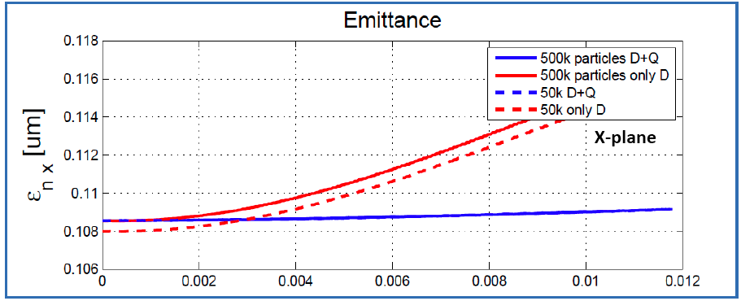
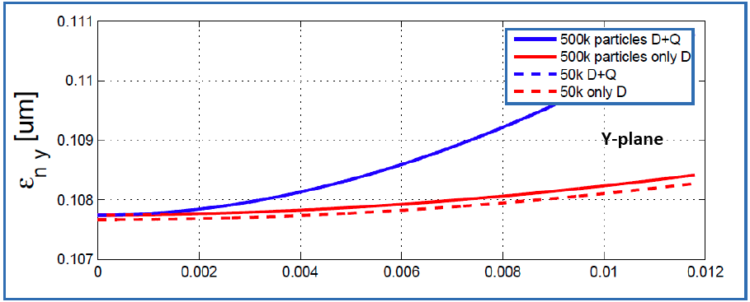
Emittance growth
Incoherent effects: physical phenomenon or artifact of the numerical simulation?
Systematic study with simple models, dipolar, quadrupolar, dipolar + quadrupolar wake fields needed
Influence of the kick position, tune foot-prints
Nicolò Biancacci

Slide 18
Mandate, goals and meeting schedule of the HDWG
Mandate → oversee and steer the use and further development of the HEADTAIL program for beam dynamics simulations including different classes of collective effects.
Goals:
  Converge to one single reliable version of the code, which can be freely distributed inside and outside CERN under request
  Report, follow up and possibly resolve specific issues encountered by users
  Propose and promote improvements and upgrades
  Discuss possible new applications and studies.
Meeting schedule:
  Meetings take place on Mondays @9h30 in 6/2-004 with biweekly frequency (or tentatively at least once a month)
  Each meeting has a ~1.5h duration (30’ devoted to follow-ups and up to 1h devoted to a specific subject)
  However meetings are also intended to be a platform for open discussion to ask questions, express doubts, look into details of both physical and numerical issues encountered in simulations!

Slide 19
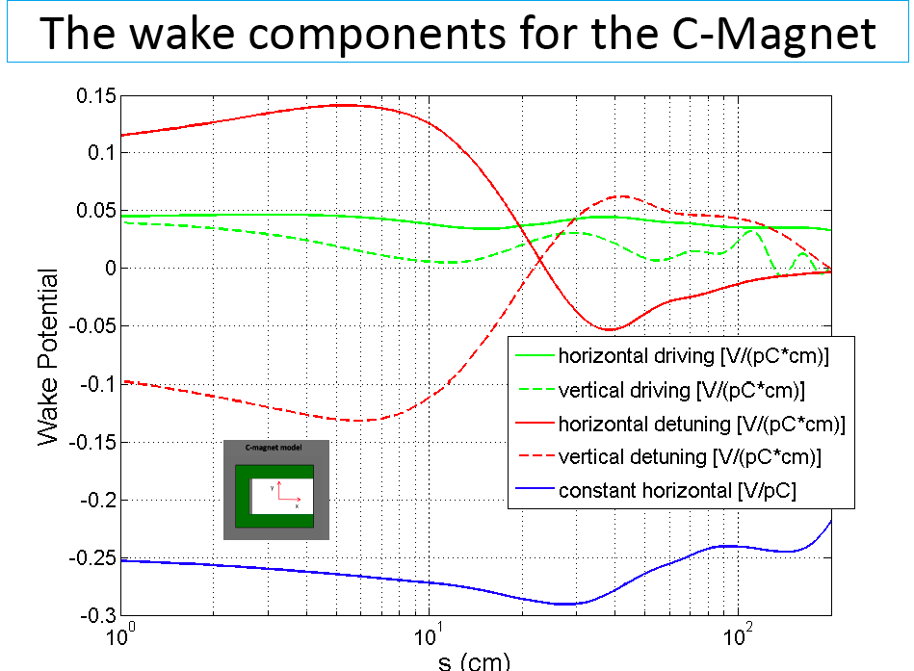
Carlo Zannini
Constant terms of the wake are created in asymmetric structures (top-bottom or left-right), or for an off-axis beam crossing a symmetric structure
How important are the constant terms of the wakes in beam dynamics simulations?

Slide 20
A non-exhaustive list of new developments and studies
Loss of Landau damping in the longitudinal plane due to space charge below transition
  Comparison with Alexey’s theory
  Maybe needs different initialization of the longitudinal distribution
Mode analysis for electron cloud instability, as a function of electron cloud density and bunch intensity
High band-width feedback system (collaboration with W. Höfle & LARP)
Tools for off-line treatment and plotting of HEADTAIL data
Schottky spectra with impedances
Effect of nonlinear chromaticity on headtail instabilities
Effect of phase advance between impedance locations
Implementation of radiation damping for damping rings
…

