Slide 1

Main Activities and News from LHC e-Cloud Simulations
Frank Zimmermann
ICE Meeting 8 June 2011

Slide 2
e-cloud simulation meetings
12 meetings since 26 November 2010
summary notes (thanks to Octavio) and all presentations available at
https://project-ecloud-meetings.web.cern.ch/project-ecloud-meetings/meetings2010.htm
regular participants: Gianluigi Arduini, Chandra Bhat, Octavio Dominguez, Kevin Li, Humberto Maury, Elias Metral, Tatiana Pieloni, Giovanni Rumolo, Frank Zimmermann, + Alexey Burov
special guests: Giuliano Franchetti, Wolfgang Hoefle, Ubaldo Iriso, Kazuhito Ohmi, EPFL team
AccNet CERN-GSI e-cloud workshop, 7-8.03.2011

Slide 3
main focus / mission
understand LHC electron-cloud observations
determine LHC surface parameters at different locations by benchmarking simulations and observations:
  measured relative pressure rise in the straight section for different filling schemes
  measured heat load in the arcs
  synchronous phase shift (with RF & GSI)
  (non-)observation of instabilities → constrain ρ_{e}
  scrubbing and running scenarios for 2011 & 2012
  longer-term operation modes & upgrade path
  beam instabilities & emittance growth due to e-cloud

Slide 4
example studies
benchmarking surface parameters with pressure rise at LSS gauges (Octavio Dominguez)
benchmarking surface parameters with arc heat load (Humberto Maury)
upgrade scenarios (Humberto Maury)
instability thresholds & tune shifts (Kevin Li)
PS e-cloud simulations for experimental test of LHC LPA upgrade scheme (Chandra Bhat)

Slide 5
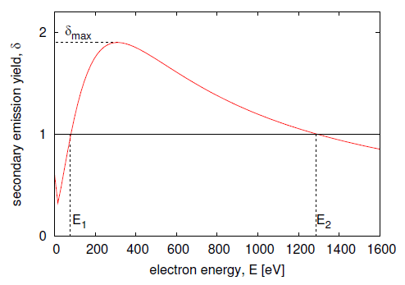
secondary emission parameters
δ_{max}: maximum secondary electron yield
ε_{max}: electron energy at which yield is maximum = δ_{max}
R: reflection probability for low-energy electrons
δ_{max}, ε_{max} (θ)!
R is assumed to be independent of θ
plot assumes θ=90°
R
ε_{max}
O. Dominguez

Slide 6
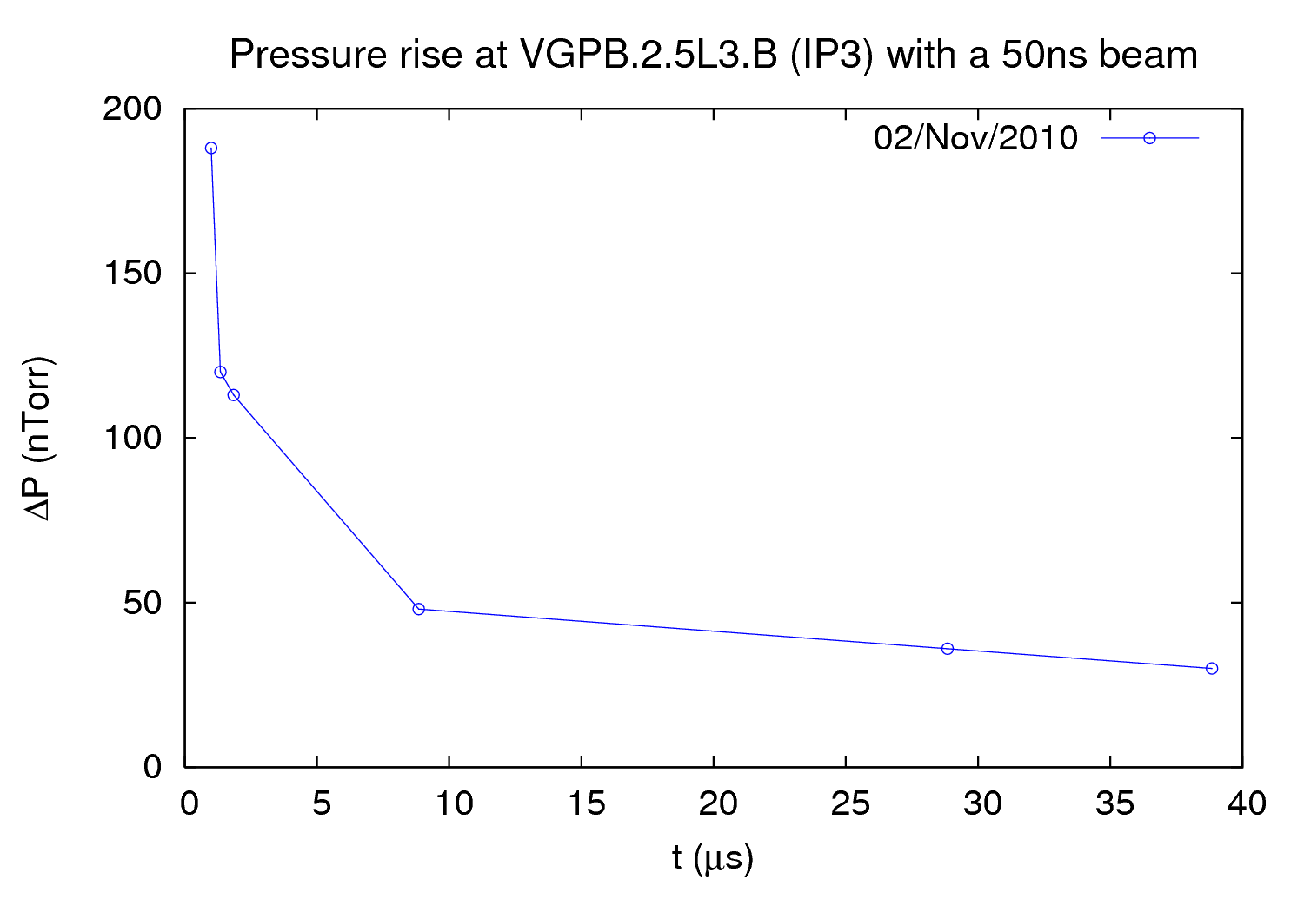
example 2010 observation
O. Dominguez
pressure increase versus batch spacing
Pilot bunch + Batch 1 (12 bunches) + 1950 ns + Batch 2 (24 bunches) + batch spacing (variable according to measurement) + Batch 3 (24 bunches)
pressure increase related to electron flux @ wall:

Slide 7
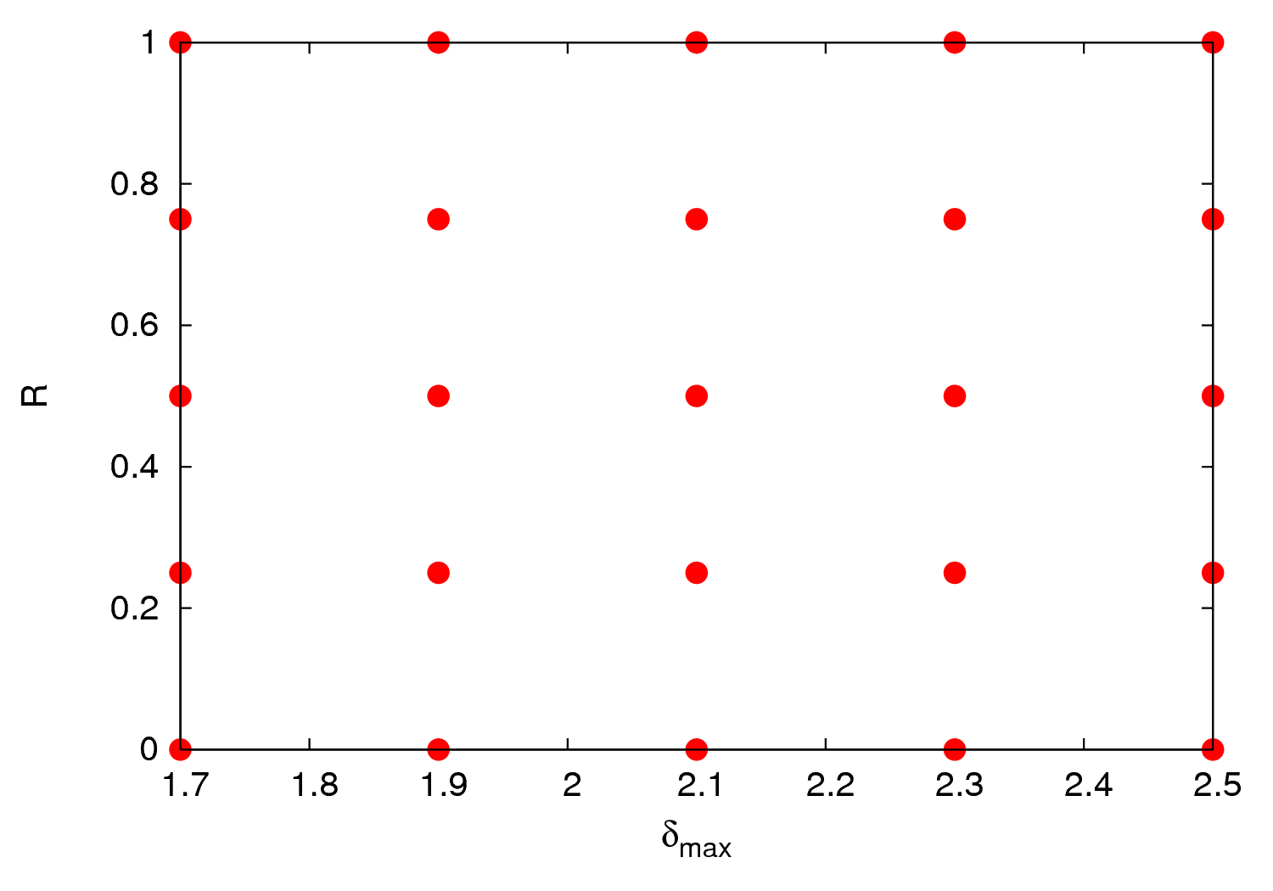
O. Dominguez

Slide 8
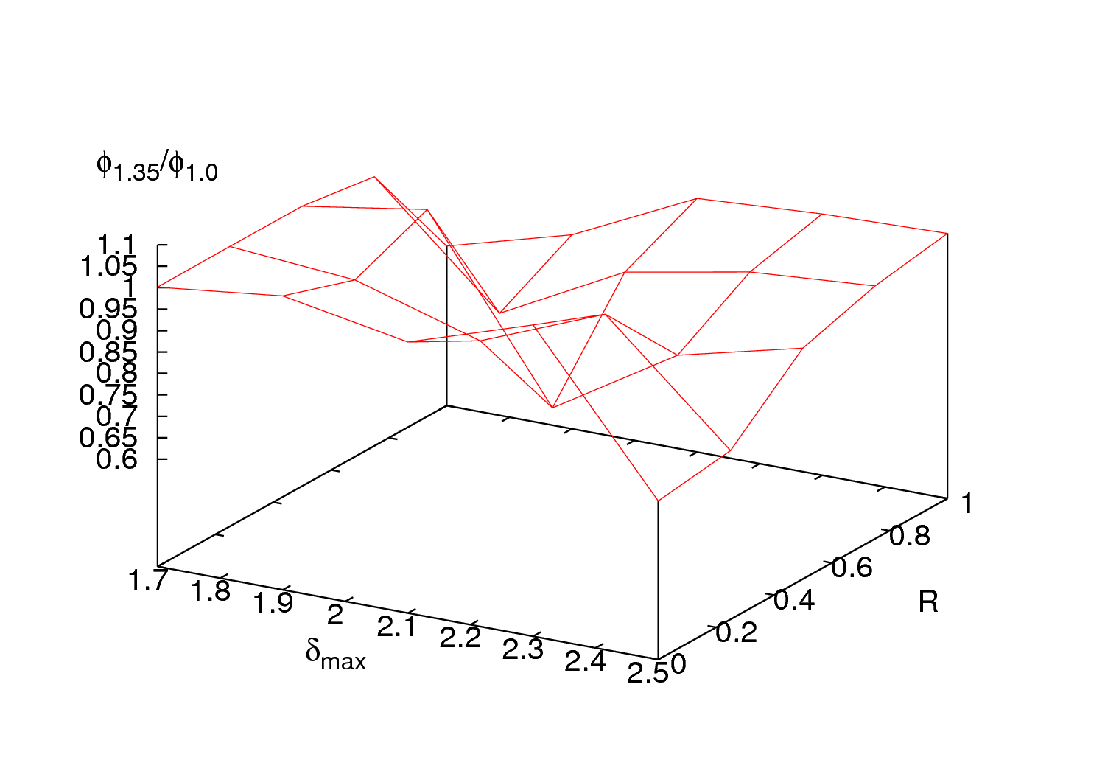
O. Dominguez

Slide 9
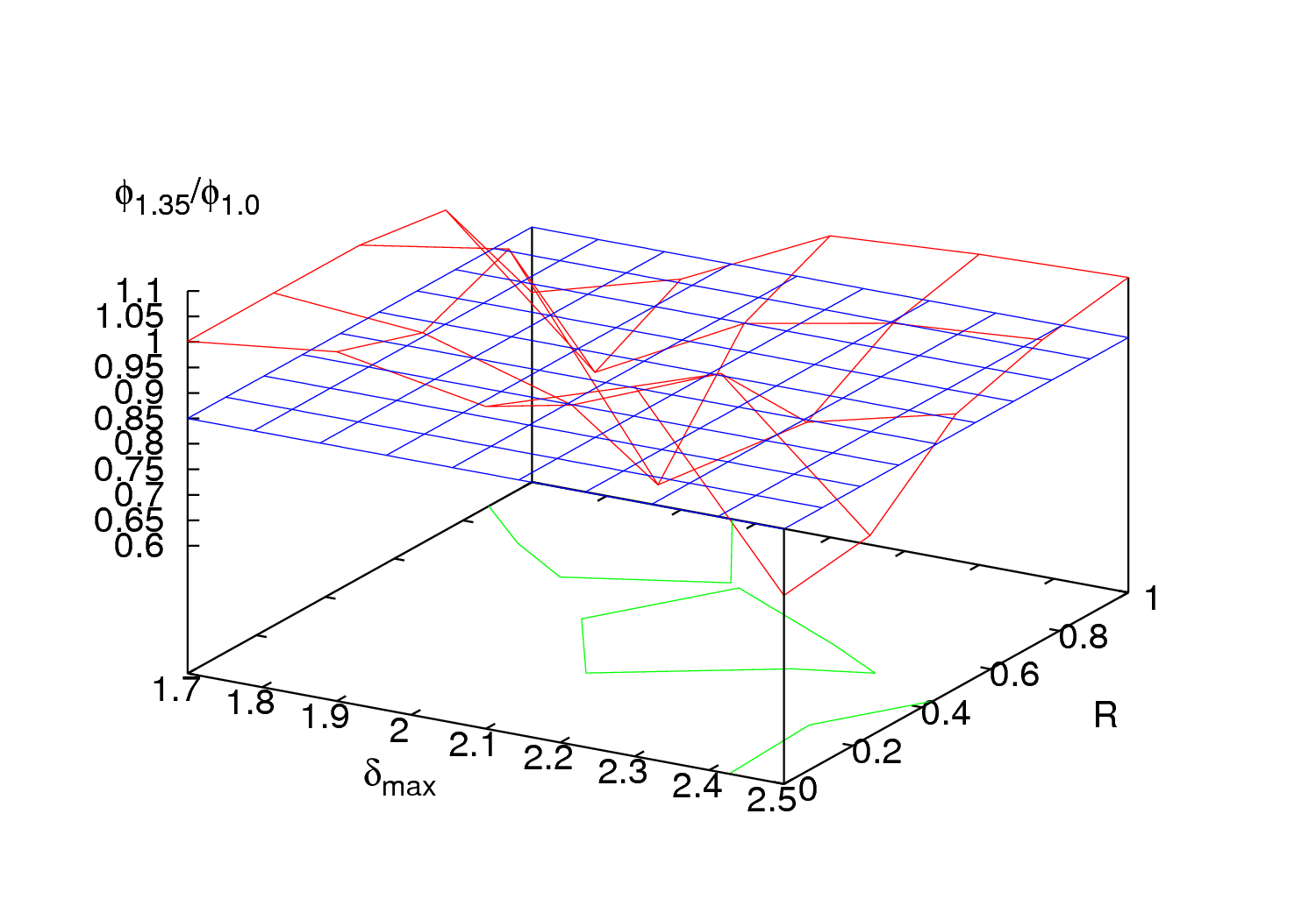
O. Dominguez

Slide 10
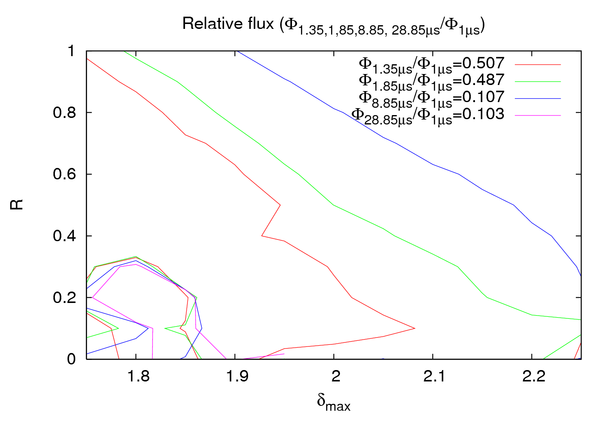
δ_{max}=1.86
R=0.25
O. Dominguez

Slide 11
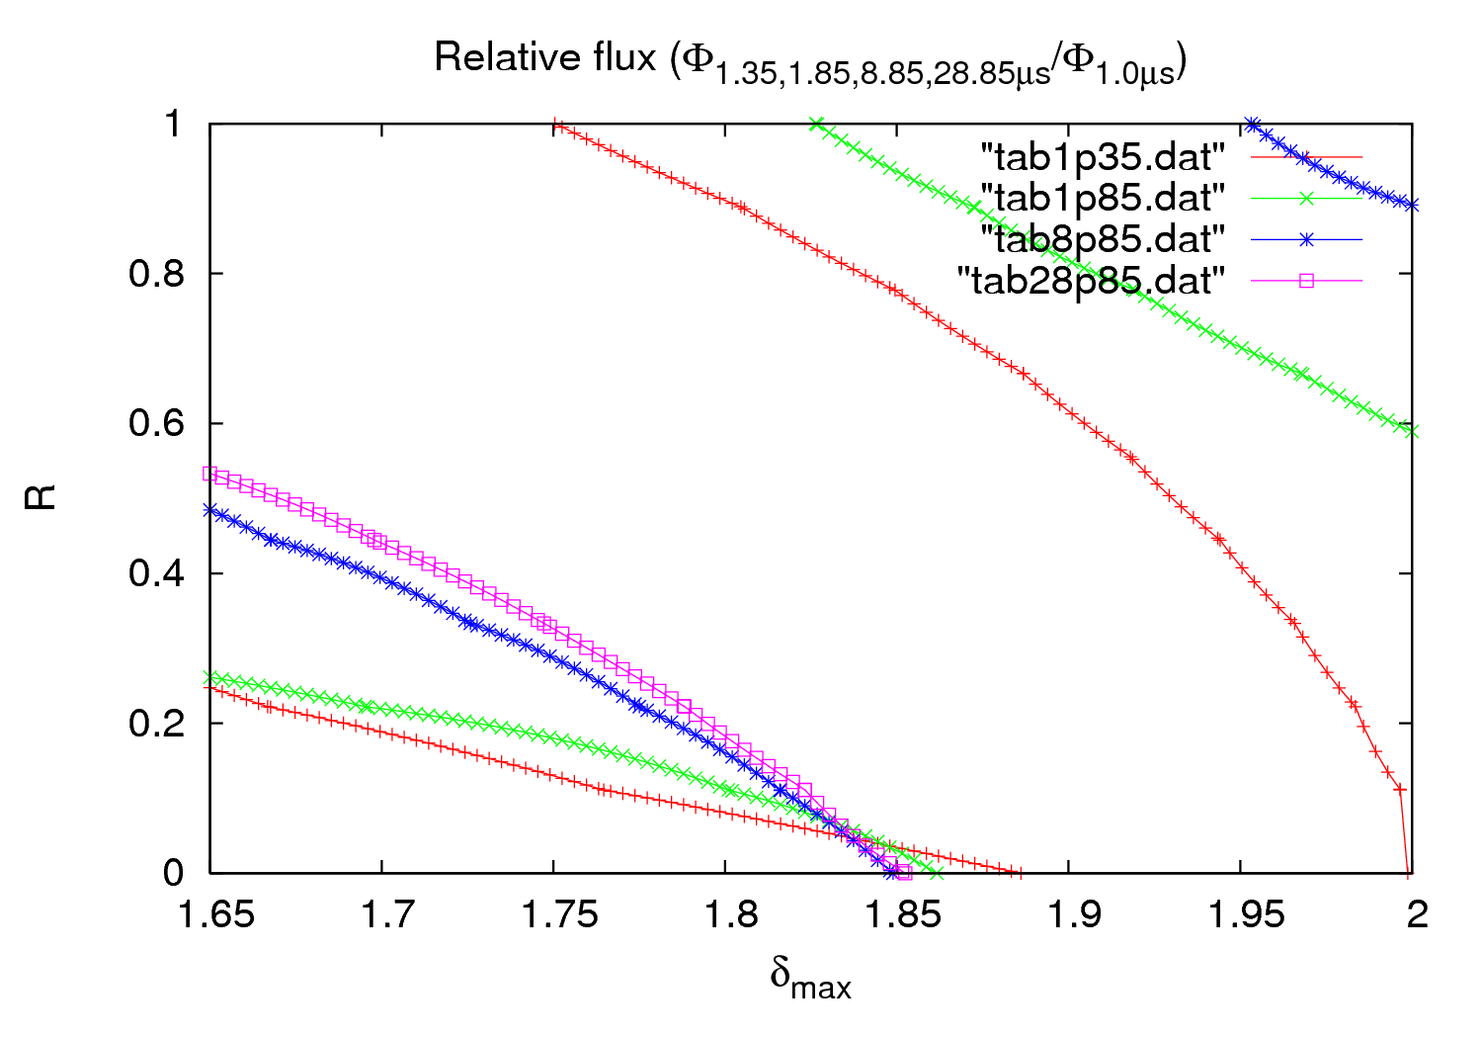
3rd order fit
Approximately same SEY but much lower R
δ_{max}~1.84
R~0.1
O. Dominguez

Slide 12
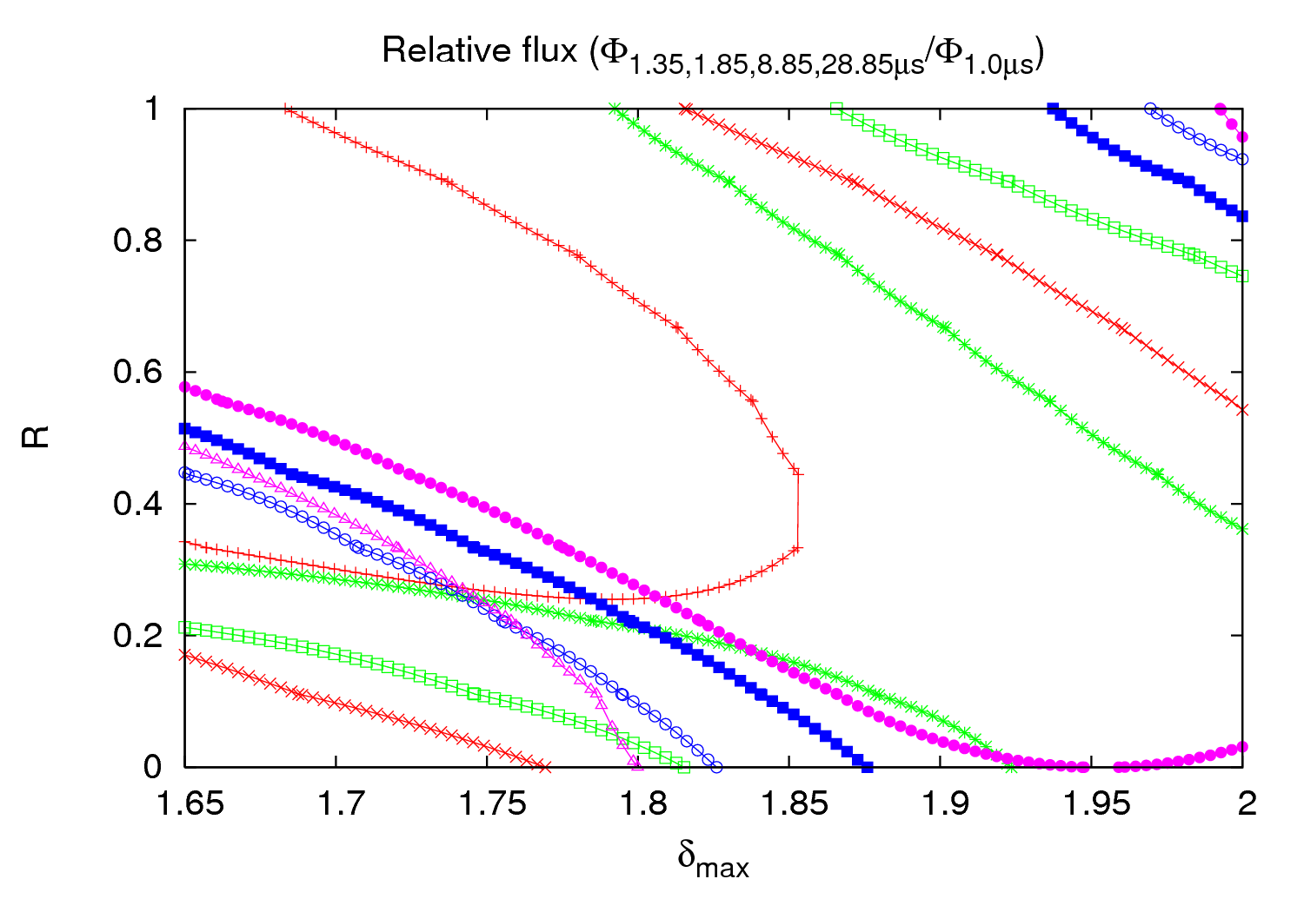
3rd order fit
taking an arbitrary 10% error in the pressure
O. Dominguez

Slide 13
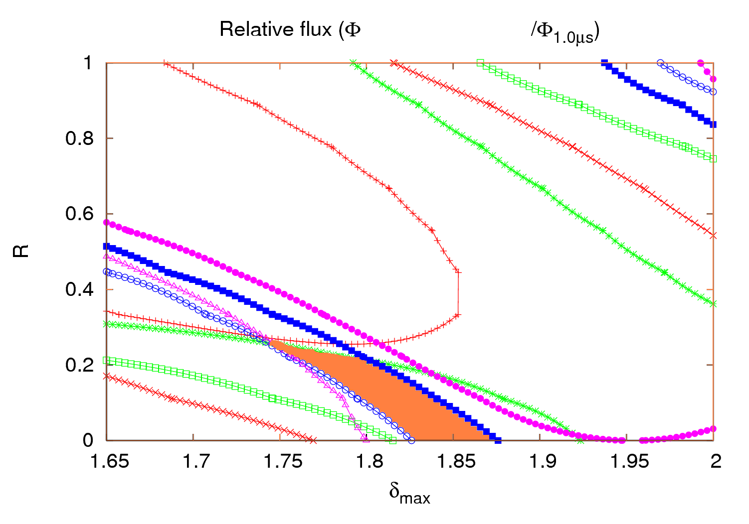
3rd order fit
1.35, 1.85, 8.85, 28.85μs
taking an arbitrary 10% error in the pressure
Should the solution be here?
O. Dominguez

Slide 14
2011 Scrubbing run – First night
Injection interlock due to BIC sanity checks not performed in the last 25 hours
We wanted:
6μs
4μs
2μs
1μs
Pressure close to the thresholds
O. Dominguez

Slide 15
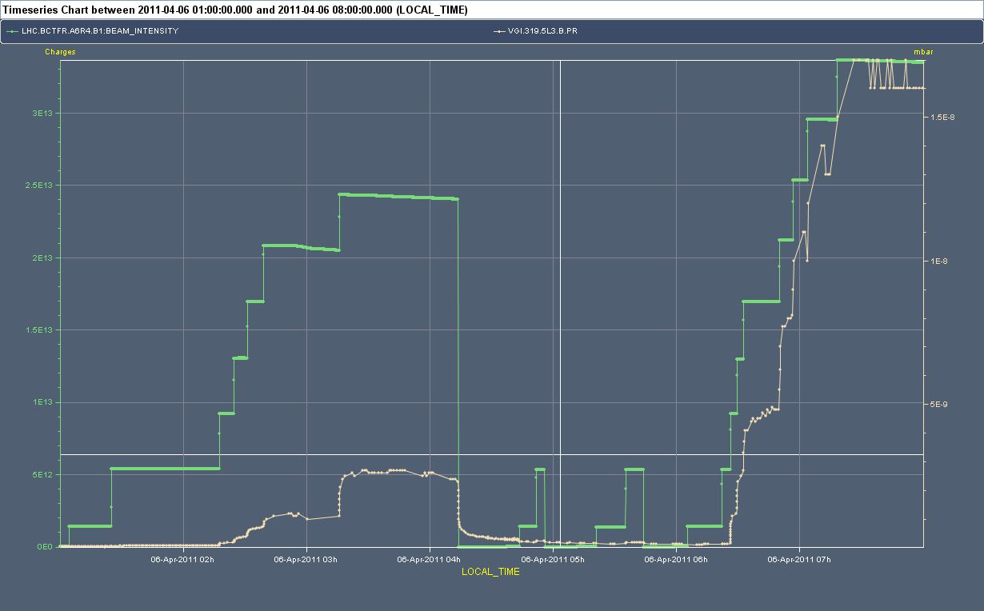
2011 Scrubbing run – First night
2μs
4μs
6μs
2μs
ΔP₁
ΔP₂
O. Dominguez

Slide 16
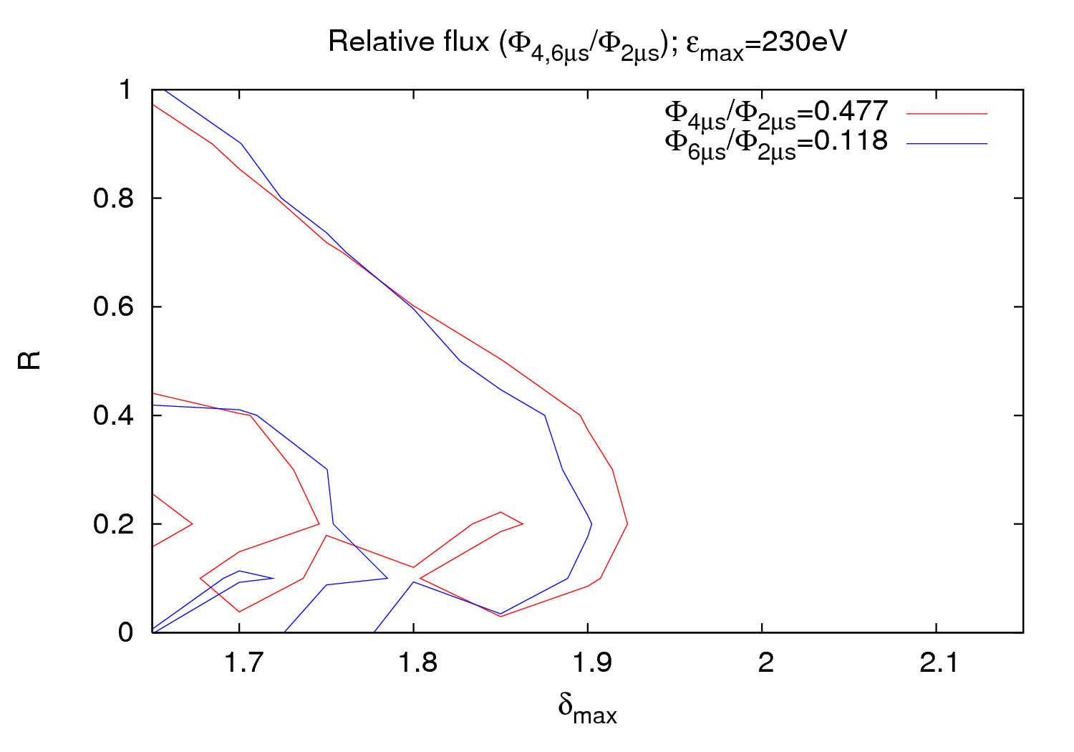
2011 P vs. batch spacing experiment
O. Dominguez

Slide 17
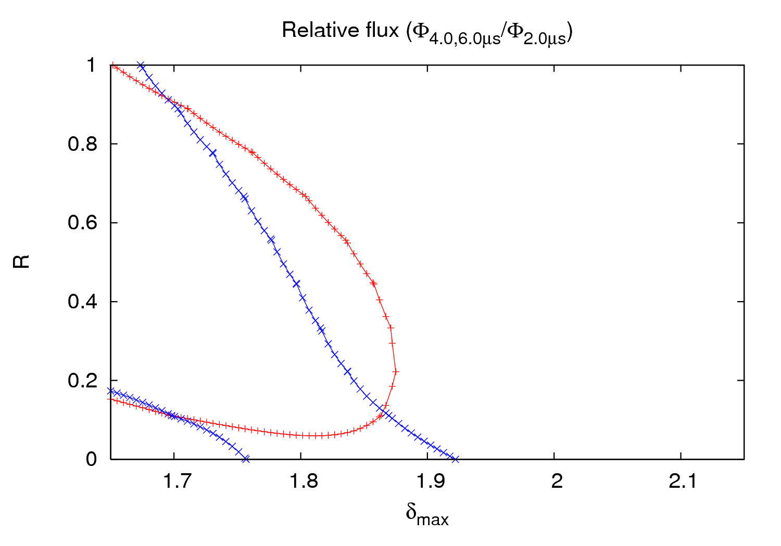
2011 P vs. batch spacing experiment
[1.86, 0.12]
3rd order fit
to simulated fluxes in order
to reduce local effect of statistical fluctuations
[1.70, 0.11]
[1.86, 0.12]
O. Dominguez

Slide 18
2011 P vs. batch spacing experiment
experiment could not be carried out as planned due to several reasons:
  - 225 ns batch spacing not available
  - satellite bunches in SPS (delay + 5000 RF buckets shift)
  - P close to thresholds for Beam 2
  - injection interlock (BIC sanity check)
only three points (2 relative measurements) and solely for beam 1
pressure did not stabilize in the time used for the first batch spacings
simulations do not give clear agreement (a 3rd point would be needed for verification)
Nevertheless possible solution in the same region as for 2010 experiment
3rd and 5th order fits have been done, showing both similar solutions
unfortunately, experiment not repeated at the end of the scrubbing run
O. Dominguez

Slide 19
2nd “experiment”: 2 μs batch spacing – P linearity
One could get contour plots from this points…
Linear behavior
Exponential growth
Saturation
O. Dominguez

Slide 20
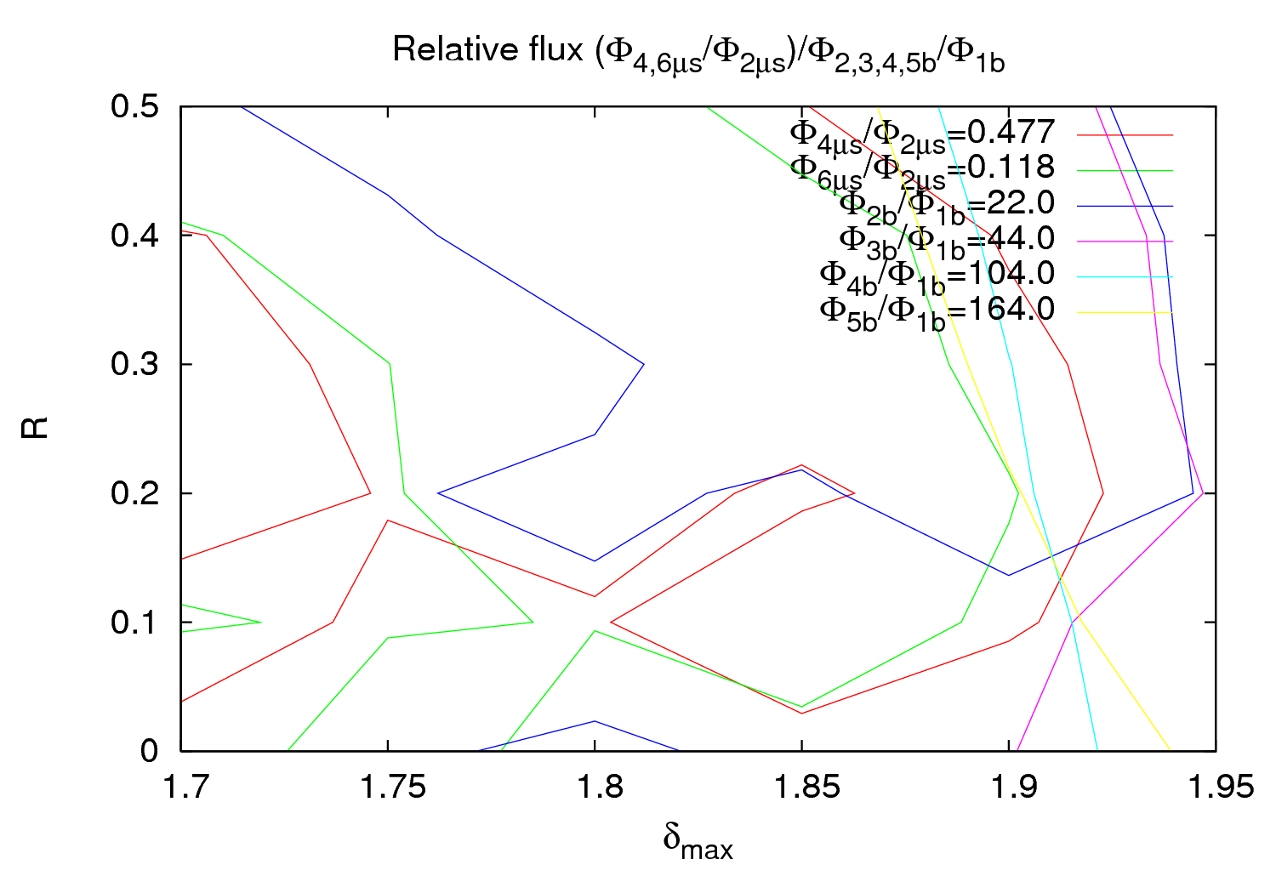
2011 scrubbing - first night experiments together
Considering ΔP
O. Dominguez

Slide 21
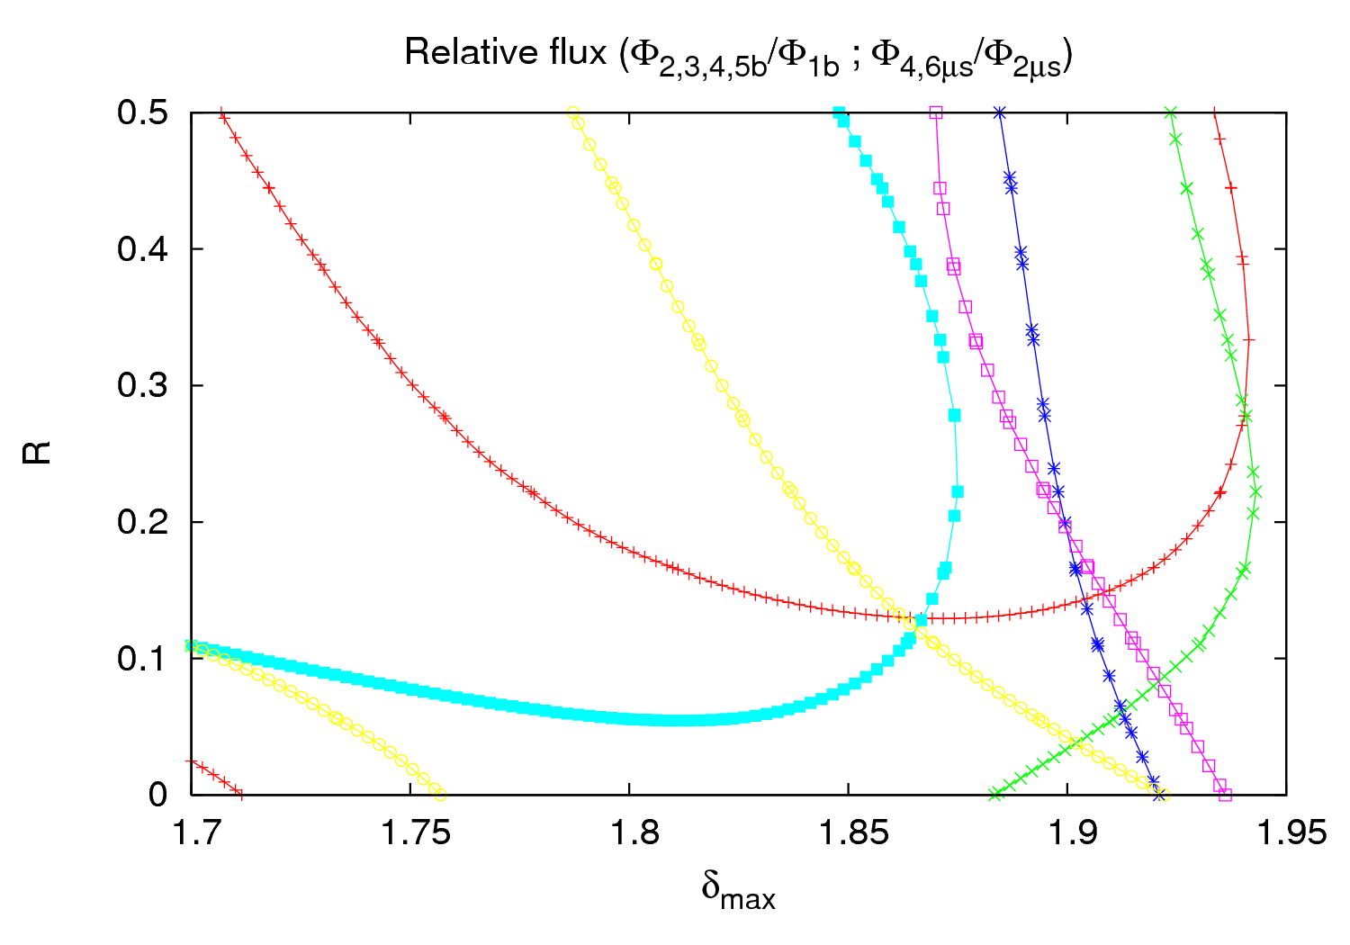
2011 scrubbing - first night experiments together
φ_{5b}/φ_{1b}
φ_{6us}/φ_{2us}
φ_{4b}/φ_{1b}
φ_{2b}/φ_{1b}
3rd order fit
φ_{4us}/φ_{2us}
φ_{3b}/φ_{1b}
O. Dominguez

Slide 22
best estimate for LSS surface :
2 Nov. 2010: δ_{max}=1.85±0.05, R=0.15±0.1
6 April 2011: δ_{max}=1.89±0.05, R=0.15±0.1
at same ionization gauge, b=40 mm, single beam
no evidence for δ_{max} reduction due to surface conditioning at this location

Slide 23
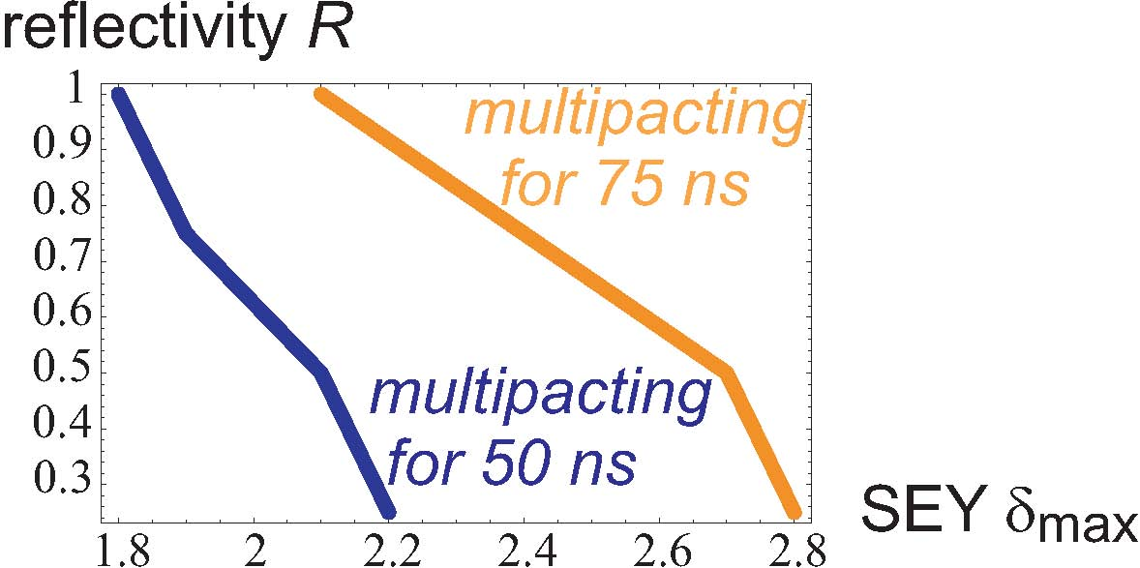
multipacting threshold in the LHC arcs
H. Maury
December 2010
H. Maury

Slide 24
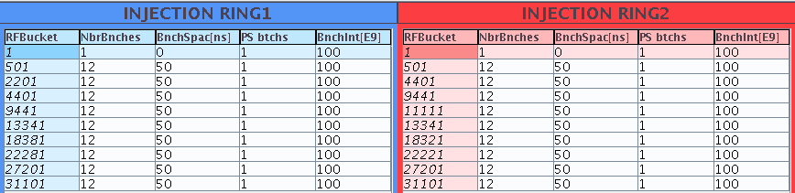
arc heat load – some 2010 data
Heat load measured in the beam screen of the cells 21L3, 33L6, 13R7 during injection and ramp of 108 bunches before (left) ~30 mW/m/beam ) and after (right) the 2010 scrubbing run.
G. Arduini

Slide 25
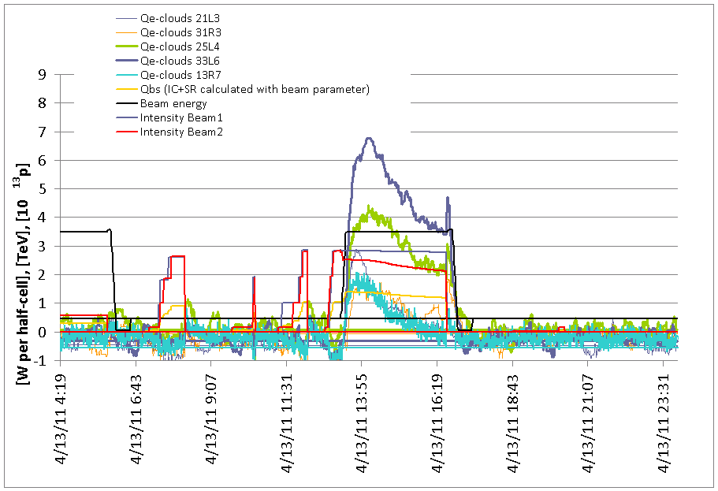
arc heat load – some 2011 data
Fill 1704 (13/4/2011 – 12:16 to 16:47
Filling scheme (for both beams): 228 bunches/beam - Average intensity 1.22 e 11 p/bunch
(first ramp after scrubbing): 50ns_1164b_36x2bi_18inj_scrub (cut at 228 bunches)
Emittances at injection
Injection # | Ring | RF bucket # | Bunch spacing [ns] | Bunches/inj | Spacing between PS trains | # PS trains/injection
1 | ring_1 | 1 | 0 | 1 | 0 | 1 | pilot
1 | ring_2 | 1 | 0 | 1 | 0 | 1 | pilot
2 | ring_1 | 441 | 50 | 12 | 0 | 1 | nominal
2 | ring_2 | 441 | 50 | 12 | 0 | 1 | nominal
3 | ring_1 | 1581 | 50 | 72 | 225 | 2 | nominal
3 | ring_2 | 1581 | 50 | 72 | 225 | 2 | nominal
4 | ring_1 | 3511 | 50 | 72 | 225 | 2 | nominal
4 | ring_2 | 3511 | 50 | 72 | 225 | 2 | nominal
5 | ring_1 | 5441 | 50 | 72 | 225 | 2 | nominal
5 | ring_2 | 5441 | 50 | 72 | 225 | 2 | nominal
trains of 72 bunches
spaced alternatingly
by 225 ns and by 1.1 μs
70-80 mW/m/beam
G. Arduini

Slide 26
simulated 2011 heat load versus δ_{max}
70 mW/m
H. Maury

Slide 27
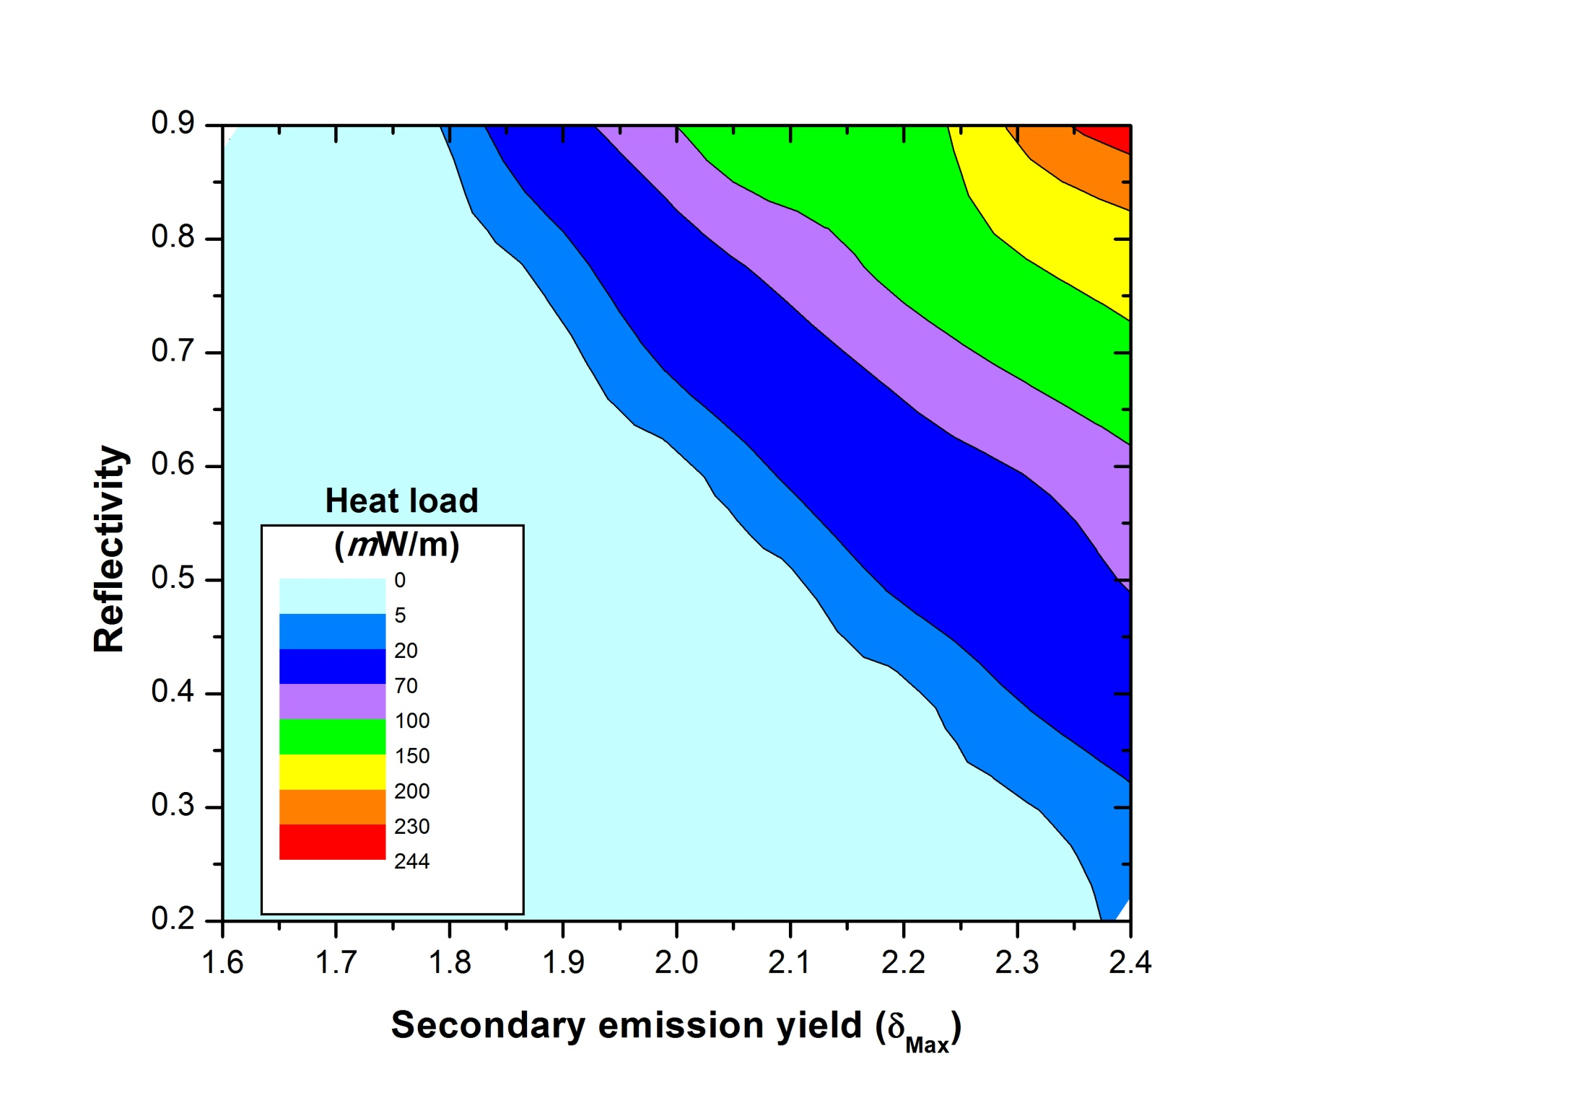
simulated heat load in δ_{max-R} plane
measured
heat load
corresponds
to blue region
H. Maury

Slide 28
multipacting threshold versus chamber radius,
50 ns bunch spacing
H. Maury

Slide 29
heat load versus chamber radius, 50 ns spacing
H. Maury

Slide 30
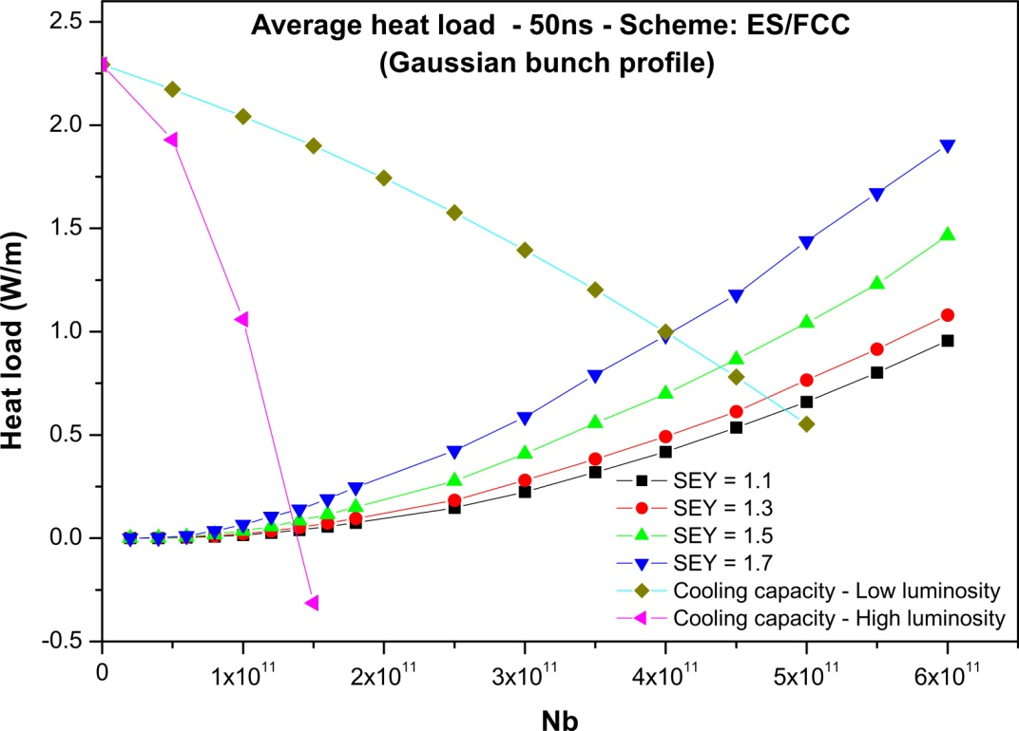
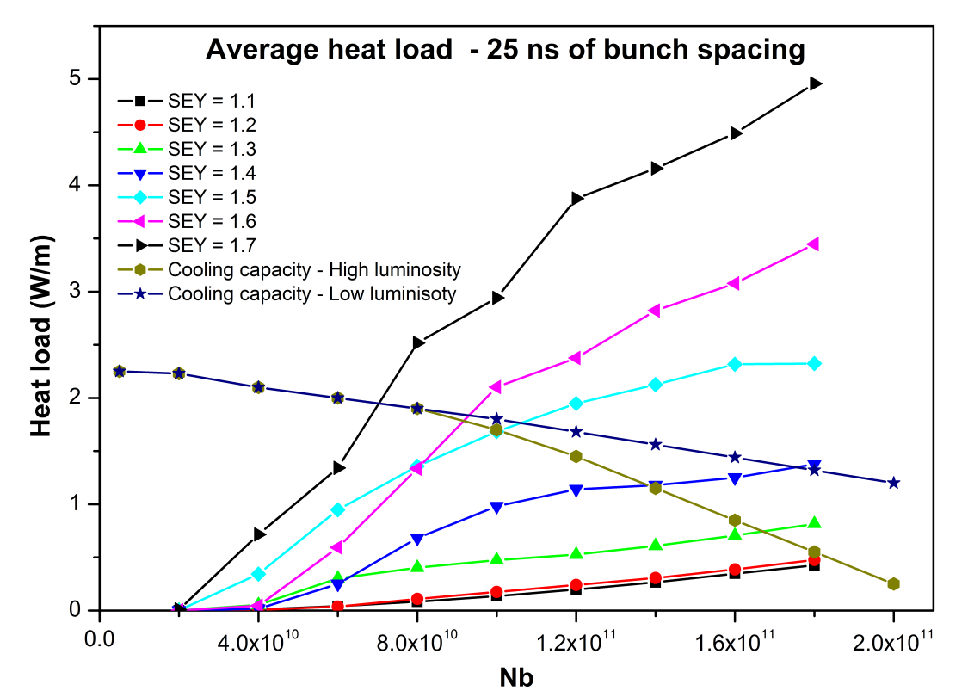
e-cloud heat load for LHC upgrades
25-ns bunch spacing
50-ns bunch spacing
H. Maury
electron cloud contribution acceptable if δ_{max}≤1.2
H. Maury

Slide 31
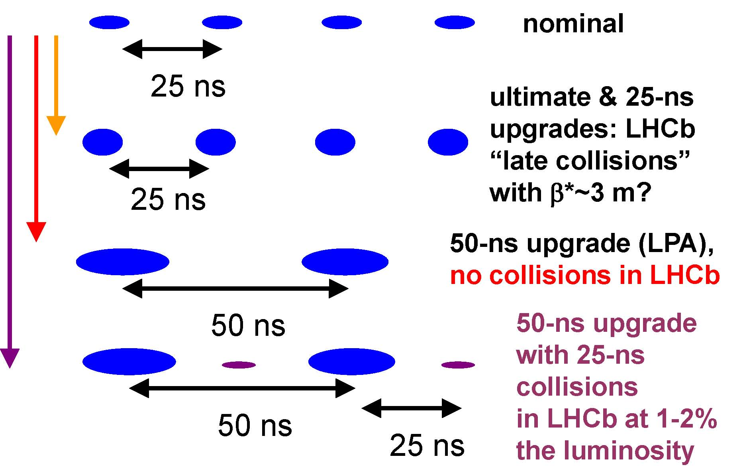
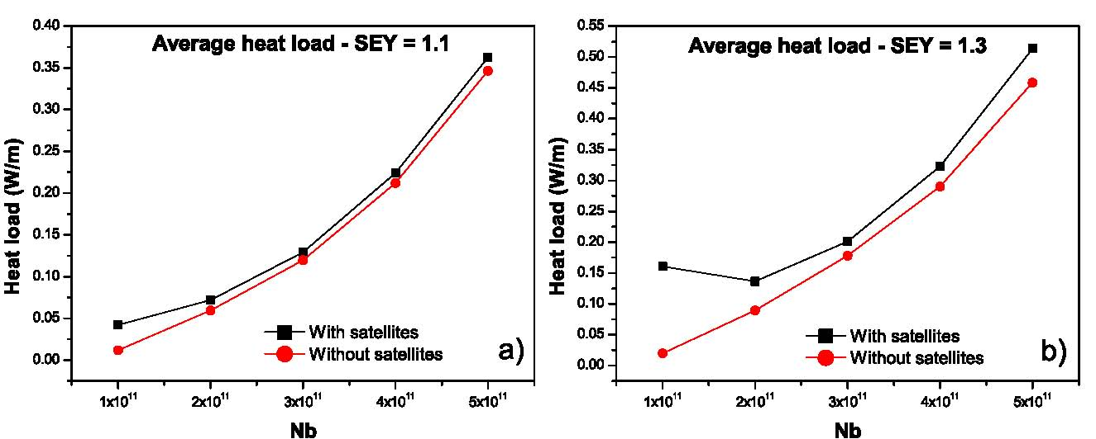
e-cloud heat load also OK for 50 ns spacing plus “LHCb satellites”
H. Maury
H. Maury

Slide 32
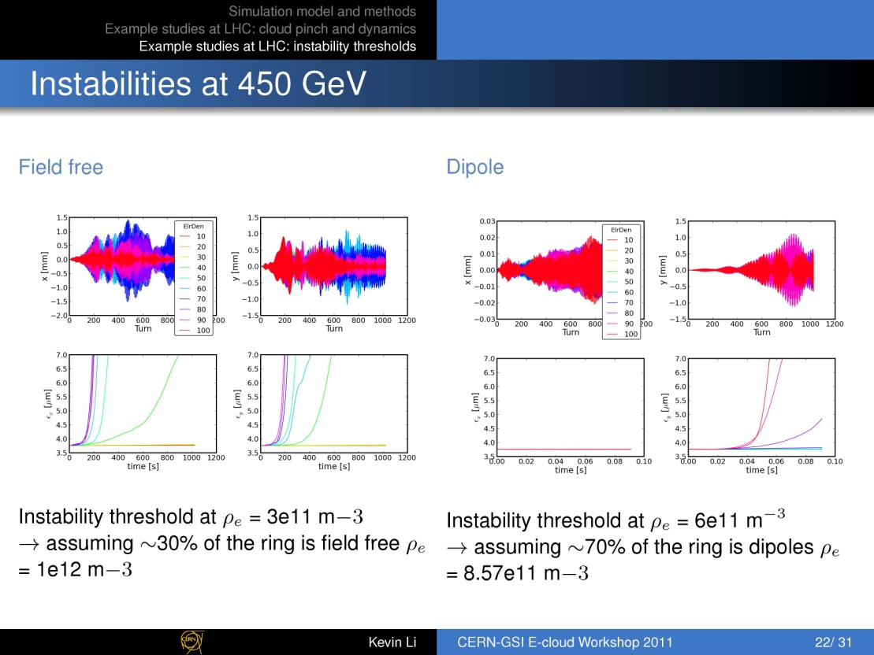
K. Li

Slide 33
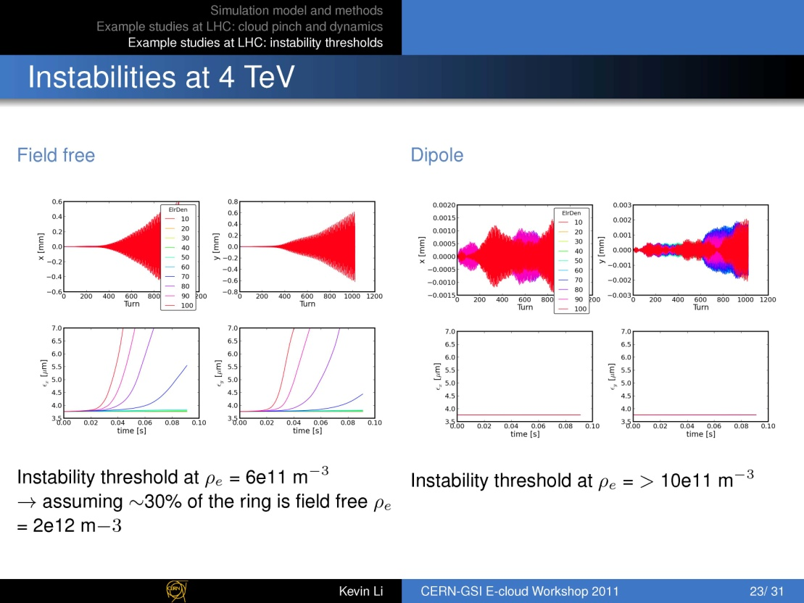
K. Li

Slide 34
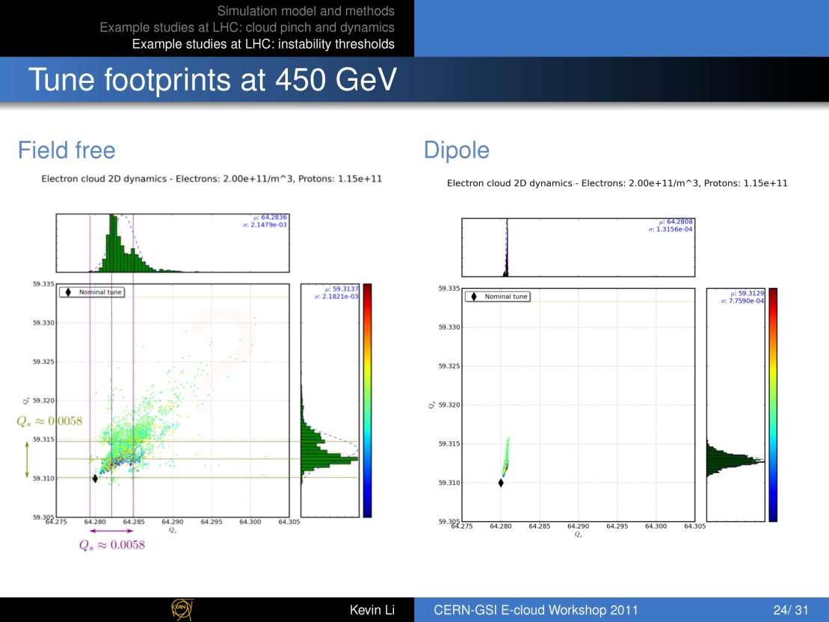
K. Li

Slide 35
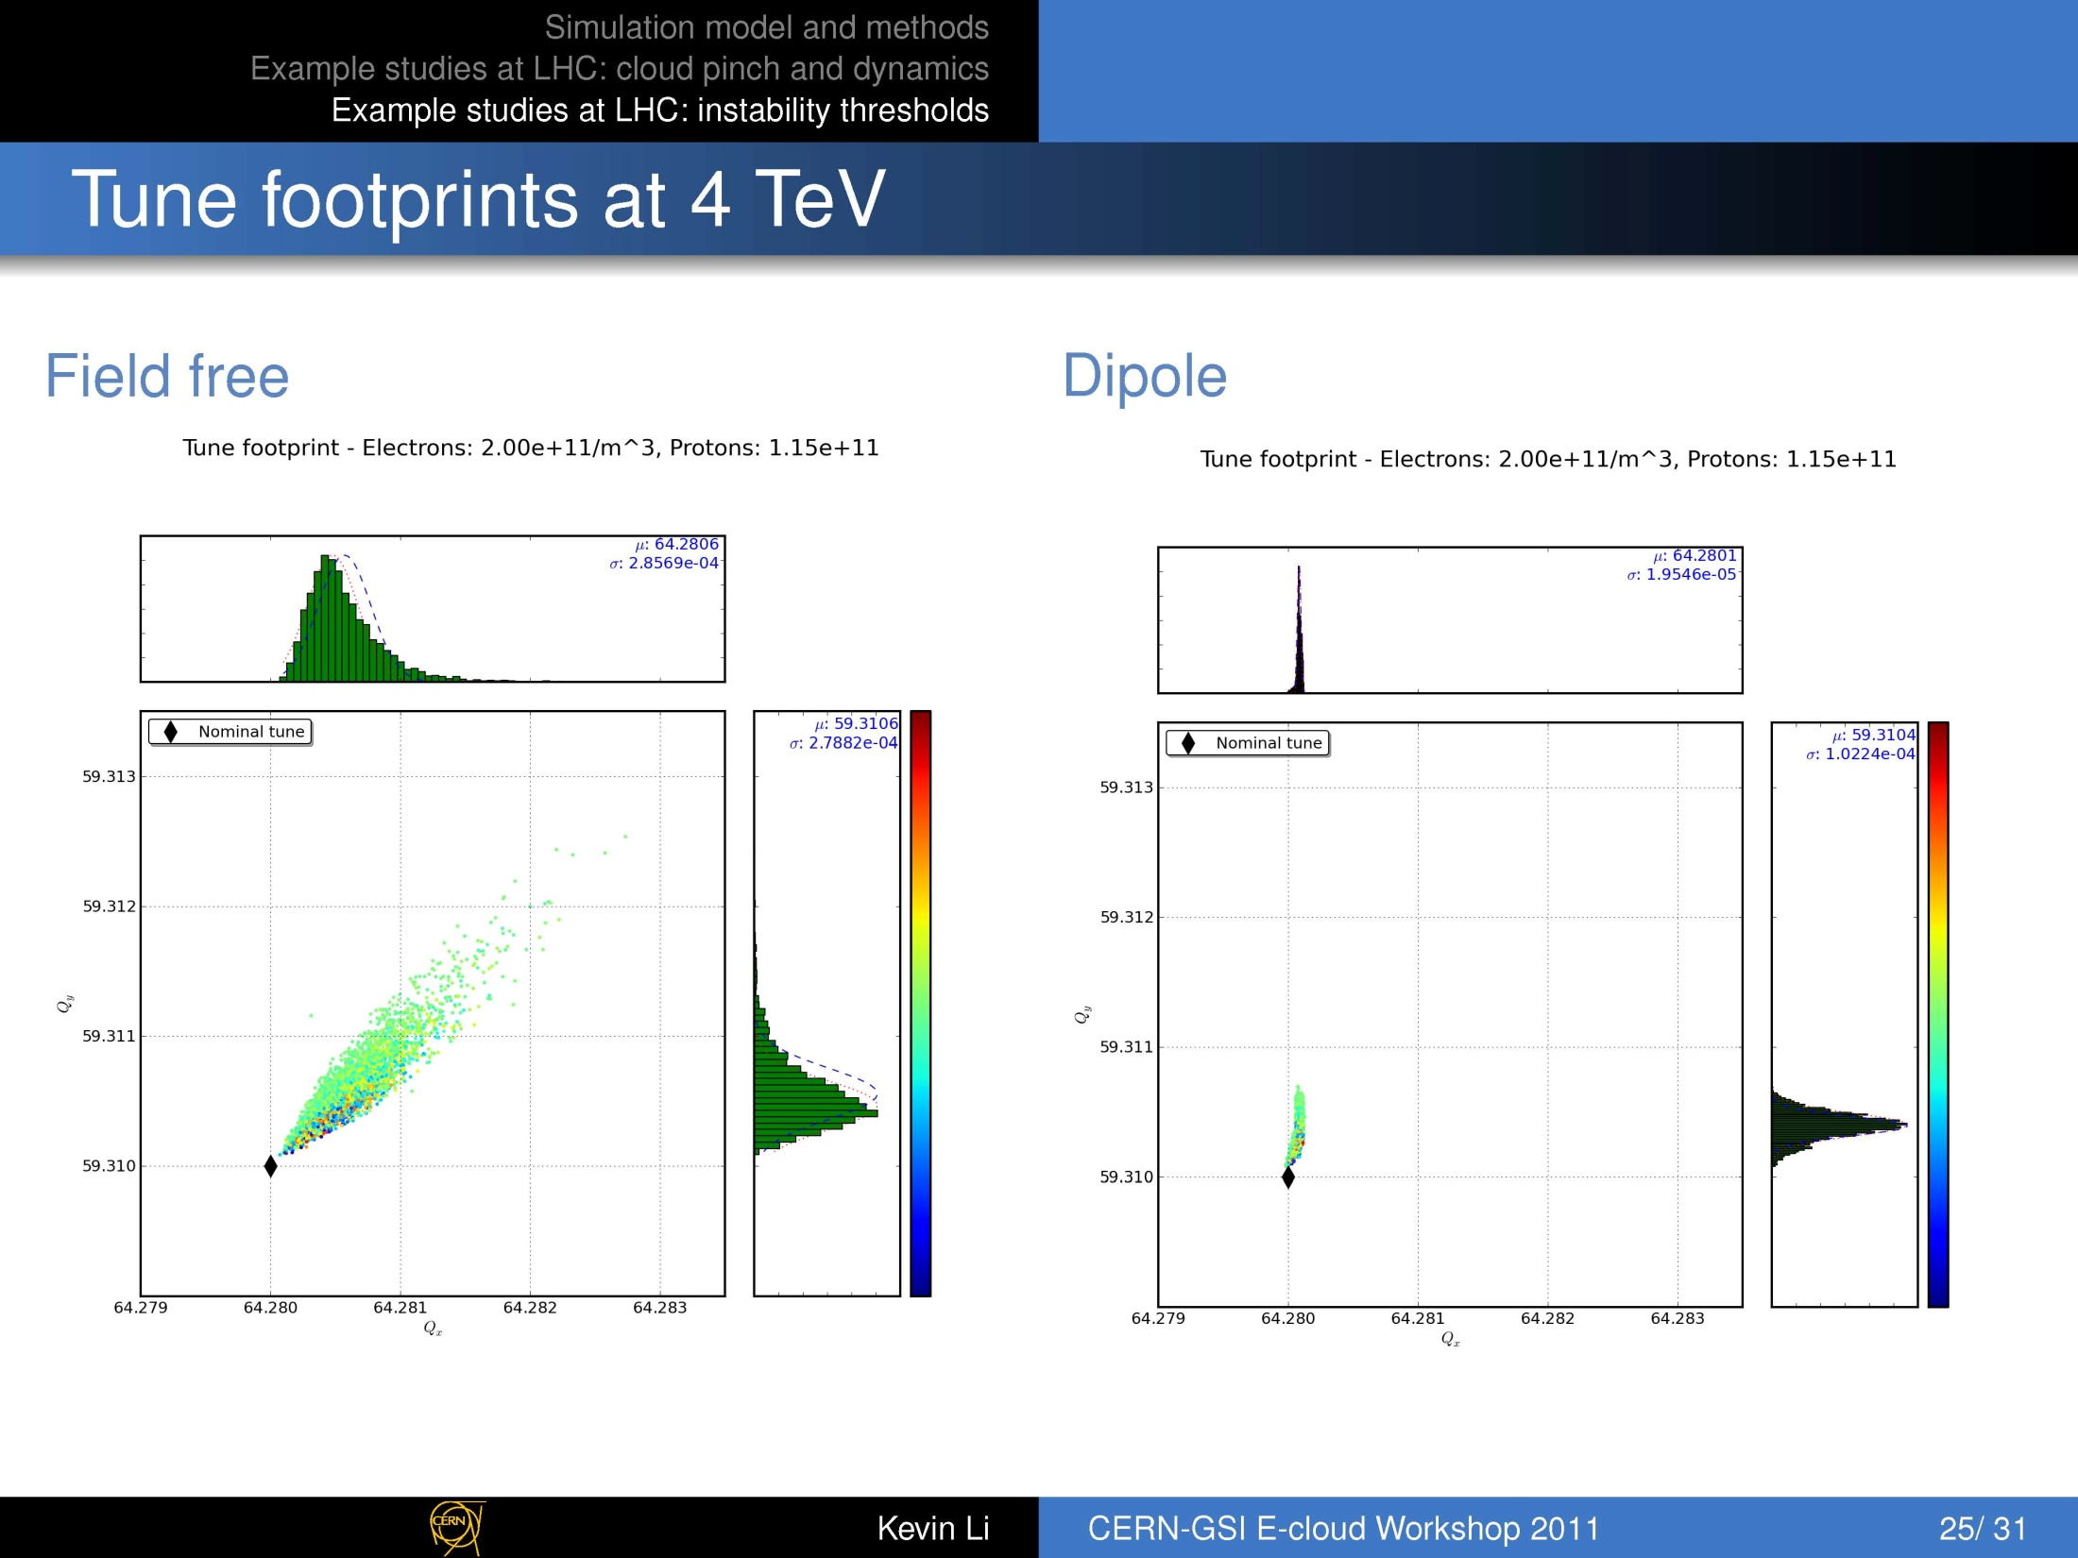
K. Li

Slide 36
instabilities
threshold e- density : 3-6x10¹¹ m⁻³ at 450 GeV
6-10x10¹¹ m⁻³ at 4 TeV
tune shift: ~0.01 at injection for 2x10¹¹ e⁻/m⁻³ (no field)
~0.002 at 4 TeV for 2x10¹¹ e⁻/m⁻³ (no field)
K. Li

Slide 37
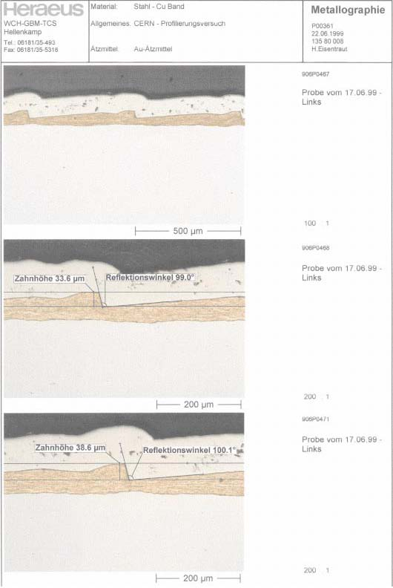
LHC arc chamber sawtooth
I. Collins,
V. Baglin,
et al.

Slide 38
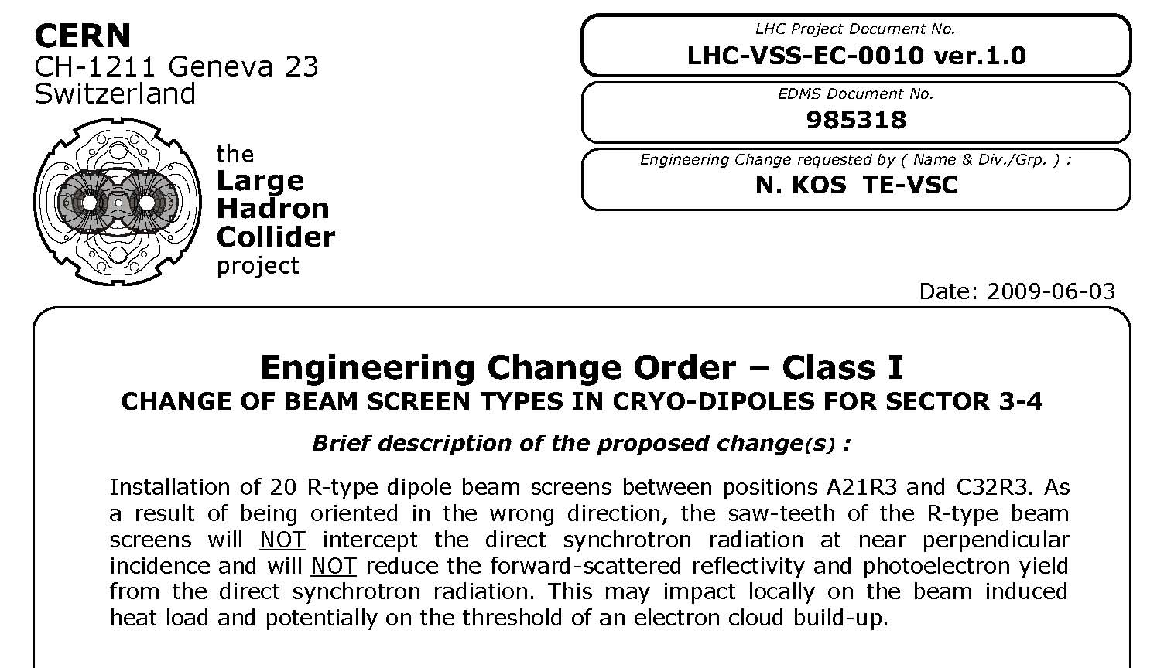
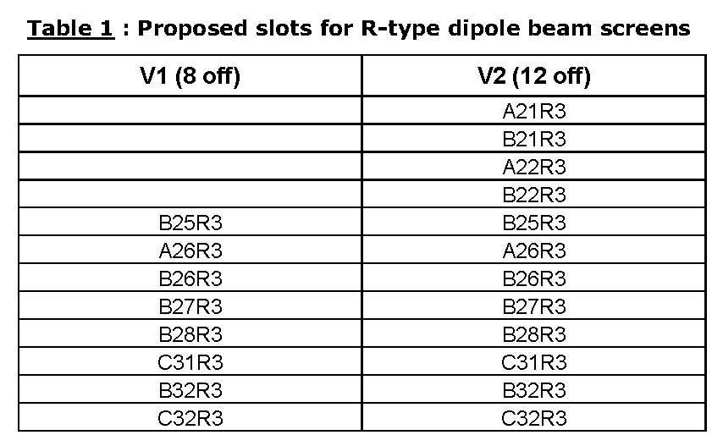
beam-screen orientation in S3-4

Slide 39
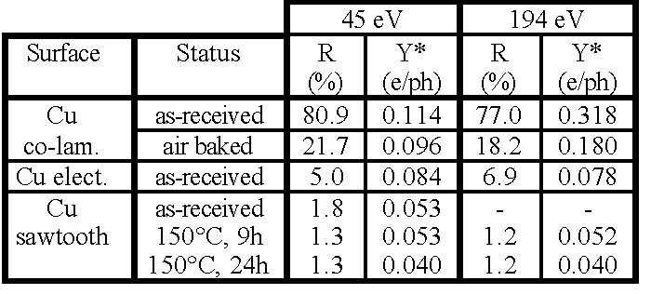
effect of the sawtooth
V. Baglin I. Collins, O. Grobner, EPAC’98
assumptions agreed with Humberto Maury
to model chamber w/o sawtooth:
change distribution of reflected photons from cos²ψ to uniform
increase reflectivity from 20% to 80%
increase photoelectron yield by factor 2

Slide 40
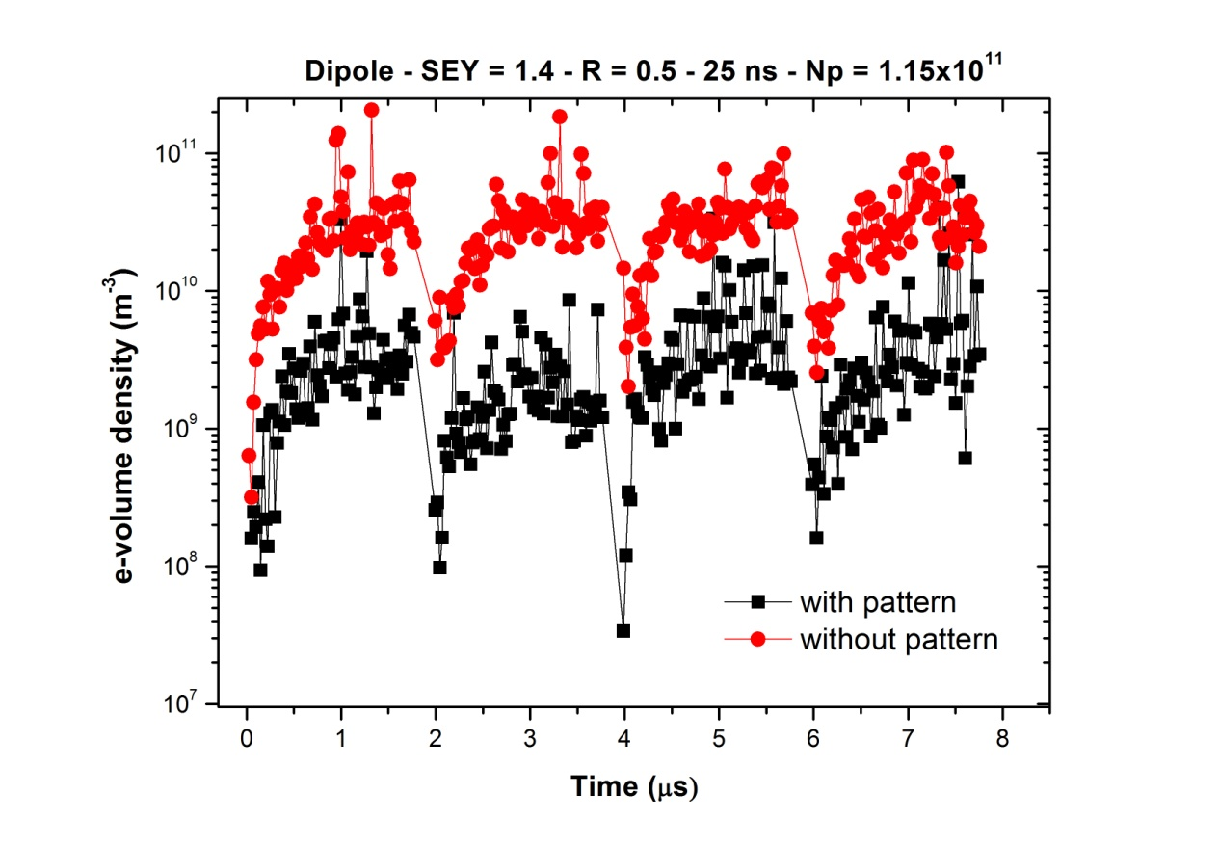
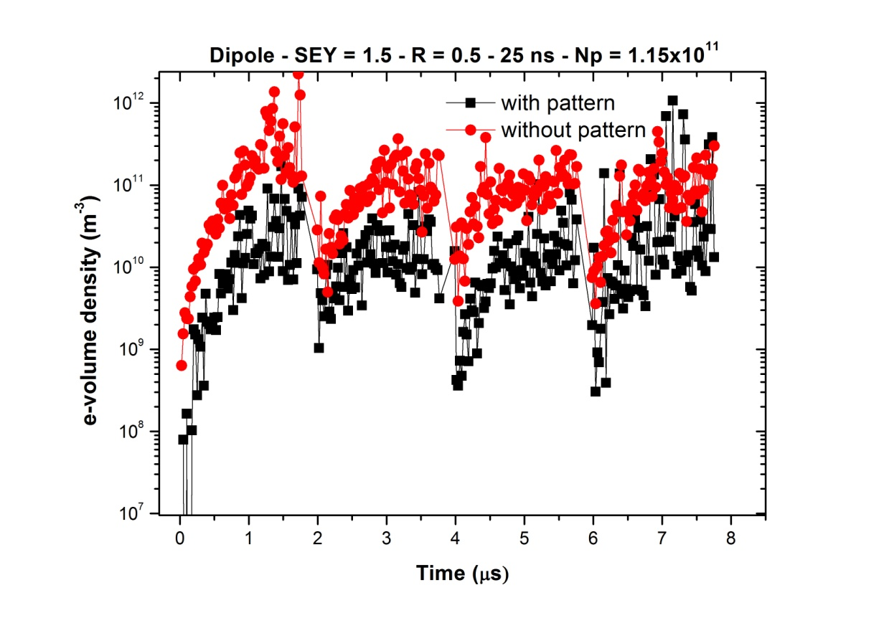
e- build up with & w/o sawtooth
δ_{max}=1.4
δ_{max}=1.5
H. Maury

Slide 41
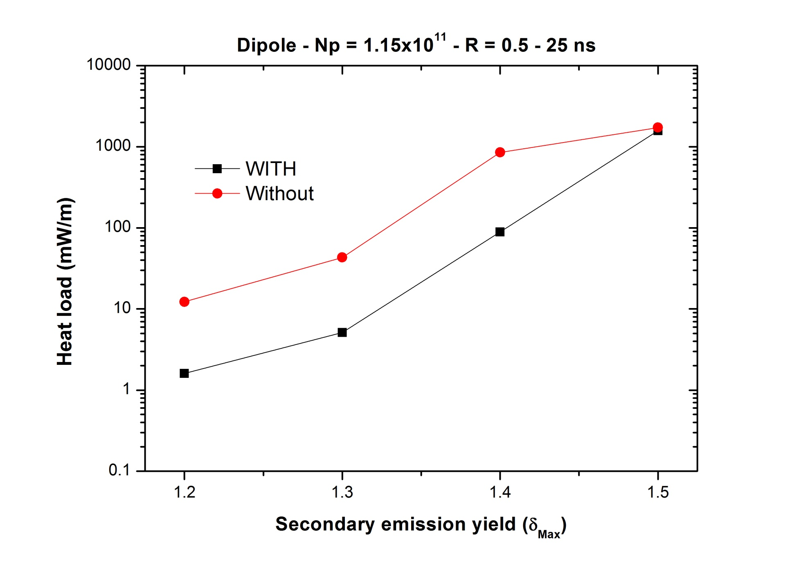
heat load with & w/o sawtooth
H. Maury

Slide 42
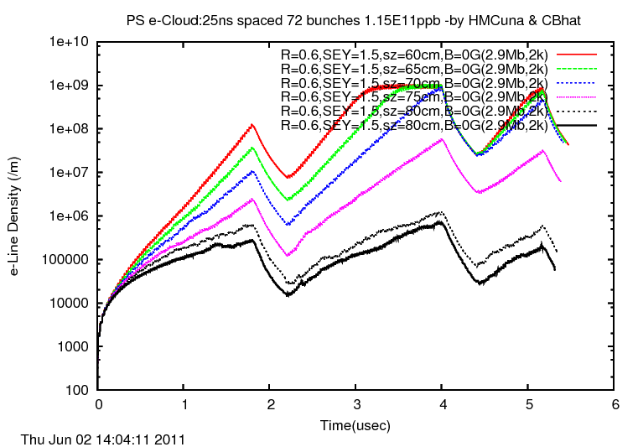
PS e-cloud simulations for different σ_{z}
PS e-cloud: σ_{ion}=2.9 Mbarn, SEY=1.5, R=0.6, B=0 G,
sz=60-85cm, Gaussian bunch(2000 macro particles)
C. Bhat

Slide 43
next steps
if/once method is established map surface parameters around the machine (>100 gauges); and track their changes
draw conclusions for inverted sawtooth chambers
make updated predictions for LHC at 25 ns spacing, e.g. optimize filling patterns for 25-ns scrubbing; scrubbing/commissioning scenarios
update predictions for LHC upgrade scenarios
higher-order coupled-bunch head-tail instability driven by e- cloud: “wake field” & growth rates

Slide 44
other ongoing or planned activities
e-cloud pinch in quadrupoles, & new approach to resonance crossing (G. Franchetti)
code development with EPFL (M. Mattes & E. Sorolla) modeling μwaves & electron cloud
e-cloud simulations for flat intense bunches in PS/SPS & corresponding MDs (Chandra Bhat)
planned studies of SPS feedback with LARP & ICE
  (W. Höfle, E. Metral, G. Rumolo)
longitudinal wake field & energy loss in SPS and LHC (collaboration with GSI (F. Yaman, O. Boine- Frankenheim, G. Rumolo, E. Shaposhnikova , F. Z.)
e-cloud at collimators, field emission, heating

