Slide 1
Beta Beams
Progress
Elena Wildner
LIS meeting 8/6 2011

Slide 2
WP4 Meeting 1/6 in LLN, ~ Brussels
Good progress
  Milestones and Deliverables
  Annual Report to be prepared
New
  Cockroft Lab (associate partner) has started work on DR RF
  Seems feasible
Many Parts are in a development phase
  Discussion on costing: many pieces needing R&D but in shadow
  Cost Drivers are Civil Engineering and DR magnets

Slide 3
ECFA review 5/5 2011
Europeean Committee for Future Accelerators
  Give recommendations for the 3 facilities
  International: Europe, US, Asia
Results
  Beta Beam/Superbeam option strongly recommended
  We are well advanced an well organized
  Technical design report should be made
  Stop research: make it!
  Report will be given to CERN Council
Report has to be started now!

Slide 4
Participants ECFA (EUROnu + Panel)
  J.J.Back@warwick.ac.uk, jsberg@bnl.gov, jose.bernabeu@ific.uv.es, Alain Blondel <alain.blondel@cern.ch>, bross@fnal.gov, decowski@nikhef.nl, andrea.donini@uam.es, marcos.dracos@ires.in2p3.fr, rob.edgecock@stfc.ac.uk, gianluigi.fogli@ba.infn.it, terence.garvey@psi.ch, Simone Gilardoni <simone.gilardoni@cern.ch>, halzen@icecube.wisc.edu, Patrick Huber <pahuber@vt.edu>, l.jenner@imperial.ac.uk, david.kelliher@stfc.ac.uk, a.kurup@imperial.ac.uk, philippe.lebrun@cern.ch, Kenneth Long <k.long@imperial.ac.uk>, jukka.maalampi@jyu.fi, tatsuya.nakada@cern.ch, koichiro.nishikawa@kek.jp, Palladino <palladino@na.infn.it>, j.pasternak@ic.ac.uk, chris.rogers@stfc.ac.uk, Ewa.Rondio@cern.ch, Paul Soler <p.soler@physics.gla.ac.uk>, Thierry Stora <thierry.stora@cern.ch>, tsenov@phys.uni-sofia.bg, vassilo@iphc.cnrs.fr, Elena Wildner <elena.wildner@cern.ch>, mszisman@lbl.gov

Slide 5
Initiatives to pave a road for a facility
Neutrino Consortium
  Ken Long, Andre Rubbia, Alain Blondel, Dave Wark, Ilias Eftimioupolos, Vittorio Palladino, Silvia Pascoli, Rob Edgecock, Marcos Dracos, Elena Wildner …
  Assemble interests for neutrinos and make a strong case
  Self nominated, mandate?
  Interact with labs and in particular CERN Council
  Final aim: neutrino physics (what exactly…?)
  How to place a project (time, reach and location)
  Results from LHC, existing Superbeam experiments, astrophysics, reactor etc
  Economical and Political considerations
  Can we build several facilities? Staggering of efforts?

Slide 6
Costing Workshop 25/5 2011
WBS Structure for all facilities presented
  Beta Beam the only facility with an implementation for the costing WBS in the wanted costing tool
To advance the EUROnu costing:
  Beta Beams is the example
  Complete prototype will be made for betabeams
  Help from P. Bonnal, costing expert CERN
Civil Engineering of EUROnu facilities at CERN
  WP4 will coordinate layout for all facilities
  Civil Engineering coordinated by John Osborne
  Rob (EUROnu) and Elena will meet S. Myers for discussion
  150 000 Chf for drawings and costing exercise

Slide 7
Costing Workshop 25/5 2011
Source
  We have a good base! Infrastructure ?
Collection Device
  We urgently need indications and a WBS
Linac (Scaling with M. Vretenar’s estimates)
RCS
  We have a good base!
Ion Production
  Being designed, including infrastructure and civil engineering
PS and SPS ???
Decay ring: new thoughts
  Many bore magnets
  May have serious consequences, Collaboration magnet group necessary
  Elena W will assemble new ideas for injection and for coll. effects

Slide 8
Costing Workshop 25/5 2011
Costing is one of few criteria for evaluation
Physics performance and safety are the others
We will have criteria for risk, contingency r&d …

Slide 9
Safety workshop 9-10/6 2011
Elena B + Elena W preparing a presentation
  Elena B will present
Safety Panel
  Elena W is safety representative of Beta Beams
  Elena B will participate depending on her workload (after September)
Will go into costing
  Design/Maintenance/Risk: TRICKY!

Slide 10
Outreach
Neutel11, February, Venice
  Presentation on web
EUCARD
  Discussions one day on Neutrinos
  Minutes on web
Nufact 1 August 2011, CERN
  I put all of us, You will be invited
  This is a chance for us! Please come,
IPAC Beta Beam Paper
  I sent an abstract Beta Beams
  Please read and give names for author list
IPAC paper for EUROnu (all facilities)
  Rob Edgecock & Elena W authors, Elena will present at IPAC

Slide 11


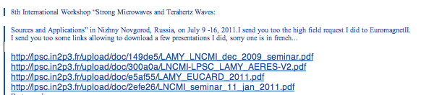
Outreach

Slide 12

CERN Beta Beams, Synoptic
RCS
SPL
Linac4
Dotted lines: alternative layouts
Linac
ISOL target
Molten Salt Loop
PR
Collection
6He
18Ne
ν-Beam
ECR
ECR
RFQ
RFQ
Baseline
6He/18Ne
8B/8Li
Linac 100 MeV
DR
PS
SPS
PS and SPS existing
RCS
Bρ ~ 500 Tm, B = ~6 T, C = ~6900 m, L_{ss}= ~2500 m, γ = 100, all ions
12
Notes:
What is changing is mainly the production

Slide 13
Isotope production rates
Aim: 2.0 10¹³ for low-Q
Targets below MWatt is a considerable advantage!
Type | Accelerator | Beam | I_{beam} _{mA} | E_{beam} _{MeV} | P_{beam} _{kW} | Target | Isotope | Flux _{S}⁻¹ | Ok?
ISOL & n-converter | SPL | p | 0.07 | 2 10³ | 135 | W/BeO | 6He | 5 10¹³
ISOL & n-converter | Saraf/GANIL | d | 17 | 40 | 680 | C/BeO | 6He | 5 10¹³
ISOL | Linac 4 | p | 6 | 160 | 960 | 23Na 19F Molten NaF loop | 18Ne | 1 10¹³
ISOL | Cyclo/Linac | p | 15 | 60 | 900 | 23Na 19F Molten NaF loop | 18Ne | 1 10¹³
ISOL | LinacX1 | 3He | 85 | 21 | 1800 | MgO 80 cm disk | 18Ne | 1 10¹³
P-Ring | LinacX2 | d | 0.160 | 25 | 4 | 7Li | 8Li | 3 10¹³
P-Ring | LinacX2 | 3He | 0.160 | 25 | 4 | 6Li | 8B | 8 10¹¹
More is possible
Planned experiments
 | Experimentally OK
 | On paper OK, exp. 2011
 | Not OK yet
NB :8Li can be produced in rates comparable to 6He using similar technology
T. Stora, P Valko, E. Benedetto, E. Wildner…

Slide 14
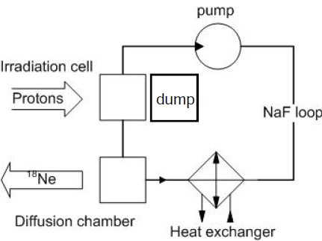
Experiments ¹⁸Ne for Beta Beams
Measure production and release from a sodium target at ISOLDE
  Proposal sent to INTC (ISOLDE and Neutron Time-of-flight Committee)
  Accepted !!
Molten salt loop to produce 18Ne !
  Experimental setup and measurements, from May 2011
The ν_{e} beam needs production of 2.0 10¹³ ¹⁸Ne/s
Theoretically possible
with 10 mA 70 MeV protons on NaF
We need measurements of the crossection ¹⁹F(p, 2n)¹⁸Ne !
T. Stora, P. Valko

Slide 15
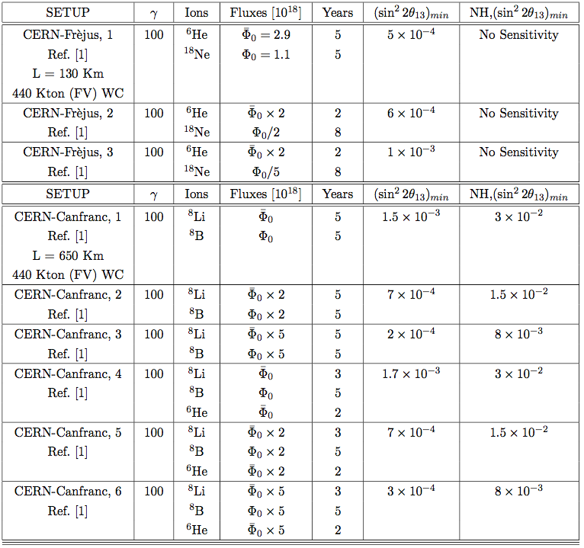
Managing intensities: “Ion Cocktails” 1
Collective effects important
Less collective effects
Less collective effects
We can get 8Li “easily”, but not 8B
Summary by A. Donini

Slide 16
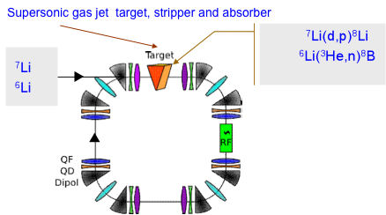
The Production Ring on Ice (8B and 8Li)
Production of 8B and 8Li
C. Rubbia, EUROnu proposal
Gas Jet target proposed in FP7:
  too high density would be needed
  vacuum problems
Direct Production (D. Neuffer) with liquid film targets
  Collaboration ANL (Benedetto/Nolen)
Basic lattice and 6D tracking ok, RF feasible (10 MHz, 300 kV)
Simulations ongoing (E. Forest helping)
Charge exchange injection to be designed
Direct kinematics could give good production efficiencies (Nolen active)
Experiment/simulations at ERIT, (FFAG solution, larger aperture)
  Proposal postponed (hardware changes needed)
Experiment/simulations at TSR, ion storage ring, Heidelberg or CERN
Aachen Univ., GSI, CERN
16

Slide 17
High Intensities
Instabilities in Decay Ring
  Probably Treatable (Optics, Impedance, Double bore magnet…)
SPS is a problem, a way out?
  Instabilities (TMCI)
  Increase emmittance in SPS?
  Many-bore magnet in DR, lower intensity per aperture
  Lower merging losses “gain” in production
  Rf restructuring (SPS upgrade participation) ?
  Magnet should not make the Decay ring too expensive
  Keep dutyfactor
  Use existing machines: not conveniemt???

Slide 18
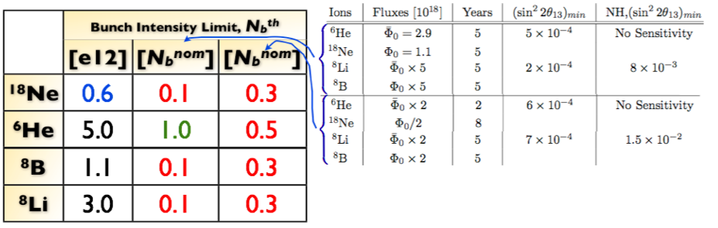
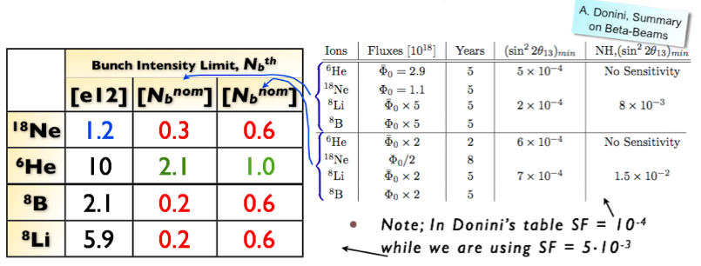
Collective Effects limits, Decay Ring
Only Transverse Mode Coupling Instabilities
Recent Encouraging results, redesigned decay ring !
Phase slip factor changed
C. Hansen, CERN & A. Chance, CEA
18

Slide 19
Collective Effects limits, Decay Ring
Two beams, LHC style double bore Magnets !?
Less heavy: octupoles (but not working ?)
Recent Encouraging results, redesigned decay ring
Phase slip factor changed
19

Slide 20
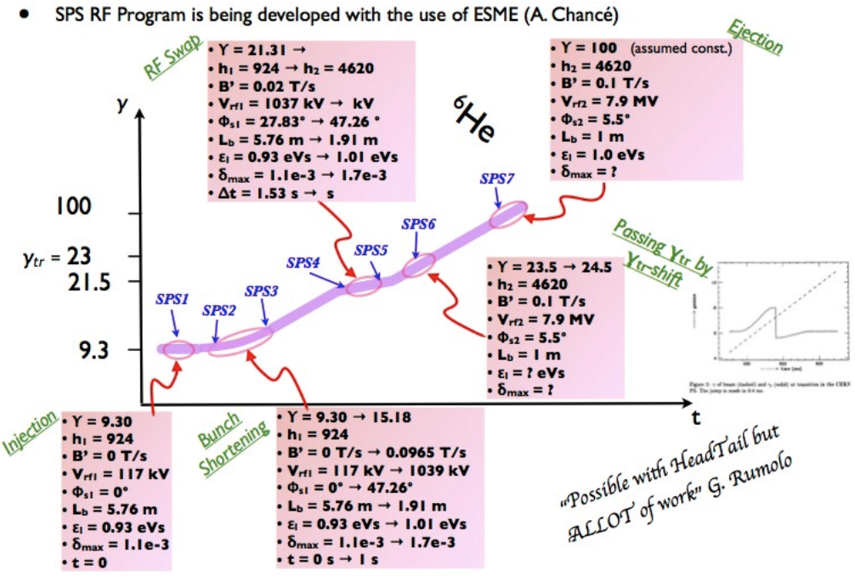
Collective Effects limits, SPS
Still much work to do and still several problems to solve.
Many bore magnets in decay ring:
Feasability, Price
Merging more efficient
Change emmittance (RF) in SPS
EW writing spec and discussing with L. Bottura/E. Todesco
C. Hansen, CERN & A. Chance, CEA
20

Slide 21
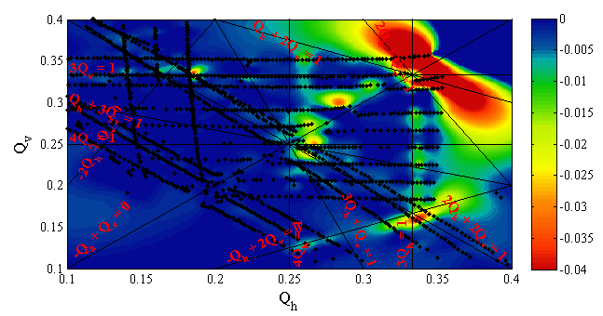
Space charge in PS
Injection from RCS 3.5 GeV: not possible
PS upgrade 2GeV
Tune scans to accommodate beams (LHC, β Beams…)
E. Benedetto

Slide 22
Imminent: RP for Beta Beams in PS
Energies of 2, 3.5 and extraction
Models from LHC-> used also for Beta Beams
S. Gilardoni (Fellow?)
E. Benedetto

Slide 23
Collimation in Decay Ring
Essentially from the stacking method (RF merging)
Collimators will melt
Crystals?
Important Challenge
Contacted R Assmann, W Scandale, E Laface
E. Benedetto

Slide 24
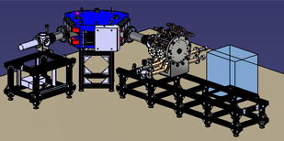
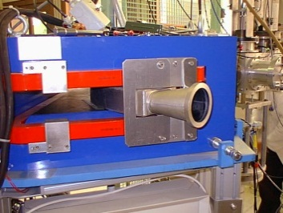
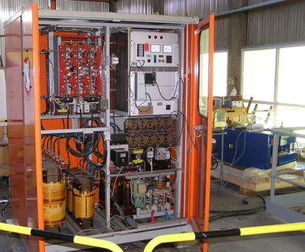
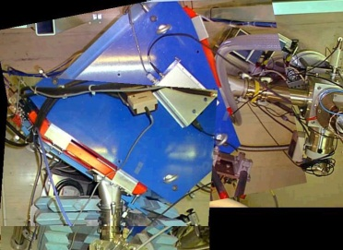
LNCMI site preparation for future experiments
Design of the High intensity beam line
  Vacuum components (turbo pumps, chambers, tubes...) ordered
  Stands ordered next week
  Magnetic spectrometer current supply operational (since one week...)
  LNCMI installation in M3 room under evaluation
      Concrete foundation slab resistance ... (Magnet > 2 tons)...
      Layout
      Magnetic fringing fields from other magnets and prototype (for gyrotron)

Slide 25

Application for magnet time
Characterization of ion beams extracted from a 28 GHz ECR plasma in a split magnet
To progress towards 60 GHz ECR operation of the ECRIS
  Simple beam line : magnetic spectrometer and beam characterization devices
  10 kW 28 GHz gyrotron available from LPSC
  A lot of safety issues (Microwaves, X rays, High voltage...)
After beam measurements ( a few weeks)
Terminate magnetic field measurements from 15000 up to 30000 A

Slide 26


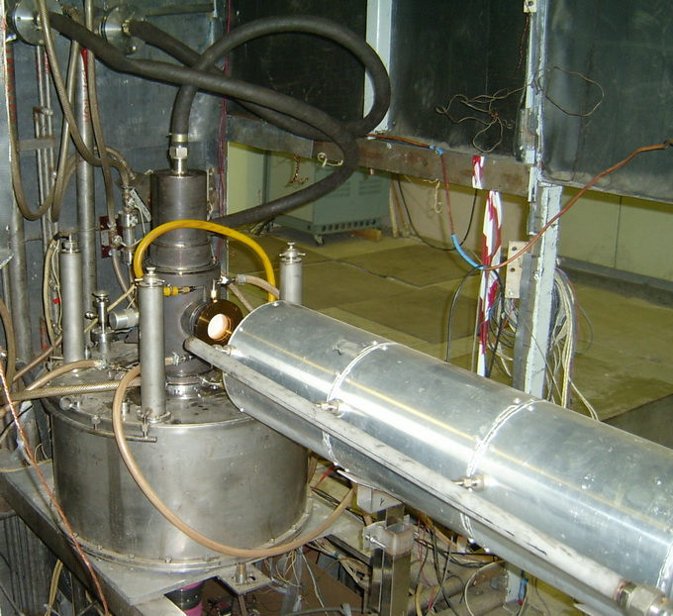
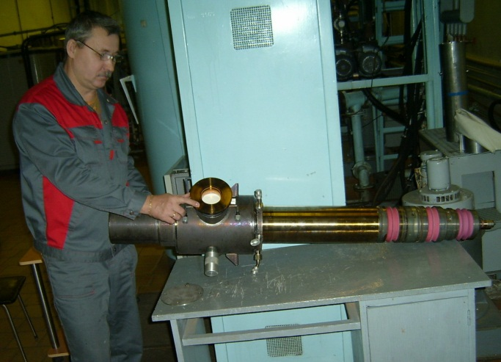
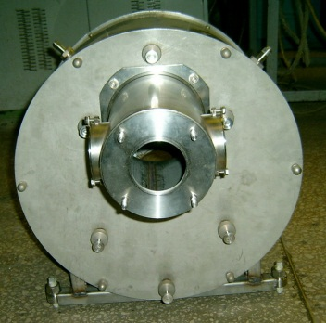
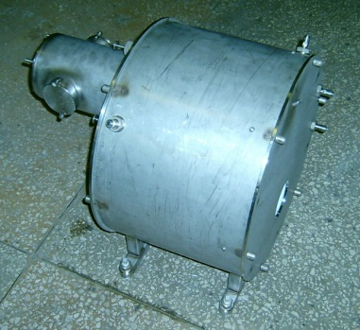
60 GHz gyrotron
60 GHz 350 kW gyrotron manufacturing at
Institute of Applied Physics - RAS (Nizhny Novgorod – Russia)
ISTC Project No. 3965
  Radiation frequency 60 GHz, MW power 10 - 300 kW
  Pulse duration from 50 ms to 1 ms, pulse repetition rate up to 5 Hz
Gyrotron in the
cryomagnet
Tube
Matching Optics Unit
Delivery at Grenoble fall 2012

Slide 27
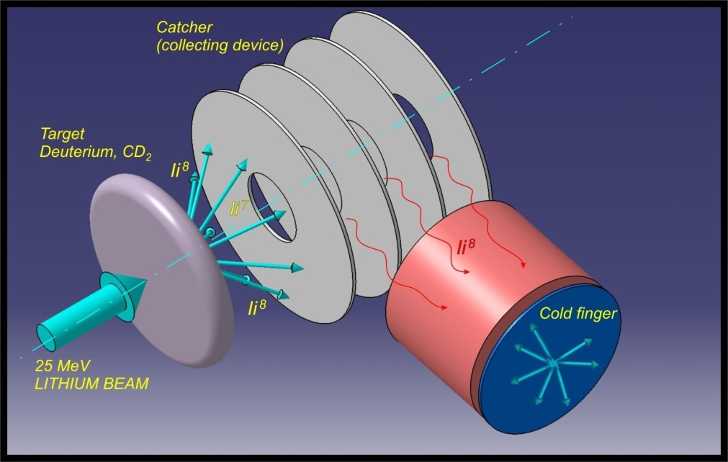
Collection device for the Production ring
We saw the device last week!
Measurements/Analysis ongoing for the collected 8Li
Direct kinematics seems ok
Setup and measurements for 8B production and collection ongoing
CRC, Louvain la Neuve

Slide 28
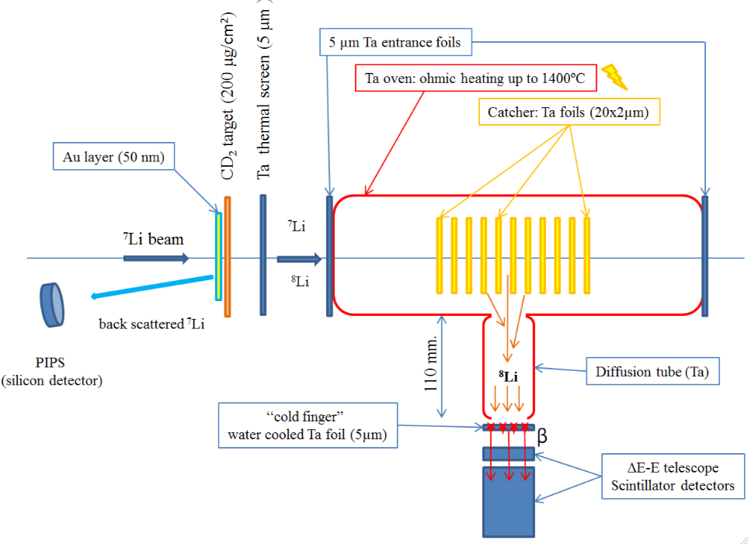
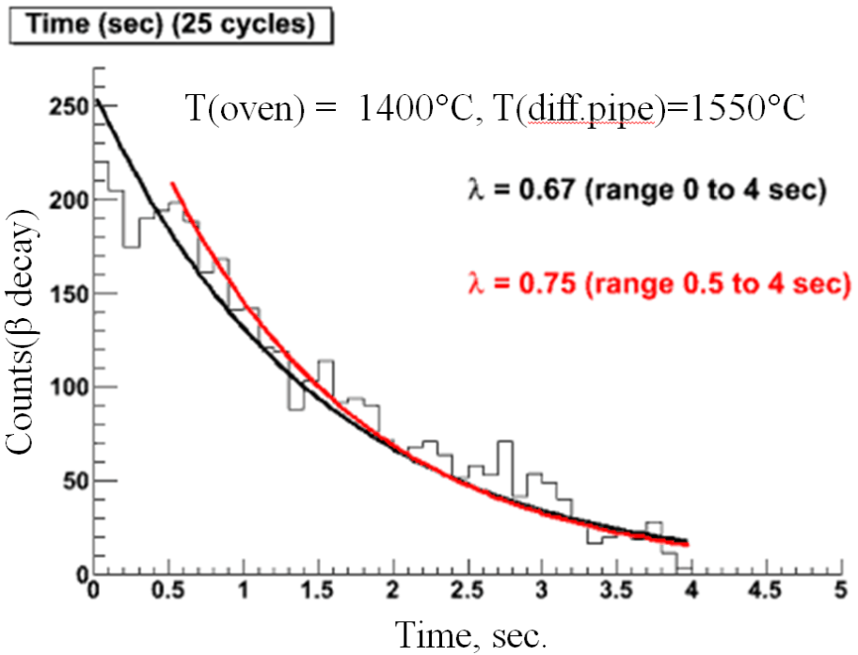
The collection device setup
⁷Li(d,p) ⁸Li and ⁶Li(³He,n) ⁸B
⁷Li(10-25 MeV) and ⁶Li(4-15 MeV)
~ 1nA beams deuteron or ³He target.
S.Mitrofanov, LNL

Slide 29
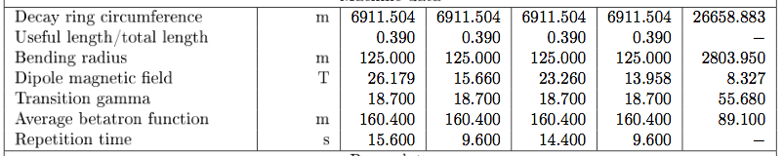
Gamma 350 implications
Choice: Decay ring the same size as the gamma = 100 decay ring
Choice: Flux after straight section the same as for the gamma = 100 decay ring
Duty factors can be reduced
We need an accelerator to give gamma 350 (SPS upgrade!?)
Superconducting magnets of 26 T not realistic for 20 years, means larger arcs
20 T magnets may be envisaged, short models in 20 years…
Price related to superconductor and iron volume (aperture) in addition to a necessary bulk cost for development and tooling
Collective effects improved
Detailed studies needed (septa, RF, Radiation…)
The option is in the EUROν proposal but for us necessarily low priority
Draft !
L. Bottura, A. Chance, C. Hansen, M. Martini, G. de Rijk, E. Wildner
29
Notes:
What is changing is mainly the production

Slide 30
Conclusion
One year still to go!
Many challenges
But…
All is progressing…
L. Bottura, A. Chance, C. Hansen, M. Martini, G. de Rijk, E. Wildner
30
Notes:
What is changing is mainly the production

