Slide 1
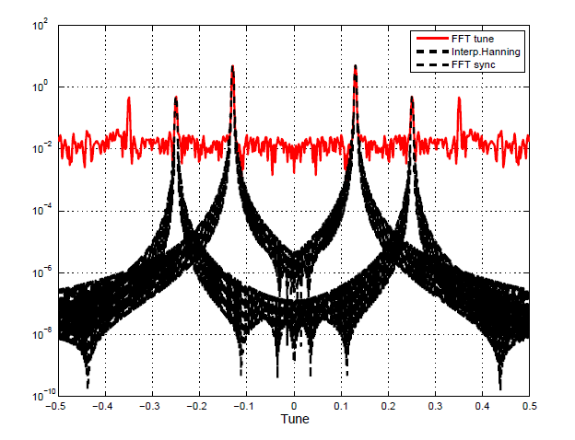
FFT corrections for tune measurements
N. Biancacci
Acknowledgements: M.Giovannozzi, E.H. Maclean, E.Métral, Y.Papaphilippou , B.Salvant, R.Tomás.

Slide 2
Outline
Discrete fourier transform (DFT) of harmonic signals
ApFFT-FFT corrected- SUSSIX
Comparisons between different operations on spectra in order to achieve higher resolution.
Conclusion and outlook

Slide 3
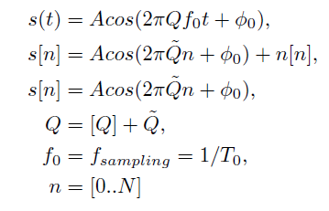
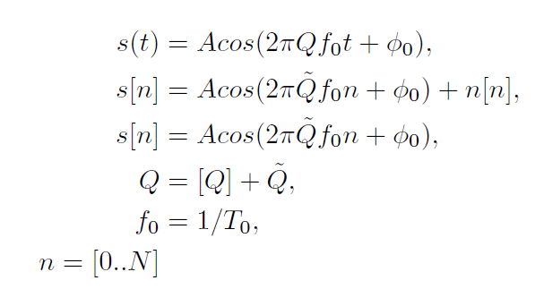
DFT on harmonic signals
BPM
= number of turns
ADC
+
Noise
Memory

Slide 4

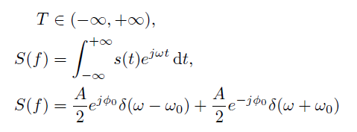

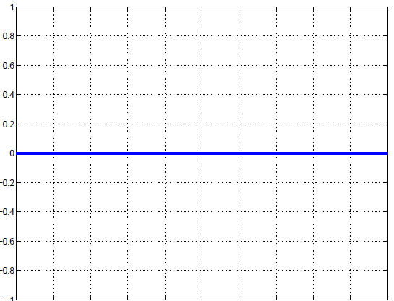
DFT on harmonic signals
Continuum case:

Slide 5
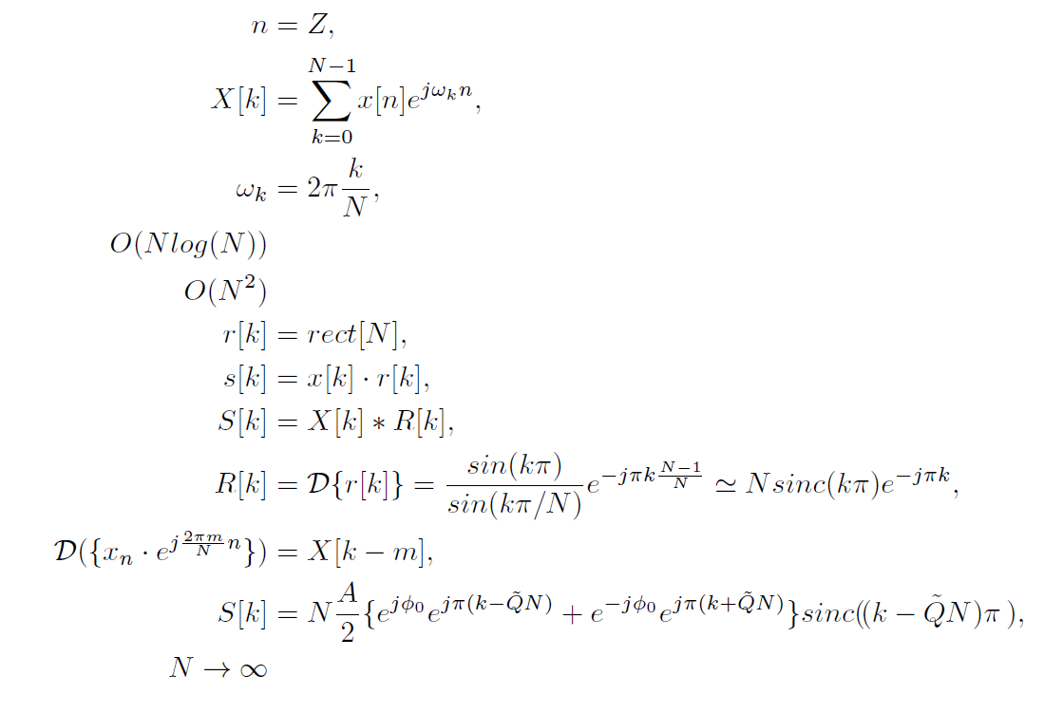
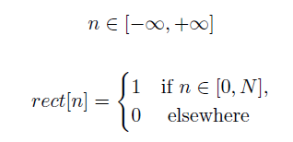


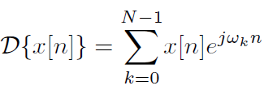
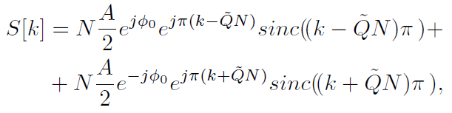
DFT on harmonic signals
Discrete case:
Having a finite number of samples corresponds to windowing with a “rect” function r[n] the sampled signal.
This operation is a convolution in the discrete frequency domain.
Applying the DFT formula on r[n] and applying translation property* from s[n], we get:
* DFT translation property

Slide 6

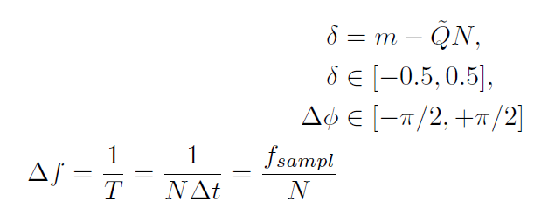
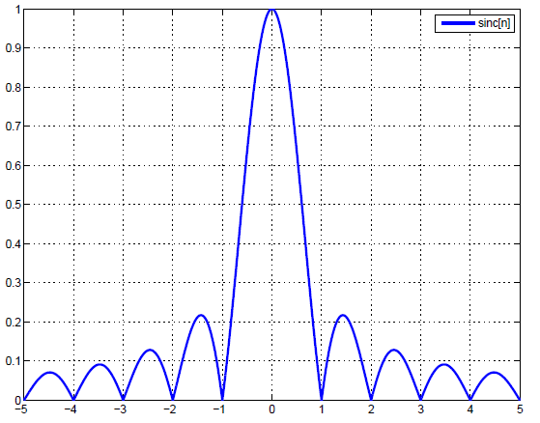
DFT on harmonic signals
Observations:
Phase shift
Frequency shift
Amplitude distortion
Naming where m is the index corresponding to the highest peak in amplitude spectrum, one can see that
Amplitude, phase and frequency resolutions depend on the error δ in localizing the spectrum maximum.
Resolution in frequency is related to the length of samples but also to the value of δ (correspond to the real value if δ=0).
Without correction,
making the phase basically useless.
Resolution in amplitude is dependent from the resolution in frequency and the window shape.
m

Slide 7
DFT on harmonic signals
To overcome these limits and recover the real parameters for the harmonic signals different methods were proposed*:
CFFT → ‘Corrected FFT’ Used to correct the amplitude, phase and frequency. Based on analytical properties of windowing functions.
ApFFT → ‘All phase - FFT’ Used to improve the phase resolution. Based on properly preprocessing the measured signal in order to cancel phase errors.
Sussix → Used to improve frequency resolution. Based on iterative routines to get the frequency of the tune.
In the following we present comparisons between these three methods.
* All references at the end of the presentation

Slide 8
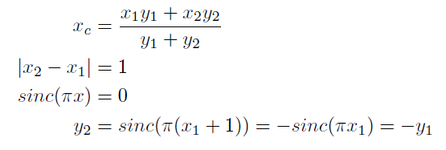



Corrected FFT
Using a “rect” window we get a “sinc” shape in frequency domain. This window has a nice property if one computes the baricentre for two points in the main lobe of the sinc.
Take the continuum function .
Take two points P1(x1,y1) and P2(x2,y2) in the main lobe.
The baricentre is given by:
If then:
It follows that
P1
P2
Since in spectral analysis, k-samples are spaced by unity, taking the shifted-maximum and the second maximum, and computing the baricentre Xc we get the exact position corresponding to the real maximum:

Slide 9

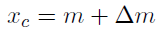
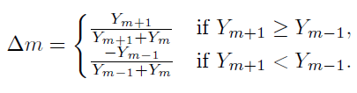
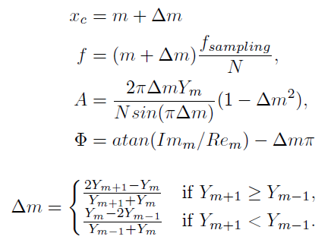
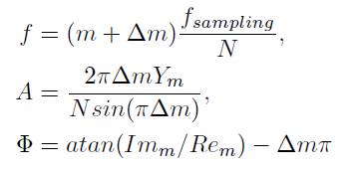
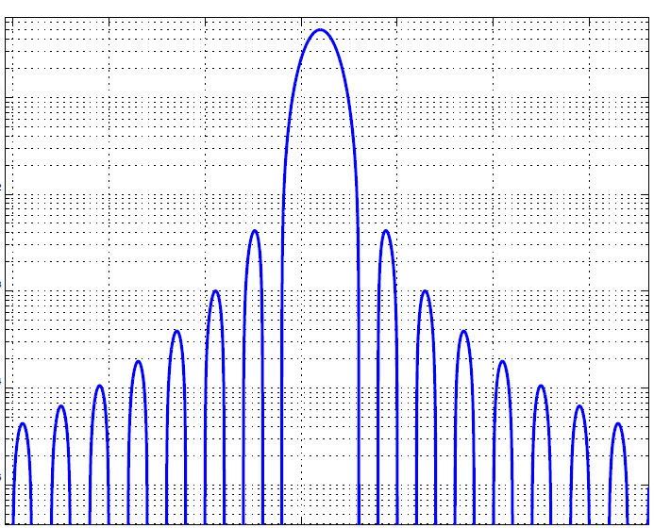
Corrected FFT
Applying the baricentre method we can get the correction formula both for “rect” and Hanning window:
Rect window
Hanning window
m
m-1
m+1
m-1
m
m+1

Slide 10
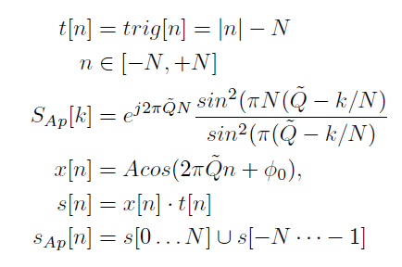

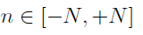


Ap-FFT
This is a preprocessing algorithm developed to correct the phase got out from the DFT operation. The computed phase is the central phase, i.e. the one corresponding to the central sample in case of an odd number of samples.
Multiply the signal with a triangular window:
Fold the windowed signal:
Proceed to FFT evaluation and extract the phase:
The phase is no more dependent on δ, i.e. doesn’t need to be corrected.

Slide 11

Sussix
At the core of SUSSIX is a Fortran Routine TUNENEWT, developed by the Bologna Group in the mid-nineties (Author: A. Bazzani ; tests by R. Bartolini, M. Giovannozzi, & E. Todesco).
  TUNENEWT determines the maximum of the amplitude of the FFT with an iterative Newton method..
  SUSSIX uses TUNENEWT to analyse the full frequency spectrum:
      The fundamental frequencies are found and corrected using TUNENEWT:
            Frequency (ν _{k}), Amplitude (a_{k}), Phase (φ_{k})
      Harmonic time series are built:
      and subtracted from the original signal
      The new signal z(n) – z_{k}(n) is re-analysed with TUNENEWT...
The spectral lines are ordered, as linear combinations of the tunes, in decreasing amplitude.
Courtesy of E.H. Maclean

Slide 12

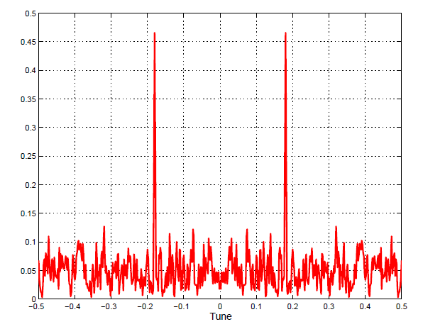
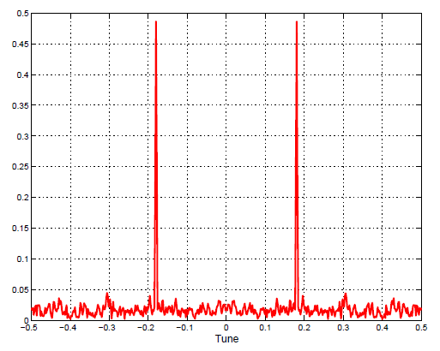
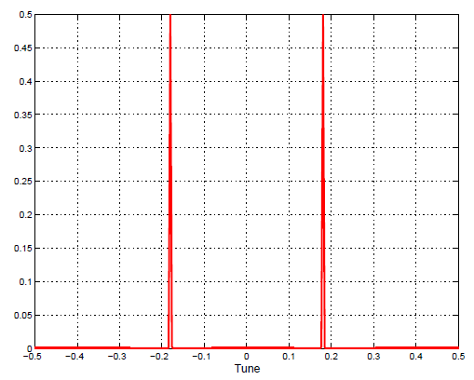
Comparisons
Different simulations were set up on detecting phase, amplitude and frequency using the three different methods.
In order to properly compare the phase accuracy, the phase difference between two signals at the same frequency will be analyzed. In real life the absolute phase has no sense cause to the decoherence in the signal.
All the simulations are set in presence of noise. The level is set in terms of power of noise:
We consider the case of 0, -10, -100 dB. These values correspond to 100%, 30%, 0% the amplitude of a unitary sinusoid.
Pn = 0dB
Pn = -10dB
Pn = -100dB

Slide 13
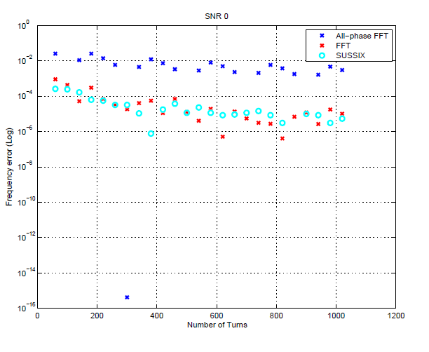
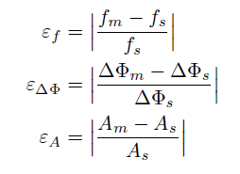
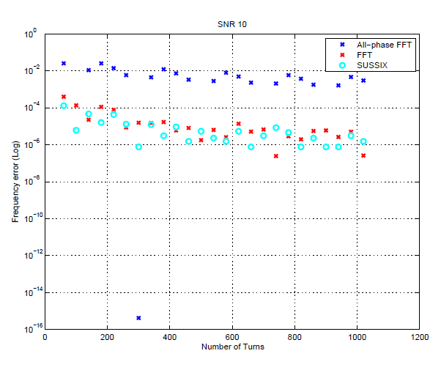
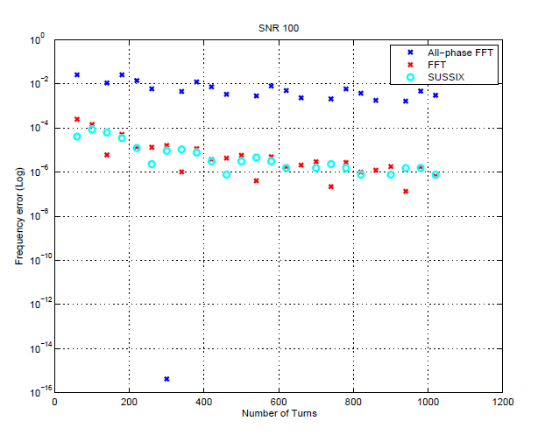
Pn = 0dB
Frequency
Both FFT and Sussix have Hanning window on the signal.
The FFT is corrected with the formulae seen before.
Sussix does the correction in TUNENEWT iteratively.
ApFFT has a rect window and doesn’t implement any correction in frequency.
Pn = -10dB
Pn = -100dB

Slide 14
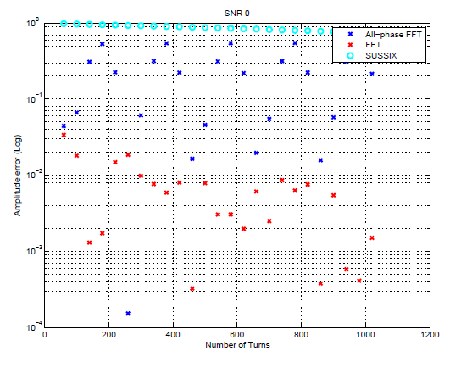
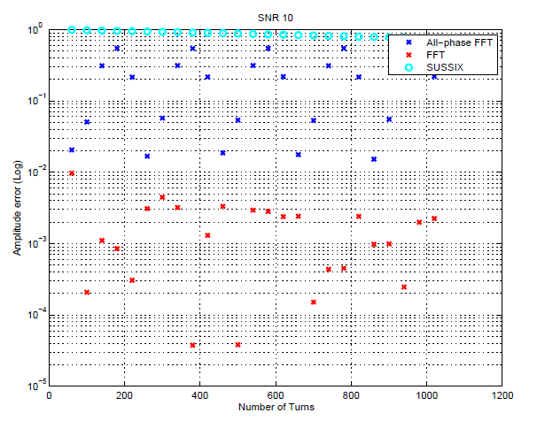
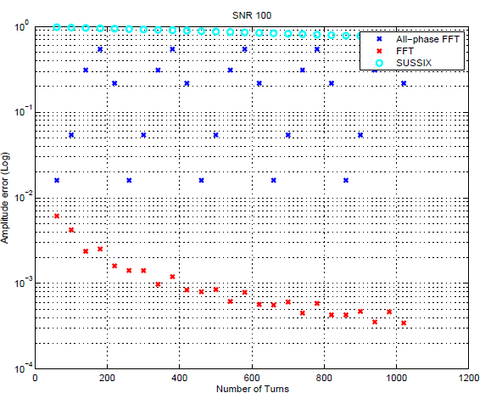
Screen clipping taken: 5/27/2011, 3:44 PM
Pn = 0dB
Amplitude
Neither Sussix nor ApFFT implement any amplitude correction.
The FFT is corrected with the formulae seen before.
Pn = -10dB
Pn = -100dB

Slide 15
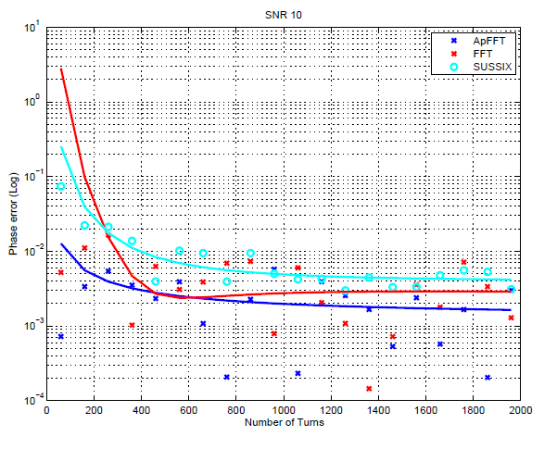
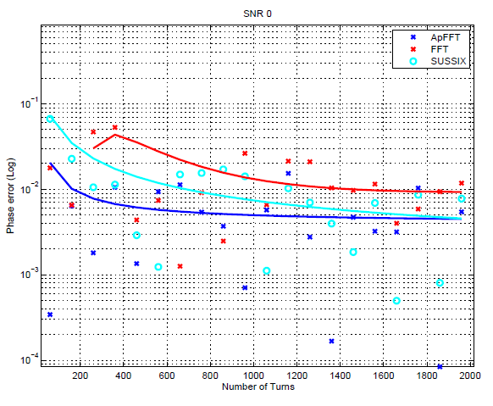
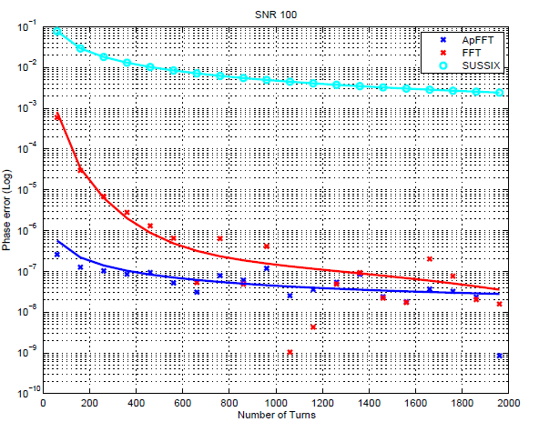
Pn = 0dB
Phase
This simulation is set up with a ∆φs=90⁰.
The FFT is corrected with the formulae seen before.
In presence of noise all the approaches give almost the same results.
Pn = -100dB
Pn = -10dB

Slide 16
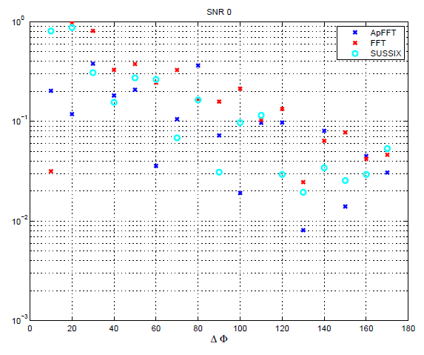
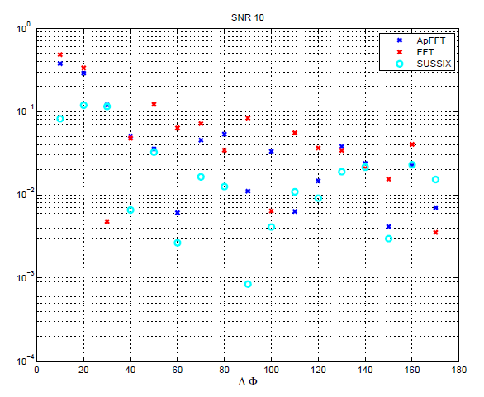
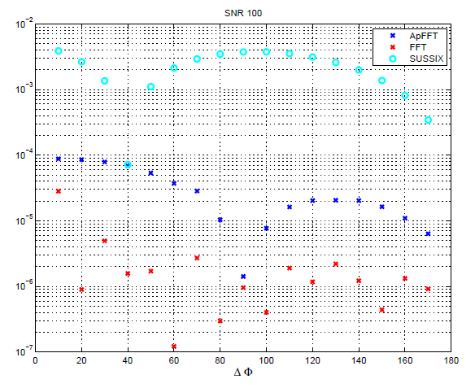
Pn = 0dB
Phase
This simulation is set up fixing N to 512 Turns and spacing the ∆φs from ∆φs =0⁰ to ∆φs =180⁰.
In case of no noise (simulations) ApFFT and the corrected FFT give higher resolution.
Pn = -10dB
Pn = -100dB

Slide 17
Conclusions and outlook
The problem of getting correct phase, amplitude and frequency out of a harmonic signal was analyzed.
Corrected FFT, ApFFT and SUSSIX algorithm were presented in both a theoretical and practical point of view .
We can improve SUSSIX speed implementing the analytical corrections (single shot corrections VS iterative loops).
We can improve the corrected FFT in order to detect subsequent armonics in the betatron signal.
We could also complete the comparison including the NAF algorithm.

Slide 18
Biography
On SUSSIX
R. Bartolini, M. Giovannozzi, W. Scandale, A. Bazzani and E. Todesco “Precise measurement of the betatron tune ” Particle Accelerators, 1996, Vol. 55, pp. [247-256] /1-10
R.Bartolini, M.Giovannozzi, W.Scandale , A.Bazzani, E.Todesco “Algorithms for a precise determination of the betatron tune”
On FFT corrections
X.Ming, D.Kang “Corrections for frequency, amplitude and phase in a fast fourier transform of a harmonic signal” Mechanical Systems and Signal Processing V. 10, 2, March 1996, Pages 211-221
On Ap-FFT
X. Huang, Z. Wang, L. Ren et al. “A novel High-accuracy Digitalized Measuring Phase Method” IEEE
X.Huang, Z.Wang, G.Hou “New method of estimation of phase, amplitude and frequency based on all phase FFT spectrum analysis” IEEE
X.Ming, D.Kang “Corrections for frequency, amplitude and phase in a fast fourier transform of a harmonic signal” Mechanical Systems and Signal Processing V. 10, 2, March 1996, Pages 211-221
On digital signal processing
J.G.Proakis, D.G. Manolakis “Digital Signal Processing, principles, algorithms and applications” 4th edition.

Slide 19
Many thanks!!

