Slide 1
Main activities and news from the Impedance working group

Slide 2
Agenda
Main activities
Impedance?
Tools
Hot topics
Issues
Where can information be found?

Slide 3
Main activities
Long term research:
Develop new models and understanding for the beam coupling impedance of typical accelerator elements
Improving our methods to compute, simulate and measure impedances
Medium term tasks:
Build knowledge and a database of impedance for all CERN synchrotrons
Implementation and population of the impedance database (ZBASE) for PSB, PS, SPS and LHC to be used for calculation or simulation of beam dynamics (HT Working group).
Short term issues:
Requests for impedance calculations of elements before hardware modification or installation

Slide 4
Agenda
Main activities
Impedance?
Tools
Hot topics
Issues
Where can information be found?

Slide 5
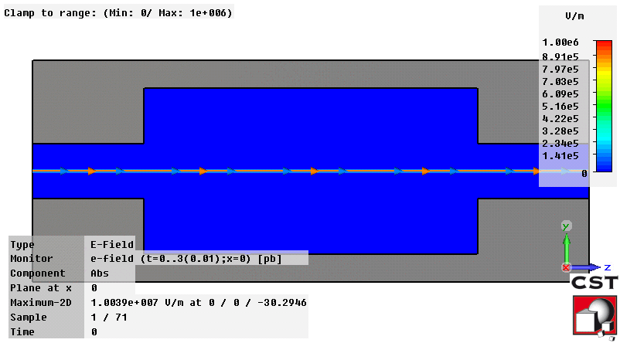
Beam coupling impedance?
Wake potentials W(z):
integrated force F generated by a source bunch (1) of longitudinal distribution ρ(z) on a witness particle (2) following at a distance z.
Wake functions G(z):
wake potential for which the source is a point charge
Beam impedance Z(ω)
Fourier Transform (FT) of the wake function
Example of 3D simulations of wake fields created by a bunch in a pipe transition
y
y₂
2
z
s₁
s₂
s
y₁
1
Accelerator element
- smaller pipe apertures - abrupt changes of the shape of the pipe - materials with larger losses
In general, larger impedances are generated by
5

Slide 6
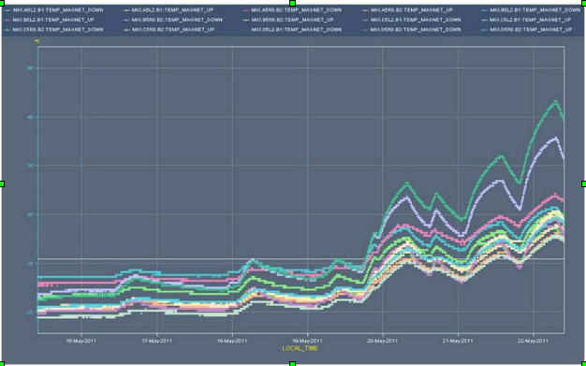
Why do we need to assess the impedance?
→ Collective effects caused by impedance
Longitudinal and transverse instabilities
→ beam losses and/or emittance blow up
Overheating of elements
→ beam interlocks

Slide 7
Agenda
Main activities
Impedance?
Tools
Hot topics
Issues
Where can information be found?

Slide 8
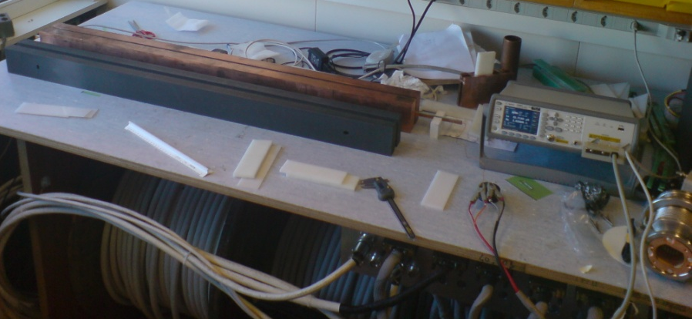
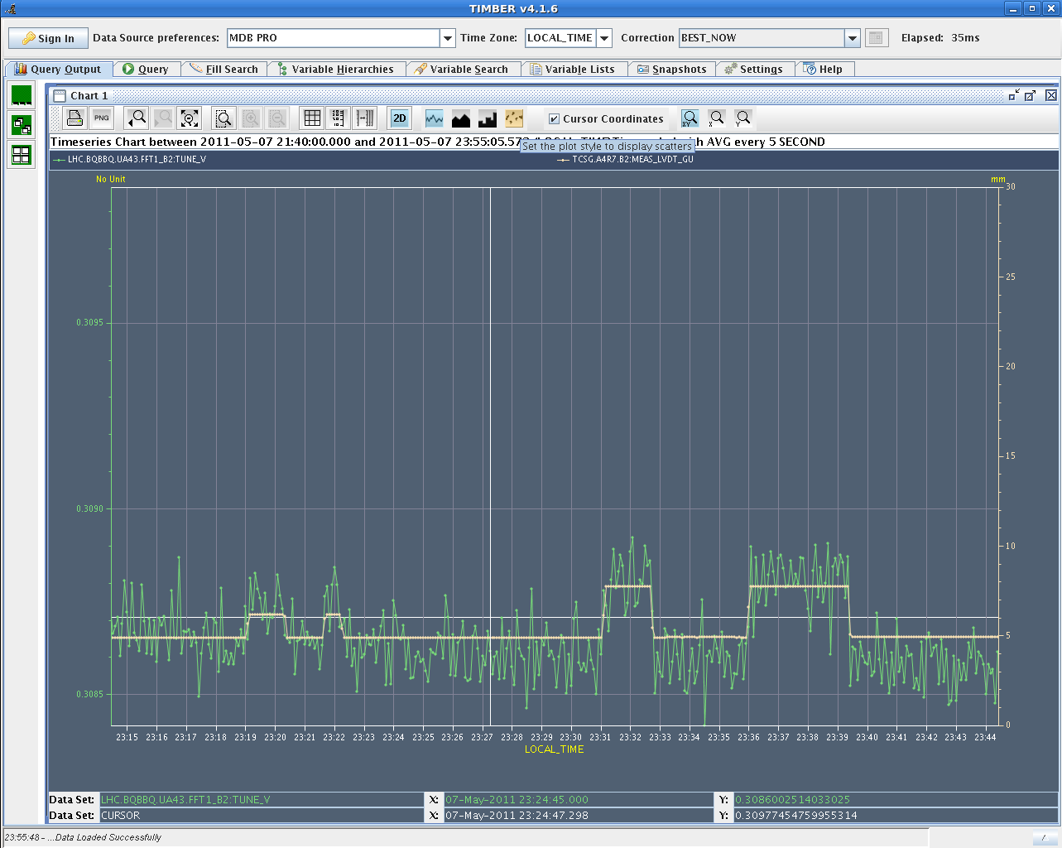
Tools
Theory:
Extensive use of field matching theories
Now also mode matching theories with Vittorio
Simulations:
Time domain (CST Particle Studio, ABCI, GdfidL, T3P)
Frequency domain (HFSS, CST Microwave Studio, Omega3P)
Measurements on test benches
With a wire used as excitation and pickup.
Measurements in the machines
Tune shift with intensity or collimator settings
Instability thresholds
Impedance localization

Slide 9
Agenda
Main activities
Impedance?
Tools
General questions and hot topics
Issues
Where can information be found?

Slide 10
Some of the general questions
Current formulae and simulations work well for beta=1
→ Working on impedance of structures with particles at low energy (in particular PSB, PS)
Current formulae work well for round and flat infinitely long beam pipes
Working on formula for impedance of elliptic beam pipes
Working on formula for impedance of elements with finite length
Current formalisms account only for linear behaviour of the transverse wake
Addressing the impedance of asymmetric structures
Working on taking into account the nonlinearity of the wake with transverse offset
Working on taking into account the internal and external circuits
Many doubts on properties of materials at very high frequencies
→ Working on measurement methods
Known issues with the wire measurements below and above cutoff
Wire measurements without wire?
Other ways to measure, compute, simulate impedance on bench or with beam?
Effective impedance shielding?

Slide 11
Hot topics
LHC injection kicker heating
Design of LHC DS and phase 2 collimators
Design of new experimental beam pipes
SPS pumping ports (shielded, unshielded)
SPS enamel flanges
PS and SPS clearing electrodes
New PS wirescanners
Segmentation, internal and external circuits of SPS kickers
Serigraphy for SPS kickers
Material characterization
Finite length
ZBASE

Slide 12
Agenda
Main activities
Impedance?
Tools
Hot topics
Issues
Where can information be found?

Slide 13
Very fruitful collaborations
GSI, TU Darmstadt and CST
La Sapienza and Frascati Rome
IHEP Beijing
KEK and J-PARC
New collaboration with India
Issues
Often hard to compute simulate real structures
Material properties
Reliability of wire measurements

Slide 14
Agenda
Main activities
Impedance?
Tools
Hot topics
Issues
Where can information be found?

Slide 15
Where can information be found?
Website: http://impedance.web.cern.ch/impedance/
Impedance meetings: usually on Friday mornings, on average once in 3 weeks. Everyone is welcome.

