Slide 1
Comparison between simulations and measurements in the LHC with heavy ions
T. Mertens,
R. Bruce, J.M. Jowett, H. Damerau,F. Roncarolo

Slide 2
Outline
Introduction
Comparison of different IBS Models
Measured data and simulation input
Comparing the simulation with single bunch data
Comparing the simulation with averaged bunch data
Side note on Protons
Conclusion and outlook

Slide 3
Introduction
Goal is to simulate Ion runs in 2010 during physics
Different IBS models available
Which fills should we try to simulate? Is all the necessary data to compare with simulation available?

Slide 4
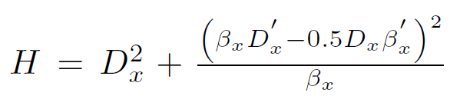
Comparison of different IBS Models[1]
Model Summary
Model | Description
Piwinski Smooth (Piwi) | Uses Piwinski’s formulas as described on page 126 of “The Accelerator Handbook” assuming vertical Dispersion to be zero. Uses a smooth Lattice approximation
Piwinski Lattice (PiwLat) | Uses Piwinski’s formulas as described on page 126 of “The Accelerator Handbook” assuming vertical Dispersion to be zero. Uses optical functions in the Lattice elements and sums growth rates over all the elements in the accelerator.
Piwinski Modified Lattice (modPiwLat) | Uses Piwinski’s formulas as described on page 126 of “The Accelerator Handbook” assuming vertical Dispersion to be zero. Uses optical functions in the Lattice elements and sums growth rates over all the elements in the accelerator. Also takes derivatives of the horizontal Beta and horizontal Dispersion into account
Interpolation (Interpolat) | Uses tri-linear interpolation on a lattice in an external file. This file can be generated using any IBS model of choice! Here we used a stand-alone software version of the modPiwLat Model to calculate the IBS growth rates on such a lattice.
Bane (Bane) | High Energy approximation using Bane’s Approximation Function (Reference : SLAC-PUB-9226 . A simplified Model of Intrabeam Scattering, 2002. Stanford Linear Accelerator Center.)
Nagaitsev (Nagaitsev) | Based on Bjorken-Mtingwa but expressed in Carlson’s Elliptic Integrals to calculate the IBS growth rates. Does not take Vertical Dispersion into account. (Reference : S. Nagaitsev. Intrabeam scattering formulas for fast numerical evaluation. Physical Review Special Topics – Accelerators and Beams, 2005. PhysRevSTAB.8.064403.)

Slide 5
Comparison of different IBS Models[2]
Simulations Input
1 = Process is on
0 = Process is off
Normalized Emittances

Slide 6
Comparison of different IBS Models[3]
Coupled = Full coupling between horizontal and vertical plane, growth rate for both planes set equal

Slide 7
Comparison of different IBS Models[4]
Horizontal
Vertical

Slide 8
Comparison of different IBS Models[5]
Decided to use Nagaitsev
Based on Carlson’s Elliptic Integral (Reference: Numerical recipes in Fortran, page 1130)
Does not include Vertical Dispersion
Depends on Coulomb Logarithm, set to 20 for the simulations here (Reference: S.K. Mtingwa J.D. Bjorken. Intrabeam scattering. Part. Acc., 13:115–143, 1983)
We hope to get rid of this in the future.

Slide 9
Measured data and simulation input [1]
Selecting Ion Fills to Study
Duration of STABLE beam mode

Slide 10
Measured data and simulation input [2]
Selecting Ion Fills to Study
All required data available?

Slide 11
Measured data and simulation input [3]
Selecting Ion Fills to Study
Final selection of Fills we simulated
Fill | N bunches Beam 1 | N bunches Beam 2 | N bunches colliding in ATLAS/CMS | Fill Length in Physics
1494 | 121 | 121 | 113 | 6.5 h
1504 | 121 | 120 | 112 | 7.25 h
1511 | 121 | 121 | 113 | 10 h
1514 | 121 | 121 | 113 | 6.5 h

Slide 12
Measured data and simulation input [4]
Single bunch for each beam
  Select a bunch in beam 1 and the bunch in beam 2 that collides with this first bunch in ATLAS/CMS
  Extract the data for these 2 bunches
  Use data at the beginning of STABLE mode to set initial conditions for the simulation
Averaged data
  Select the bunches colliding in ATLAS/CMS from beam 1 and beam 2
  Extract the data and average it over the selected bunches
  Use these averages at the beginning of STABLE mode to set initial conditions for the simulation

Slide 13
Comparing simulation with single bunch data[1]
Bunch length for bunch 2
Fill 1494
Bunch length for bunch 3
Fill 1494

Slide 14
Comparing simulation with single bunch data[2]
Intensity for bunch 2
Fill 1514
Intensity for bunch 4
Fill 1514

Slide 15
Compare simulation with averaged bunch data[1]
Uncorrected data
Corrected data
Luminosity from ATLAS
Luminosity from (just 2 bunches colliding)
Bunch length data BQM
Intensity data FBCT
Transverse data from BSRTS corrected as (F. Roncarolo)
Note : correction factors different in horizontal and vertical plane but the same for all fills
Luminosity from ATLAS
Bunch length data BQM
Intensity data FBCT
Transverse data from BSRTS corrected so that luminosity from ATLAS and simulated luminosity match.
Note: same correction factor used for both planes here (can be improved!) but not the same for all fills -> Fill dependent!

Slide 16
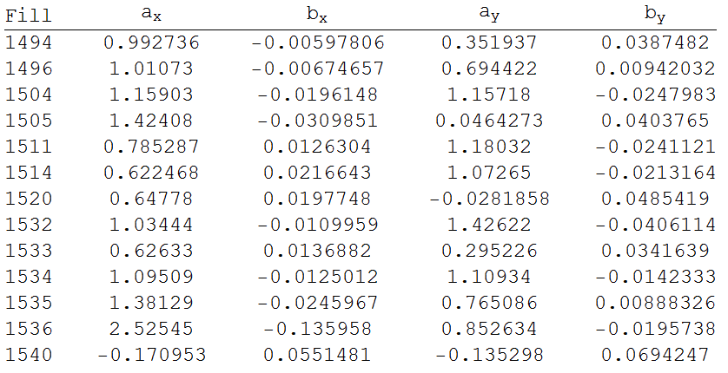
Compare simulation with averaged bunch data[2]
Careful : sigma's are at ATLAS IP, take Beta’s into account!

Slide 17
Compare simulation with averaged bunch data[3]
Determining Averages
Bunch lengths : all bunches have same timestamp -> just average for each point in time
FBCT : same procedure as for Bunch Lengths
BSRTS :
  Scans through the bunches : data for different bunches is at different moments in time!
  Create an interpolation function for each bunch
  Create a lattice of points in time
  Calculate values of interpolation functions on time lattice
  Use these values to calculate averages

Slide 18
Compare simulation with averaged bunch data[4]
Determining Averages
Plots of the BSRTS interpolating functions for some of the bunches

Slide 19
Compare simulation with averaged bunch data[5]
Determining Averages
Plots of the BSRTS interpolating functions for some of the bunches

Slide 20
Compare simulation with averaged bunch data[6]
Fill 1511

Slide 21
Compare simulation with averaged bunch data[7]
Example 1
Uncorrected
Corrected

Slide 22
Compare simulation with averaged bunch data[8]
Example 1
Uncorrected
Corrected

Slide 23
Compare simulation with averaged bunch data[9]
Example 1
Uncorrected
Corrected

Slide 24
Compare simulation with averaged bunch data[10]
Fill 1494

Slide 25
Compare simulation with averaged bunch data[11]
Example 2
Uncorrected
Corrected

Slide 26
Compare simulation with averaged bunch data[12]
Example 2
Uncorrected
Corrected

Slide 27
Compare simulation with averaged bunch data[13]
Example 2
Uncorrected
Corrected

Slide 28
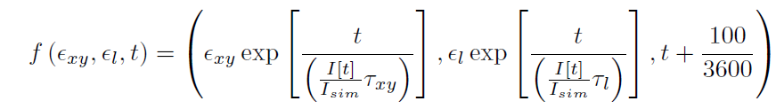
Side note on Protons[1]
We are planning to use particle tracking to simulate proton runs.
2010 : used different approach
  Assuming round beams calculate IBS growth rates on a Lattice (RF Voltage, Longitudinal Emittance, Transverse Emittance) using MAD-X
  Choose initial point (Longitudinal and Transverse emittance)
  Use iterative function (NestList command in Mathematica)

Slide 29
Side note on Protons[2]
Blue curves are the simulations based on the iterative function.
Red curves are ATLAS Luminous Region Data

Slide 30
Side note on Protons[3]
Blue curves are the simulations based on the iterative function.
Red curves are ATLAS Luminous Region Data

Slide 31
Conclusion and outlook
Observations of comparison with particle tracking:
  Transverse growth underestimated
  Bunch length growth overestimated
  Both are different expressions of same effect, when simulation would follow the transverse growth, bunch length would also agree better with data.
Particle Tracking Simulation seems to be missing some effect(s) that makes transverse emittances grow faster than predicted by our IBS models. (hump?, particularly in vertical plane)
Same observations can be made for protons.
Would be interesting to do same comparison at injection energy without beams in collision. But more problems with data at injection : no BSRTS, BGI can not be trusted yet. Usually short periods of time at injection -> not much data available.
Next step add hump model to simulation (Vertical? Beam 2? )
Try to compare particle tracking simulations for protons.

Slide 32
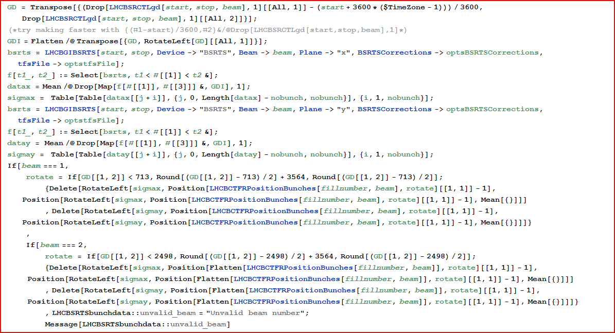
Back up

Slide 33
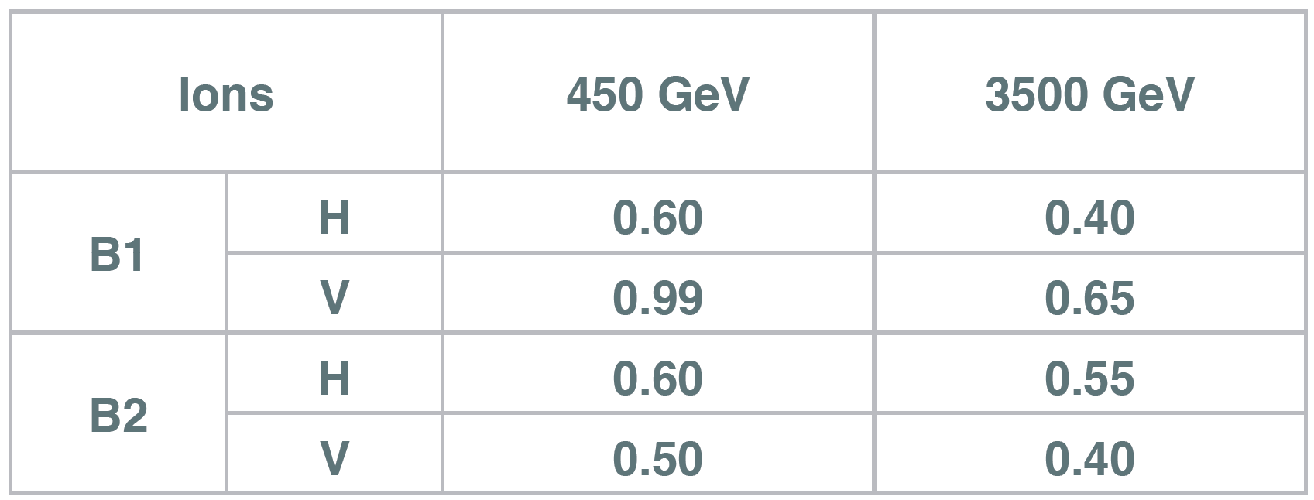
Correction Factors
F. Roncarolo

Slide 34
Compare simulation with averaged bunch data
Example 3
Uncorrected
Corrected

Slide 35
Compare simulation with averaged bunch data
Example 3
Uncorrected
Corrected

Slide 36
Compare simulation with averaged bunch data
Example 3
Uncorrected
Corrected

Slide 37
Compare simulation with averaged bunch data
Example 4
Uncorrected
Corrected

Slide 38
Compare simulation with averaged bunch data
Example 4
Uncorrected
Corrected

Slide 39
Compare simulation with averaged bunch data
Example 4
Uncorrected
Corrected

Slide 40
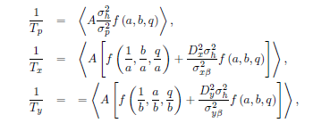
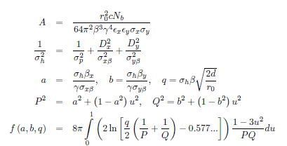


Formulas Piwinski
For Piwinski Smooth
For Piwinski Modified

Slide 41
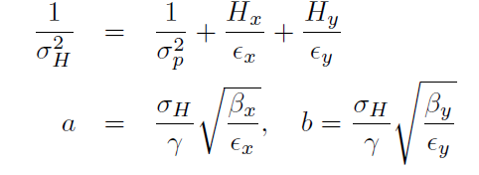
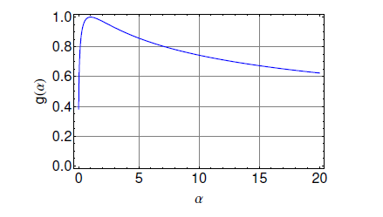
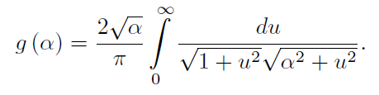
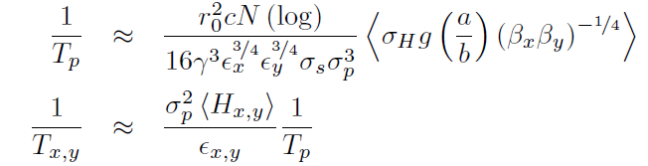
Formulas Bane

Slide 42
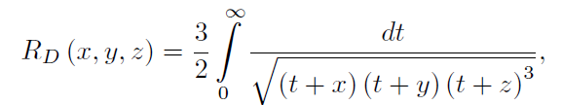
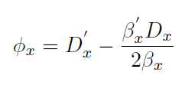
Formulas Nagaitsev[1]

Slide 43
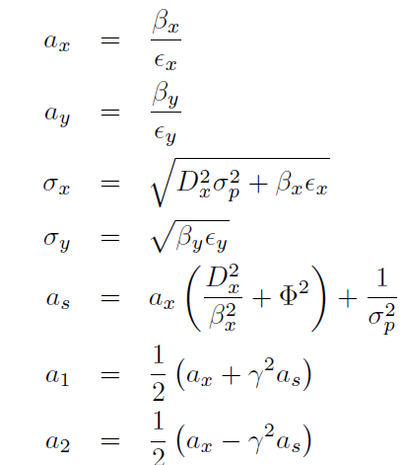
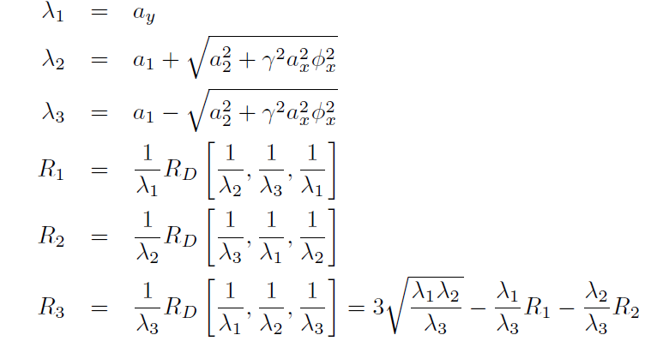
Formulas Nagaitsev[2]

Slide 44
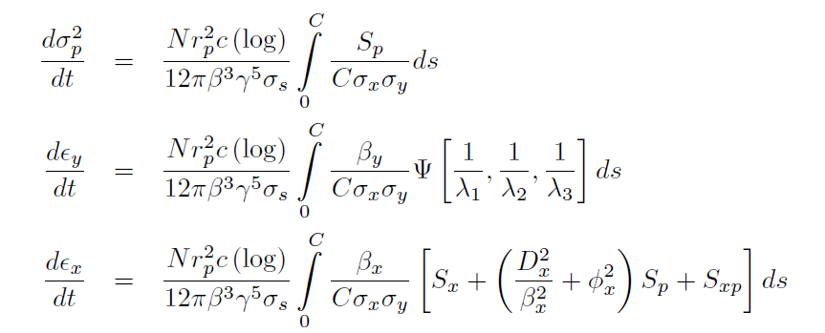
Formulas Nagaitsev[3]

