Slide 1
SUSSIX: A Computer Code for Frequency Analysis of Non-Linear Betatron Motion
F. Schmidt
R. Bartolini
H. Renshall
G. Vanbavinckhove
E. Maclean (presenting)

Slide 2
Outline
What is SUSSIX?
How is SUSSIX used?
How does SUSSIX work?
How effective is SUSSIX?
Speeding up SUSSIX...
Conclusion

Slide 3
What is SUSSIX?
SUSSIX : a program for post processing of turn-by-turn betatron oscillation data written by F. Schmidt & R. Bartolini.
Computes the frequency decomposition of the signal using an interpolated FFT with time filter to determine the tune to high precision.
Calculates dynamical quantities: Resonance driving terms,
                Detuning,
                Smear…
            Data: Computed from particle tracking
  Measured from BPMs
http://www.cern.ch/emaclean/ source files
example
documentation

Slide 4
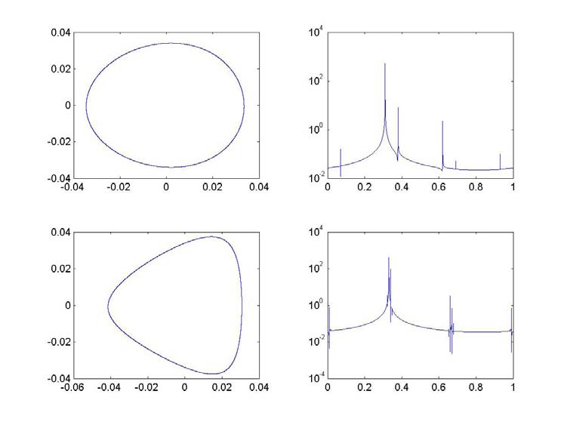
FFT / SUSSIX
The amplitude spectrum of the turn-by-turn data
Tracking data signal
P_{x} (rad)
x
Frequency (tune units)
P_{x} (rad)
x
Frequency (tune units)
Tracking data in the x plane for Diamond light source.
From R.Bartolini, ICAP 2006, Chamonix, 02 October 2006

Slide 5
Data is output from SUSSIX to “lines” file
Data output for each plane considered
For each BPM file studied
ANALYSIS OF X SIGNAL, CASE: 1
TUNE X = 0.280005910458087
Line Frequency Amplitude Phase Error mx my ms p
1 0.2800059104581E+00 0.622905178776E-01 0.380122180962E-01 0.00000000000E+00 1 0 0 0
2 0.4399884392791E+00 0.989214203213E-04 -.391350614723E+02 0.26019532406E-06 -2 0 0 -1
3 -.4399870444290E+00 0.708127509993E-04 -.210210002990E+02 0.11346548138E-05 2 0 0 1
4 0.4244673396355E-05 0.571770494641E-04 0.636737742552E+02 0.42446733964E-05 0 0 0 0
5 0.4100132929610E+00 0.408801734260E-04 0.258199339300E+02 0.11735779843E-04 -1 -1 0 -1
6 0.3800158793311E+00 0.450761326468E-04 0.422299367249E+02 0.94405265322E-06 0 -2 0 -1
7 -.3800181350819E+00 0.449392480866E-04 -.108056969751E+03 0.31998034197E-05 0 2 0 1
8 0.2998237923637E-01 0.181993216160E-04 -.990361266979E+02 0.42426663168E-05 -1 1 0 0
9 -.4100020901909E+00 0.145698681839E-04 0.614182554491E+02 0.53300974268E-06 1 1 0 1
10 0.3099896694036E+00 0.157916924317E-04 -.416195601121E+02 0.28629571418E-05 0 1 0 0
The frequency (in tune units), amplitude and phase of the spectral lines are output
If requested additional output given:
“reson#”
      “smear#”
      “invar#”
      “conju#”
The spectral lines are ordered in decreasing amplitude
Spectral lines are matched to the closest frequency resonant driving term and errors given
Tunes are also specified separately

Slide 6
Using SUSSIX
Data sources: SIXTRACK binary file “fort.90”
ASCII file “bpm.0001”
          two columns per plane of motion: x, px, y, py, σ, pσ
sussix.inp file specifies the SUSSIX actions.
      Details of the flags may be found in the SUSSIX documentation.
sussix system dependant executable

Slide 7
Using SUSSIX
Sussix.inp :
C
C INPUT FOR SUSSIX_V4 ---17/09/1997---
C DETAILS ARE IN THE MAIN PROGRAM SUSSIX_V4.F
C
ISIX = 0
NTOT = 1
IANA = 2
ICONV = 1
TURNS = 1 1000
NARM = 20
ISTUN = 0
TUNES = 0.29 .235 .07
NSUS = 0
IDAM = 2
NTWIX = 1
IR = 1
IMETH = 1
NRC = 3
EPS = .2000D-2
NLINE = 4
L,M,K = 1 0 0
= -2 0 0
= 2 0 0
= 0 1 0
IDAMX = 1
NFIN = 40
ISME = 1
IUSME = 20
INV = 1
IINV = 25
ICF = 1
IICF = 35
Data type ASCII or binary
Analysis type:
(0) = postprocessing of previous output
= full data analysis
= also output the FFT
Number of files to analyse
Specifies the initial and final turn number over which the data will be analysed.
Selects method for determining tunes.
(0) take highest amplitude spectral line
Take spectral lines lying inside a certain frequency range
Enforce selected tunes
Specifies whether the signal z(n)=x(n)-ipx(n) is real or complex.
Without momentum information the FT of Z at negative values is just the complex conjugate of positive frequency spectrum. Consider frequencies like +2Qx and -2Qx, which are generated by different resonances and would have different amplitudes given the full signal. Without the momentum information the information on the two lines gets mixed up and they will have the same amplitude
Turns on or off the time window filter
Outputs specific spectral lines to a separate file: reson#

Slide 8
How does SUSSIX work?
SUSSIX performs a frequency analysis on the provided turn-by-turn data. The time signal with the turn-by-turn data is decomposed into a series of spectral lines.
    The turn by turn data signal {z(1),z(2)...z(N)} is decomposed as a quasi-periodic signal:
    Turn by turn data signal is analysed to give the Amplitude spectrum:
Line with the largest amplitude is in most cases the fundamental frequency (tune).
    this can be overridden using the ISTUNE in the sussix.inp file
Regular motion means other frequencies are linear combinations of the fundamental tunes:

Slide 9
How does SUSSIX work?
At the core of SUSSIX is a Fortran Routine TUNENEWT, developed by the Bologna Group in the mid-nineties (Author: A. Bazzani ; tests by R. Bartolini, M. Giovannozzi, & E. Todesco).
  TUNENEWT determines the maximum of the amplitude of the FFT.
  SUSSIX uses TUNENEWT to analyse the full frequency spectrum:
      The fundamental frequencies are found using TUNENEWT:
            Frequency (ν _{k}), Amplitude (a_{k}), Phase (φ_{k})
      Harmonic time series built:
      & subtracted from the original signal
      New signal z(n) – z_{k}(n) is re-analysed with tunenewt...
The spectral lines are ordered, as linear combinations of the tunes, in decreasing amplitude.

Slide 10
How effective is SUSSIX?
Use of time window filters improves the effectiveness of the determination of tunes / principal with TUNENEWT.
In SUSSIX a Hanning filter may be applied by selecting the IMETH 1 flag in sussix.inp
Applying the filter broadens the main peak FWHM from 2/N to 4/N
reduces the height of side lobes by a factor 1/N²

Slide 11
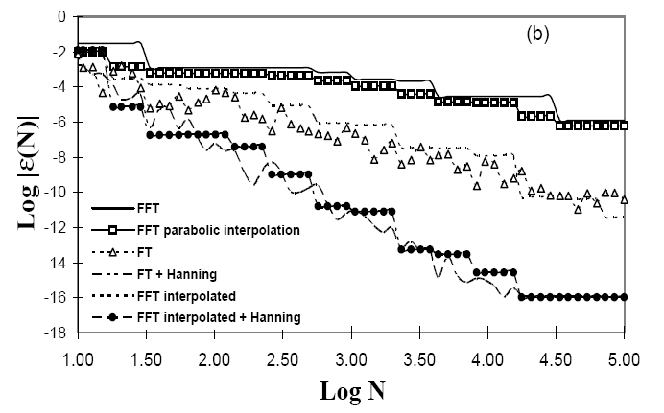
Numerical precision of the TUNENEWT algorithm for finding principal frequencies
FFT scales as 1/N
No time filter
Interpolated FFT
scales as 1/N²
Hanning filter
Interpolated FFT
scales as 1/N⁴
from R. Bartolini et al. Part. Acc., 52, 147, (1996)

Slide 12
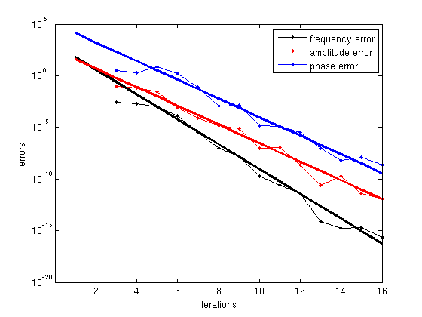
However the reconstruction of the amplitude and phase of the Fourier coefficient is slightly less precise than for frequency...
Phase error 1/N³
Amplitude error 1/N³
Frequency error 1/N⁴
Courtesy R. Bartolini

Slide 13
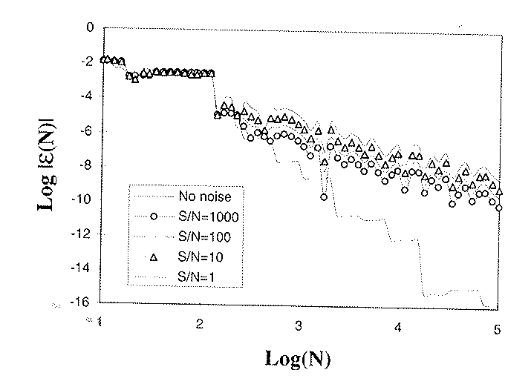
The 1/N⁴ scaling of errors in the interpolated FFT with Hanning filter does not hold when the signal is noisy…
With Noise: 1/N^{1.5} – 1/N²
BUT STILL BETTER THAN FFT WITHOUT NOISE
No noise: 1/N⁴
from R. Bartolini et al. Part. Acc., 55, 1, (1996)

Slide 14
Further limits:
Due to the finite time signal the spectral lines have finite FWHM 4/N (with Hanning filter)
    To resolve the spectral lines they must be separated by at least the FWHM
    If a spectral line lies within a FWHM SUSSIX will loop around the correct frequency without properly subtracting the two contributions.
    Observe a cluster of lines about the correct frequency.
    Increasing N will allow closer spectral lines to be distinguished…
The signal is decomposed as a quasi-periodic time series:
    Implies a regular stable orbit
    In highly chaotic regime or close to resonances cannot produce meaningful results

Slide 15
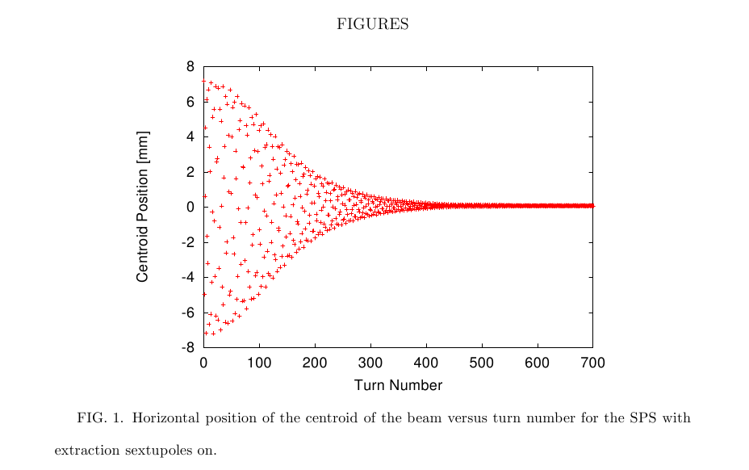
Further limits:
In applications to BPM data SUSSIX is limited by the decoherence of the turn-by-turn oscillations.
The centroid of the beam is measured in the BPMs. If particles are oscillating with different frequencies (decoherence) then motion of the centroid is damped.
Signal quality is reduced and hence it becomes more difficult to identify the resonant driving terms

Slide 16
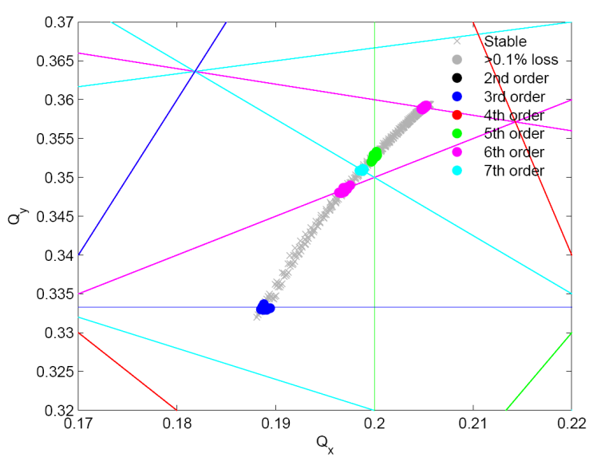
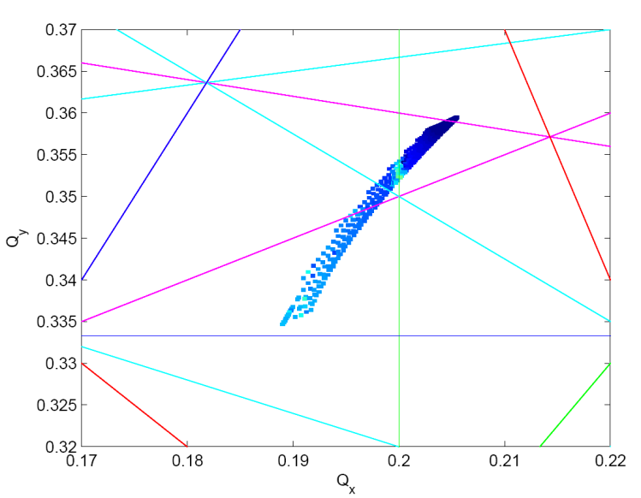
SUSSIX is still better than an FFT
Frequency Map analysis is a powerful method of extracting information on the Beam Dynamics.
Method relies on being able to very accurately determine the tune. TUNENEWT provides the level of precision necessary for these studies.
Modeled data
Measured data
Diamond Frequency Maps
Courtesy R. Bartolini

Slide 17
Improving the SUSSIX runtime: parallelization of the BPMs
SUSSIX represents a bottleneck in the control room.
  For a single off momentum measurement, the beta-beat group would be required to analyze 15 sets of ~500bpm signals. >15minutes spent running sussix per measurement.
Two approaches to speeding up the running of SUSSIX have been attempted:
  Parallelization of the FFT using recently released NAG parallel FFT routines
        overheads involved in setting up the parallelization cancelled out the benefits of the parallel FFT
  Parallelization of the analysis of multiple BPMs
        At present SUSSIX performs the analysis of each set of BPM data in series.
        Parallelizing the BPM analysis has produced a substantial improvement in the run time of SUSSIX when analysing a large number of BPMs
        Harry Renshall who has been working on the parallelization of SUSSIX will talk further on this topic.

Slide 18
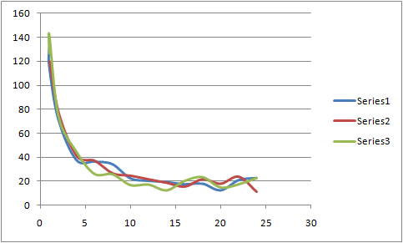
Time for sussix to run on dedicated 24 core spareb7.
Input data was 1000 bpm dual plane files. Analysis over 1900 turns.
Time (s)
Cores

Slide 19
Conclusion
SUSSIX calculates dynamical quantities (tune, resonance driving terms…) from turn-by-turn betatron oscillation data.
The code is well tested on both tracking and experimental data.
SUSSIX uses the TUNENEWT routine to find the fundamental frequencies of the signal. The corresponding harmonic is subtracted and the new signal re-analyzed.
SUSSIX uses an in interpolated FFT with a Hanning filter to obtain the amplitude spectrum. This substantially improves the precision of determination of fundamental frequencies, allowing application to Frequency Map Analysis.
The precision of sussix is limited by noise, decoherence of the beam, and the chaotic regime. Spectral lines within 4/N may not be resolved.
Recent progress has been made in speeding up the operation of SUSSIX, Harry Renshall will discuss further.
SUSSIX is looking forwards to use in several MDs through the 2011/12 period

