Slide 1
Three examples of application of Sussix
Data from simulations → sensitivity
Data from measurements → frequency resolution

Slide 2
Data from simulations
HEADTAIL simulation data:
  Interaction of a bunch of macroparticles with a localized broadband impedance
  8192 simulated turns
  Looking for coherent tune shift and transverse mode coupling instabilities
  In this case possibility to compare with an analytical code MOSES
  For more details, see http://library.epfl.ch/theses/?nr=4585

Slide 3
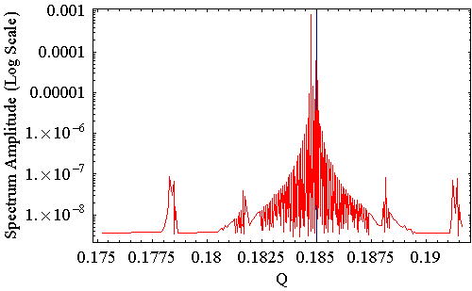
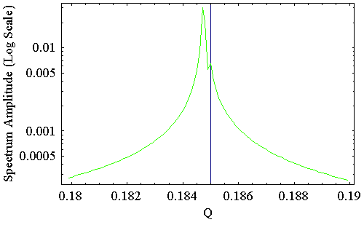
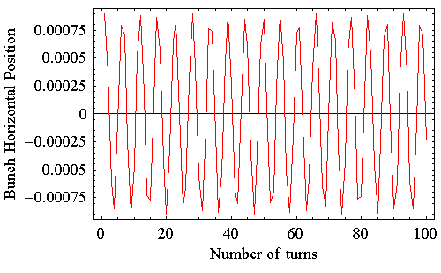
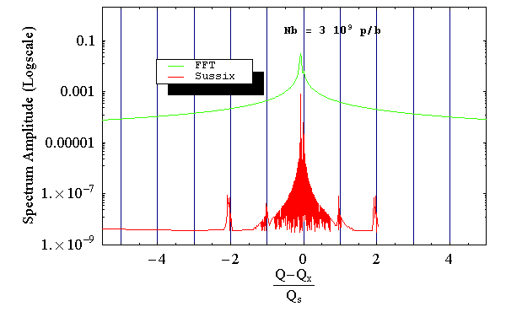
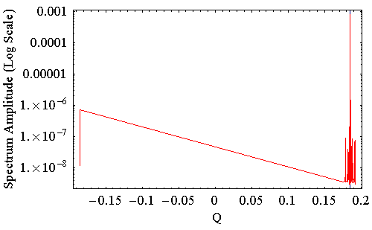
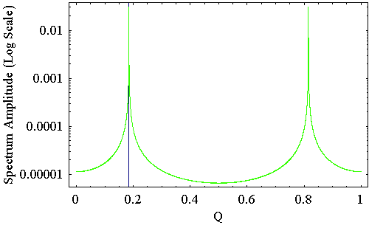
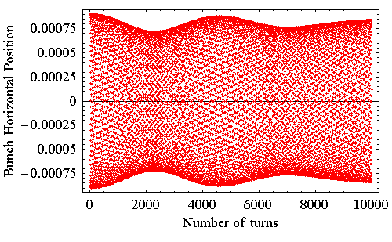
Methods : What to do with HEADTAIL outputs ?
Extract the position of the centroid of the bunch (vertical or horizontal) turn after turn → simulated BPM signal
Apply a classical FFT to this simulated BPM signal (x)
Apply SUSSIX* to this same simulated BPM signal (actually x – j β_{x} x’ )
Translate the tune spectrum by Q_{x0}=0 and normalize it to Q_{s}
(*) Sussix code : R. Bartolini, F. Schmidt, SL Note 98-017AP, CERN 1998
Theory behind Sussix : R. Bartolini, F. Schmidt, LHC Project Report 132, CERN 1997
J. Laskar et al., Physica D 56, pp. 253-269 (1992)

Slide 4
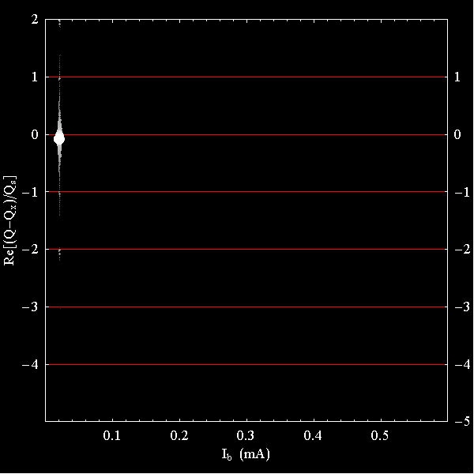
Another visualization of the tune spectrum
for Nb = 3 10⁹ p/b (I_{b} = 0.02 mA)
Displaying the Sussix spectrum on one line per bunch intensity
The dots are brighter and bigger if the amplitude is larger

Slide 5
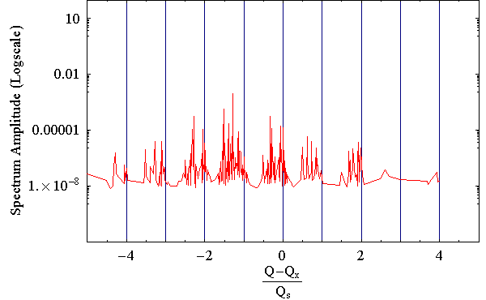
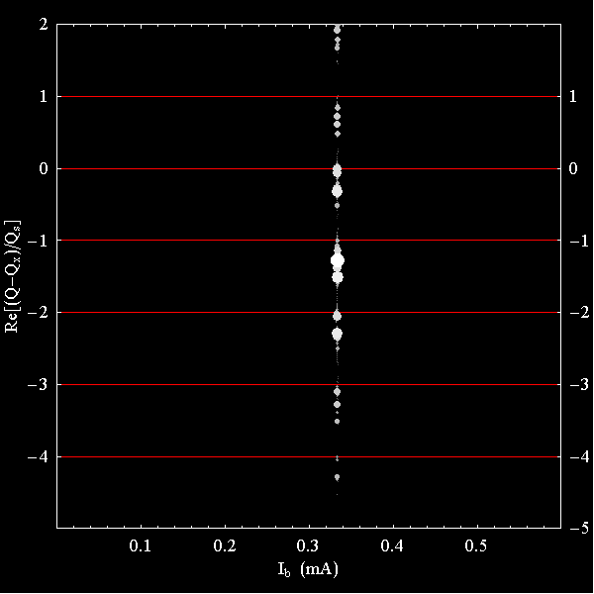
Another visualization of the tune spectrum
for Nb = 48 10⁹ p/b (I_{b} = 0.33 mA)
Displaying the Sussix spectrum on one line per bunch intensity
The dots are brighter and bigger if the amplitude is larger

Slide 6
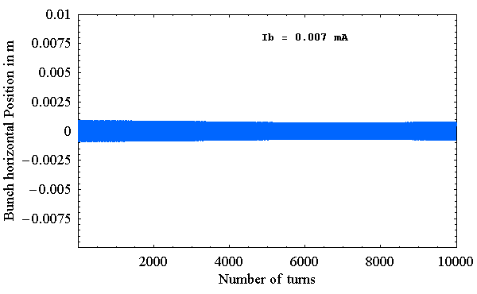
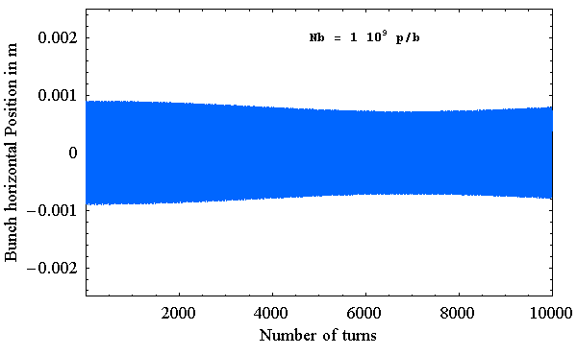
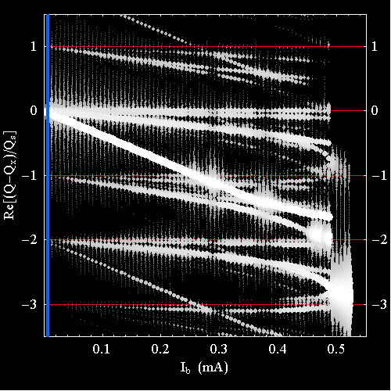
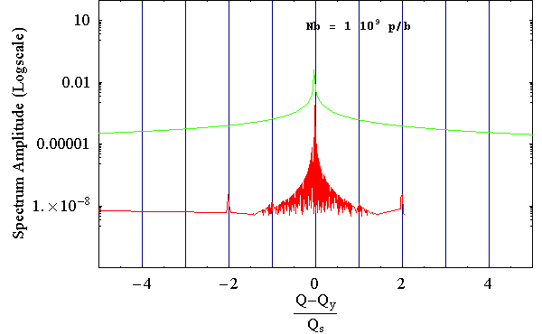
SPS with high currents: What do HEADTAIL simulations predict?
HEADTAIL simulated coherent
bunch transverse position at a BPM location
HEADTAIL simulation parameters:
Broadband impedance
Round beam pipe
No space charge, no spread, no chromaticity
Linear longitudinal restoring force
HEADTAIL Simulated mode spectrum
FFT
or
SUSSIX
FFT
SUSSIX
→ Transverse modes are observed to shift,
couple and decouple with current
HEADTAIL predicts a TMCI:
large coupling between transverse modes -2 and -3
Notes:
6

Slide 7
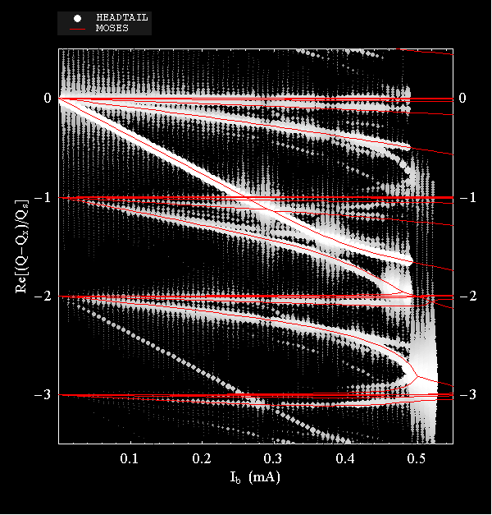
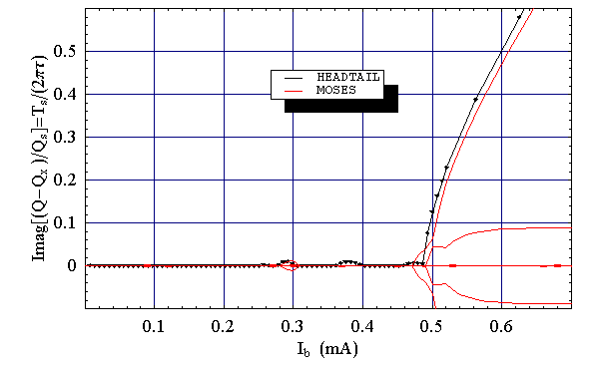
Benchmark of HEADTAIL simulations with MOSES analytical calculations
MOSES and HEADTAIL mode spectra Vs current
HEADTAIL and MOSES parameters:
Broadband impedance
Round beam pipe
No space charge, no spread, no chromaticity
Linear longitudinal restoring force
Tune shift with beam intensity
MOSES and HEADTAIL growth rate Vs Current
instability threshold
→ Very good agreement between MOSES and HEADTAIL
→ Very good resolution of sidebands by SUSSIX. even for low intensities
Notes:
7

Slide 8
Data from measurements
LHC measured data
  BBQ signals when moving collimators in 2010
  Transverse damper data during scrubbing run 2011
  For more details, see http://library.epfl.ch/theses/?nr=4585

Slide 9
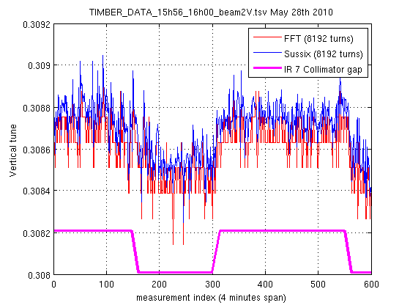
B2: effect on vertical tune shift of moving IR7 collimators (2010)
→ Vertical tune shift prediction when moving IR7 from 15σ to 5σ (ZBASE model with measured
collimator settings and Sacherer formula with measured beam settings):
ΔQy (theory) ~ -2.0 10⁻⁴
Std(sussix)=0.6 10⁻⁴
Std(fft)=0.7 10⁻⁴
out (15 σ)
out
in (5 σ)
in
→ The tune shift is indeed correlated to the collimator position, and ΔQy (meas.) ~ -2.4 10⁻⁴
→ SUSSIX resolution is a bit better than FFT but not so much gain as in simulations.

Slide 10
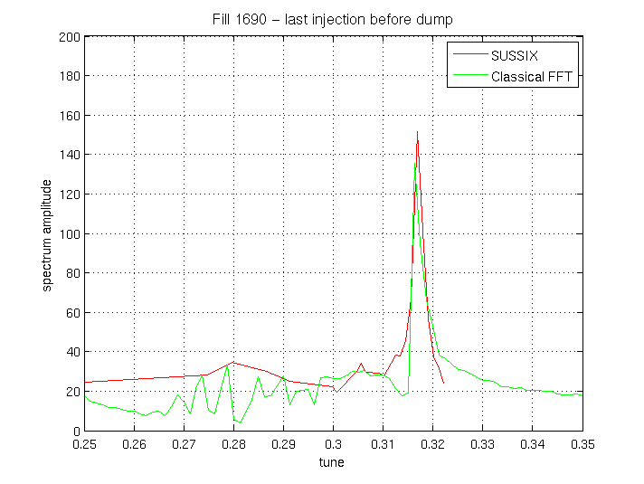
Transverse damper pickup data (2011)
73 turns of bunch by bunch data are available from the application of Riccardo de Maria.
Very low frequency resolution of the FFT.
Can SUSSIX be trusted with such a small number of turns?

Slide 11
Some things I observed as a user:
for the same number of turns, SUSSIX has higher resolution and higher sensitivity than
the classical FFT, in particular if the complex signal can be used as input.
-> Very nice tool!!!!
However it should not be used in all cases as:
SUSSIX is slower than the FFT
SUSSIX is very slow for large number of turns
SUSSIX can give strange results when the motion is exponentially growing
SUSSIX is used heavily in the LHC python-based beta-beat applications for SPS and LHC .
- FFT is present by default or as a library in most codes and languages, while SUSSIX is not
(yet).

