Slide 1
Phase advance accuracy (rms value)
Comparing the phase accuracy got by different FFT codes, All-phase FFT (see article on footnote), Matlab FFT, and SUSSIX-FFT, in case of ideal sinusoidal signals with phase advance typical for SPS FODO lattice, and adding additive gaussian noise.
No noise case
DeltaPhi | Ap-FFT* | Matlab | Sussix
90 | 0.8e-6 | 2.0e-4 | 5e-3
180 | 1.0e-6 | 4.6e-4 | 4.2e-4
270 | 3.1e-6 | 7.8e-4 | 4.8e-3
10% Gaussian noise
DeltaPhi | Ap-FFT | Matlab | Sussix
90 | 1e-2 | 9e-3 | 6e-3
180 | 9.5e-3 | 2.1e-2 | 2.8e-2
270 | 6e-3 | 1.7e-2 | 1.9e-2
* “NEW METHOD OF ESTIMATION OF PHASE ,AMPLITUDE, AND FREQUENCY BASED ON ALL PHASE FFT SPECTRUM ANALYSIS” Huang Xiaohong, Wang Zhaohua, Hou Guoqiang.

Slide 2
Phase advance accuracy on 90deg lattice (rms value)
Methodology:
1- Put 1 Impedance source (MKPA.11936)
2- Track HEADTAIL multi-kick code and get phase advances with Matlab.
3- Do the same increasing the wake field strength with factors [x1 x10 x20]
DeltaPhi | x1 | x10 | x20
90 | 4.1e-4 | 4.3e-3 | 9.6e-3
180 | 2.3e-4 | 2.5e-3 | 5.3e-3
270 | 1.9e-4 | 2.2e-3 | 4.4e-3
Phase advance rms values for different phase advances and different impedance strength
Obs: I measured M=var(ΣX)=Σvar(X)=N var(X) in case of N indipendent measurements -> std(X)=sqrt(var(X))=sqrt(M/N).

Slide 3
Phase advance accuracy on 67deg (low γ) lattice (rms value)
Methodology:
1- Put 1 Impedance source (MKPA.11931)
2- Track HEADTAIL multi-kick code and get phase advances with Matlab.
DeltaPhi | rms
67 | 4.0e-4
133 | 4.7e-4
200 | 8.7e-5

Slide 4
Frequency accuracy (rms value)
Comparing the frequency accuracy got by different FFT codes, in case of ideal and noisy sinusoidal signals with phase advance typical for SPS FODO lattice, as done before for the phase.
No noise case
DeltaPhi | Ap-FFT | Matlab | Sussix
90 | 1e-3 | 1e-3 | 1e-7
180 | 1e-3 | 1e-3 | 1e-7
207 | 1e-3 | 1e-3 | 1e-7
10% Gaussian noise
DeltaPhi | Ap-FFT | Matlab | Sussix
90 | 1e-3 | 1e-3 | 5e-6
180 | 1e-3 | 1e-3 | 5e-6
270 | 1e-3 | 1e-3 | 5e-6

Slide 5
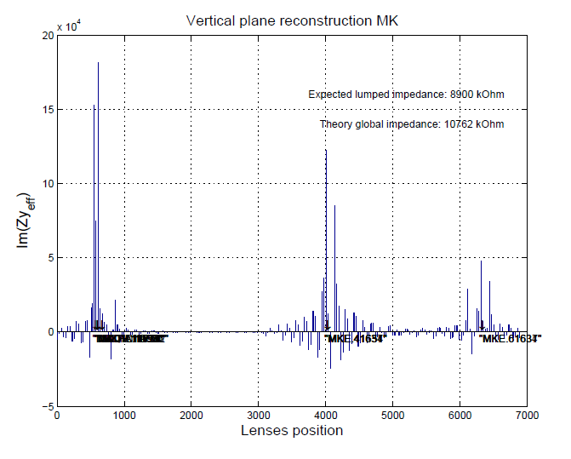
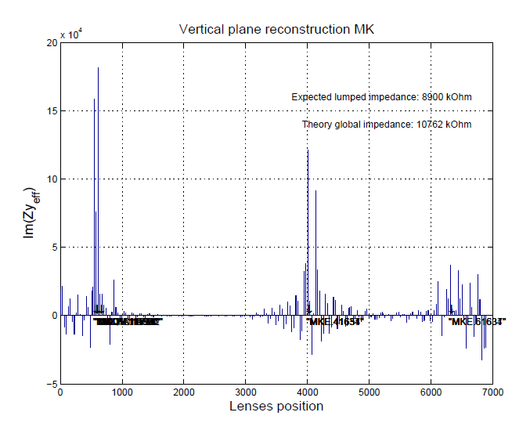
Some quick comparison: using ap-FFT for simulation data increase the accuracy in phase determination for the tracked signals. This permits to gain a better resolution in reconstruction (avoids peaks forest at the end).
Using Ap-FFT
Using Matlab-FFT
Example of localization with a low gamma lattice using ap-FFTand matlab FFT.

