Slide 1



Summary of the CERN-GSI Workshop on Electron Cloud
G. Rumolo
in ABP-ICE Meeting 16/03/2011

Slide 2
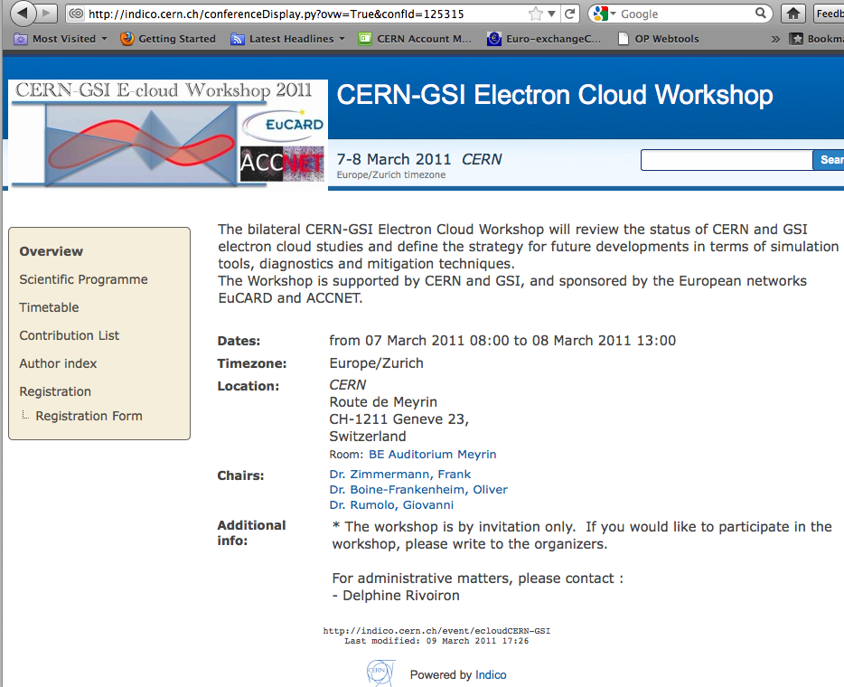
30 registered participants, half of whom coming from CERN

Slide 3
Proposed by O. Boine-Frankenheim (GSI) as a starting point to discuss electron cloud modeling with the CERN experts
Organized by myself, Frank and Oliver under the EuCARD/ACCNET sponsorship
Goals of the workshop
  Review the status of CERN and GSI electron cloud studies
    Machine observations
    Modeling
    Simulations
    Diagnostics
  Find synergies between the two laboratories
  Define a common strategy for future developments in terms of simulation tools, diagnostics and mitigation techniques.

Slide 4
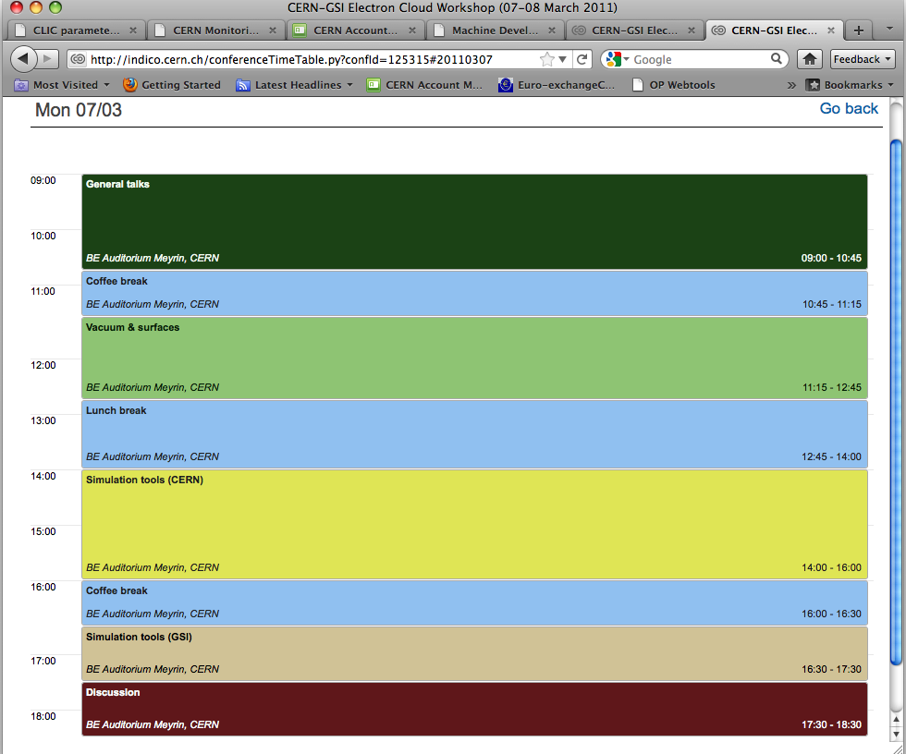
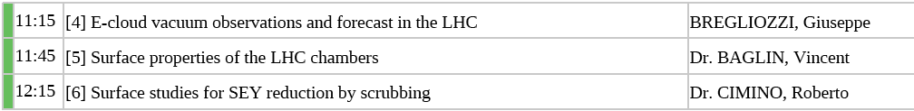
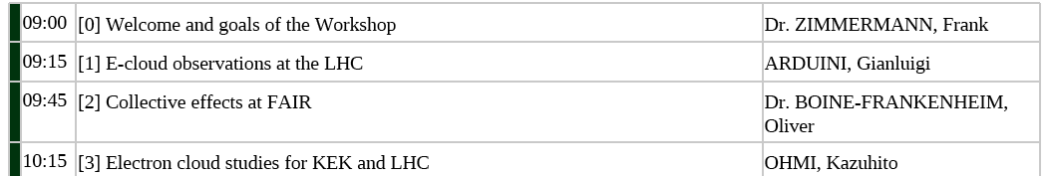

Slide 5
Electron cloud observation in LHC overview
150ns beams
  Pressure rise in common beam pipe, suppressed with solenoids
75ns beams
  Same as 150ns
  Pressure rise in cold-warm and warm-warm transitions
  Beam instability for last bunches in one or more batches
50ns beams
  Same as 75ns, and even more pronounced
  Additional heat load (40mW/m) on the beam screen

Slide 6
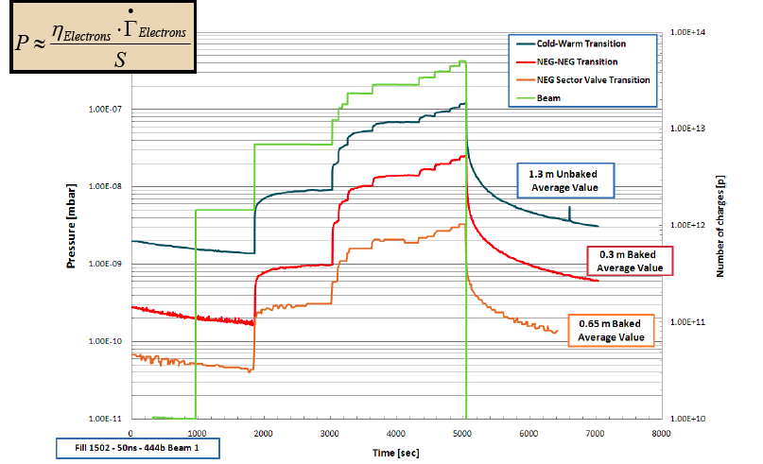
Electron cloud observation in LHC pressure rise at transitions
Pressure rise at several types of gauges → its occurrence depends strongly on the local electron flux!
More than one order of magnitude between Cold-Warm and Room Temperature transitions

Slide 7
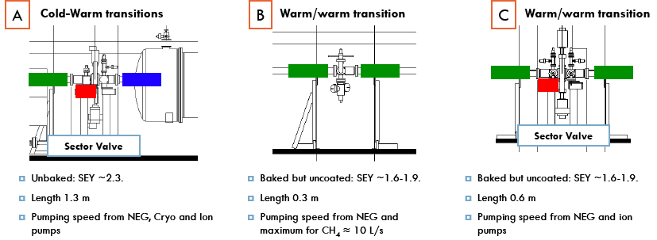

Electron cloud observation in LHC pressure rise at transitions
Zoom on the three types of transitions
Pressure rise determined by electron flux, but also local desorption yields and pumping speeds (neighboring configuration)
Scrubbing acts on both!!

Slide 8
Electron cloud observation in LHC
Scrubbing experience and plans
Pressure rise with 50ns a factor ~15 worse than with 75ns, therefore scrubbing more efficient with 50ns beams
An improvement by a factor ~6 was observed in the same beam conditions after 20h of scrubbing with 50ns beams
Scrubbing at injection reduces the SEY (logarithmically) and should serve the purpose also for top energy
  90% of the photoelectrons confined in the 1/γ cone thanks to the saw-tooth, the remaining 10% should not multipact if the inner surface of the chamber is uniformly scrubbed
  However SR scrubbing of SEY was found not to be effective, so there’s no additional advantage to scrub at top energy
Scrubbing was shown to work both on warm and cold surfaces
1 week scrubbing with 50ns beams at injection energy and constant electron cloud activity (i.e. topping up with beam when the pressure is seen to decrease) is expected to ensure safe operation with 75ns beams

Slide 9
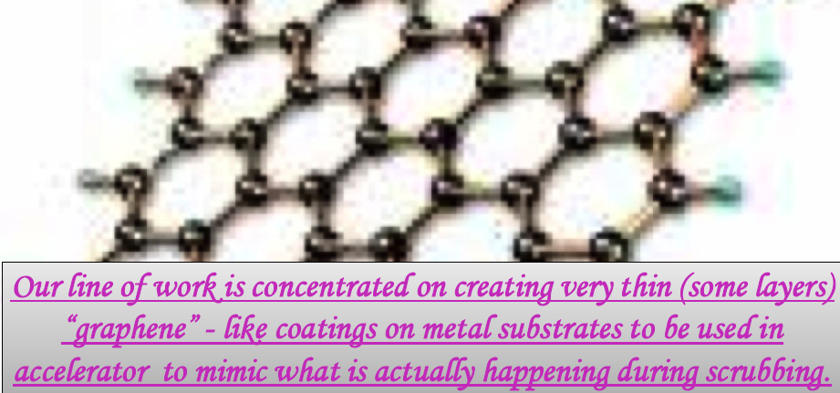
More on scrubbing
Scrubbing, or conditioning, is usually ascribed to a graphitization of the surface under photon, electron or ion bombardment (seems confirmed by surface spectroscopy)
Therefore it can be aided by depositing on the surface some monolayers of graphitic C (graphene) in a preventive manner → however, issues of stability in an accelerator environment??

Slide 10
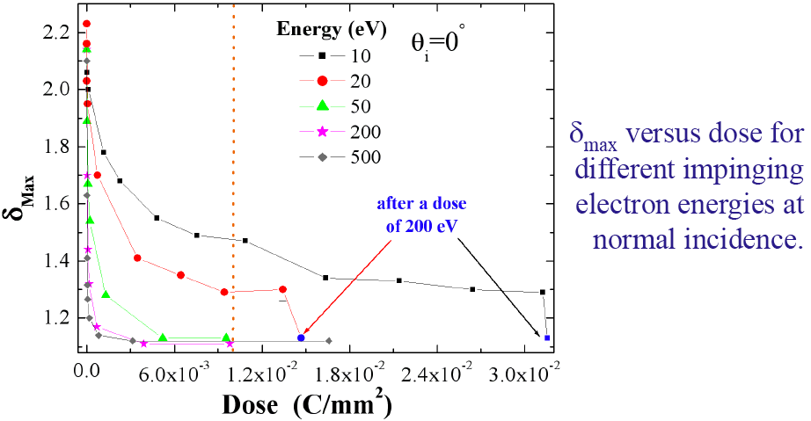
More on scrubbing
Scrubbing clearly depends not only on the electron dose but on electron energy
Electrons with energy <50eV have low scrubbing efficiency
Suggestion → do not look only at the electron dose but also at the percent of electrons hitting the beam pipe with E > 50 eV
Provocative → ECLOUD simulations show that 75ns beams with e-cloud build up seem to have 20% of electrons hitting the chamber with E>50eV, wrt to 25ns beams, which have the 10% (however the fluxes??)

Slide 11
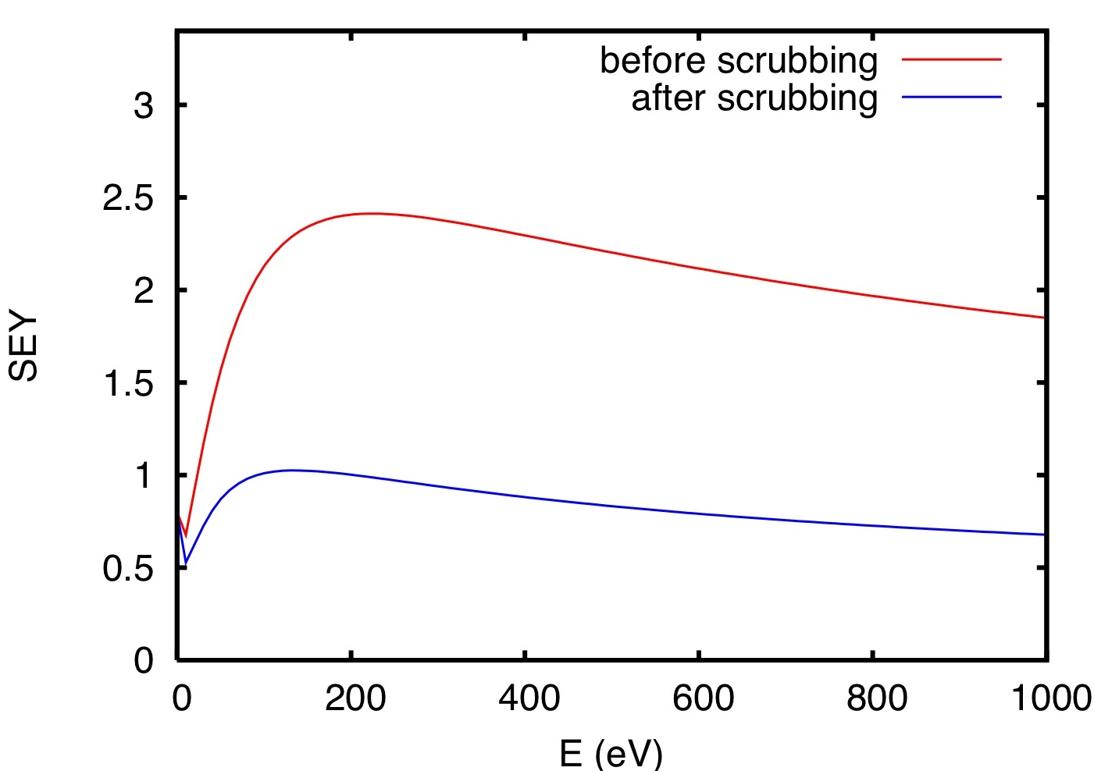
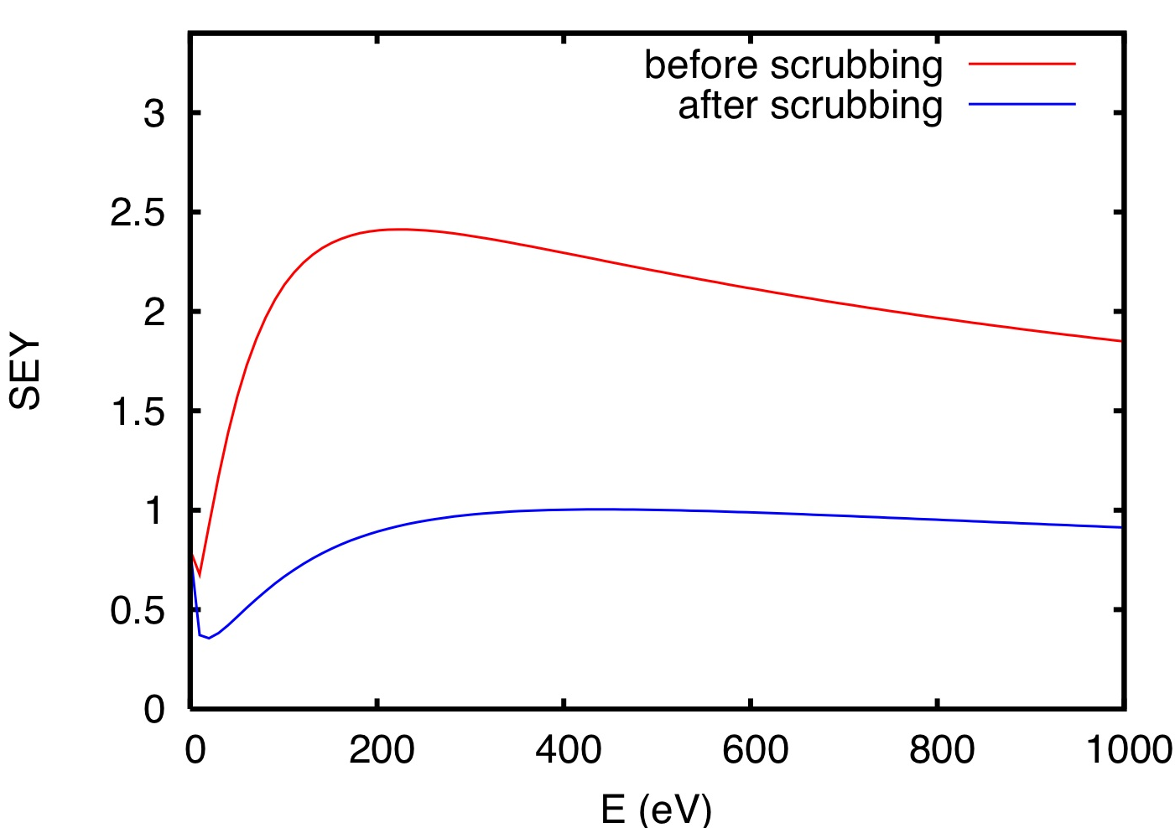
More on scrubbing
During scrubbing δ_{max} certainly decreases, but what happens to E_{max} ??……..

Slide 12
More on scrubbing
During scrubbing δ_{max} certainly decreases, but what happens to E_{max} ??…
EPA data (Baglin-Henrist-Hilleret, 2000) show E_{max} decreasing with photon scrubbing on Cu, as well as in situ SEY measurements in the SPS (Hilleret LHC Project 632), even if the observed decrease is small
Hilleret-Collins data (EPAC 1998) show an increase of E_{max} after electron bombardment on Cu sample
Cimino-Collins data (PRL, 93 014801, 2004) show a non-monotonic behavior, in which partially scrubbed Cu has lower E_{max} than the ”as received” sample, but the fully scrubbed sample exhibits far higher E_{max} and flatter SEY curve.
Kato’s measurements (KEK) show a decreasing E_{max} for conditioned Cu, but increasing for conditioned TiN
Le Pimpec’s measurements (SLAC) on Al show a slightly lower E_{max} after conditoning
The dependence is non-trivial and probably also depends significantly on the history of the sample
If scrubbing means surface cleaning + graphitization, it’s sensible to believe that E_{max} goes toward the bare metal value during the cleaning phase and eventually it tends to increase toward the value of graphite (M. Taborelli)

Slide 13
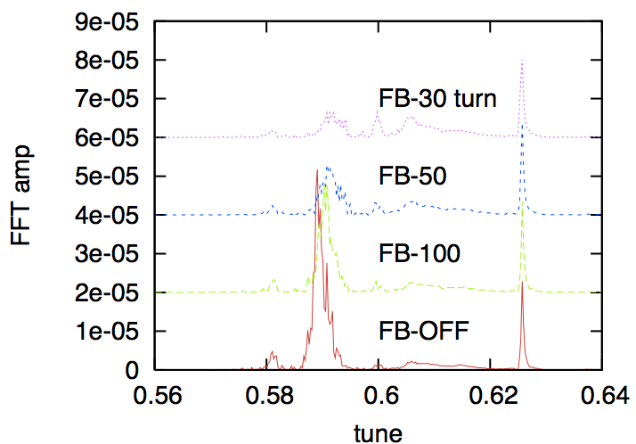
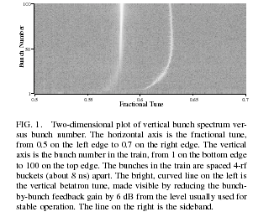
Instabilities in positron machines
Single bunch instability shows an upper side band spaced by >ν_{s}
PEHTS and HEADTAIL simulations exhibit the same feature in the bunch spectrum
Betatron tune sideband
Tail of train
>νs
Head of train
Measurement at KEKB

Slide 14
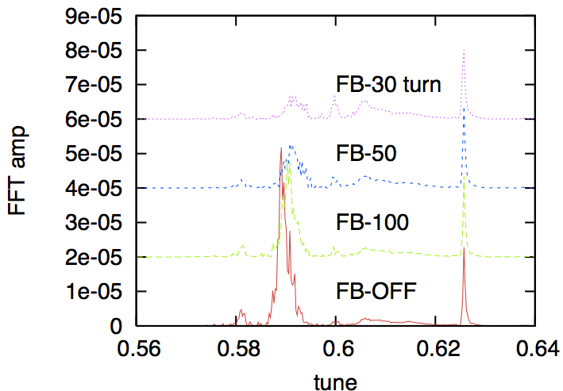
Instabilities in positron machines
Feedback system
Bunch-by-bunch (wide-band) feedback system can suppress the coherent motion associated to the betatron tune line if it has high enough gain and band
It cannot suppress the sideband!
Tune sideband

Slide 15
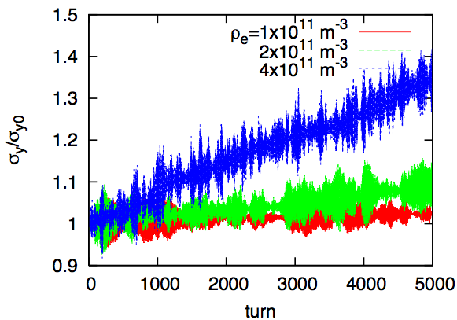
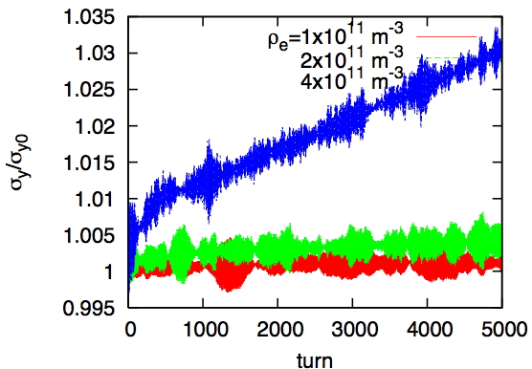
Electron cloud fluctuations
Cloud density fluctuations in space and time can affect the beam evolution
In particular:
  They can increase the threshold for coherent instability
  They can increase the percent of emittance growth below threshold for coherent instability
  Nature of these fluctuations?
30% fluctuation
No fluctuation

Slide 16
Electron cloud @ GSI & FAIR
No electron cloud build up in the current SIS18
Anticipated possible problems for future operation with higher intensities:
  Electron cloud build up along trains of bunched beams in both SIS18 and SIS100, but only if bunch length is below 5m
  Two-stream instabilities with coasting beams during the slow extraction in SIS100
Development of tools underway:
  Electron cloud and coasting beam
  Electron cloud wake fields with a 3D model of cloud pinch

Slide 17
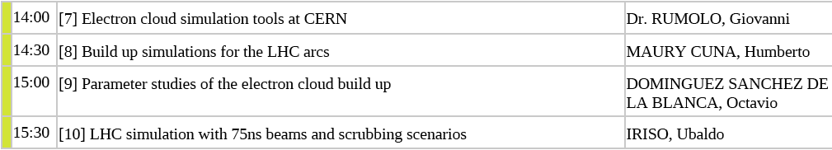

Slide 18
Simulations of electron cloud build up
Applications to LHC
Model parameters are (not exhaustive)
  Maximum secondary emission yield δ_{max}
  Probability of elastic reflection at low energy R₀
They are obtained by fitting simulation results to LHC measurements (pressure rise, heat load, threshold with intensity)
  LHC arc dipoles
  IR3 CW transition
  Cross-check with 50 and 75ns beams

Slide 19
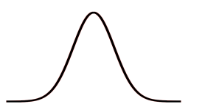
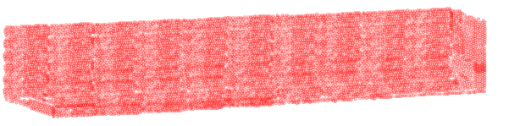
Simulations of electron cloud wakes
Calculation with 3D PIC code
Imports the beam pipe geometry prepared in CST Particle Studio
Discretizes the computational domain with cartesian grid
Loads the domain with electrons
Emits beam and tracks both the beam and electrons
σ_{rms}
L/n_{z}
y
l_{b}
2a/n_{y}
a
.
L
2a/n_{x}
z
-a
0
a
x

Slide 20
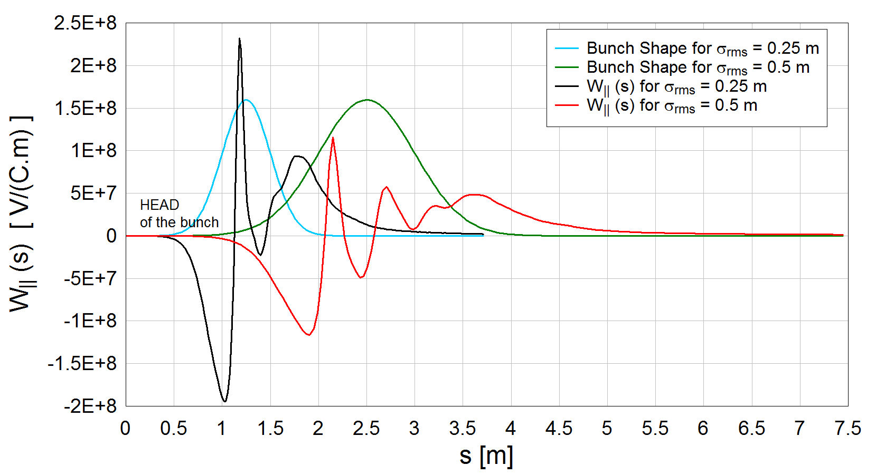

Simulations of electron cloud wakes
Calculation with 3D PIC code
Calculates wake fields using a full Maxwell solver
Can answer to the questions:
  Effect of magnetic field from electrons on the beam (due to E_{e}(t))
  Can the longitudinal e-field be responsible for the energy loss measured by Elena?
Follow up: use the SPS parameters to calculate transverse and longitudinal wakes.

Slide 21
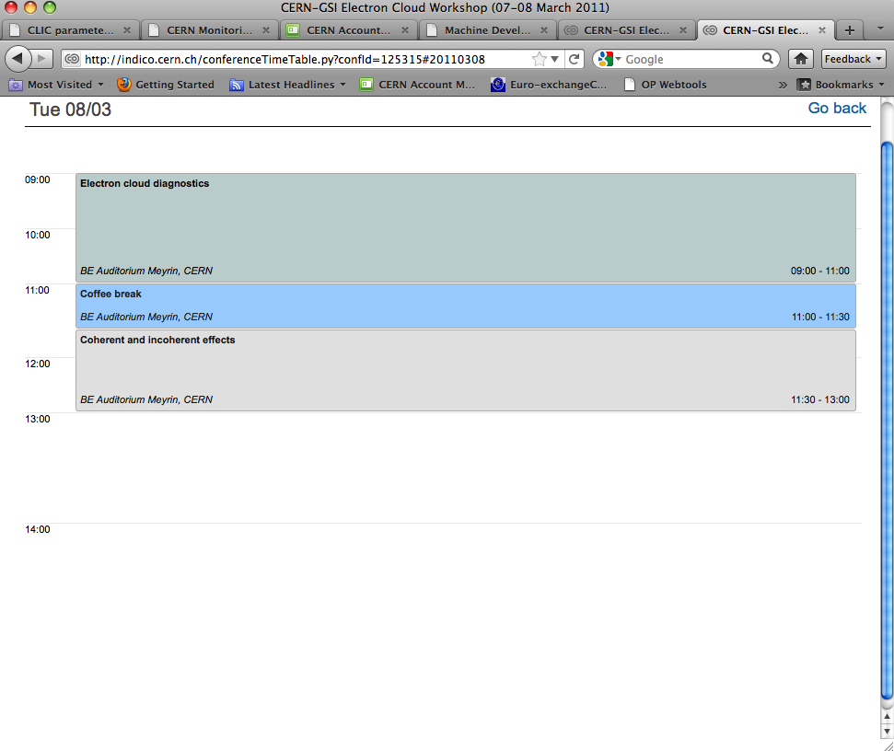
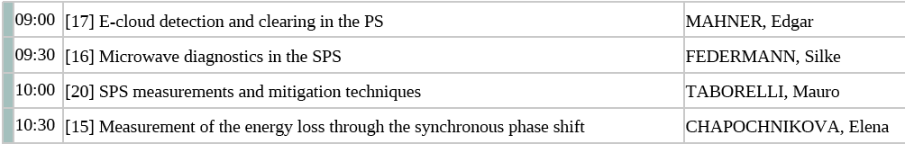
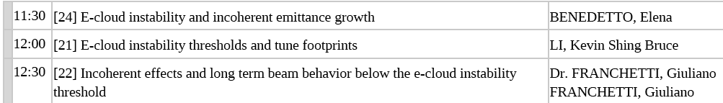

Slide 22
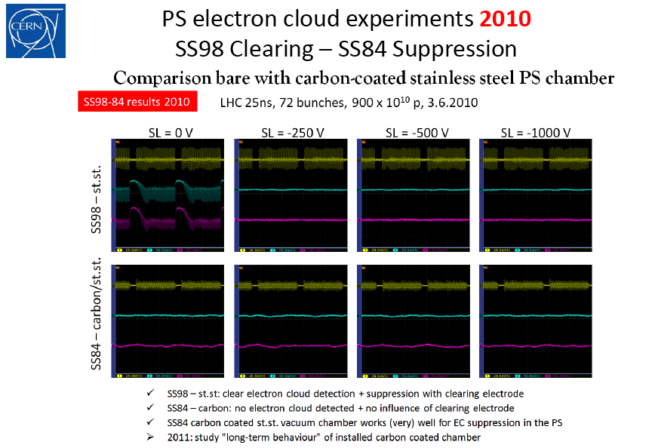
More on the PS measurements
Clearing and suppression with a-C coating

Slide 23
More on the SPS measurements
Electron cloud as a function of SEY
50 ns threshold (simul.)
DLC
StSt
DLC cond.
a-C

Slide 24
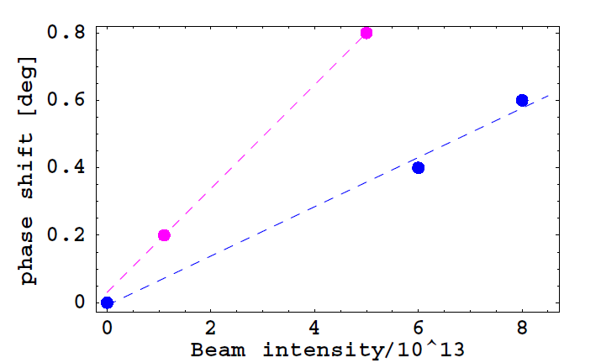
More on the LHC measurements
Energy loss due to e-cloud?
Observation: if we assume 1kW lost by 200 nominal bunches (compatible with the measured heat load of 40mW/m), this would translate into Δφ_{s}=0.45 deg …

Slide 25
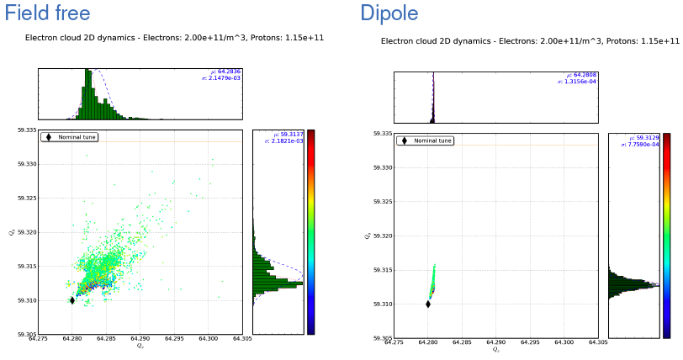
Coherent and incoherent effects
Tune footprints
Electron cloud tune footprints
  Injection and top energy
  Field-free and dipole region
0.02
6 x 10⁻³

Slide 26
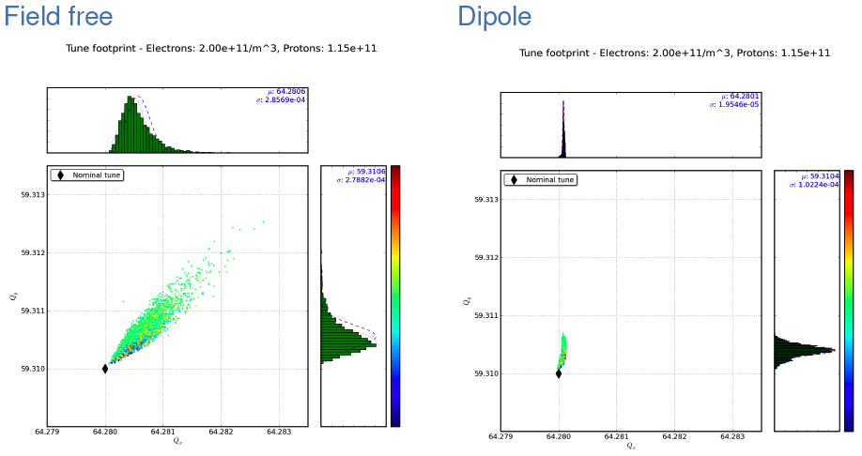
Coherent and incoherent effects
Tune footprints
Electron cloud tune footprints
  Injection and top energy (4TeV)
  Field-free and dipole region
0.003
8 x 10⁻⁴

Slide 27
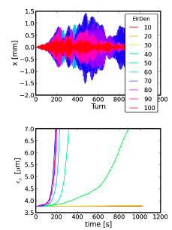
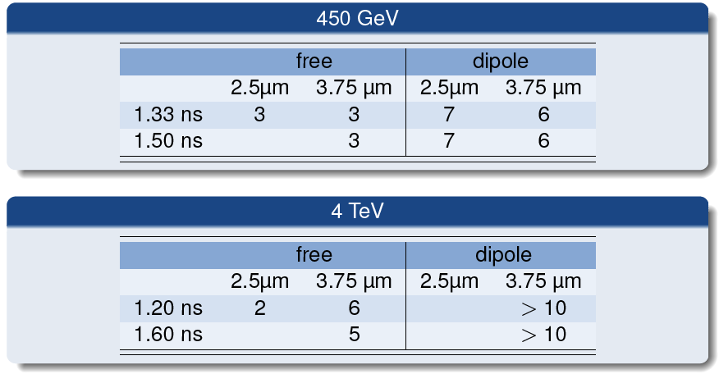
Coherent and incoherent effects
Tune footprints
Electron cloud instability thresholds
  Injection and top energy (4TeV)
  Field-free and dipole region
  Different emittances and bunch lengths
Exactly same numbers quoted by Elena (HEADTAIL 2003), Kevin (HEADTAIL 2010), Ohmi-san (PEHTS 2010)

Slide 28
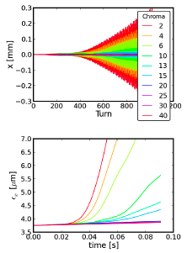
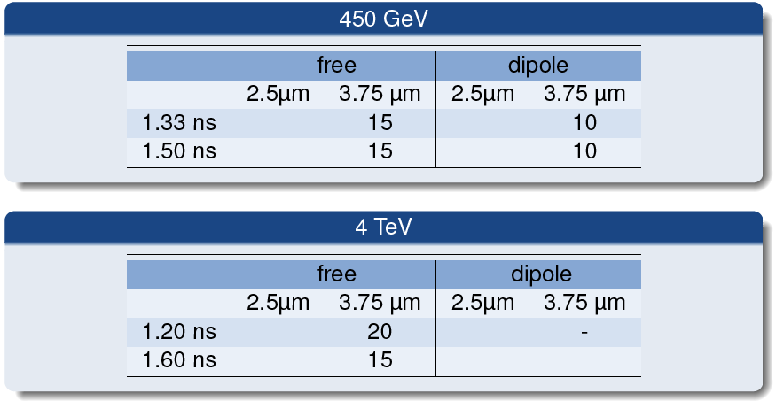
Coherent and incoherent effects
Tune footprints
Electron cloud instability thresholds
  Injection and top energy (4TeV)
  Field-free and dipole region
  Recovery of stability through chromaticity

Slide 29
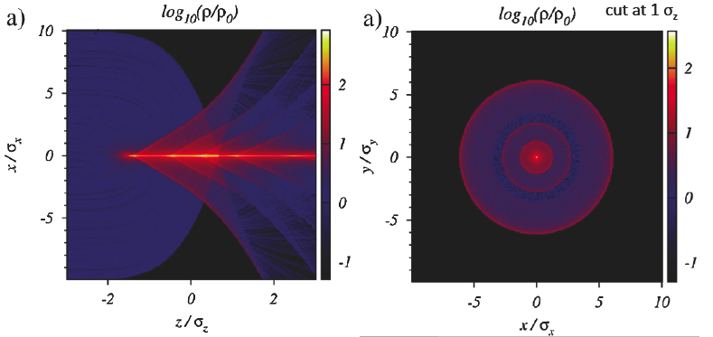
Coherent and incoherent effects
Long term beam behavior
Long term behavior of the beam under the action of an electron cloud. Model planned to include elements with pinch from
  Field-free regions
  Dipoles
  Quadrupoles

Slide 30
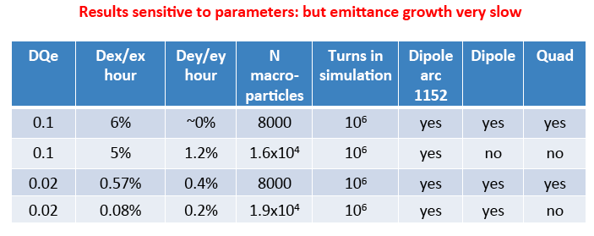
Coherent and incoherent effects
Long term beam behavior
Preliminary simulations have been carried out with toy model electron cloud kicks of the field-free type alone (assuming a total tune spread as that obtained by Kevin’s footprints)
Very low emiitance growth rates have been found
Model needs to be refined with the correct e-cloud kicks in magnetic fields

Slide 31
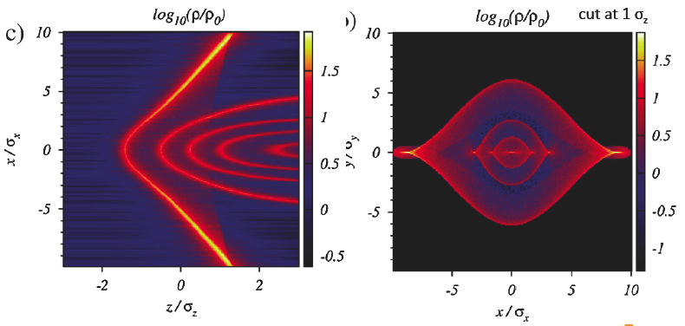
Coherent and incoherent effects
Long term beam behavior
Long term behavior of the beam under the action of an electron cloud. Model planned to include elements with pinch from
  Field-free regions
  Dipoles
  Quadrupoles

Slide 32
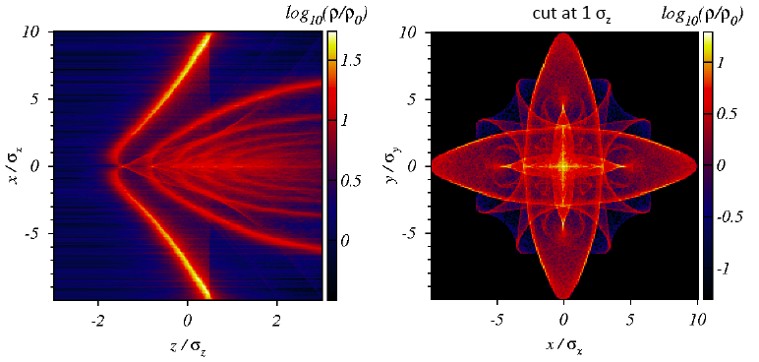
Coherent and incoherent effects
Long term beam behavior
Long term behavior of the beam under the action of an electron cloud. Model planned to include elements with pinch from
  Field-free regions
  Dipoles
  Quadrupoles (approximation of strong field, not always true, under verification)

Slide 33

Main follow ups from Workshop
Long term behavior of the beam under the action of an electron cloud. Model planned to include elements with detailed pinch
Giuliano
Kevin, Frank, etc.
3D self-consistent calculation of e-cloud wake fields
  Quantify energy loss
  Influence of electron magnetic field on transverse wakes
Fatih, Oliver, etc.
Giovanni, et al.
Giuseppe, Vincent
E-cloud build simulations with ECLOUD
  in warm-warm transitions with the present pressure rise data (internal to CERN)
  Benchmark with GSI Petrov’s code for SIS18 bunches
Octavio
Fedor

Slide 34
Other miscellaneous questions
Feedback system? Inefficient?
Electron cloud fluctuations
Scrubbing:
  Change of E_{max}?
  Graphene layers
  Beams with high energy electrons
Energy loss measured with the synchronous phase shift related to electron cloud?
Another proof that a-C does not build e-cloud (PS)? Why then pressure rise in SPS?

