Slide 1
BBQ system
Tatiana and Benoit,
thanks to a lot of help from
Christian Boccard, Marek Gasior and Ralph Steinhagen (BE/BI-QP)

Slide 2
Agenda
Objectives of the BBQ system
Principle
Things to remember
Example
Next steps

Slide 3
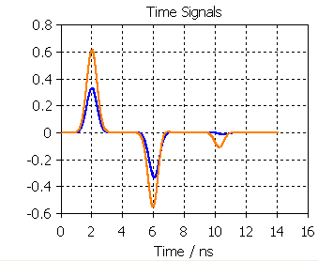
Objectives of the BBQ system
BBQ means BaseBand Q measurement
→ tune mesurement
→ goal: sensitivity below a μm
in all tune measurement systems, the betatron amplitude modulation signal is very small compared to the overall signal created in the pickup electrodes → with standard electronics measuring μV on top of Volts is not possible → large beam excitation required (performed in general by dedicated tune kicker).
The full name is 3D-BBQ (3D= Direct Diode Detection)
The BBQ system can be used with a PLL excitation, but this was only tested on LHC during few MDs. In the LHC case with the current damper operation PLL is not efficient (beam transfer function dominated by the damper, PLL excitation damped by the damper, PLL excitation must be an order of magnitude larger than residual beam oscillations, which are sufficient for FFT operation)
Port 1
Port 2

Slide 4
Agenda
Objectives of the BBQ system
Principle
Things to remember
Example
Next steps

Slide 5
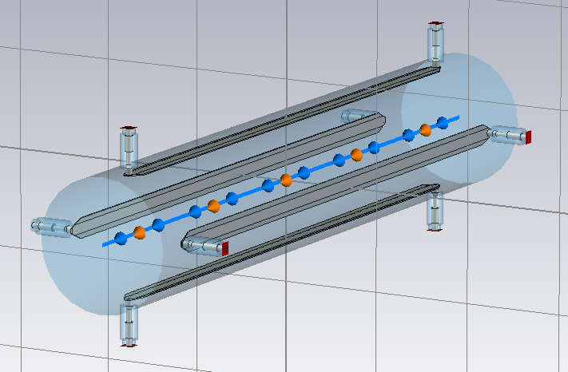
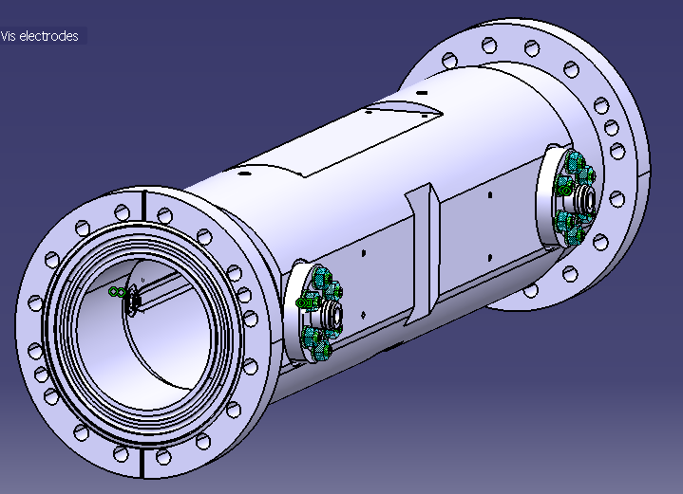
What is the BBQ system?
Uses the same type of stripline BPM than the Headtail monitor)
BBQ FFT1 “continuous” systems use BPLH, BPLV (as head-tail), betas 400-500 m
FFT2 “on demand” systems use BPLX, betas 250-300 m
DEV “development” systems use BPLH, BPLV, betas 400-500 m
… But the signal is treated in a very different way
BPLX type
BPLH type

Slide 6
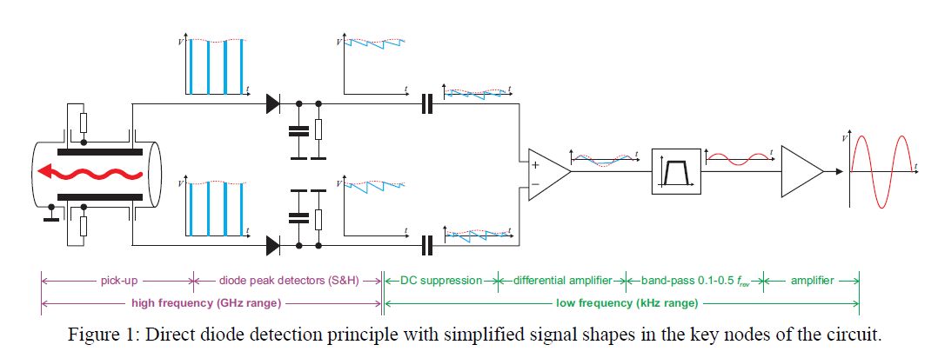
Principle
The diode acts as a peak detector
→detects small variations (< mV) of the peak of the intensity signal (> 100V)
→differentiates the opposite electrode signals to make signal more robust for tunnel interference and noise (otherwise it would work fine with just one electrode)
Reference: An overview of the LHC Transverse Diagnostics Systems http://cdsweb.cern.ch/record/1156346/files/LHC-PROJECT-REPORT-1166.pdf

Slide 7
Agenda
Objectives of the BBQ system
Principle
Things to remember
Example
Next steps

Slide 8
Things to remember
No gating on single buches → takes all bunches into account → signal reflects the tune from the most intense bunches
(in fact gating by the beam itself at every bunch – no timing required)
The transverse damper strongly affects the sensitivity of the BBQ measurement (decrease of the beam tune signal and increase of the beam noise)
Data is only kept for 7 days in measurement database. After that most of the data is lost (only 1 spectrum per minute is kept in logging database).
Huge files!!! Strong need to use the mulifile saving (need to cut the time range into files containing 1 or2 min for 1 beam for 1 plane to avoid crashing timber)

Slide 9
Where are the systems located?
PLL excitation system (now for MDs only, and only H.B1)
→ micrometer excitation by dedicated 1 m striplines (not meant to work in parallel with the damper)
BQKH.6R4.B2 and BQKV.6R4.B2
BQKV.6L4.B1 and BQKH.6L4.B1
Chirp Excitation (generated by BI) also goes through the damper (RF)
BBQ pickups →
  “continuous “ FFT in Timber:
  B1 → H: BPLH.B6R4.B1 and V: BPLV.C6R4.B1
  B2 → H: BPLH.A7L4.B2 and V: BPLV.A5L4.B2
  “on demand” FFT in Timber
  B1 → H+V: BPLX.D6R4.B1
  B2 → H+V: BPLX.D6R4.B2
  development system “DEV” in Timber
  B1 → H: BPLH.A6R4.B1 and V: BPLV.B6R4.B1
  B2 → H: BPLH.B7L4.B2 and V: BPLV.B5L4.B2

Slide 10
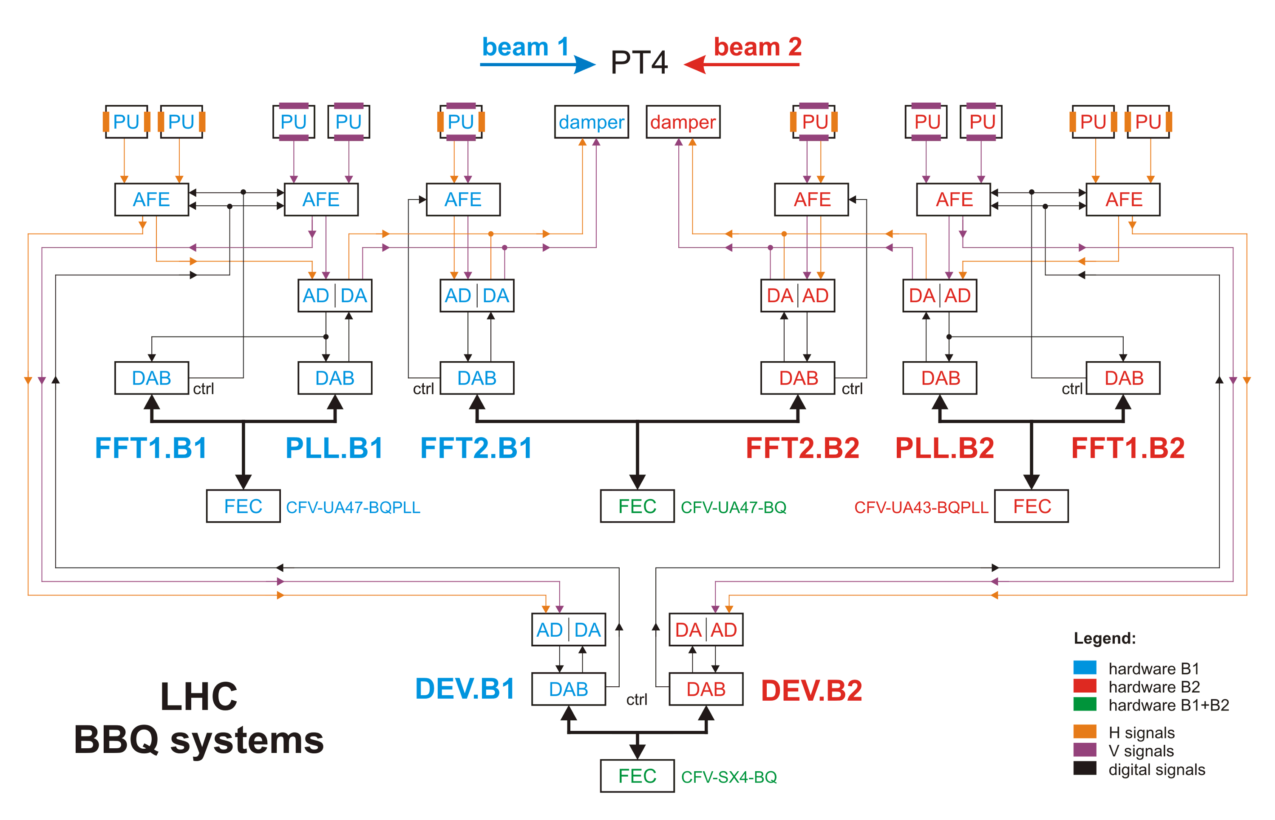
Schematics of the BBQ system
http://www.cern.ch/gasior/pro/BBQLHC/files/BBQ_LHC_systems_diagram.pdf

Slide 11
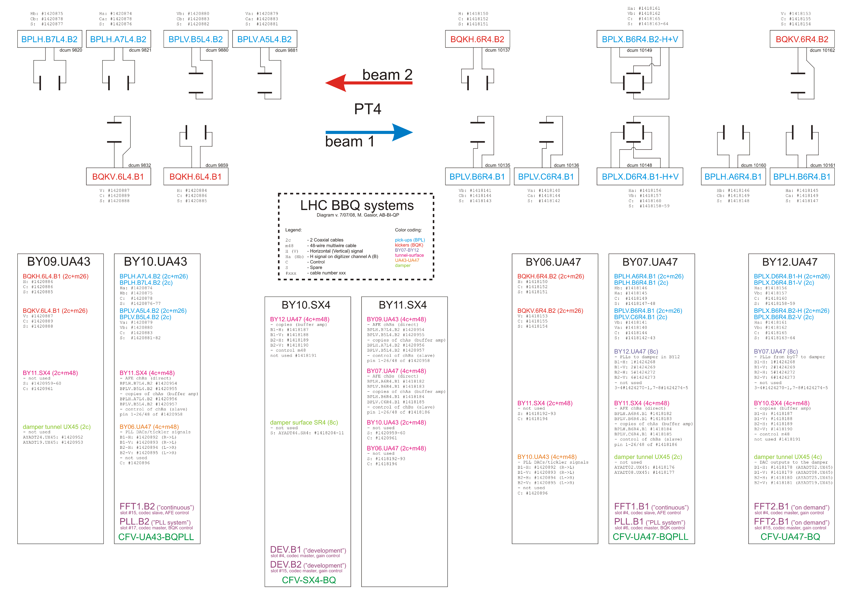
http://www.cern.ch/gasior/pro/BBQLHC/files/BBQ_LHC_systems_schem.pdf

Slide 12
Agenda
Objectives of the BBQ system
Principle
Things to remember
Example
Next steps

Slide 13
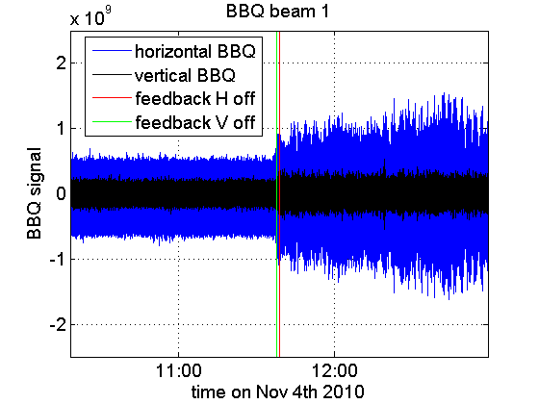
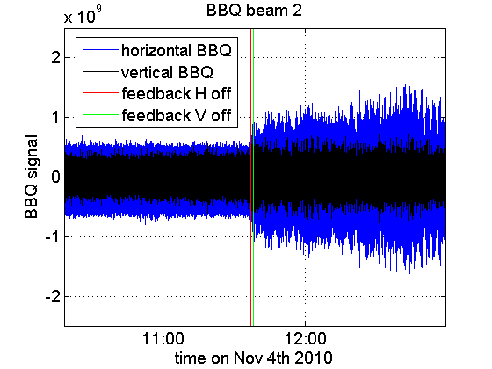
Example:
Switching feedback off (B1 and B2)
Time on Oct 31st 2010 after 01:00 AM (mm:ss)
Time on Oct 31st 2010 after 01:00 AM (mm:ss)
Increase of the BBQ signal after switching the transverse feedback off
With the transverse FB on residual beam oscillations were damped

Slide 14
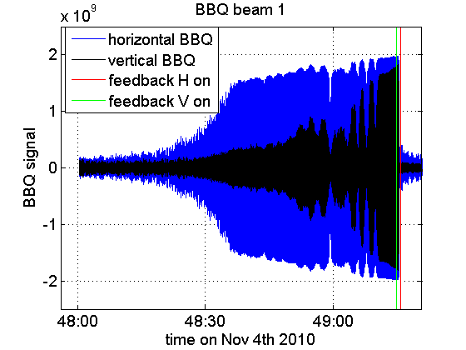
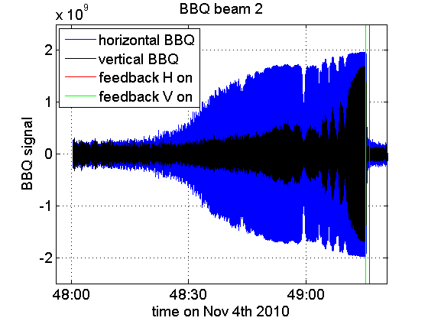
Instability rise times
Rise times:
B1H: 12 s
B2H: 16 s
B1V: 22 s
B2V: 31 s
Time on Oct 31st 2010 after 01:00 AM (mm:ss)
Clamping of the BBQ signals
tunes measured still correctly
no good for instability observations
gain should have been lowered for instability observation
Time on Oct 31st 2010 after 01:00 AM (mm:ss)

Slide 15
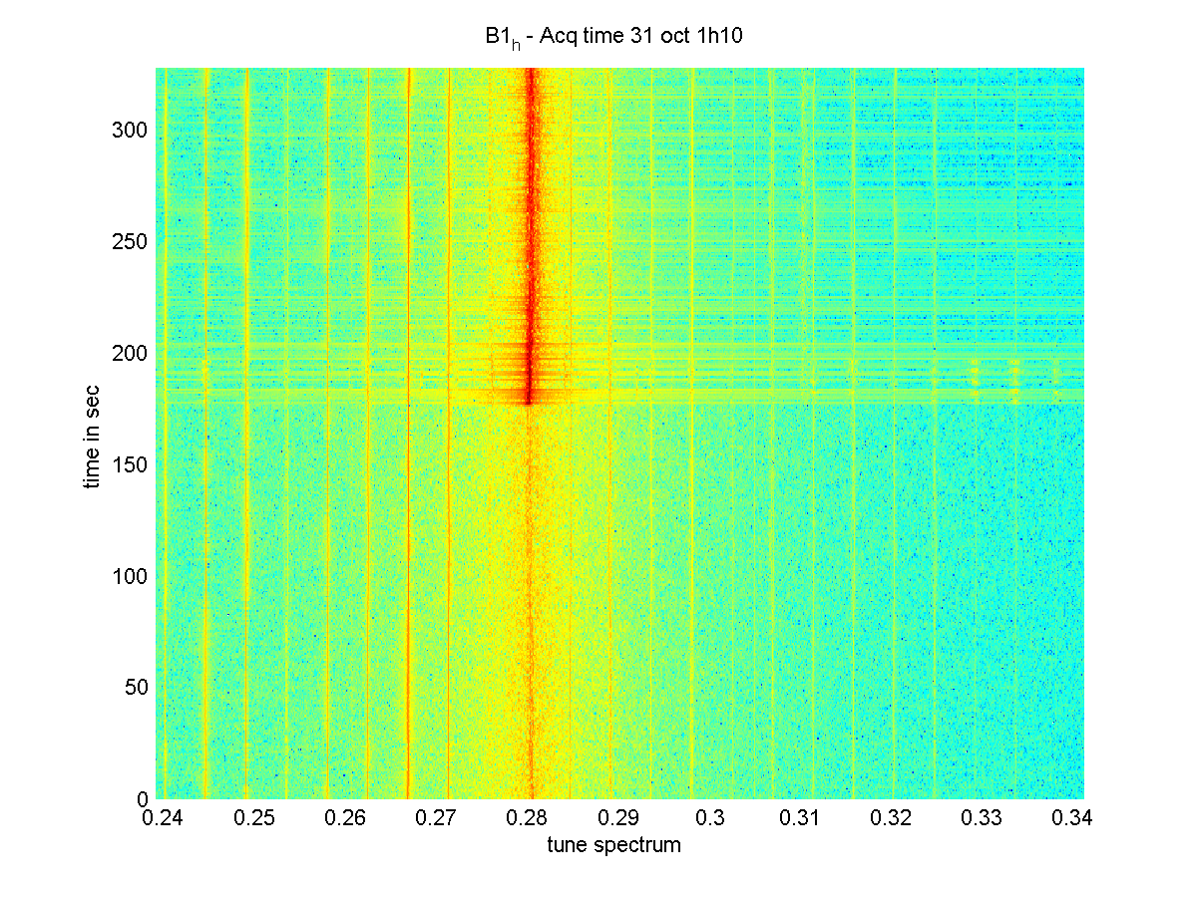
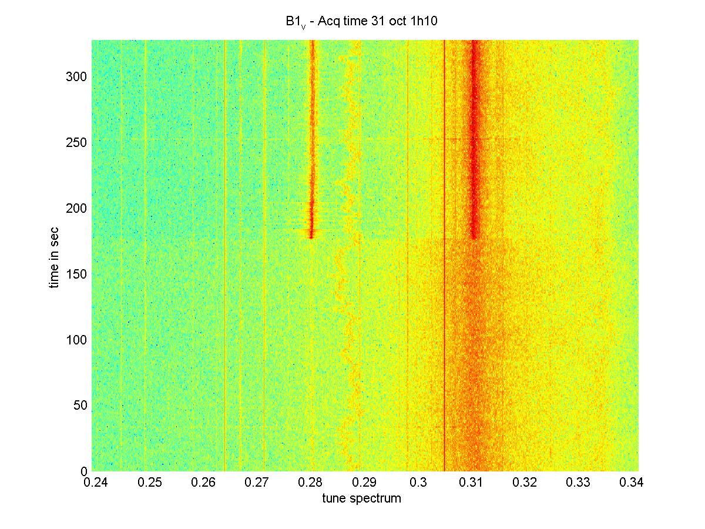
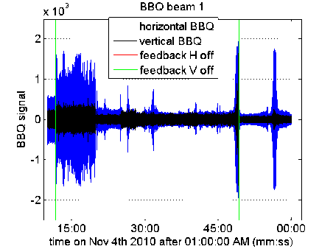
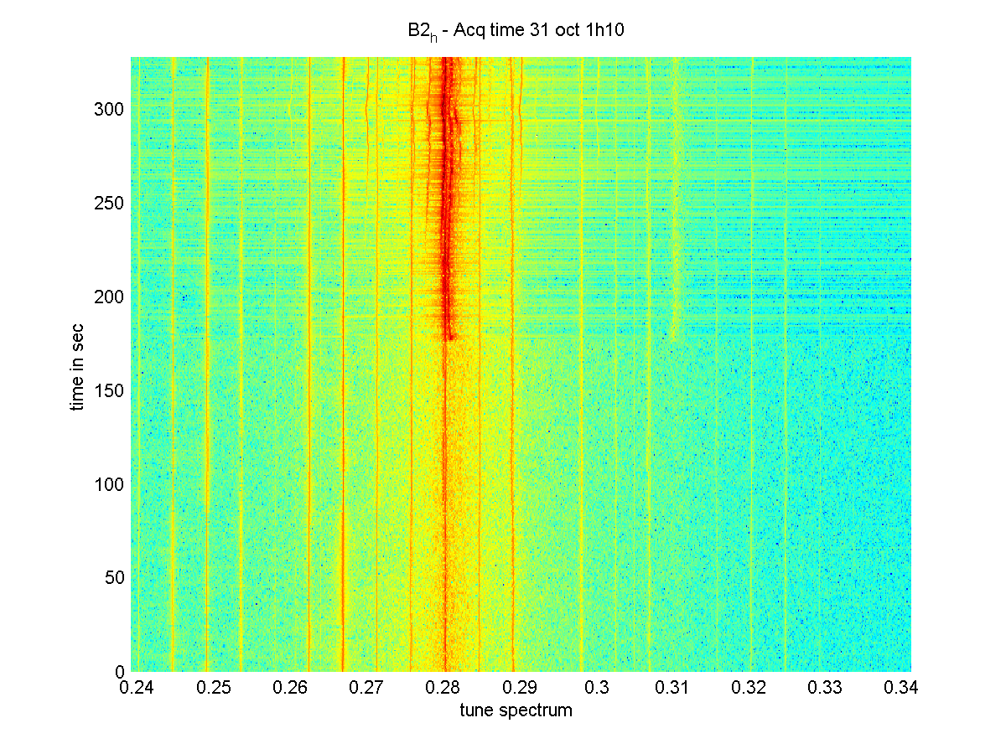
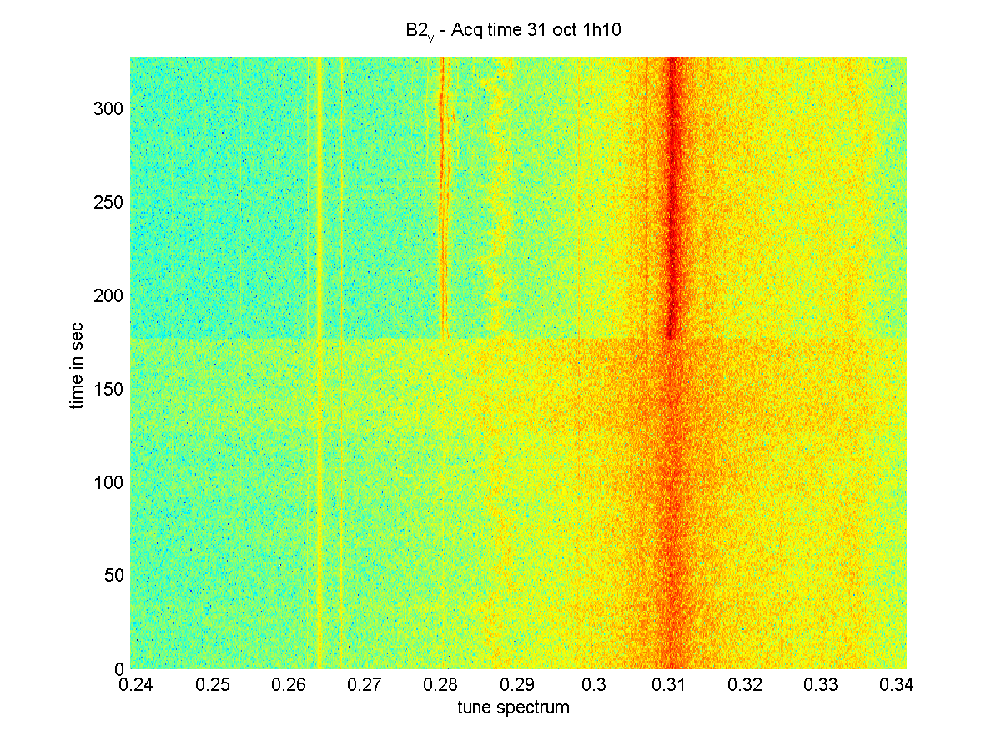
Tune spectra at 1:10:00 am (just before damper off)
B1H
B1V
H tune
Damper off
B2H
B2V
H tune
Damper off

Slide 16
Agenda
Objectives of the BBQ system
Principle
Things to remember
Example
Next steps

Slide 17
Next steps
Marek is working on the possibility to be sensitive to all bunches (average instead of peak detection).
He is also looking at gating the BBQ signal, but this is much more challenging.
There is also a recent proposition to have a dedicated special bunch in the filling scheme (pilot? nominal?) on which the damper would not be active and which would be measured individually by the BBQ system
→ exact conditions to be discussed

Slide 19
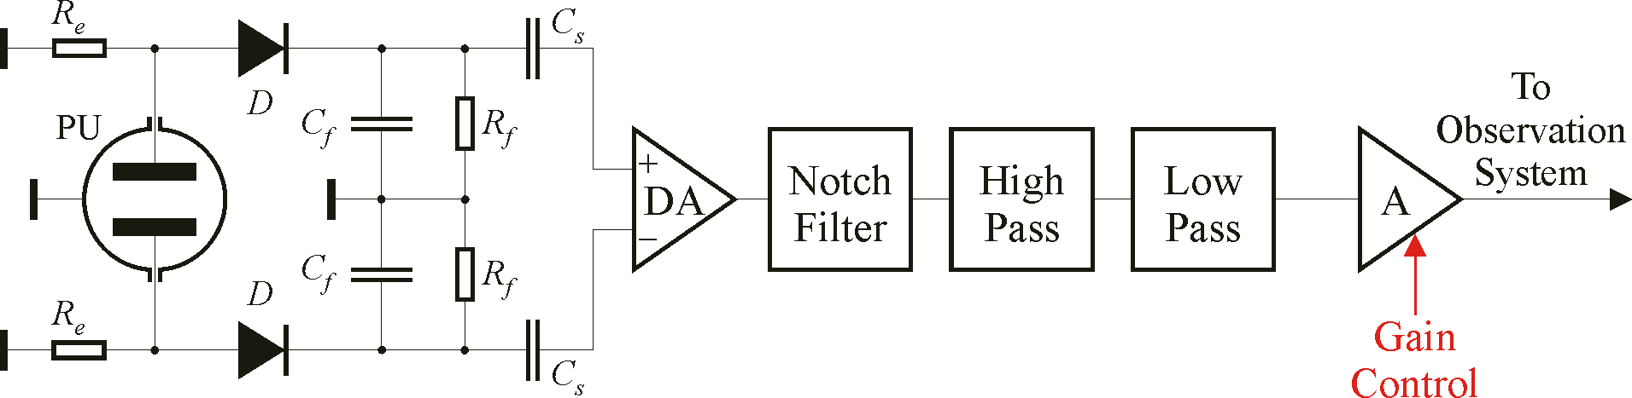
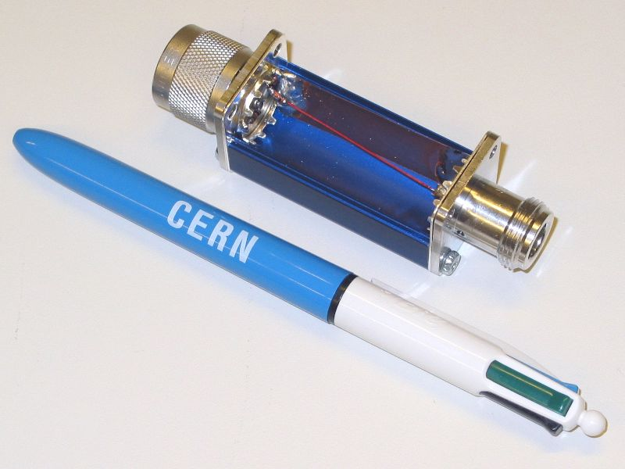
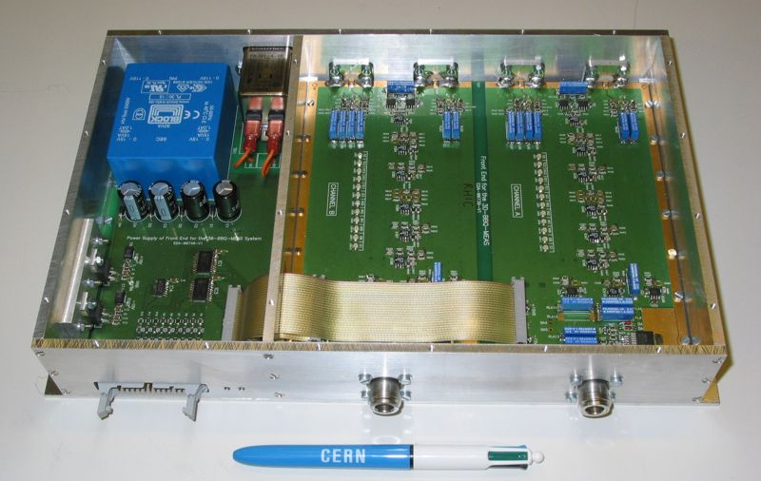
Tune Measurement Systems
Standard Tune Measurement (FFT) and PLL tune tracker will use a new BaseBand Tune (BBQ) system developed at CERN using Direct Diode Detection (3D)

Slide 20
3D Method Advantages / Disadvantages
Advantages
Sensitivity (noise floor measured at RHIC in the 10 nm range!!)
Virtually impossible to saturate
  large Frev suppression already at the detectors + large dynamic range
Simplicity and low cost
  no resonant PU, no movable PU, no hybrid, no mixers, it can work with any PU
Base band operation
  excellent 24 bit audio ADCs available
Signal conditioning / processing is easy
  powerful components for low frequencies
Independence from the machine filling pattern guaranteed
Flattening out the beam dynamic range (small sensitivity to number of bunches)
Disadvantages
Operation in the low frequency range
  More susceptible to EMC
It is sensitive to the “bunch majority”
  gating needed to measure individual bunches

