Slide 1
Coherent tune shift measurements at ps injection and Extraction
S. Aumon, H. Bartosik, P. Freyermuth, O. Hans
S. Gilardoni

Slide 2
Contents
Motivations
Injection beam parameters
Coherent tune shift at injection energy
Effective impedance at injection
Extraction beam parameters
Coherent tune shift at extraction
Effective impedance at LHC extraction energy
Estimation of the coherent tune shift due to the space charge at injection in the vertical plane
Conclusions - Remarks

Slide 3
Motivations
What is the transverse impedance of the PS now ?
Most of the high intensity and High brightness LHC beam remained unstable at injection.
PS 2 GeV upgrade
Fast instability measurements at transition crossing in the PS gave an estimation of Real(Zt)
Estimate the low frequency imaginary part of the broad-band impedance.
Estimation of the tune shift due to the space charge.

Slide 4
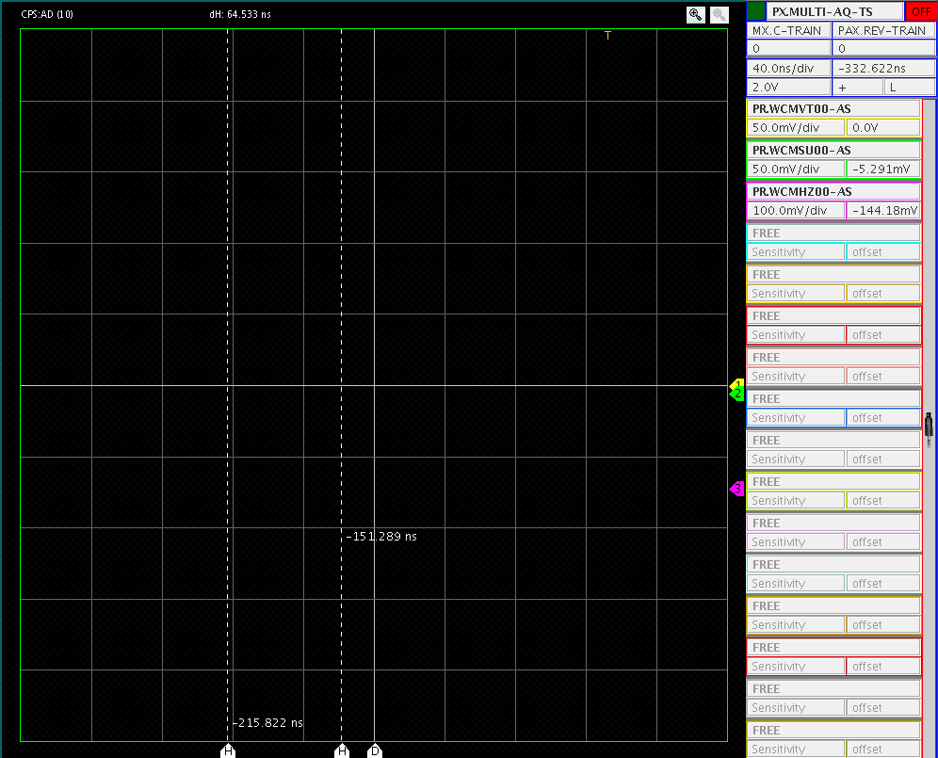
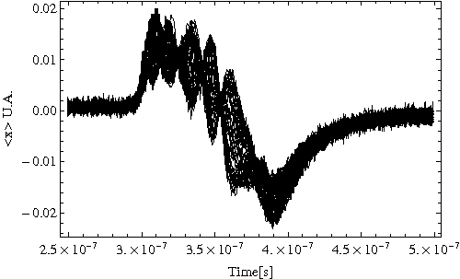
Motivations - Examples
HI-LHC beam at injection
(2010)
AD beam in the PS at injection (2010)

Slide 5
Why is important ?
ToF
Single bunch
Since 2010, accelerated intensity 850e10 protons !

Slide 6
Injection beam parameters
Tune shift measurements done with the BBQ.

Slide 7
Coherent tune shift at injection
Fractional part of the tune as a function of the Nb particles

Slide 8
Effective impedance at PS injection
From Sacherer formula (CERN/PS/BR 76-21):
with

Slide 9
Effective impedance at PS injection
m | 0
Bunch length | ~ 180 ns
βrel | 0.91
γ rel | 2.47
ω0 | 2728 e3 rad.s-1
Machine radius | 100 m
Horizontal:
Zeff=3.5 MOhm/m
Vertical:
Zeff=12 MOhm/m

Slide 10
Beam parameters at LHC extraction energy

Slide 11
Coherent tune shift at extraction
Horizontal tune decrease as a function of time (also in vertical).
Independent of the energy, visible on long plateau (B. Vandorpe)
Phenomena not understood.

Slide 12
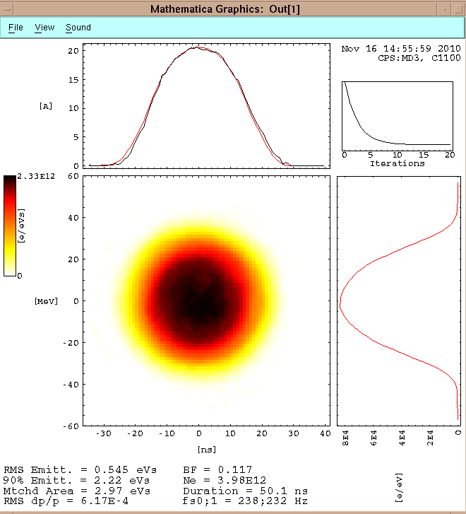
Effective impedance at extraction
m | 0
Bunch length | ~ 50 ns
βrel | 0.9993
γ rel | 27.729
ω0 | 2996 e3 rad.s-1
Machine radius | 100 m
Horizontal:
Zeff~1 MOhm/m
Vertical:
Zeff=6.8 MOhm/m

Slide 13
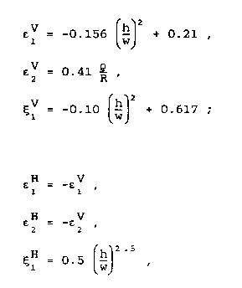
Estimation of the coherent tune shift due to the space charge at injection and extraction
Rough estimation of the space charge contribution in the impedance at injection.
Reference to “Tune shift and stop bands at injection in the CERN PS”, Y. Baconnier CERN/PS 87-89.
“Non penetrating field”
Laslett coefficients for elliptical chamber a centered beam in the vacuum chamber valid for h/w < 0.7 (B. Zotter CERN ISR-TH/72-8)

Slide 14
Estimation of the coherent tune shift due to the space charge at injection in the vertical plane
26 GeV/c
1.4 GeV/c
Estimated tune shift due to Space charge with analytical formulas
Total vertical tune shift
Estimation!
ΔQ-Space charge ~ ¼ Total measured ΔQ at injection

Slide 15
Conclusions - Remarks
Vertical : Zeff=12 Mohm/m @ 1.4 GeV/c and 6.8 MOhm/m @ 26 GeV/c
Horizontal: Zeff=3.5 Mohm/m and ~1MOhm/m
Measurements done in the past (1989) by R.Cappi et al and by Elias (2001) Zt(Vert)~3 MOhm/m and Zt(Hor)~1 MOhm/m
Analytical formulas estimates ¼ the coherent tune shift due to space charge in the vertical plane.
MTE kickers (2006) ? The studies planed an 10% increase of the transverse impedance.

Slide 16
Conclusions- Remarks
Extract as much informations as possible from those measurements.
Incoherent tune shift for injection studies (PTC-Orbit), thanks to Hannes!

Slide 17
Thank you for your attention !
Thanks to B. Salvant, E. Benedetto, E. Metral, G. Rumolo, R. Steerenberg

Slide 18
appendix

Slide 19
Horizontal emittance blow up
25%

Slide 20
Beam Stability

