Slide 1
SPS Pumping ports

Slide 2
The story leading up to this massive enterprise started in 1994 when analysis showed that the intense proton bunches to be used for the LHC could be unstable due to so-called longitudinal "microwave instability". The longitudinal microwave instability is observed in the SPS as intensity-dependent bunch lengthening associated with strong beam signals at high frequencies.
Microwave instability depends on the intensity per bunch. Microwave instability occurs due to voltage induced by bunches of circulating particles in the different elements of the accelerator acting back on the bunches themselves – microwave instability is therefore a local effect on a single bunch. It is based on a broadband impedance.
For the memory[E.Shaposhnikova]: It is convenient to divide the various types of impedance
in the accelerator ring according to the type of instability they lead to. Below we shall consider:
Narrow-band impedances with Δω _ 1/τ, where Δω is the impedance bandwidth (for a resonator with quality factor Q and resonant frequency ωr = 2πfr, Δω = ωr/(2Q)) and τ is the bunch length. Their sources are the fundamental and HOMs in the different (at the moment 5) RF systems of the SPS. The wake field created by this impedance lasts during the passage of many bunches. These impedances lead to coupled bunch instabilities.
Broad-band impedances with Δω _ 1/τ. Sources: space charge, steps in accelerator chamber crosssection, bellows, stripes and so on. The wakefield created by these impedances is very local and decays over one bunch length. So it can lead only to single bunch instabilities. e.g. microwave instability
Impedances with Δω ∼ 1/τ lead usually to batch type instabilities. In this case a short-range wakefield can couple a few consecutive bunches but decays in any significant gap (as exists in the LHC type beam in the SPS). The sources are for example well damped HOM in the RF systems or resonant modes in accidental cavities (like vacuum ports, septa, kickers and others).
The problem expectedly turned out to be the injection and extraction kickers and septa, but un-expectedly the main culprits proved to be the 1000 or so pumping port chambers spread around the machine. During the shutdown 2000-2001, all the pumping ports were equipped with inserts that maintained the shape of the vacuum chambers inside the magnets. The pumping ports were no longer cavities.

Slide 3
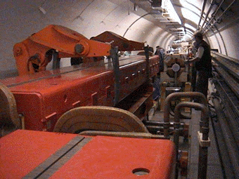
SPS Pumping ports

Slide 4
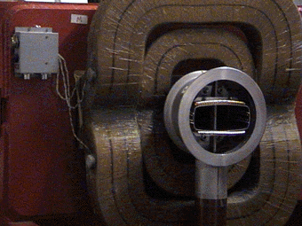
SPS Pumping ports

Slide 5
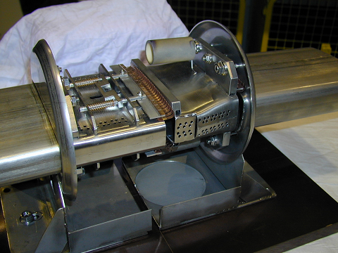
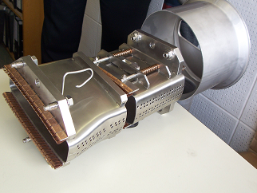
SPS Pumping ports

Slide 6
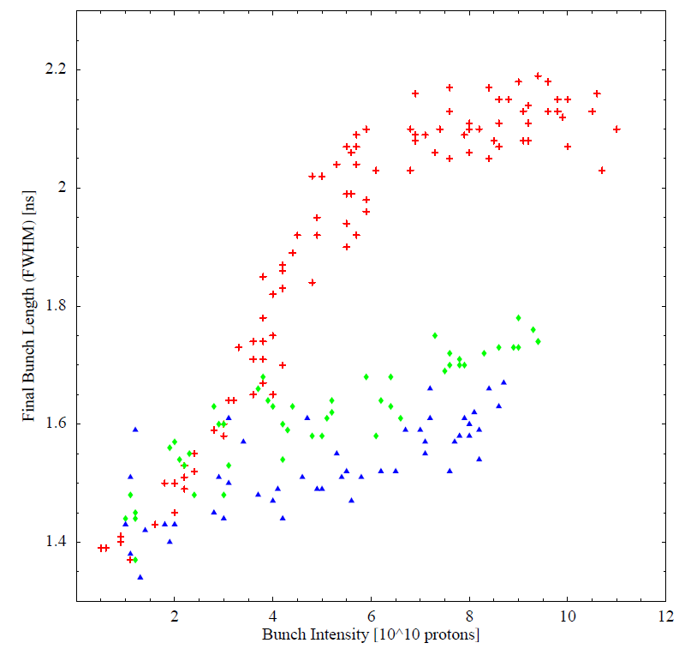
SPS Pumping ports
The bunch length (FWHM) measured at 600 ms after injection as a function of bunch intensity for different MD runs: on 25.11.1999 (red), on 7.08.2001 am (green) and pm (blue). [T. Bohl, T. Linnecar, E. Shaposhnikova]

Slide 7
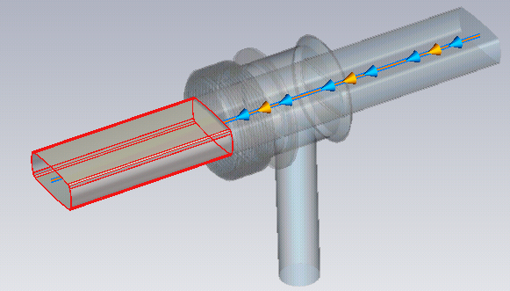
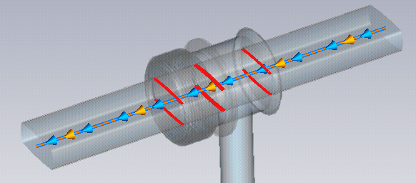
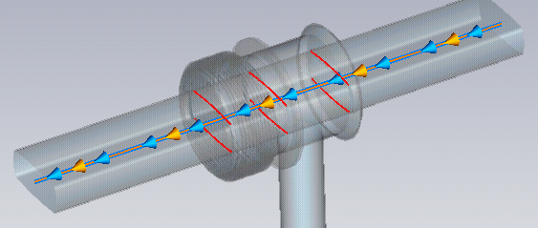
Vacuum pipe
RF contacts
(with no resistance i.e. R=0 Ohm)
RF contacts
(with resistance e.g. R= 0.00308906 Ohm)

Slide 8
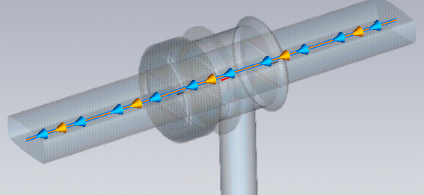
RF contacts
(with no resistance i.e. R=0 Ohm)
RF contacts
(with resistance e.g. R= 0.00308906 Ohm)
RF wires
(The three RF wires, connecting the inserts)

Slide 9
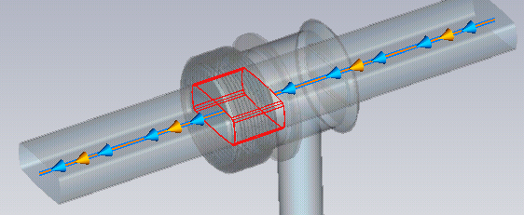
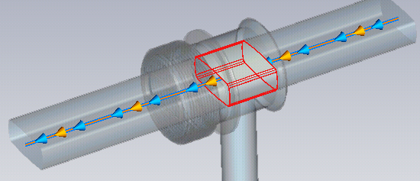
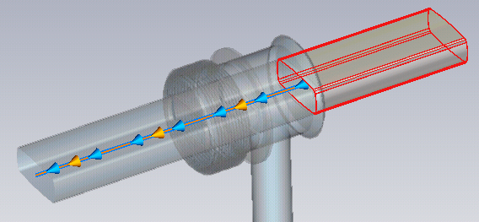
Insert - bellow
Insert – pumping port
Vacuum pipe

Slide 10
X-potential:

Slide 11
Y-potential:
Y-potential:
Y-potential:

Slide 12
z-potential:

Slide 13
