Slide 1
Electron-Cloud Activities for LHC
Frank Zimmermann
ICE Meeting, 24.11.2010

Slide 2
electron-cloud effects
vacuum pressure rise
- desorption yield, pumping speed,…
single-bunch instability
- interplay w. impedance & beam-beam
multibunch instability
incoherent emittance growth
heat load in cold arcs (quench)
perturbation of beam diagnostics

Slide 3
modeling tools at CERN
ECLOUD (F. Zimmermann, G. Rumolo, et al ++)
- e-cloud build up, electron flux on wall,
heat load, multi-bunch wake field
HEADTAIL (G. Rumolo, F.Z., E. Benedetto,…)
- e-cloud driven single-bunch instability,
incoherent emittance growth, interplay
w. impedance & space charge
Micromaps (G. Franchetti, E.B., F.Z.)
- precise incoherent effects
Faktor2 (W. Bruns, G. Rumolo) for 3D

Slide 4
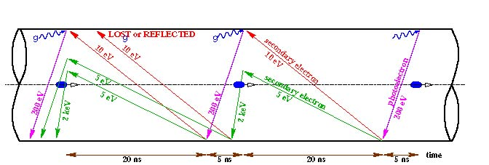
schematic of e- cloud build up in LHC arc beam pipe,
due to photoemission and secondary emission
[F. Ruggiero]

Slide 5
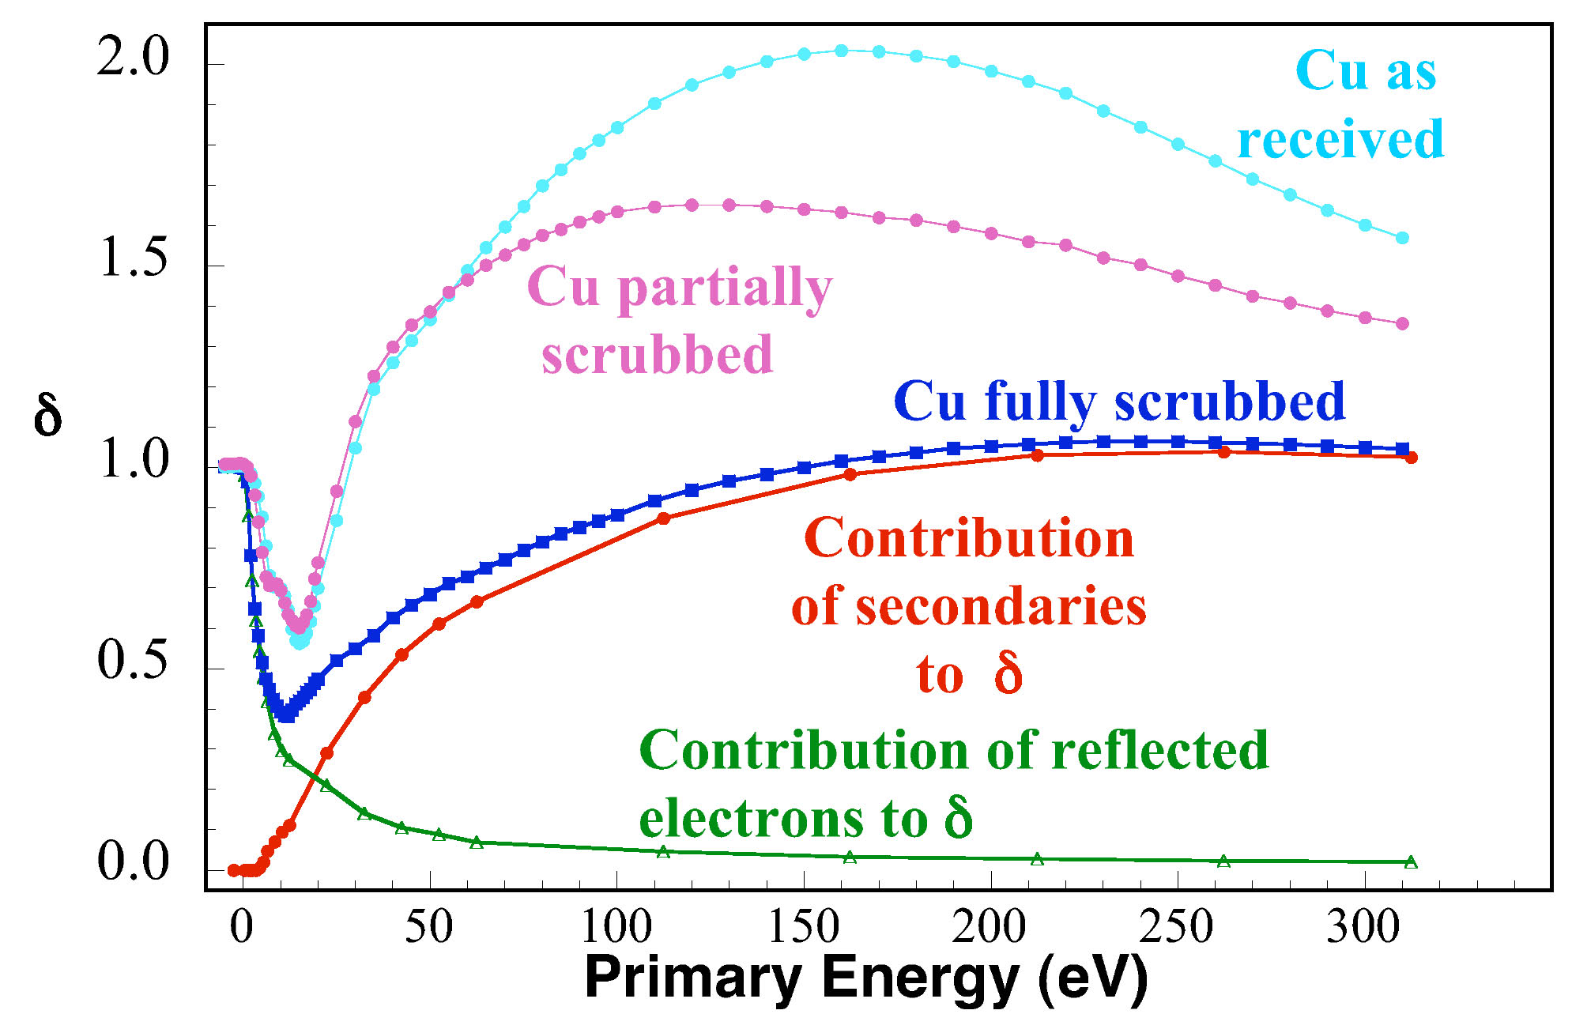
R. Cimino, I. Collins, 2003; CERN-AB-2004-012
yield
δ_{max}
R
ε_{max}
probability of elastic electron reflection seems to approach 1 for
zero incident energy and is independent of δ*_{max}

Slide 6
Present Model of Secondary Emission Yield
secondary electrons consist of true secondaries and elastically reflected;
since 2003 we assume that elastic reflection is independent of Θ (no data)
true secondaries:
[M. Furman, 1997]
this δ∗_{max}
is rescaled
considering
R
[Kirby, 2001;
Henrist, 2002;
Furman, 1997]
elastic reflection:
[Cimino, Collins, et al., 2003]
this quantum-mechanical formula fits the data well for E₀~150 eV
M. Furman includes rediffused electrons and finds that they increase the
heat load by 100%

Slide 7
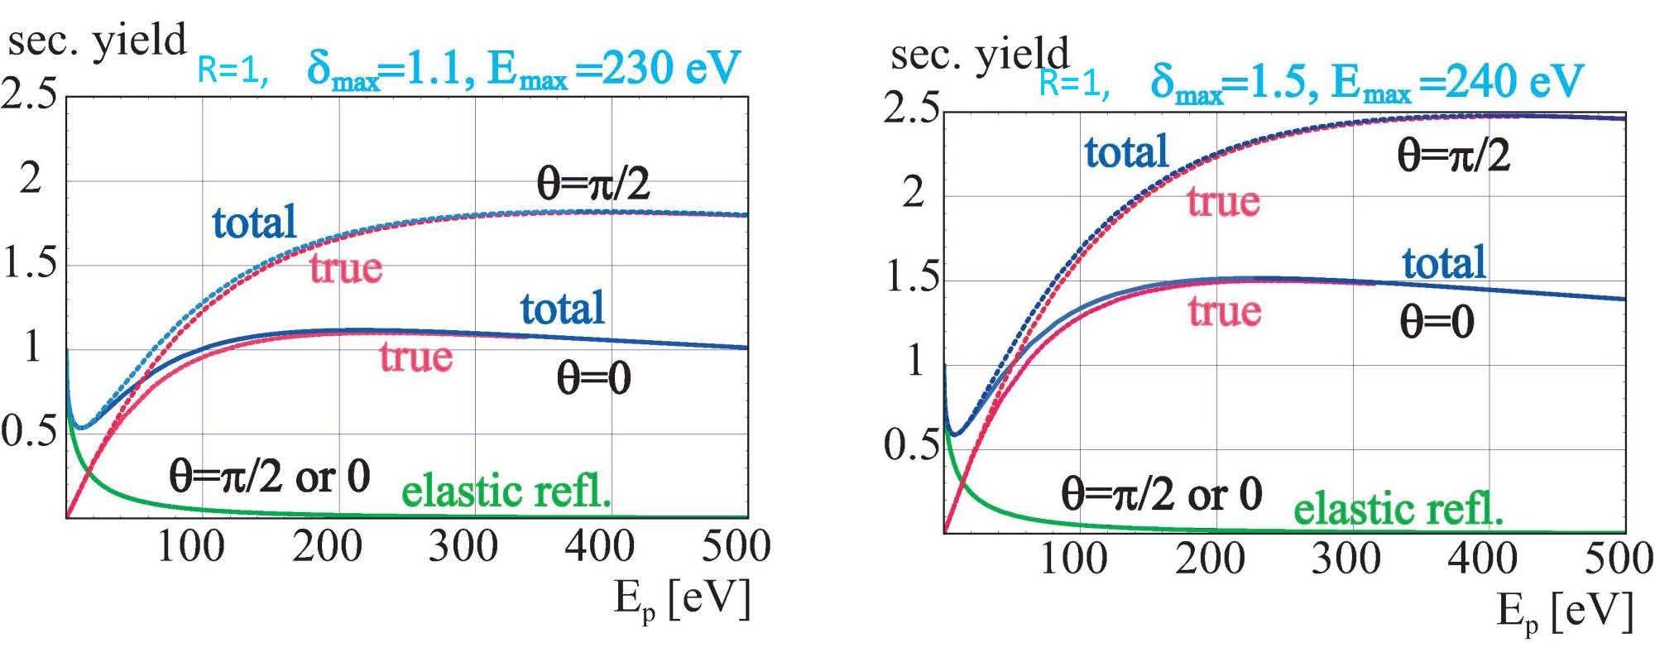
SEY model examples

Slide 8
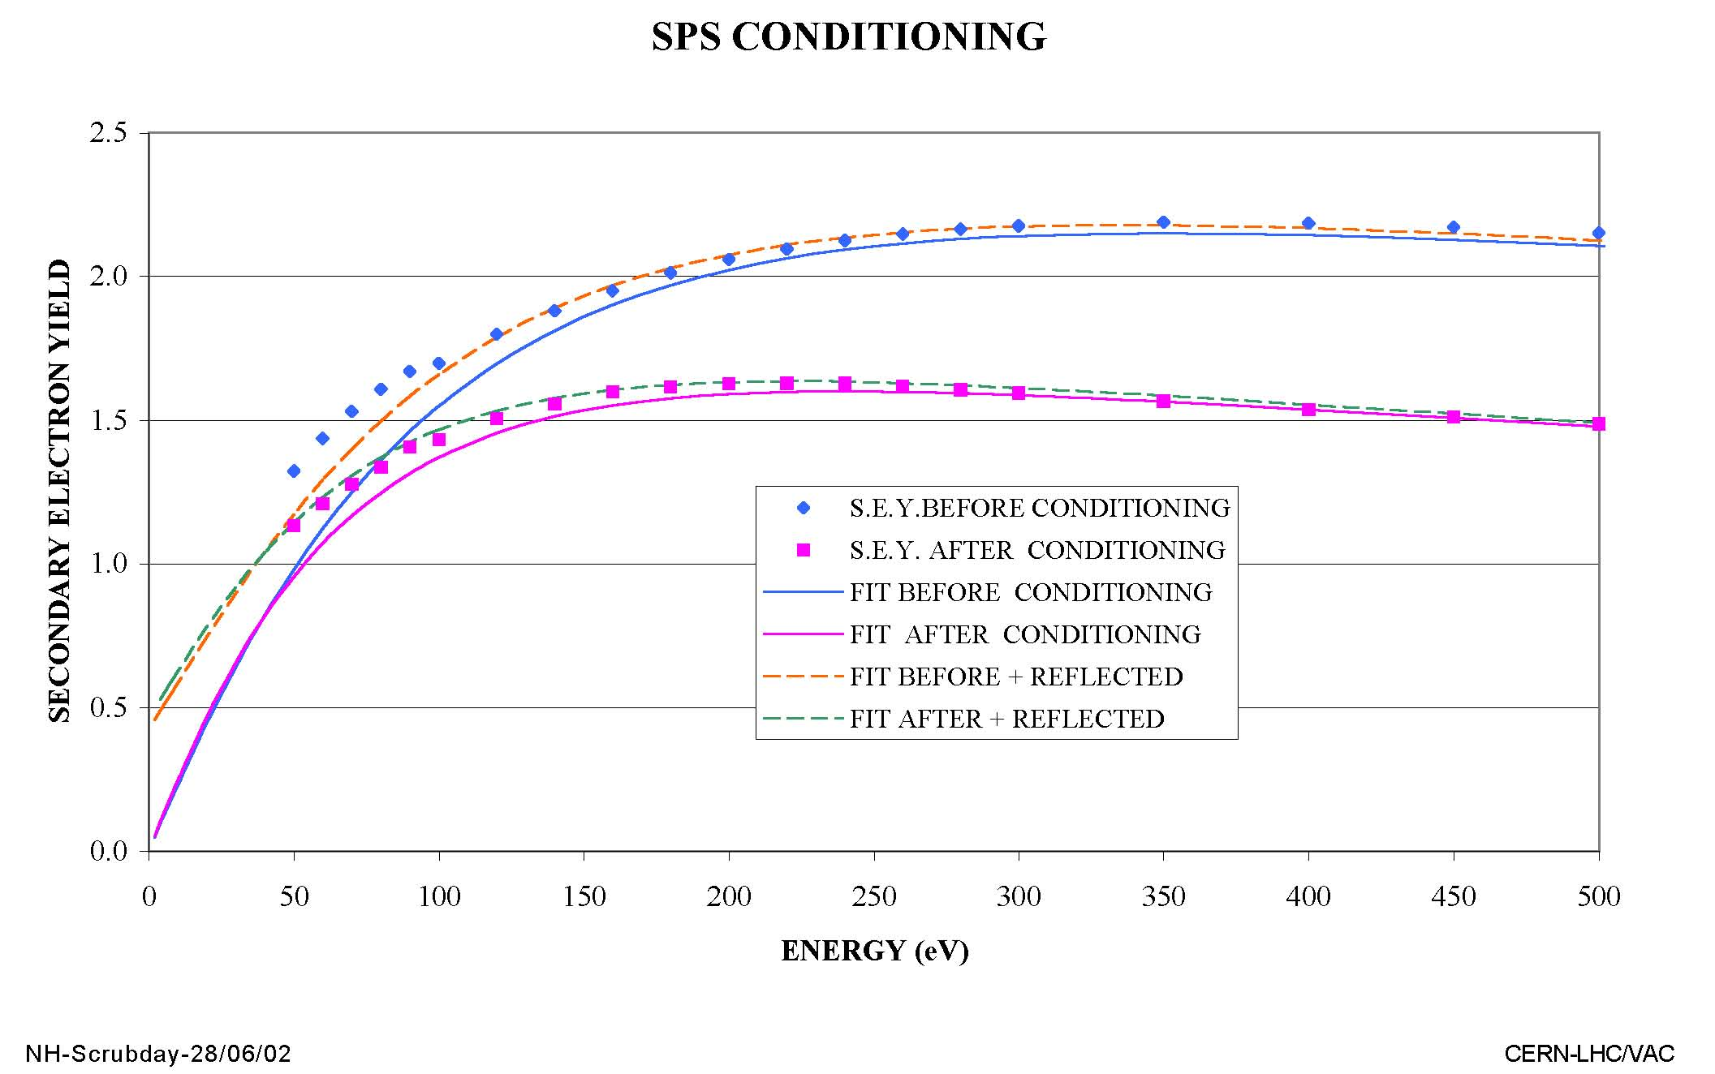
in-situ conditioning in the SPS (2002)
N. Hilleret, SPS Scrubbing Day, CERN, 2002

Slide 9
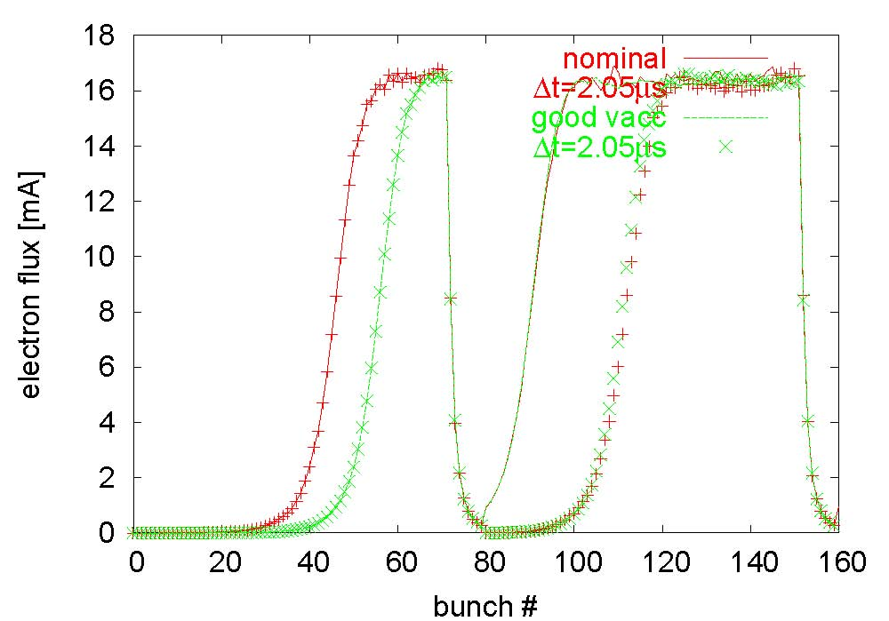
SPS benchmarking 2004, strip detector simulation
Daniel Schulte
two different
bunch train
spacings
two different
pressures
(40 ntorr
and 4 ntorr)
surface conditions (δ_{max}, R) and detector properties are uncertain
constrain parameters by benchmarking multiple measurements
change distance between trains & use relative measurements

Slide 10
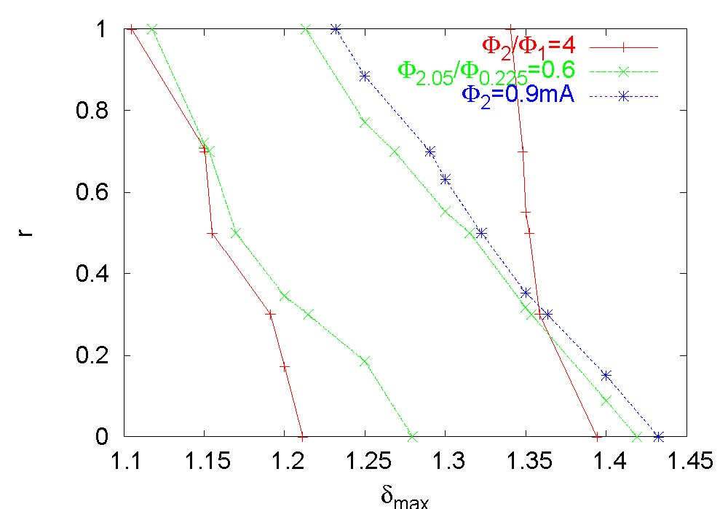
flux: (1) ratio 1&2 trains, (2) two spacings, (3) absolute
Daniel
Schulte
note:
results
sensitive
to pressure,
chamber
geometry,
etc.,
variation:
δ_{max}~1.4-1.3
R~0.1-0.7
three curves intersect at δ_{max}=1.35, R=0.3;
flux at later times (Φ=0.3 mA) δ_{max}=1.2 reached in SPS!

Slide 11
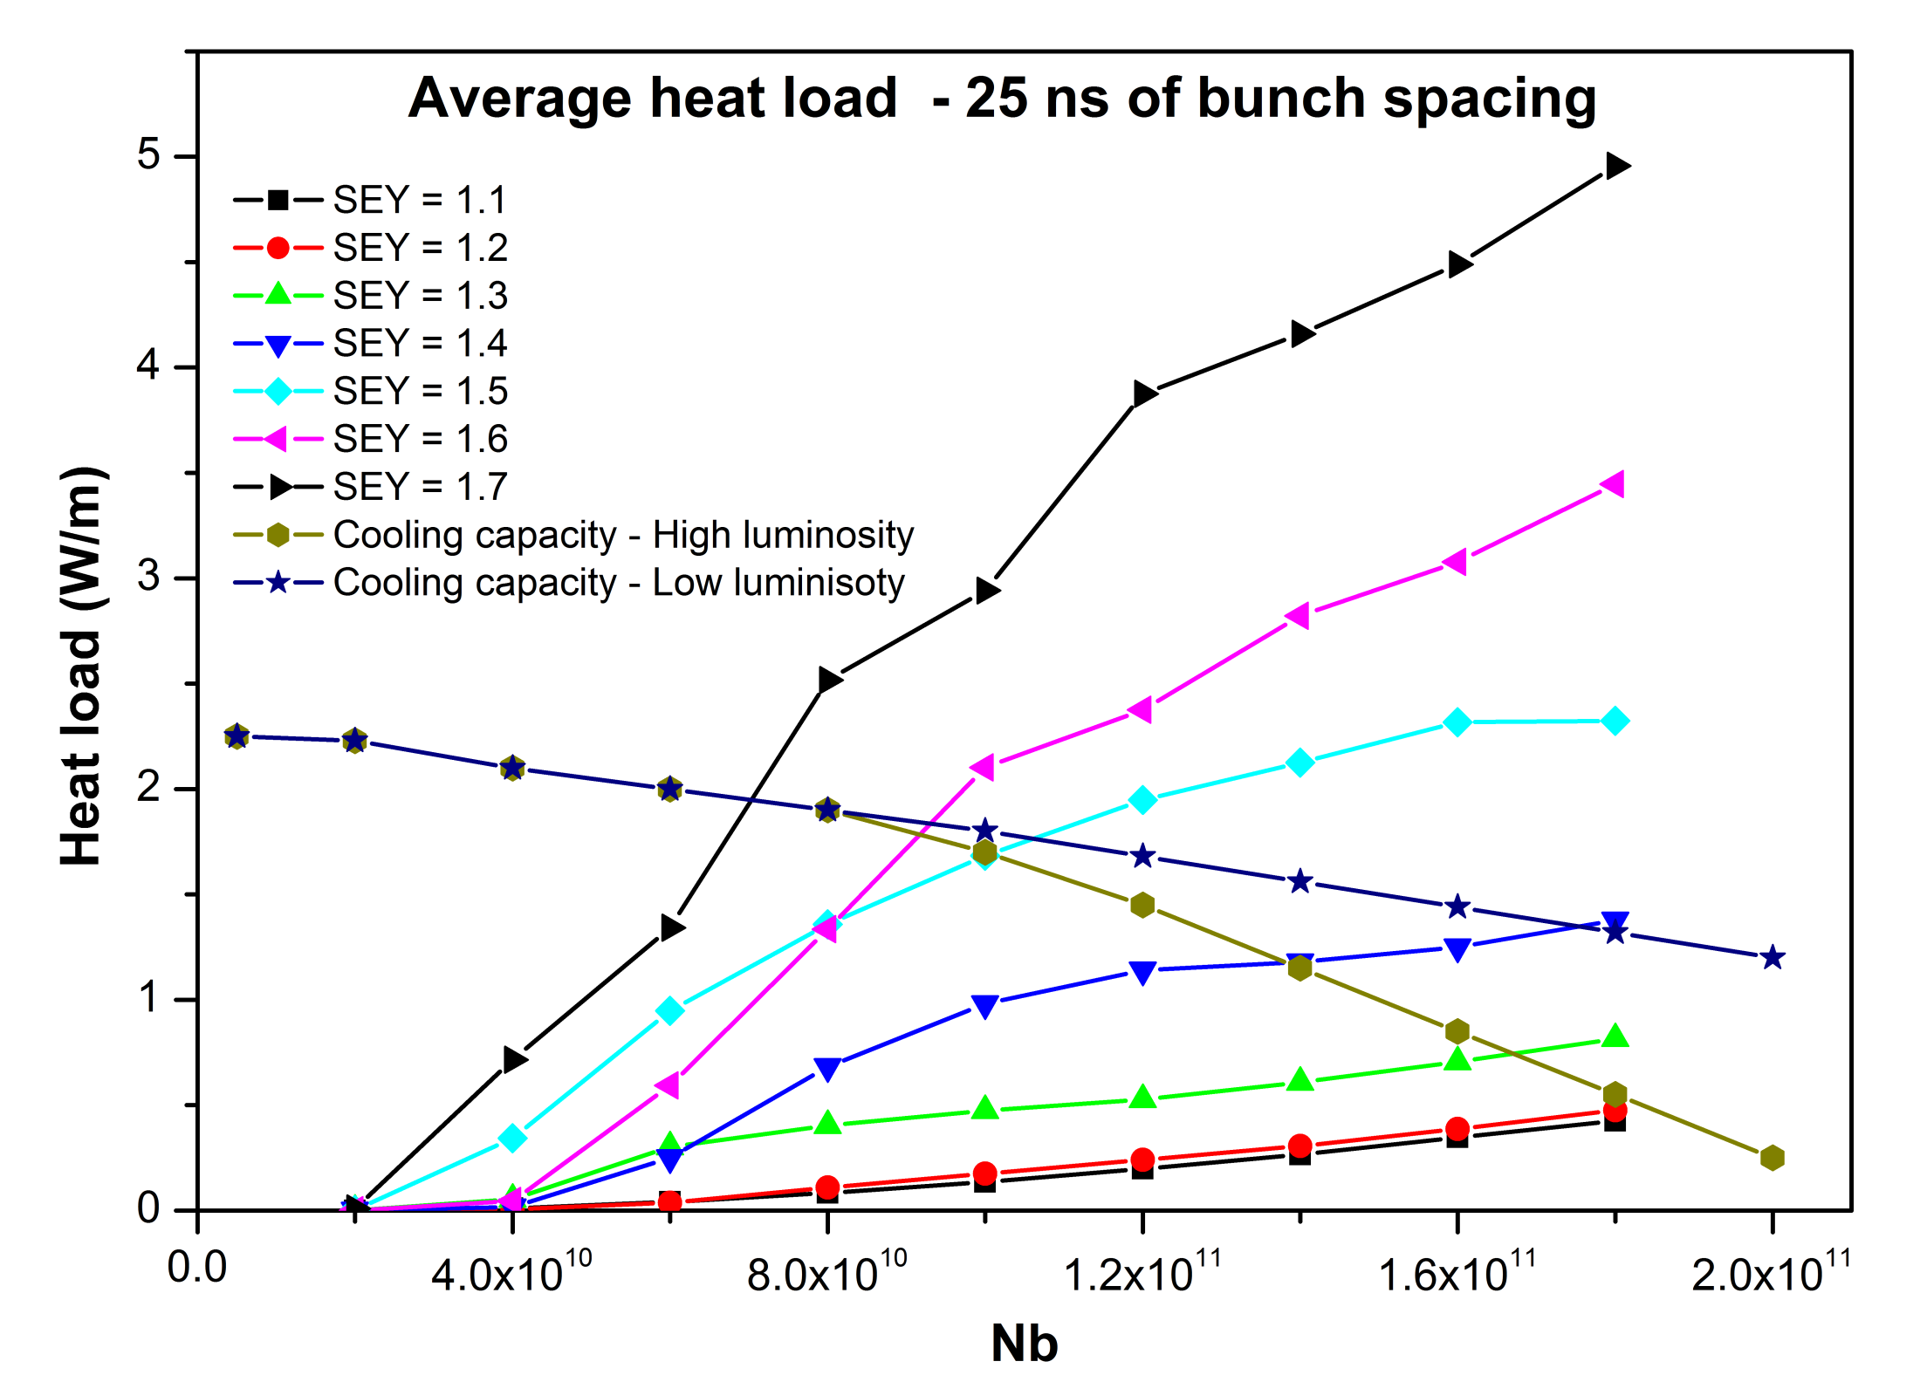
Simulated heat-load for nominal LHC
need SEY<1.5
H. Maury Cuna

Slide 12
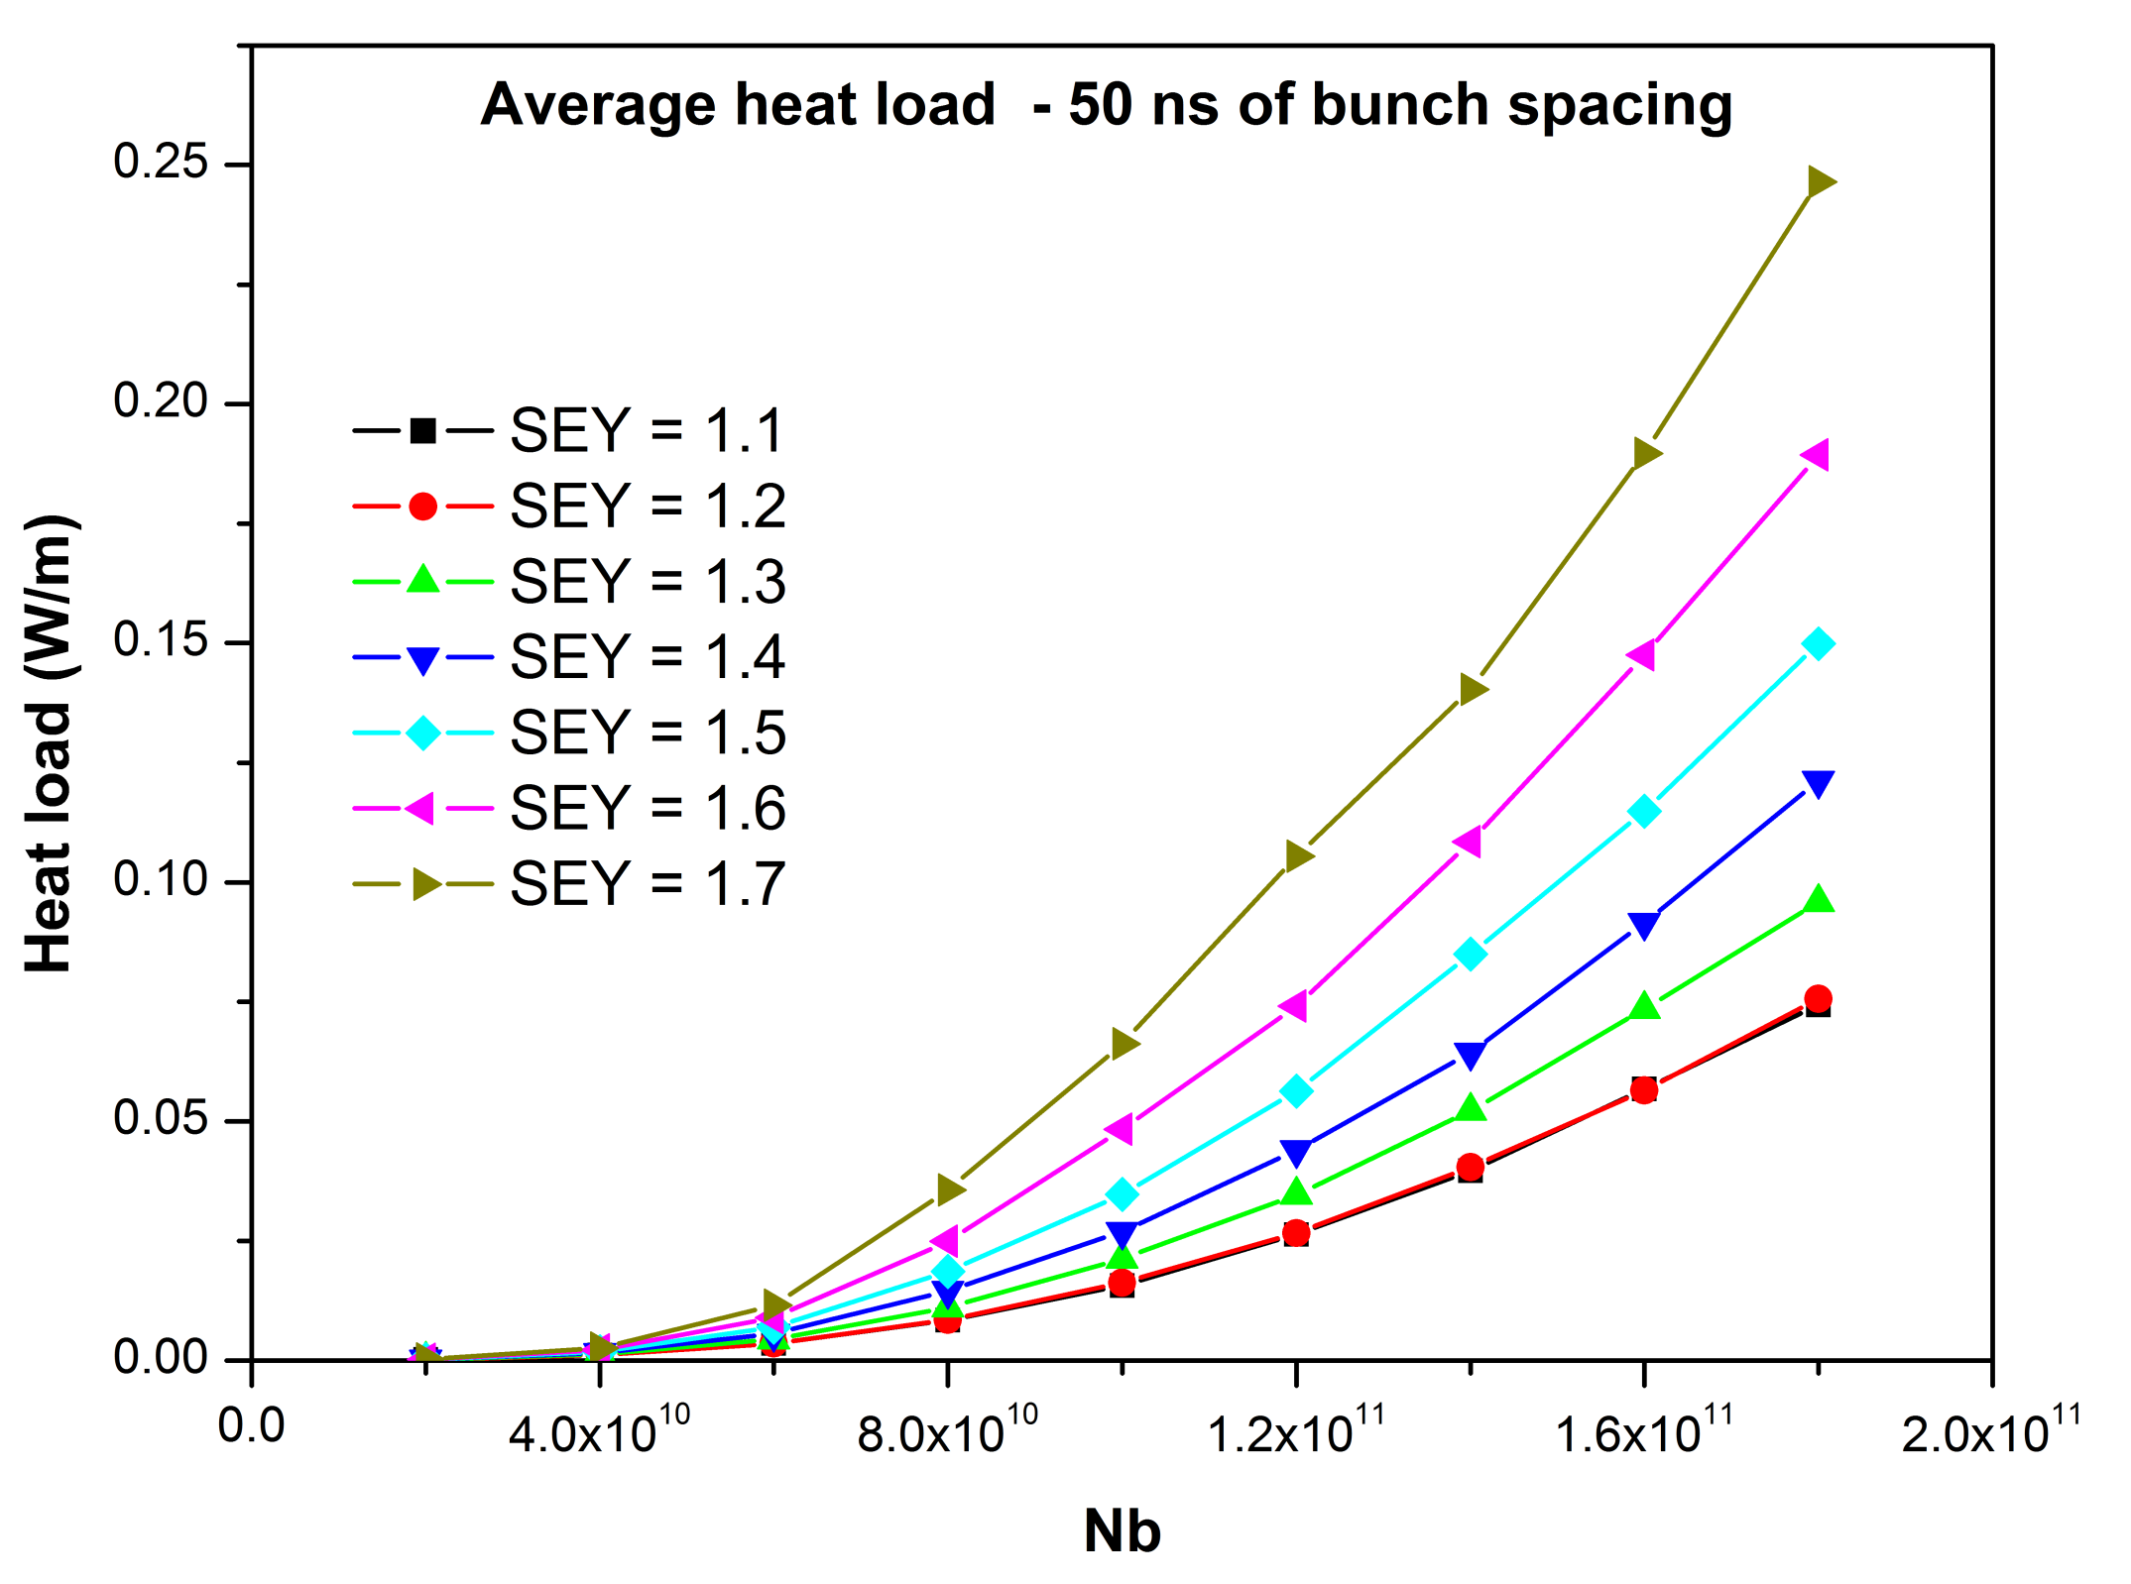
Simulated heat-load for LHC w 50-ns spacing
1404 bunches at 7 TeV
50 ns should have no problem !?!
H. Maury Cuna

Slide 13
e- cloud can lead to bunch instability

Slide 14
LHC emittance growth for different ρ_{e}
LHC injection, Q’=2,
N_{b}=1.15x10¹¹
single-bunch
instability
threshold
~3x10¹¹ m⁻³
K. Ohmi, F.Z.,
PRL85, 2000
E. Benedetto, Ph.D. Thesis, Politecnico di Torino, 2006

Slide 15
LHC emittance growth for different N_{b}
LHC injection,
Q’=2,
ρ_{e}=6x10¹¹ m⁻³
at ρ_{e}=6x10¹¹m⁻³
single-bunch
instability
threshold
N_{b}~6x10¹⁰
E. Benedetto, Ph.D. Thesis, Politecnico di Torino, 2006

Slide 16
LHC emittance growth for different Q’
E. Benedetto, Ph.D. Thesis, Politecnico di Torino, 2006
at ρ_{e}=6x10¹¹m⁻³
instability
suppressed
for Q’>15
similar to LHC
slow
emittance
growth
below
threshold
LHC injection,
N_{b}=1.15x10¹¹,
ρ_{e}=6x10¹¹ m⁻³
slow emittance growth never vanishes; precise value depends on optics & e-cloud distribution around the ring (E. Benedetto, G. Franchetti, F.Z., PRL97:034801,2006)

Slide 17
surface conditioning

Slide 18
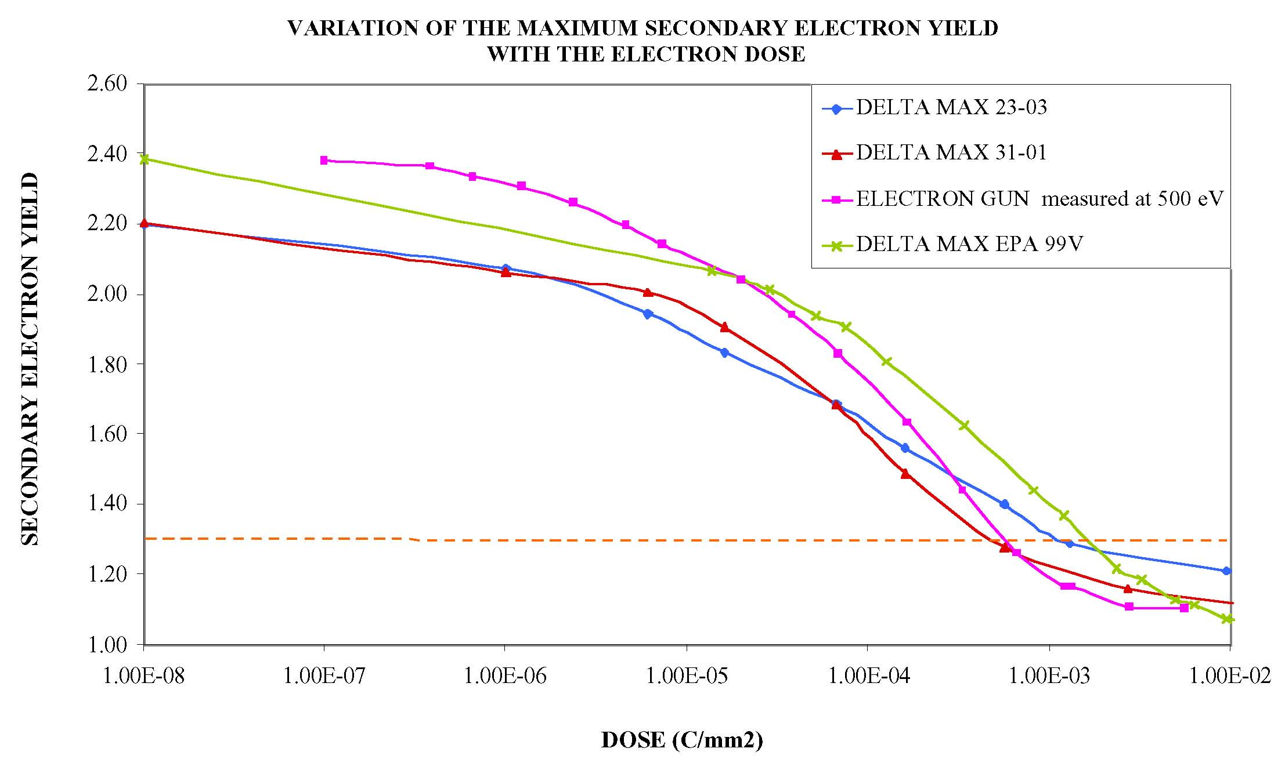
surface conditioning by e- bombardment
1 mC/mm²
N. Hilleret, Twostream Instabilities workshop, KEK, 2001

Slide 19
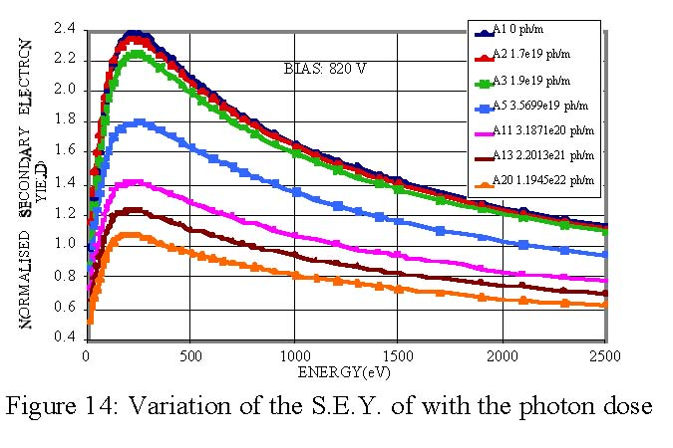
surface conditioning by synchrotron light
N. Hilleret et al, EPAC2000
need 10²⁰ ph/m! with 0.01 ph/m/proton/turn
7 hours with 400 nominal bunches at 3.5 TeV might do??!

Slide 20
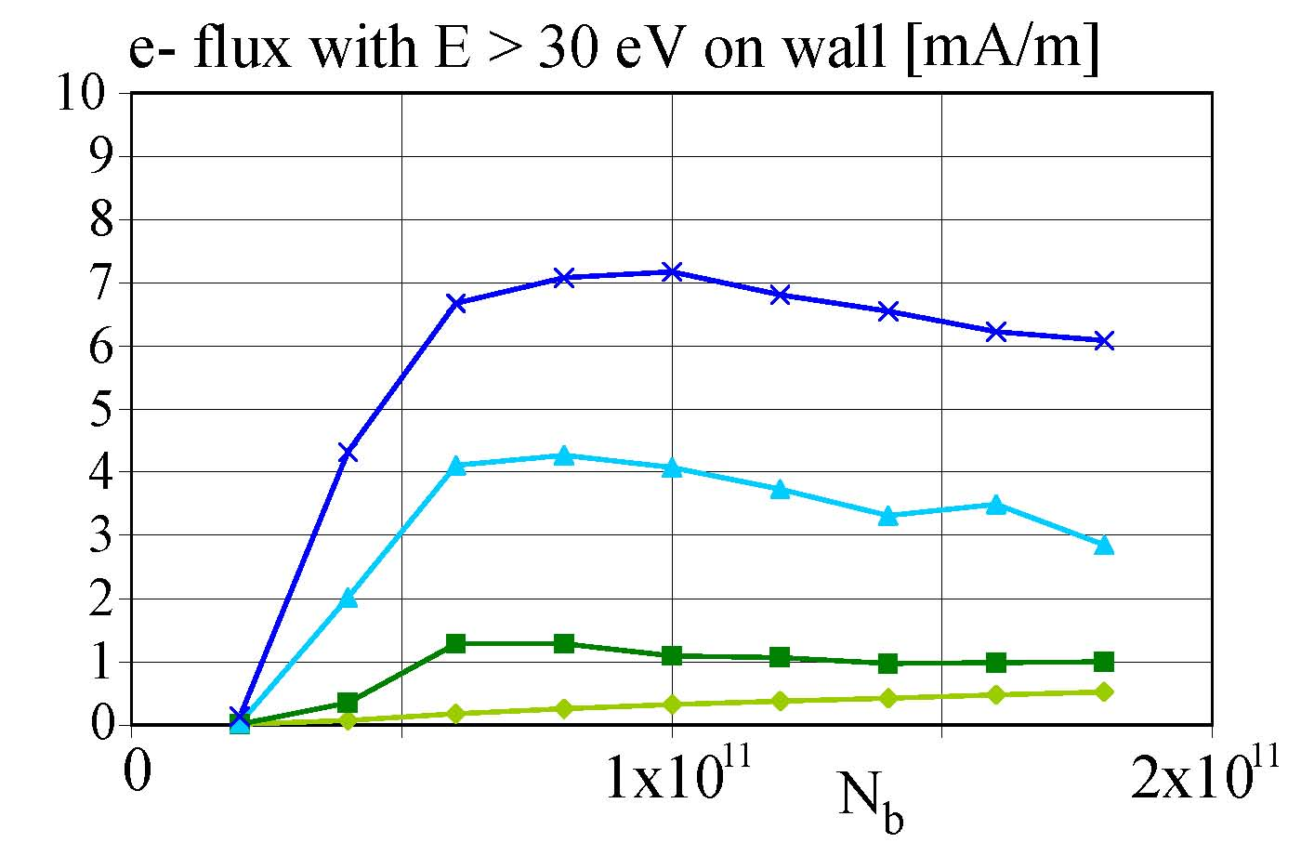
Presentation to LHC MAC 10 June 2005
LHC vacuum pressure with electron cloud
e- flux@wall vs. intensity, 25 ns spacing, ‘best’ model
δ_{max}=1.7
δ_{max}=1.5
δ_{max}=1.3
δ_{max}=1.1
R=0.5
calculation for 1 batch
17 hr running at 3 mA/m gives CO pressure corresponding to
100-hr beam lifetime (N. Hilleret, LHC MAC December 2004)

Slide 21
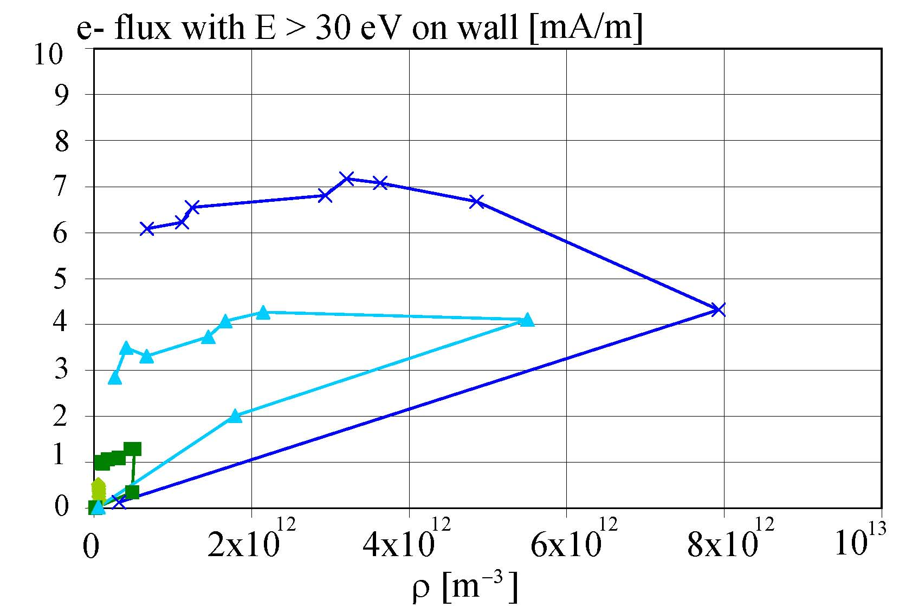
Presentation to LHC MAC 10 June 2005
stability limit
at injection
nominal filling pattern
top energy
δ_{max}=1.7
nominal N_{b}
δ_{max}=1.5
δ_{max}=1.3
δ_{max}=1.1
the challenge is to decrease δ_{max} to 1.3 with a stable beam

Slide 22
electron cloud in the LSS
electron-cloud simulations at 25-ns bunch spacing for the two-beam IR sections were performed by Giovanni Rumolo, Adriana Rossi and Frank Zimmermann in the period 1999-2002 to specify the acceptable maximum secondary emission yield in this region
nominal LHC beam & SEY values between 1.1 and 1.4 had been considered; see
F. Zimmermann: Electron-Cloud Simulations for the LHC Straight Sections, LHC Project Note 201, 1999;
Rossi, G. Rumolo, F. Zimmermann: A Simulation Study of the Electron Cloud in the Experimental Regions of LHC, Proceedings ECLOUD’02 workshop, Geneva, Yellow Report CERN-2002-001, pp. 123).
new simulations for much higher SEY are being launched

Slide 23
early preliminary LHC findings
at 50-ns spacing strong evidence for large electron
cloud build up in warm and cold sections
cold sections are of bigger concern
both heat load & instability in 3rd and 4th train
indicate SEY δ_{max}~2.5&R=0.5 or R~2.2&R=1.0
in the arcs
av. e-cloud density ~6x10¹¹ m⁻³ (from Q’ effect)
expected tune shift: ΔQ~r_{p}ρ_{e}Cβ/(2γ)~ 0.0025
new simulations for LSS and more simulations for
arcs are in progress
determine R from memory effect between trains

Slide 24
ongoing, planned & proposed studies

Slide 25
ECLOUD simulations (Humberto, Octavio)
SPS benchmark – ONGOING (Octavio)
simulations for 25, 50 and 75 ns; MBB, MBA and detectors, beam parameters (?)
consistency check with 2010 SPS data (question by M. Jimenez)
find δ,R,ε for SPS
LHC LSS at 150 ns – PLANNED (Humberto)
3 locations &fields at about 59 m from IP1 with both beams present
simulate passage of 17 bunches with known time separation
effect of solenoid ; + generic study: dependence on LSS aperture
memory effect in LSSs at 50 ns – PLANNED (Octavio?)
simulations for IR3 as a start, N_{b} scan
need memory data from other IRs; find δ,R,ε ; triplet heat load (L8)
other LSS simulations for different train patterns (scrubbing), common sections
simulations for arc – ONGOING (Humberto)
heat load, central density (instability), flux on wall (scrubbing); find δ,R,ε
dependence on beam size & bunch length

Slide 26
ECLOUD simulations (Humberto, Octavio)
multi-bunch wake field and CB instability rise times
including combined coupled/single-bunch effects
wake field from ECLOUD (see nice study by Daniel a few years back)
scrubbing scenario for 2011
simulations for 50 and 75 ns
determine stable regions in δ,R,ε space for different beams ; LSS solenoid effect
iterate with expected evolution of δ,R,ε as a function of flux
effect of satellite bunches – STARTED (Humberto)
scrubbing optimization for 2011
simulations for 50 and 75 ns to determine map coefficients
use map to optimize fill pattern and generalize map approach to find optimum scrubbing stages
help from Theo Demma and/or Ubaldo Iriso?
extended LHC forecast – PLANNED (Humberto)
simulations for larger values of δ

Slide 27
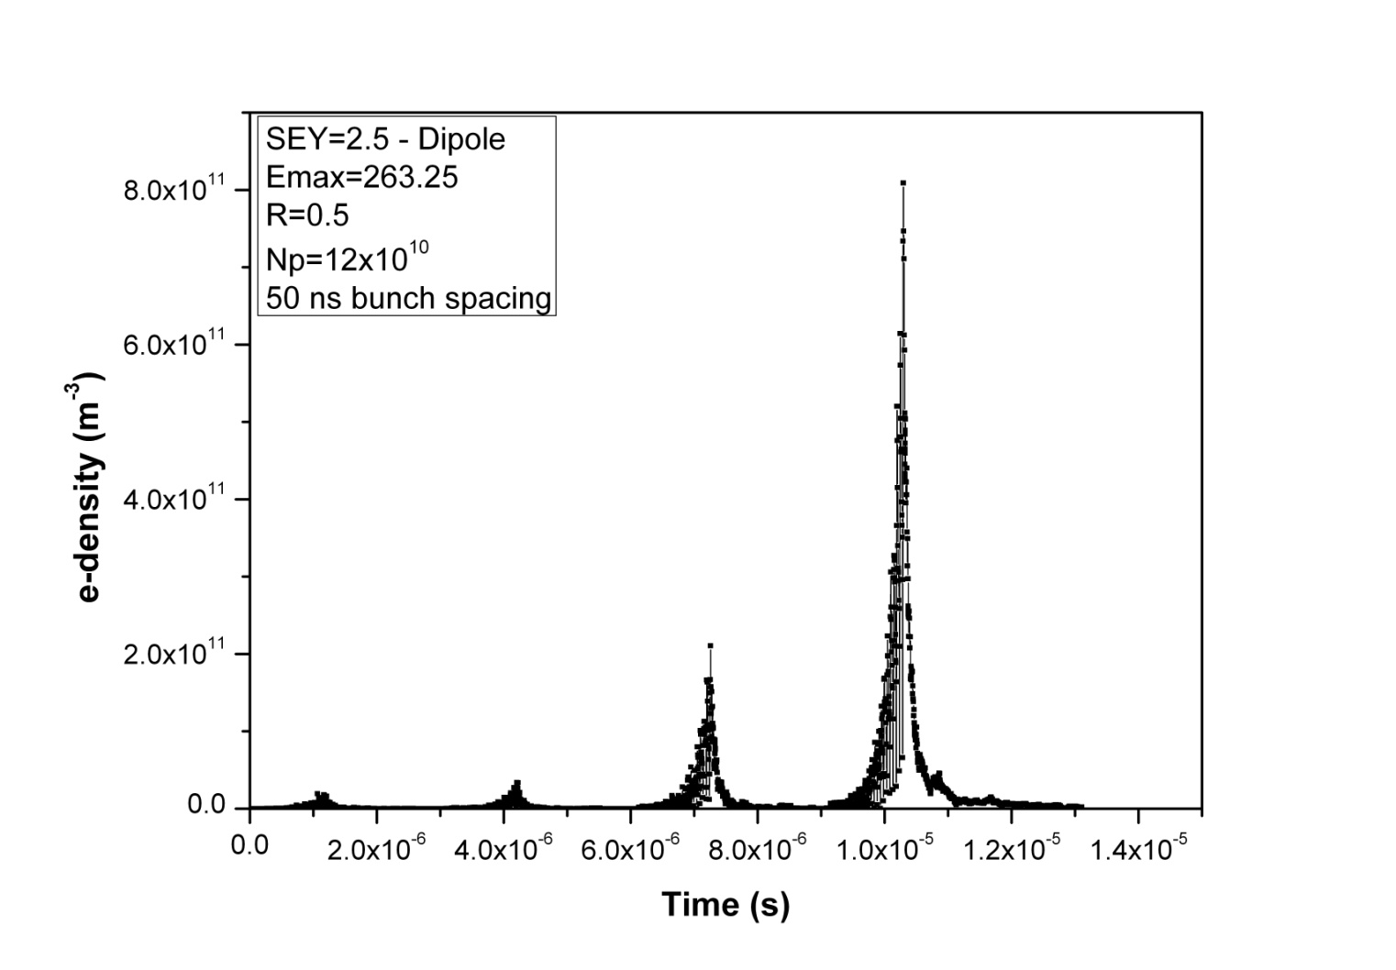
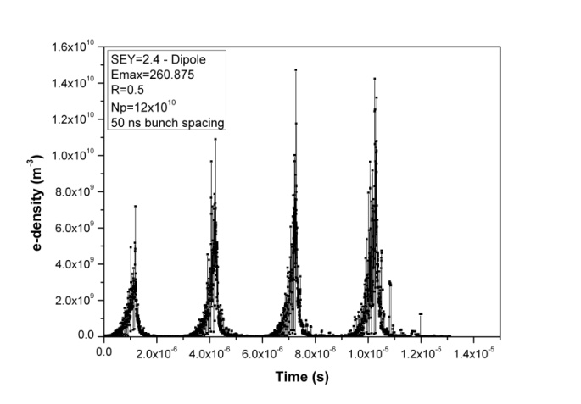
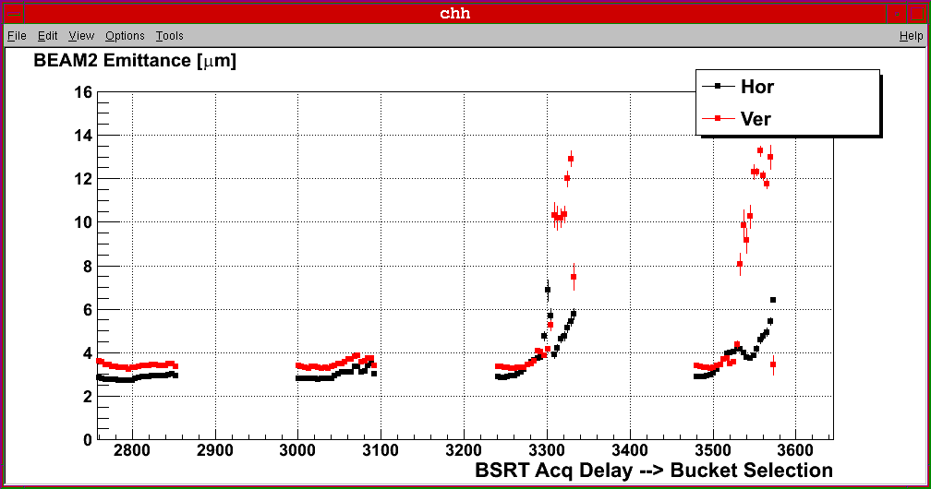
LHC at injection: 4x24 bunch pattern (+3x37 missing bunches)
8x10¹¹
m⁻³
for δ_{max}=2.4, R=0.5:
no multipacting
arc dipole
δ_{max}=2.5
R=0.5
1 nTorr
N_{b}=1.2x10¹¹
10¹⁰ m⁻³
~instability
threshold
arc dipole
δ_{max}=2.4
R=0.5
1 nTorr
N_{b}=1.2x10¹¹
central
cloud
density
with R=0.5,
multipacting
for δ_{max}≥2.5
emittance growth observation
F. Roncarolo
2/11/2010
Humberto

Slide 28
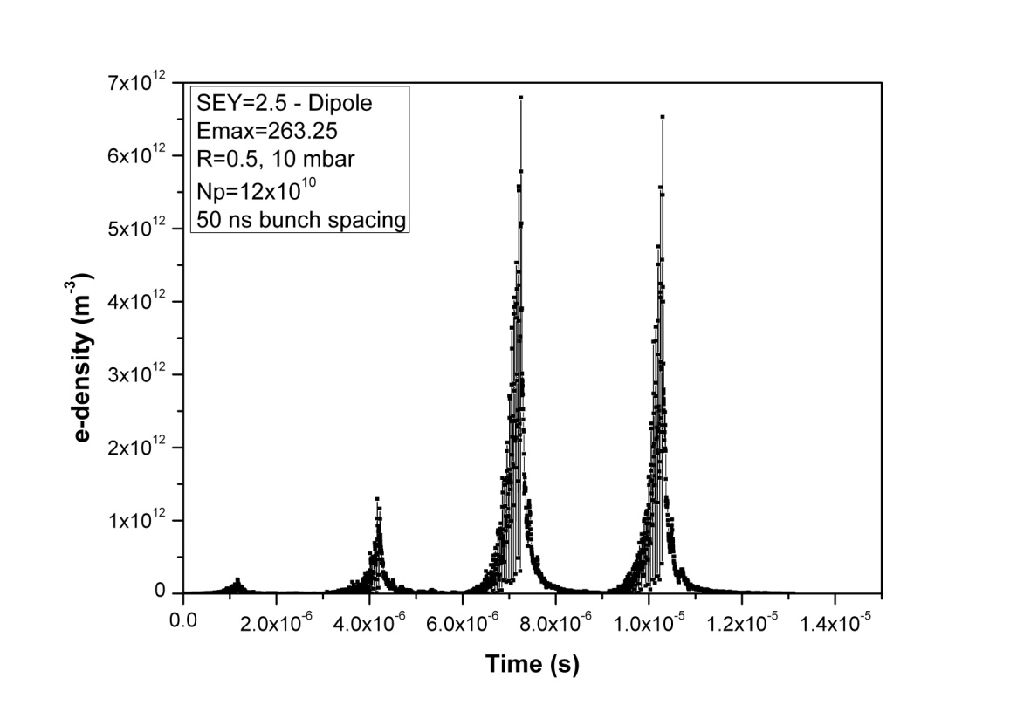
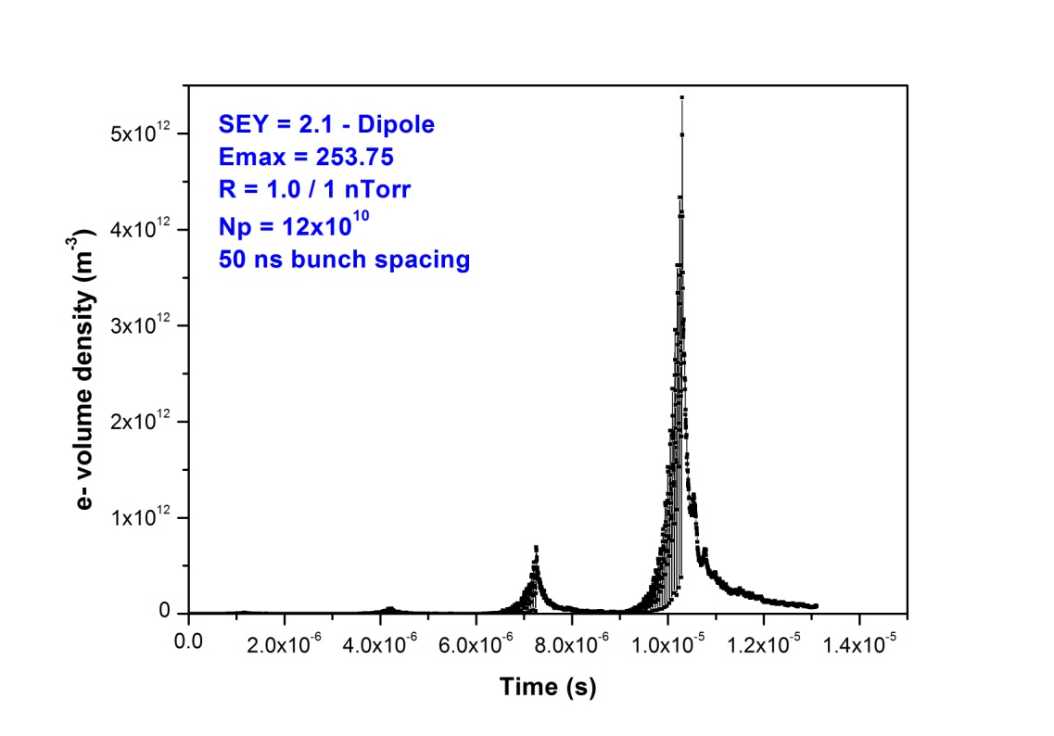
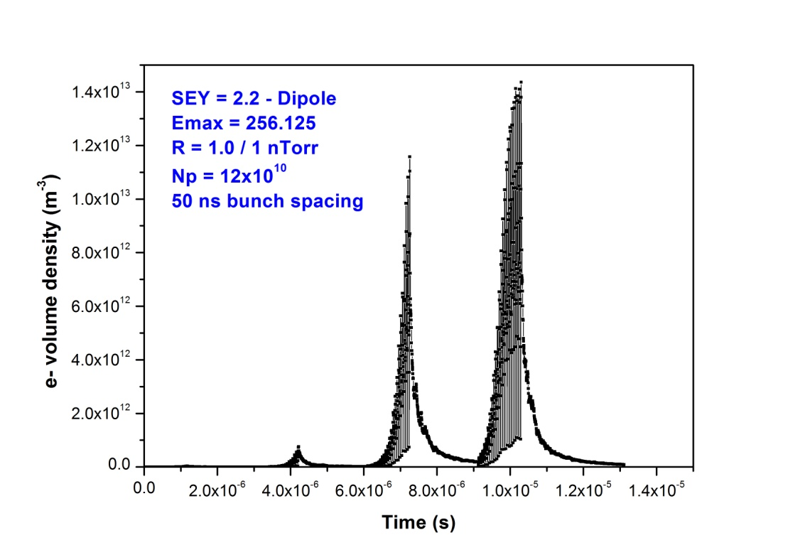
LHC at injection: 4x24 bunch pattern (+3x37 missing bunches)
central cloud density
8x10¹¹
m⁻³
7x10¹²
m⁻³
arc dipole
δ_{max}=2.5
R=0.5
1 nTorr
N_{b}=1.2x10¹¹
arc dipole
δ_{max}=2.5
R=0.5
10 nTorr
N_{b}=1.2x10¹¹
~instability
threshold
~instability
threshold
5x10¹²
m⁻³
arc dipole
δ_{max}=2.2
R=1.0
1 nTorr
N_{b}=1.2x10¹¹
arc dipole
δ_{max}=2.1
R=1.0
1 nTorr
N_{b}=1.2x10¹¹
1.0x10¹³
m⁻³
~instability
threshold
~instability
threshold
Humberto

Slide 29
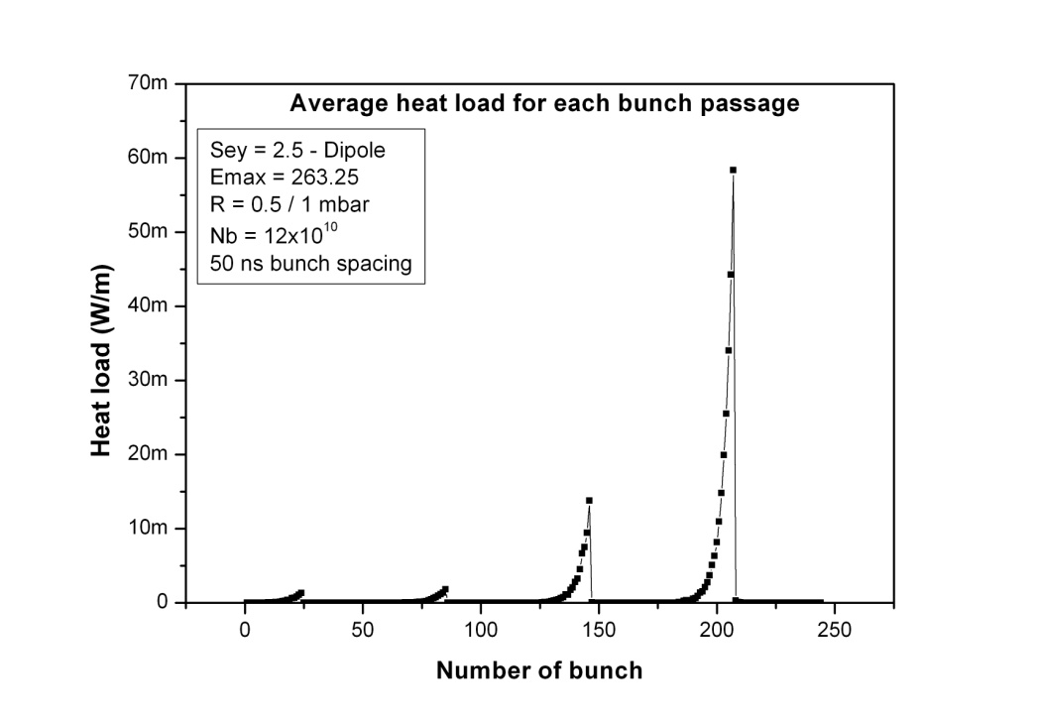
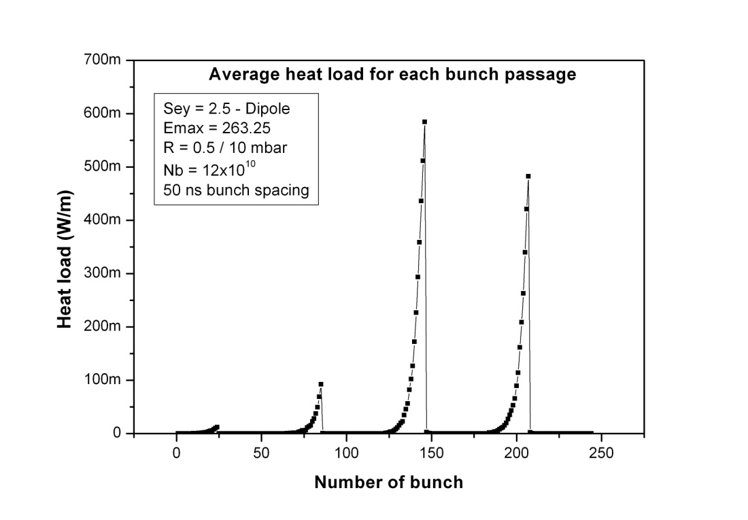
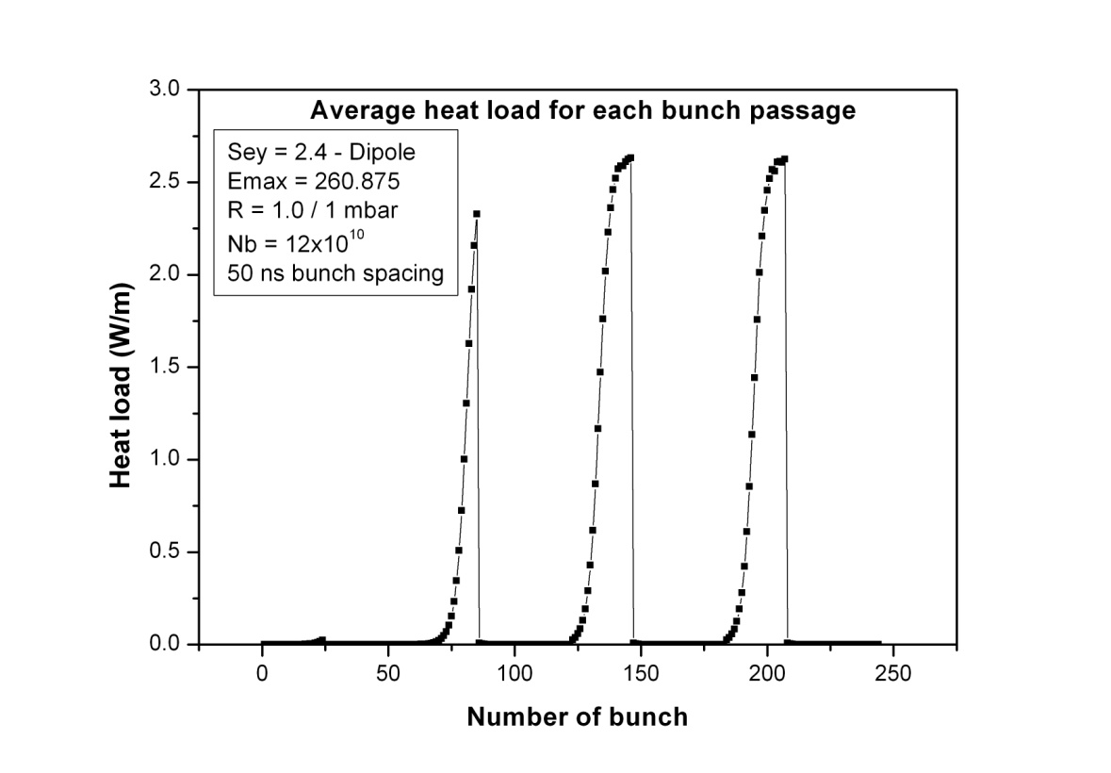
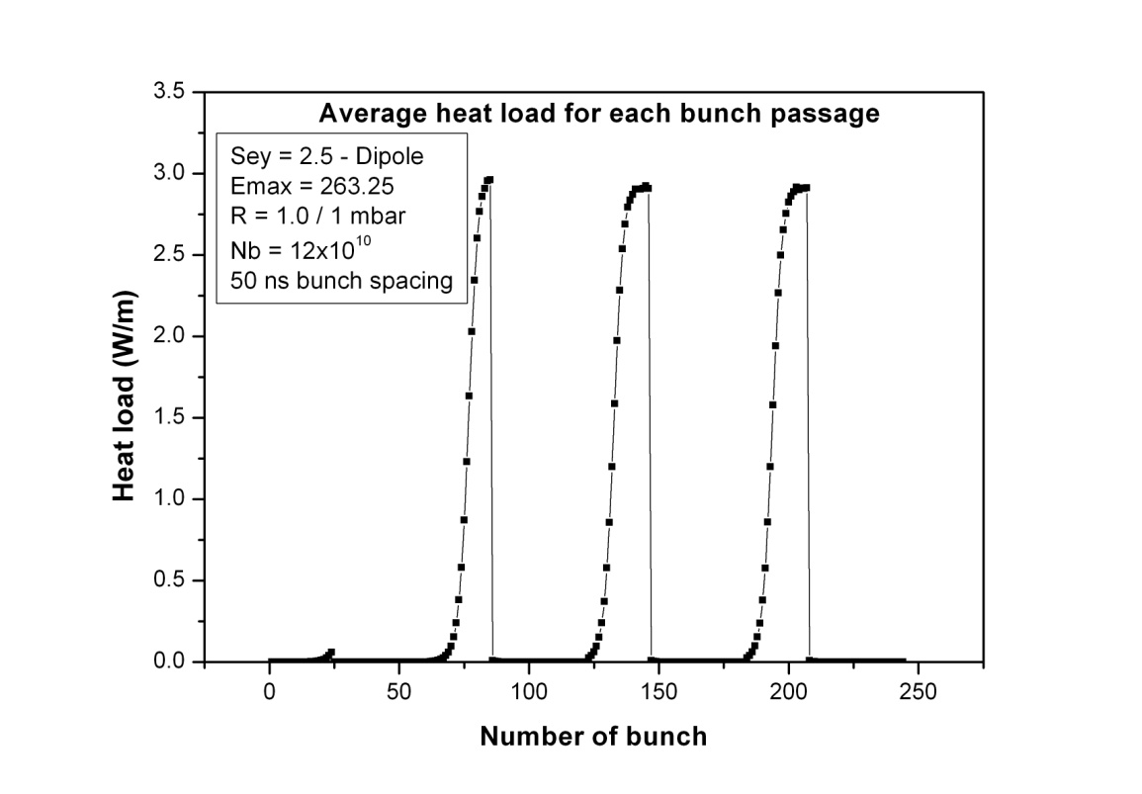
LHC at injection: 4x24 bunch pattern (+3x37 missing bunches)
heat load
70
mW/m
/bunch
700
mW/m
/bunch
arc dipole
δ_{max}=2.5
R=0.5
1 nTorr
N_{b}=1.2x10¹¹
arc dipole
δ_{max}=2.5
R=0.5
10 nTorr
N_{b}=1.2x10¹¹
3 W/m
/bunch
3.5 W/m
/bunch
arc dipole
δ_{max}=2.4
R=1.0
1 nTorr
N_{b}=1.2x10¹¹
arc dipole
δ_{max}=2.5
R=1.0
1 nTorr
N_{b}=1.2x10¹¹
Humberto

Slide 30
simulation results for 4x24 bunches [at injection]
(1.85 μs spacing between batches)
H. Maury Cuna
δ_{max} | N_{b} | P [nTorr] | R | dP/ds [mW/m] | total e- flux [μA/m] | e- flux > 30 eV [μA/m]
2.4 | 1.2x10¹¹ | 1 | 0.5 | 0.001 | 0.034 | 0.011
2.5 | 1.2x10¹¹ | 1 | 0.5 | 0.18 | 0.697 | 0.239
2.5 | 1.2x10¹¹ | 10 | 0.5 | 3.3 | 12.3 | 4.34
2.5 | 1.2x10¹¹ | 1 | 1.0 | 61 | 268 | 69.8
2.4 | 1.2x10¹¹ | 1 | 1.0 | 46 | 200 | 52.7
2.5 | 1.0x10¹¹ | 1 | 0.5 | 0.44 | 2.1 | 0.71
2.5 (top!) | 1.2x10¹¹ | 1 | 0.5 | 59 | 356 | 93.8
30 days continuous running at 70 μA/m gives CO pressure
corresponding to 100-hr beam lifetime (N. Hilleret, LHC MAC Dec.2004);
2 days continuous running at 70 μA/m gives 1 mC/mm² !

Slide 31
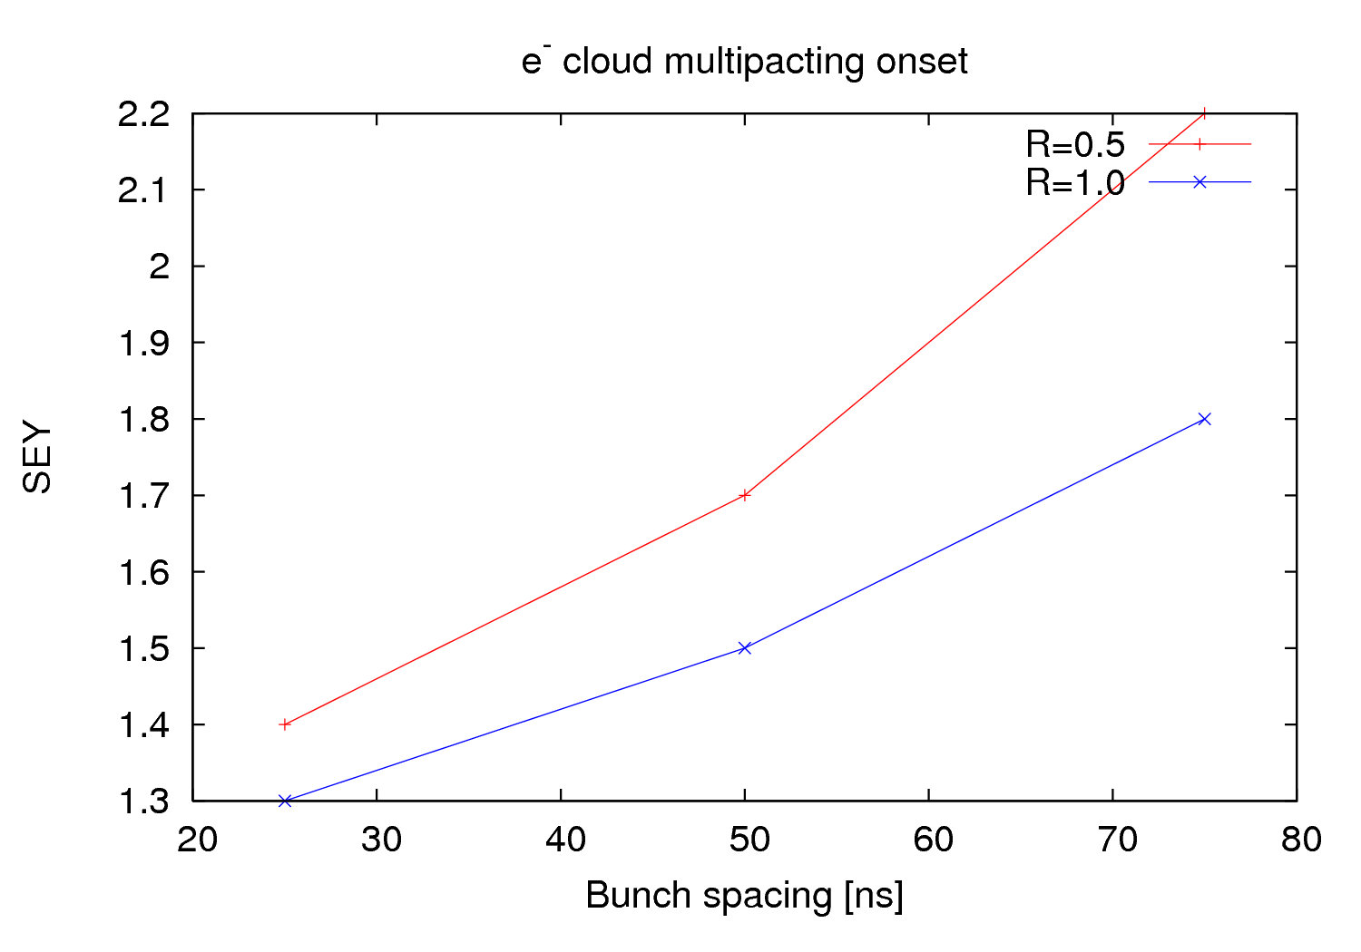
LHC, R=0.5 (Humberto)
Octavio
strip detector (~MBB)
LHC, R=1.0 (Humberto)
threshold much lower
than for LHC;
check MBA chamber

Slide 32
difference SPS - LHC? (chamber shape? chamber radius?)
bending field, 2.025 T
σ_{x}= 0.9 mm; σ_{y}= 0.4 mm; σ_{z}= 11.8 cm; ε_{max}= 230
Octavio
Bs [ns] | R | pipe shape | hx[m] | hy,hz [m] | pressure [nTorr] | onset
50 | 0.7 | Elliptical | 0.07 | 0.0243 | 9 | 1.7
50 | 0.7 | Elliptical | 0.07 | 0.04715 | 9 | 1.3
50 | 0.7 | Round | 0.07 | 0.07 | 9 | 1.5
50 | 0.7 | Elliptical | 0.04715 | 0.0243 | 9 | 1.7
50 | 0.7 | Round | 0.0243 | 0.0243 | 9 | 1.6
24.3 mm
70.0 mm
47.15 mm
24.3 mm
70.0 mm
47.15 mm

Slide 33
R
δ_{max}

Slide 34
HEADTAIL simulations (Tatiana, Kevin?, Giovanni? Elena? )
tune shift with stripes (question by Stephane Fartoukh)
include proper chamber boundaries with image current; analytical estimate?
see APAC’01 paper with Ohmi and Sam H., and Chamonix 2001 paper
single-bunch instability threshold and growth rates
simulations for 0.45, 3.5, and 7 TeV; parameters to be defined
e-cloud induced energy loss & phase shift
old studies by G. Rumolo & F.Z., USC group, A. Novokhatski
effect of transverse offset (question by Wolfgang Hofle)
include proper chamber boundaries with image current and reasonable electron reflection/secondary emission
start with SPS ; - some analytical estimate could also be developed
incoherent effects - collaboration with Giuliano Franchetti (?)
interplay with beam-beam
old (2002) study by Ohmi and Chao in ECLOUD02 proceedings

Slide 35
experiments
need to collect all relevant data (bunch length, emittance, aperture,…)
propose additional experiments

