Slide 1
Beam Commissioning WG , 10 August 2010
Luminosity Scans in the LHC
S. White

Slide 2
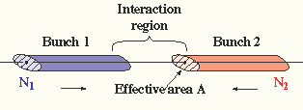
The Van Der Meer Method
Beam intensities and revolution frequency should be known with good accuracy. The effective overlap area can be determined by scans in separation.
Regardless of the beam density distribution:
Perfect Gauss :
Measuring the collision rates as a function of the separation provides a direct
measurement of the overlap area. Critical parameters: intensity, beam displacement.

Slide 3
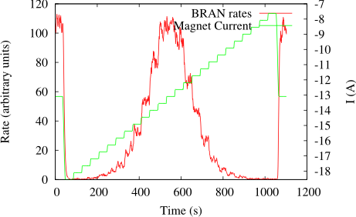
The Scans in Practice
Time history plot of a scan done at IP5.
Move the beams stepwise across each other and measure the collision rates as a function of the beam displacement. Repeat in both planes to compute the effective overlap area.
Rates: given by any luminosity monitor (LHC: BRAN, experiments)
Statistical accuracy: not an issue. Step length is a user input can be changed depending on
beam parameters
Beam displacement: done with closed orbit bump. Subject to non-closure due to optics
errors, hysteresis, etc
Beam intensity: requires bunch by bunch measurements (FBCTs). Collision pattern.
Other parameters like emittance should be stable in order to avoid additional errors.

Slide 4
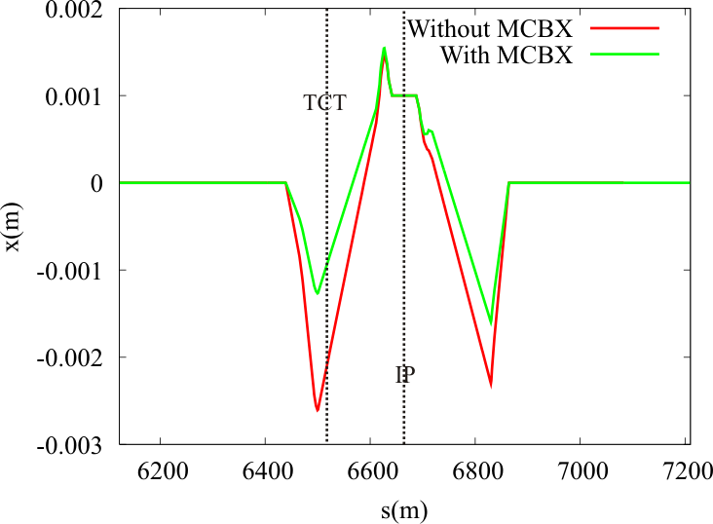
Orbit Bumps
Example of an IP bump with and without MCBX:
Displacing the beam at the IP creates a large offset in the TCT region.
Smaller if MCBX are used. Factor 2 between IP and TCT displacement otherwise.
Displacing the beam at the TCT can compromise the collimators hierarchy and the
triplet protection: trim amplitude has to remain within certain range.
IP orbit bumps should not be used for large corrections.
Limits on the trim amplitude should be enforced.
Always try to distribute the amplitude between beam 1 and beam 2.

Slide 5
Software
Developed for IR steering, luminosity optimization and calibration. Dedicated routines
for each purpose.
IR Steering:
Allows to trim angle and position at the IP.
No control on the trim amplitude.
Luminosity Calibration (VDM):
Large amplitude scans around the maximum. Measure beam profile.
Not optimized to find the peak as it assume we are close to the optimum.
No control on the trim amplitude.
Luminosity Optimization (Optimize):
Peak finder.
Enforces limits on the trim amplitude.
All the trims are sent via LSA: the three methods are equivalent, last two provide
optimum with a fit.
Only the method dedicated to optimization enforces limits on the trims.

Slide 6
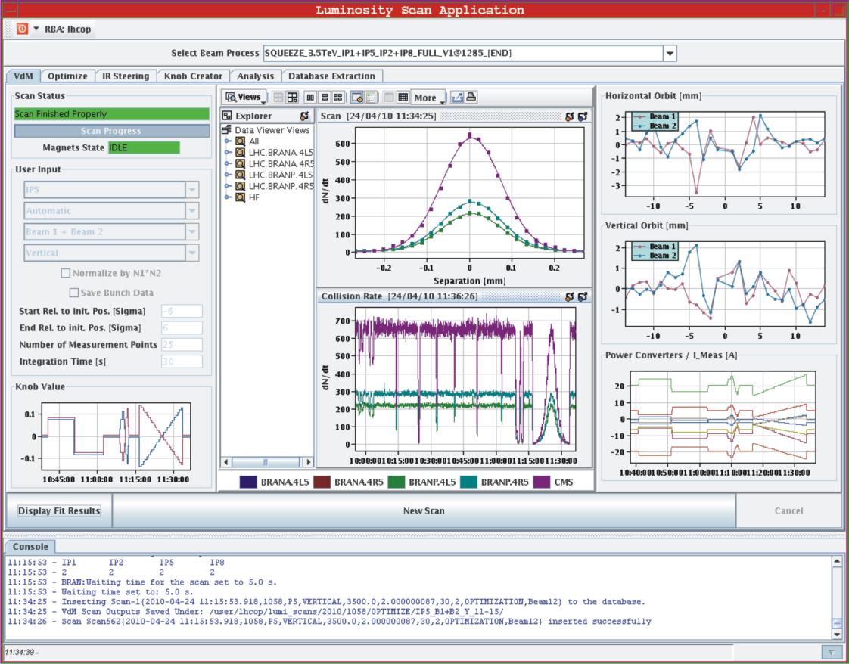
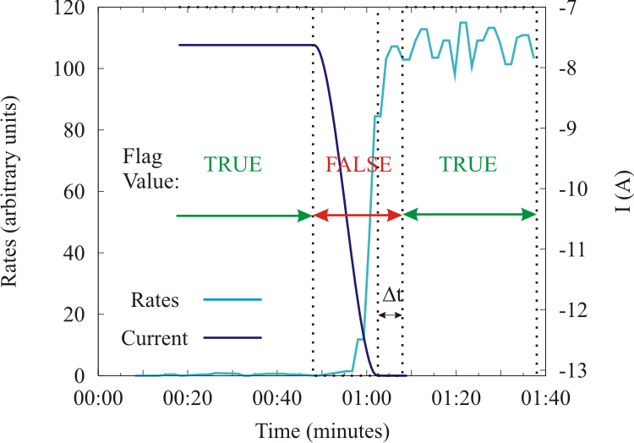
Calibration Panel
VDM Panel
Online analysis.
Automated calibration measurement.
Database access.
Only scan around the maximum. Not optimized to find the peak
Data exchange with experiments:
Publishes the scan status and progress
in real time.
Allow for experiments to perform
analysis.
Flag used as trigger by the experiments.

Slide 7
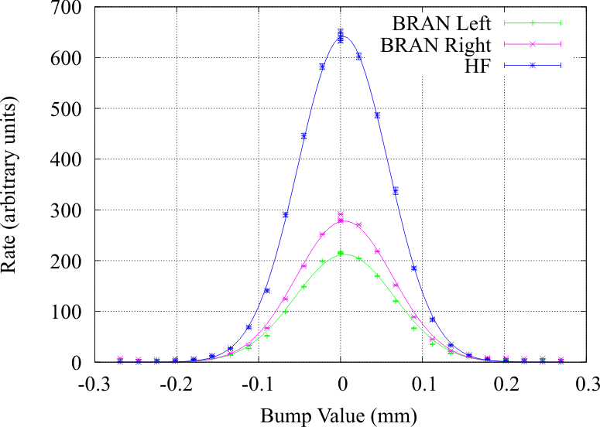
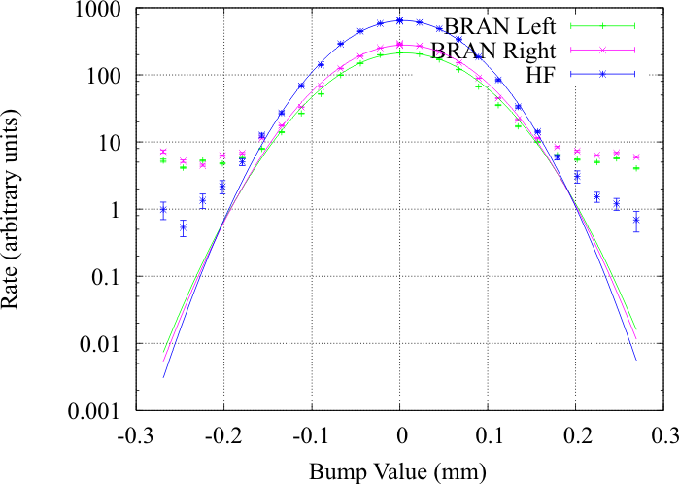
Calibration Scans
Van Der Meer scans performed in all IPs. Move both beams opposite directions to allow +/-6σ scan range (limits the offset at the TCT). Done with 2x2e10 p/bunch.
First scan performed in CMS. Excellent results for a first try.
Non-Gaussian tails observed, could be fitted with a double Gauss.
Still allows for analytical approach.
Statistical errors on the effective beam size proved to be negligible with respect
to other sources of systematics (<1%). Confirmed by excellent consistency from one
monitor to the other.

Slide 8
Systematics for Luminosity Calibration
The main sources of systematics were identified and qualified:
Hysteresis: checked with lab measurements + during the scans. Effect very small. Further reduced by scanning always in the same direction. Negligible.
Fit errors : determined by statistical accuracy: ~1%.
Emittance blow-up: Maximum blow-up 2% per plane over the scans: 2-3%.
Bump calibration: 1-2% per plane: 2%.
Intensity measurement: determined by experts 5% per beam: 10%.
Other effect such as coupling (round beams), beam-beam (low intensity) can be neglected with respect to these errors.
Adding all these errors in quadrature: ~11% overall error.
Clearly dominated by intensity measurements.
Possible improvements (besides intensity, work in progress by experts):
Scan faster / less points. If emittance blow-up still a problem.
Calibrate the bumps of beam 1 and beam 2 independently: error down to the vertex position resolution (less than 1%).
Scan at slightly higher intensity. Still small beam-beam, pile-up but increased precision on intensity and reduce time per step.

Slide 9
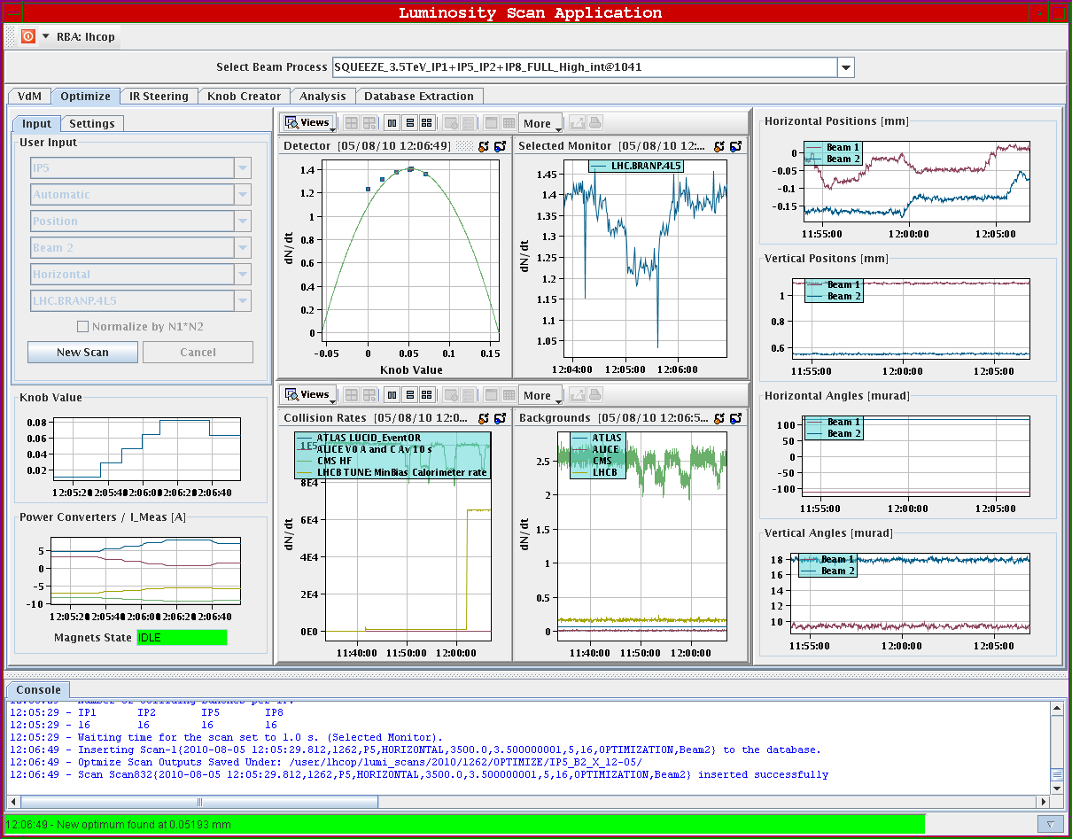
Optimize Panel
Optimize panel:
Automated IR steering / peak finder.
Select IP / beam / plane / detector.
User input: step size / time per step.
Defaults: 0.5σ / 5s.
Limit on the trim amplitude +/-2σ. Can be changed if really far off.
Optimum given by a parabola calculated on the last three points.
Allows for fast automatic optimization.
Tested last week at IP5. Beam 1, beam 2, beam 1 + beam 2. Behaves as expected.
Method is now operational.
Optimization few minutes minutes per IP.

Slide 10
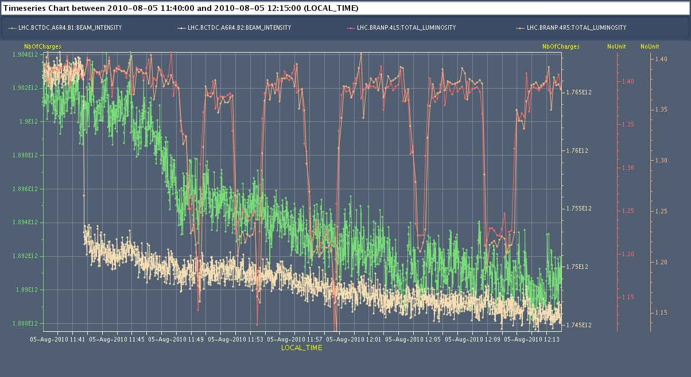
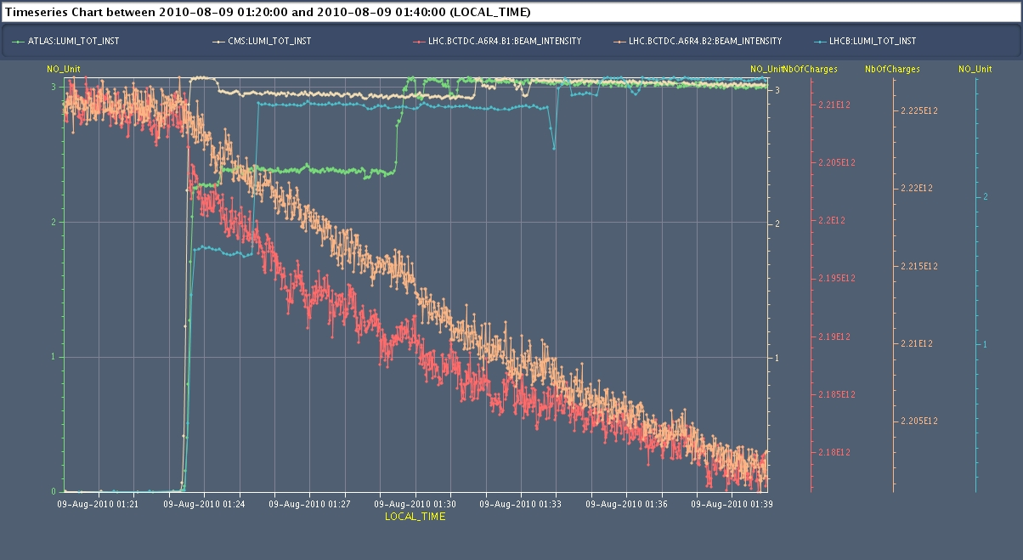
Tests and Fill 1268
First tests (end of fill):
Done for IP5.
Separate the beams and launch routine to re-align.
Small losses observed on B1 when separating beams the first time.
No losses afterwards.
Losses on B2: tune swap.
Fill 1268
Losses when bringing beams into collisions.
No losses during optimization.
Optimizing IP1+IP5+IP8:
~10 minutes.
No significant effects or losses with high intensity.

Slide 11
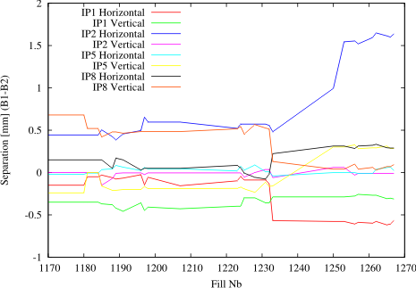
IP Orbit
Corrections applied B1-B2: information on orbit stability at the IP.
Corrections for 3.5 m optics:
Before 1232: good stability. Max 200 μm.
1232: Jump. (see Jorg’s talk last week).
After 1232: Excellent stability. Max 50 μm.
IP2 seems more difficult to control.
In general very good stability.
In some case very large changes.
For now set the limit in the software with respect to the previous value. Longer term set it with respect to reference orbit.

Slide 12
Summary
Luminosity Calibration:
First calibration in all IPs: 11% uncertainty. 10% from intensity.
All experiments asked for more scans at low and nominal intensity.
Luminosity Optimization:
New automated method tested and operational.
Enforces limits on the trims.
Few fills with high intensity showed not losses due to the scans.
Future Steps:
Need more experience: run like this for a couple of weeks.
Extend to parallel optimization. Full optimization few minutes.
Set limits with respect to the reference orbit.
IP2:
Colliding with an offset. Cannot apply automatic steering.
Set reference with head-on collisions:
Automatic optimization, control separation in both planes, easier to find collisions.

Slide 13
Backup Slides

Slide 14
Hysteresis During the Scans
For each plane scan in opposite directions (opposite hysteresis branch) to check for consistency and hysteresis: effect given by the shift of the distribution.
Done for ATLAS and CMS.
 | σ_{effx} (mm) | σ_{effy} (mm) | Mean x (mm) | Mean y (mm)
Scan 1 IP1 | 0.0589+/-0.0004 | 0.0622+/-0.001 | 0.007+/-0.0001 | 0.002+/-0.0001
Scan 2 IP1 | 0.0590+/-0.0005 | 0.0623+/-0.0009 | 0.006+/-0.0001 | 4e-5+/-0.0001
Diff. | -0.0001 | -0.0001 | 0.001 | 0.002
Scan 1 IP5 | 0.0553+/-0.0006 | 0.0596+/-0.0005 | -0.01+/-0.0001 | 0.003+/-0.0001
Scan 2 IP5 | 0.0554+/-0.0005 | 0.0602+/-0.0004 | -0.01+/-0.0001 | 0.002+/-0.0001
Diff. | -0.0001 | -0.0006 | 0.0003 | 0.001
Largest shift seen in ATLAS vertical ~0.002 mm: negligible effect on the rates.
Effective beam size measurement very consistent from one scan to the other.
Hysteresis effects can be considered negligible. 0.002 mm ~ 0.05σ → 0.1% loss in luminosity.
Results confirm simulation shown before.
Further reduced by scanning always on the same hysteresis branch (direction).

Slide 15
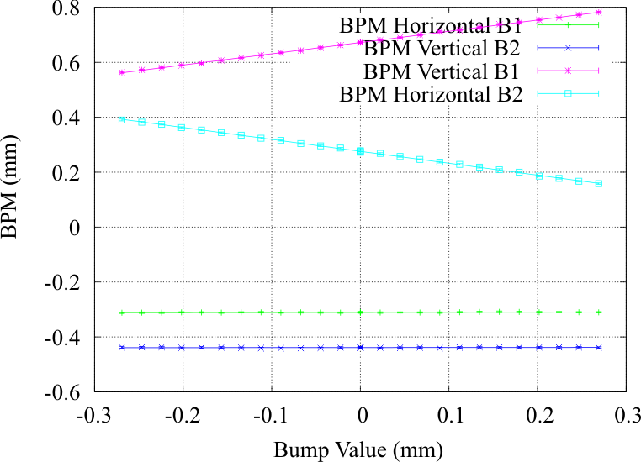
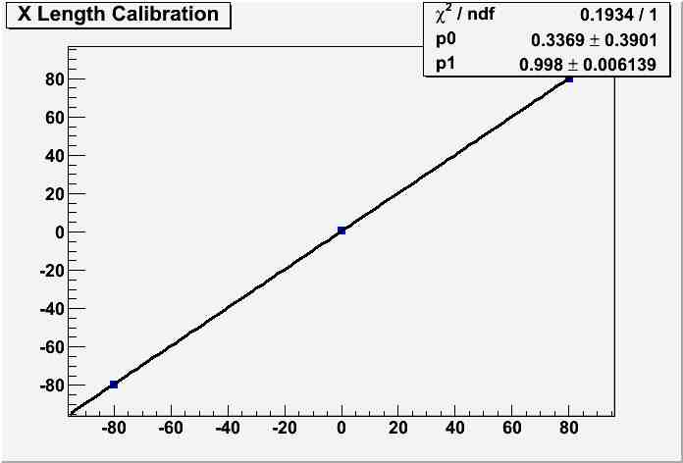
Bump Calibration and Linearity
Relative beam displacement essential for effective beam size measurement.
CMS
Method:
Displace the IP transversally by moving the two beams in the same direction. Compare value
given by magnet settings with luminous region position.
Agreement of less than 1% in CMS and ALICE. About 1-2% in ATLAS.
LHCb: scan with only one beam and compare with luminous region centroid displacement . Similar results.
In general, very good agreement which confirms the good status of the optics.
Bump very linear. No significant coupling observed. BPM scale disagree by 10%.

Slide 16
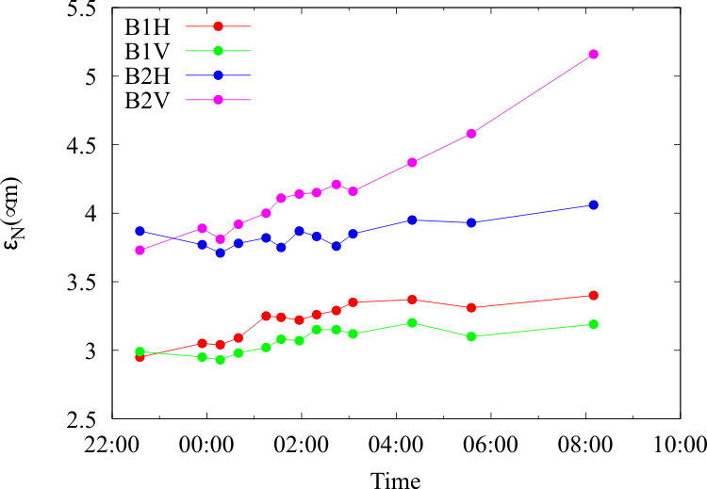
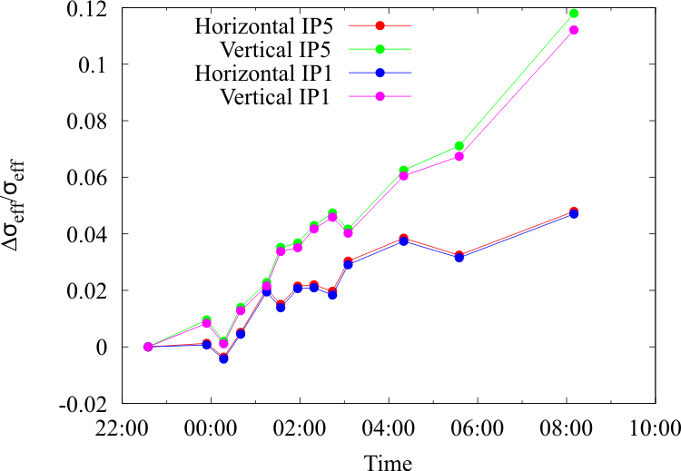
Emittance
Wire scanner emittance measurements during calibration scan session.
VDM
VDM
Emittance blow up during the scan (left) : the effective beam size (right) measured
during the scan is also affected.
The duration of a scan is about 20 minutes: the growth of the effective beam size during
one scan is ~1%. In the worst case: full calibration 1-2%.
Looking at the trend over the fill there could be a small blow-up due to the scan itself .To be
confirmed with higher intensity. Else wire scanner/hump?

Slide 17
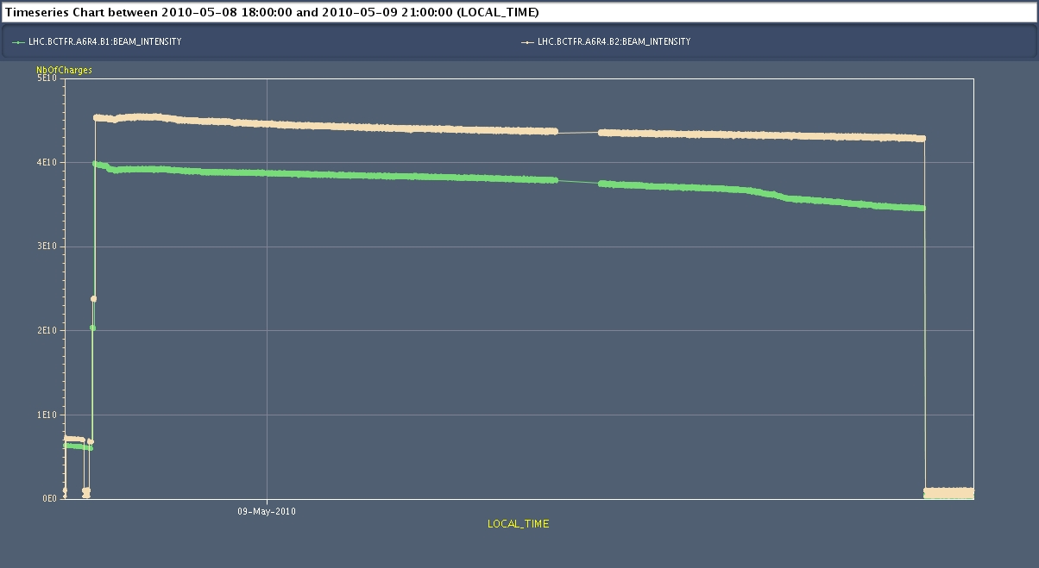
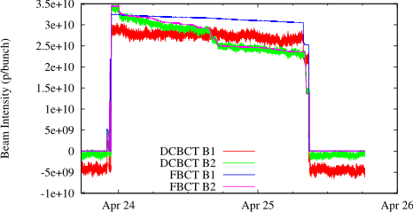
Intensity Measurements
Two systems available in LHC: FBCT (bunch by bunch) and DCCT (DC current).
Luminosity calibration requires bunch by bunch measurements.
Intensity over the fill 1089:
Intensity very stable, lifetime
of several hundred hours.
Scan ~20 minutes. Intensity
variations of the order of 0.1%
over the duration of the scan.
No corrections required from
intensity variations over the scans.
FBCT and DCCT measurements over a fill:
DCCT easier to calibrate.
Cross calibrate FBCT with DCCT.
DCCT: negative offset, noisy at low
Intensity.
Intensity systematics: includes DCCT+
other systematics (FBCT phase, drift…)
5% per beam, 10% for the product.

Slide 18
BRAN vs Experiments
Fit results comparison between BRANs and experiments:
Constant added to the fit parameters to get a reasonable Chi2. Effect larger in IP5.
Take only the best fit for each scan.
 | σ_{effx} (mm) | σ_{effy} (mm) | Mean x (mm) | Mean y (mm)
BRAN IP1 (1) | 0.0591+/-0.002 | 0.0624+/-0.0034 | 0.007+/-0.0001 | 0.002+/-0.0001
BRAN IP1 (2) | 0.0585+/-0.034 | 0.0618+/-0.0034 | 0.006+/-0.0001 | 4e-5+/-0.0001
ATLAS (1) | 0.0589+/-0.0004 | 0.0622+/-0.001 | 0.007+/-0.0001 | 0.002+/-0.0001
ATLAS (2) | 0.0590+/-0.0005 | 0.0623+/-0.0009 | 0.006+/-0.0001 | 4e-5+/-0.0001
BRAN IP5 (1) | 0.0548+/-0.0018 | 0.0596+/-0.0022 | -0.01+/-0.0001 | 0.003+/-0.0001
BRAN IP5 (2) | 0.0556+/-0.0018 | 0.0598+/-0.0022 | -0.01+/-0.0001 | 0.002+/-0.0001
CMS (1) | 0.0553+/-0.0006 | 0.0596+/-0.0005 | -0.01+/-0.0001 | 0.003+/-0.0001
CMS (2) | 0.0554+/-0.0005 | 0.0602+/-0.0004 | -0.01+/-0.0001 | 0.002+/-0.0001
Excellent agreement on the optimum : initial purpose of the BRANs.
Large error bars on the effective beam size. Still consistent with experiments data.
In general good agreement with experiment, large error bars due to background component
and lower efficiency.

Slide 19
Consistency Checks
Systematic emittance measurements were performed only for the ATLAS and CMS
scans. In addition, only ATLAS and CMS had measurements in different fills.
 | Horizontal B1 | Vertical B1 | Horizontal B2 | Vertical B2
IP1 β* (m) | 2.08+/-0.32 | 2.18+/-0.1 | 1.89+/-0.13 | 2.03+/-0.07
IP5 β* (m) | 2.18+/-0.22 | 1.83+/-0.39 | 1.85+/-0.15 | 2.02+/-0.15
Compare effective area from scan and optics/emittance measurements:
ATLAS : A_{eff} = 0.0230 +/- 0.0004 mm² / A_{eff} = 0.0245 +/- 0.005 mm²
CMS : A_{eff} = 0.0208 +/- 0.0002 mm² / A_{eff} = 0.0229 +/- 0.005 mm²
Optics/emittance seem to over-estimate effective beam size. Gain issues found with
wire scanner.
Fill to fill consistency (visible cross section):
ATLAS : 5%
CMS : 4%
Comparison with Monte-Carlo calibration (preliminary):
ALICE: fact = 1.05
ATLAS: fact = 1.13
CMS: fact = 1.007
LHCb: fact = 1.1

