Slide 1
CST simulations of the impedance of a new design for the PS wire scanners
F. Caspers, A. Grudiev, E. Métral, B. Salvant
Many thanks to W. Andreazza, R. Calaga and F. Roncarolo (BI)

Slide 2
Agenda
Context
Main assumptions
Simulation of the wire scanner tank alone
Simulations of the wire scanner with the wire and arm (parking position IN)
Simulations of the wire scanner with the wire and arm (parking position OUT)
Summary

Slide 3
Context
4 wire scanners are installed in the PS
Beam losses due to small aperture of current wire scanner tank design
→ New design for wire scanner in the PS
→ See EDMS document 999629
Request for building the new tanks, but impedance had not been checked.
History of broken wires in the SPS due to beam induced losses "Cavity Mode Related Wire Breaking of the SPS Wire Scanners and Loss Measurements of Wire Materials" F. Caspers, B. Dehning, E. Jensen, J. Koopman, J.F. Malo, F. Roncarolo - Proc DIPAC 2003 (pdf) "Wire Measurements on the LHC wire scanner" F. Caspers, T. Kroyer, ABP/RLC meeting (pdf)
2 main risks to this new design → increased impedance (longitudinal and/or transverse) can lead to instabilities
→ increased longitudinal impedance can lead to burning the wire

Slide 4
What can we do to check the impedance?
Theory
Simulations
Measurements
Here we use simulations (CST)
Time domain → simulates the EM interaction of a line density bunch with a 3D model
→ CST Particle Studio Wakefield Solver
Frequency domain → simulates the modes that can be excited in a 3D model
→ CST Microwave Studio Eigenmode Solver

Slide 5
Main assumptions
Geometrical model
Hexahedral mesh approximates the structure
Model can be different from drawing
Drawing can be different from what is really installed!!!!
Material properties
In time domain, very coarse fit of the input frequency dependence (see work of Carlo and Lukas Haenichen of TU Darmstadt)
EM properties of materials at high frequencies are not always measured and can be very different from the model used in CST (very often, they are not part of the specs!!! Also, effect of mechanical and RF damage over time, anisotropies, inhomogeneities, etc.) → See work of Tatiana, Carlo and phase 2 collimation for instance
Specific issues of modeling a thin wire (see work of Tom Kroyer CERN-AB-Note-2008-018 )
Interaction with the bunch (Particle Studio)
→ single pass of a line current density (see work of Carlo and Prof. Vaccaro)
→ limited wakelength → limitated to low Q values
→ in MWS, perturbation method, well suited to high Q values and no thick dispersive materials

Slide 6
Agenda
Context
Main assumptions
Simulation of the wire scanner tank alone
Simulations of the wire scanner with the wire and arm (parking position IN)
Simulations of the wire scanner with the wire and arm (parking position OUT)
Summary

Slide 7
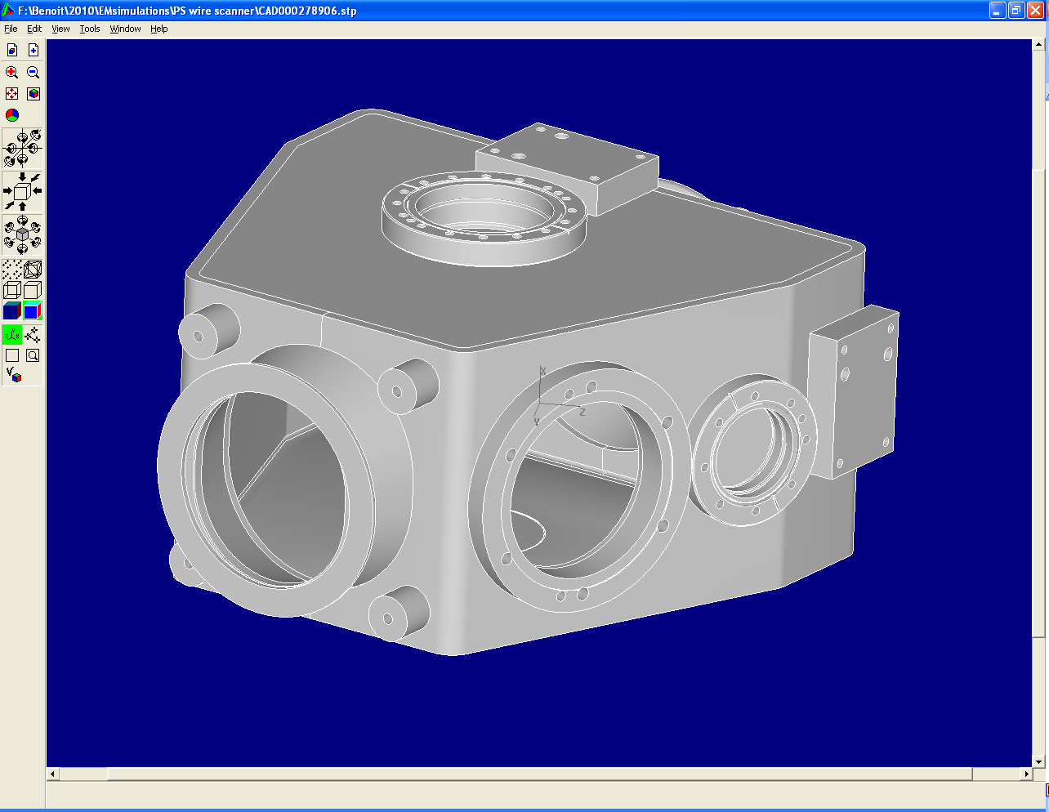
1. Wire scanner tank alone
STP model exported from CATIA
CST model after import and processing
Reasons for changing the tank: - improve aperture
- enhance measurement accuracy

Slide 8
Note: import a model from CATIA
Method currently used:
Ask the model owner to export it in *.STP format
Open the *.STP file in HFSS (and check the structure…)
Export in *.SAT format
Import the *.SAT in CST
Suppress unnecessary parts and use the CST healing functions
Fill the simulation space with vacuum and use the separate shape function on the resulting solid to keep the vacuum inside the element and suppress the vacuum around it.
Current issues:
CERN does not have a direct import license for CATIA or STEP files, hence the need to go through HFSS
CATIA models are only accessible through SMARTEAM, a shared environment (2-week-training course required)
Resulting models in CST sometimes present serious issues, and obtaining a consistent model is not always trivial

Slide 9
Longitudinal wake from CST Particle Studio beta =1, sigma = 2 cm, 2 M mesh cells, wake of ~20 m, indirect testbeams wake integration
1.18 GHz
1.45 GHz
0.95 GHz
1.12 GHz
0.9 GHz
0.8 GHz

Slide 10
Eigenmodes of the tank
Mode ID | frequency (GHz) | Q | Rs (x,y=0) | Rs/Q | P_{loss} in W
3 | 0.79 | 5890 | 30 kΩ | 5 Ω | 3 10⁻⁷
6 | 0.90 | 4730 | 24 kΩ | 5 Ω | 2 10⁻¹⁰
8 | 0.94 | 6030 | 103 kΩ | 17 Ω | 4 10⁻¹¹
12 | 1.11 | 4930 | 92 kΩ | 2.8 Ω | 3 10⁻¹⁷
15 | 1.17 | 6730 | 116 kΩ | 17 Ω | 3 10⁻¹⁹
Very small !!!
Remarks: Q is obtained with the formula
with W= total stored energy
and P=dissipated power
(W=1J in eigenmode)
(linac convention)
Perturbation method id used to obtain the Q and R for stainless steel.

Slide 11
Power losses calculations
If we assume the mode frequency overlaps with one of the beam harmonics (conservative approach)
With the parameters of the LHC nominal beam at ejection of the PS
nominal bunch charge after splitting q = 18.4 nC (1.15 e11 p/b)
bunch spacing = 25 ns (worst case scenario)
smallest nominal RMS bunch length = 30 cm
R_{s} is the shunt impedance (linac convention)
σ_{z} is the rms bunch length in m

Slide 12
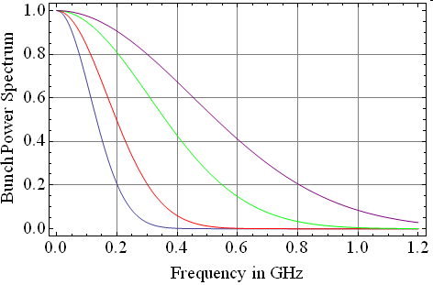
Why is the dissipated power so small?
Bunch power spectrum for LHC type bunches of various lengths
σ = 30 cm (PS ejection nominal)
σ = 20 cm (PS ejection smaller emittance)
σ = 11 cm (LHC injection)
σ = 7.5 cm (LHC ejection)
Peaks higher than 0.5 GHz are washed out by the large bunch length in the PS
With LHC bunches with small longitudinal emittance, bunch length is around 20 cm,
and dissipated power for mode 1 becomes 0.3 W.

Slide 13
Agenda
Context
Main assumptions
Simulation of the wire scanner tank alone
Simulations of the wire scanner with the wire and arm (parking position IN)
Simulations of the wire scanner with the wire and arm (parking position OUT)
Summary

Slide 14
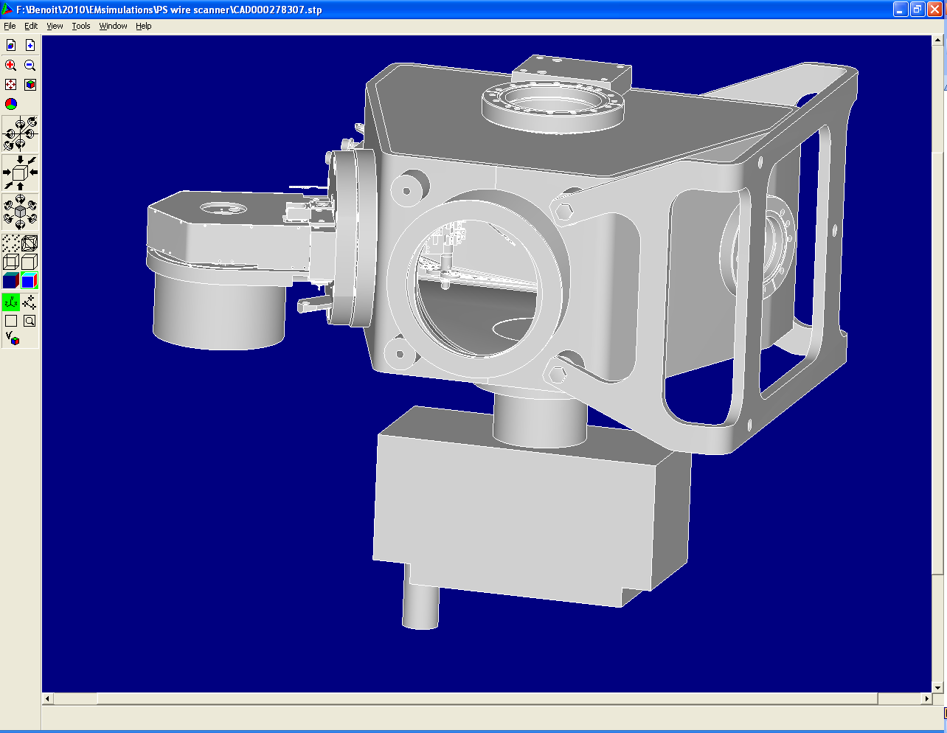
2. Wire scanner tank with wire and mechanical system
CST model after import and processing
STP model exported from CATIA
Wire at parking position (OUT)
CST model after import and simplification
fork
Mechanical system
Ion pump
Wire after scan (IN)

Slide 15
Tank with wire (IN position) Longitudinal impedance beta =1, sigma = 3 cm, 2 M mesh cells, wake of ~20 m
Fork and casing in stainless steel, wire as PEC wire
Additional simulation with Eigenmode solver
(152,000 mesh cells) f₀ =292 MHz
R_{s}= 43 kΩ
Q= 1200
→ total power loss in the structure P=800 W for this mode

Slide 16
Is this new mode an issue?
→ Compare with the losses of the old design
Fork and casing in stainless steel
Additional simulation with Eigenmode solver
(156,000 mesh cells) f₀ = 292 MHz
R_{s}= 8.7 kΩ
Q= 730
→ total power loss in the structure P=160 W for that mode (new design → 800 W)

Slide 17
Surface currents (freq domain)
Old design
New design

Slide 18
Voltage in the wire (1st try…)
Old design
New design
Charge of the bunch = 1 nC
Rms bunch length: 20 cm
R=1.43 Ohm → P = V²/R = (0.004*18.4)²/1.43 = 4 mW peak in the wire
→ this method should be crosschecked with the SPS case for which wires actually broke

Slide 19
Can we damp this mode?

Slide 20
Trying to damp this 300 MHz mode
Putting some dispersive materials in the structure helps reducing losses due to HOM:
Fritz:
1) Losses are proportional to R_{s} → “ P = R_{s} I² ”
2) R_{s}/Q is constant whatever the material
3) Both R_{s} and Q decrease if we create losses in dispersive materials
4) “ P = R_{s}/Q *Q I² ”
→ create EM losses with dispersive materials
→ lower Q for that mode
→ fewer losses!
However, of course more losses at low frequencies are expected, and we should be careful with the transverse impedance

Slide 21
First try to damp that modes with available blocks of ferrite
William says the only possible spots for ferrites are on the top and bottom
They already have 4S60 ferrite plates and they would like to use them if possible.
Possible positions

Slide 22
Where do we put the ferrite plate
Proposed position for the ferrite

Slide 23
Longitudinal impedance (real)
Time domain wakefield solver
Rms bunch length 20 cm
All materials ss304L except wire
Ferrite 4S60
→ Nice damping!
→ frequency shifts down

Slide 24
Mode properties
 | Simulation type | f0 | Rs | Q | Ploss
No ferrite | eigenmode | 292 MHz | 43 kΩ | 1200 | 800 W
With ferrite | wakefield | 270 MHz | 0.26 kΩ | 21 | 8 W

Slide 25
Longitudinal impedance (imaginary)
Not too much additional low frequency longitudinal impedance
→ maybe not expected
→ to be checked
Im(Z/n) = 0.07 to 0.08 Ω

Slide 26
Horizontal “dipolar” impedance (LF)
No symmetry…
We displace the beam by 10 mm towards the engine and look for the slope of the horizontal impedance (first approximation)
Imaginary LF horizontal “dipolar” impedance =(20-8)/0.01= 1.2 kΩ/m

Slide 27
Vertical dipolar impedance (LF)
There is a symmetry in the vertical plane
Imaginary LF vertical dipolar impedance =13/0.01= 1.3 kΩ/m

Slide 28
Agenda
Context
Main assumptions
Simulation of the wire scanner tank alone
Simulations of the wire scanner with the wire and arm (parking position IN)
Simulations of the wire scanner with the wire and arm (parking position OUT)
Summary

Slide 29
Tank with wire (OUT position)
No other harmful mode detected
Longitudinal: Z/n=0.04 Ohm
horizontal: 0.9 kOhm/m
Vertical: 0.5 kOhm/m
Mode due to the wire and fork
Wire position |  | Simulation type | f0 | Rs | Q | Ploss
OUT | No ferrite | eigenmode | 264 MHz | 2.6 kΩ | 853 | 89 W
OUT | With ferrite | wakefield | 256 MHz | 0.06 kΩ | 30 | 2 W
IN | No ferrite | eigenmode | 292 MHz | 43 kΩ | 1200 | 800 W
IN | With ferrite | wakefield | 270 MHz | 0.26 kΩ | 21 | 8 W

Slide 30
Summary
Need to check the new wire scanner design for the PS
From these simulations, new design seems to create more longitudinal impedance and more losses.
From the figures obtained, this increase does not appear huge
What should we do?
→ recommendation for short term:
build like this and be ready to install ferrites if needed.
→ recommendation for longer term:
Compare these figures with simulation of the SPS wire that broke. Perform wire measurements when the tank is built.
optimise the position, shape and material of the ferrites

Slide 31
Thank you for your attention

Slide 32
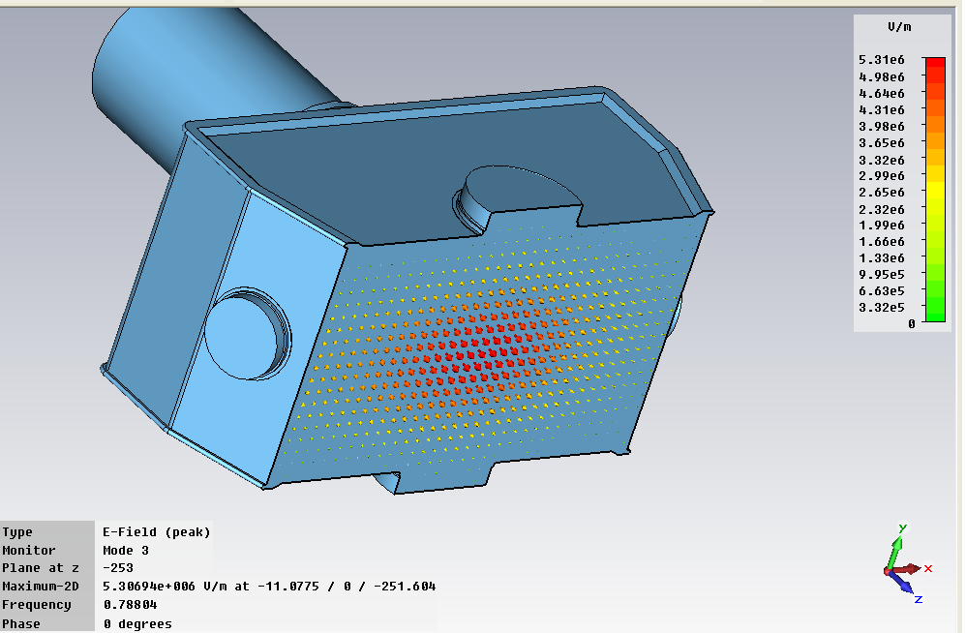
Mode 3
H field
E field

Slide 33
Mode 6

Slide 34
Longitudinal impedance

Slide 35
Horizontal dipolar impedance at low frequency
LF simulation parameters:
40,000 mesh cells
Rms bunch length=20cm

Slide 36
E_{z} Field patterns of this mode

Slide 37
|H| field pattern of this mode

