Slide 1
Status of ZBASE
10 November 2010
Jean-Luc Nougaret, with special thanks to Chris Roderick, Benoit Salvant, Nicolas Mounet and Elias Metral.
Notes:
I am going to present the database schema for ZBASE, the impedance database.

Slide 2
Outline
Introduction
Database schema
Populating the database
Java application
Conclusion and future work
Notes:
My talk is structured as follows:
First I will introduce the subject
In the core part of my presentation, I will present the conceptual model and schema of the database.
Then I will describe the issues we will be facing for populating the database.
Finally I will tell a few words about the Java application for which a first prototype has been created.
And then I will conclude.

Slide 3
Introduction
Motivation, data storage requirements and architecture.
Notes:
Let’s start with the introduction.

Slide 4
Motivations
Keep track of the impedance of the machines
  To understand high-intensity limitations of the machine.
  To predict the effect of modifications.
Previous implementations with a GUI
  ZBASE (1996), ZBASE3 (2006) now replaced by a Matlab program.
Organizing the data with standard relational database
  Rely on a self-describing data system.
  Insulate program from data.
  Manage data with SQL.
  Provide data backup, recovery, transactions and JDBC...
Notes:
The impedance database was meant to keep track of the impedance of the machines.
There has been two successive implementations in 96 and 2006, but they are no longer used as they have been replaced by a Matlab program without a GUI.
But we’ve kind of reached the limit of what can be achieved to handle a database with the means of flat files.
Hence there is motivation to rely on a full-fledge relational database.
The first reason why we propose to rely on a relational database is that the system is self-describing in terms of what the data consist of and how they relate to each other.
This insulates the program from the data. By contrast relying on flat files mean that the program must know how to parse the files to extract information.
By relying on a relational database, we can use SQL, which stands for Sequential Query Language. This helps managing the data efficiently from a high-level language.
This provides many advantages in terms of robustness.
Last but not least, we can use the Java Database Connectivity interface, also known as JDBC, to provide a layer to access the database from Java.

Slide 5
Data storage requirements
Store wake fields and impedances.
Store elements and their beta functions.
Store lists of elements on which to perform a sum.
Store machines, beams and OP_MODES.
Store ancillary data such as authors, methods, tunes …
Derived data are not stored.
Notes:
The database must store complementary pieces of data. First of all, it must store wake fields obtained by CST Studio simulations. It must also store impedances which can either be obtained from a Fourier transform, or from applying theoretical models.
On the second hand, the database must store the elements as well as their beta functions.
One key purpose of ZBASE is to allow summing wake fields across a machine, or across a list of elements. Such lists must be stored in the database as well.
Additionally, the database must store a variety of ancillary data, mostly the OP_MODES, which is the list of operational modes a machine can run.
Ideally derived data such as sum results for head tail should be considered to be transient and they should not be stored in the database.

Slide 6

Architecture
User
Store, retrieve
and process
impedance data
Database schema
Java application
Provides pedestal
Structures
SQL
Client
data
Server
Oracle database
Stored procedure
Notes:
ZBase is a Java application…
For a user to store, retrieve and process impedance data.
The Java application runs on the client computer.
The database itself lives on a dedicated Oracle server.
The Java application issues queries in SQL. The server retrieves data from the database and sends them through IPC.
The schema is a model that structures the data stored in the Oracle database…
And which serves as a foundation to build the Java application. In a database application, the schema is therefore of paramount importance.
In addition stored procedures can be invoked on the server-side.

Slide 7
Database schema
From the conceptual model to the database schema…
Notes:
The core part of my presentation will now focus on the database schema.

Slide 8
Assumptions
Element name is unique across accelerators.
Element family name is unique across accelerators.
Wake fields and impedance data belong to a given family of elements.
Data are versioned with one PROD version and several user-defined TEST versions.
Wake fields and impedance data are stored per family, per year, per version, per machine, and per OP_MODE of the machine.
Sums per machine, year, OP_MODE, for selected elements and versions.
Elements are populated from the layout database for a given year.
Optic functions and parameters are populated by loading Twiss MAD files for a given year, machine and OP_MODE.
Tunes, γ and γ_{tr} are stored per year, per machine and per OP_MODE.
Elements built from cells store the compound wake field per family.
Notes:
When designing the database schema, we made several assumptions which are listed here.
I won’t go into the details at this stage because we are going to address the main points later on in the presentation.

Slide 9
Conceptual model
Category
Name: string
In addition to the version, wake fields, impedances and optic functions are stored per machine, year, and OP_MODE.
*
*
*
Family
Name: string
Wakefield
Version
Impedance
Version
*
*
*
*
Element
Name: string
Wakefield
Record
Coordinate
S: double
W: double
Impedance
Record
Coordinate
S: double
Re: double
Im: double
Betas
βx : double
βy : double
Notes:
The conceptual model of the database depicts the key concepts and how they relate to each other.
A category refers to an abstract type of elements, such as the top level classes used by MAD. They consist of collimators, kickers and so on…
A family refers to a concrete type of elements, such as a BPM for which a wake field can be simulated or measured.
On request by Benoit, it is assumed that several versions of a wake field may coexist in the database.
A wake field is an s-sampled signal that can be obtained for several coordinates such as XDIP, YDIP, XQUAD, YQUAD, and Z.
In a similar fashion, impedances consist of records containing both real and imaginary values of a given s and coordinate.
Finally, an element features a name…
As well as the beta functions for the element.
Note that this diagram is a simplified view which does not illustrate the fact that both the wake field and impedance data are store on a per year, per machine and per OP_MODE basis.

Slide 10
Conceptual model (cont’d)
Category
Name: string
1
1
*
*
machine
OP_MODE
*
1
1
*
*
*
*
Family
Name: string
Wakefield
Impedance
*
*
*
1
year
*
*
*
*
*
*
1
Element
Name: string
Wakefield
Record
Coordinate
S: double
W: double
Impedance
Record
Coordinate
S: double
Re: double
Im: double
version
*
*
Same structures for wake fields
Betas
βx : double
βy : double
*
Notes:
The following diagram depicts the conceptual model of the database in more details.
We see that the impedance is stored per machine…
Per year…
Per version.
And per OP_MODE of the machine. The many-to-many relationship between machines and OP_MODES illustrates the fact that each machine exhibits a set of OP_MODES and that an OP_MODE like “injection” can apply to several machines. In the same fashion, there is a many-to-many relationship between machines and years.
An element is installed for several years on a given machine…
While its beta functions also apply to a given OP_MODE.
Note that similar structures exist for the wake fields.

Slide 11
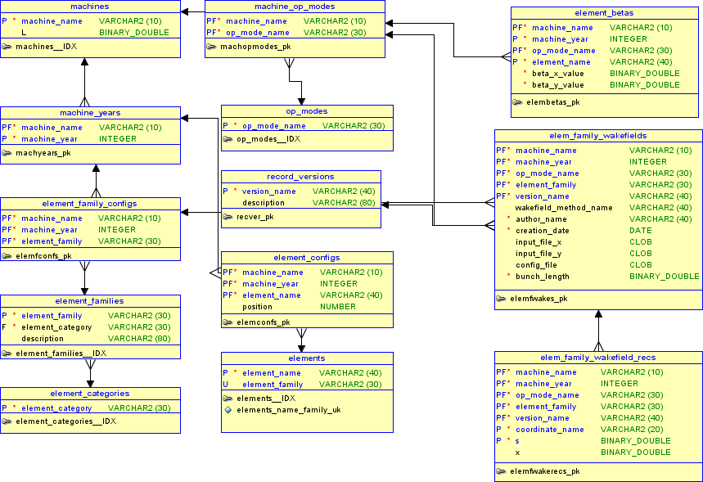
Same structure for impedances
Sums related tables not shown
Ancillary tables not shown
Indexes not shown
Database schema (extract)
Notes:
The database schema implements the conceptual model of the database into Oracle.
It consists of tables and relations between these tables.
Each table consists of a set of attributes – or columns – which feature a name and type.
For instance on the far right, we can see the tables that store the data for a wake field that applies to a family of elements.
Each table has a primary key that identifies each row uniquely.
Whereas a foreign key in another table is referring to the primary key to ensure referential integrity constraints.
Some columns operate as parts of both a primary key and a foreign key.
Note that this database schema is much simplified in that…
It does not show the tables to store impedance data, but only the wake fields…
The tables that store the sums are not showed either.
Several ancillary tables are also missing from the diagram.
Finally, we do not show up the so-called indexes which are add-on structures to speed-up the search of the tables with logarithmic performance.

Slide 12
SQL DDL example
CREATE TABLE elem_family_wakefields (
machine_name VARCHAR2(10),
machine_year INTEGER,
op_mode_name VARCHAR2(30),
element_family VARCHAR2(30),
version_name VARCHAR2(40),
input_file_x CLOB,
input_file_y CLOB,
config_file CLOB,
CONSTRAINT elemfwakes_pk PRIMARY KEY (machine_name, machine_year, op_mode_name, element_family, version_name),
);
CREATE TABLE elem_family_wakefield_recs (
machine_name VARCHAR2(10),
machine_year INTEGER,
op_mode_name VARCHAR2(30),
element_family VARCHAR2(30),
version_name VARCHAR2(40),
coordinate_name VARCHAR2(20) CONSTRAINT elemfwakerecs_coordinates_fk REFERENCES coordinates(coordinate_name),
s BINARY_DOUBLE,
x BINARY_DOUBLE,
CONSTRAINT elemfwakerecs_pk PRIMARY KEY (machine_name, machine_year, op_mode_name, element_family, version_name, coordinate_name, s),
CONSTRAINT elemfwakerecs_wakes_fk FOREIGN KEY (machine_name, machine_year, op_mode_name, element_family, version_name) REFERENCES elem_family_wakefields (machine_name, machine_year, op_mode_name, element_family, version_name)
) ORGANIZATION INDEX COMPRESS 6;
Notes:
In this slide, we show the SQL DDL code that creates the two tables to store information about the wake fields. DDL stands for Data Definition Language which is used to create new structures.
At the top, we create a table to store the CST simulation files, in the form of CLOBs for character large objects.
At the bottom we create a table to store the records of the wake fields’ waveform’s samples in the form of couples of doubles.
A foreign key refers to the top table primary key in order to ensure that each sample of the wake field data actually refers to the parent table.
The last line of this slide instructs Oracle to store the table as an index organized table which means the data is stored in B-tree to provide logarithmic search efficiency.
It also says that the primary key should be compressed in order to save space.
Similar pieces of SQL code are used to progressively build the database schema into Oracle.

Slide 13
Populating the database
Current issues.
Notes:
I will now discuss about the issues related to populating the database.

Slide 14
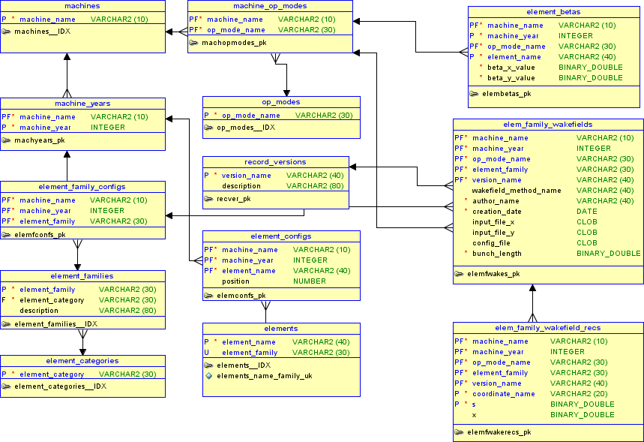
Populating the database in two stages
Data administrator
User
1
Store substrate layers
of data beforehand
2
Store wake fields
& impedance data
Oracle
SQL Tools
Java
Application
Notes:
Populating the database must be performed in two stages, by different kind of users.
Before hand, one must store all kinds of data in order to prepare ground for subsequent insertions of wake field and impedance data. Prior to that, one must store the list of available machines, categories, families and elements, OP_MODES etc...
To this end, one can rely on standard SQL tools provided with Oracle.
Once the database has been prepared A ZBASE user may then start to populate the database with wake field and impedance data, by using a dedicated Java application.

Slide 15
Bottom-up layers of data
Data that can be entered once for all: machines, categories, authors, methods…
Data that must be entered once before hand: element_families, elements, OP_MODES…
Data that must be entered beforehand each year: element_betas.
Data that can be populated automatically: element_configs, element_family_configs.
Data that must be entered by end-users of the ZBASE system: wakefields, impedances.
Notes:
This slide summarizes the successive layers of data that must be entered in before being able to populate the database with new wake field and impedance data.
All the items listed at the top refer to pieces of information that must be entered beforehand by the data administrator.
Finally, the end user of ZBASE can store wake field and impedance data.

Slide 16
SQL DML example
Populate element_families:
    CREATE SYNONYM mad_sequences for lhclayout.mad_sequences;
    INSERT INTO element_families (element_family, element_category)
    (
    SELECT DISTINCT type_name, mad_class -- returns only one row
    FROM mad_sequences
    WHERE type_name=‘BPMYA’ AND version=‘STUDY’
    );
Populate elements:
    INSERT INTO elements(element_name, element_family)
    (
    SELECT name, type_name
    FROM mad_sequences
    WHERE type_name=‘BPMYA’ AND version=‘STUDY’
    );
Elements not belonging to the MAD sequence must be dealt with separately.
Notes:
On this slide I show some code snippets to illustrate the DML part of SQL, which stands for the Data Manipulation Language. It is meant for instance meant to populate a database.
The first statement retrieves a family from the layout database and stores it in the ZBASE database.
The second statement retrieves all the elements for a given family from the layout database and store them in the ZBASE database. And it does so in one go.
This illustrates how powerful the SQL DML is.
Note that not all the elements belong to the MAD sequence which means some families of elements will require some specific handling.

Slide 17
Java application
First prototype to store wake field and impedance data for CST simulations.
Notes:
Finally I will tell a few words about first prototype to store wake field and impedance data.

Slide 18
First prototype
Technologies
  Written in Java 1.6.
  Distributed through Java Web Start. http://abwww.cern.ch/ap/dist/accsoft/app/accsoft-app-zbase/PRO/Zbase.jnlp
  Relies on the Swing GUI toolkit.
  Accesses the database through JDBC.
Current functionalities
  Store CST simulation data into database (5 mn for 500KB*5).
  Retrieve CST simulation data from database.
  Compute impedance by direct Fourier transform (5 mn).
  Plot wake field and impedance.
Notes:
The first prototype of the ZBASE tool is written in Java …
and available from the following web link.
It relies on the Swing toolkit …
and accesses the Oracle database through JDBC.
Currently the tool allows to do the following:
Storage of wake fields in the form of CST simulation files. This assumes the files are stored in a standard format on which we agreed upon with Benoit.
Retrieval of CST files from the database.
Computation of impedances by direct Fourier transform through launching a Matlab process on either Windows or Linux.
The tool also allows plotting the graph of a wake field or impedance, by relying on the data viewer standard component.

Slide 19
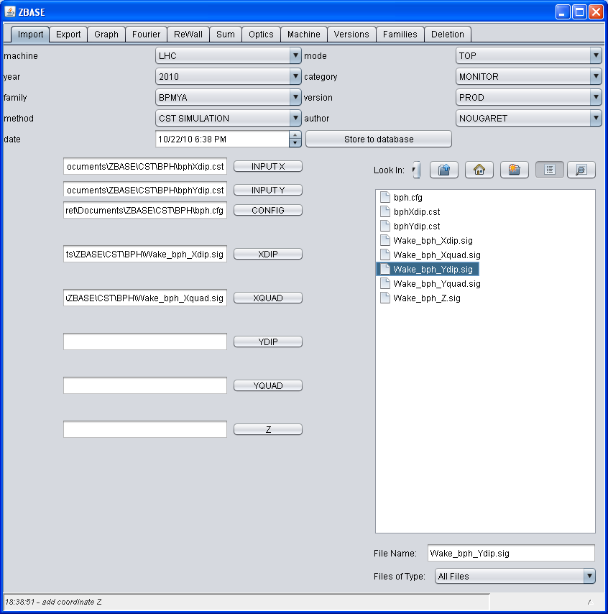
First prototype (cont’d)
Notes:
This is a snapshot of the GUI of the ZBASE application prototype.

Slide 20
Conclusion and future work
Database schema
  Almost complete.
Java application
  CST simulation storage and retrieval.
  Sum implementation to be improved.
Populating the database
  Nothing done.
  Identify some families to be stored first.
Notes:
To conclude, the database schema is almost complete.
The Java application is already able to store wake fields obtained from CST simulation.
From now on, the immediate challenge will be to start populating the database.

