Slide 1
Impedance localization in SPS ring
Nicolò Biancacci
ICE Meeting 08/09/2010
Acknowledgements: | G.Arduini, R.Calaga, E.Métral, M.Migliorati,L.Palumbo, D.Quatraro, G.Rumolo, B.Salvant, G.Sterbini, R.Tomás, C.Zannini

Slide 2
Outline
Why detecting impedances?
How: detecting algorithm.
Past results.
New objectives.
Present results.
Outlook.

Slide 3
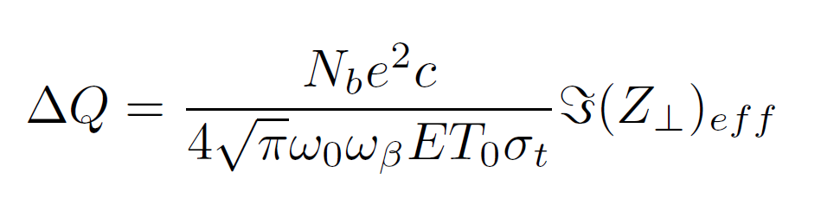
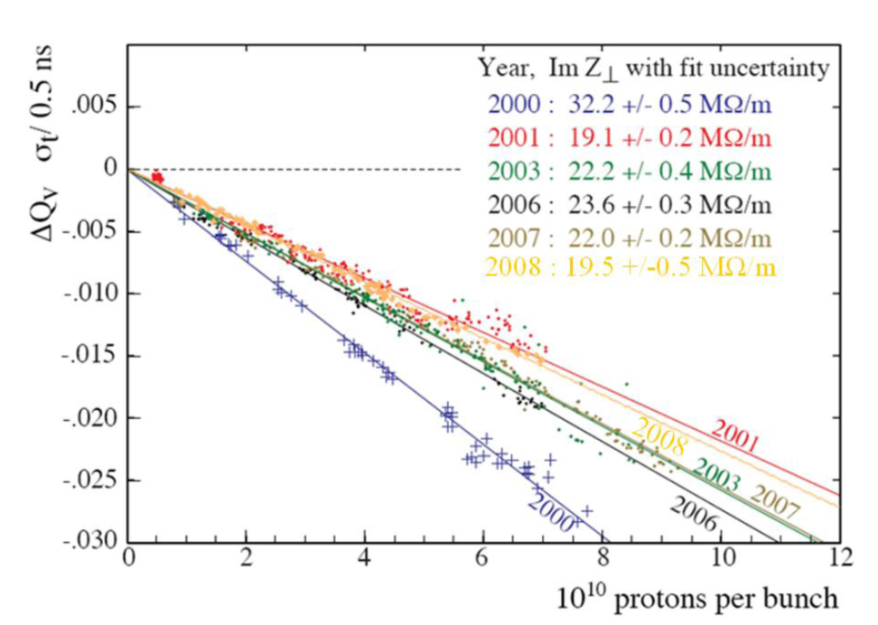
Why?
Impedance represents one of the main sources of instabilities in accelerators.
Year by year, monitoring the total amount of impedances is necessary.
Sacherer formula can give us a global evaluation of the total effective impedance.
In order to fully understand what are main impedance sources (kickers, bpms, vacuum ports, etc) in order to correct them, we need a local analysis.
Courtesy of H.Burkhardt, B.Salvant

Slide 4
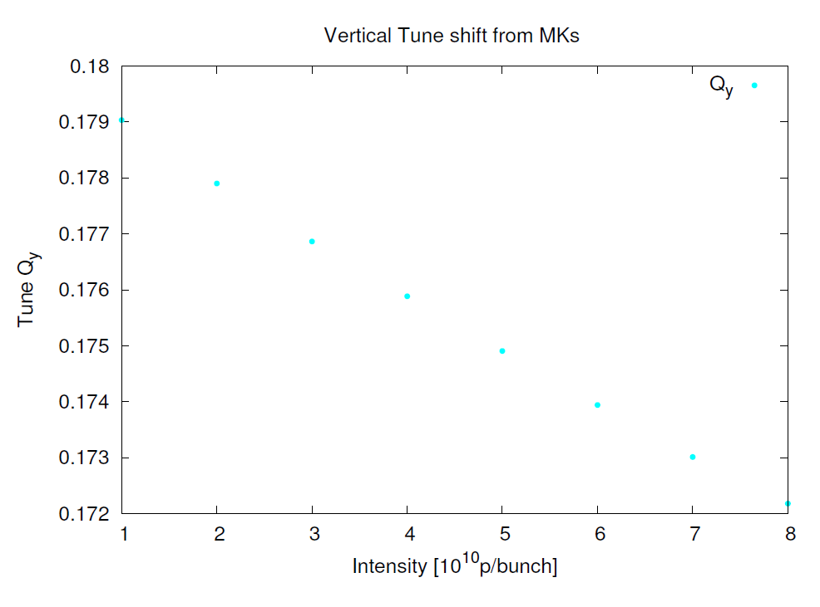

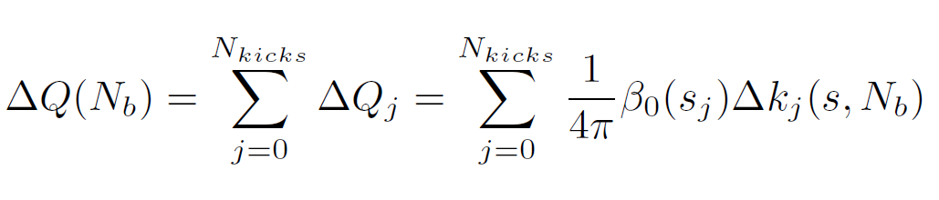
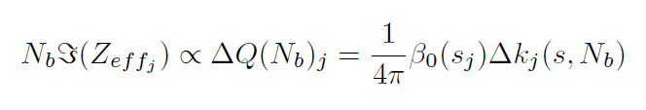
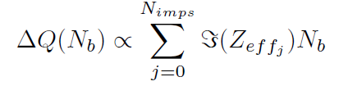
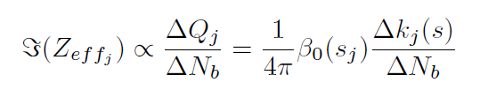
How: detecting algorithm* 1/4
Assumptions:
“Small” tune shift (≈0.01)
Linear tune shift
Local impedances not coupled
*”Localizing Impedance Sources from Betatron Phase Beating in the CERN SPS”, G.Arduini, C.Carli, F.Zimmermann

Slide 5
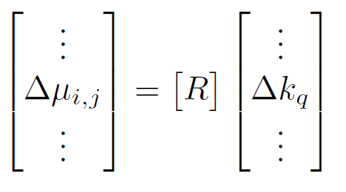
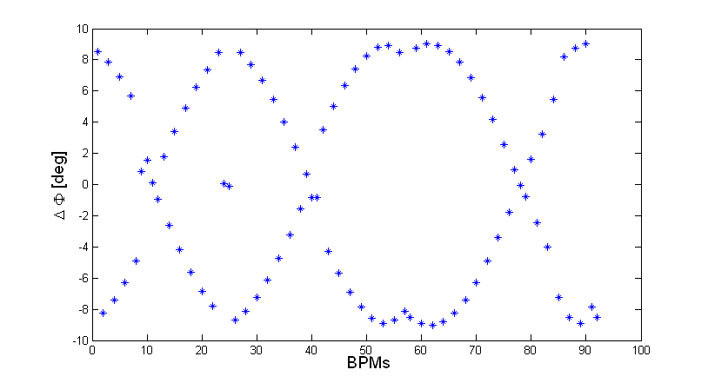
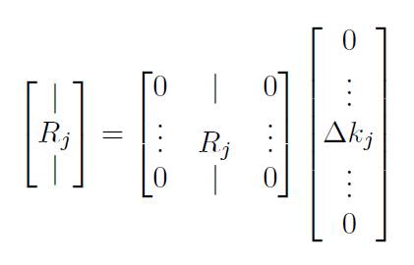
How: detecting algorithm 2/4
Need to compute this term…
… looking to phase advance beating
Response Matrix
Typical phase advance beating pattern
BPMs
MAD-X
Kick

Slide 6
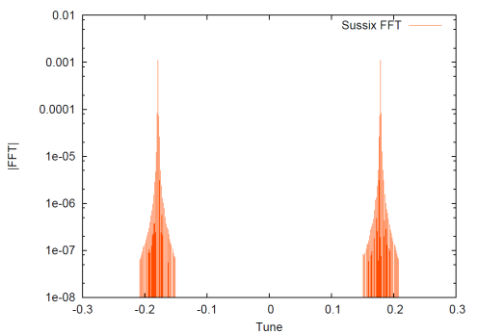

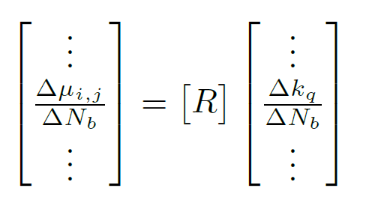


How: detecting algorithm 3/4
Wakes
Tracking data
BPH | BPV
Fourier
analysis
HDTL*
N
MAD-X
Pseudoinverse
*HDTL release developed by D.Quatraro and G.Rumolo.

Slide 7
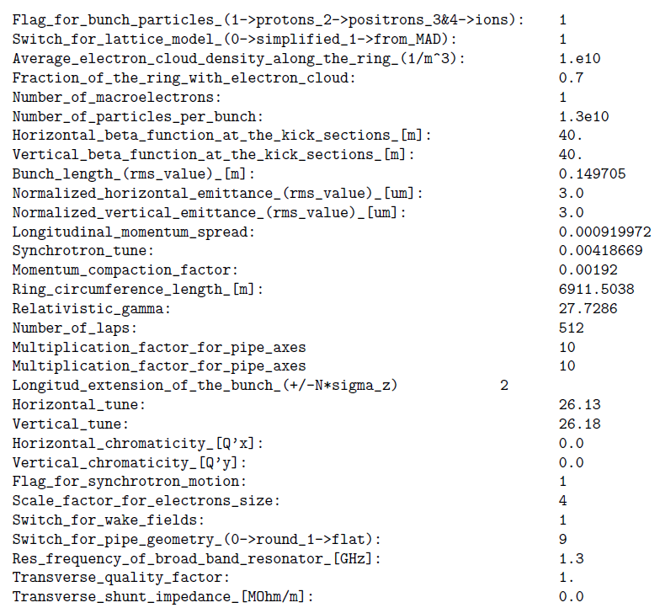
How: detecting algorithm 4/4

Slide 8
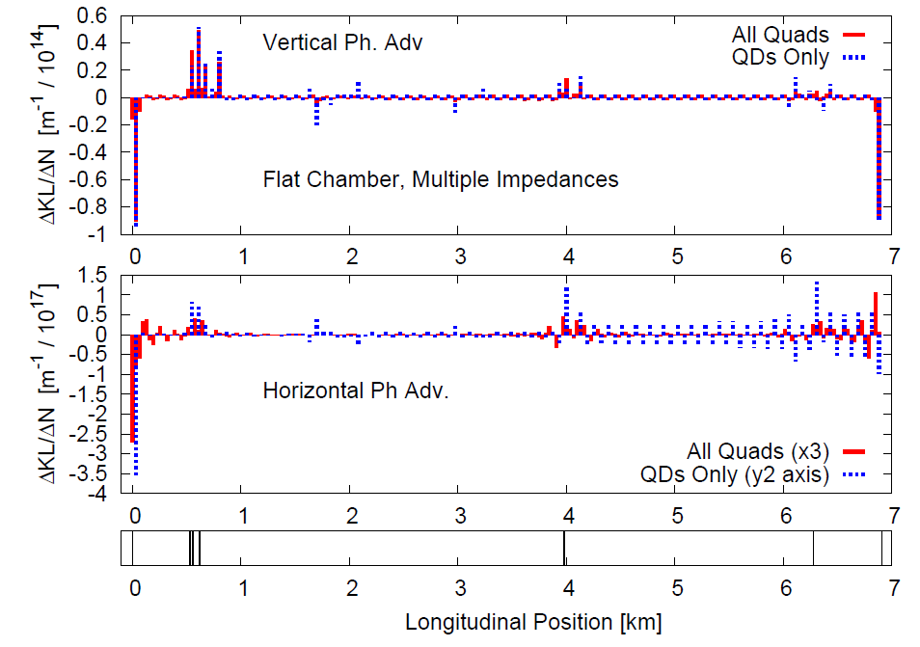
Past results* 1/2
* Impedance Localization: HDTL Studies, R. Calaga, D. Quatraro, G. Rumolo, R. Tomas. Imp. Meeting, May 30, 2008

Slide 9
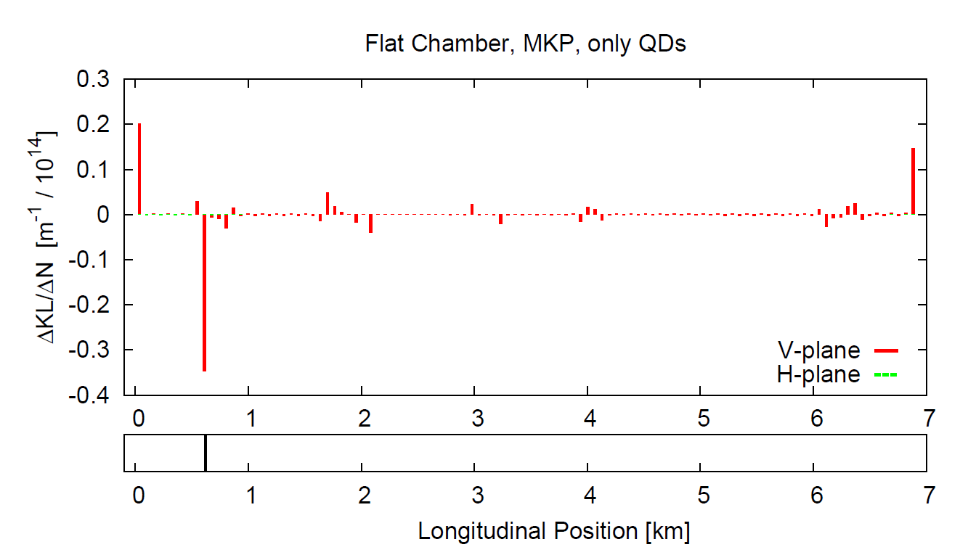
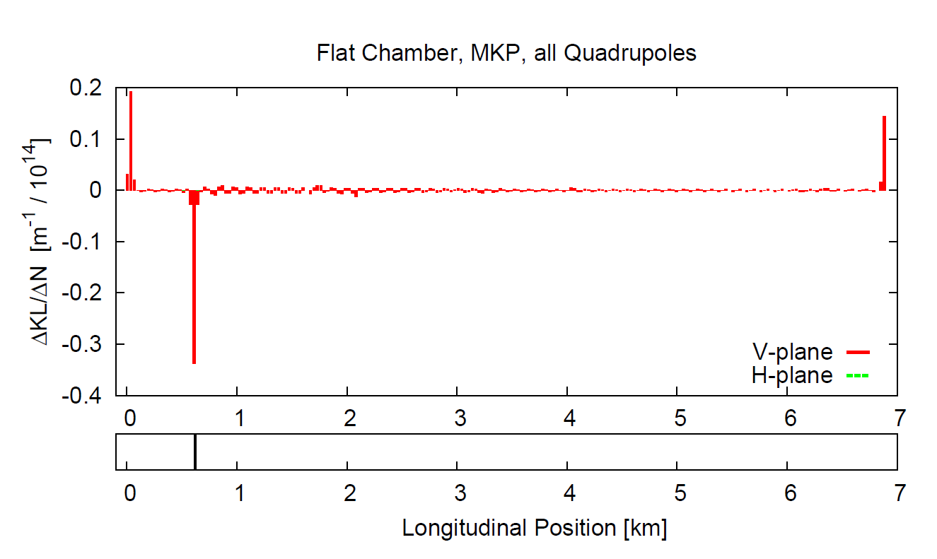
Past results 2/2
Example: MKPs
Reconstruction using only QDs
000000000
000000000
BPM
BPM
BPM
QD
QF
QD
Phase advance taken between consecutive BPMs
Reconstruction using all quadrupoles
000000000
Better results with all quadrupoles, more elements for fitting.
#BPV | #BPH | #QDs | #QD+QF
93 | 105 | 108 | 232

Slide 10
New objectives 1/1
Beam stability.
Localize impedances, and in case correct them.
Let the code work again (mainly informatic issues).
Implement thin lenses scheme in place of quadrupoles (R.Tomas idea).
Simple simulations of single impedance or quadrupole kick.
Multi-kick simulations.
Localization algorithm.

Slide 11
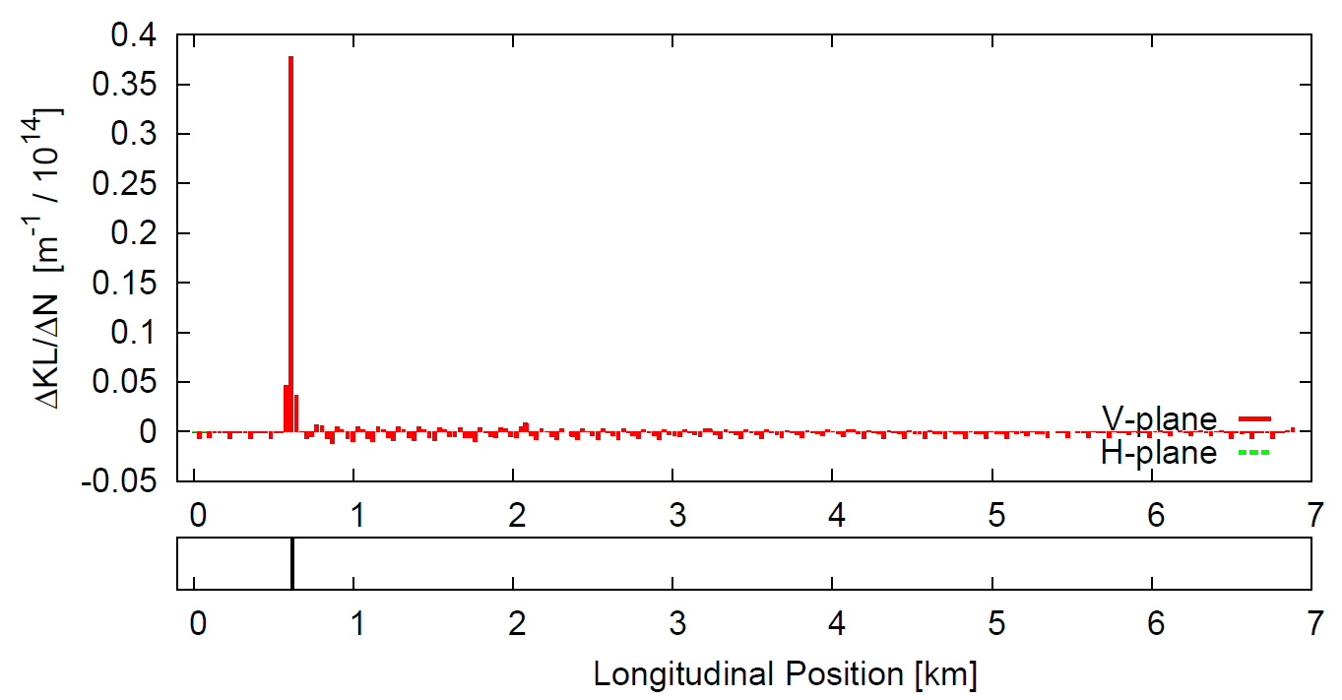
Present results 1/14
Example: MKPs
Reconstruction using thin lenses (MQs)
BPM
BPM
BPM
QD
QF
QD
Thin lenses are added at the edge of every quadrupole. From MAD-X are treated as 0-length elements and matrix response:
Advantages:
Vertical and horizontal planes can be fit with independent parameters.
Same resolution as QD+QF reconstruction.
Easier to place in the ring.
#BPV | #BPH | #QDs | #QD+QF | #LENSES
93 | 105 | 108 | 232 | 238

Slide 12
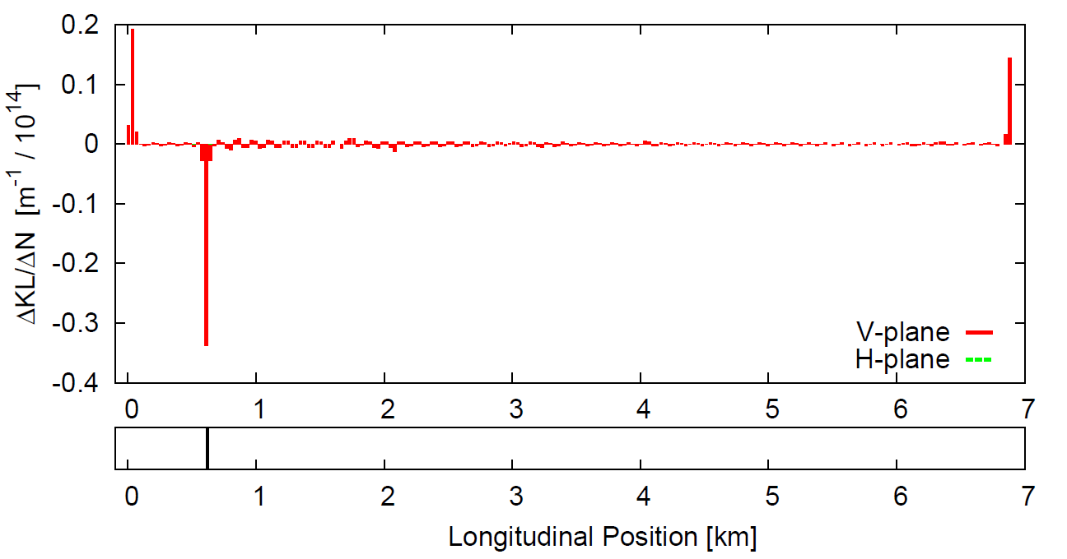
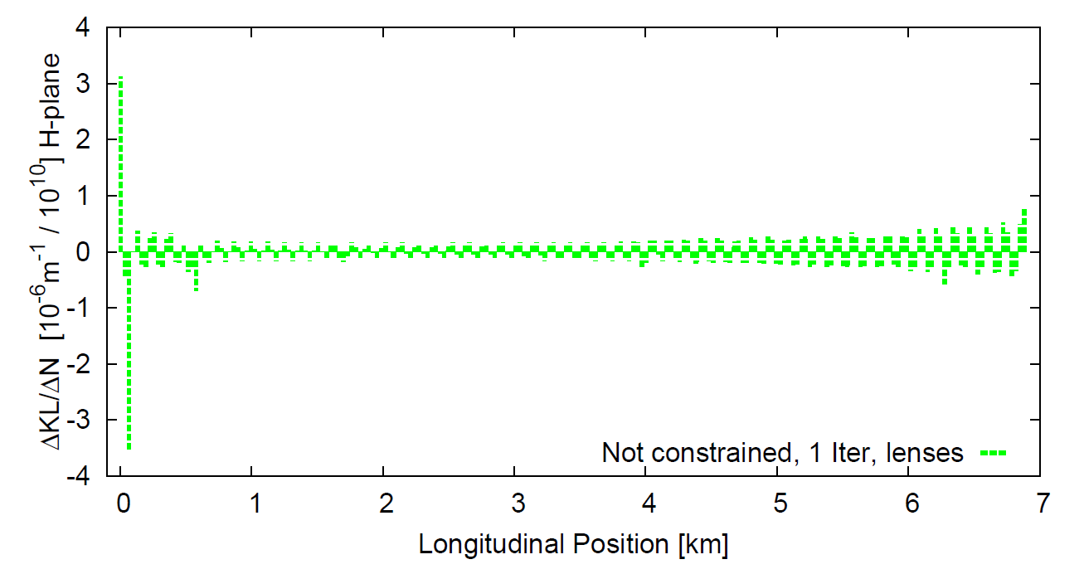
Present results 2/14
Present issues:
Peaks at beginning and end.
Non linearities in phase
advance with intensity.
Peaks splitting.
Response matrix
Example: MKPA.11936 with Tsutsui model.
Observations:
HDTL code was carefully analyzed and no kick at beginning was found until now.

Slide 13
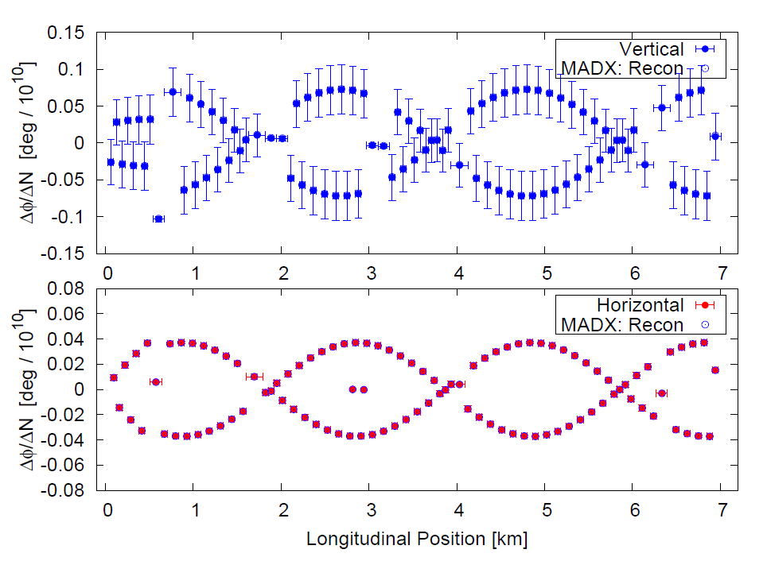
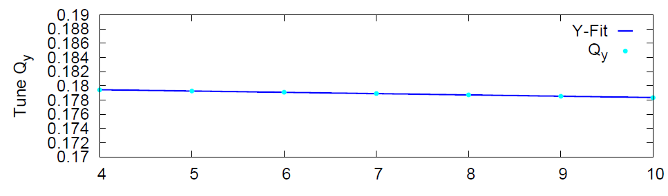
Present results 3/14
Phase advance slope
Present issues:
Peaks at beginning and end.
Non linearities in phase
advance with intensity.
Peaks splitting.
Response matrix
Example: MKPA.11936 with Tsutsui model.
Observations:
Tune V-plane
Large error bars suggest a non linear behaviour in phase advance whit intensity.

Slide 14
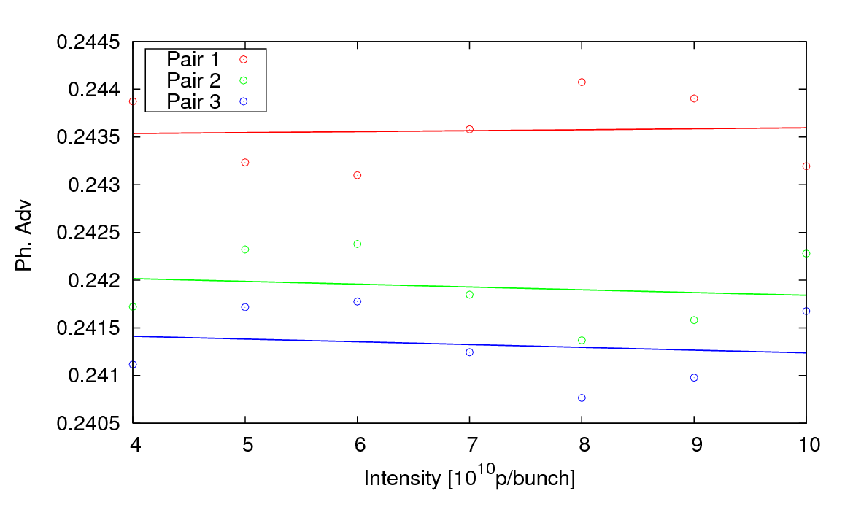
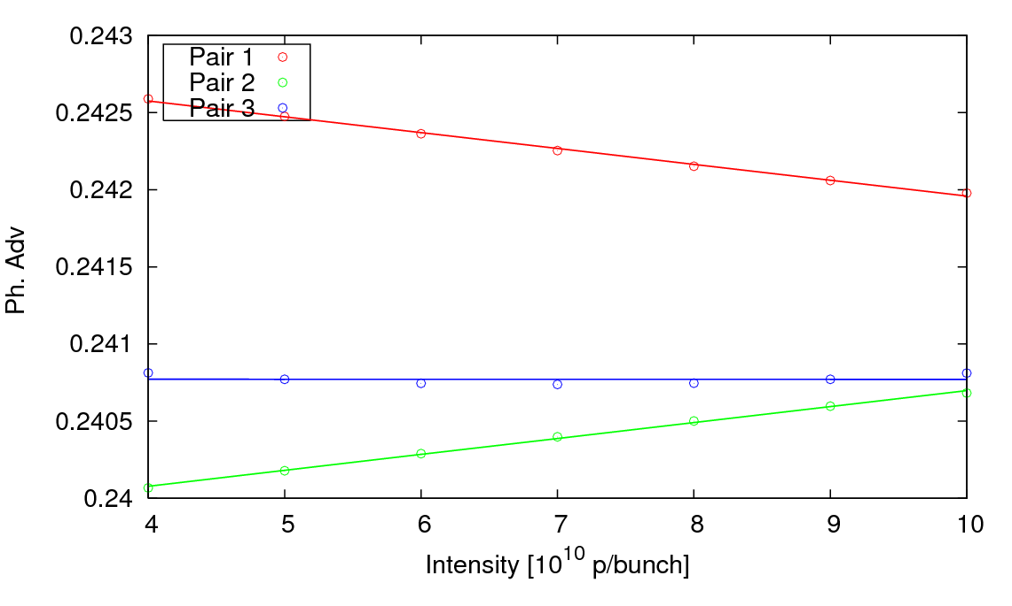
Present results 4/14
Present issues:
Phase advance with Intensity
Peaks at beginning and end.
Non linearities in phase
advance with intensity.
V-plane
Peaks splitting.
Response matrix
Example: MKPA.11936 with Tsutsui model.
Observations:
H-plane
sin(Nb) like behaviour, makes the linear fit range-dependent…!

Slide 15
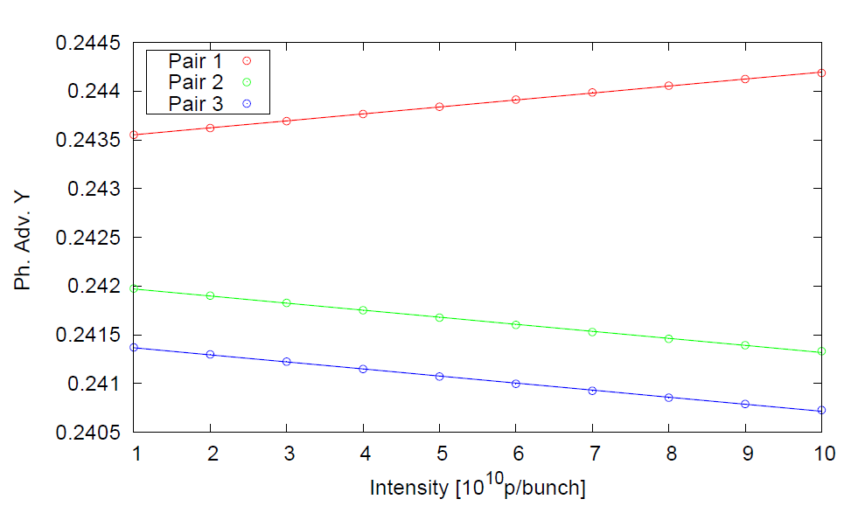
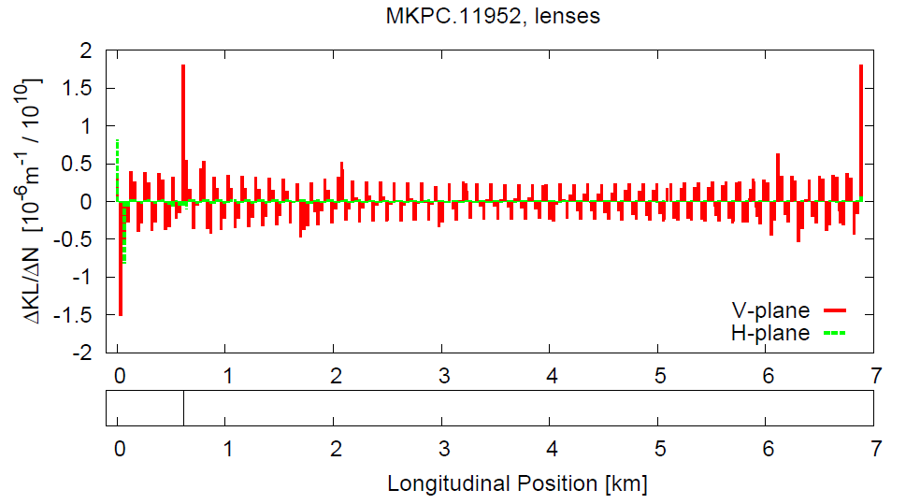
Present results 5/14
Present issues:
Phase advance with Intensity (1.0-5.5)e10
Peaks at beginning and end.
Non linearities in phase
advance with intensity.
V-plane
Peaks splitting.
Response matrix
Example: MKPC.11952 with Tsutsui model.
Observations:
Working with shorter range
do not solve the problem…

Slide 16
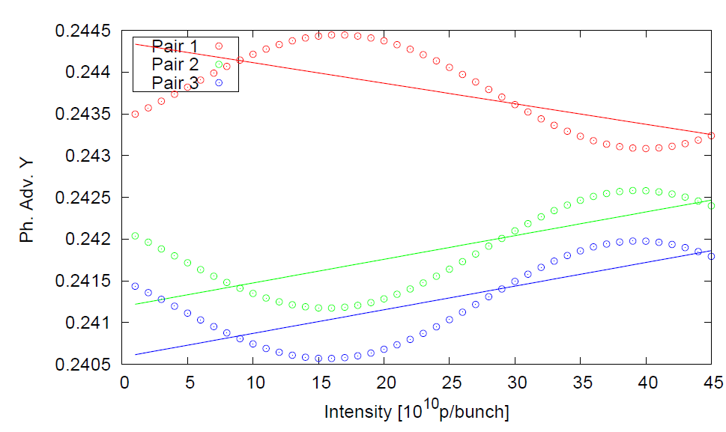
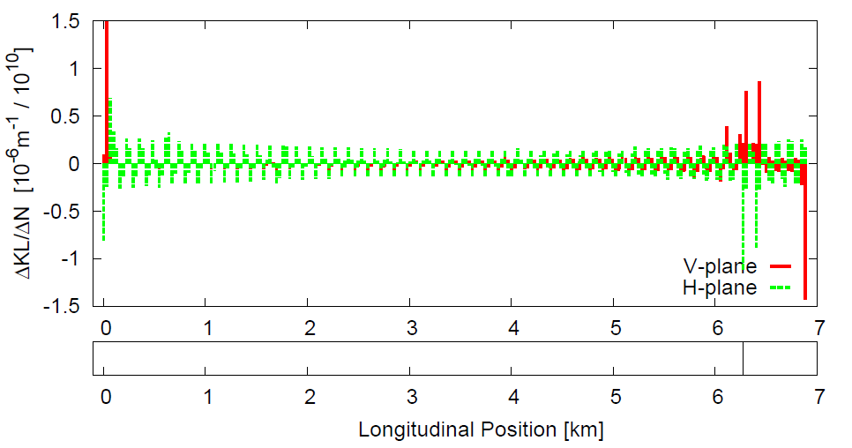
Present results 6/14
Present issues:
Phase advance with Intensity (1.0-45.0)e10
Peaks at beginning and end.
Non linearities in phase
advance with intensity.
V-plane
Peaks splitting.
Response matrix
Example: MKE.61631 with Tsutsui model.
Observations:
… idem working with longer range.

Slide 17
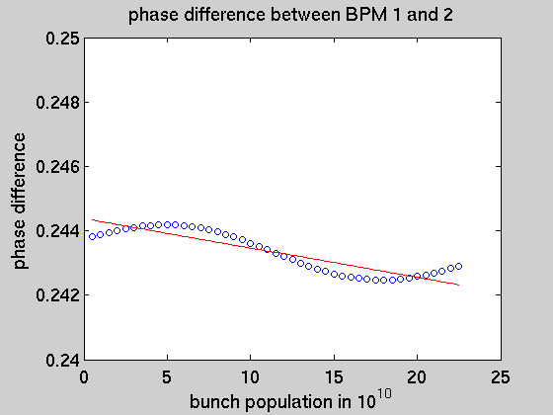
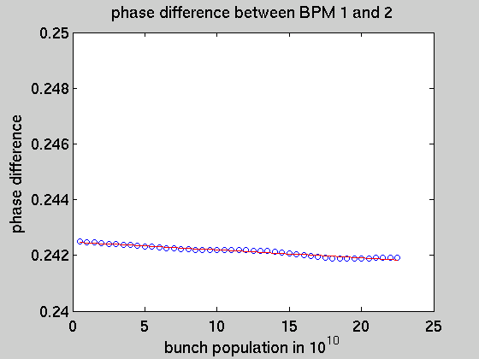
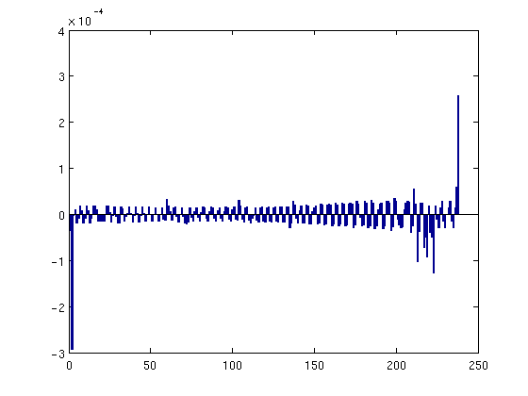
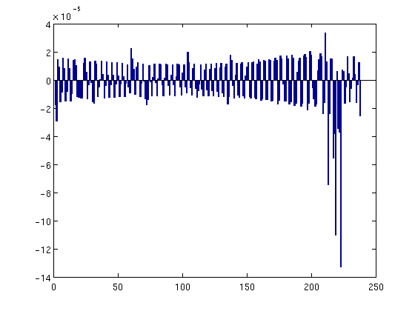
Present results 6bis/14
Present issues:
Phase advance with Intensity (1.0-40.0)e10
Peaks at beginning and end.
Non linearities in phase
advance with intensity.
Peaks splitting.
Response matrix
Example: MKE.61631 with Tsutsui model 1024 turns.
512 turns
1024 turns
Observations:
20h00 07/09/2010. Oscillation is made shorter taking higher number of turns. Also peaks at Beg/End seem to disappear.
V-plane Recon
V-plane Recon
V-plane Recon

Slide 18
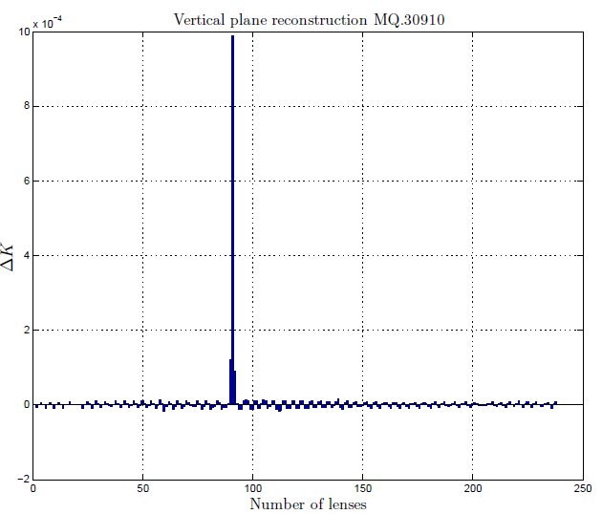
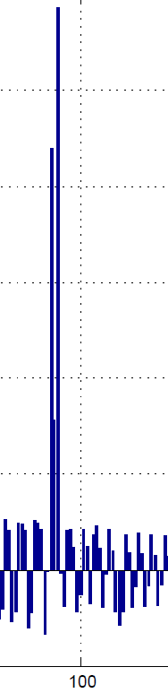
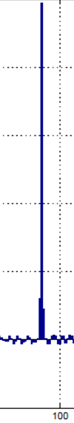
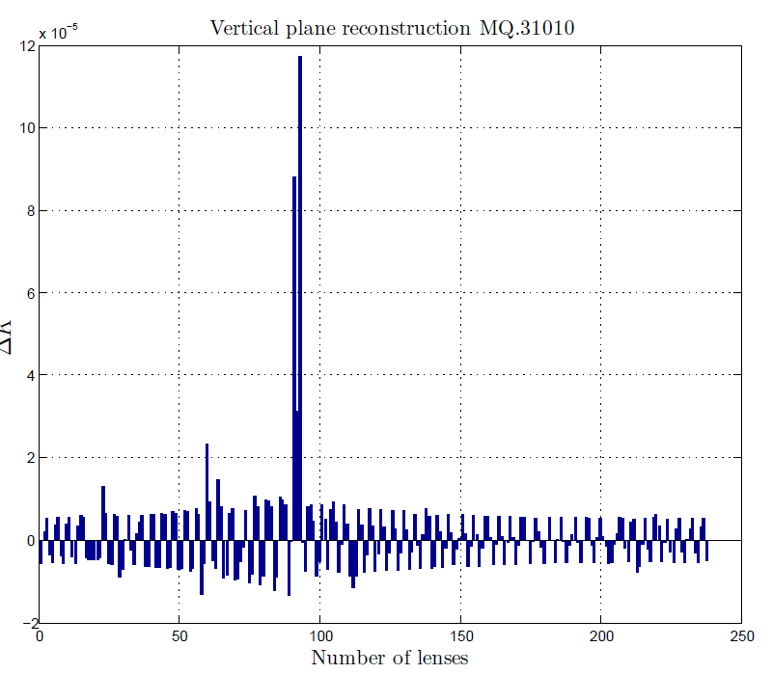
Present results 7/14
Present issues:
MQ.31010
Next to QF.31010
Peaks at beginning and end.
Non linearities in phase
advance with intensity.
Peaks splitting.
Response matrix
Example: Kick from lenses
MQ.30910 and MQ.31010.
MQ.30910
Next to QD.31010
Observations:
This is due to betatron function oscillation. Normalizing response matrix can solve it.

Slide 19
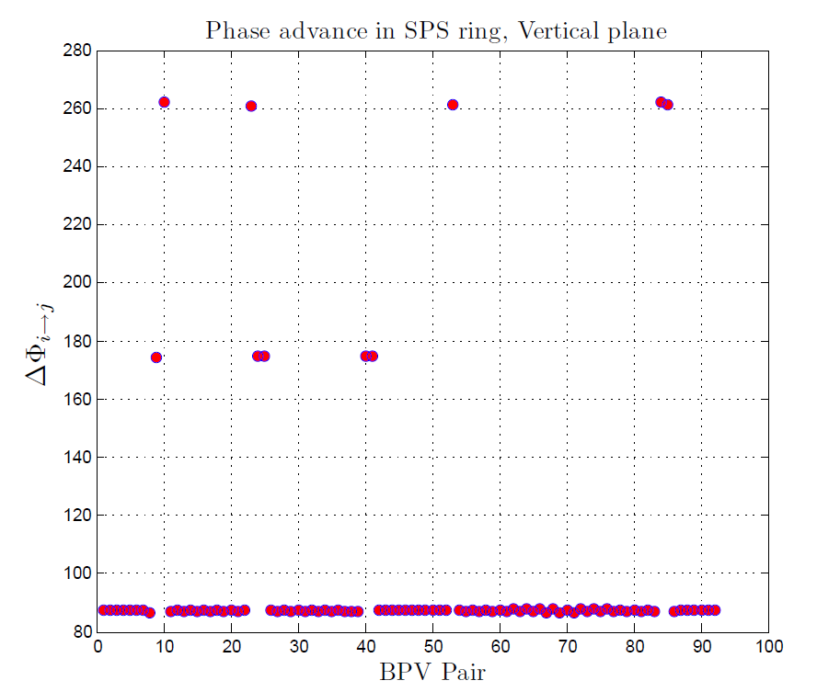
Present results 8/14
Present issues:
Peaks at beginning and end.
Non linearities in phase
advance with intensity.
Peaks splitting.
Response matrix
90° phase adv.
Observations:
Phase advance is almost always 90°.
Derived analytical formula enables us to better study the response matrix.

Slide 20
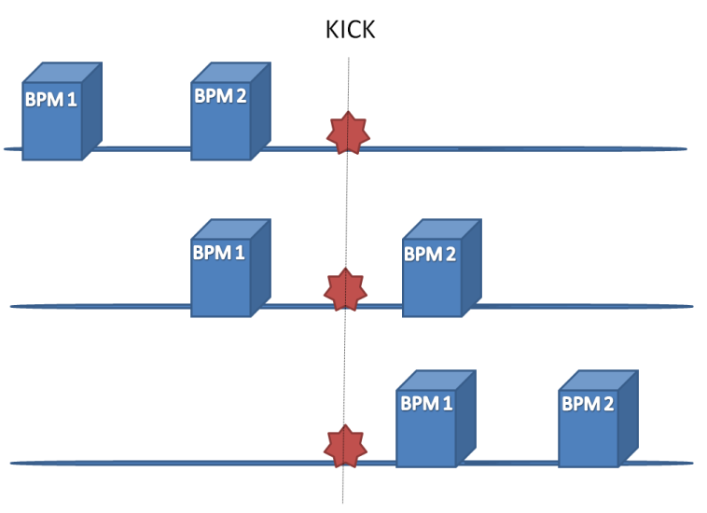





Present results 9/14
Present issues:
Peaks at beginning and end.
Non linearities in phase
advance with intensity.
Peaks splitting.
Response matrix
90° phase adv.
Observations:
Phase advance is almost always 90°.
Derived analytical formula enables us to better study the response matrix.

Slide 21
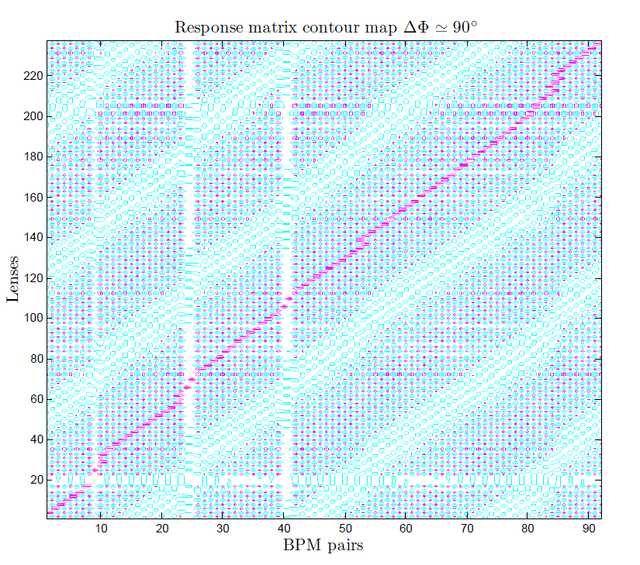
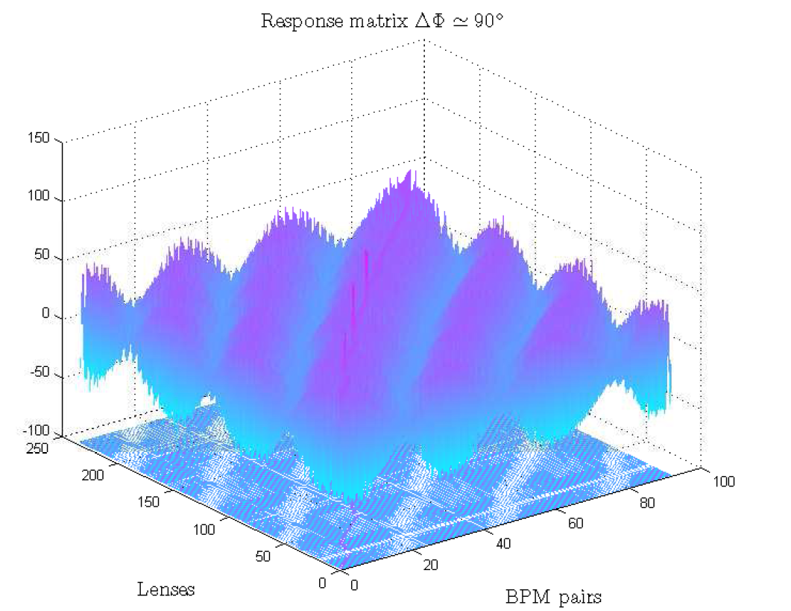
Present results 10/14
Present issues:
Peaks at beginning and end.
3
Non linearities in phase
advance with intensity.
Peaks splitting.
Response matrix
90° phase adv.
Observations:
1
180° advance BPM have a clearer beating response.
QDs have lower response.
Identical lines induce multiple solutions.

Slide 22
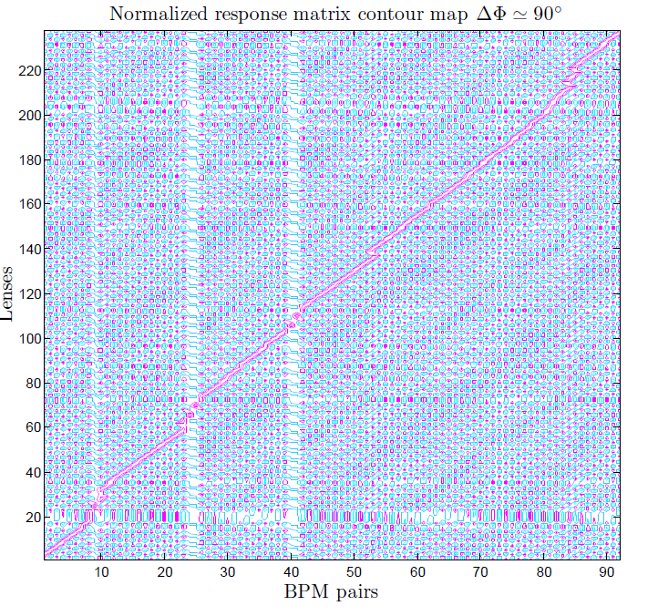
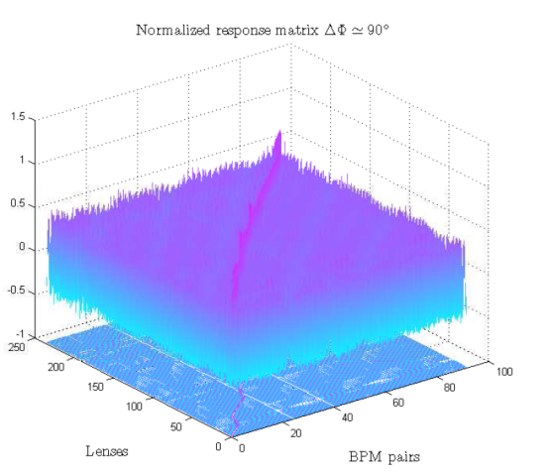
Present results 11/14
Present issues:
Peaks at beginning and end.
Non linearities in phase
advance with intensity.
Peaks splitting.
Response matrix
90° phase adv. Normalized by
beta function
Observations:
180° advance BPM have a clearer beating response.
QDs have same response, solve peak splitting.
Identical lines induce multiple solutions.

Slide 23
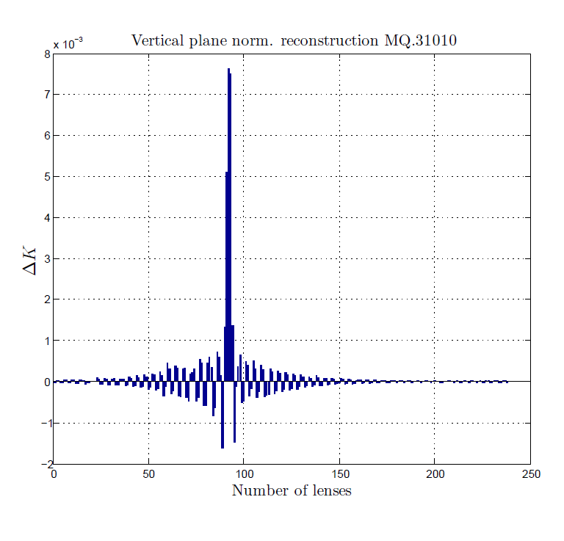
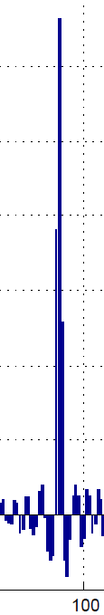
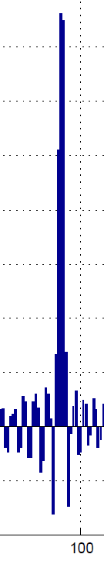
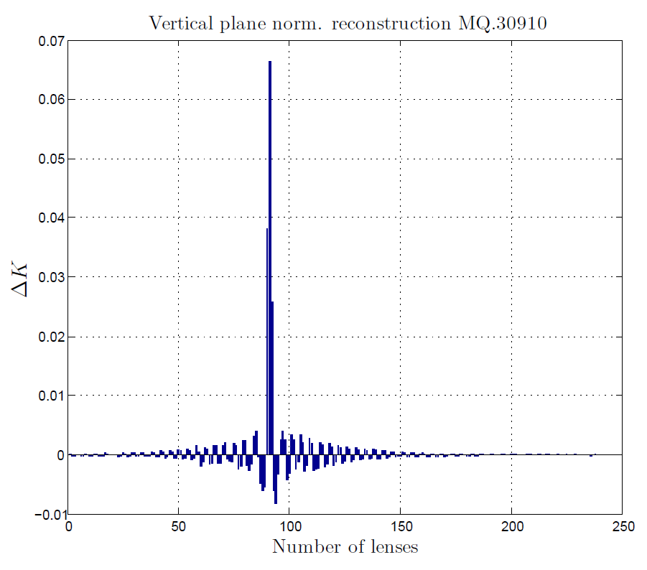
Present results 12/14
Present issues:
Peaks at beginning and end.
Non linearities in phase
advance with intensity.
Peaks splitting.
Response matrix
90° phase adv. Normalized by
beta function
Observations:
180° advance BPM have a clearer beating response.
QDs have same response, solve peak splitting.
Identical lines induce multiple solutions.

Slide 24
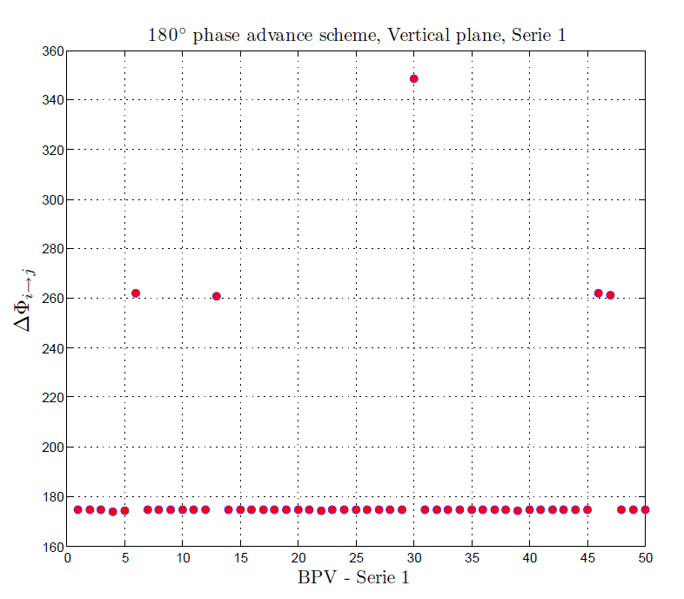
Present results 13/14
Present issues:
180° - Serie 1
Peaks at beginning and end.
Non linearities in phase
advance with intensity.
BPM
BPM
BPM
BPM
Peaks splitting.
QD
QF
QD
QF
Response matrix
180° - Serie 2
180° phase adv.
Spacing BPMs with 180° we can perfectly detect a kick in the middle (i.e. at 90°).
In SPS not always is possible, cause to the phase jump in kickers location…
Normalizing on beta function, we avoid QD, QF different responses.

Slide 25
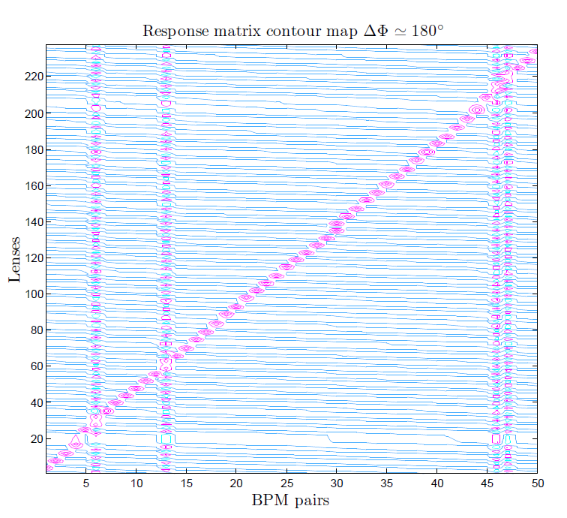
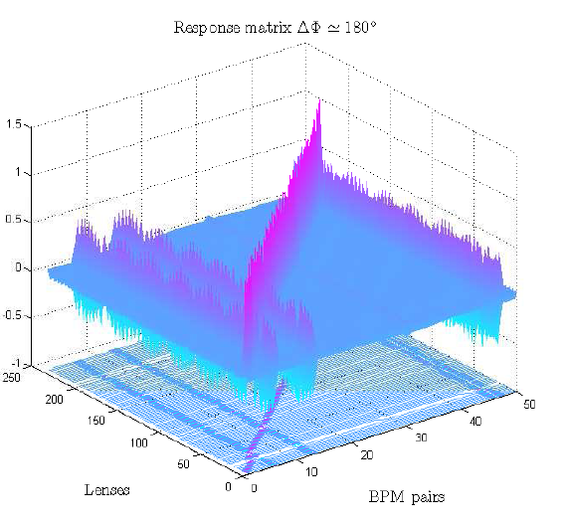
Present results 14/14
Present issues:
Peaks at beginning and end.
Non linearities in phase
advance with intensity.
Peaks splitting.
Response matrix
180° phase adv.
Normalized serie 1

Slide 26
Outlook
Peaks at beginning and end. Under analysis.
Maybe related to the wrong slope fit caused by non linearities.
Also starting tracking from different position in the lattice.
Non linearities in phase advance with intensity. Solved.
Related to the number of turns in FFT analysis. New simulations have been sent to verify this behaviour. Compute relation between #turns and phase resolution.
Peaks splitting. Explained.
Some lines in the response matrix are similar, and response from QD and QF is different. Normalization by beta helps in this direction.
Response matrix. The response matrix has to be as “diagonal” as possible.
Taking a 180° phase advance scheme avails to reduce undesired oscllations in response
matrix. BPV – Serie 2 has to be implemented. New scheme has to be benchmarked.

Slide 27
Thanks!!

Slide 29
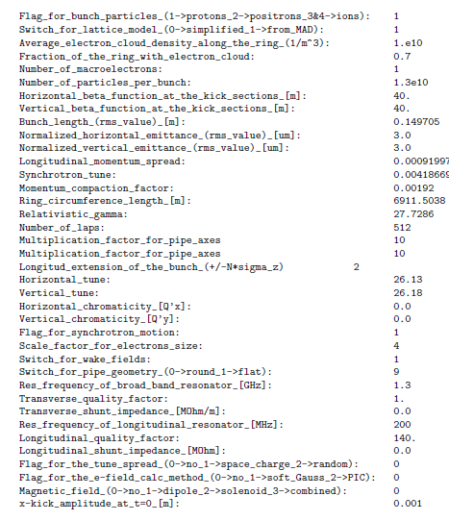
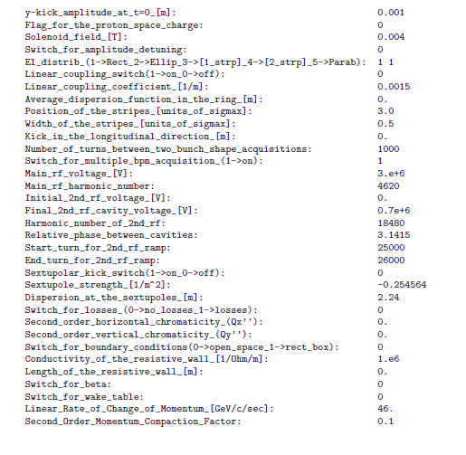
Complete HDTL cfg.

