Slide 1
First measurements of longitudinal impedance and single-bunch effects in LHC
E. Shaposhnikova for BE/RF
Thanks: P. Baudrenghien, A. Butterworth, T. Bohl, M. Jaussi, J. Tuckmantel, U. Wehrle
Operation team (G. Papotti + …)

Slide 2
Reminder
Longitudinal emittance of nominal beam in LHC Design Report:
  0.7 eVs (inj.) → 1 eVs (after filamentation) at 450 GeV
  2.5 eVs at 7 TeV (controlled emit. blow-up during ramp)
  IBS growth rates in longitudinal and transverse plane
  Longitudinal beam stability:
  to have the same thresholds as at 450 GeV with 0.7 eVs and as at 7 TeV with 2.5 eVs
  → 1.75 eVs was proposed at 3.5 TeV

Slide 3
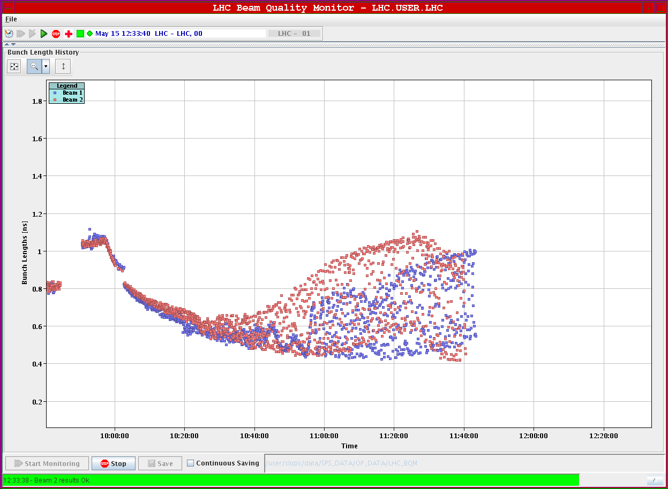
Loss of Landau damping: during the ramp (1.8 TeV)
B1 - 1.1x10¹¹
B2 - 1.05x10¹¹
1.05 ns – 0.35 eVs
(450 GeV, 5 MV)
BQM of G. Papotti

Slide 4
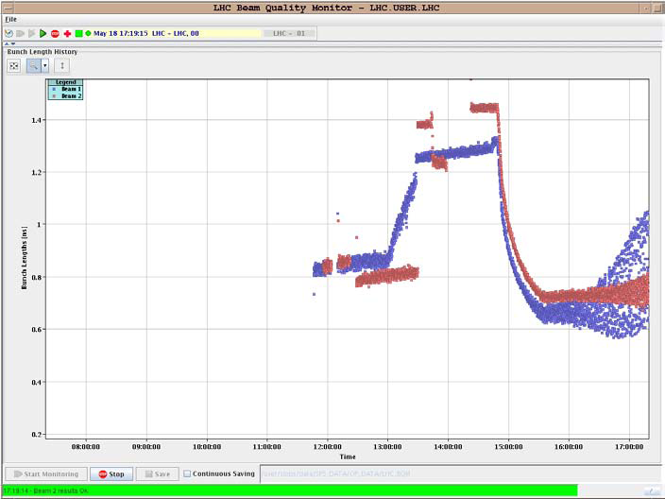
and on flat top
B1 - 1.1x10¹¹
450 GeV, 5 MV:
1.25 ns - 1.3 ns → 0.5 eVs
3.5 TeV, 8MV:
0.65 ns → 0.5 eVs
B2 - 1.05x10¹¹
450 GeV, 5 MV:
1.45 ns → 0.6 eVs
3.5 TeV, 8MV:
0.72 ns → 0.6 eVs

Slide 5
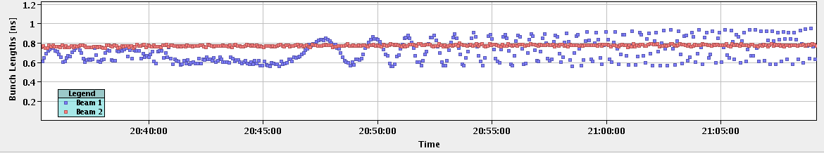
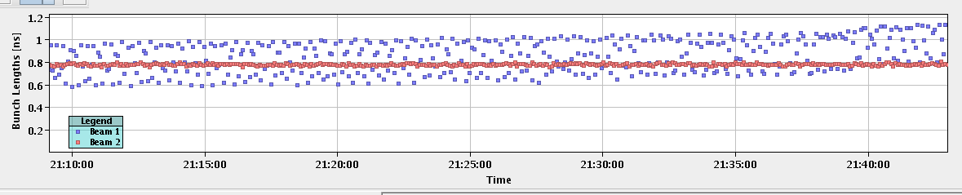
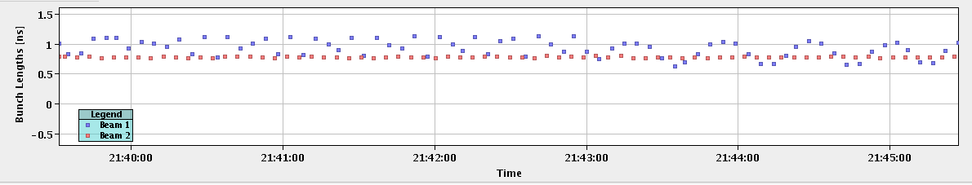
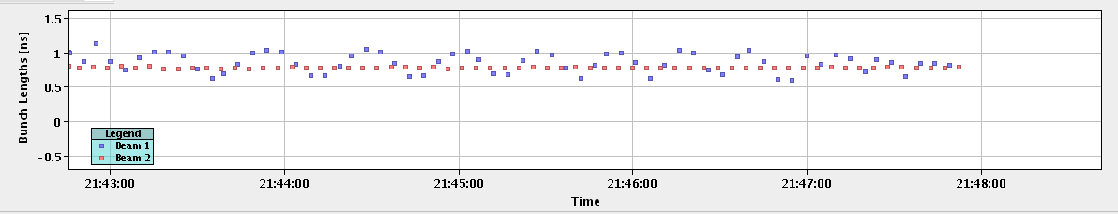
Quadrupole oscillations on flat top with different RF voltages (26 May 2010)
8 MV
8 MV
→7 MV
→6 MV
10 MV
12 MV

Slide 6


Loss of Landau damping
Landau damping (m=1) is lost if
During the cycle threshold changes as
→To avoid threshold decreasing during the cycle emittance should be increased at least as ε ~ E^{1/2} V^{1/10}
Bucket area also grows with energy ~ E^{1/2} →
constant bucket filling factor → constant bunch length

Slide 7
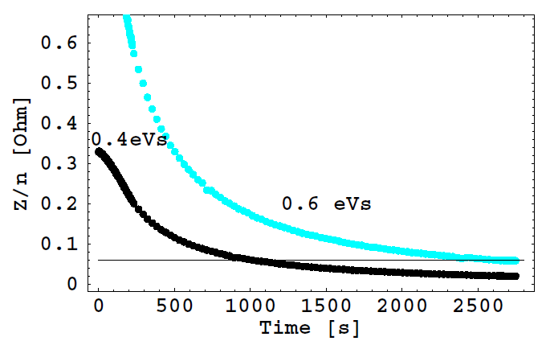
Loss of Landau damping: threshold during the cycle (old voltage program, 5- 8 MV)
loss of Landau damping
Z/n=0.06 Ohm

Slide 8
Loss of Landau damping
Leads to undamped bunch oscillations: quadrupole in our case (dipole are damped by phase loop). Observed in other machines (SPS, Fermilab MR, …) – “dancing bunches”
(Z/n)_{eff}^{m=2} = 1.5x0.06 = 0.09 Ohm
In LHC DR low frequency inductive impedance budget
ImZ/n = 0.07 Ohm
Weak dependence on voltage (~ V^{1/4}) – observed (6-12 MV)
Strong dependence on longitudinal emittance (~ ε^{5/2} )
Energy dependence 1/E_{s}^{5/4}→ emittance blow-up: ε ~ E_{s}^{1/2}
(factor 2.8 from 450 GeV to 3.5 TeV)

Slide 9
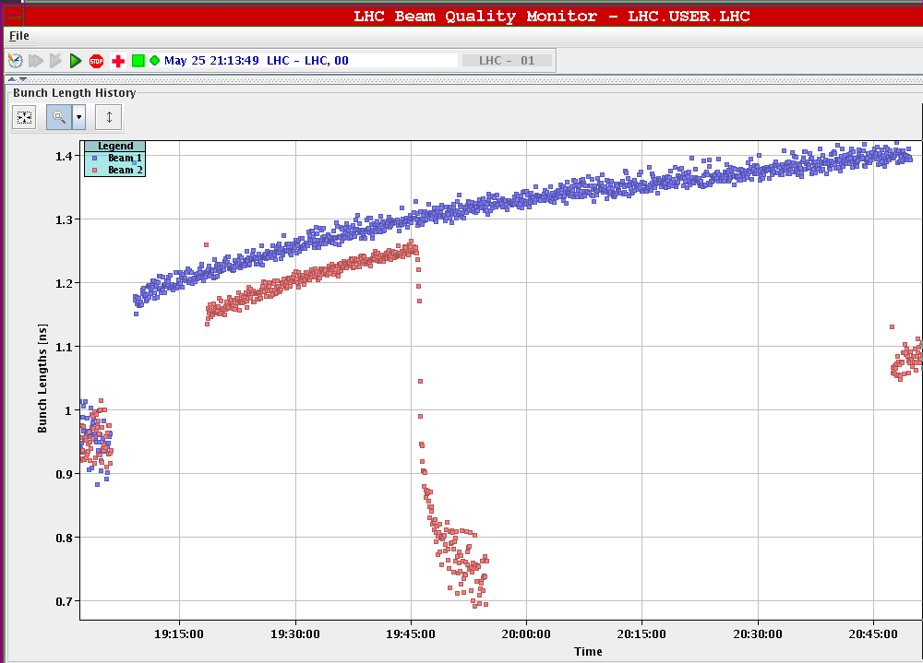
Flat bottom: longitudinal emittance growth for nominal intensity (25 May)
Fast emittance blow-up for small emittances
In agreement with IBS calculations (F. Zimmermann, J. Jowet)?

Slide 10
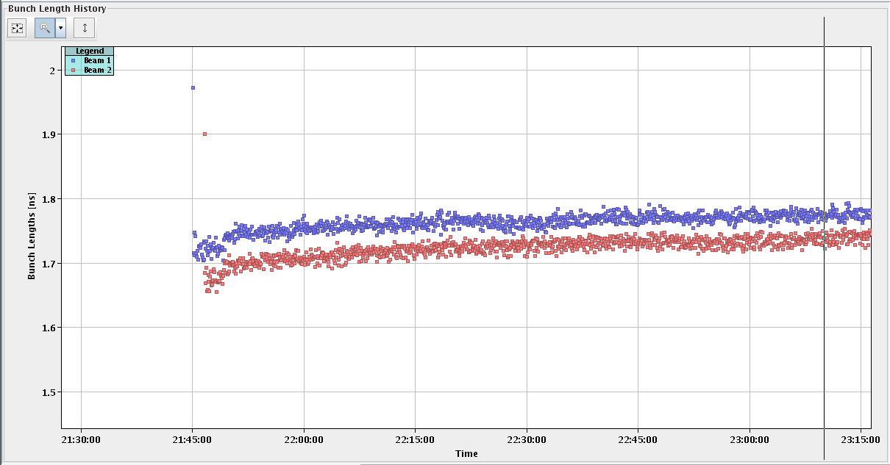
Flat bottom: longitudinal emittance growth for nominal intensity
No emittance blow-up for large emittance, but…

Slide 11
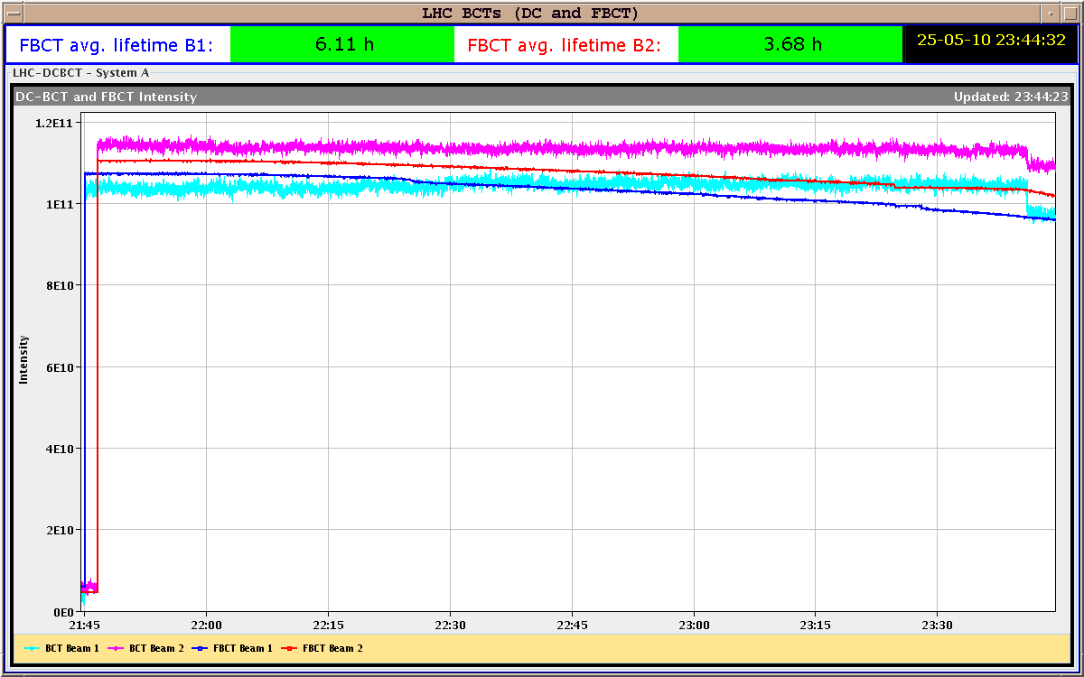
Flat bottom: longitudinal emittance growth for nominal intensity
No emittance blow-up for large emittance, but losses…

Slide 12
Longitudinal emittances from SPS
  Practically no loss on FB for bunch length below 1.7 ns, initial bunch length growth …, growth rate is reducing with bunch length increase
  Some losses for bunch length > 1.7 ns (after injection and filamentation in 3.5 MV) due to full bucket – maximum injected emittance of 0.65 eVs
  Higher voltage on FB is less matched to the shape of the SPS bunches → tails, more loss on FB
→ Emittance of 0.6 eVs from SPS is a good compromise to minimise losses on FB and ease the emittance blow-up in LHC →
controlled emittance blow-up in the SPS plus during the ramp in LHC

Slide 13
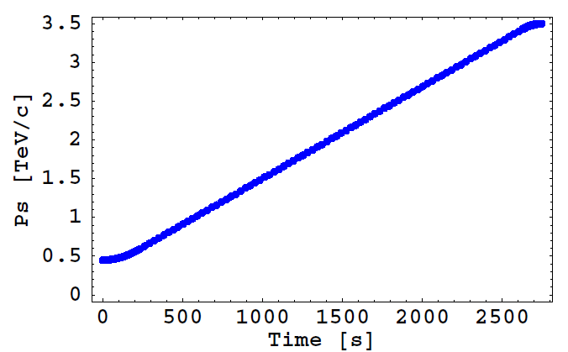
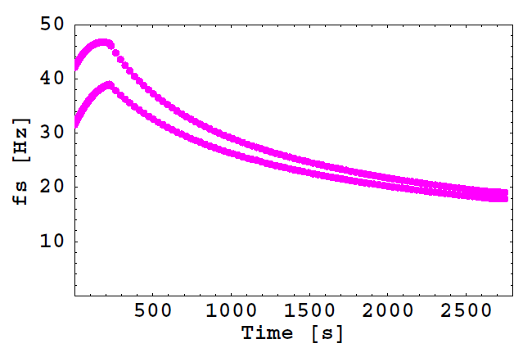
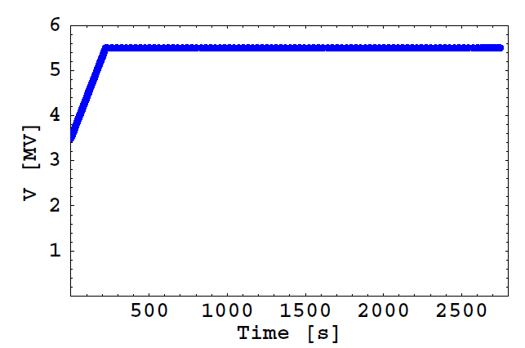
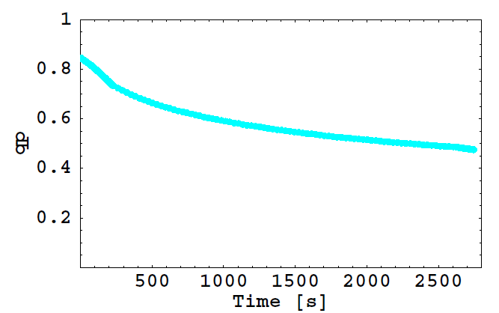
Longitudinal beam parameters during present cycle
synch. freq. spread for emit. of 0.6 eVs
momentum
1st blow-up
“new” 400 MHz
voltage program
momentum filling factor for emittance of 0.6 eVs

Slide 14
Longitudinal emittance blow-up in LHC
Emittance of 0.7 eVs will be sufficient for longitudinal bunch stability at 3.5 TeV, but there are other limitations (IBS)…
Controlled blow-up is more difficult for smaller synchrotron frequency spread (small bucket filling factor), but small filling factor is required to avoid particle losses during blow-up and ramp
Relative incoherent synchrotron frequency shift ~ 0.015 - calculated for
  ImZ/n=0.1 Ohm
  bunch intensity 10¹¹
  short bunches (0.8 ns)
  parabolic bunch (factor 2 more for other distributions)
→ comparable to the synchrotron frequency spread at high energies (without blow-up)

Slide 15
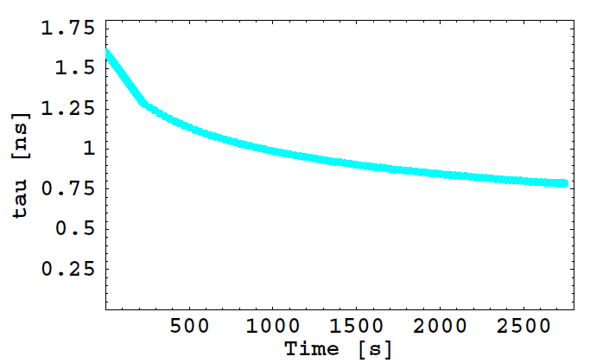
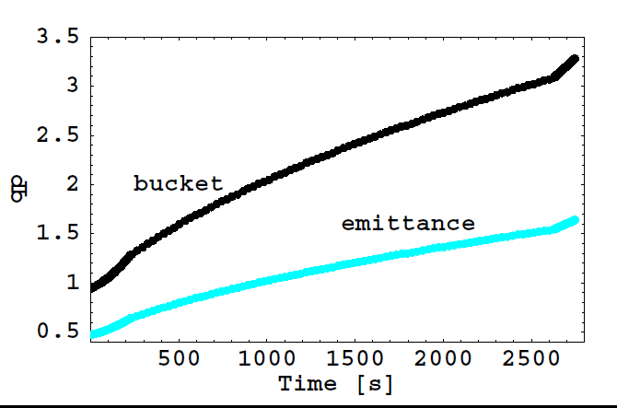
Emittance blow-up during the ramp
bunch length for emittance of 0.6eVs

Slide 16
Summary and future plans
Loss of Landau damping was observed for small longitudinal emittances during the ramp and on flat top. Different observations agree with each other and estimated impedance is not far from the DR budget. More accurate calculations needed.
Successful first tests at 450 GeV and during the ramp of controlled blow-up to a given value by controlling the amplitude of the applied phase noise (with slow FB around bunch length).
Measurements of quadrupole frequency shift with intensity could give more information about Z/n (tried at injection, data still to be analysed, seems to have the same problem as in SPS – dependence on injected beam parameters). Other measurements – from PD Schottky spectrum.

Slide 17
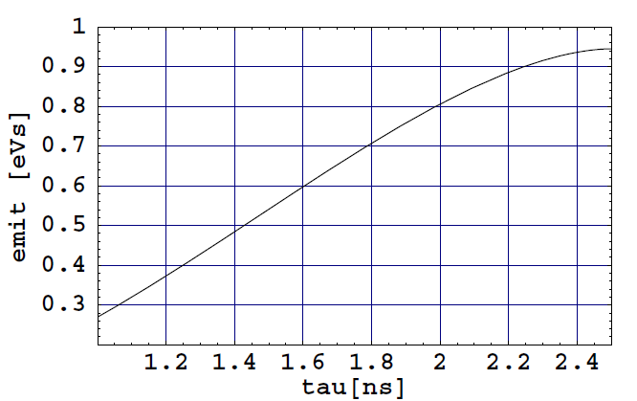
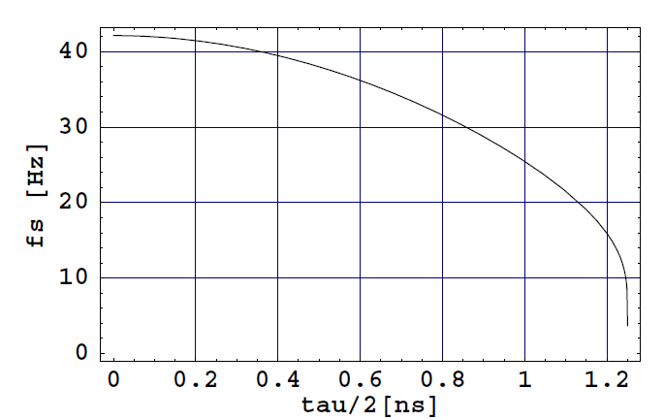
Limited bandwidth phase noise for emittance blow-up
Synchrotron frequency distribution
450 GeV, 3.5 MV
Longitudinal emittance, 450 GeV, 3.5 MV
Emittance blow-up during the ramp: phase noise with a bandwidth corresponding to the fixed relative synchrotron frequency spread (fixed filling factor) for low and high intensity bunches

