Slide 1
Build-up simulations for dafne wiggler w/ electrodes
Theo Demma

Slide 2
New param.s & old assumptions
Some (maybe too much) simplified features of fields and chamber properties are assumed in the simulations:
Chamber is assumed elliptic and the SEY is that of Aluminum (this feature can already be changed in order to take into account that electrodes are made of copper).
Magnetic field is assumed uniform and equal to the maximum value in the wiggler.
The electric field is assumed vertical and uniform in the region of the chamber occupied by the electrodes and zero outside this region. The value of the field is obtained from: E=V/L (L is the vertical size of the chamber and V the potential of the electrode with respect to the chamber)
Parametr | Value
Bunch population | 1.68x10¹⁰
Number of bunches | 100
Bunch spacing [m] | 0.8
Bunch length [mm] | 12.3
Bunch horizontal size [mm] | 1.08
Bunch vertical size [mm] | 0.05
Hor./vert. Cham. sizes [cm] | 12/2
Primary electron rate | 0.0088
Photon Reflectivity | 100% (uniform)
Max. SEY | 1.9
Energy at Max. SEY [eV] | 250
Vert. magnetic field [T] | 1.64

Slide 3
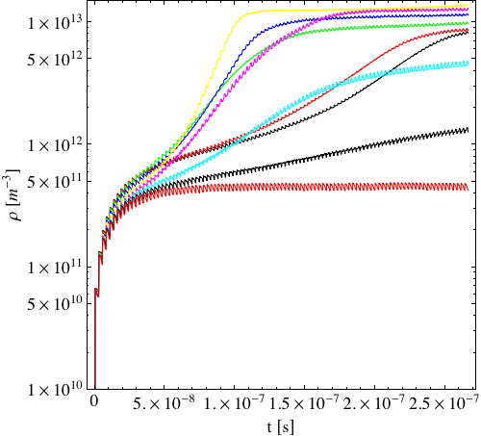
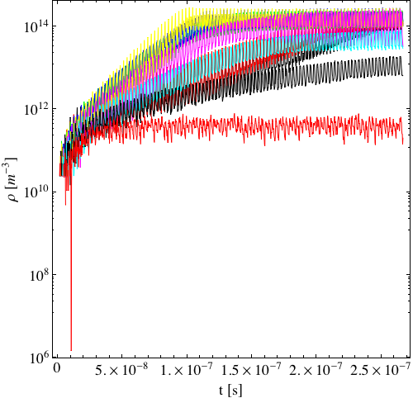
Build-Up (Log scale)
Average Denisity
Density at Center
250V
250V
300V
300V
Color code: 0V -10V - 50V - 100V - 150V - 200V - 225V - 250V - 300V

Slide 4
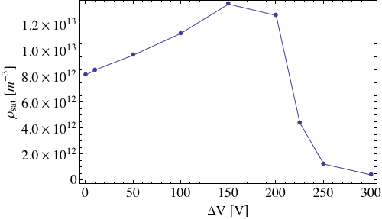
Saturation density vs electrode voltage

Slide 5
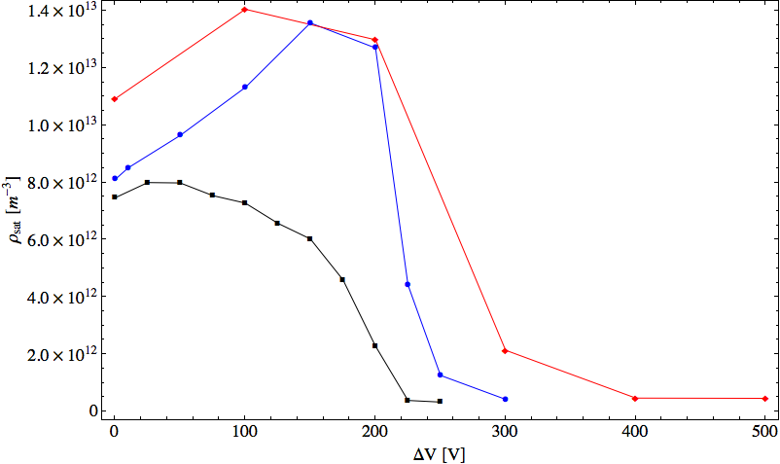
Saturation density vs electrode DV
Points correspond to electron cloud density at saturation (i.e. at the end of bunch train) as a function of the electrode voltage. Different colors corresponds to different beam currents: 500 mA Black; 800 mA Blue; 1000 mA Red. Unfortunately for some points the saturation is not yet reached at the end of the bunch train. In any case the behavior is very similar to that observed in experimental tension current curves.

Slide 6
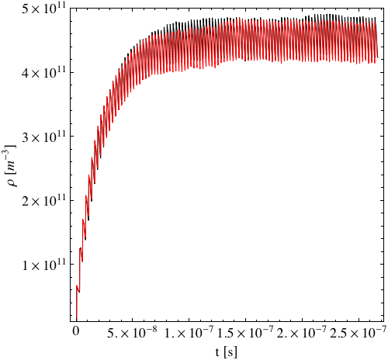
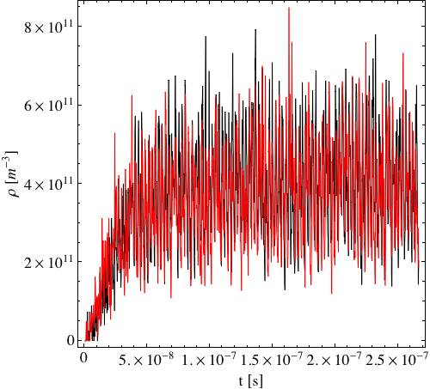
Electrode polarity: E⬆E⬇
Average density
Central density

Slide 7
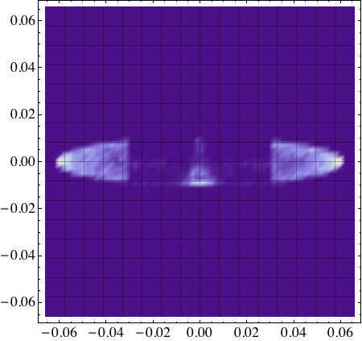
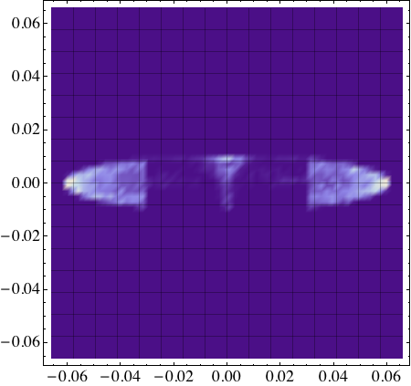
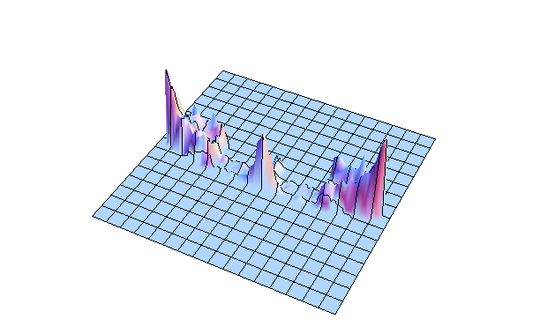
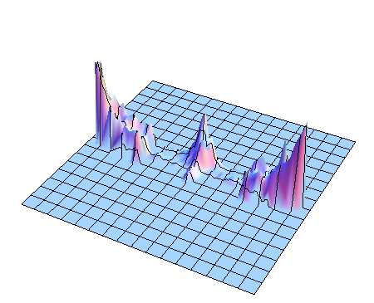
e-cloud distribution snapshot
Field up
Field down
Beam current 800 mA electrode voltage +/- 300 V.

Slide 8
Comments
With respect to previous (2010) simulations:
  Several “bugs” discovered and corrected in ECLOUD (I look forward to have the new CERN code). Now simulations seem to be much more reliable and stable (I checked the results with other codes during the simulation campaign for ILC-DR).
  Much more simple but also much more reliable model of magnetic and electric field.
  Photon distribution changed: cos^2->uniform.
Parameters updated to those corresponding to the measurements.
Inverting electrode polarity nothing change for the cloud density (sey is uniform) but the flux at the wall is inverted. In the case field down the most of the flux is on the chamber side opposite to the electrode that is “grounded” hence low or no current is observed through the generator.

