Slide 1
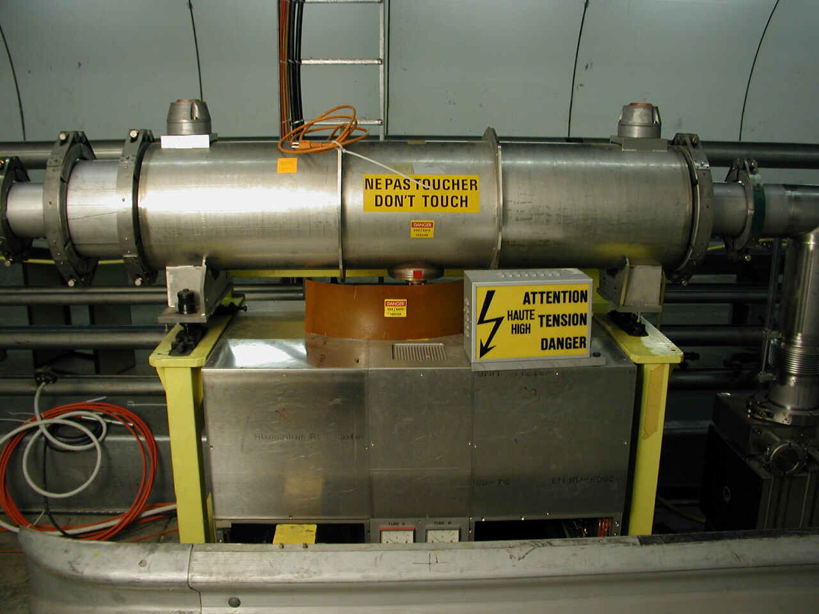
SPS Transverse Damper System

Slide 2
Overview
What is it used for ?
How does it work ?
Control and Diagnostics
Electronic details

Slide 3
What is it used for ?
Damping of transverse injection errors
Feedback: to cure transverse coupled bunch instabilities
Excitation of transverse oscillations for beam measurements (Multi-Q) and increase of emittance (blow up)

Slide 4
How does it work ?
A feedback loop including :
Pick-ups (2.04 => 2.15)
Associated by pairs according to the beam type
A Low Level part
(Signal process + Pick-up Mixing + Low Level)
4 “electrostatic” kickers (H1, H2, V1 and V2)
H1, H2 and V1 Installed in LSS2-
V2 installed in LSS2+

Slide 5
Feedback Loop
Position
monitor
Beam
deflector
BEAM
+
-
Low Level
Surface – BA2

Slide 6
Association of the Pick-ups
2.04 2.06 | H plane LHC | 2.08 2.10 | H plane - Ions (before) | 2.12 2.14 | H plane Fix Target
2.05 2.07 | V plane LHC | 2.09 2.11 | V plane - Ions (before) | 2.13 2.15 | V plane Fix Target
Used as spares

Slide 7
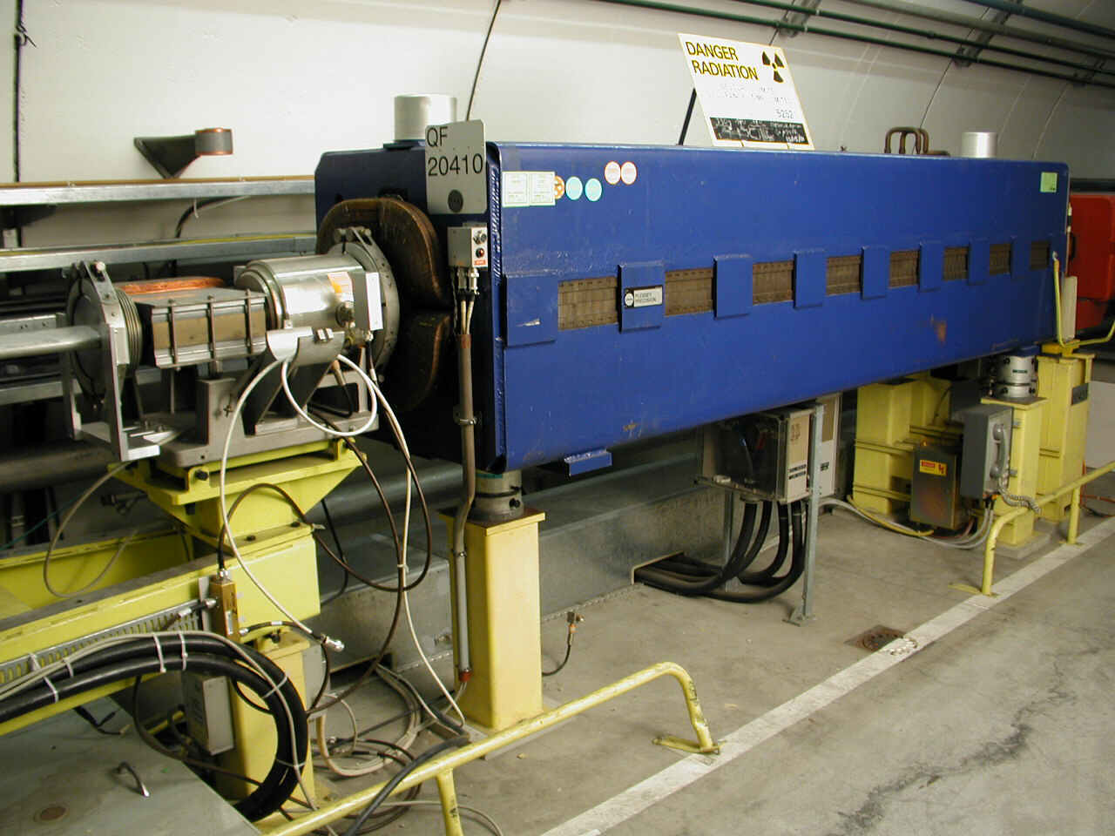
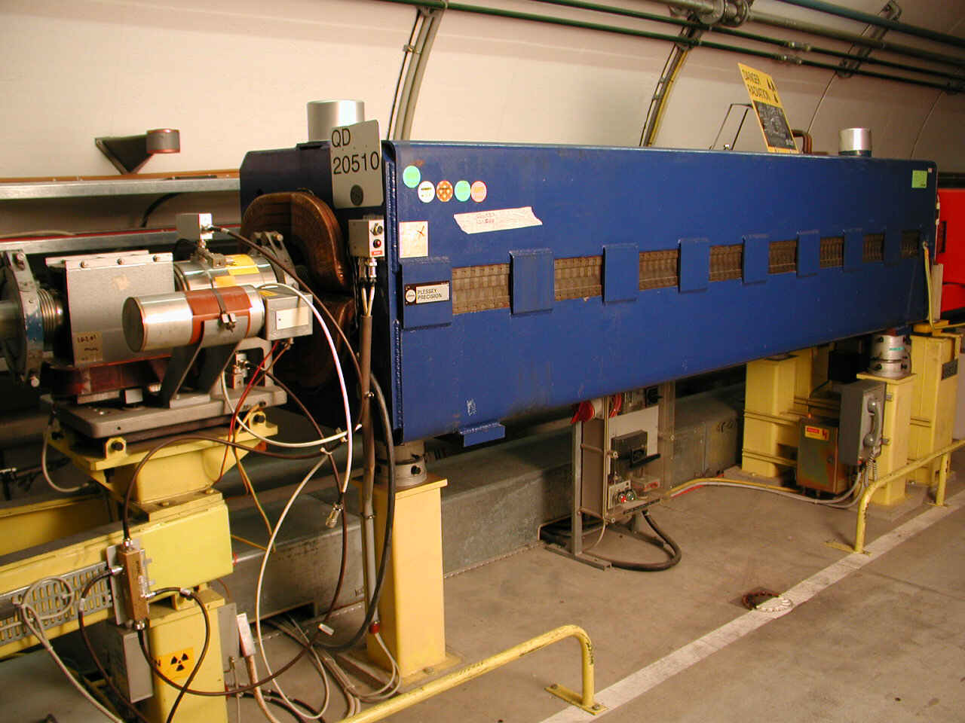
The Pick-ups (position monitors)
BDH 2.04 BDV 2.05
➔ Shared with BI (MOPOS) but specific electronics

Slide 8
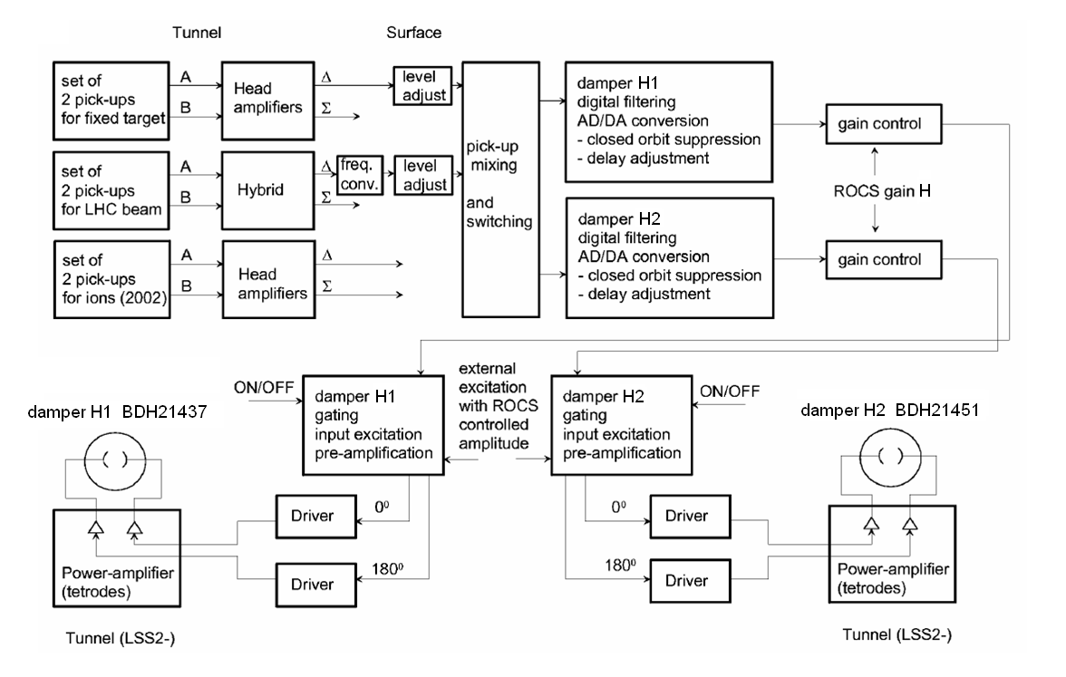
Block Diagram (H1 & H2)

Slide 9
Simplified Block Diagram (H1 & H2)
2 pick-ups
2.12
&
2.14
Fixed Target beam
Pick-ups Mixing
➔Betatron phase adjust.
Closed orbit suppr.
Delay adjust.
Timing ON/OFF
External excitation
Damper H1
BDH 214.37
( )
Δ
Level adjust.
Gain LSA
Σ
Level adjust.
2 pick-ups
2.04
&
2.06
LHC beam
Closed orbit suppr.
Delay adjust.
Timing ON/OFF
External excitation
Damper H2
BDH 214.51
( )
Δ
Level adjust.
Gain LSA
Σ
Level adjust.

Slide 10
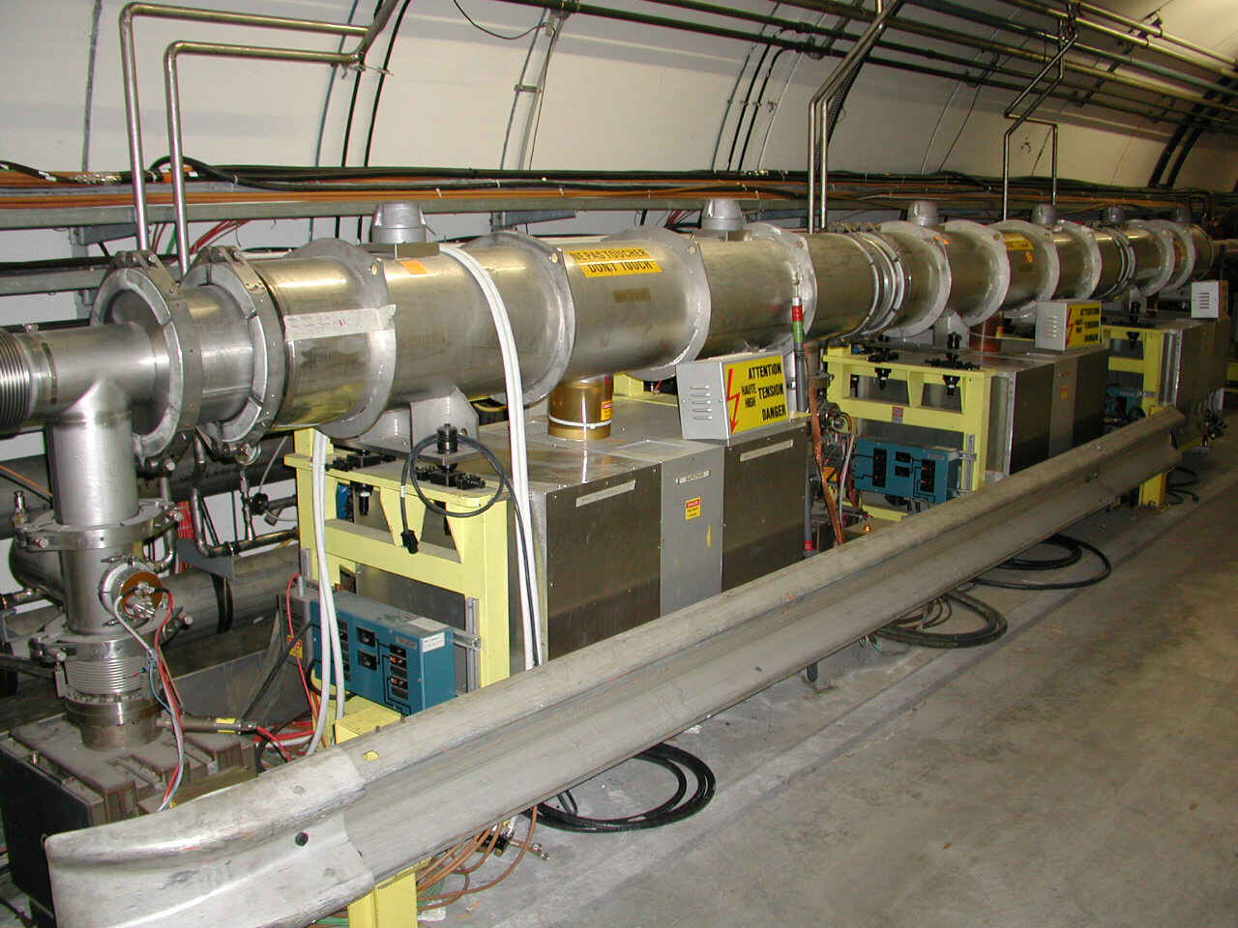
The electrostatic kickers
BDH 214.37 (H1)
BDH 214.51 (H2)
BDV 214.57 (V1)
BDV 221.76 (V2)
➔ LSS 2 +
➔ LSS 2 -

Slide 11
Control and Diagnostics
Control ➔ New RF Control Application (MMI)
➔ Trim Editor Application (LSA)
Diagnostics ➔ Oasis Application
Compare with reference signals

Slide 12
New RF Control Application
More ergonomic
All parameters readable
Role based access to change settings
Synoptic :
Experts view / Simplified view for Operation

Slide 13
Block Diagram (H1 & H2)
New
MMI
LSA
2.12 & 2.14
LSA
New
MMI
2.04 & 2.06
timing
timing
Multi-Q

Slide 14
Dampers H1 & H2 (simplified)
2 pick-ups
2.12
&
2.14
Fixed Target beam
Level adjust
‘DGCA’
Pick-ups Mixing
‘DPUM’
- p.u. select
- Polarity
Phase
➔Betatron phase adjust.
Closed orbit suppr.
(Notch Filter)
Delay adjust.
Gain LSA
Timing ON/OFF
External excitation
Damper H1
BDH 214.37
( )
Δ
Σ
Level adjust
‘DGCA’
2 pick-ups
2.04
&
2.06
LHC beam
Level adjust
‘DGCA’
Closed orbit suppr.
(Notch Filter)
Delay adjust.
Timing ON/OFF
External excitation
Damper H2
BDH 214.51
( )
Δ
Gain LSA
Σ
Level adjust
‘DGCA’
- Controlled by the new MMI application
- Controlled by LSA (Trim Editor Application)

Slide 15
Diagnostics
Observation with OASIS Application:
Delta : difference between the signals of one pick-up
(= not normalised transverse position of the beam
➔ position * Intensity)
Sum : sum of the signals of one pick-up
(= intensity of the beam)
Input : signal leaving the low level
Plates : voltage of the kicker’s plates
(= delta signal between the two plates)

Slide 16
Diagnostics
Delta
Sum
Input
Plates

Slide 17
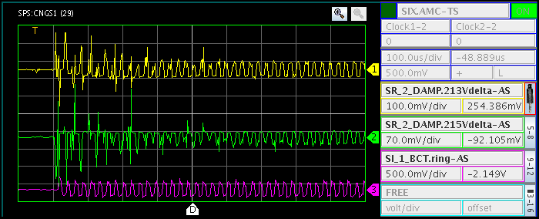
Diagnostics
Delta signals + BCT (100μs/div)
2.13V and 2.15V (CNGS beam – Damper V)

Slide 18
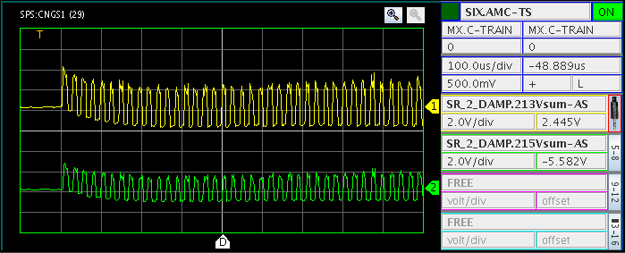
Diagnostics
Sum signals (100μs/div)
2.13V and 2.15V (CNGS beam – Damper V)

Slide 19
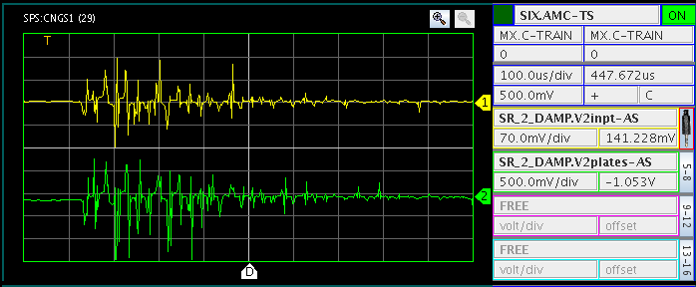
Diagnostics
Input V2 and Plates V2 signals (100μs/div)

Slide 20
Diagnostics
Observation | Diagnostic
- Damper Trip | - Reset and restart
- No signals from the Pick-ups (Δ and Σ) | - Bad contact in the tunnel - Problem pre-ampli alimentation
- Phase error on an ‘Input‘ signal | - MMI datas corrupted (software error)
- Amplitude difference between 2 ‘Plates’ signals of the same plane | - Power Problem
Damping too long - Bad damping | - Need more gain (Trim Editor) Wolfgang’s settings Bad Tune

Slide 21
Few more details..
How the signals are treated in the electronic part of the system ?

Slide 22
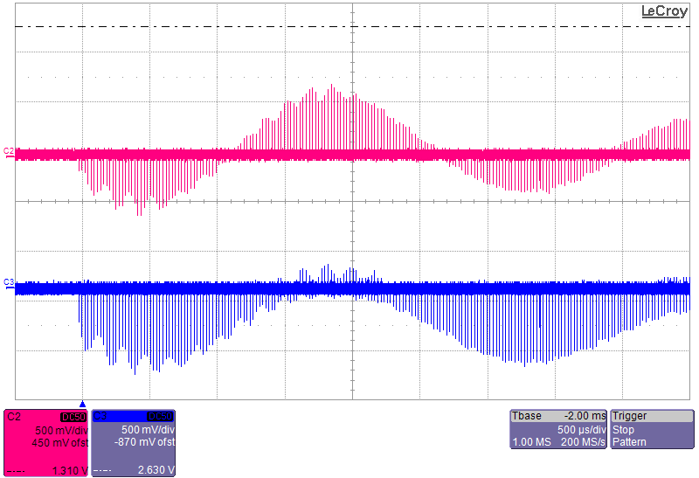
2.04 Δ and 2.06 Δ – H plane (LHC Beam - Single Bunch, scope in SR4)

Slide 23
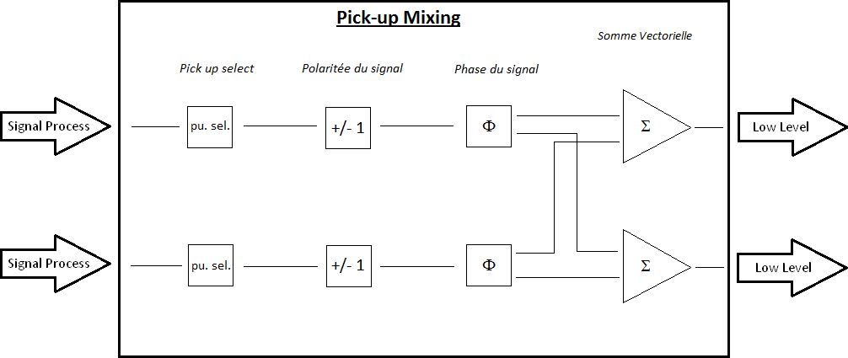
Pick-up Mixing
Main * cos Φ
Aux * sin Φ
➔ Betatron phase advance between p.u. and the kicker has to be = 90°

Slide 24
Pick-up Mixing
Vector sum
Aux. pu Δ
Φ
Main pu Δ
Vector sum = Main*cos Φ + Aux*sin Φ
➔ Betatron phase adjustment is done by combining 2 “orthogonal” (~ 88°) signals with good signs and good ratios

Slide 25
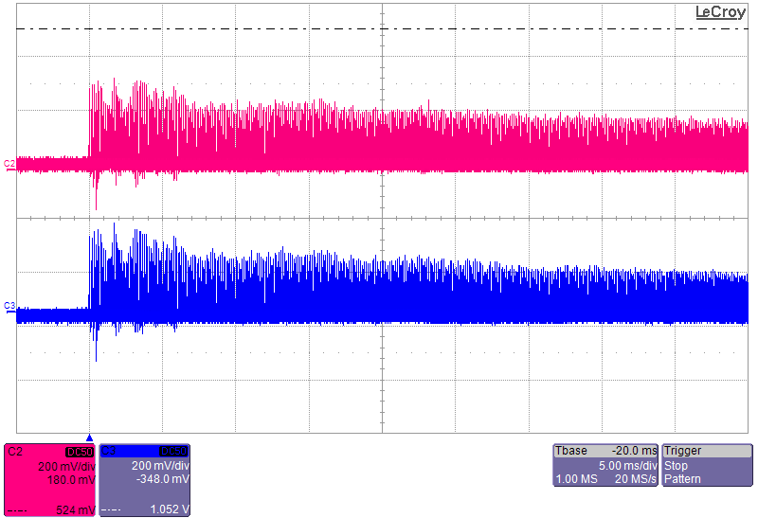
After Pick-up Mixing

Slide 26
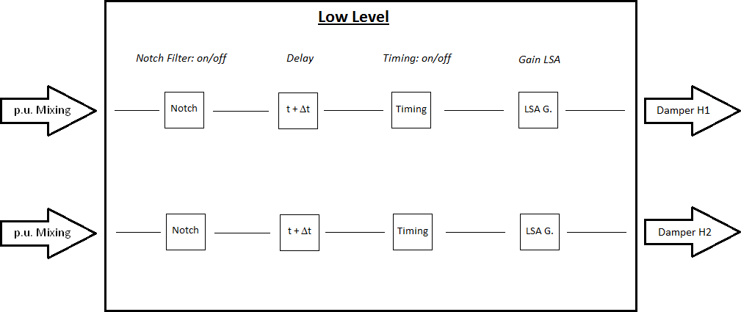
Low Level
Notch Filter does the difference between 2 turns ➔ delete the closed orbit
Delay is to ensure that the signal arrives at the kicker at the right time (right bunch)
(Delay = Δt + temps de vol du signal)
LSA Gain to be adjusted with the Energy of the Beam (damping time & losses)

Slide 27
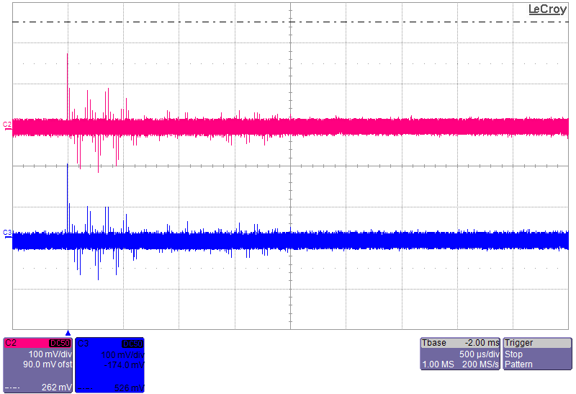
After closed orbit suppression

Slide 28
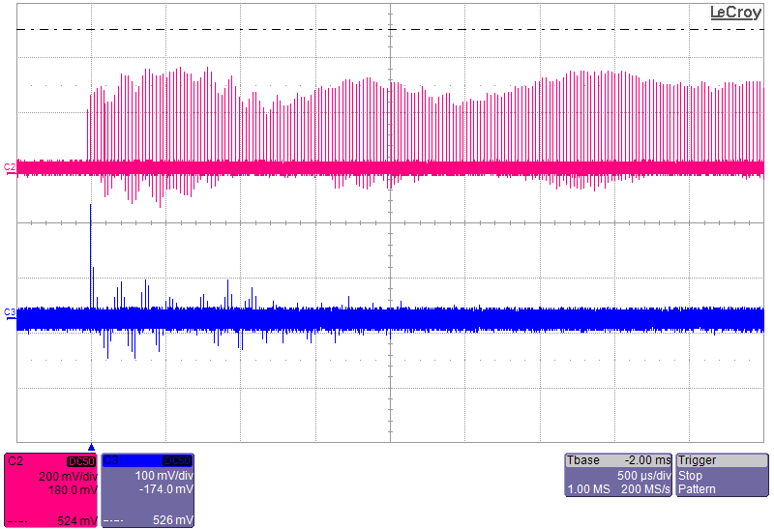
Before & after Notch

Slide 29
Feedback Loop
Position
monitor
Beam
deflector
BEAM
Low Level
Surface – BA2
1st turn: Measurements only
2nd turn: Meas + correct but with orbit offset
3rd turn: Correction OK

