Slide 1
Review of Ferrites on Collimators
LRFF Meeting 31-07-2012

Slide 2
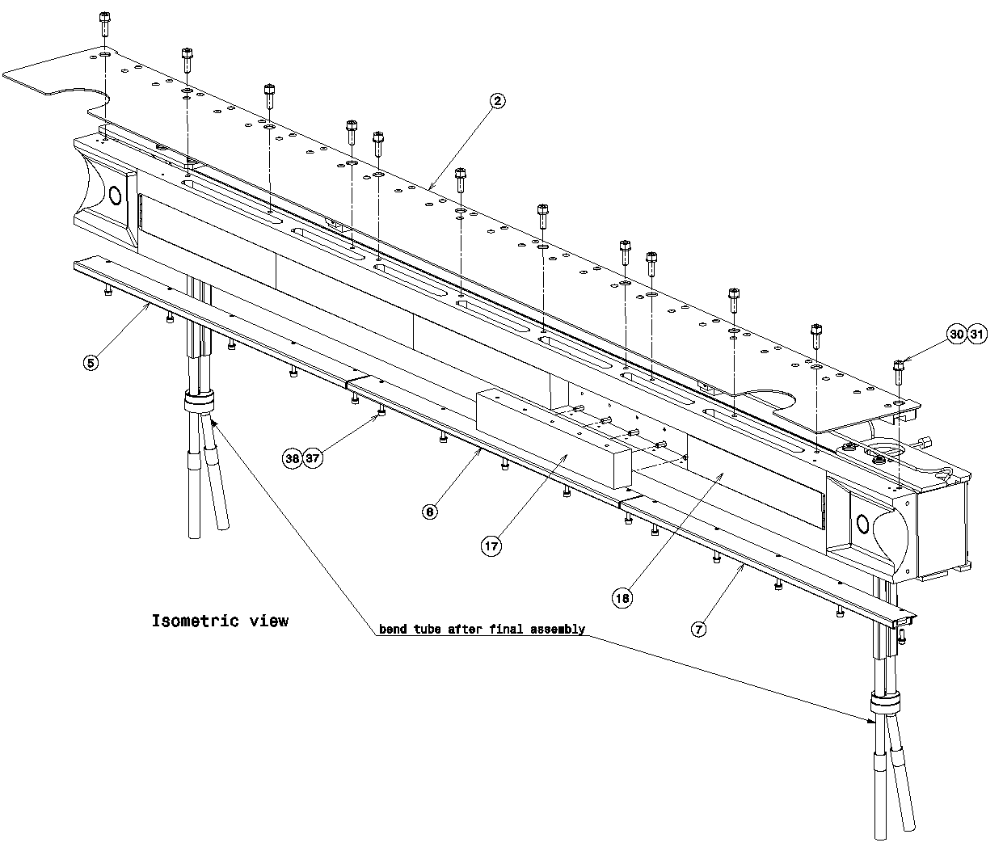
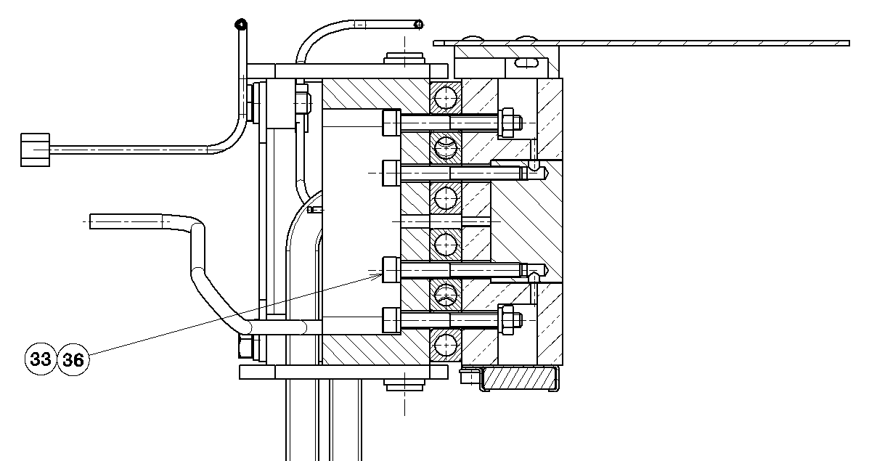
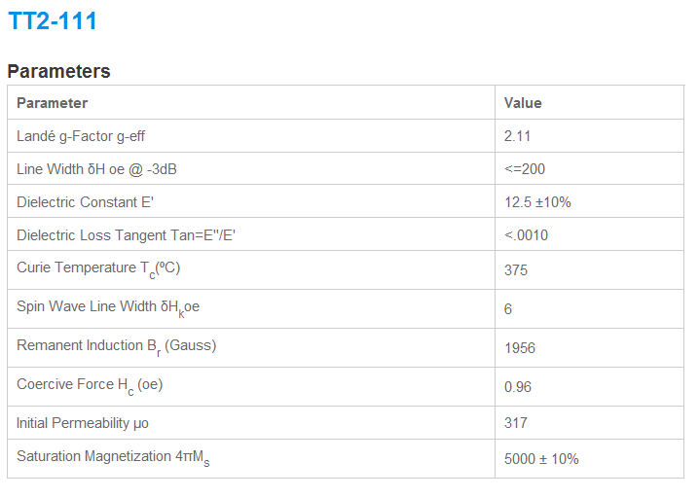
TCTP:
To be implemented…
TT2-111 (Tiles from Skyworks )
Properties of TT2-111 Ferrite
Ferrite
Ref. dwg:
LHCTCTP_0002
LHCTCTP_0027
Notes:
Tile dimension 6x20x397 mm

Slide 3
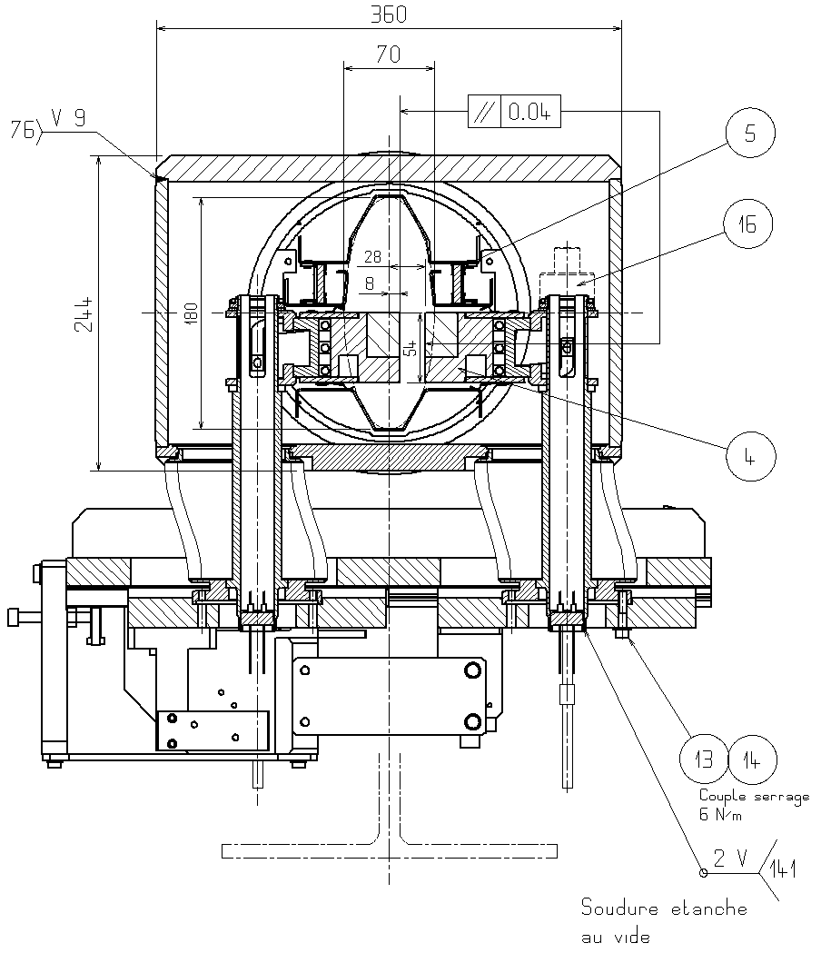
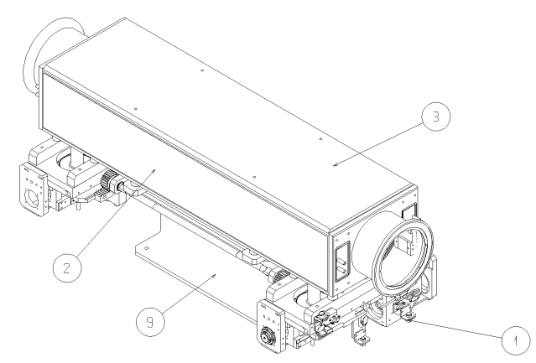
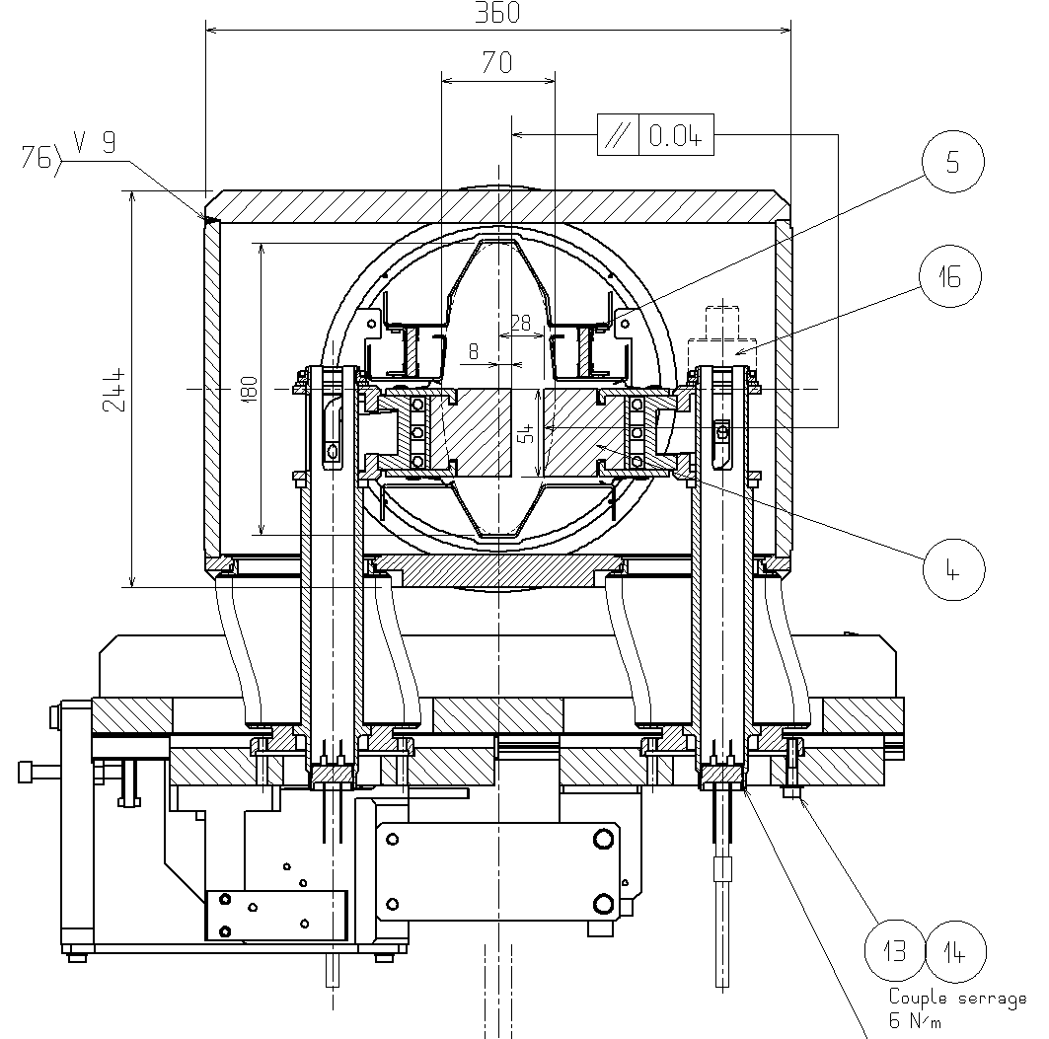
TCTVB (& TCLIA):
Ferrite
RF Fingers
4S60 (NiZn tiles from Ferroxcube)
TCLIA:
Ref. dwg:
LHCTCTVB0001
Ref. dwg:
LHCTCLIA0002
LHCTCLIA0069
Notes:
Tile dimension 6x30x100mm

Slide 4
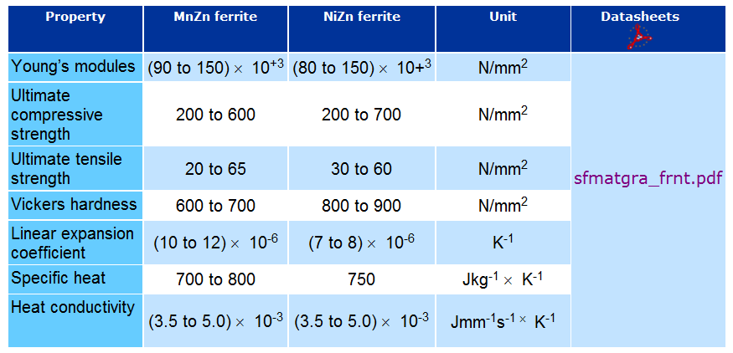
Properties of 4S60 Ferrite:

