Slide 1
Review of ferrites used at CERN to damp HOMs: TE/ABT equipment
M.J. Barnes and W. Weterings
05 June 2012

Slide 2
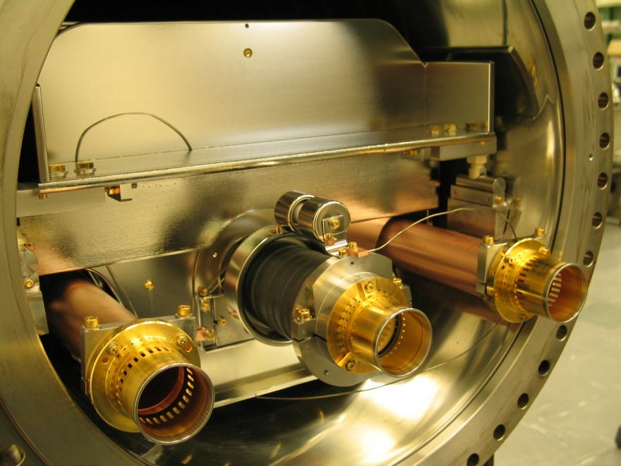
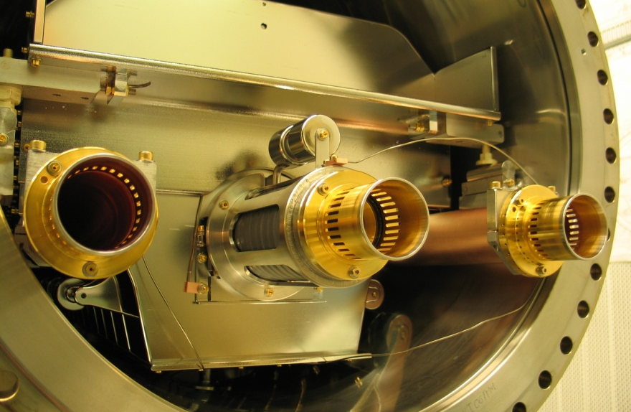
TE/ABT HOM Damping Ferrites
Only HOM damping ferrites in TE/ABT equipment, that we are presently aware of, are in the MKI tank.
Beam impedance reduction ferrites
(lossy + low-loss)
Beam impedance reduction ferrites
(lossy + low-loss)
Damping resistor (now at both ends)
ground
plate
Screen conductors capacitively coupled to “ground”
ground
plate
HV plate
Screen conductors soldered to “ground”
HV plate
capacitor
Kicked Beam
ferrite
yoke
Beam impedance reduction ferrites
(lossy + low-loss)
entrance box connection
TMR connection
Beam impedance reduction ferrite
(lossy + low-loss)
Notes:
NiZn: 4B3; medium permeability.
NiZn: 4M2;
MnZn: 3E25

Slide 3
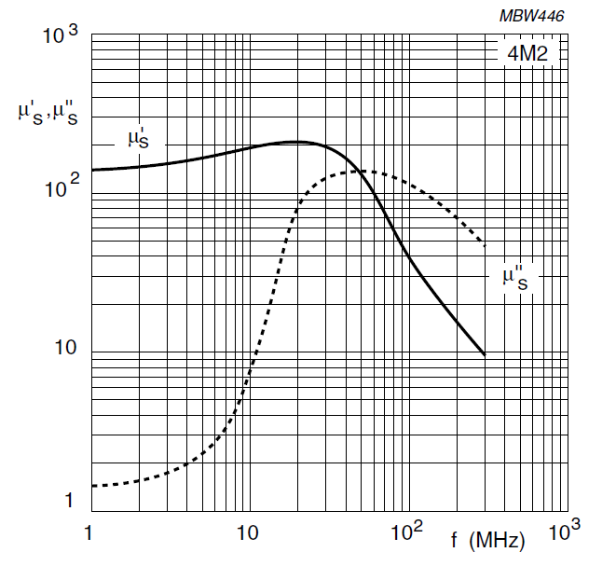
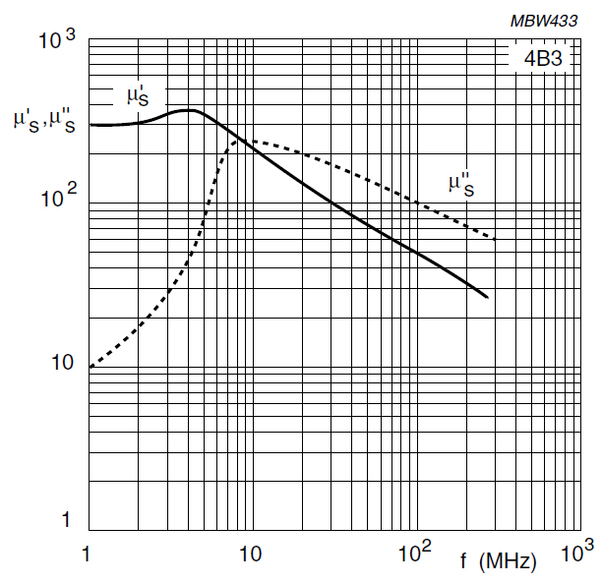
MKI: HOM Damping Ferrites
Each of the two sets of MKI HOM damping ferrites (a.k.a. “beam impedance reduction ferrites”) consists of 9 toroidal cores: 4 or 5 of each of Ferroxcube T87/54/14-4M2 and T87/54/14-4B3 per set.
Treatment - after surface treatment by Marina:
Treatment in air in an oven, ramped at 50°C /hour to 1000°C, plateau of 2 hours, then reduction in temperature at 50°C/hour.
Redo the same treatment but under vacuum.

Slide 4
Other HOM Damping Materials…
The SPS septa and protection elements do not use ferrites to damp HOM’s, but do use a ceramic capacitor with carbon deposit resistors.

