Slide 1
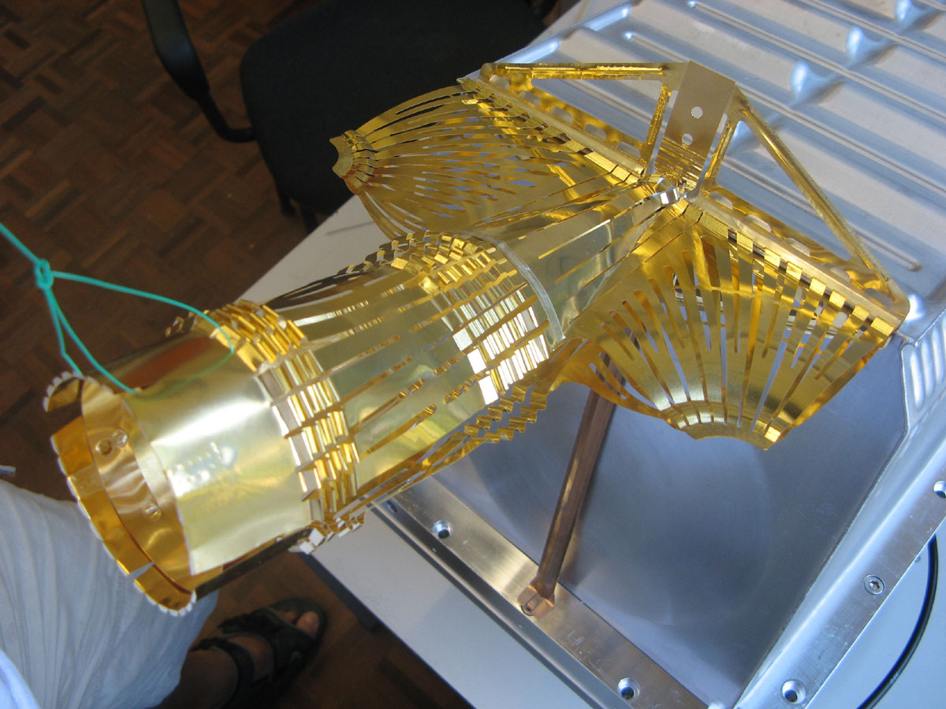
OUTCOMES OF THE LRFF (LHC RF FINGERS) TASK FORCE IN 2012
E. Métral, O. Aberle, R.W. Assmann, V. Baglin, M.J. Barnes, O.E. Berrig, A. Bertarelli, G. Bregliozzi, S. Calatroni, F. Carra, F. Caspers, H.A. Day, M. Ferro-Luzzi, M.A. Gallilee, C. Garion, M. Garlasche, A. Grudiev, J.M. Jimenez, R. Jones, O. Kononenko, R. Losito, J.L. Nougaret, V. Parma, S. Redaelli, B. Salvant, P. Strubin, R. Veness, C. Vollinger, W. Weterings
Some people installed this in the LHC and are very happy!

Slide 2
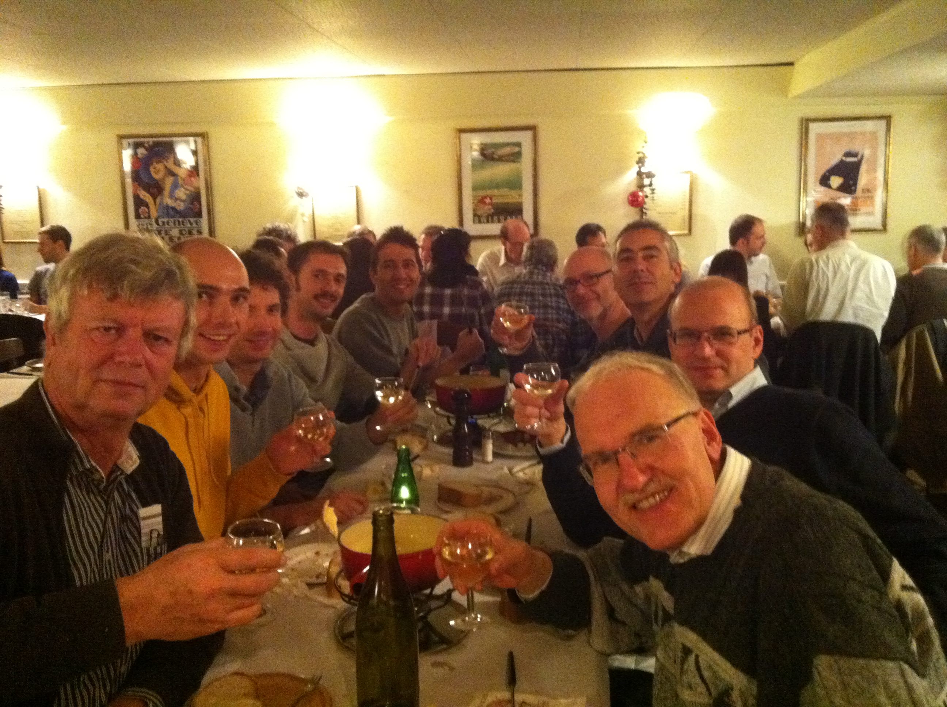
MELTED CHEESE TO AVOID MELTED EQUIPMENTS!

Slide 3
OUTLINE (for 15 min)
Introduction
Why do we need RF fingers and/or ferrite (absorbers)?
Several designs for RF fingers
Possible issues to consider with RF fingers
Typical nonconformities in warm modules found with X-rays
Conclusions and recommendations
Appendix 1: List of all the (92) nonconformities
Appendix 2: VMTSA found with defects in 2011 (8 bellows out of 20)
Appendix 3: “Ideal” outline

Slide 4
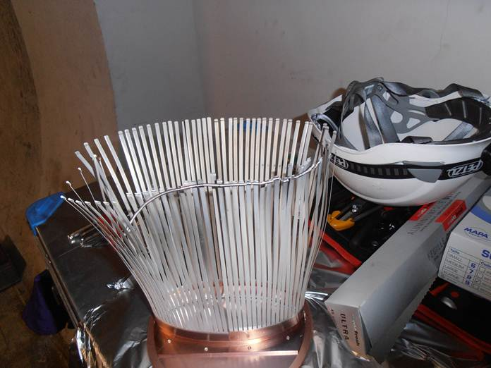
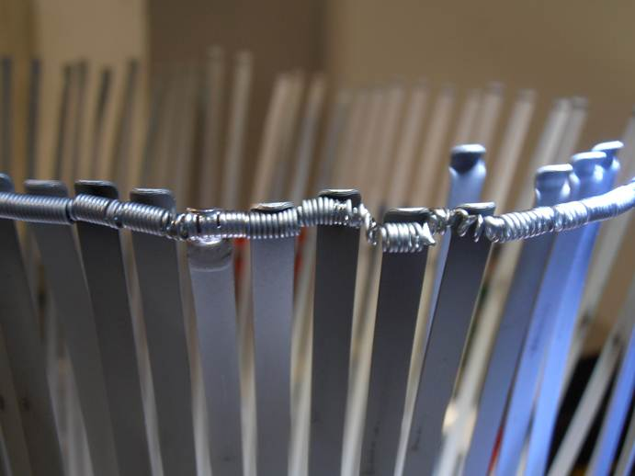
INTRODUCTION (1/3)
Beam-induced heating has been observed in several LHC components during the 2011 run when the bunch/beam intensity was increased and/or the bunch length reduced
In particular 8 bellows, out of the 10 double-bellows modules (called VMTSA) present in the machine, were found with the spring, which should keep the RF fingers in good electrical contact with the central insert, broken
SS spring deformed and brazed to the CuBe RF fingers with RF fingers permanently deformed => Estimated temp. of ~ 800 - 1000 °C
From X-rays

Slide 5
INTRODUCTION (2/3)
Proposition made during the LMC meeting # 119 (18/01/2012) to review the design of all the components of the LHC equipped with RF fingers => LRFF (LHC RF Fingers) Task Force before LS1
Web site: http://emetral.web.cern.ch/emetral/LRFF/LRFF.htm
1st (kick-off) meeting: 20/03/2012
20th (last) meeting: 27/11/2012
Members

Slide 6
INTRODUCTION (3/3)
Mandate
Review the design of all components of the LHC equipped with RF fingers, evaluate the compatibility with ultimate (and HL-LHC) bunch populations (i.e. up to 2.2E11 p/b for the 25 ns beam and 3.5E11 p/b for the 50 ns beam) and (rms) bunch lengths (i.e. 7.5 cm but also ~ 4 cm which could be an option) regarding impedance and HOM screening and provide a list of maximum bunch currents, acceptable bunch lengths etc.
Evaluate all associated mitigation solutions like ferrite absorbers and their collateral effects, in particular the induced heating and resulting outgassing
Make proposals of design changes and/or mitigation measures for each configuration depending on its criticality for beam operation
Approve functional specifications for all equipments by the end of the year (2012)

Slide 7
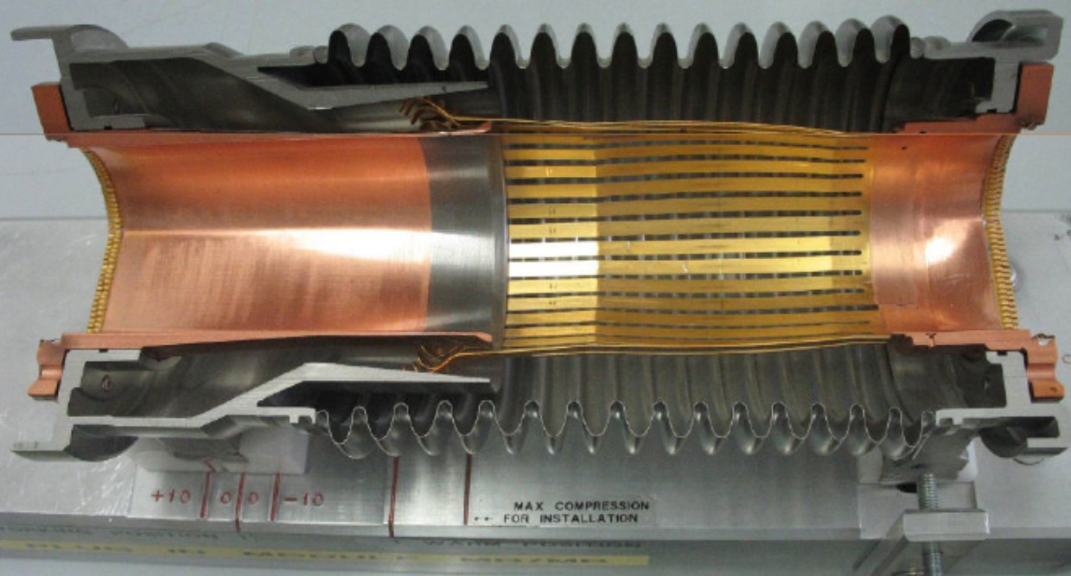
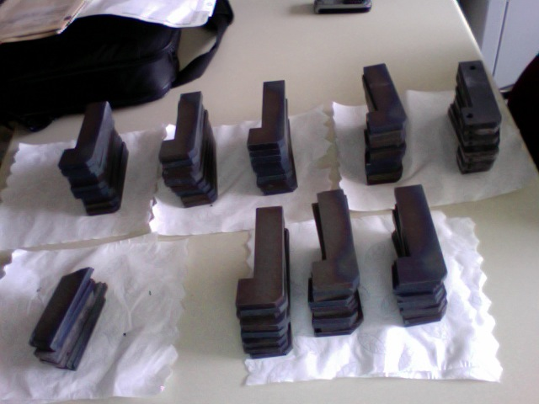
WHY DO WE NEED RF FINGERS AND/OR FERRITE? (1/5)
To avoid having too large impedances (longitudinal or transverse) due to (big) changes of geometry for moving equipments, which can lead to
Beam-induced RF heating (if real part of longitudinal impedance)
Longitudinal or transverse beam instabilities (if real and/or imaginary parts of longitudinal or transverse impedances)
Example of RF fingers:
PIMs = Plug-In Modules
Example of ferrite tiles:
Installed in the new VMTSA
in 2012
Initial dimensions (quickly available!): ~ 12 cm × 3 cm × 1 cm

Slide 8
WHY DO WE NEED RF FINGERS AND/OR FERRITE? (2/5)
Example for the RF heating => Consider the case of a narrow resonance (trapped mode due to the geometry) => 3 parameters (obtained from EM simulations):
Resonance frequency => Assumed to be here f_{r} = 1 GHz
Shunt impedance => Assumed to be here R_{l} = 10 Ω
Quality factor Q => Scanned below
HWHH = Half Width at Half Height
= f_{r} / (2 Q)
Typically between few 10² and few 10³
R_{l}
Coupled-bunch lines
Re ( Z_{l} ) [Ω]
Re ( Z_{l} ) [Ω]
Q = 100
Q = 20
f_{r}

Slide 9
WHY DO WE NEED RF FINGERS AND/OR FERRITE? (3/5)
Power loss formula for the case of a (sharp) resonance (i.e. with only 1 line)
Total beam current:
M = # bunches
I_{b} = N_{b} e f₀
P_{dB} ( f_{r} ) is the power in dB read from a power spectrum (computed or measured) at the frequency f_{r}
~ 1 for HL-LHC
Typically below few 10s of kΩ (between few 100s Ω and few kΩ)

Slide 10
WHY DO WE NEED RF FINGERS AND/OR FERRITE? (4/5)
Consider the following (analytical) distribution
Computed P_{dB} ( f )
5 kΩ gives 1 W at 1.4 GHz

Slide 11
WHY DO WE NEED RF FINGERS AND/OR FERRITE? (5/5)
Assuming the same shape of the profile

Slide 12
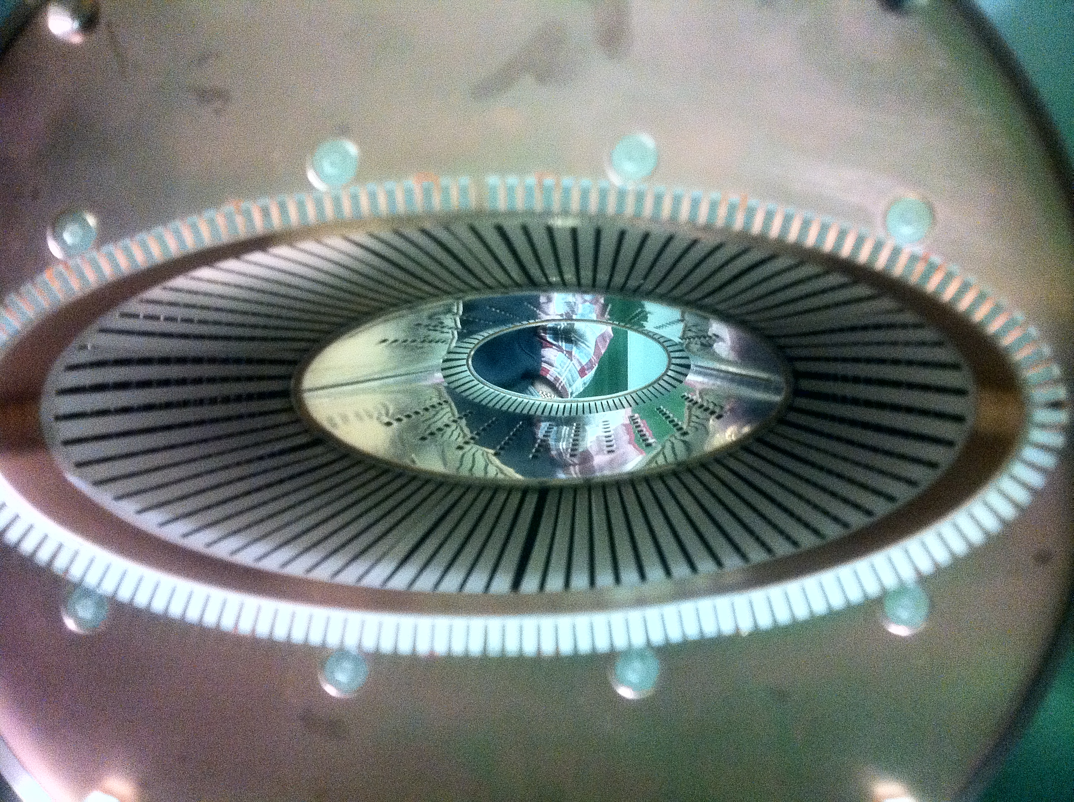
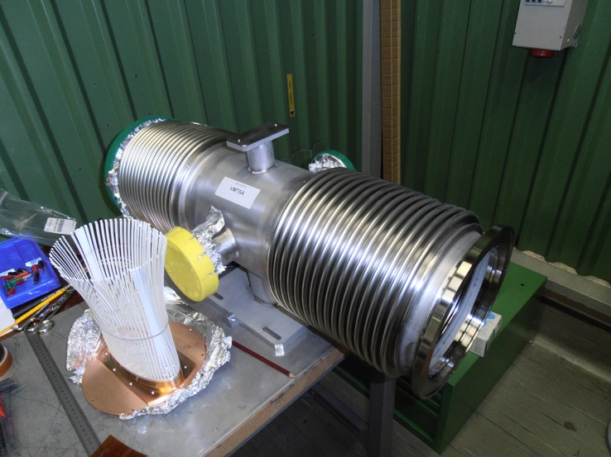
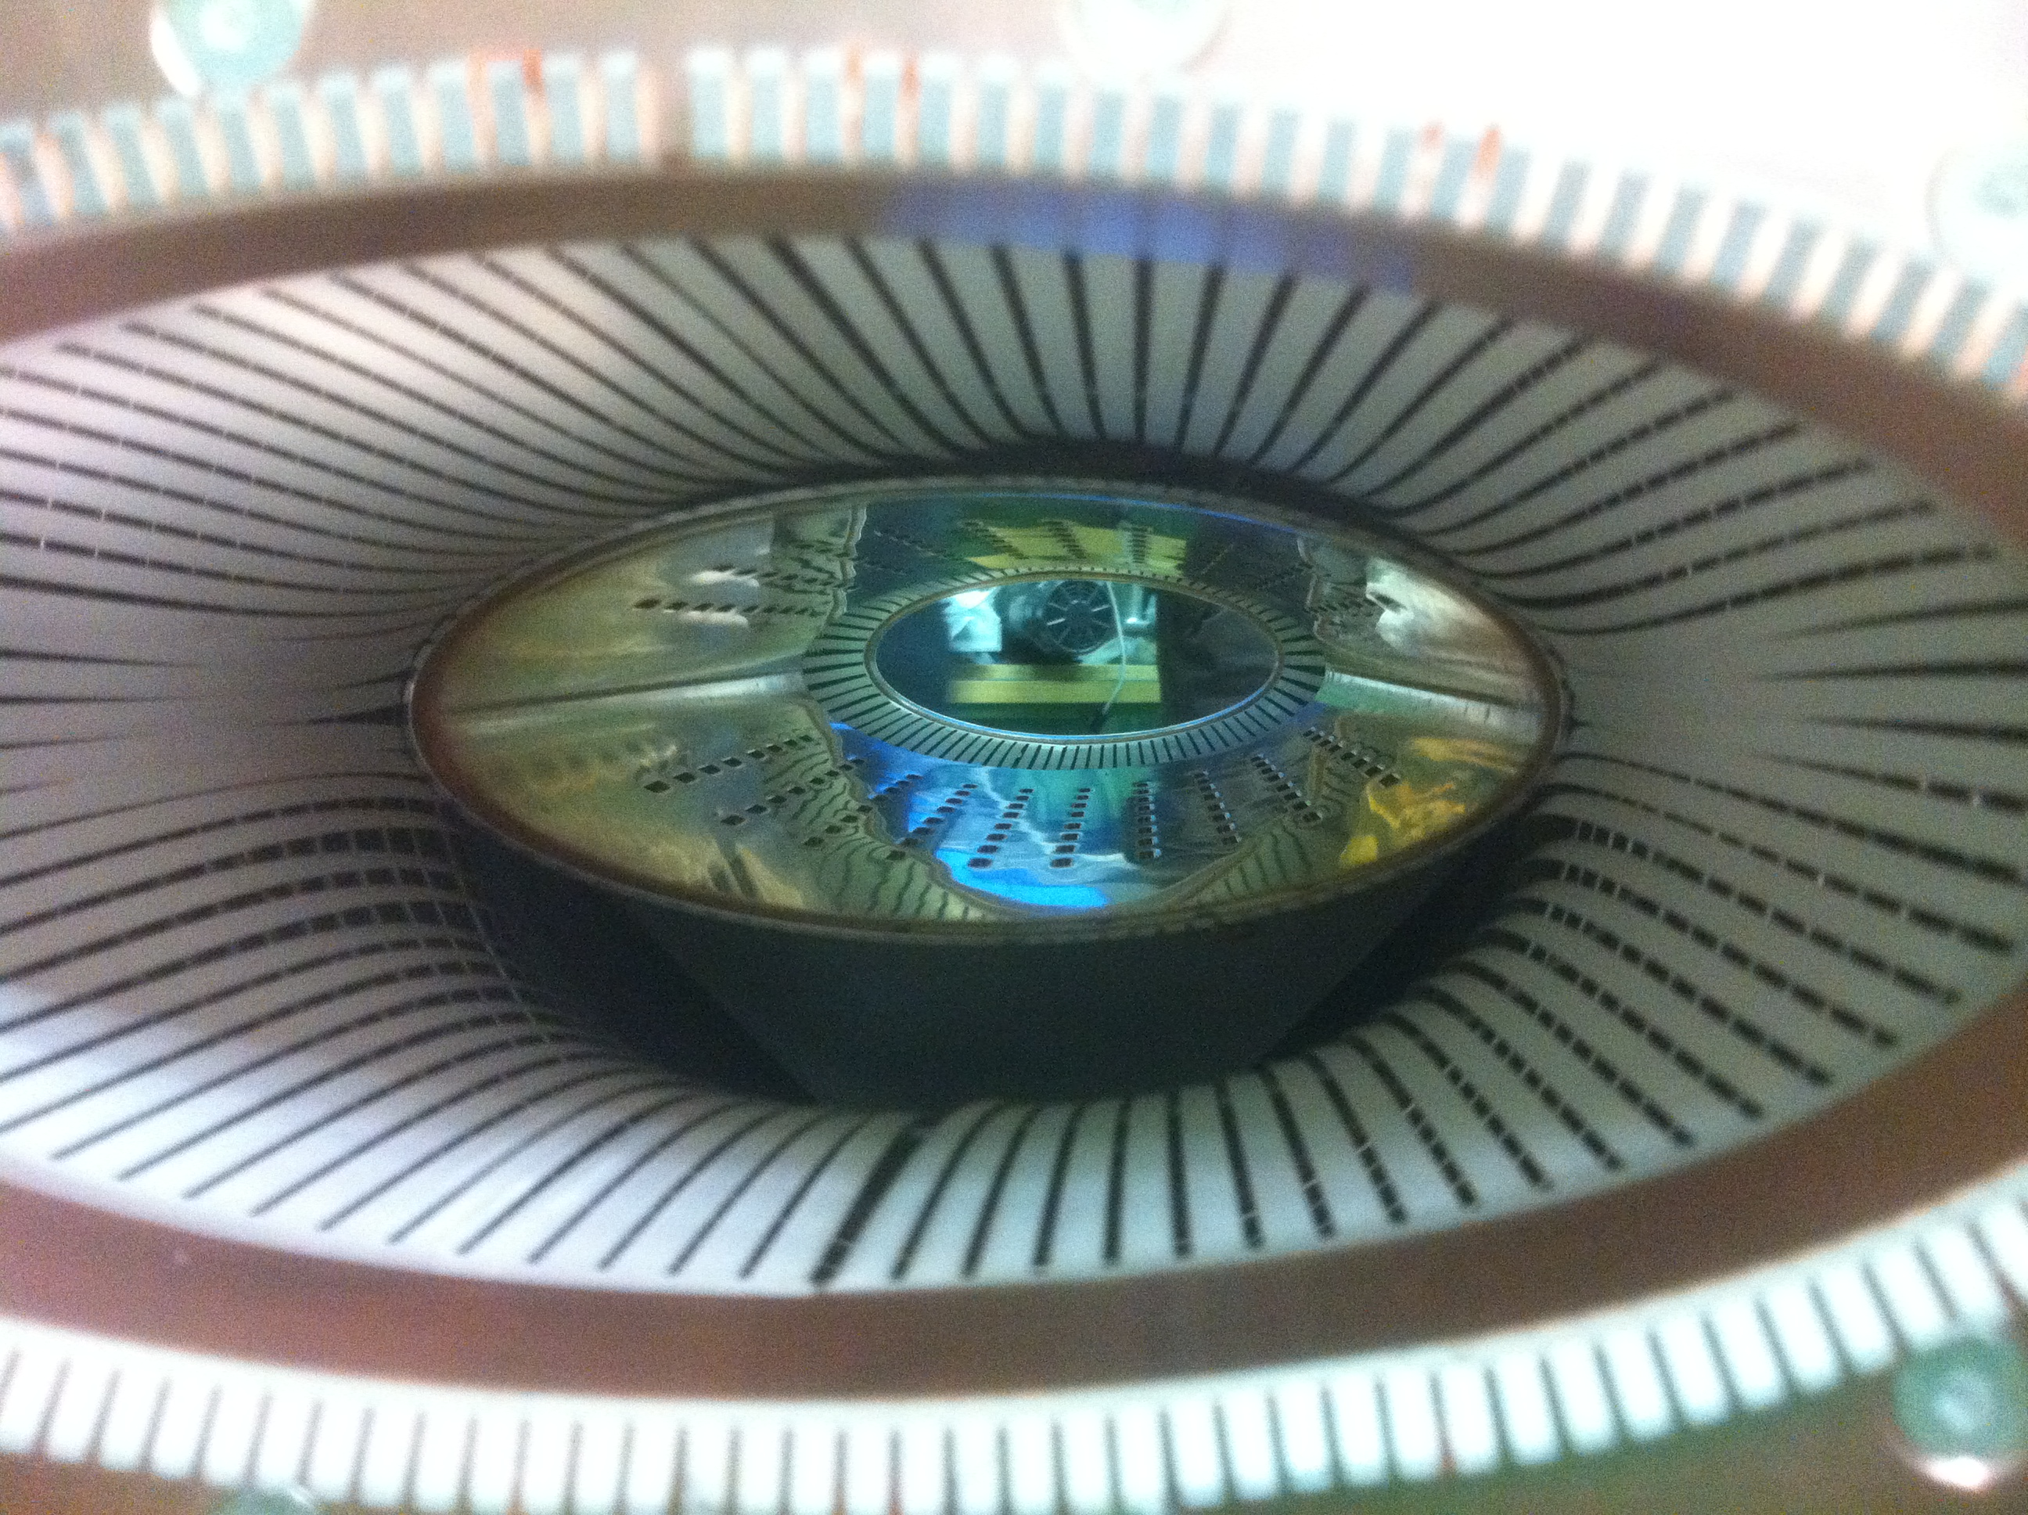
SEVERAL DESIGNS FOR RF FINGERS (1/3)
1) Funnel for the PIMs
For case of longitudinal movement (only)
Good for contact / gap
Possible issue with buckling and aperture restriction
Funnel
RF contact fingers to shield the distorted geometry of the bellows from the beam
Spring (to be put at the extremity of the RF fingers where there is a groove)
Conforming RF fingers
2) Spring for the VMTSA
For case of transversal movement
Possible issue with contact / gap (due to elliptical shape) => RF heating
Possible issue with aperture restriction
Big gap created in case the spring is NOT in place

Slide 13
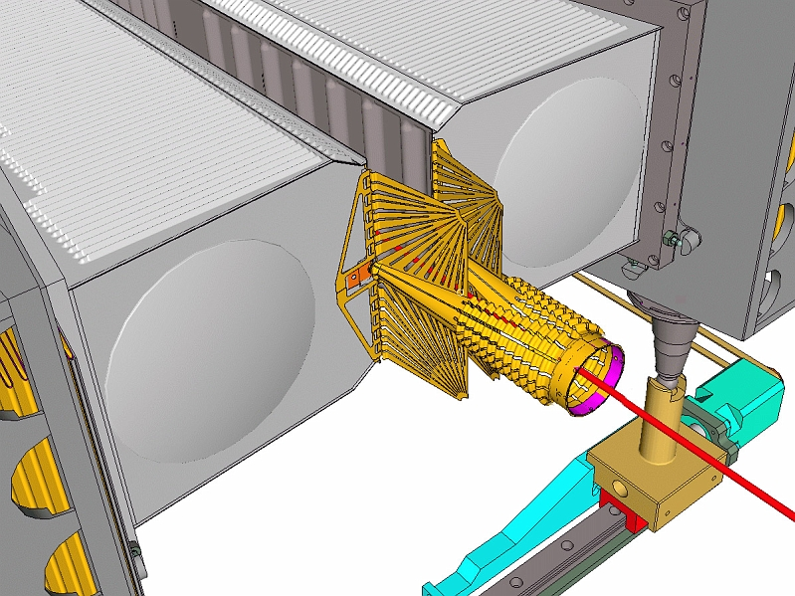
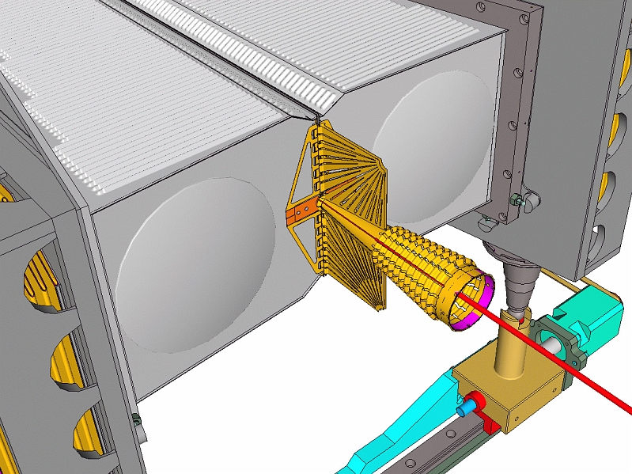
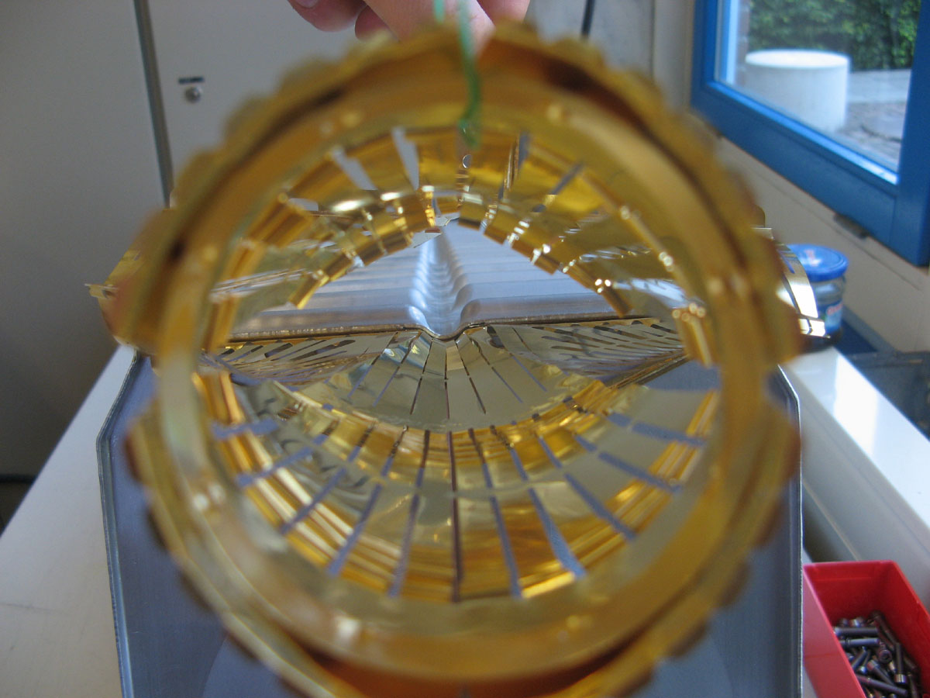
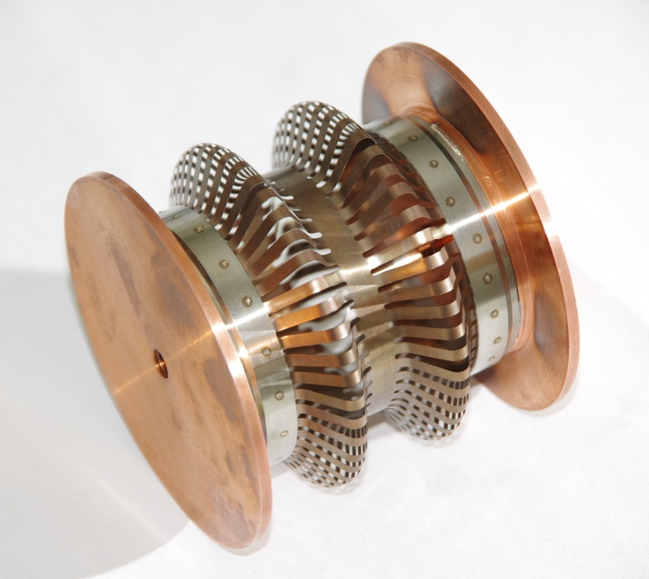
SEVERAL DESIGNS FOR RF FINGERS (2/3)
3) Fixed extremities for the LHCb VELO (VErtex LOcator)
Seems to work very well!
Well-studied VELO design in terms of impedance effects paid off => No issue observed
Future upgrade: Reduction of the inner radius of the foil (from 5.5 to 3 − 4 mm)
4) New RF design from TE/VSC
1st prototype based on 2 convolutions manufactured this year. Tests ongoing
Issue: Imaginary part of the longitudinal impedance (if many and not elongated)
Device EM longer than mechanically due to induced current having to follow the convolutions

Slide 14
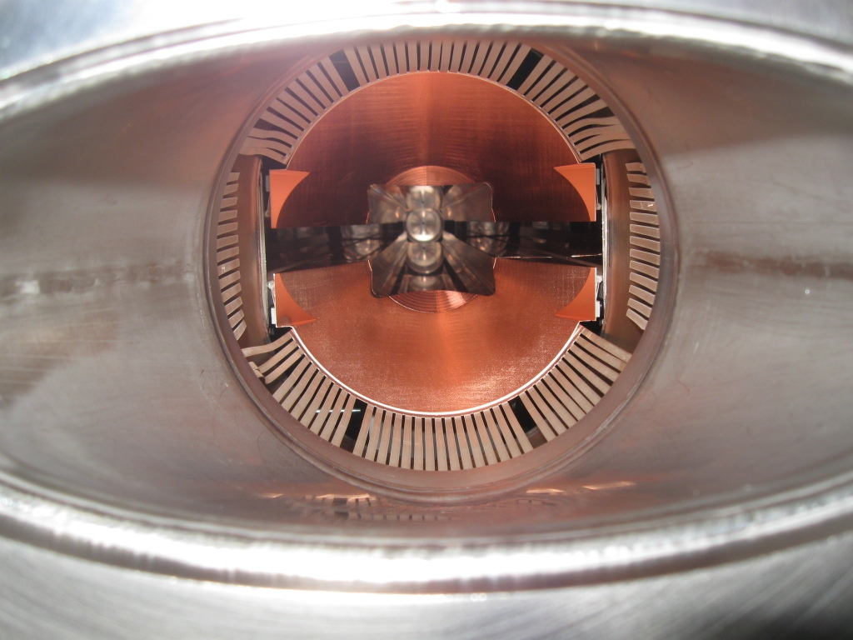
SEVERAL DESIGNS FOR RF FINGERS (3/3)
5) Longitudinal sliding contacts for collimators
Initial proposal for 1st (SPS) prototype (2003)
Uncoated CuBe fingers sliding on C/C
Electrical contact resistance ~ 30 mΩ (specification: 1 mΩ) => Redesign necessary
Solution to the pb observed with the TCDD

Slide 15
POSSIBLE ISSUES TO CONSIDER WITH RF FINGERS
RF fingers for PIMs
Low contact resistance < 0.1 mΩ (i.e. 3 mΩ / RF finger as there are 30 RF fingers in //)
No cold welding
Low friction
Good formability properties
RF fingers for collimators
Same as above with contact resistance < 1 mΩ
Resistance to bake out: 250°C / 1000 h
Resistance to heating => Good thermal conductivity
Wear after many cycles “open-close of the jaws” (1500 cycles ~ 4 years)
Good electric contacts requires
Low surface roughness
Soft metals (at least one)
No oxide layer at the surface

Slide 16
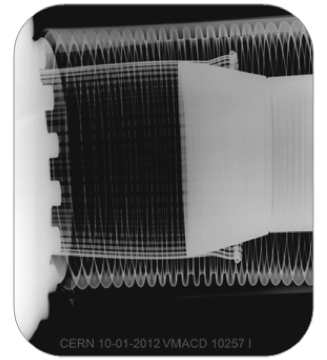
TYPICAL NONCONFORMITIES IN WARM MODULES FOUND WITH X-RAYS (1/2)
1800 X-rays taken
92 NC (~ 5 %) => 2 types of design: circular and elliptical (VMTSA)
58 vacuum sectors concerned out of 190 at room temperature (88 sectors at cryogenic temperature)
CONFORMITY

Slide 17
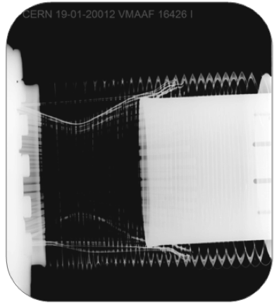
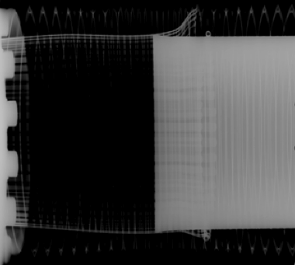
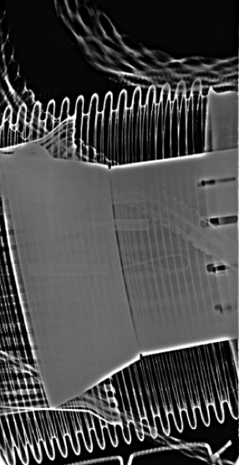
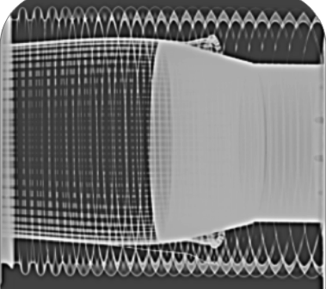
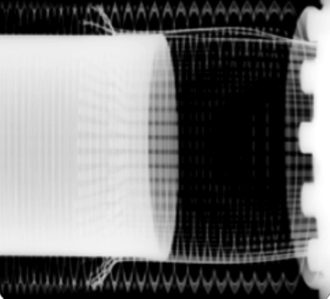
TYPICAL NONCONFORMITIES IN WARM MODULES FOUND WITH X-RAYS (2/2)
NONCONFORMITIES

Slide 18
CONCLUSIONS AND RECOMMENDATIONS (1/3)
A lot of experience has been accumulated at CERN over the past decades for the use of RF fingers and/or ferrite absorbers
This experience needs to be (and will be) summarized in a forthcoming internal report
Guidelines for the use of RF fingers
Guidelines for the use of ferrite absorbers => Nominated “ferrite responsible persons” at CERN: Fritz Caspers and Christine Vollinger
Several designs of RF fingers are used in the LHC depending on the requirements
Some have been studied in great detail
=> Takes time but it paid off!
New design from TE/VSC under careful checks

Slide 19
CONCLUSIONS AND RECOMMENDATIONS (2/3)
VMTSA issues observed in 2011 have been reproduced by simulations and traced back to be due to a gap between some RF fingers and central insert
The spring acted as a fuse => Robust mechanical design needed
No issue at all this year => Our modifications during last year Xmas break’s crash program were sufficient to assure a good contact
All the VMTSA modules will be removed during LS1
Full list of the 92 nonconformities revealed in warm modules after X-rays campaign => Should be repaired during LS1
For the cases studied, we didn’t see any problem with impedance for conforming RF fingers => No (big) pb expected for HL-LHC bunch populations (i.e. up to 2.2E11 p/b for the 25 ns beam and 3.5E11 p/b for the 50 ns beam)
=> Top priority for the future: Robust mechanical design to keep the contacts of all the RF fingers (e.g. with funnel as for the PIMs, or fixed extremities) + Very careful installation

Slide 20
CONCLUSIONS AND RECOMMENDATIONS (3/3)
BUT the big problem is the possible very short bunch of ~ 4 cm
2012 run made with ~ 10 cm rms bunch length
Nominal (rms) bunch length = 7.5 cm (for both LHC and HL-LHC) and ~ 4 cm was also considered for HL-LHC => Needs many careful checks!!
Assuming the same shape of the profile
5 kΩ gave 1 W at 1.4 GHz for 9 cm => Becomes ~ 2 kW for 4.5 cm

Slide 21
APPENDIX 1: LIST OF ALL NONCONFORMITIES (1/3)

Slide 22
APPENDIX 1: LIST OF ALL NONCONFORMITIES (2/3)

Slide 23
APPENDIX 1: LIST OF ALL NONCONFORMITIES (3/3)

Slide 24
APPENDIX 2: VMTSA FOUND WITH DEFECTS IN 2011
=> 10 modules (each of 2 bellows) in total in 2011. 8 bellows were found with defects (see arrows below)

Slide 25
APPENDIX 3: “IDEAL” OUTLINE (1/2)
But no time in 15 min
Introduction
Why do we need RF fingers and/or ferrite (absorbers)?
What we planned to do
What was done
RF fingers
Several designs
Possible issues to consider
Example of a known issue with a TCDD
Typical nonconformities found with X-rays
List of all the nonconformities
Recent issues observed with RF contacts in SPS
Guidelines

Slide 26
APPENDIX 3: “IDEAL” OUTLINE (2/2)
But no time in 15 min
Ferrite absorbers
Several types, criteria and guidelines
Measurements of the EM properties
Figure of merit and design guidelines for the ferrite heating
Measurements of the vacuum properties
Pros and cons of RF fingers and ferrite absorbers
What was wrong with the PIMs in the cold part of LHC?
Follow-up of VMTSA issues in 2011
Conclusions and recommendations
=> See last meeting of the LRFF TF: http://emetral.web.cern.ch/emetral/LRFF/20thMeeting_27-11-12/LRFF_EM_03-12-12_AfterMeetingComments_Final.pptx (76 slides)
=> See yesterday’s summary at TE-TM: http://emetral.web.cern.ch/emetral/LRFF/SummaryAtTE-TM_11-12-12/LRFF_EM_11-12-12_TE-TM.pptx (55 slides)

