Slide 1
New design for RF fingers
C. Garion
Acknowledgements to A. Lacroix and H. Rambeau for materials and help.

Slide 2
Outline
Brief introduction
Concept of this RF finger:
Principle
Comparison with present technology
Design of the RF fingers
Mechanical behavior
Fatigue tests and prototyping
Next steps
Conclusion

Slide 3
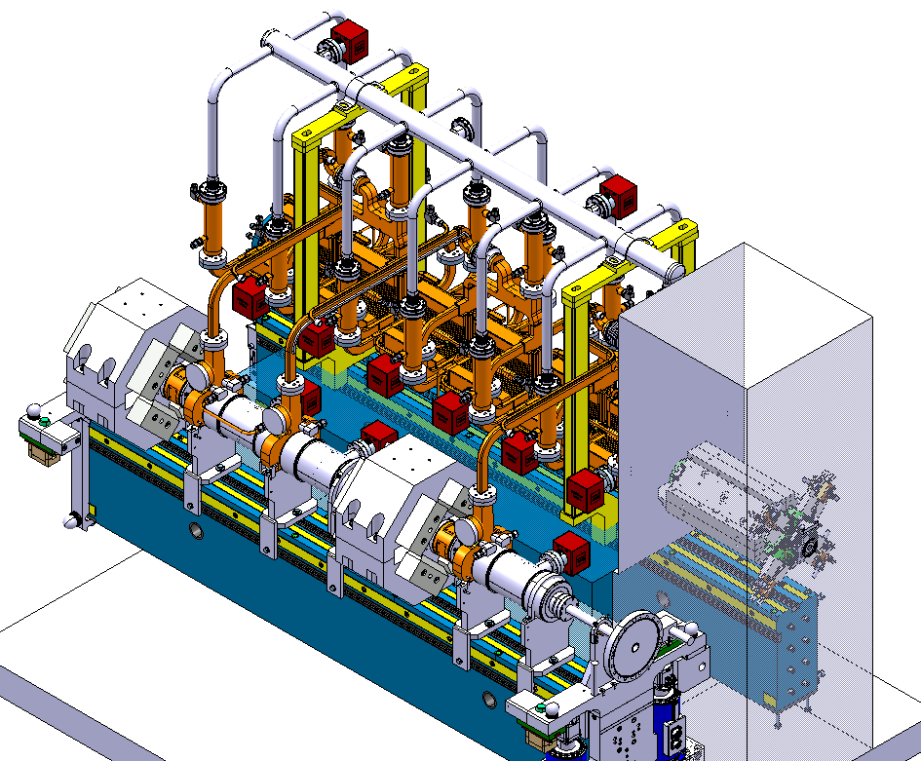
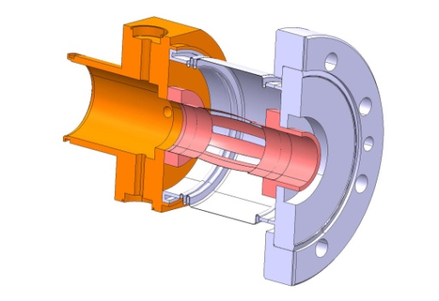
Introduction
Aim of the presentation:
Present and give a status of the current development on deformable RF finger concept.
Framework of the development:
The study has been initiated for the CLIC study, in particular for the drive beam interconnections in two beam modules.
Two beam module
Drive beam interconnection concept

Slide 4
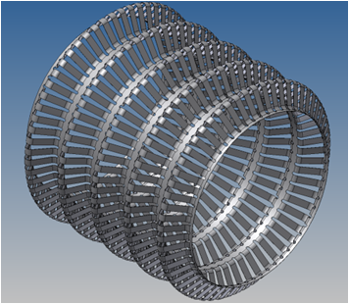
Concept of this RF finger
Principle:
Deformable thin walled sheet:
with both extremities attached to the adjacent chamber
sort of corrugated bellows in free position
almost straight in operation position
Convolutions with meridional grooves to:
avoid circonferential stresses during displacements
pump the volume between the fingers and the bellows

Slide 5
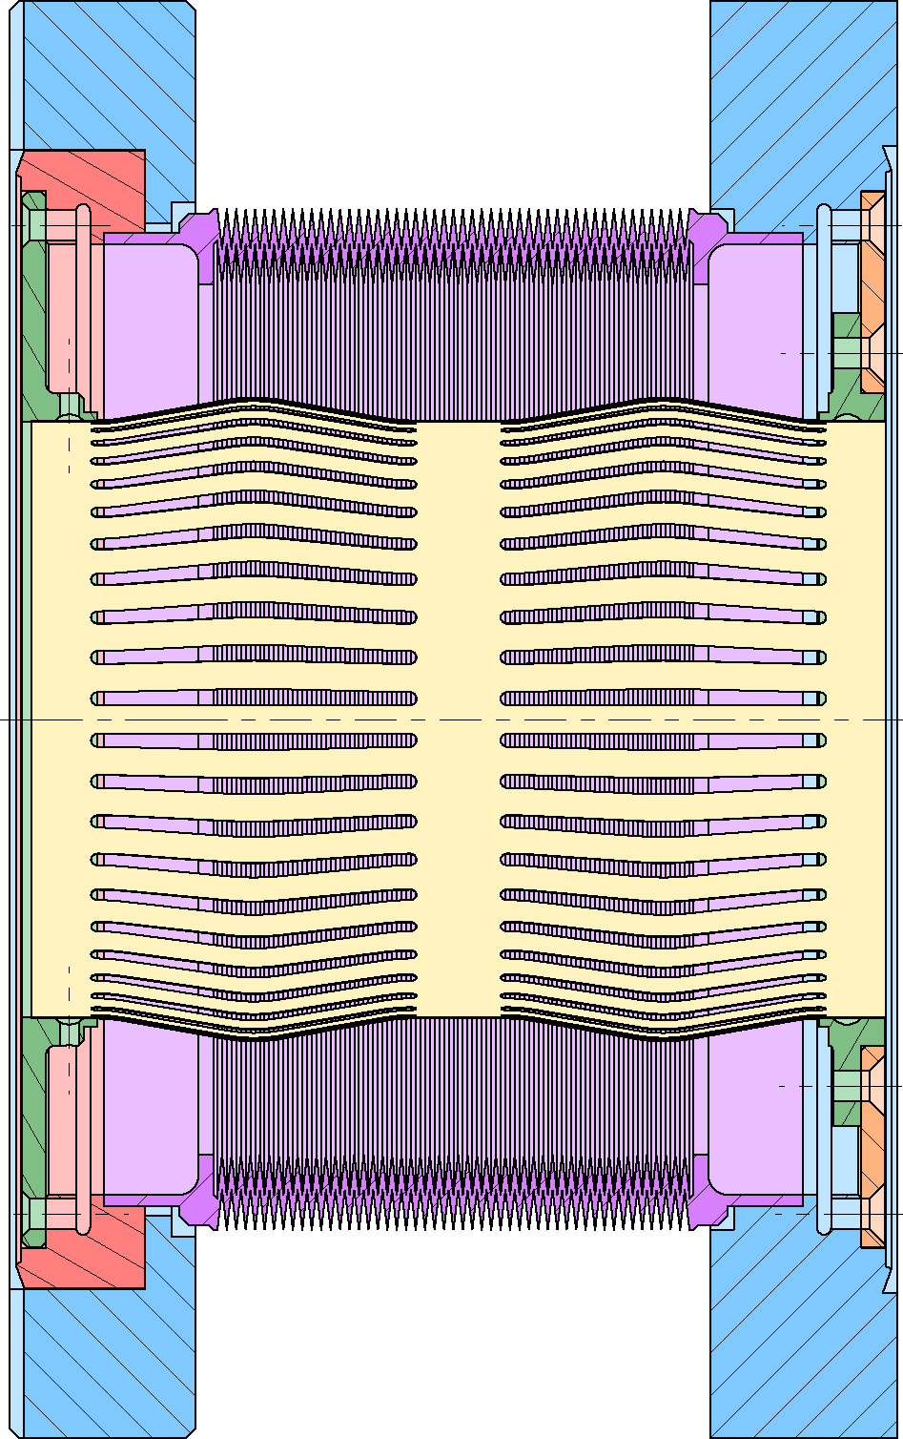
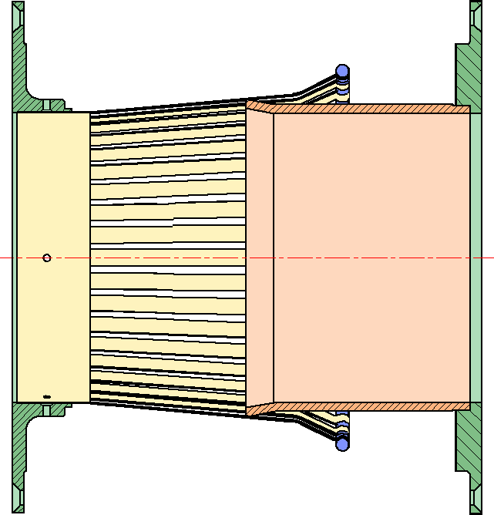
Concept of this RF finger
Comparison with present design
Principle: deformable body
Principle: “Rigid” sliding body
 | Deformable RF finger | Sliding RF finger
Electrical resistance | Material conductivity | Material conductivity + Contact resistance
“Smoothness” | undulations | Step
Span | Given by the convolution shape (~35 mm) | Given by the module length/stroke
Mechanical tolerances | Limited in extension | Limited by spring/contact issues
Reliability | Limited by fatigue | Contact ageing Buckling
Some comparison points

Slide 6
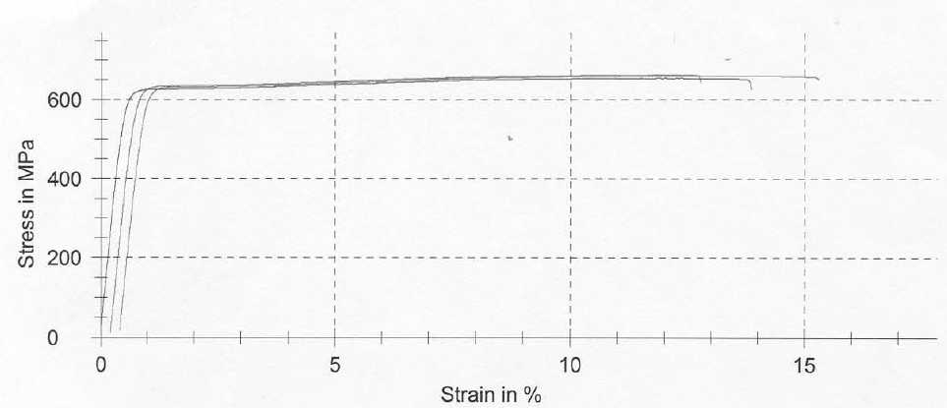
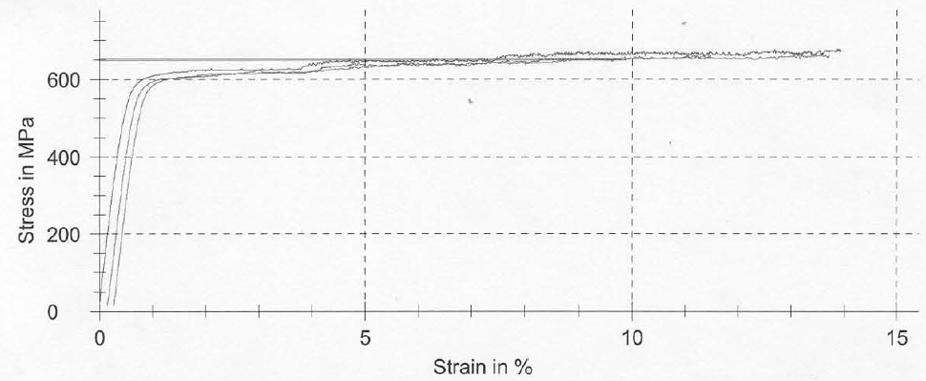
Design of RF finger
Material choice:
Presently, CuBe C17200 alloy (1/2 H) has been used for first tests.
Gold coating can (and has to) be done to increase surface conductivity.
Tensile tests at RT
Tensile tests at 150 °C
Temperature [°C] | Young Modulus [GPa] | Yield stress [MPa] | Tensile strength [MPa] | Elongation A%
20 | 117 | 616 | 659 | 13.2
150 | 117 | 580 | 668 | 12.4
Material has been modelized by an elastic-plastic model with a linear kinematic hardening.

Slide 7
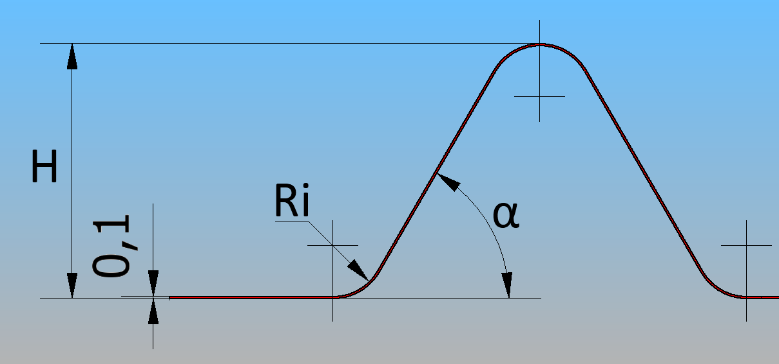
Design of RF finger
Geometrical parameters (free position):
Sheet thickness (t)
Convolution height (H)
Angle α₀ (α in free position)
Bending radius (Ri)
Number of convolutions
Number of strips
Ratio of width strip/gap
t
Mainly driven by mechanics
RF

Slide 8
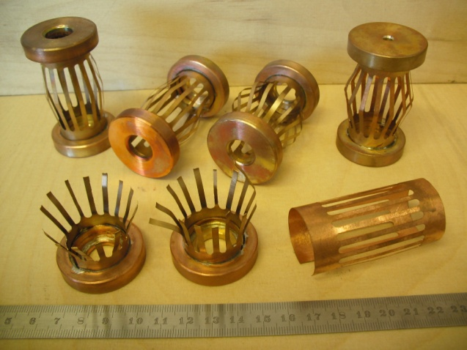
Design of RF finger
Geometrical parameters (free position):
t
Sheet thickness (t): t↓, fatigue life ↑
First tests with rough geometry and thickness of 0.05, 0.1 and 0.2 mm: 0.1 mm thick is a good compromise between fatigue life and robustness.
Convolution height (H)
Fixed to 12.5 mm which corresponds to the space needed for screws, rings,… This value is usual in common design between the fingers and the bellows

Slide 9
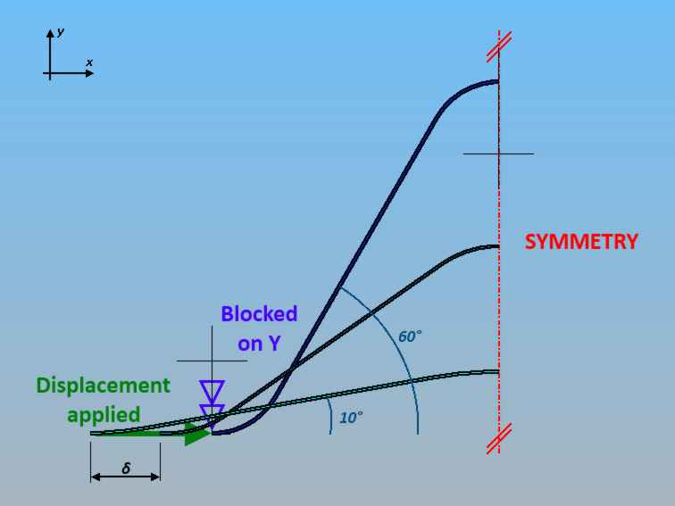
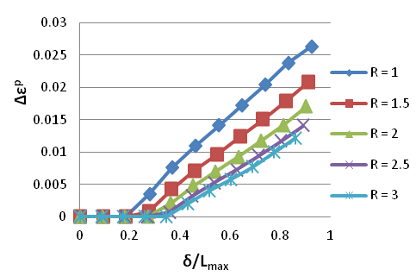
Design of RF finger
Geometrical parameters (free position):
t
Angle α₀ (α in free position)
Compressive force has to be minimized to prevent column buckling, especially for several convolution fingers
Usual maximum stroke for a bellows is 50% of its free length
→ α₀= 60 °
Bending radius (Ri)
It is optimised for fatigue, driven by
the plastic strain. Plastic strain over a
cycle is almost minium for bending radius
Ri =2.5 mm.
L_{max}

Slide 10
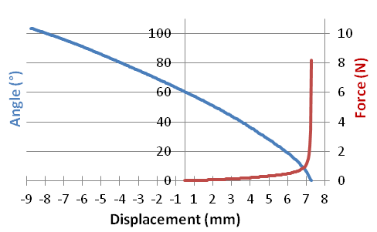
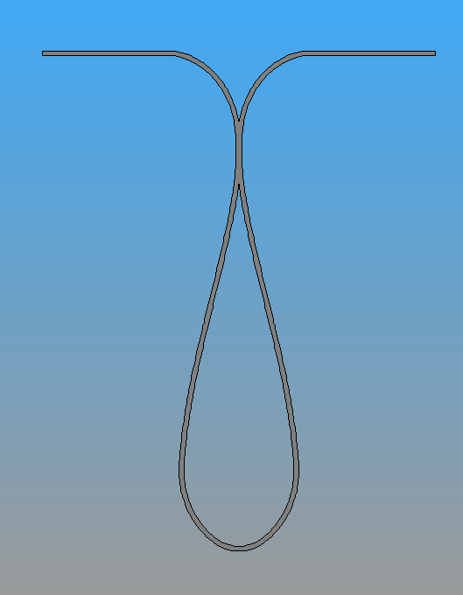
Mechanical behaviour
Axial stroke:
Evolution of the angle α and the axial force as a function of the axial displacement (on half a convolution):
Finger ~ straight
Finger in contact
L_{max}
Maximum stroke per convolution
 | Nominal angle [°]
 | 5 | 10 | 15 | 20
Nominal extension | 13.1 | 12.4 | 11.6 | 10.9
Nominal compression [mm] | -16.5 | -16.5 | -16.5 | -16.5
Tolerance in extension [mm] | 0.28 | 0.94 | 1.64 | 2.39
→ α_{operation} is a key parameter for RF but for mechanics also.

Slide 11
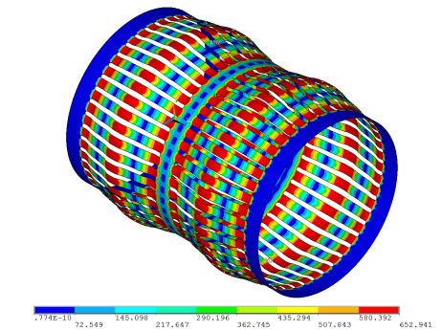
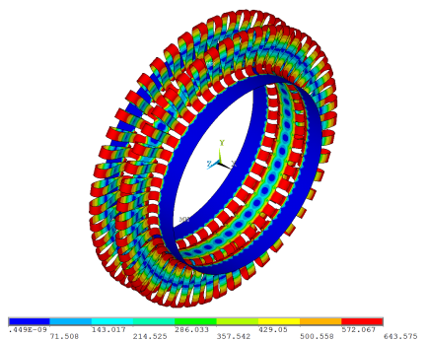
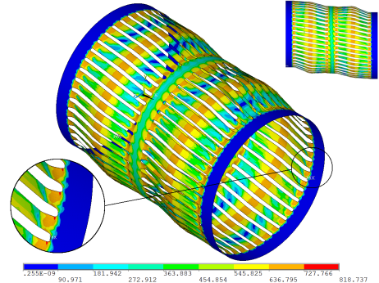
Mechanical behaviour
3D behaviour and misalignement study:
3D shell model with geometrical and material non-linearity:
stress-strain analysis,
buckling study
Elongation (α = 10° Working position)
Compression
Offset
Twist study to be done

Slide 12
Fatigue tests
Low cycle fatigue:
Manson-Coffin equation is used to determine the low cycle fatigue:
β and C are 2 material parameters
Number of cycles to failure
Accumulated plastic strain over a cycle
Fatigue tests:
Fatigue life tests on unrolled geometry, standard CERN C17200 alloy

Slide 13
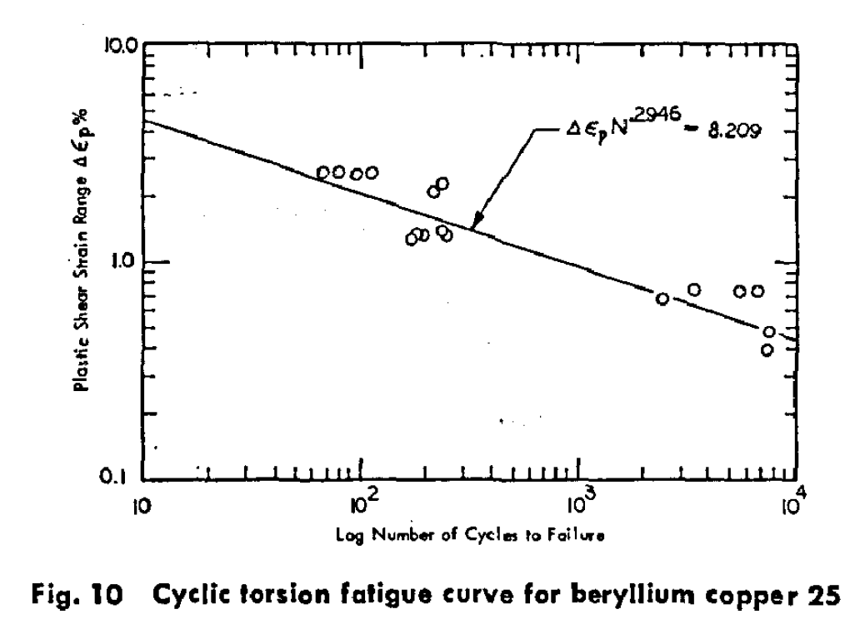
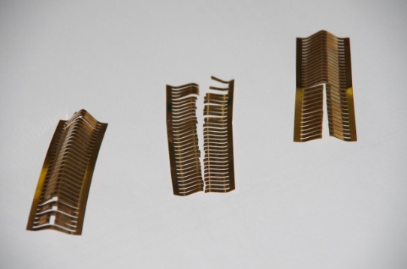
Fatigue tests
Fatigue tests results:
Effect of axial compression on low-cycle fatigue of metals in torsion
B. Mazely, T.H. Lin, S.R. Lin, C.K. Yu
Observations:
All failures occurred at the crest of the convolutions (predicted by FE analysis).
Fingers remains outward the aperture.

Slide 14
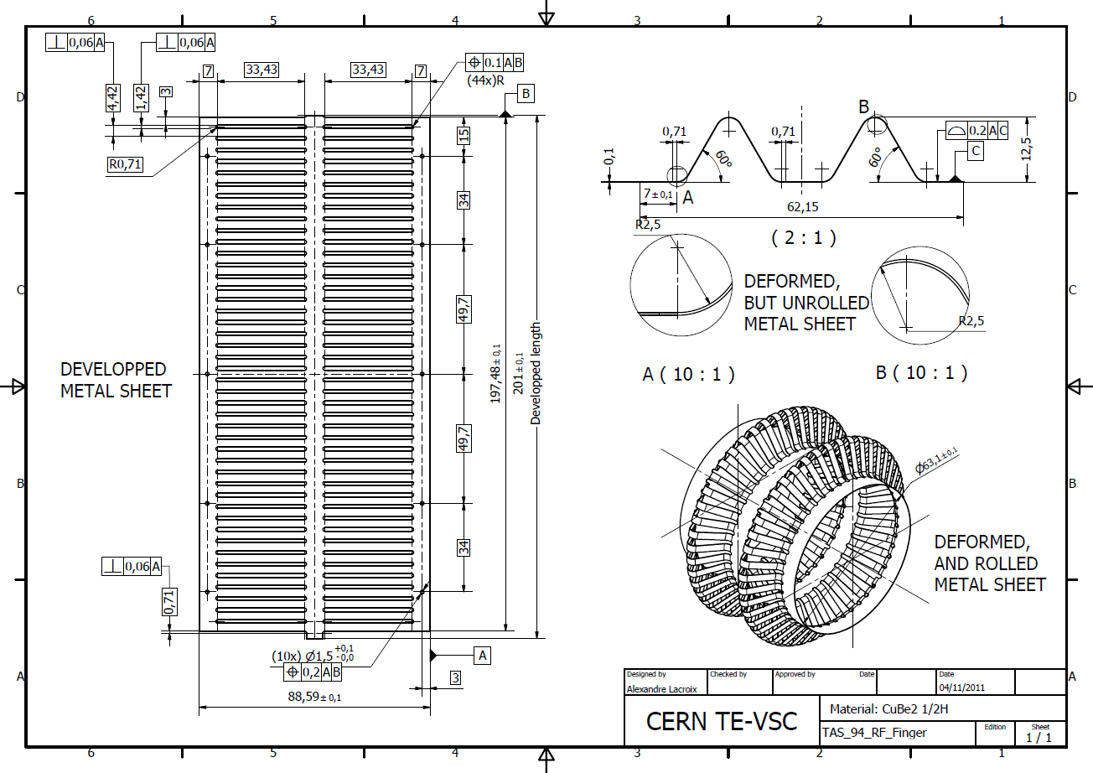
Prototyping
RF finger parameters:
First prototype has been done in the framework of the TAS
Convolution length | Number of convolutions | Extremity length | Elongation per convolution | Total length in operation | Inter-convolution length | Flat length
20.2 mm | 2 | 7 | 12.4 mm | 86.9 mm | 7.7 mm | 88.6 mm

Slide 15
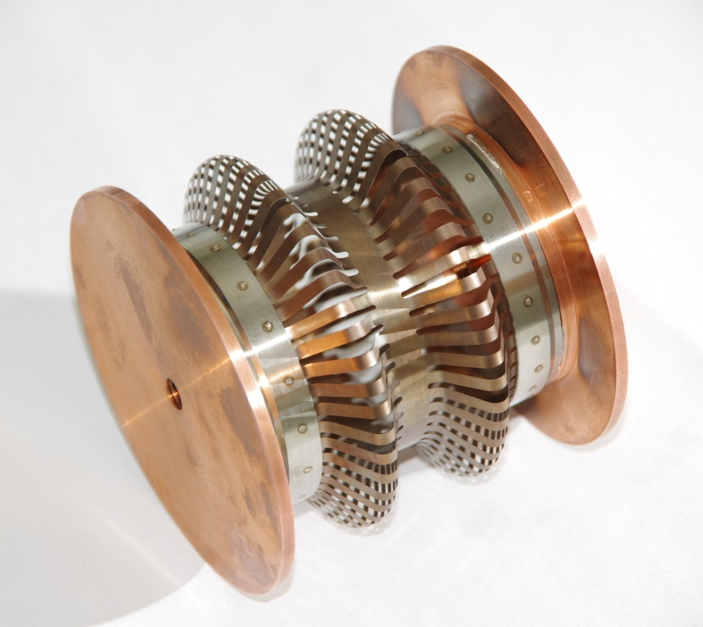
Prototyping
First prototype:
Interface to the flanges and the flanges not representative.

Slide 16
Next steps
Material:
Define the best copper alloy and heat treatment for mechanical aspects.
Mechanical tests:
Fatigue tests on RF finger prototypes with different conditions:
Temperature: 20 °C and high temperature (230 °C?),
Stroke,
Misalignment
Monotonic tests
Assembly study:
Define the interface and assembly process between the RF fingers and the copper rings.

Slide 17
Conclusion
A new RF finger concept, presenting some advantages from an RF and mechanical points of view, is under study.
It is based on deformable thin fingers.
The design of the RF fingers has been done from a mechanical point of view.
Preliminary tests on a simplified geometry are promising.
A first prototype based on two convolutions has been manufactured and a test campaign will start soon.

