Slide 1
Longitudinal Impedance Studies of VMTSA
O. Kononenko, B. Salvant, E. Métral
LRFF Meeting, CERN, May 29, 2012

Slide 2
Introduction
RF Fingers deformations => need simulations to study impedance problems
HFSS – one of the best frequency domain solvers => accurate eigenvalue and s-parameters results (IF the convergence is controlled carefully)
It is possible to take into account frequency dependent properties of ferrites
We can cross-check the results with CST and measurements to see if we really understand the problem

Slide 3
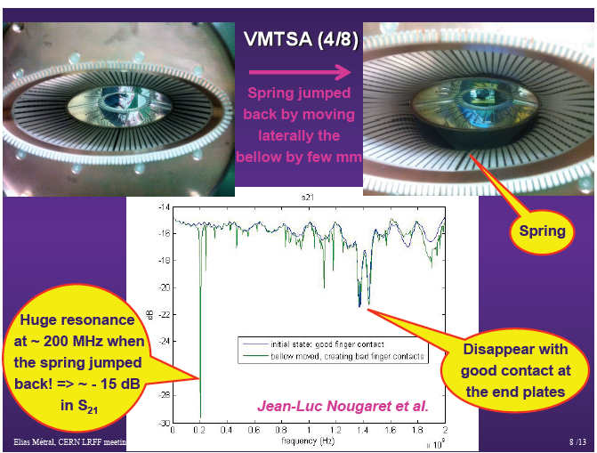
RF Fingers Deformation in VMTSA

Slide 4
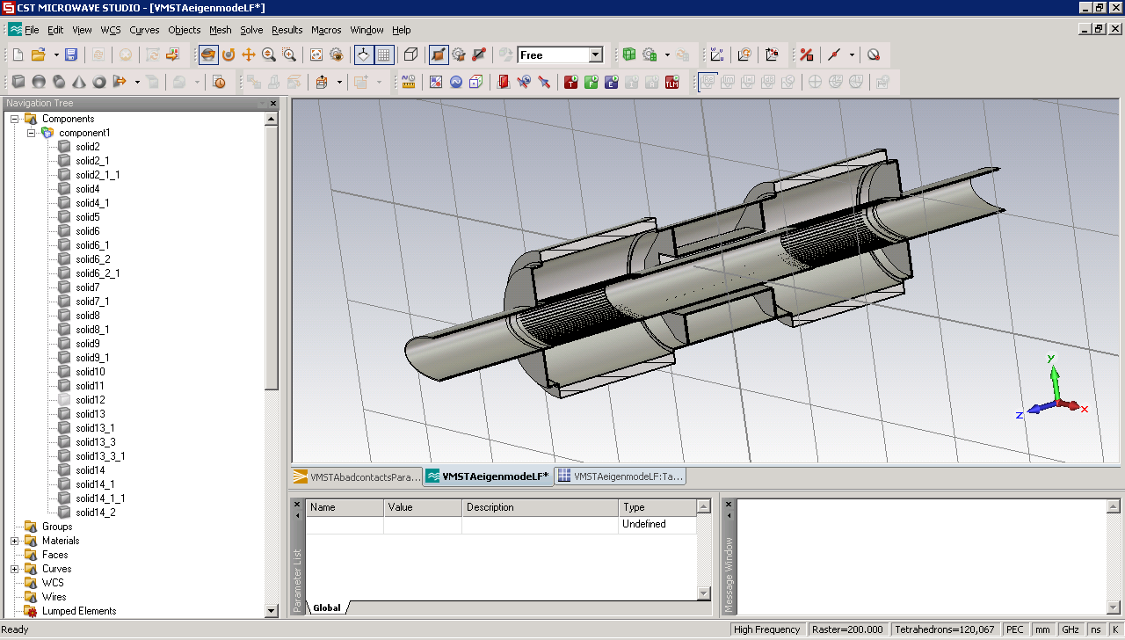
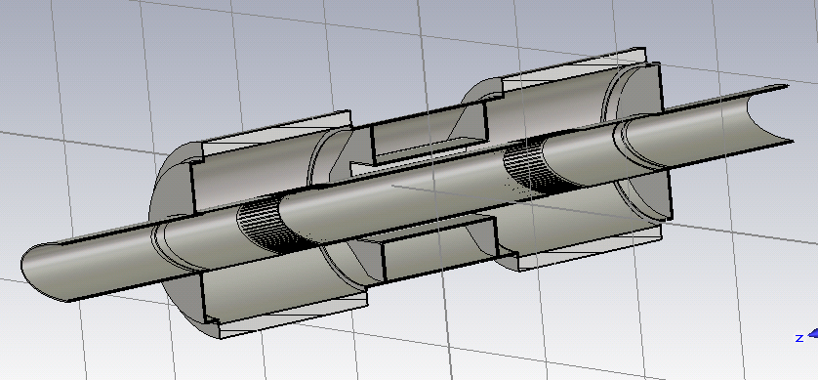
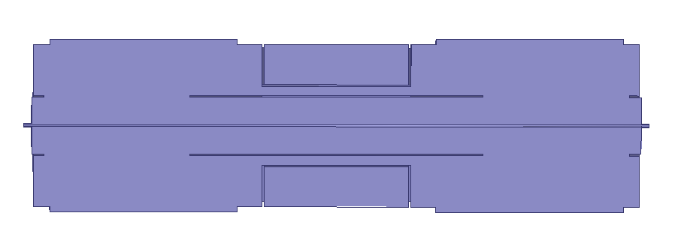
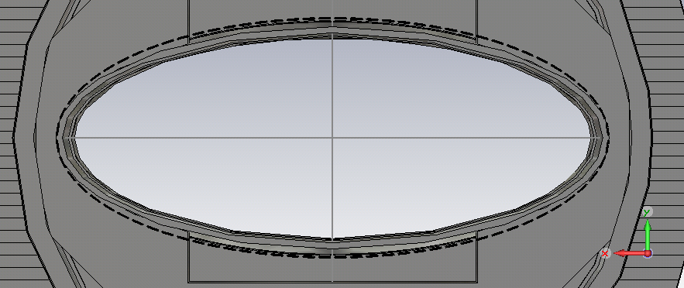
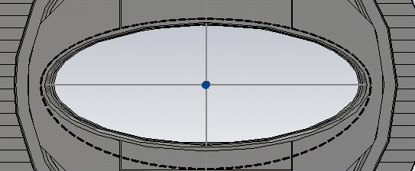
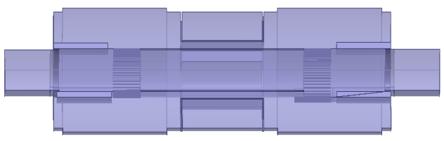
Setups to Be Simulated
Conforming
old fingers
Conforming
new fingers
Wire,
no fingers
Bad contact 1st type
Deformations, ferrites, etc
Bad contact 2nd type
Ferrites in, Philips 8C11

Slide 5
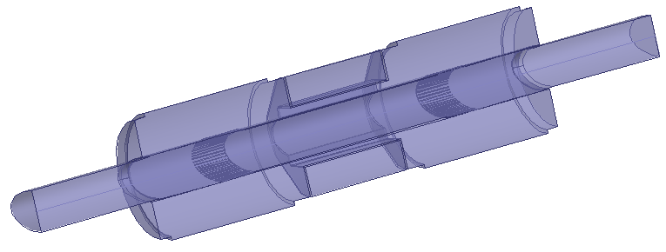
Conforming new RF Fingers
HFSS Simulation Setup: Eigensolver
Model:
  180 deg of the structure
  copper outer wall
Perfect H
Copper
Simulation profile:
- second order basis functions
  curvilinear elements enabled
  1% frequency accuracy leads to ~150K tet10 mesh,
  problems with mesh/convergence

Slide 6
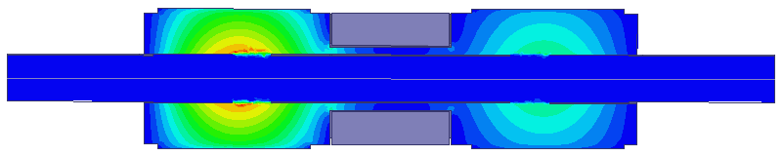
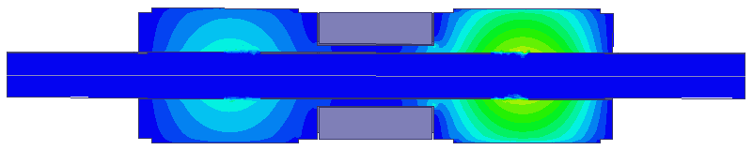
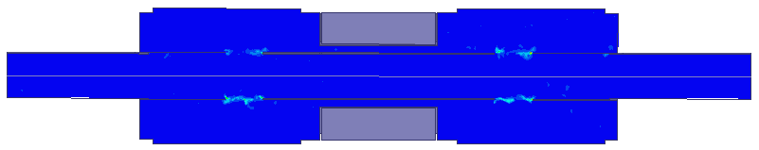
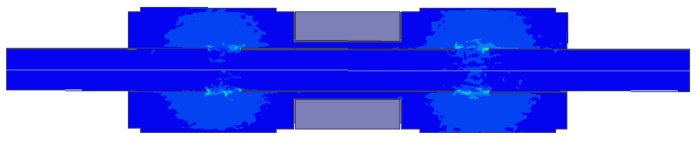

Conforming New RF Fingers: CmplxMag(E)
0.1 V/m
0.12 V/m
0.012 V/m
0.012 V/m
0.014 V/m
Mode 1
Mode 2
Mode 3
Mode 4
Mode 5
Looks like a numerical noise

Slide 7
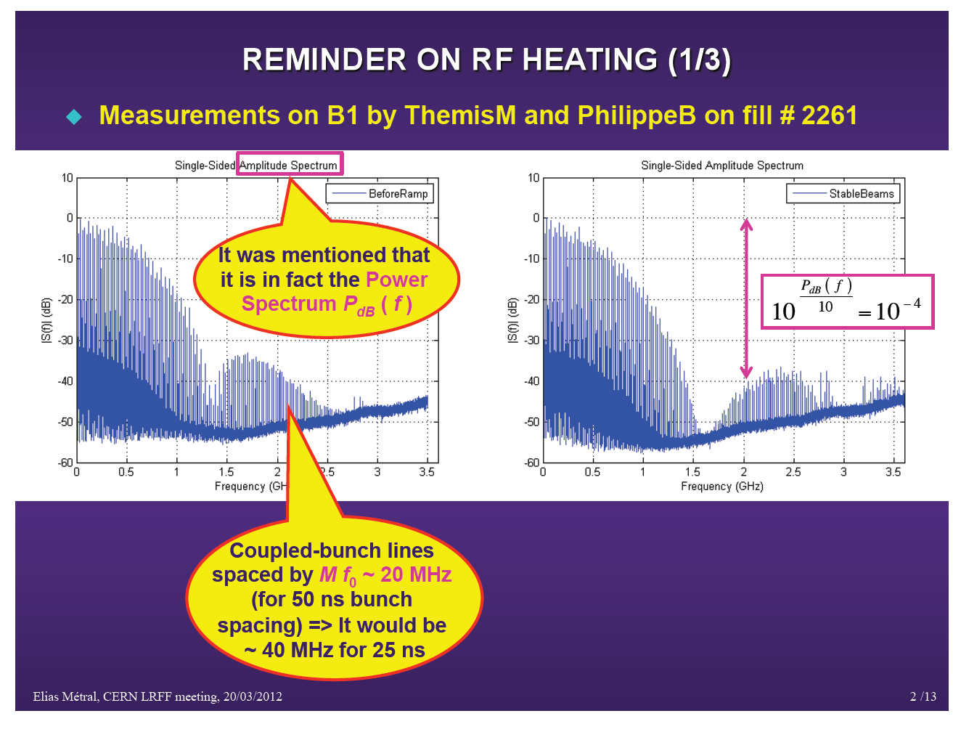
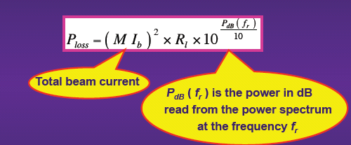
Power Spectrum Measurements

Slide 8
Conforming New RF Fingers: Results
 | Eigen Frequency, MHz |  | Q-factor |  | Shunt Impedance, Ω |  | Power Loss,W
 | HFSS | CST | HFSS | CST | HFSS | CST | HFSS | CST
Mode 1 | 549 | 550.3 | 6011 | 6770 | 0.008 | 0.03 | 0.001 | 0.001
Mode 2 | 549 | 550.4 | 6016 | 6790 | 0.014 | 0.03 | 0.002 | 0.001
Mode 3 | 886 | 829 | 6695 | 5930 | 515 | ~0 | X | ~0
Mode 4 | 888 | 1085 | 7821 | 10310 | 242 | 0.15 | X | 0.0003
Mode 5 | 915 | - | 5127 | - | 20 | - | X | -
HFSS convergence still to be checked,
but conforming RF fingers look ok
Longitudinal Shunt Impedance
Voltage along beam path,
including transit time factor
Energy stored in the volume

Slide 9
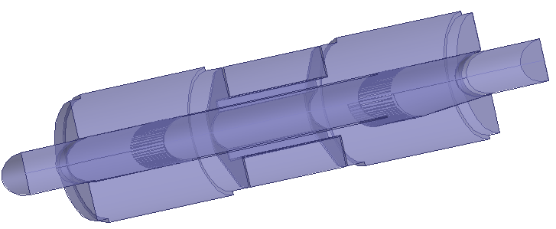
New RF Fingers, 2nd Type Bad Contact HFSS Simulation Setup: Eigensolver
Model:
  180 deg of the structure
  copper outer walls
  10mm gap
Perfect H
Copper
10 mm gap
Simulation profile:
- second order basis functions
  curvilinear elements enabled
  1% frequency accuracy leads to ~300K tet10 mesh

Slide 10
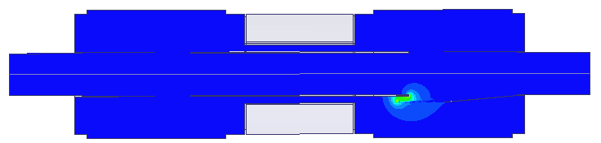
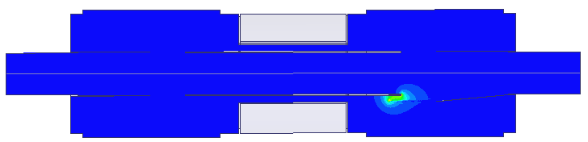
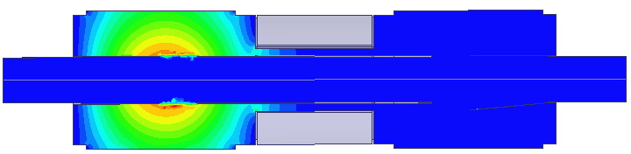
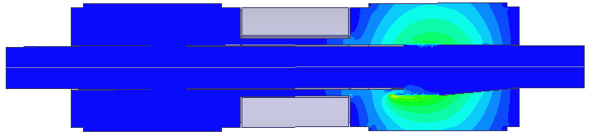

New RF Fingers, 2nd Type Bad Contact CmplxMag(E)
0.113 V/m
0.037 V/m
0.030 V/m
0.005 V/m
0.028 V/m
Mode 1
Mode 2
Mode 3
Mode 4
Mode 5
Eigenmodes
of the Bellows

Slide 11
New RF Fingers, 2nd Type Bad Contact
Results
 | Eigen Frequency, MHz |  | Q-factor |  | Shunt Impedance, Ω |  | Power Loss,W
 | HFSS | CST | HFSS | CST | HFSS | CST | HFSS | CST
Mode 1 | 335 | 339 | 2372 | 32 | 49764 | 676 | 6449 | 87
Mode 2 | 519 | 531 | 1654 | 322 | 7343 | 1438 | 951 | 186
Mode 3 | 549 | 550 | 6324 | 6837 | 0.63 | 0.03 | 0.081 | 0.004
Mode 4 | 576 | 583 | 2823 | 155 | 762 | 7 | 99 | 0.907
Mode 5 | 657 | - | 1202 | - | 408 | - | 53 | -
CST results (Q, R) look suspicious

Slide 12
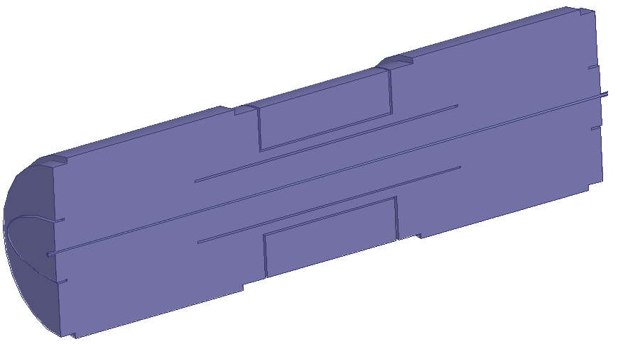
VMTSA with Wire and No Fingers
Model:
  180 deg of the structure
  copper outer walls
Perfect H
Port 2
Copper
Wire
Port 1
Simulation profile:
- second order basis functions
  curvilinear elements enabled
  0.01 s-parameters accuracy => ~170K tet10 mesh
  discrete sweep from 20MHz to 2GHz, 10MHz step

Slide 13
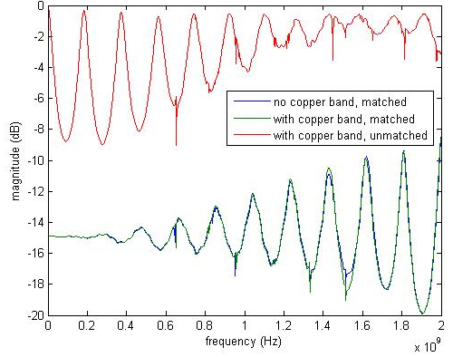
Transmission: s21
Jean-Luc Nougaret, VMTSA measurements,
December 2011-January 2012
Good agreement of the CST/HFSS/Measurements results

Slide 14
Conclusions
Good experience simulating RF Fingers in HFSS
Convergence still to be checked for some simulations
It looks like CST gives incorrect Q-factors and shunt impedances. Convergence problem?
Ferrites simulations must be accomplished
Overall simulation strategy should be clearly understand
We can move forward quickly

