Slide 1
ABT Equipment in the LHC with RF Contact Fingers
LRFF Task Force
M. Barnes, W. Weterings
08-05-2012

Slide 2
LHC Injection Kicker Magnet (MKI) – Requirements
Bake-out to 320˚C internal temperature for ~100 hours;
Thermal expansion of Al₂O₃ ceramic tube (for carrying screen conductors): 6.5 µm/(m∙˚C);
Thermal expansion of SS 403L tank: 17.3 µm/(m∙˚C);
Difference in thermal expansion of tank and ceramic tube ~8mm (assuming all items are at the same temperature) – worst case is ~17mm;
Tank vacuum of ~10⁻¹¹ mbar;
RF fingers must accommodate some misalignment of tank and ceramic tube;
RF fingers must provide low impedance path for beam image current;
Area between adjacent RF fingers provides some pumping of tube.
Above figure is taken from S. Calatroni. Bake-out of Copper Beryllium at 325˚C⇨40% residual elasticity. Hence SS 316L chosen for MKI RF fingers.

Slide 3
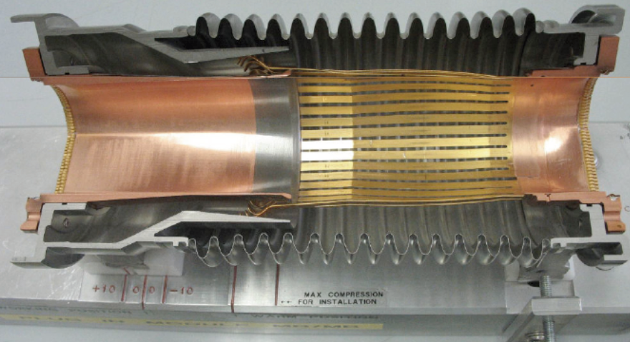
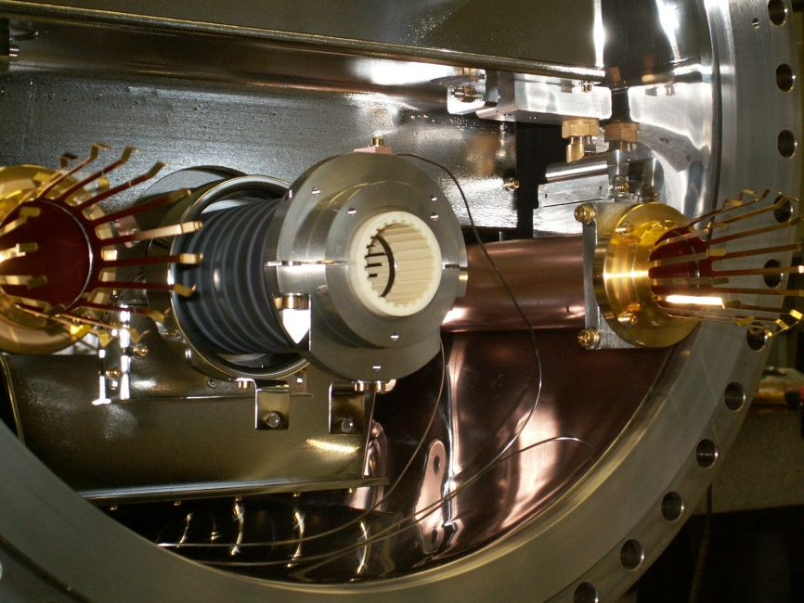
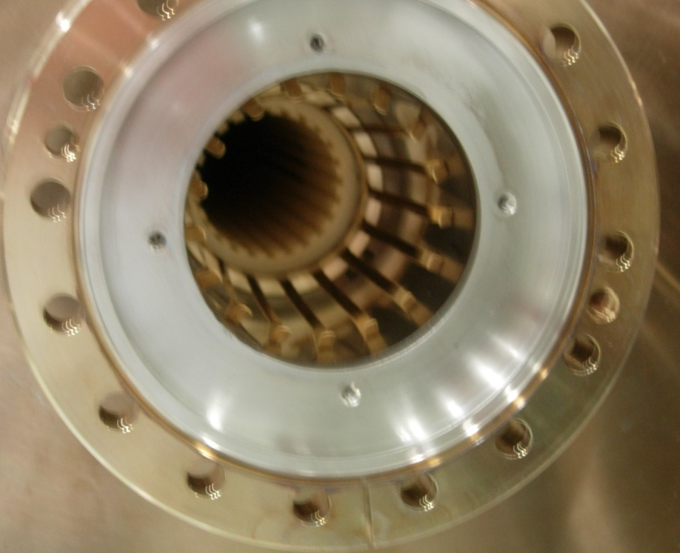
MKI – “old” RF fingers (based on PIMs)
PIMs Model
Contact fingers: SS 316L,
0.5 µm Au coating on drawings!!
No evidence of Rh coating on drawings, but believed to be done in later versions to prevent cold welding
17 RF fingers with 6 mm gap (for pumping of tubes)
7 of 8 installed MKIs have these “old” RF fingers
LHCMKIMA0132

Slide 4
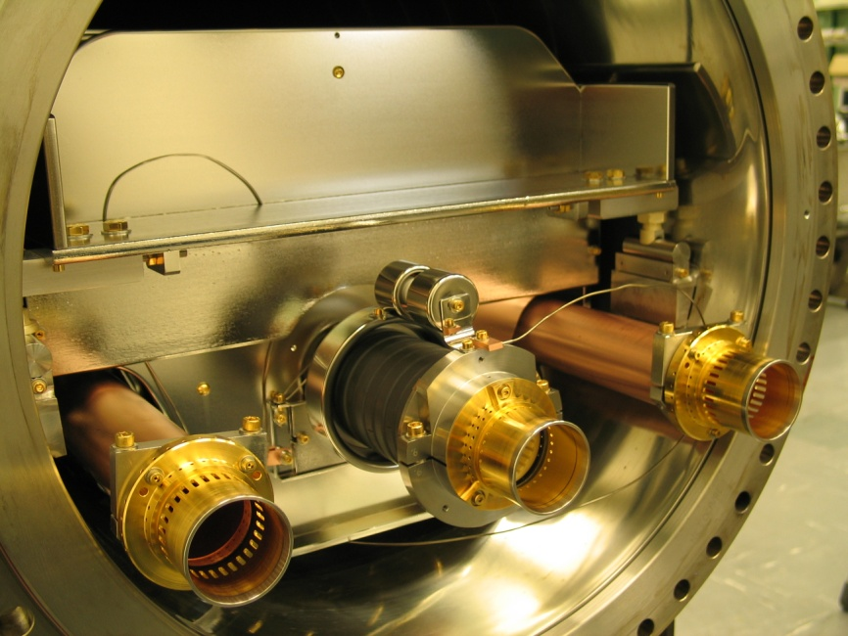
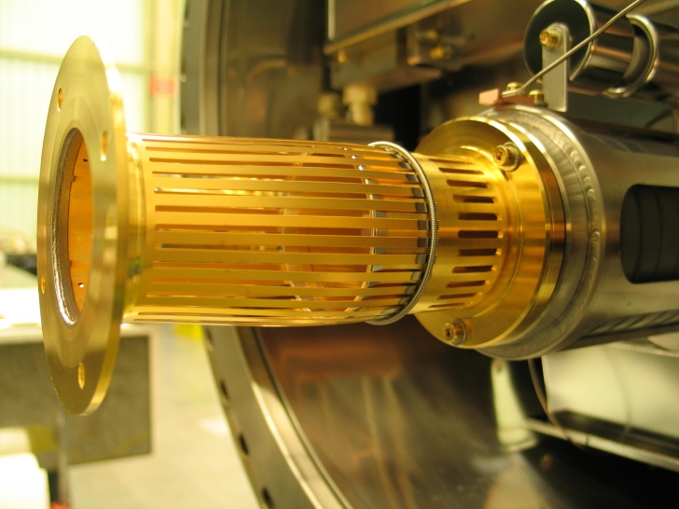
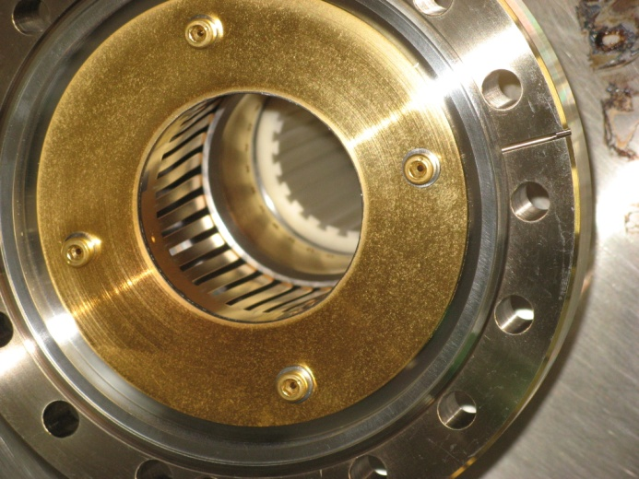
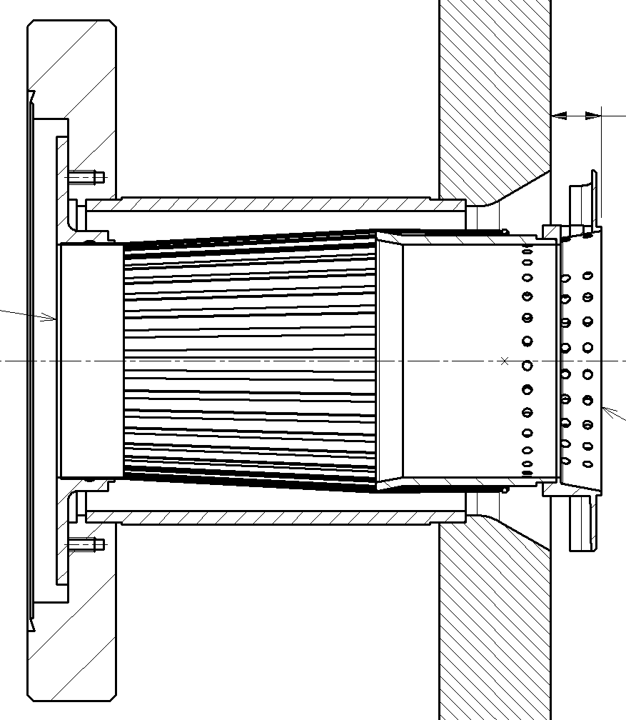
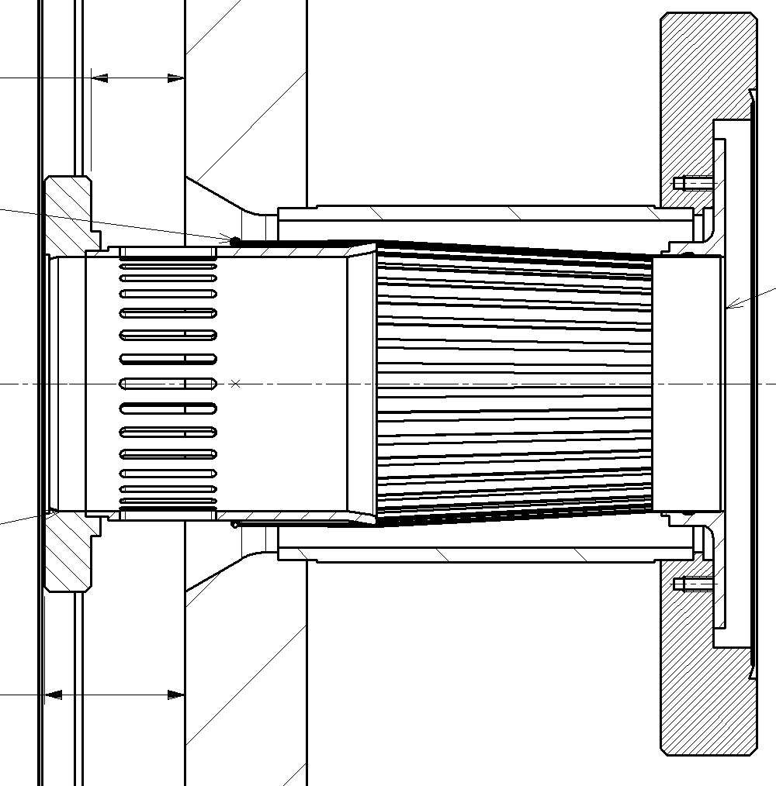
MKI – “new” RF fingers (design based on warm interconnects)
Cu Contact fingers
LHCMKIMA0245
Contact fingers: SS 316L,
10 µm Au coating on drawings
2 µm Rh coating on drawings
36 RF fingers with 1.59 mm gap (for pumping of tubes)
Spring to maintain contact force
1 of 8 installed MKIs (MKI2.B) has these “new” RF fingers
Beam
Beam
Injection end & capacitive coupling end
Ceramic tube fixed in magnet

Slide 5
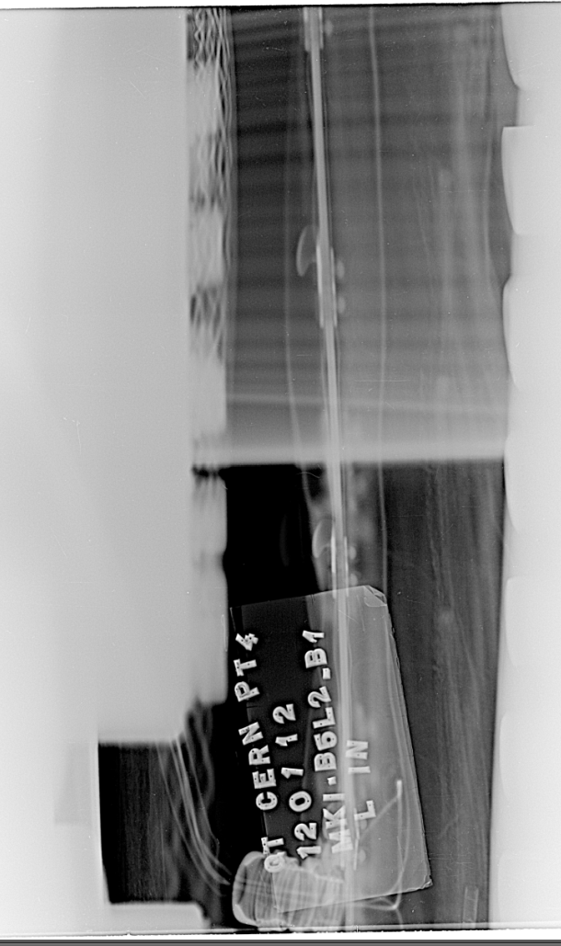
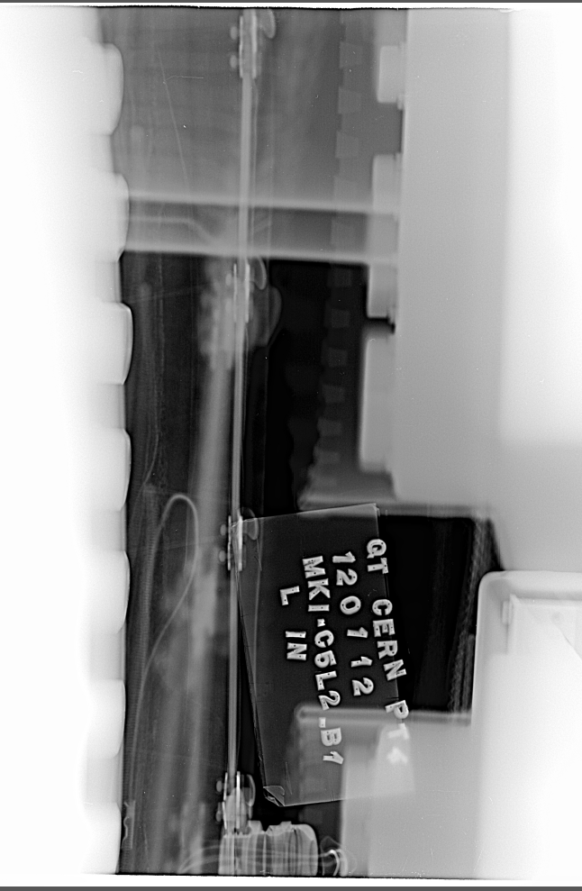
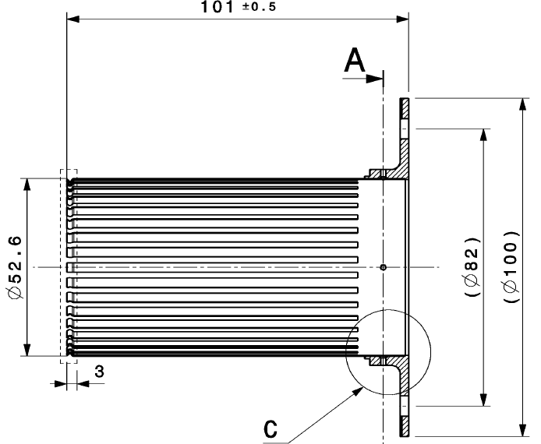
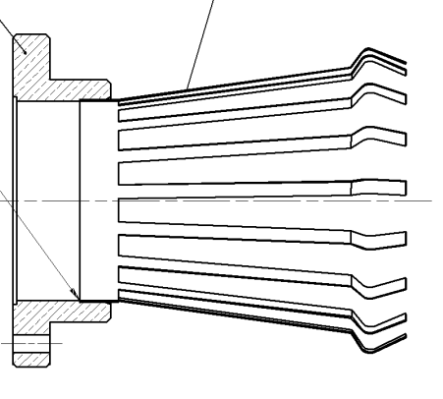
MKI – Radiography
Radiography of installed MKI RF fingers is difficult (poor access due to valves, etc) – hence results are inconclusive.
New RF fingers
Old RF fingers

Slide 6
MKI: Measured Longitudinal Impedance
Some measurement data courtesy of H. Day
Even with the new RF fingers, real impedance goes up after bakeout

Slide 7
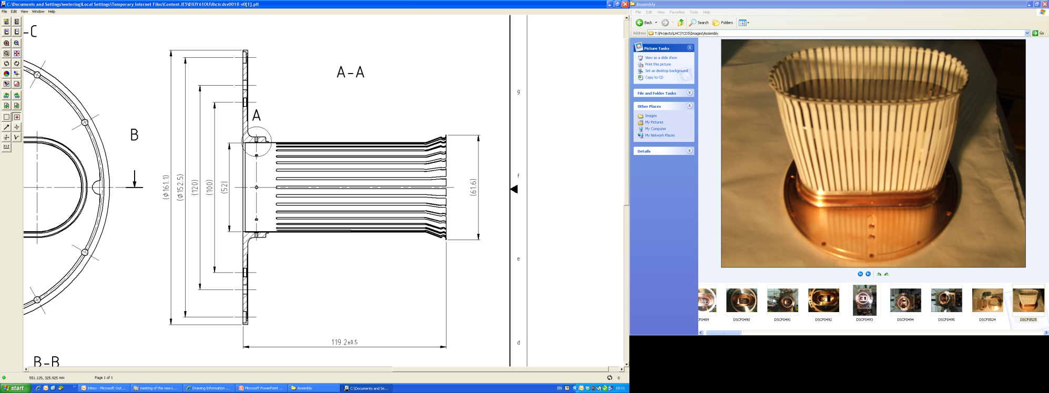
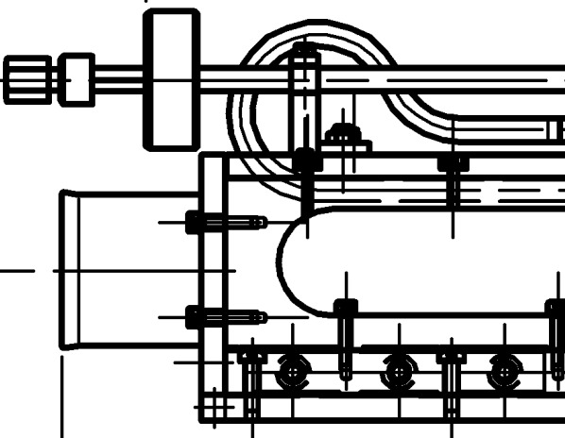
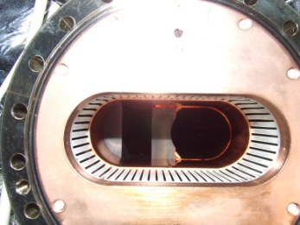
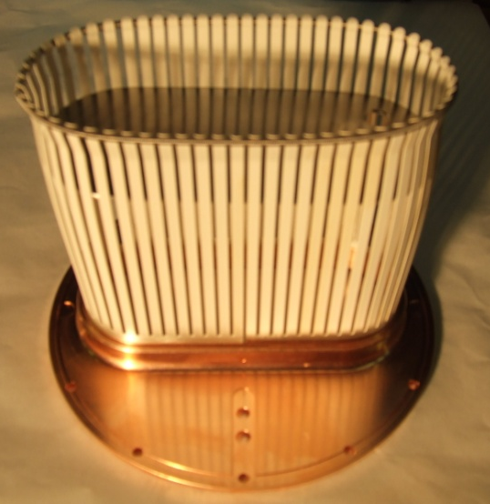
TCDS - TCDQ
LHCTCDSV0018
LHCTCDSV0021
Contact fingers, CuBe 17410, 10 µm Ag coating
Other components Cu-OFE.
No indication of Rh coating on drawings

Slide 8
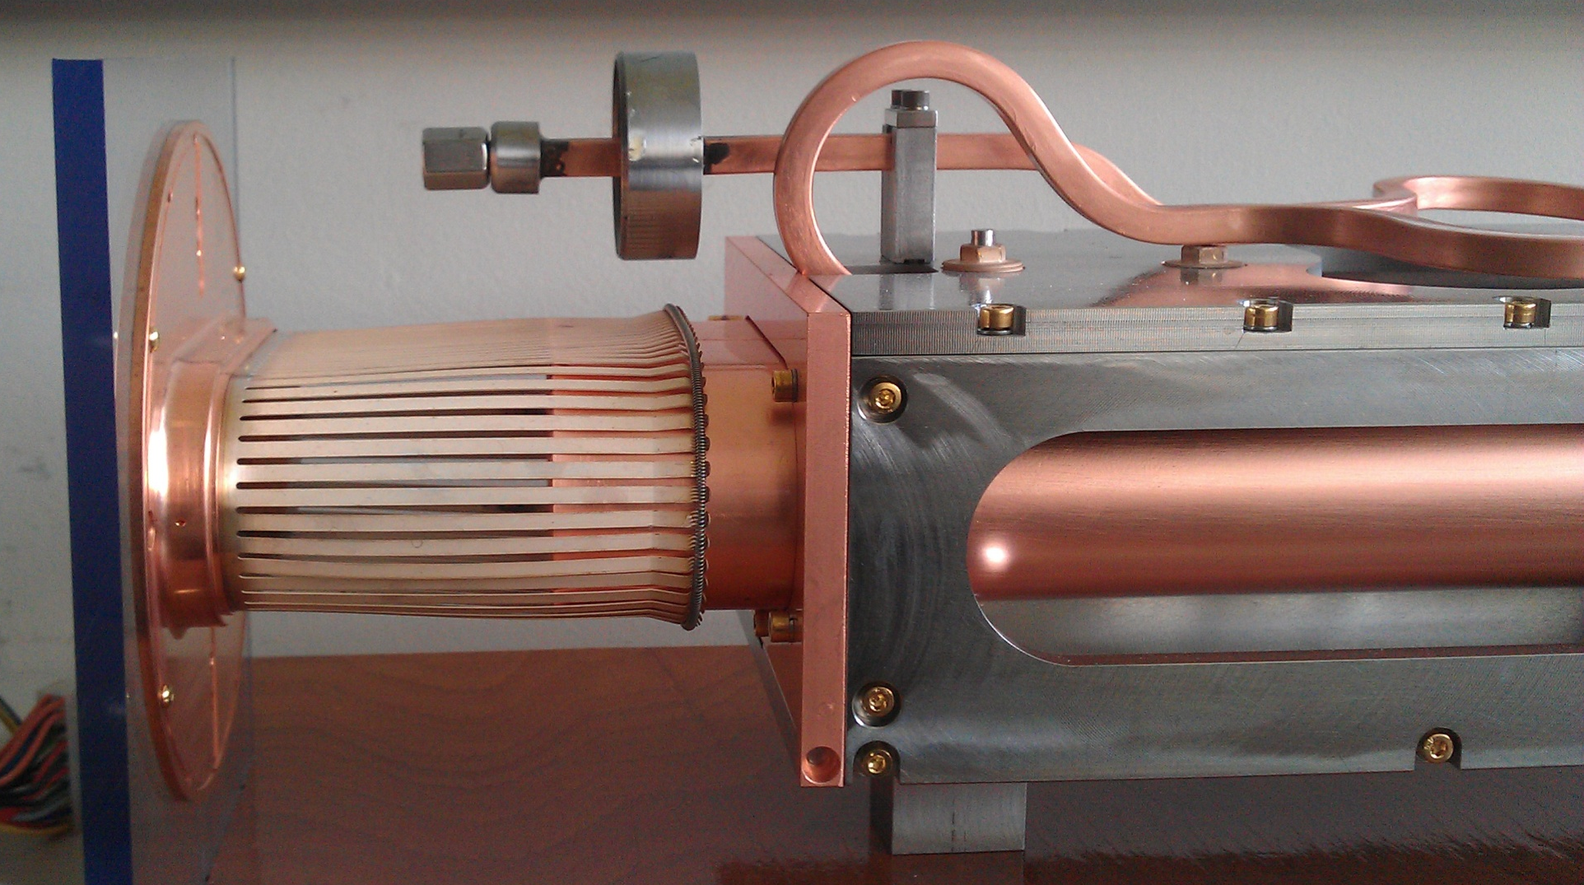
TCDS - TCDQ

Slide 9
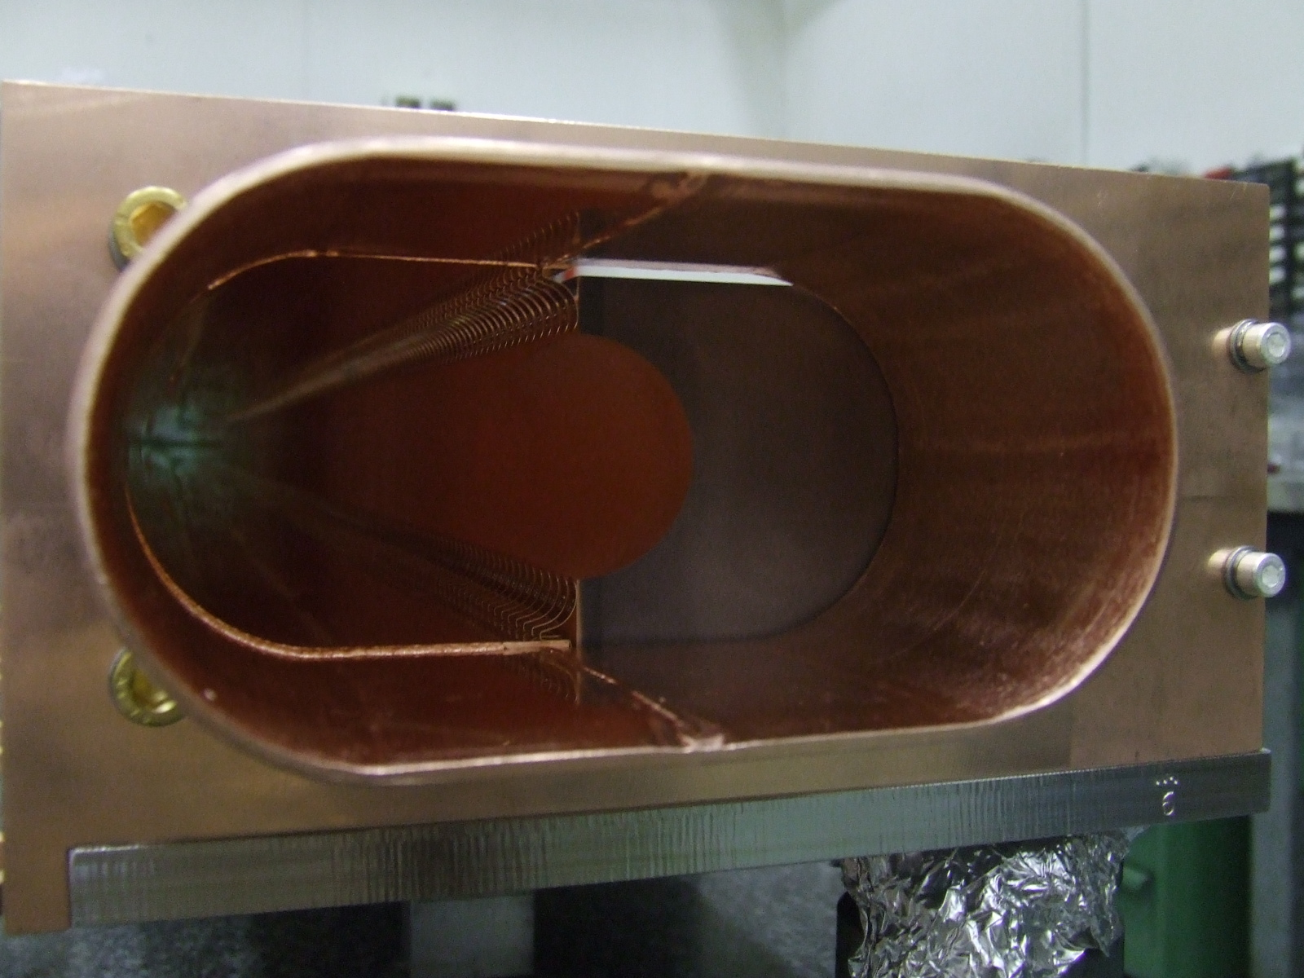
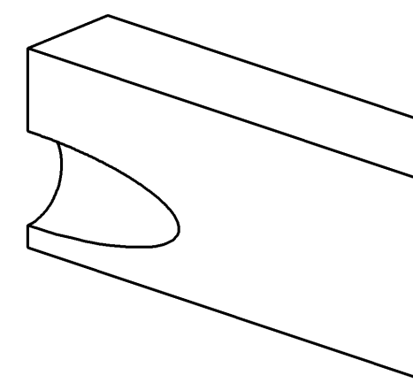
TCDS - TCDQ
Cu Contact
fingers
Cu Coated absorber
blocks
Curved machined entrance block

Slide 10
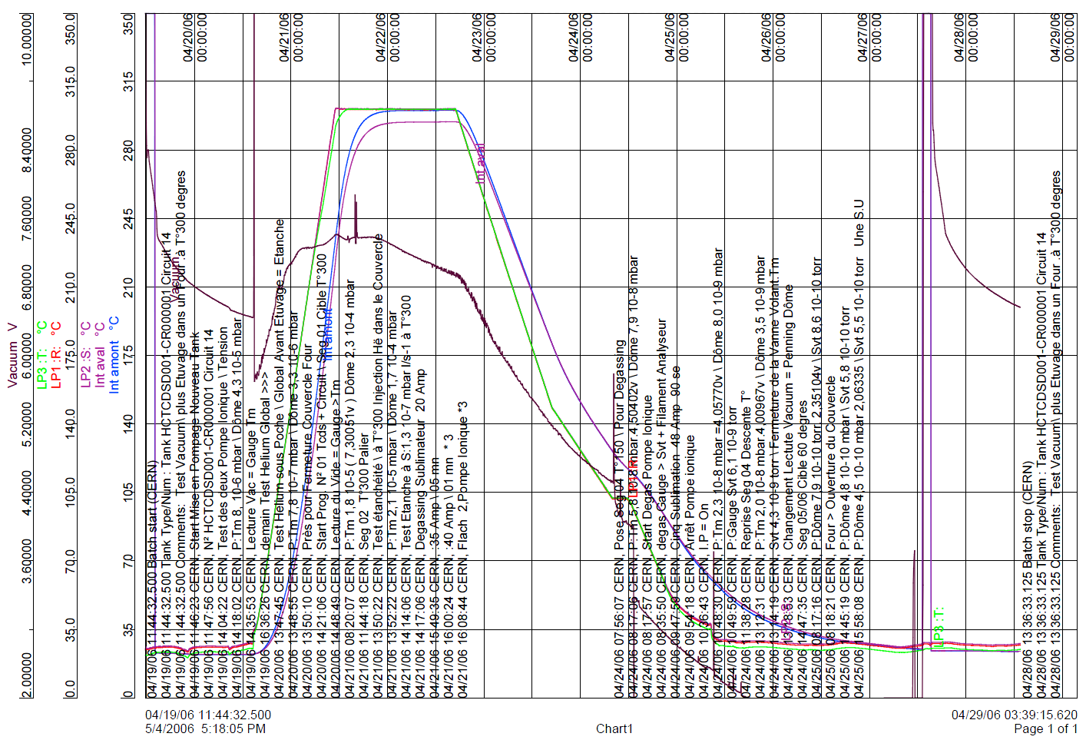
TCDS – TCDQ Bake-out
All tanks have undergone a
bake-out cycle of 24h@300ºC
in an oven.
Furthermore,
they are baked in the tunnel @250ºC

Slide 11
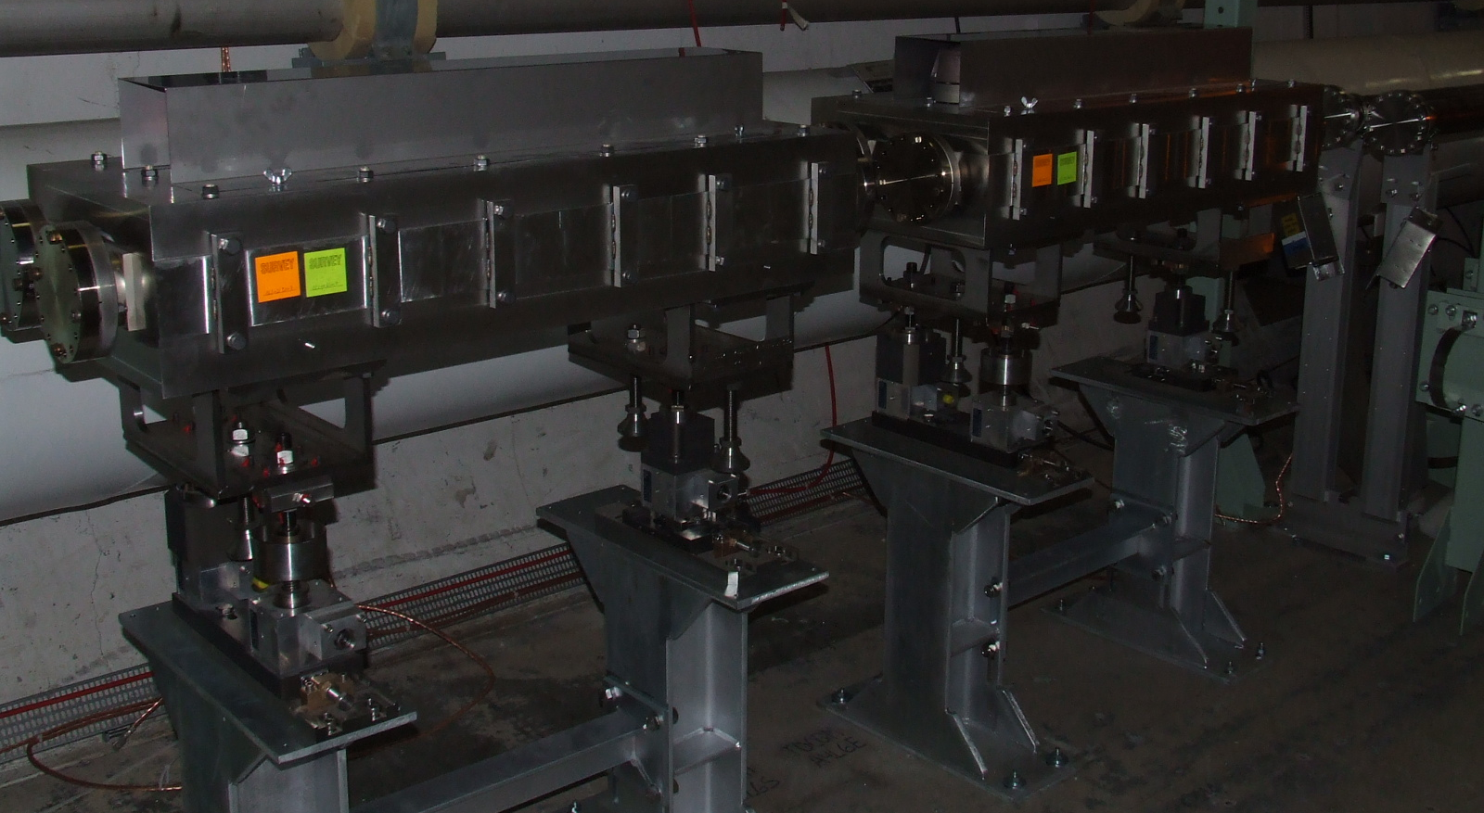
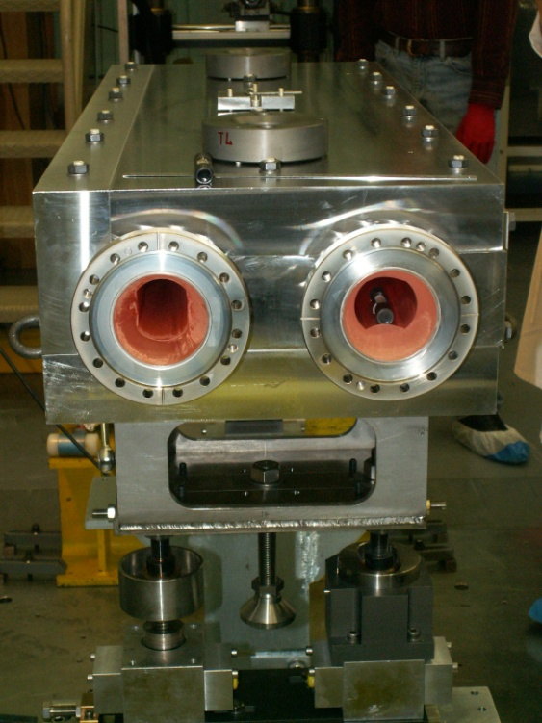
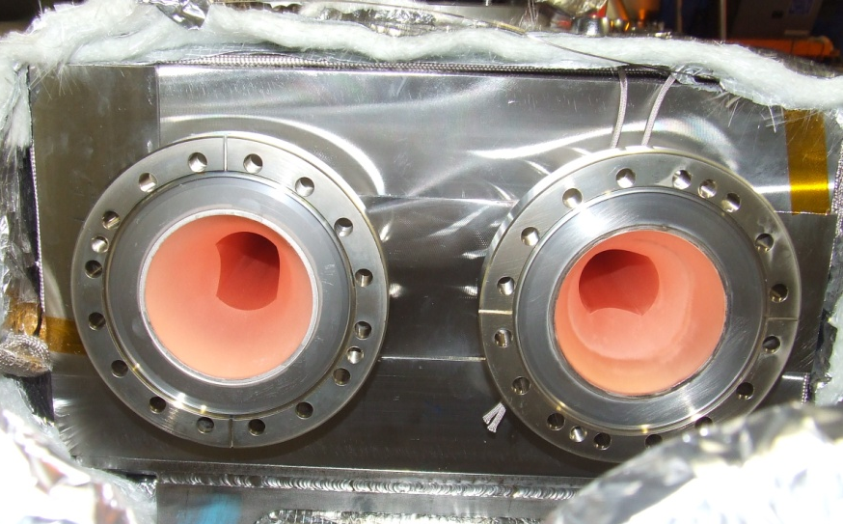
TCDQM - TCLIM
LHCTCDQM0023
LHCTCLIM0019
No contact fingers,
X2CrNi1911 chamber,
20 µm Cu coating

Slide 12
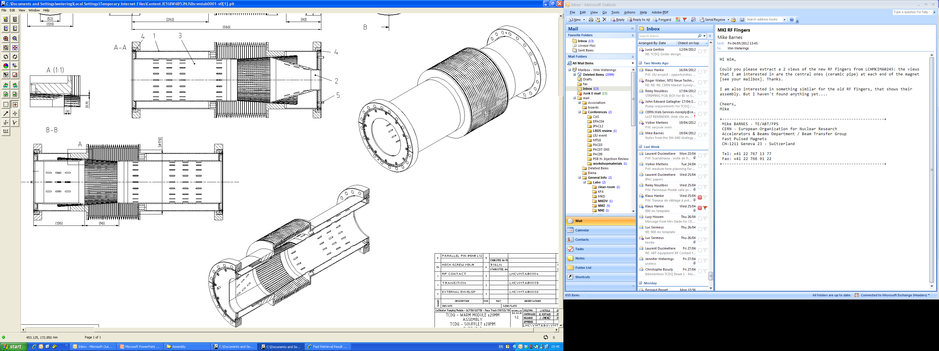
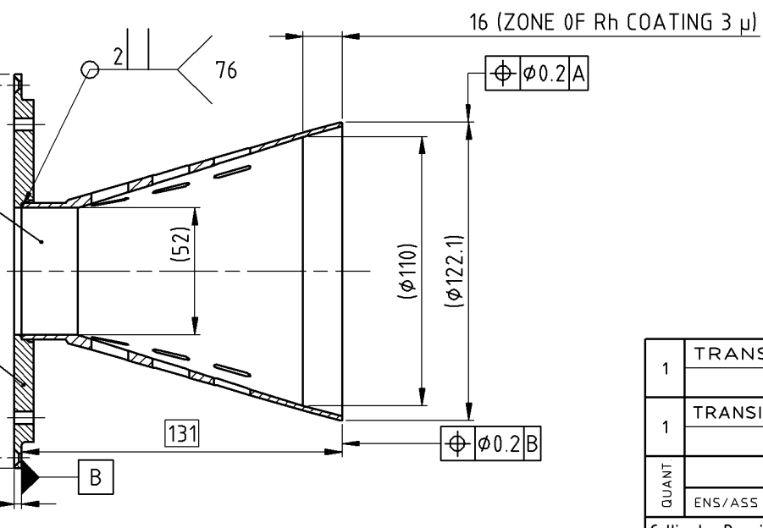
VMTAB
LHCVMTAB0001
Contact fingers,
CuBe 17410,
10 µm Ag coating
Internal components
Cu-OFE
External envelope
316L Steel

Slide 13
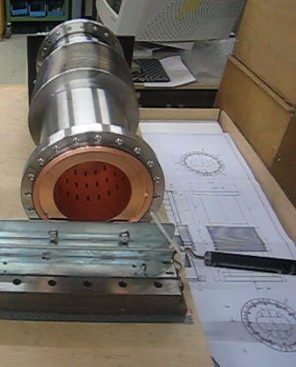
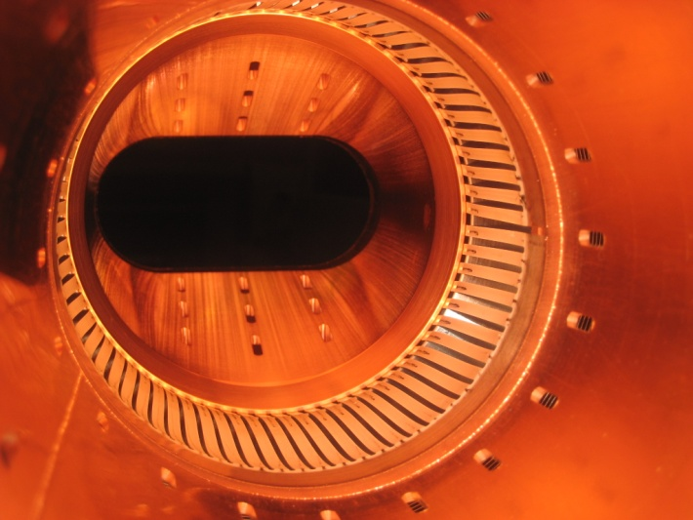
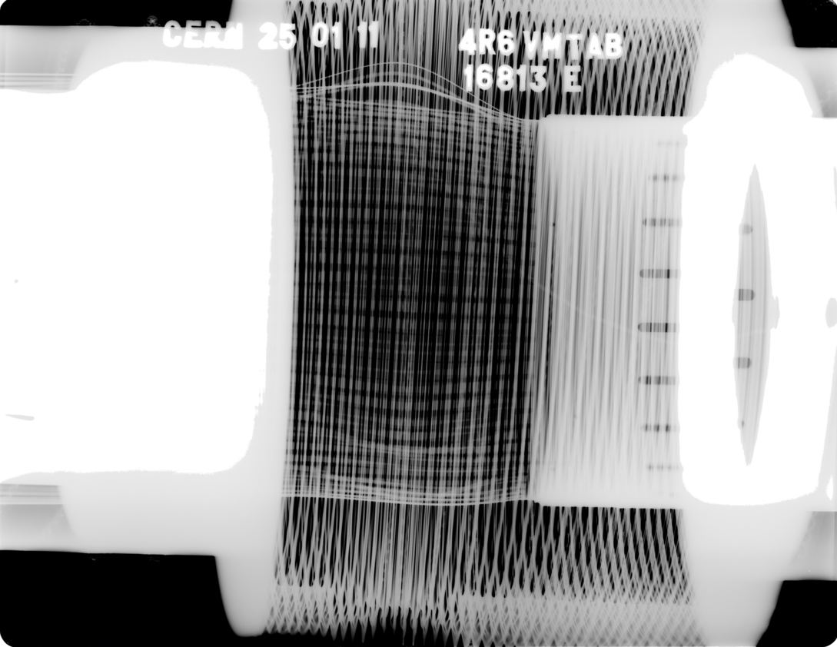
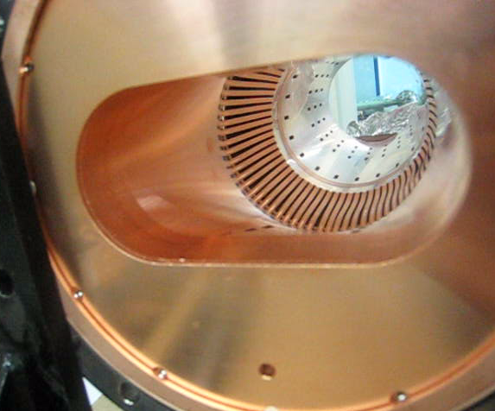
VMTAB
Installed VMTAB bellow in 4R6, showing problem with bulged out contact fingers

Slide 14
Summary
Injection MKI;
Contact fingers between tank & ceramic chamber and between tank & copper chamber
Injection TCLIM and Extraction TCDQM;
No contact fingers, Cu metallisation of the St. Steel chamber
Extraction MKD and Measurement MKQ;
No contact fingers, Ti metallisation of ceramic chamber directly connected to flanges
Extraction MKB;
Not on the circulating beam, no metallisation, no contact fingers.
Extraction TCDS;
Contact fingers between tank & Absorber
Extraction TCDQ;
Contact fingers between tank & absorber and between beam screen & absorber blocks;
Special Bellow VMTAB

Slide 15
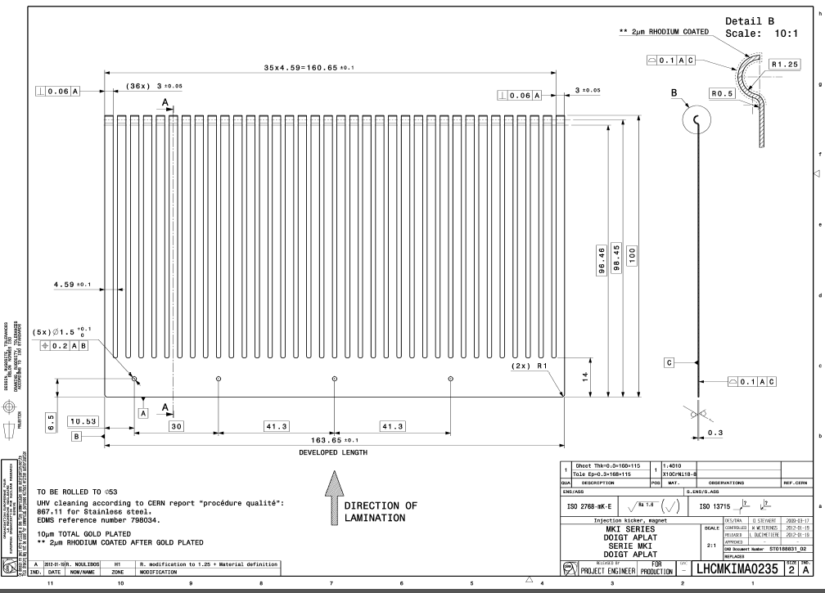
MKI – Spare Slide: new RF fingers

Slide 16
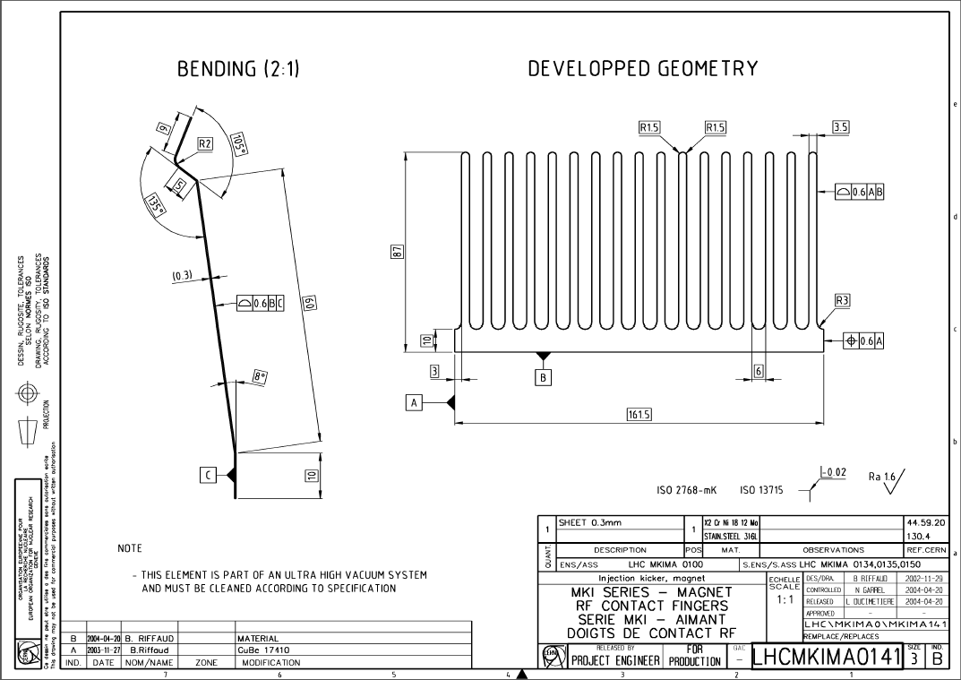
MKI – Spare Slide: old RF fingers

Slide 17
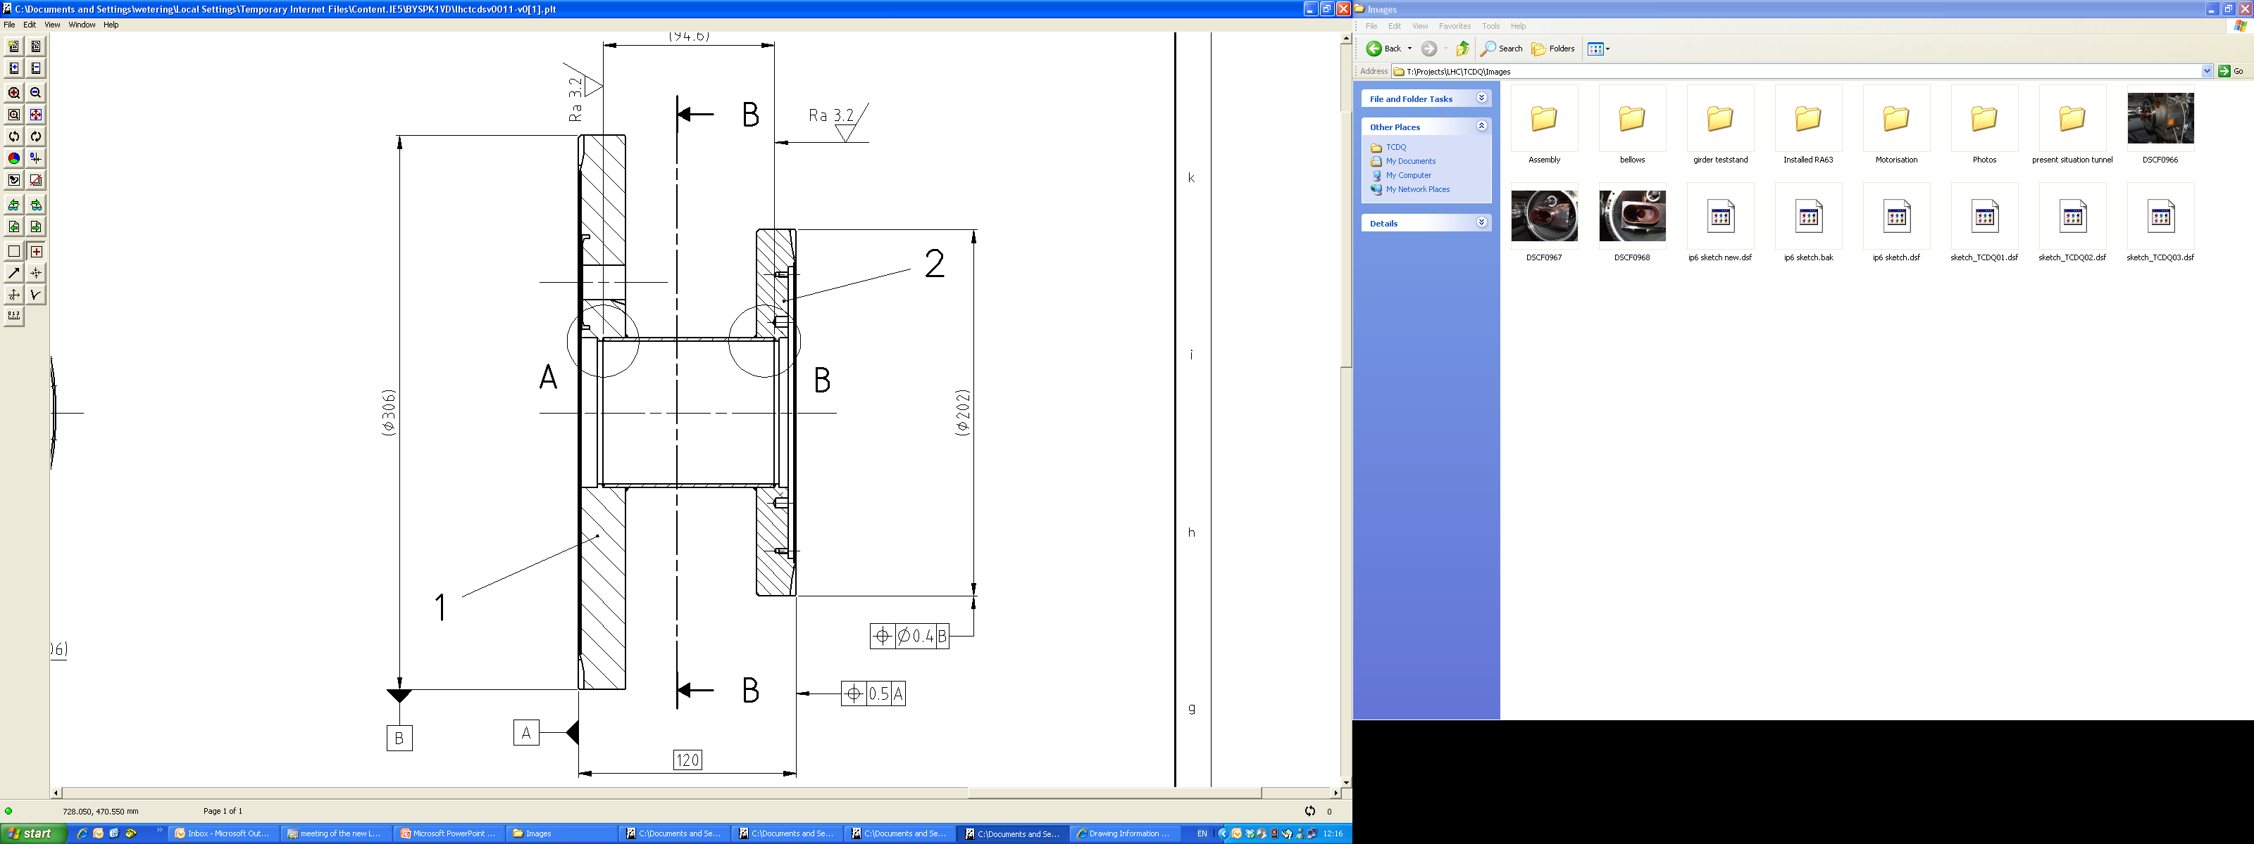

TCDS – TCDQ Spare Slide
LHCTCDSV0011
LHCTCDSV0018
LHCTCDSV0021

Slide 18
TCDS – TCDQ Spare slide (Principle and LS1 upgrade layout & cross-section)

