Slide 1
What was wrong with the Plug-In Modules (PIMs) in the cold part of LHC?
P. Strubin, based on documents from many colleagues

Slide 2
Outline
Introduction
What happened in August 2007?
Fact findings and calculations
Why did it happen?
How did the non-conformity crop in?
Local anomalies
ANSYS simulation to confirm the diagnostic
Impact on resistance
Corrective actions
Means of detection of damaged PIMs

Slide 3
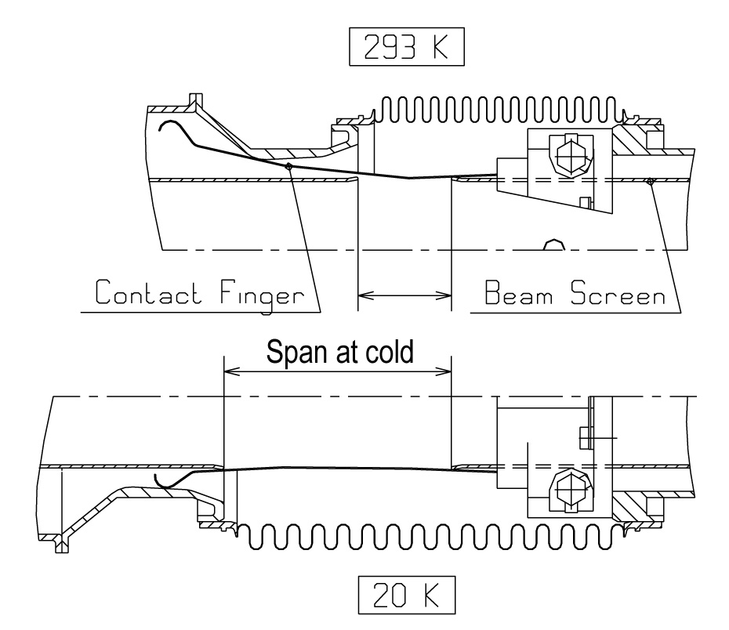
Some key dimensions
Notes:
Original design verified in 2007 by Delio, who did not participate in the original design. Found correct.

Slide 4
What does a PIM look like?

Slide 5
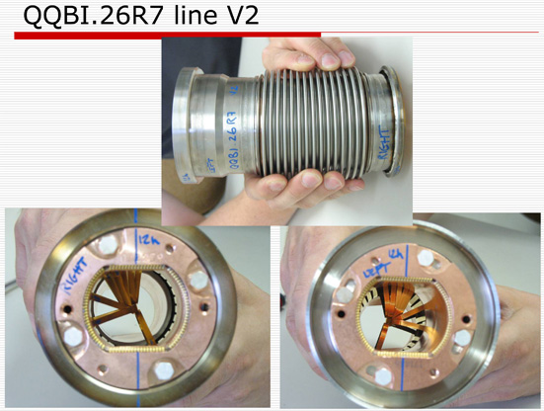
What happened in August 2007?
After warm-up of sector 7-8
A buckled PIM was discovered in interconnect QQBI.26.R7
Was really found by chance!
Notes:
5 PIMs damaged in sector 7-8, all QQBI type. 12 faulty ones in sector 4-5, all QQBI type.

Slide 6
Why did it happen?
Several ideas followed, but rapidly converging to a non conformity during manufacturing

Slide 7
How did the non-conformity crop in?
Specification
Measured DC resistance of fingers was an acceptance criteria
Dimensions and angles were defined via approved drawings
Only “OK” on the traveller, no real measurements registered
Difficulties at the manufacturer
Maximum value of resistance sometimes not met with nominal angles
Original reason was an incorrect height of the end of the finger, wrongly corrected by increasing an angle
Fingers were bent “by hand”, no tooling made, hence no reproducibility between PIMs
Corrective actions not documented!
6.7mm finger height
12° bend angle
Notes:
Problem identified and mentioned to BINP during the readiness review, but no corrective action taken by BINP for the series. Traveller not filled in properly.
Finger height found at 4mm and angle >19º, up to 45º for first non conforming PIMs measured.

Slide 8
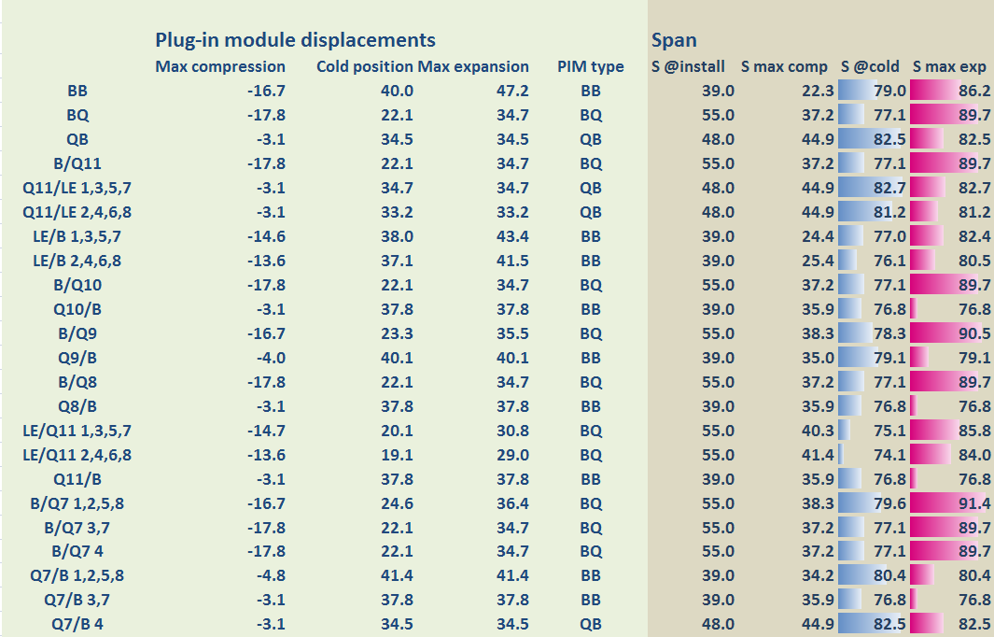
Local anomalies
Length of interconnects sometime at the limit of acceptable
Notes:
Stroke measured in situ during cool down on both sides of Q9L5 and found more or less as expected (+1 to 2 mm).

Slide 9
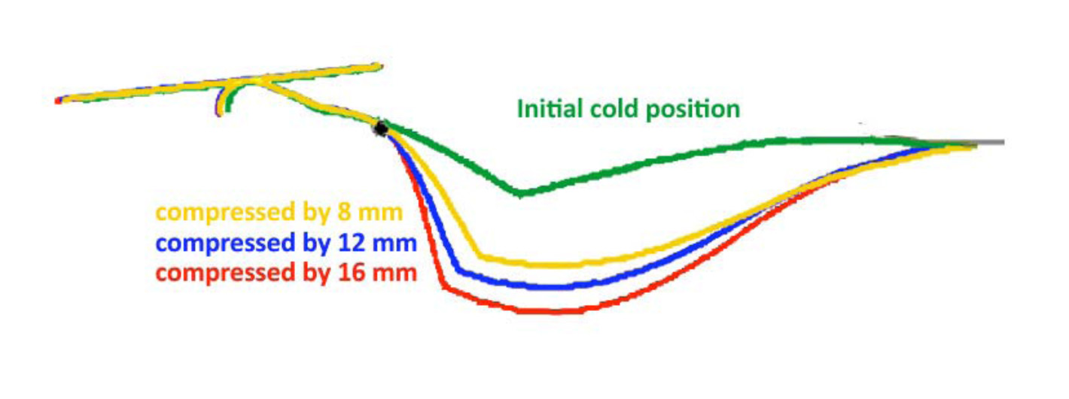
ANSYS simulation
Simulations made on “nominal” and “faulty” PIMs
Critical parameters, like friction coefficient, measured as accurately as possible
Example with a conforming PIM
Example with a faulty PIM
Notes:
Friction coefficient measured at cold, found within range used for design.

Slide 10
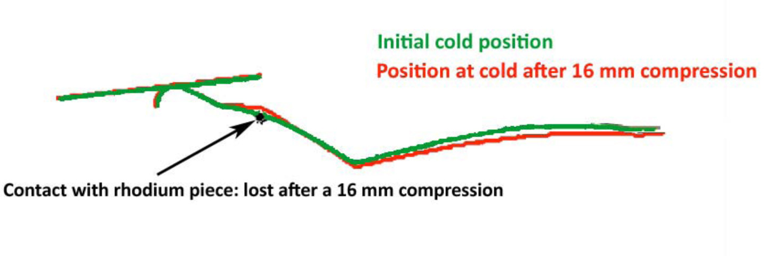
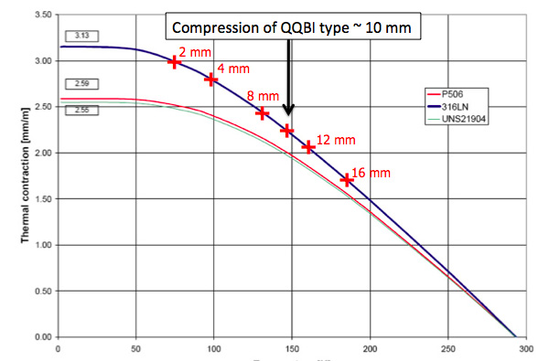
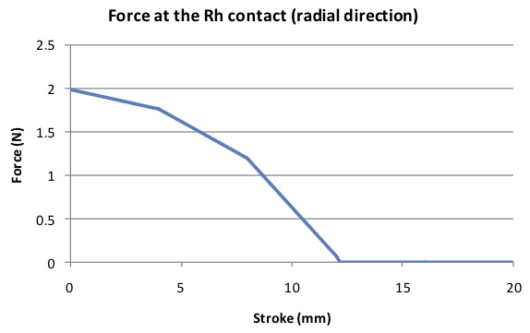
Impact on resistance
A buckled finger may loose contact when warmed-up
Notes:
A non conforming finger may loose contact after a partial warm up.

Slide 11
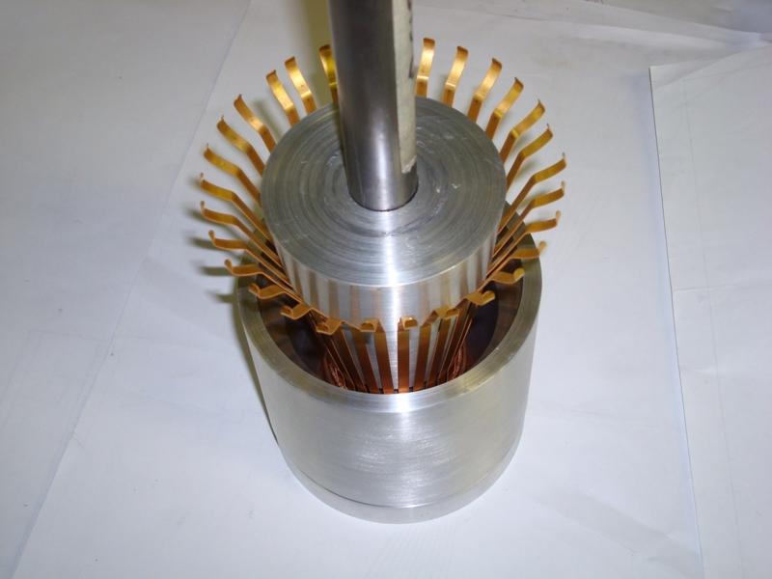
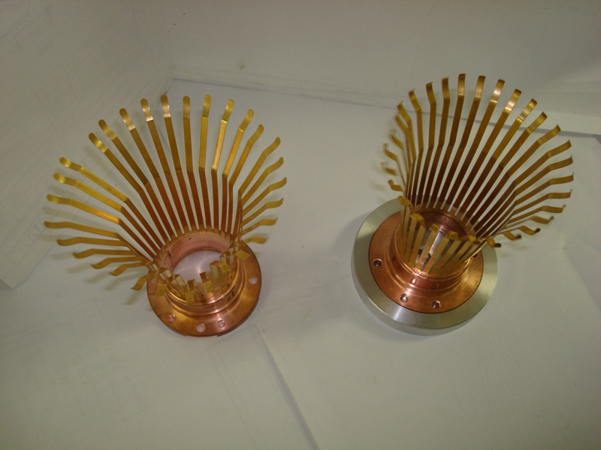
Corrective actions
A tooling was designed to restore the correct geometry of the fingers
Move the SSS by 2 mm to reduce the span of the QQBI
A non-conforming RF contact assembly inserted in the correcting tool prototype
An example of a non-conforming assembly, and a corrected assembly
Notes:
No damage on coatings with the corrective tooling. Stroke amplitude restored, DC resistance OK.

Slide 12
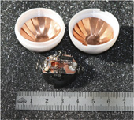
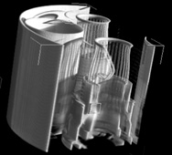
Means of detection of damaged PIMs
Quite a few solutions analysed
Rolling a ball from one extremity of a sector to the other, localise the ball with the BPMs, move it by a draft created by pumping at one end
Photometry
Principle OK, but not adapted for the required length
RF probe from the extremities
Needed “at cold” calibration
Sensitivity at the limit for reliable detection
X-ray tomography
Can measure through the external bellows
Notes:
Ball speed around 2 m/s, draft around 4 m/s
X-ray tomograph used in the LHC, also to try and diagnostic bad splices.

Slide 13
Follow-up (end 2008 –beginning 2009)
Finding ways to repair a broken PIM without global warm up
Limit the warming up to one half-cell
Use neon flushing to prevent condensation of gas in beam tube
Analyse and mitigate risk at the extremity of the arcs
Minimise the warm up during long cryogenic stand-by periods
Analyse the situation in the stand-alone magnets
Related problems after the 3-4 incident
Debris in the beam pipe and PIMs (could affect resistance)
Buckling of the nested bellows
Strategy of PIM replacement
Notes:
Partial warm up validate in SM18, used several times since then

Slide 14
Summary
The PIM problem was purely mechanical
It has been fully understood
Non conforming PIMs can be repaired
Strategy for replacement has been defined and is applied
With some “accrobacy”, a PIM can even be replaced in a cold sector
only partial warm up of one cell
A “repaired” PIM has a DC resistance as specified
RF measurements were also made end 2008 and beginning 2009
But… I cannot remember of a “PIM crisis”
Could have been a supply problem after the 3-4 incident

