Slide 1
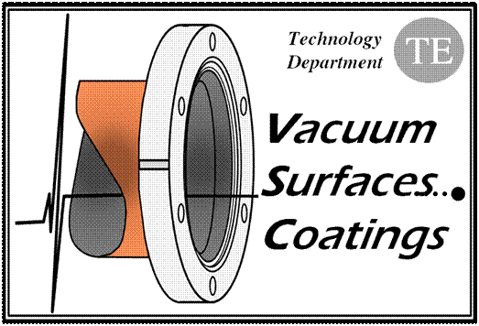
Vacuum Modules
in LHC Septa
V. Baglin (10/4/12)
CERN TE-VSC, Geneva

Slide 2
MSI in LSS2
Vacuum modules with RF insert
5 typical from LSS (VMAPA, VMAPB, VMZAF)
6 special for MSI and BTVSS area (VMSIA, O, P3, S, R_1, R_2)

Slide 3
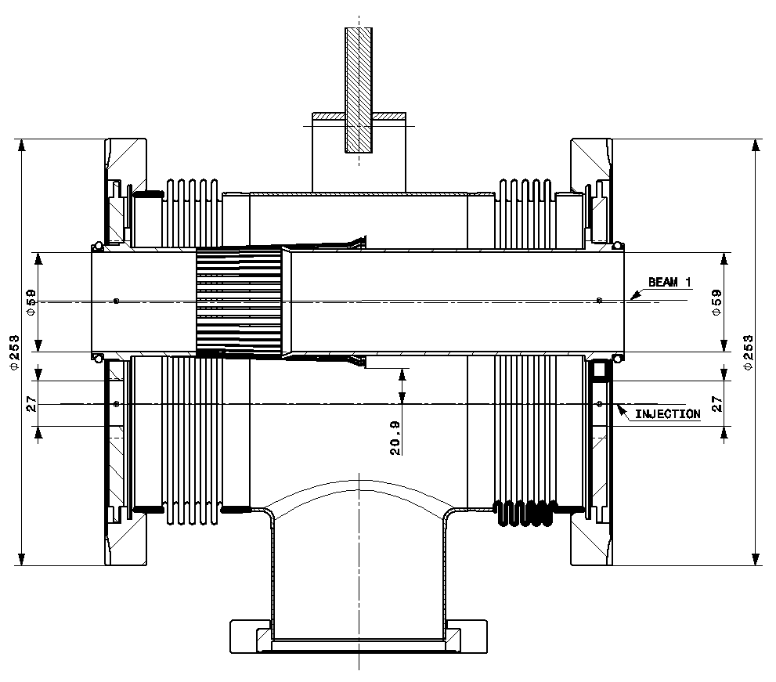
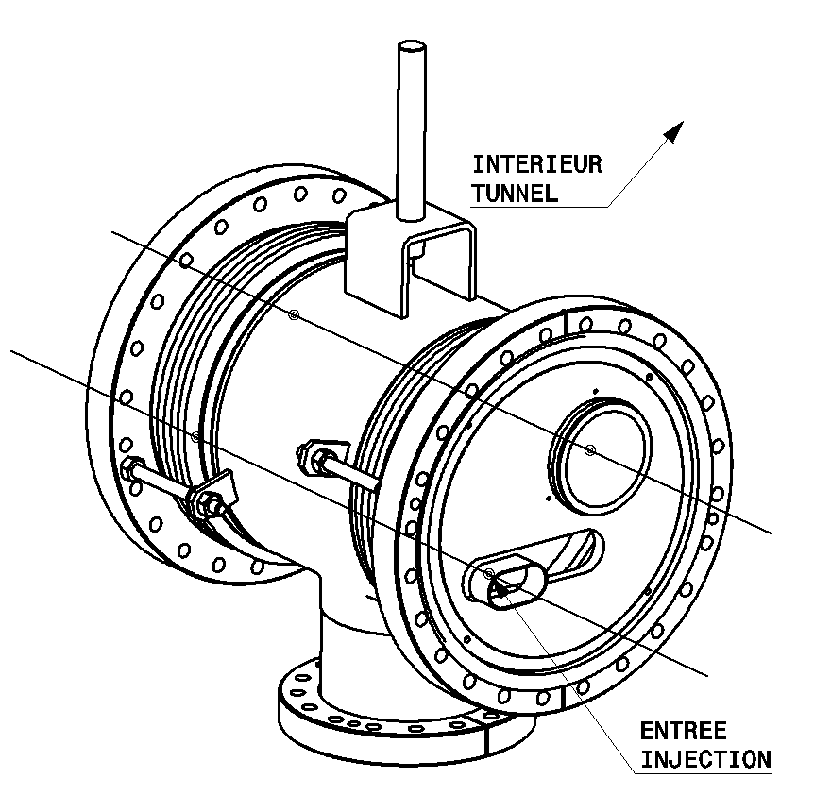
MSI in LSS2: VMSIR 0002
Cu insert
3 micron Rh coating
IP2

Slide 4
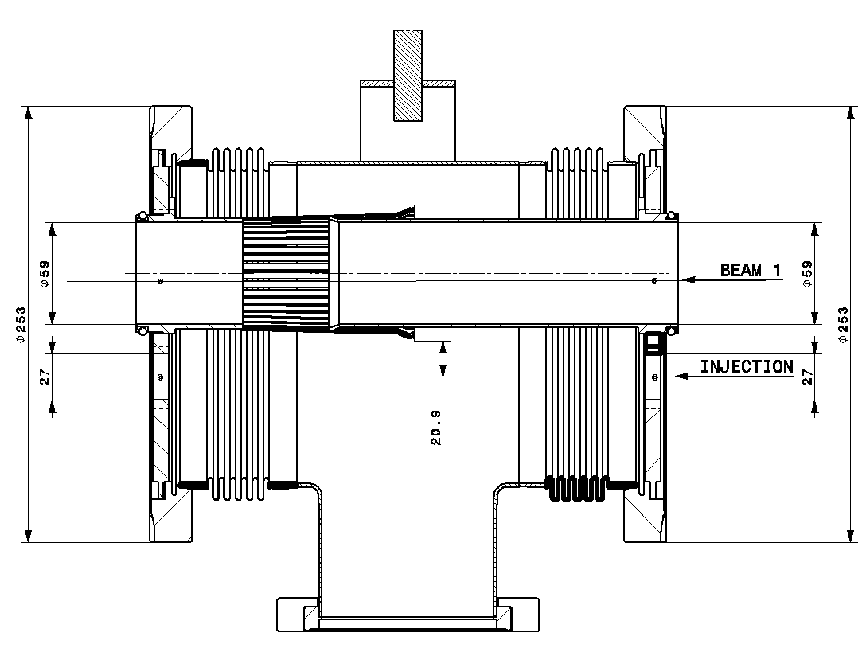
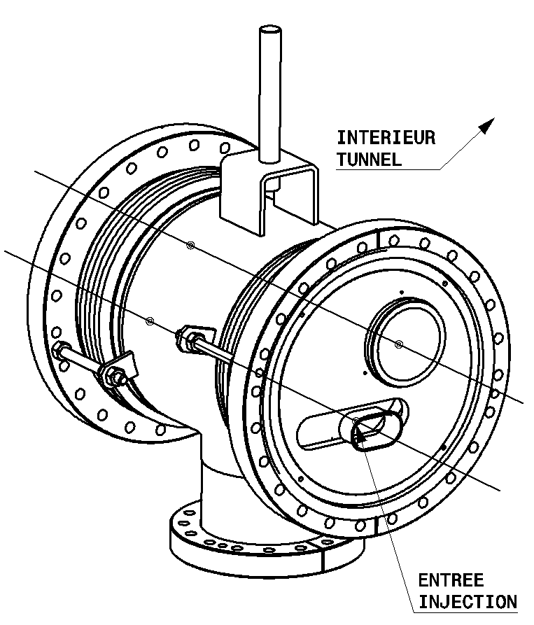
MSI in LSS2: VMSIR 0001
Cu insert
3 micron Rh coating
IP2

Slide 5
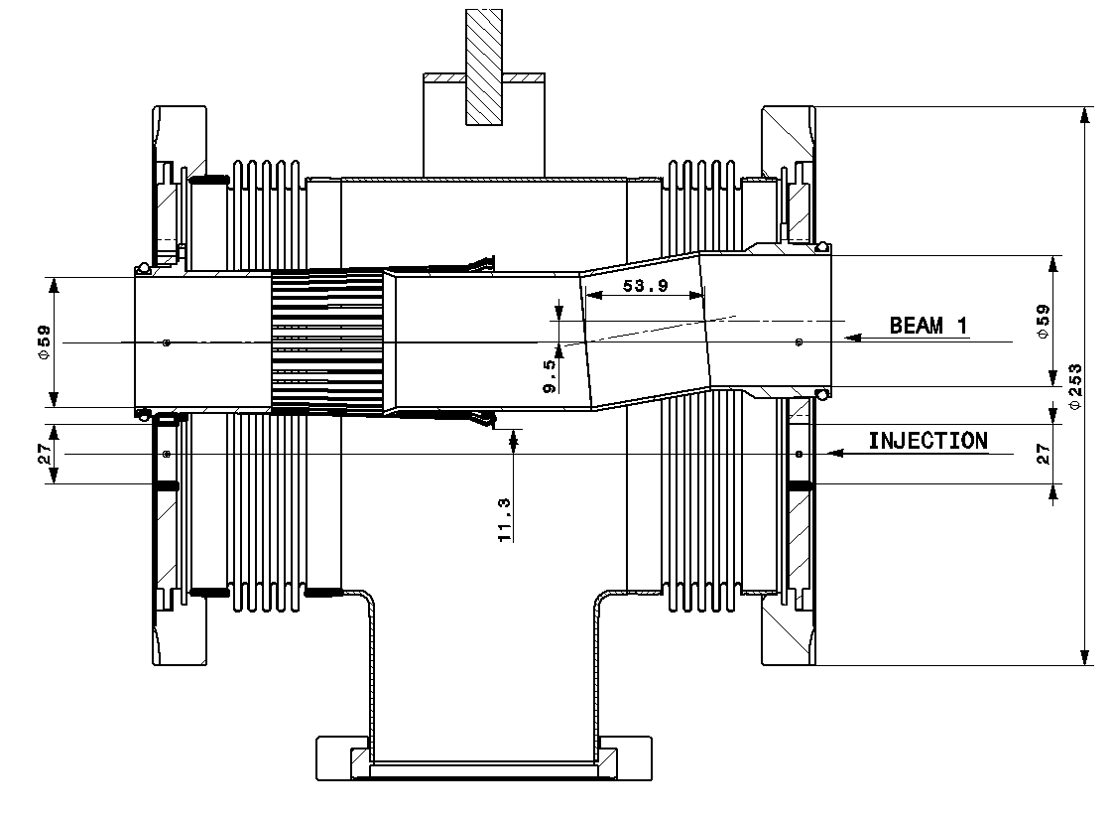
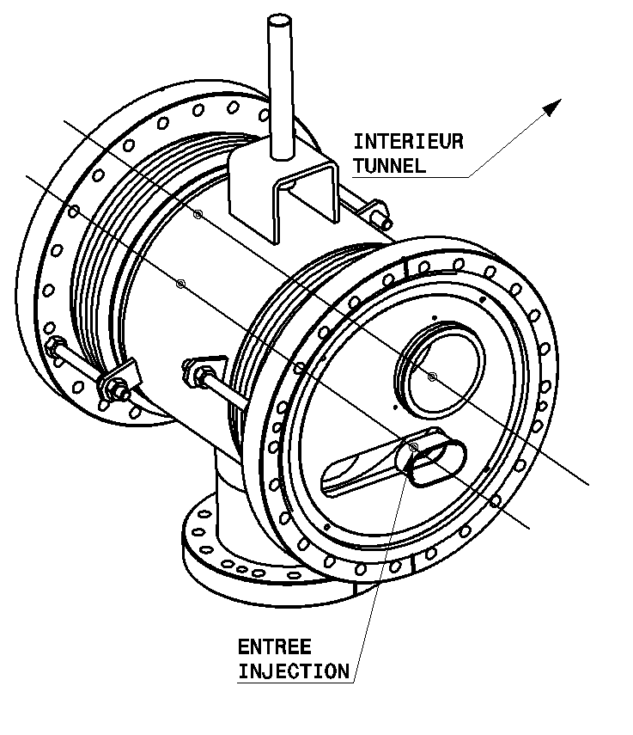
MSI in LSS2: VMSIS
Cu insert
3 micron Rh coating
Step between MSIB and MSIA
IP2

Slide 6
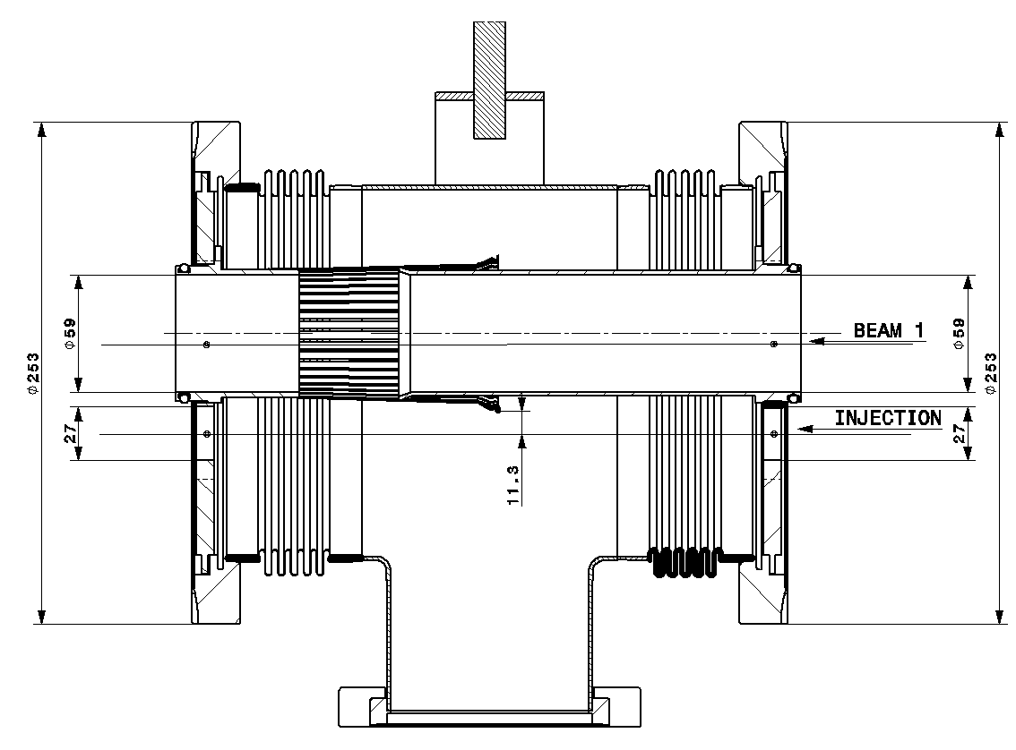
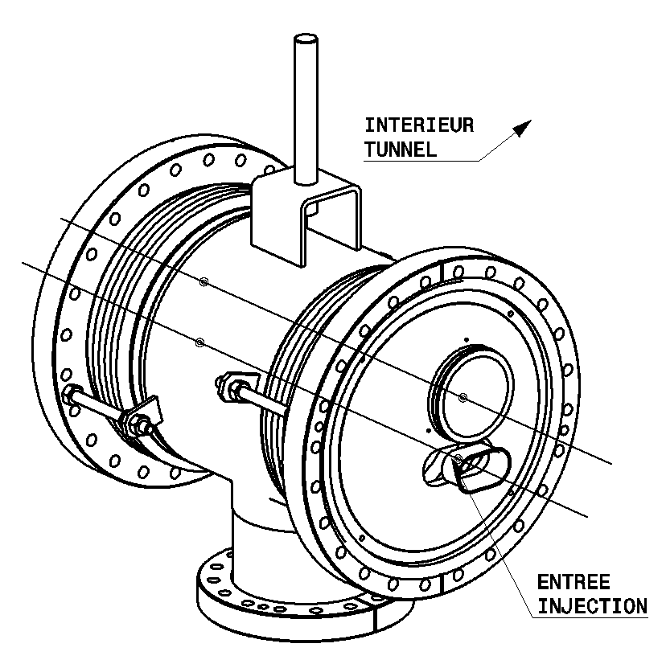
MSI in LSS2: VMSIP 0003
Cu insert
3 micron Rh coating
IP2

Slide 7
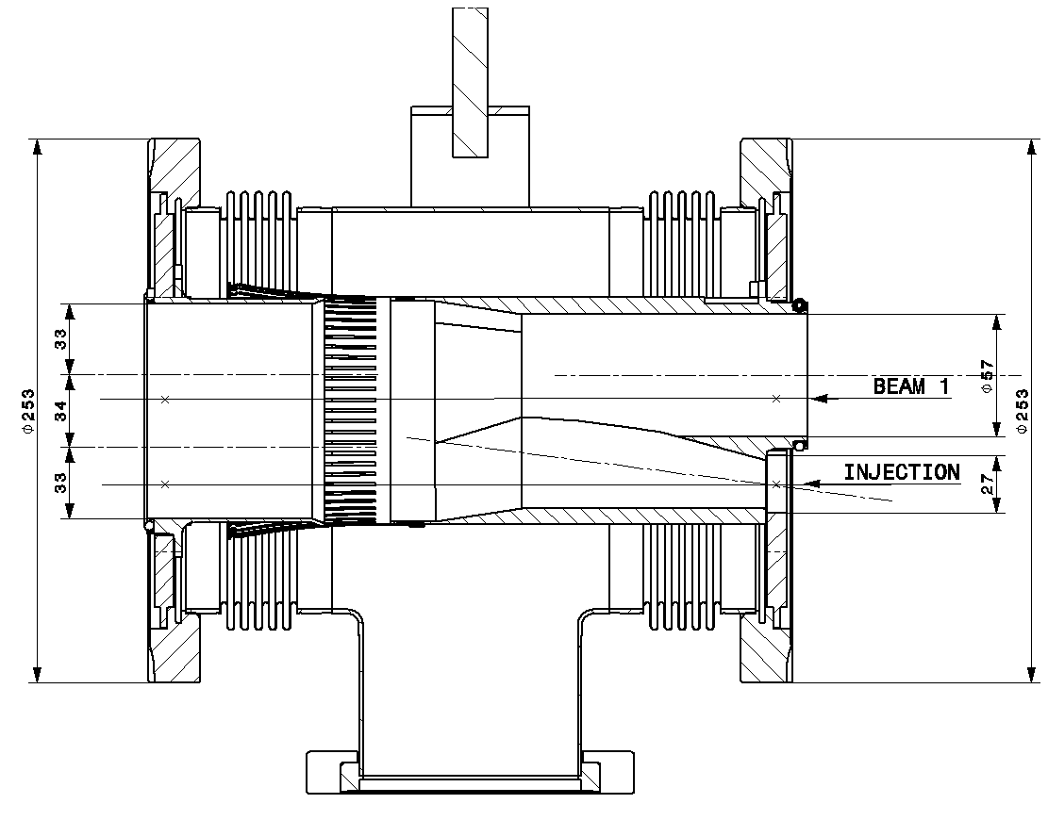
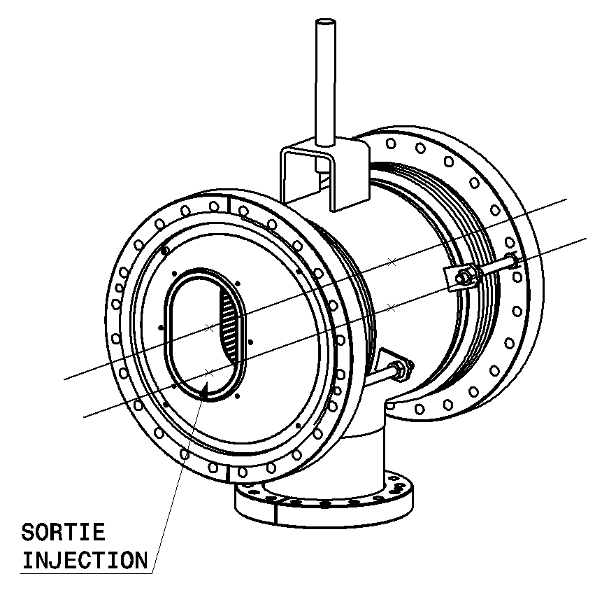
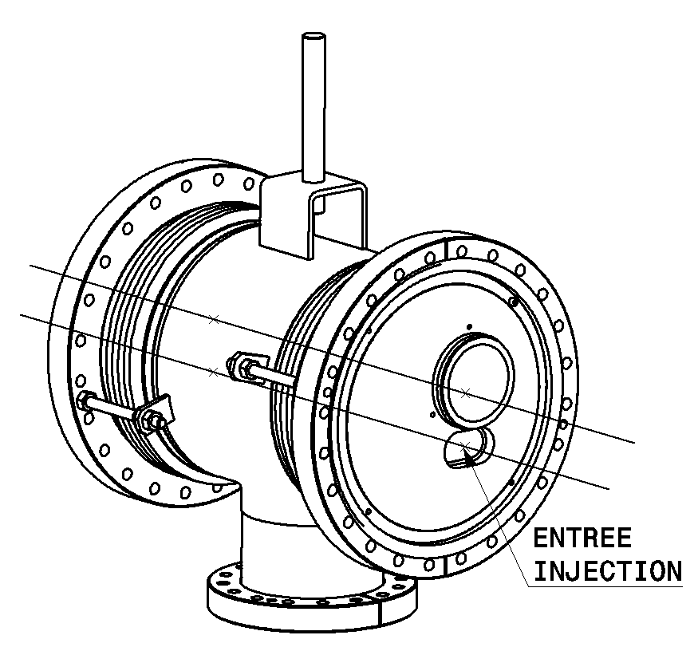
MSI in LSS2: VMSIO
Cu insert
3 micron Rh coating
Recombination of B1 and injection
Between MSIA and BTVSS
IP2

Slide 8
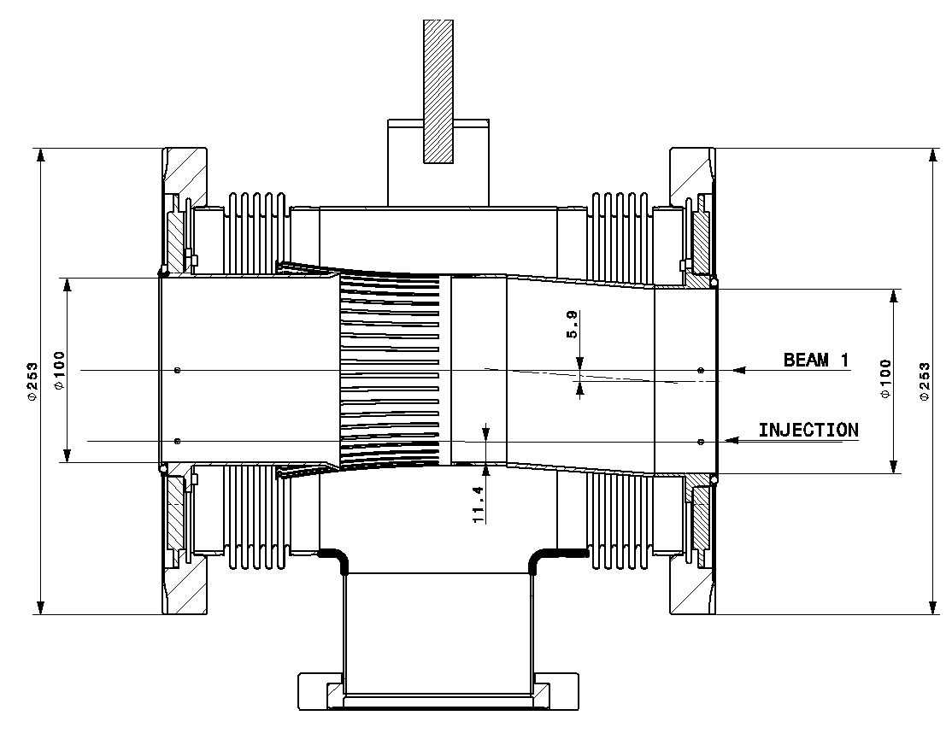
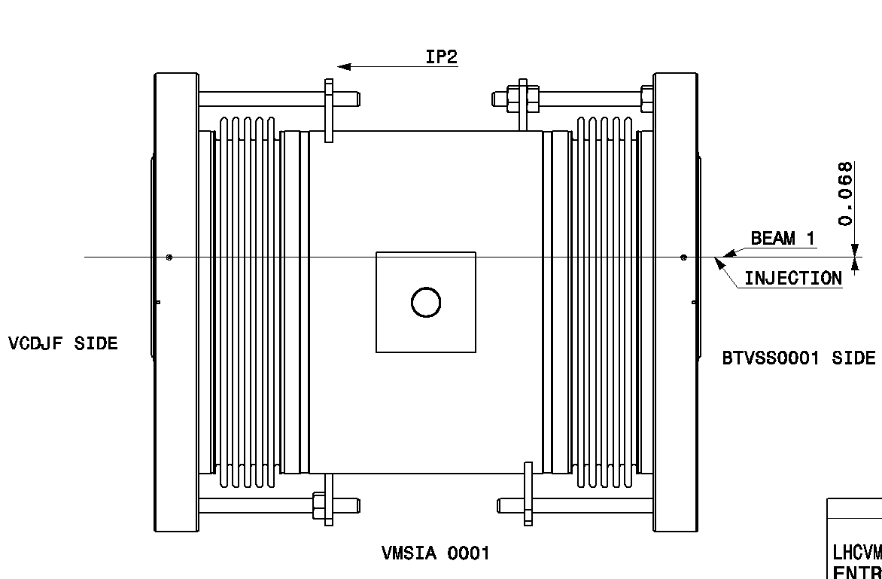
MSI in LSS2: VMSIA
Cu insert
3 micron Rh coating
Accommodates BTVSS offsets
IP2

Slide 9
MSI in LSS8
Vacuum modules with RF insert
5 typical from LSS (VMAPA, VMAPB, VMZAD)
6 special for MSI and BTVSS area (VMSIN, P2,Q, R3,R4, Z)

Slide 10
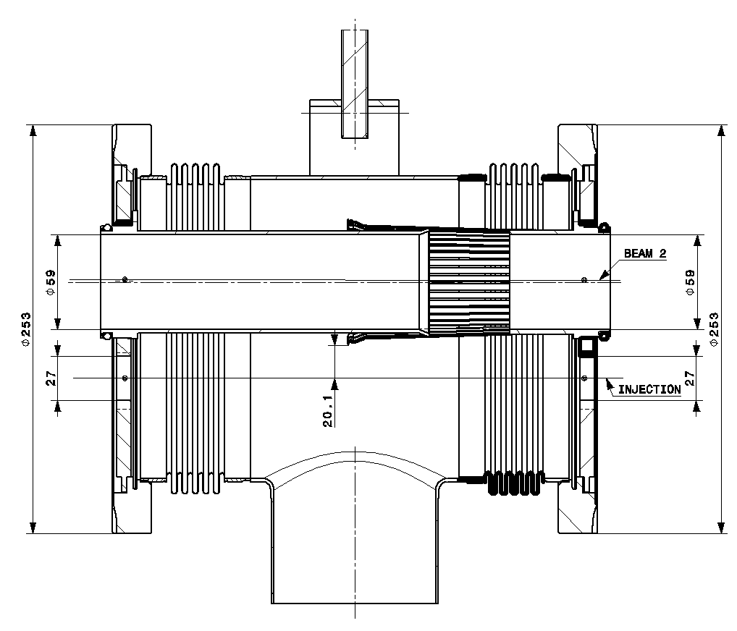
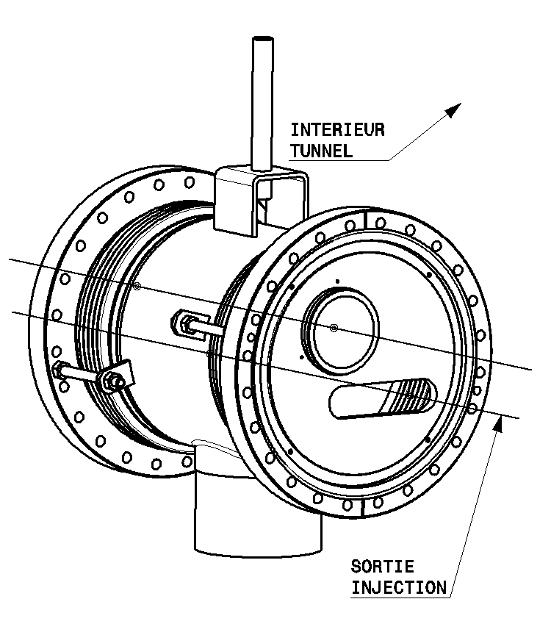
MSI in LSS8: VMSIR0004
Cu insert
3 micron Rh coating
IP8

Slide 11
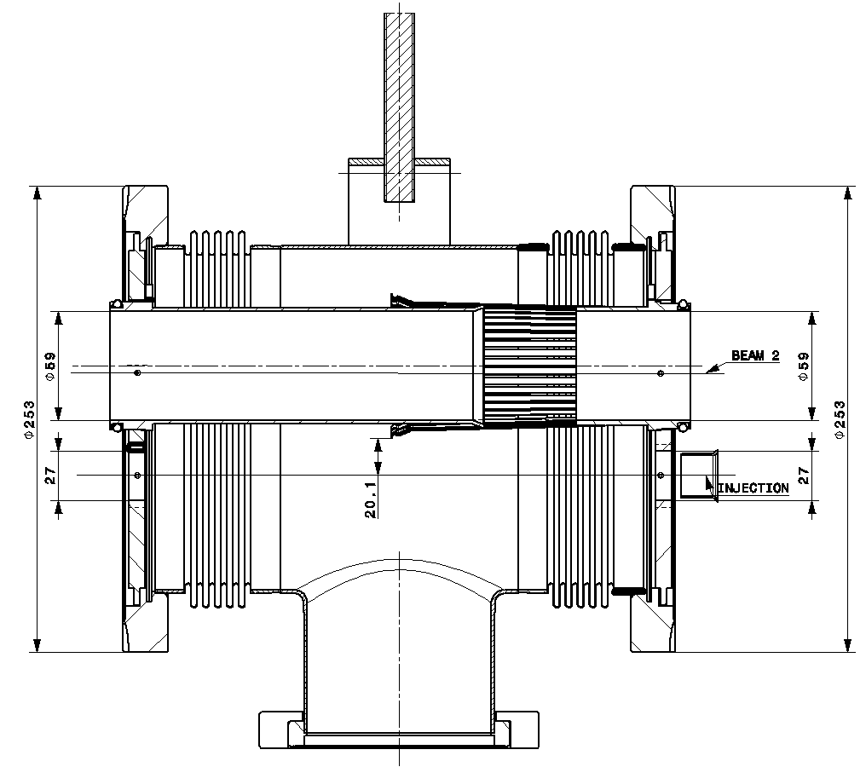
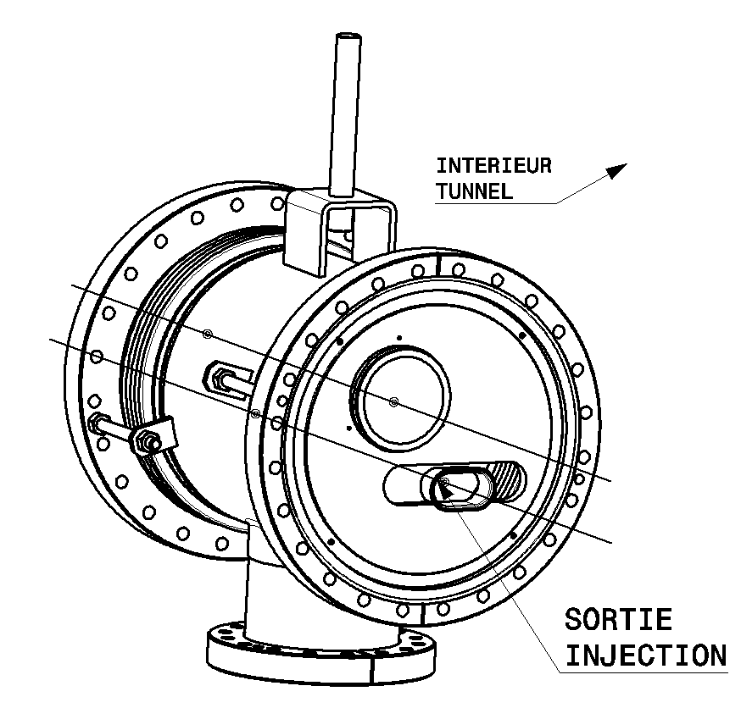
MSI in LSS8: VMSIR0003
Cu insert
3 micron Rh coating
IP8

Slide 12
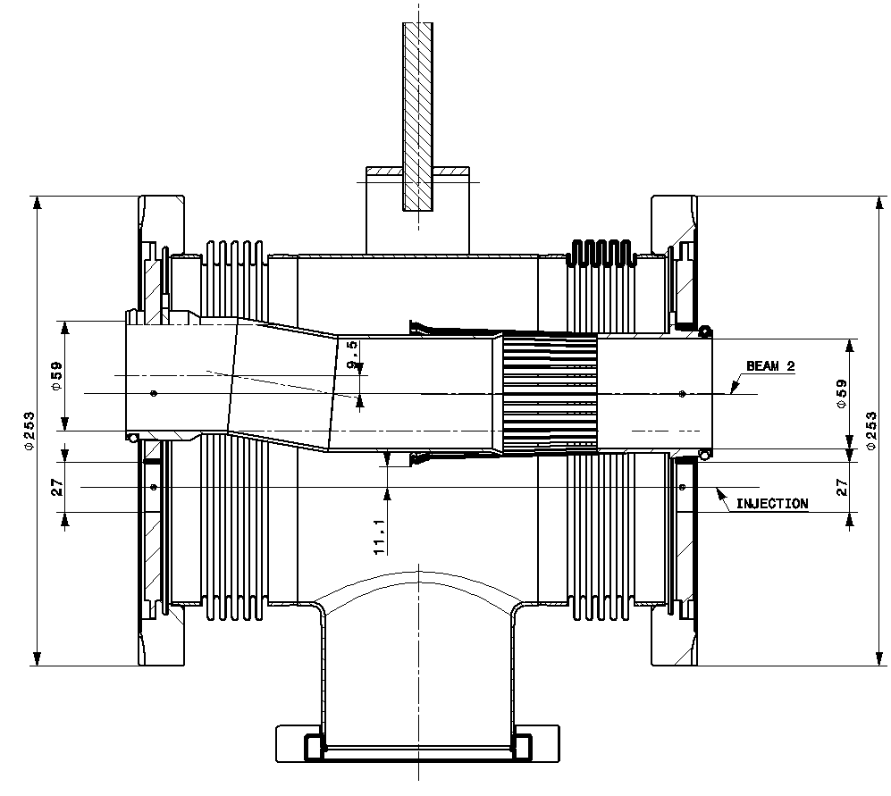
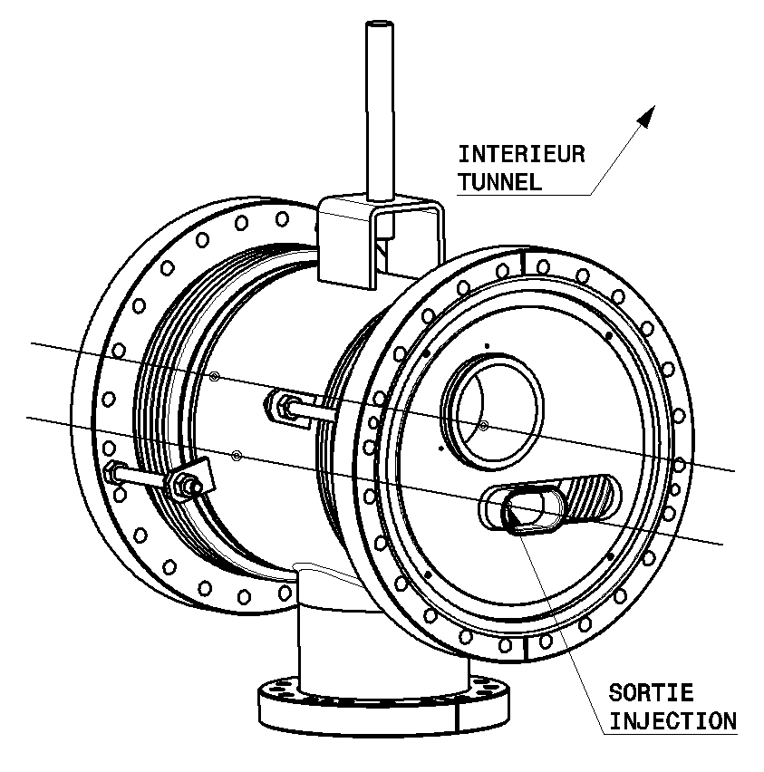
MSI in LSS8: VMSIQ
Cu insert
3 micron Rh coating
Step between MSIB and MSIA
IP8

Slide 13
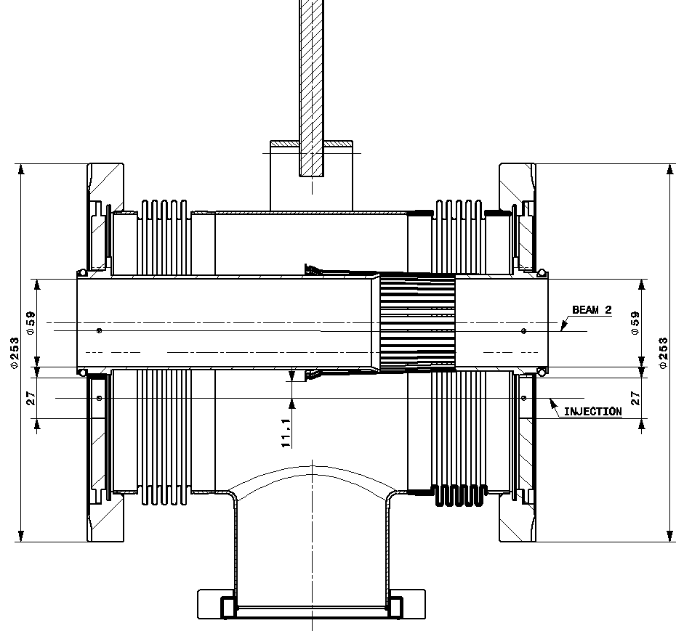
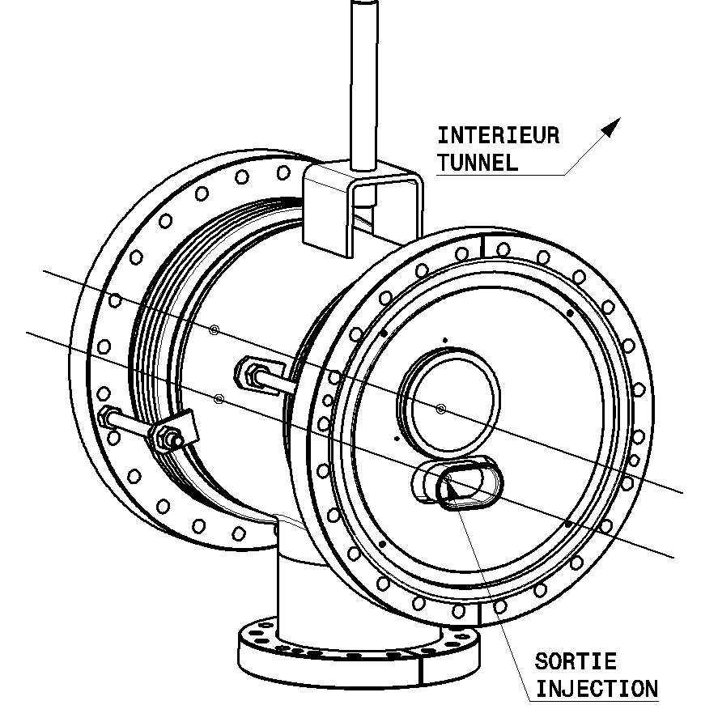
MSI in LSS8: VMSIP0002
Cu insert
3 micron Rh coating
IP8

Slide 14
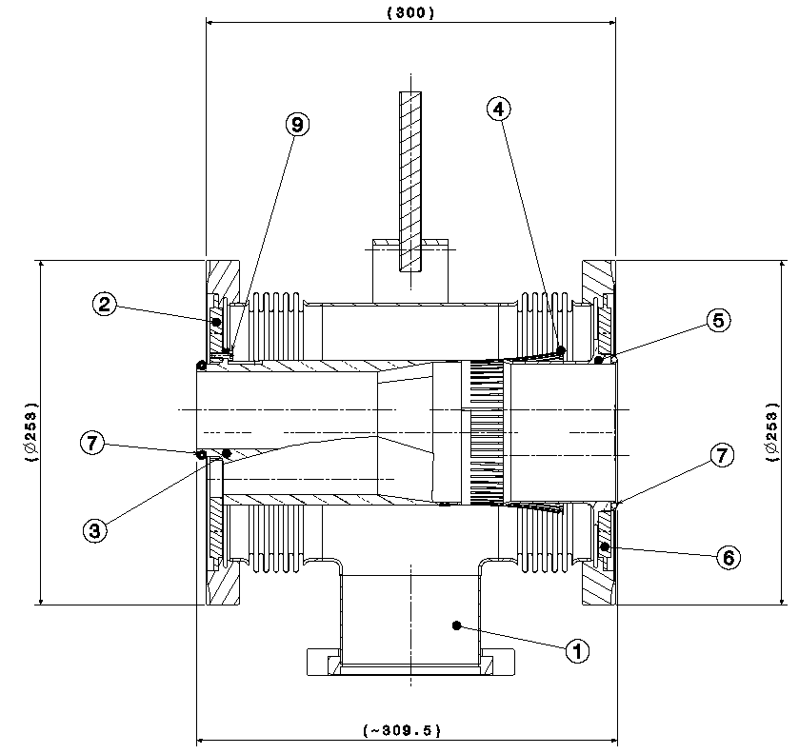
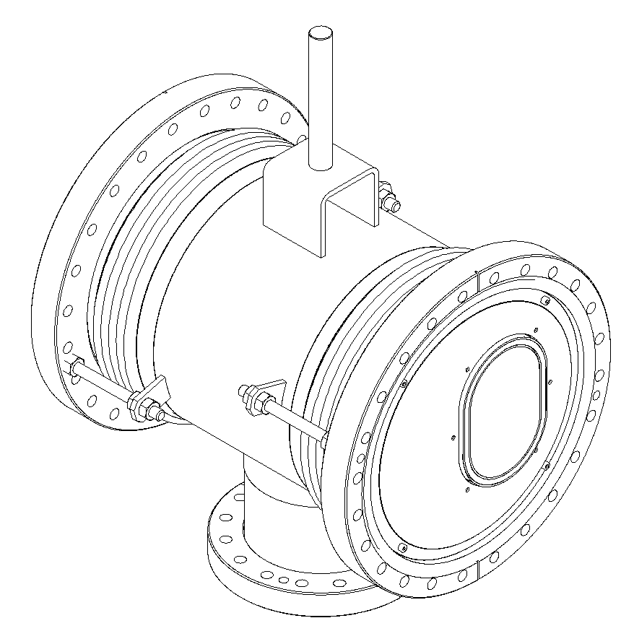
MSI in LSS8: VMSIN
Cu insert
3 micron Rh coating
Recombination of B1 and injection
Between MSIA and BTVSS
IP8

Slide 15
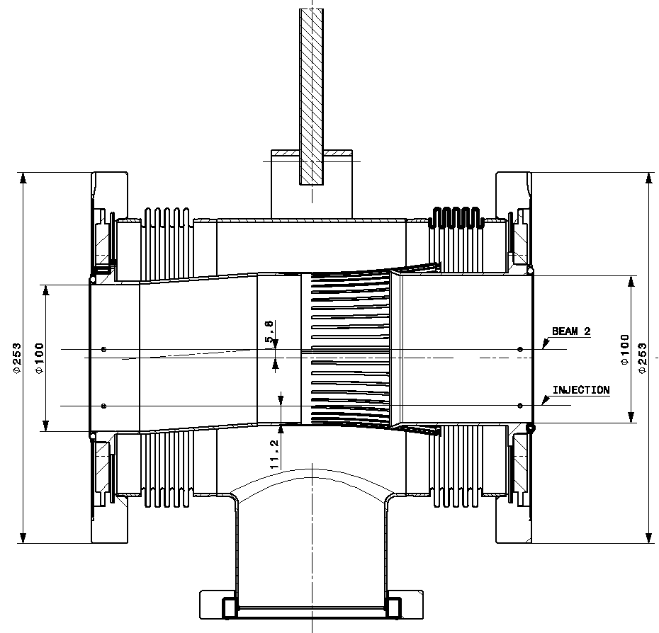
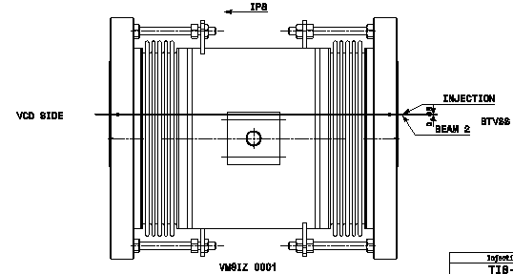
MSI in LSS8: VMSIZ
Cu insert
3 micron Rh coating
Accommodates BTVSS offsets
IP8

Slide 16
MSD in LSS6
Vacuum modules with RF insert
18 special for MSD and TCDS area (VMSDO, P, Q, R, S, T, U)

Slide 17
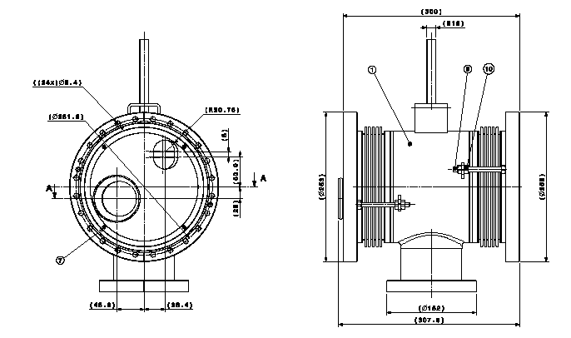
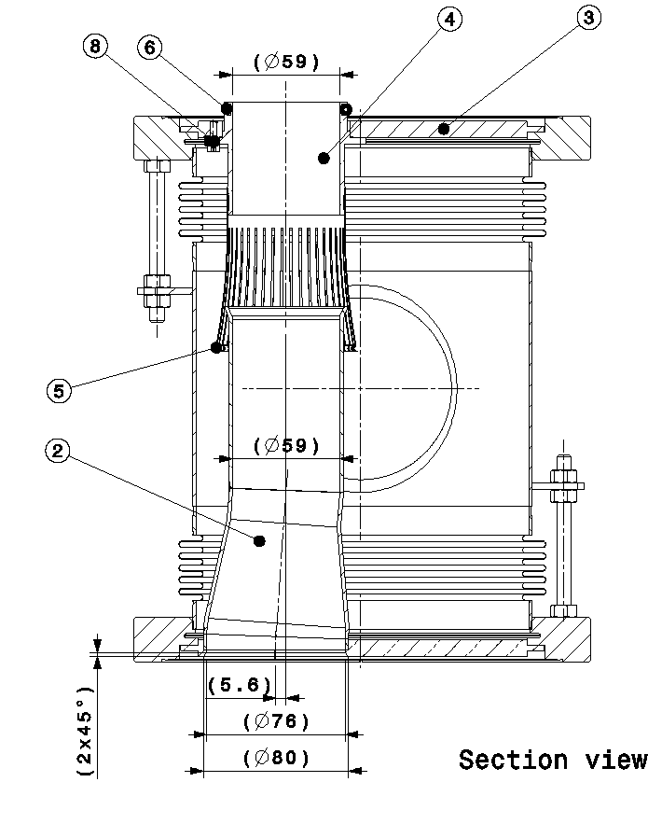
MSD in LSS6: VMSDU
Cu insert
3 micron Rh coating
Extracted beam
MSD
Circulating beam
Extraction chamber
VCTYE

Slide 18
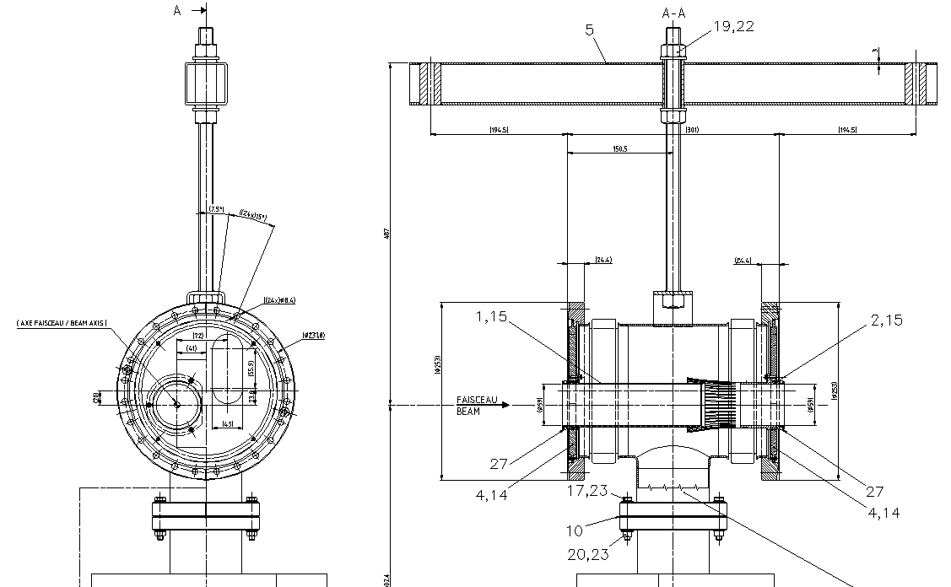
MSD in LSS6: VMSDT
Cu insert
3 micron Rh coating
For MSDC
Extracted beam
Circulating beam

Slide 19
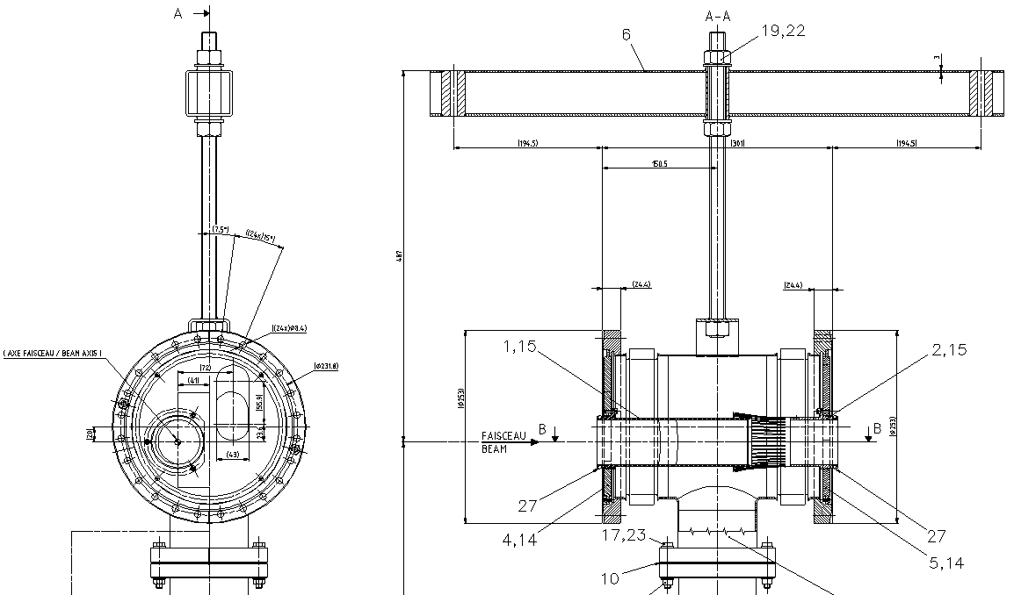
MSD in LSS6: VMSDS
Cu insert
3 micron Rh coating
Transition MSDC-MSDB
Extracted beam
Circulating beam

Slide 20
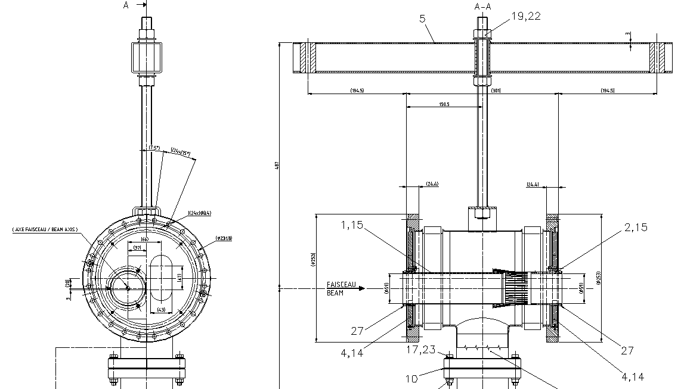
MSD in LSS6: VMSDR
Cu insert
3 micron Rh coating
For MSDB
Extracted beam
Circulating beam

Slide 21
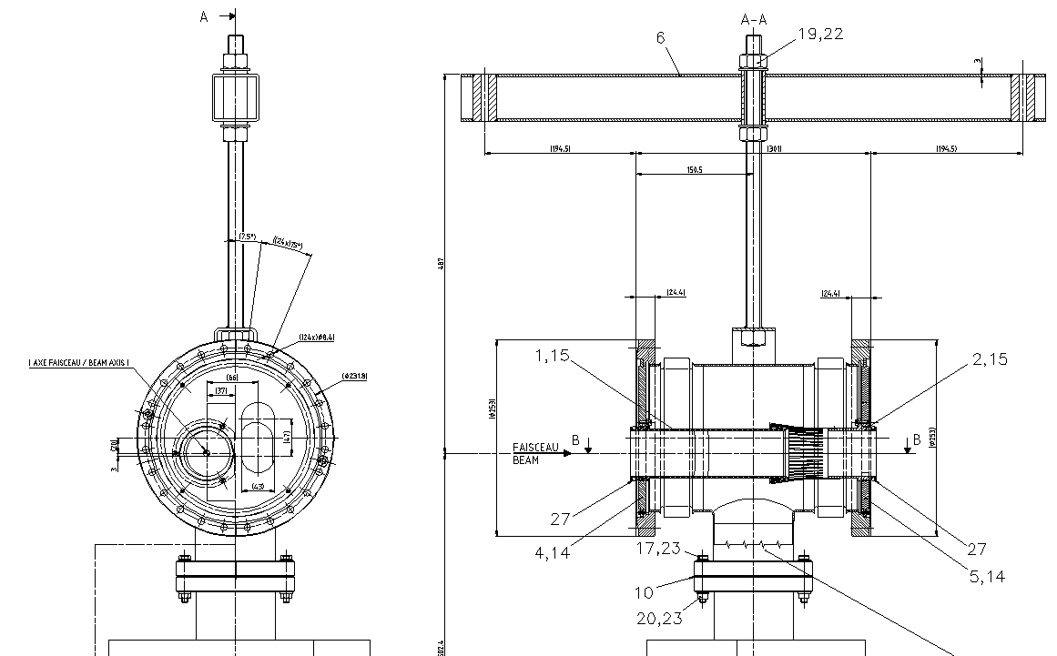
MSD in LSS6: VMSDQ
Cu insert
3 micron Rh coating
Transition MSDB-MSDA
Extracted beam
Circulating beam

Slide 22
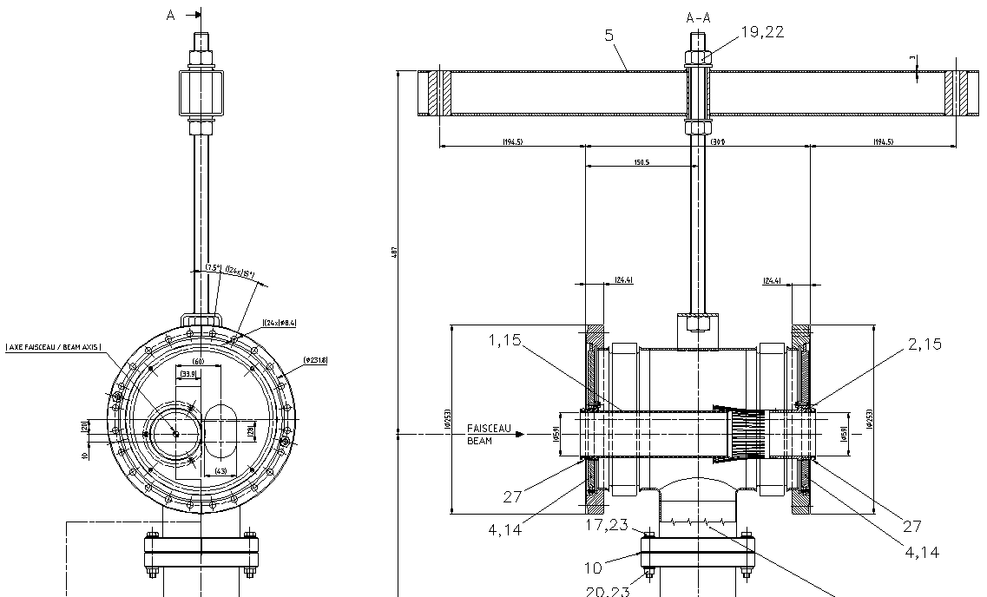
MSD in LSS6: VMSDP
Cu insert
3 micron Rh coating
For MSDA
Extracted beam
Circulating beam

Slide 23
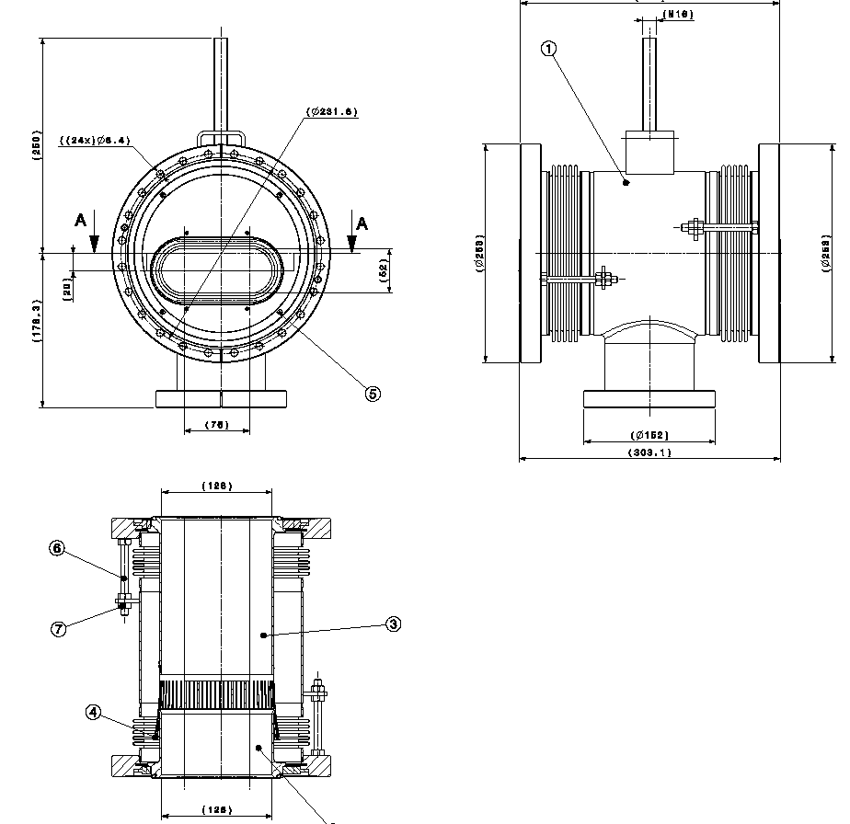
MSD in LSS6: VMSDO
Cu insert
3 micron Rh coating
Transition MSDA-TCDS
MSDA entering flask ?
=> need design of a recombination insert (type VMSIN, O) ?
TCDS
MSDA

