Slide 1
Past development work on RF fingers
Sergio Calatroni summarising the work of several colleagues

Slide 2
Work on RF fingers
RF fingers for PIMs
  Low contact resistance < 0.1 mΩ
  No cold welding, low friction
  Good formability properties
RF fingers for collimators
  3 above (R < 1 mΩ)
  Resistance to bake out 250 °C / 1000 h
  Resistance to RF heating: good thermal conductivity

Slide 3
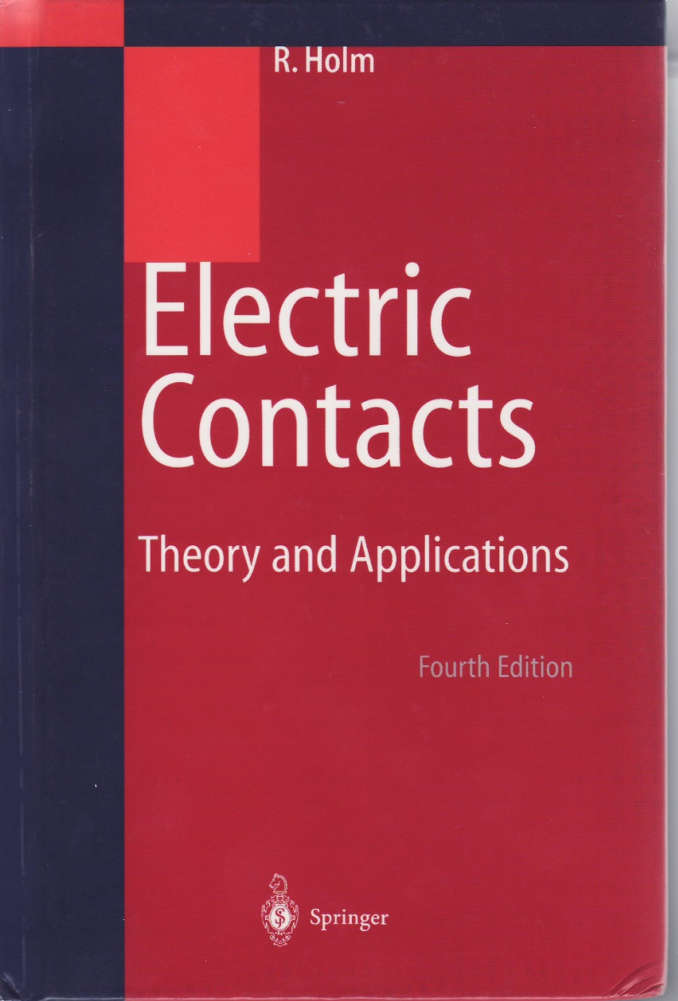
Good electric contacts...
...Require:
Literature
Low surface roughness
Soft metals (at least one)
No oxide layer at the surface
Theoretically:
  R∝P^{-1/3} in elastic regime
  R∝P^{-1/2} in plastic regime
Experimentally:
  R∝P^{-1÷-1/2}

Slide 4
RF fingers for PIMs
LHC Beam Vacuum Interconnection Study Group
  Chairman: N. Hilleret
  Technical Secretary: J. Knaster / R. Veness
WG minutes
  http://at-div-vac.web.cern.ch/at-div-vac/VACPAGES/MINUTES/LHC_Beam_Vacuum_Interconnection/wel.html
PAC 2001 paper
  http://accelconf.web.cern.ch/AccelConf/p01/PAPERS/WPAH037.PDF

Slide 5
Topics
Good formability: was covered by Stefano Sgobba, Karine Couturier
No cold welding: was covered by Paolo Chiggiato
Low contact resistance: was covered by SC
Low friction: was covered by Mauro Taborelli

Slide 6
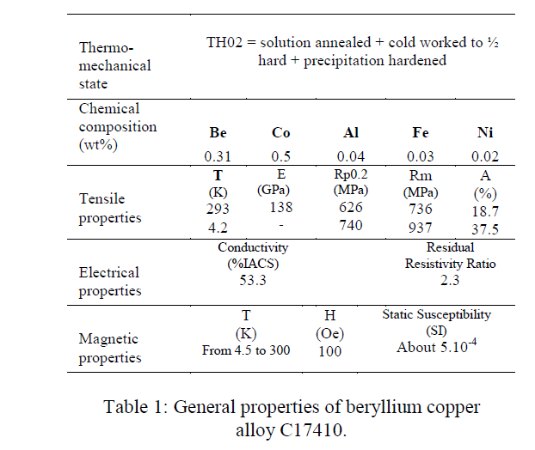
Cu 17410
Good adhesion of coatings, weldability by e-beam, formability w/o need of further annealing for hardening, lower Ni content than usual C17200 alloy, but contains Co (amount small enough for RP)

Slide 8
Electric conductivity
CuBe C17410 has conductivity of 53% IACS (standard C17200 25% IACS) and RRR 2.3
This is still too high for a reasonable surface impedance
  Coating is needed in order to increase surface conductivity
  Coating is needed for a low contact resistance (+ avoiding cold welding)

Slide 9
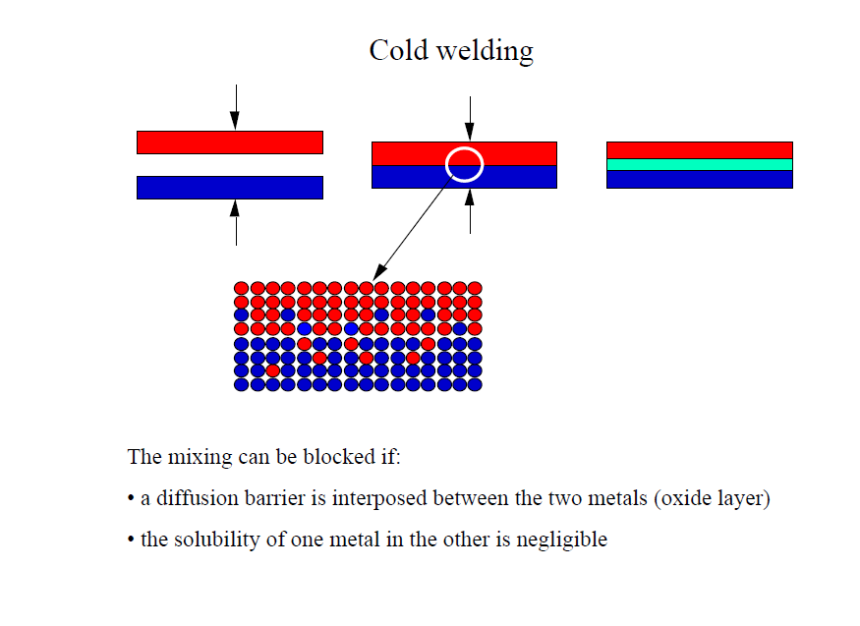
No cold welding

Slide 10
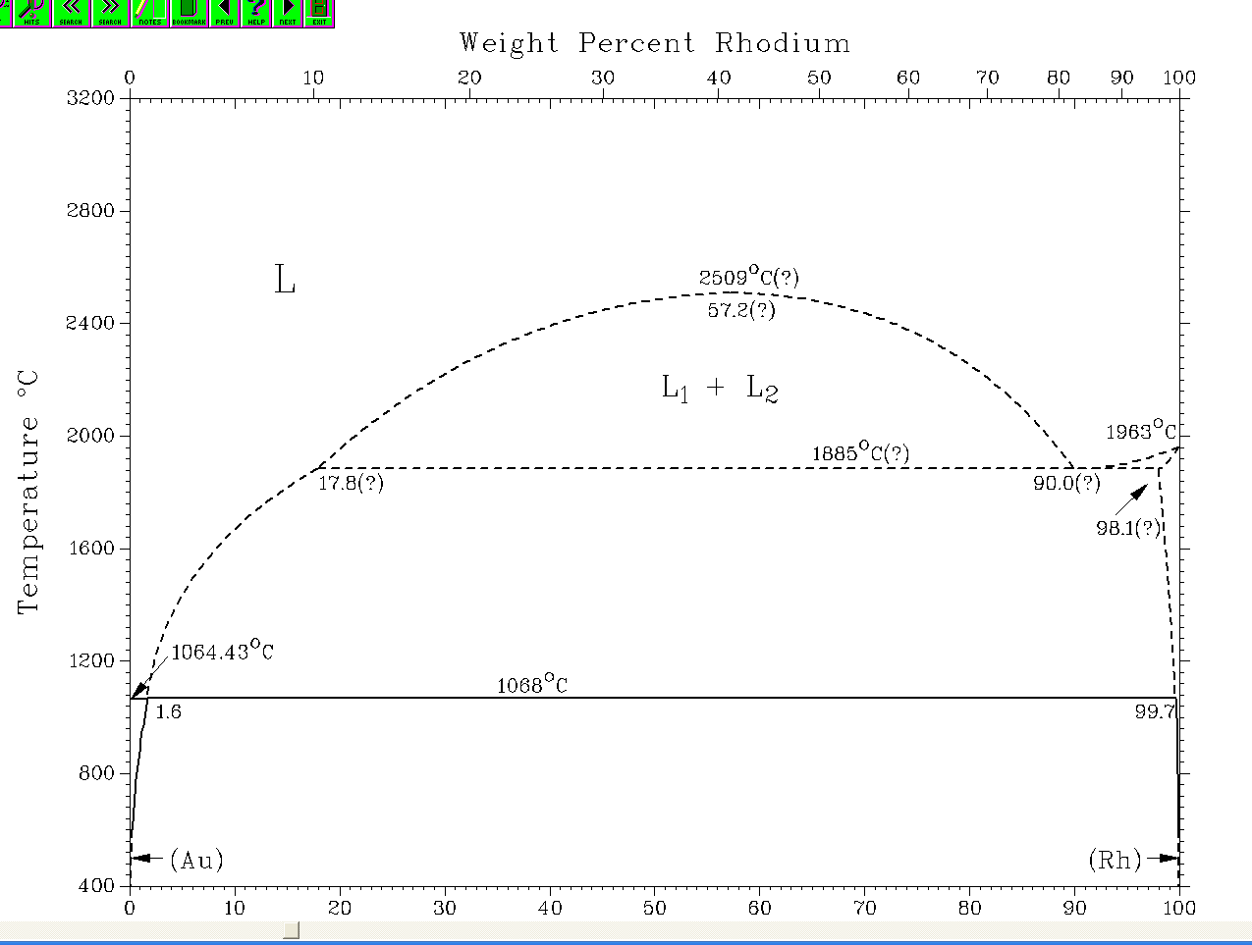
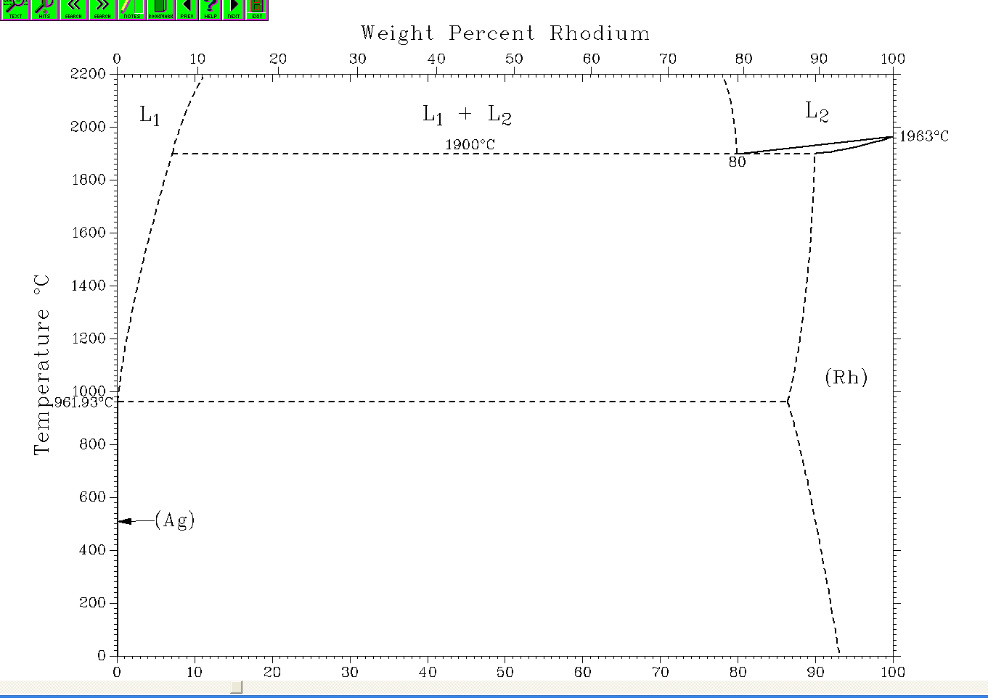
Phase diagrams
Au - Rh
Ag - Rh

Slide 11
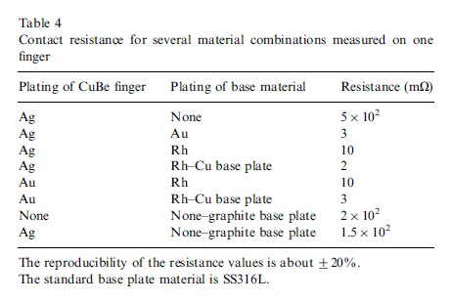
Contact resistance
+U
-U
Force: 25-125 g
+I
-I
5 mm
R=0.5
40 mm
Set-up in cryostat at 4.2K – 300 K, and summary of RT measurements

Slide 12
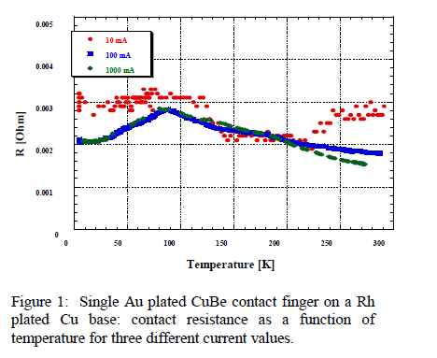
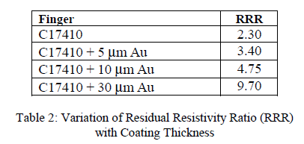
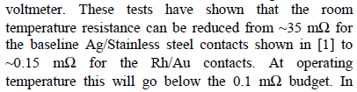
Contact resistance
After testing the resistance of real PIMs Au was probably reduced to 10 µm

Slide 13
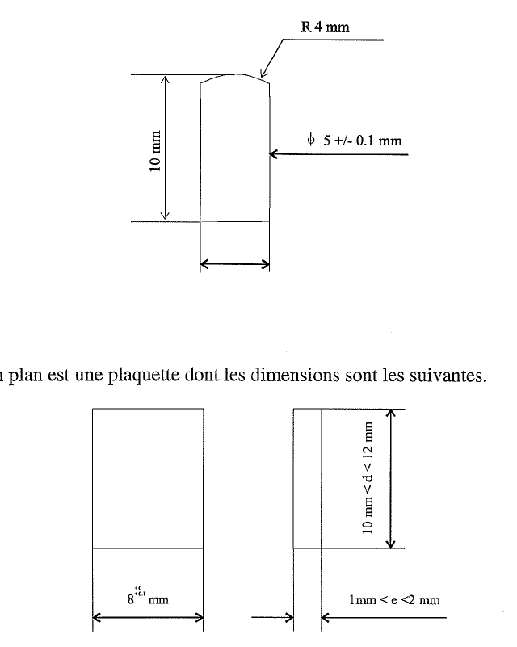
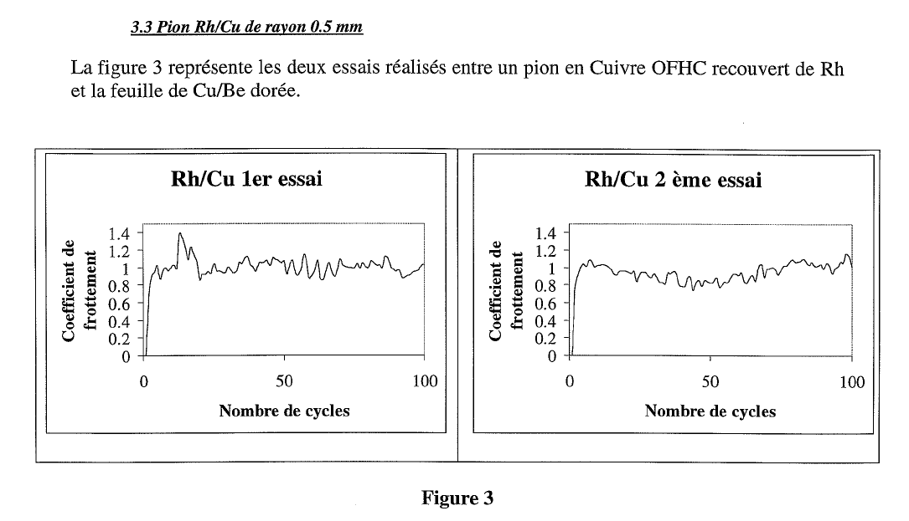
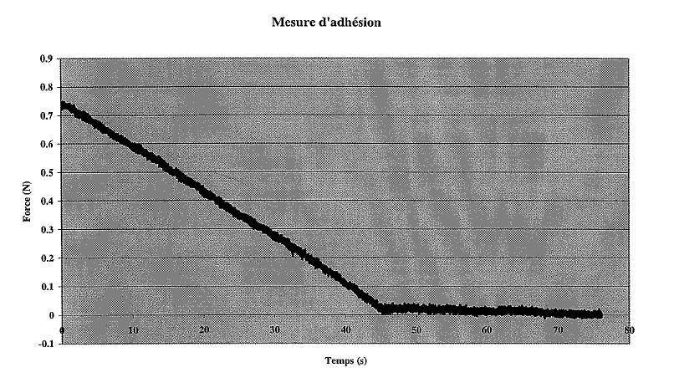
Friction
2 mm path, 0.5 mm/s, 0.7 N force, 100 cycles in vacuum 10⁻⁹ mbar, cooled to liquid nitrogen
Performed at Ecole Centrale Lyon. We have now a contact with Tekniker (Spain) where these measurement can also be performed

Slide 14
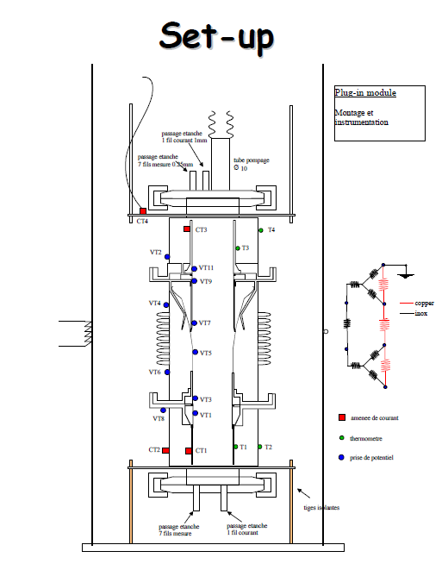
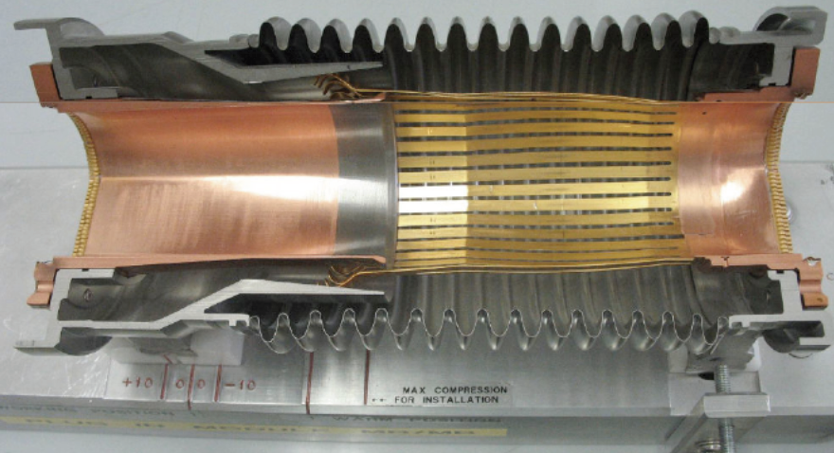
Engineering of PIMs
Ray Veness / Pierre Strubin have probably the best information on it (with Juan Knaster, Patrick Lepeule)
Giovanna Vandoni made a test of a full PIM at the cryolab, before final validation in the String2

Slide 15
RF fingers for collimators
Collimator design WG led by Alessandro Bertarelli and Manfred Mayer
  http://lhc-collimation-project.web.cern.ch/lhc-collimation-project/coll-design-meeting.htm
NIM-A paper
  http://www.sciencedirect.com/science/article/pii/S0168900206012095

Slide 19
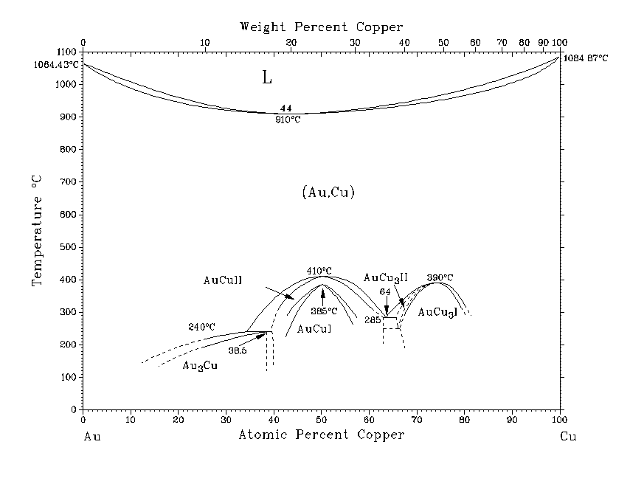
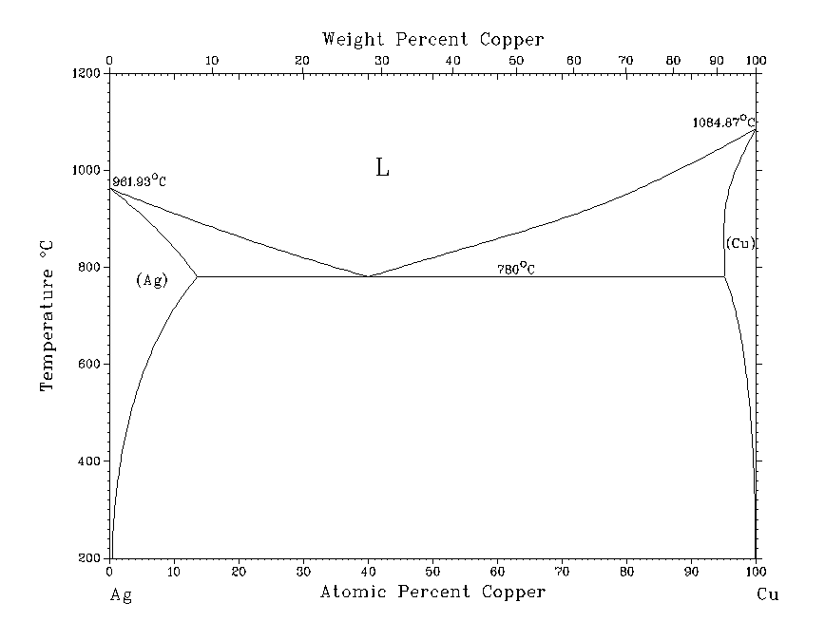
Phase diagrams
Cu-Au: solubility
Cu-Ag: much lower solubility

Slide 20
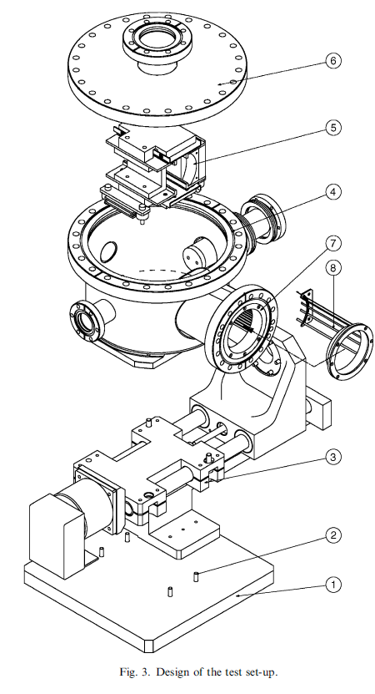
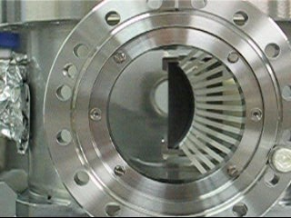
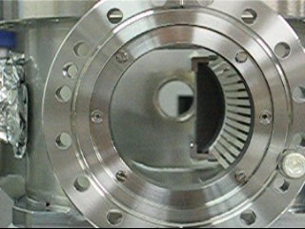
RF fingers test bench

Slide 27
Prescription: collimators should be baked-out when fingers are in position of lowest stress

Slide 28
Follow-up
15000 cycles test + bake were successful
Changed fixing of CuBe fingers set to C-C jaw (IKEA type)
Sliding problems appeared in series production. Modifications:
  Pre-forming of fingers to better follow the circumference
  End-point limiters for sliding movement, to prevent fingers to open-up too much when jaw is fully closed.
Test >30k cycles OK

Slide 29
Longitudinal contacts for collimators
They must withstand a wear equivalent to 15000 cycles (open-close of the jaw) times 30 mm ≅ 1 km !
Silver plated CuBe – Ag plated sliding onto electropolished s.steel plates supported by springs
Made of standard CuBe C17200
May suffer from compression set
Some changes to the springs and plate supports have been introduced in the series following first experience

