Slide 1
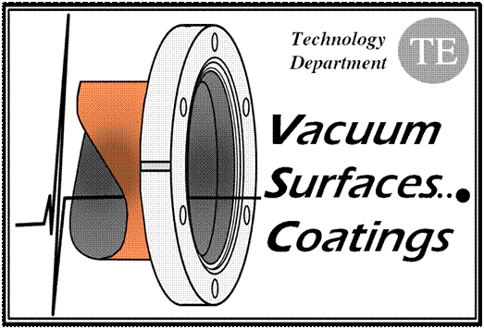
Vacuum Modules
in LHC Experiments
V. Baglin (26/3/12)
CERN TE-VSC, Geneva

Slide 2
ATLAS from Q1L to Q1R
Vacuum modules with RF insert
2 typical from LSS (VMABB)
2 special for experiments (VBX)
2 special vacuum chambers (VCIJP, X)

Slide 3
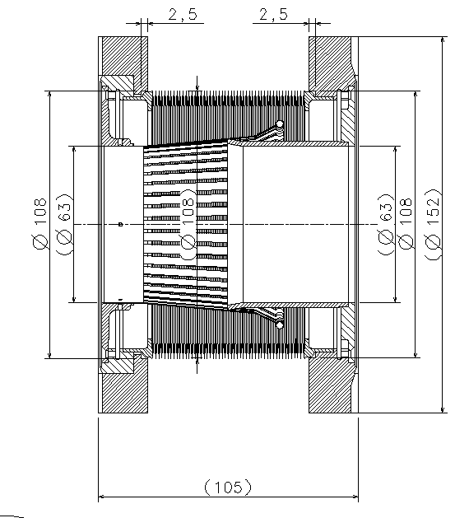
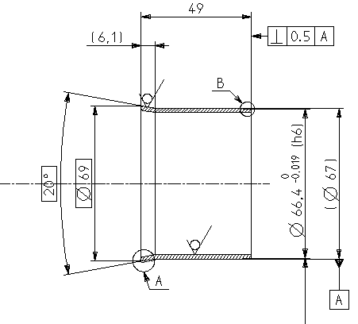
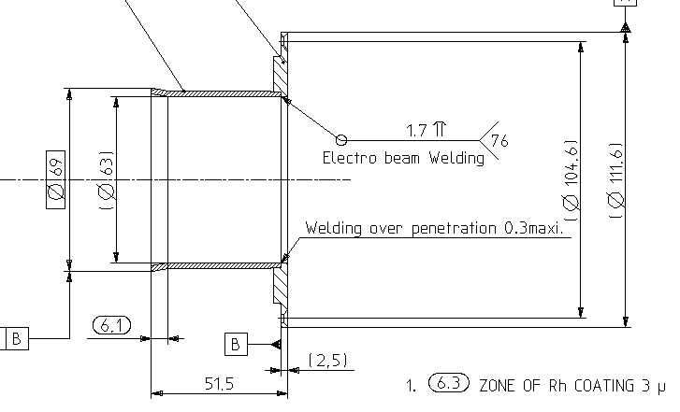
ATLAS: VBX
Cu insert
3 micron Rh coating

Slide 4
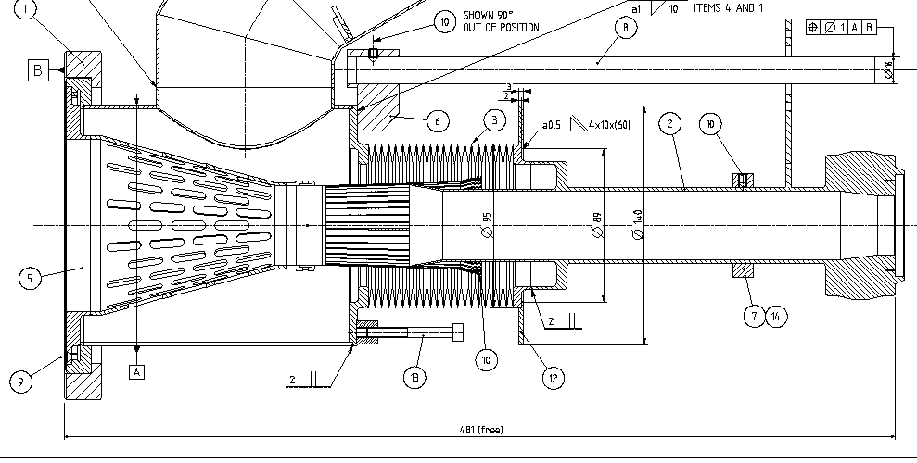
ATLAS: VC1JP
Cu coating 10 micron
Should have Rh
Same as CMS VBX5B (see later)

Slide 5
CMS from Q1L to Q1R
Vacuum modules with RF insert
2 typical from LSS (VMDQB)
2 special for experiments (VBX)
4 special for CMS (VBX5A and B)

Slide 6
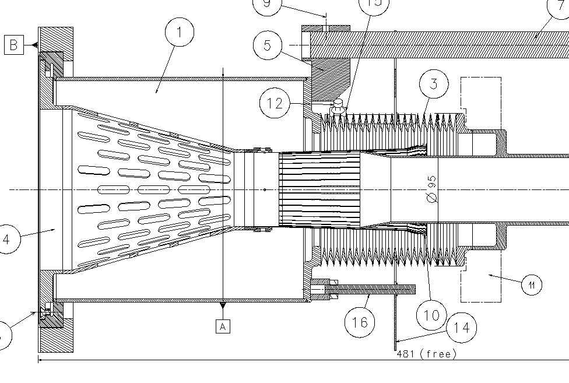
CMS: VBX5B
100 micron Cu coating
Installed at 500 mm, so overlap about 23 mm

Slide 7
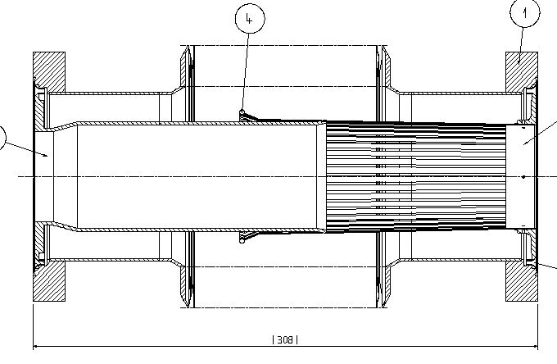
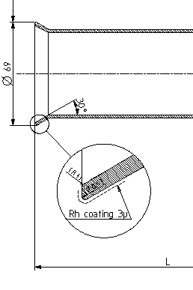
CMS: VBX5A
Cu insert
Installed at 312 mm, so overlap about 48 mm

Slide 8
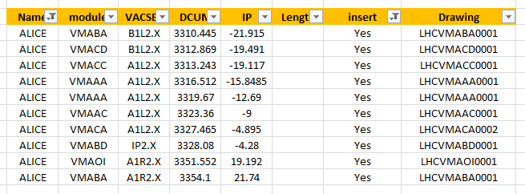
ALICE from Q1L to Q1R
Vacuum modules with RF insert
10 typical from LSS (Vmxyz)
Y=A => 80/80
Y=B => 63/63
Y=C => 63/80
Y=O => 100/63

Slide 9
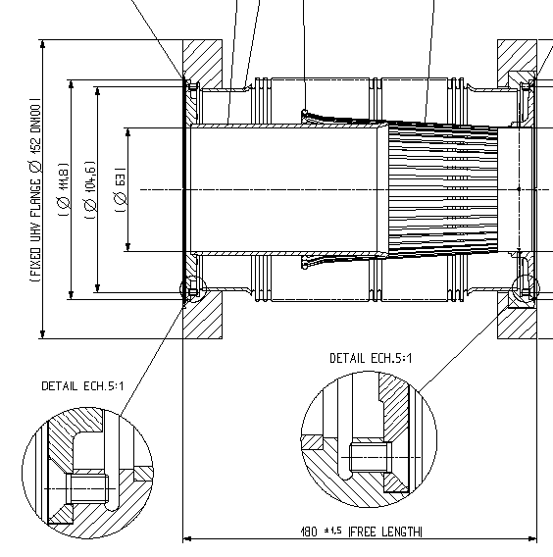
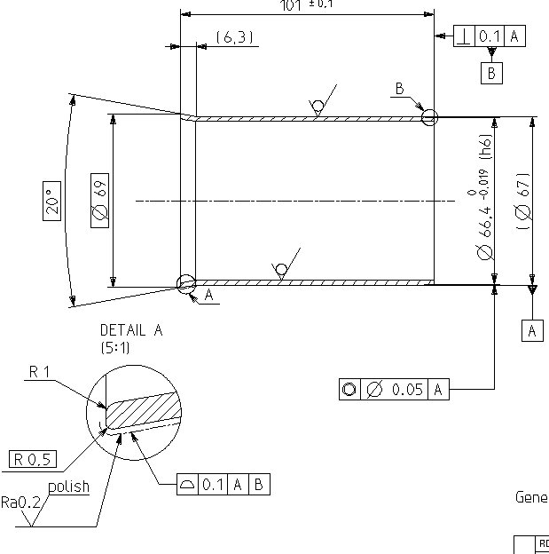
ALICE: VMABA
Cu insert
20 deg angle
Should have Rh coating

Slide 10
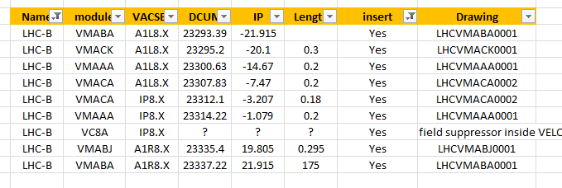
LHCb from Q1L to Q1R
Vacuum modules with RF insert
8 typical from LSS
1 special wake field suppressor for VELO vacuum chamber (VC8A)

Slide 11
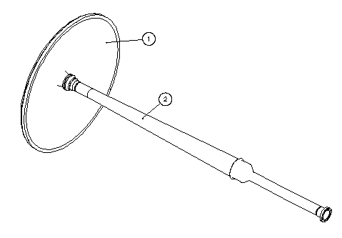
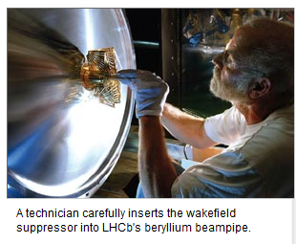
LHCb: VC8A
I have to check and find the drawings
Ref: CERN courier -Oct 2006

