Slide 1
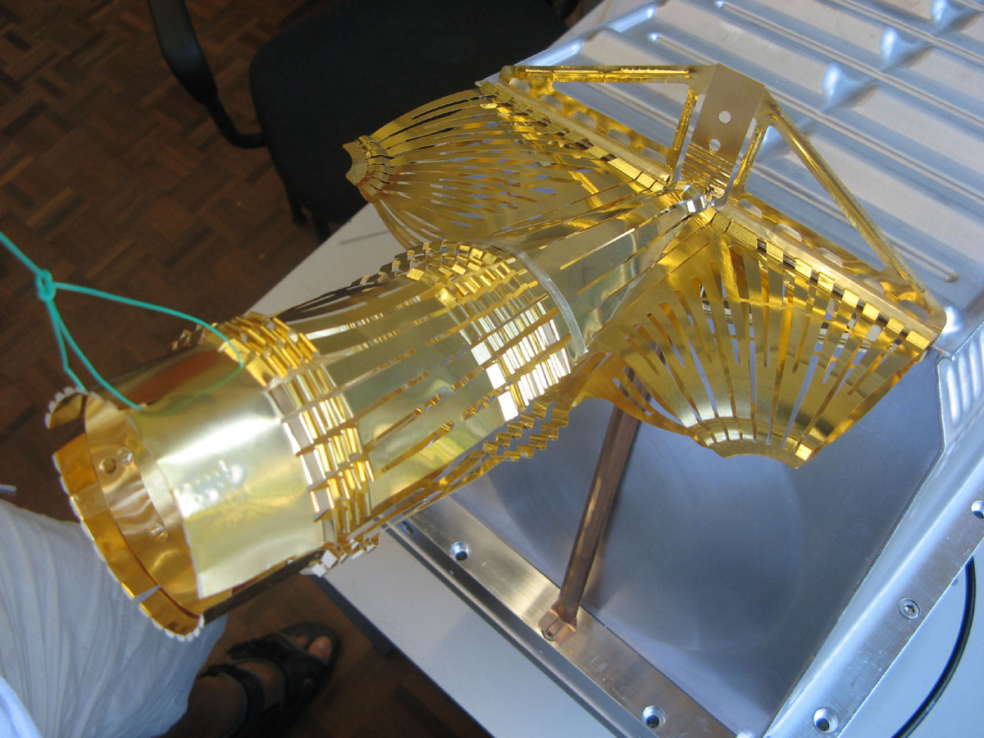
OUTCOMES OF THE LRFF
(LHC RF FINGERS) TASK FORCE IN 2012
E. Métral, O. Aberle, R.W. Assmann, V. Baglin, M.J. Barnes, O.E. Berrig, A. Bertarelli, G. Bregliozzi, S. Calatroni, F. Carra, F. Caspers, H.A. Day, M. Ferro-Luzzi, M.A. Gallilee, C. Garion, M. Garlasche, A. Grudiev, J.M. Jimenez, R. Jones, O. Kononenko, R. Losito, J.L. Nougaret, V. Parma, S. Redaelli, B. Salvant, P. Strubin, R. Veness, C. Vollinger, W. Weterings
Some people
installed this in the LHC and are very happy!

Slide 2
OUTLINE (1/2)
Introduction
Why do we need RF fingers and/or ferrite (absorbers)?
What we planned to do
What was done
RF fingers
  Several designs
  Possible issues to consider
  Example of a known issue with a TCDD
  Typical nonconformities found with X-rays
  List of all the nonconformities
  Recent issues observed with RF contacts in SPS
  Guidelines

Slide 3
OUTLINE (2/2)
Ferrite absorbers
  Several types, criteria and guidelines
  Measurements of the EM properties
  Figure of merit and design guidelines for the ferrite heating
  Measurements of the vacuum properties
Pros and cons of RF fingers and ferrite absorbers
What was wrong with the PIMs in the cold part of LHC?
Follow-up of VMTSA issues in 2011
Conclusions and recommendations

Slide 4
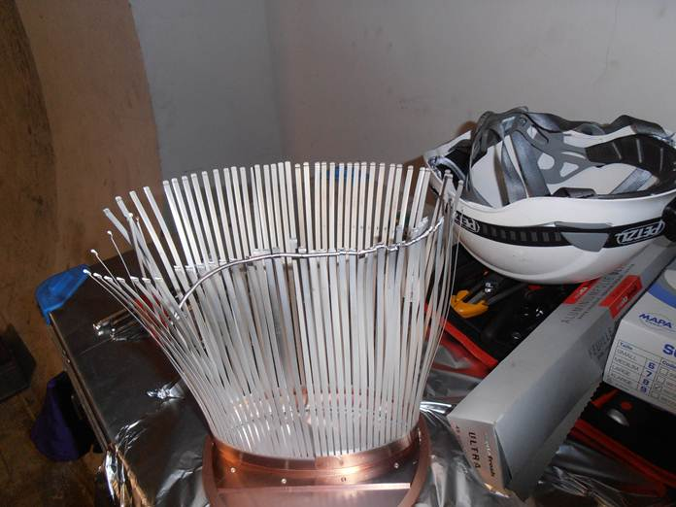
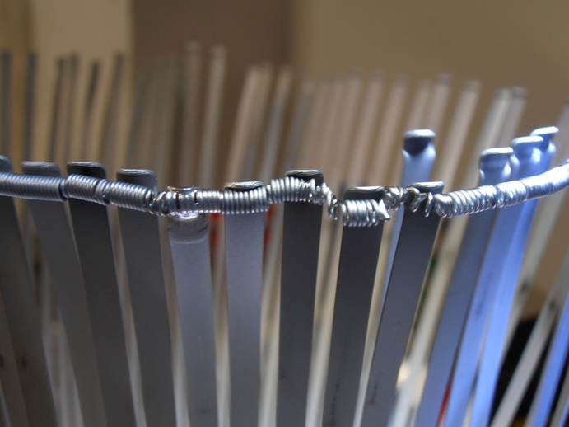
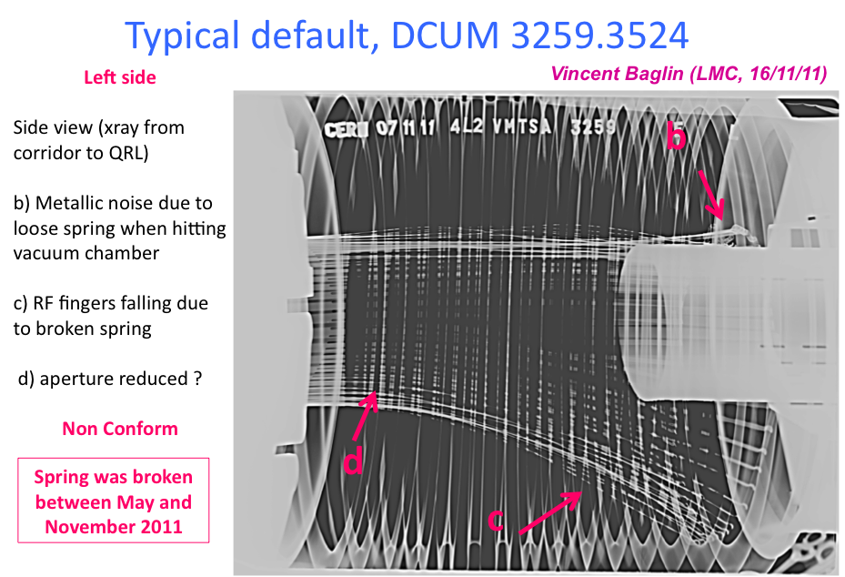
INTRODUCTION (1/3)
Beam-induced heating has been observed in several LHC components during the 2011 run when the bunch/beam intensity was increased and/or the bunch length reduced
In particular 8 bellows, out of the 10 double-bellows modules (called VMTSA) present in the machine, were found with the spring, which should keep the RF fingers in good electrical contact with the central insert, broken
SS spring deformed and brazed to the CuBe RF fingers with RF fingers permanently deformed => Estimated temp. of ~ 800 - 1000 °C
From X-rays

Slide 5
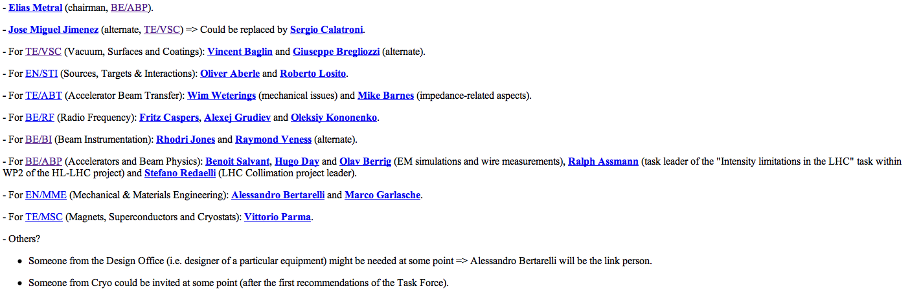
INTRODUCTION (2/3)
Proposition made during the LMC meeting # 119 (18/01/2012) to review the design of all the components of the LHC equipped with RF fingers => LRFF (LHC RF Fingers) Task Force before LS1
Web site: http://emetral.web.cern.ch/emetral/LRFF/LRFF.htm
  1st (kick-off) meeting: 20/03/2012
  20th (last) meeting: 27/11/2012
Members

Slide 6
INTRODUCTION (3/3)
Mandate
  Review the design of all components of the LHC equipped with RF fingers, evaluate the compatibility with ultimate (and HL-LHC) bunch populations (i.e. up to 2.2E11 p/b for the 25 ns beam and 3.5E11 p/b for the 50 ns beam) and (rms) bunch lengths (i.e. 7.5 cm but also ~ 4 cm which could be an option) regarding impedance and HOM screening and provide a list of maximum bunch currents, acceptable bunch lengths etc.
  Evaluate all associated mitigation solutions like ferrite absorbers and their collateral effects, in particular the induced heating and resulting outgassing
  Make proposals of design changes and/or mitigation measures for each configuration depending on its criticality for beam operation
  Approve functional specifications for all equipments by the end of the year (2012)

Slide 7
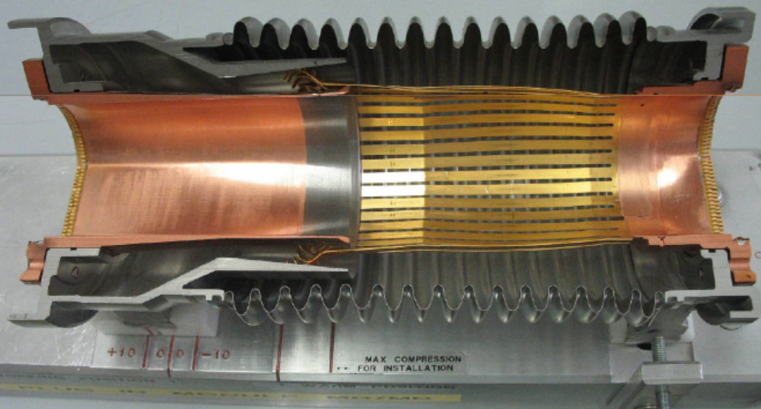
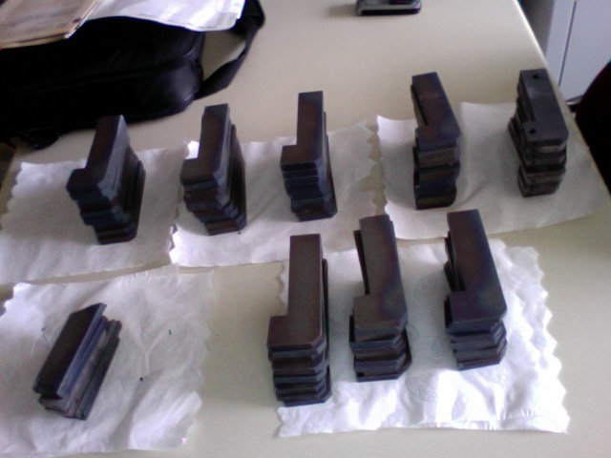
WHY DO WE NEED RF FINGERS AND/OR FERRITE? (1/13)
To avoid having too large impedances (longitudinal or transverse) due to (big) changes of geometry for moving equipments, which can lead to
  Beam-induced RF heating (if real part of longitudinal impedance)
  Longitudinal or transverse beam instabilities (if real and/or imaginary parts of longitudinal or transverse impedances)
Example of RF fingers:
PIMs = Plug-In Modules
Example of ferrite tiles:
Installed in the new VMTSA
in 2012
Initial dimensions (quickly available!):
~ 12 cm × 3 cm × 1 cm

Slide 8
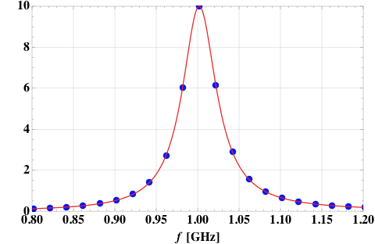
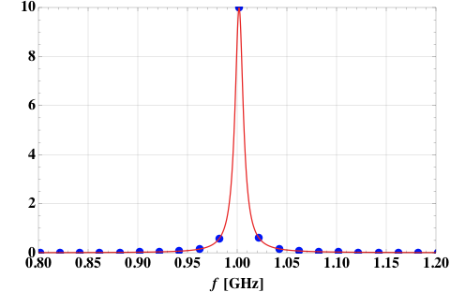
WHY DO WE NEED RF FINGERS AND/OR FERRITE? (2/13)
Example for the RF heating => Consider the case of a narrow resonance (trapped mode due to the geometry) => 3 parameters (obtained from EM simulations):
  Resonance frequency => Assumed to be here f_{r} = 1 GHz
  Shunt impedance => Assumed to be here R_{l} = 10 Ω
  Quality factor Q => Scanned below
HWHH = Half
Width at Half Height
= f_{r} / (2 Q)
Trapped modes typically have very low R_{l} / Q
R_{l}
Coupled-bunch
lines
Re ( Z_{l} ) [Ω]
Re ( Z_{l} ) [Ω]
Q = 100
Q = 20
f_{r}

Slide 9
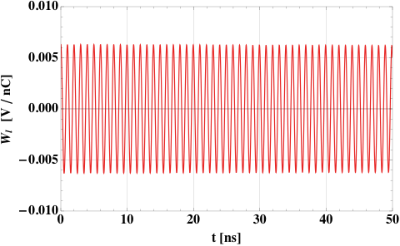
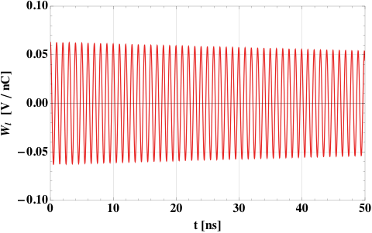
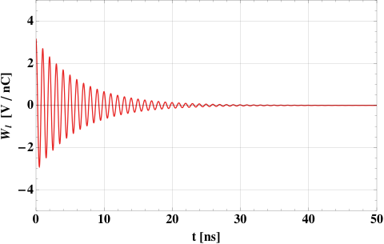
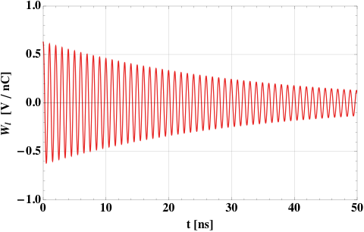
WHY DO WE NEED RF FINGERS AND/OR FERRITE? (3/13)
Q = 10000
Q = 1000
Q = 20
Q = 100
1st bunch
2nd bunch

Slide 10
WHY DO WE NEED RF FINGERS AND/OR FERRITE? (4/13)
Power loss formula for the case of a (sharp) resonance (i.e. with only 1 line)
  A.N.: M = 1380, N_{b} = 1.45E11 p/b => M × I_{b} = I_{total} ≈ 0.36 A,
  R_{l} = 10 Ohm and f_{r} = 1 GHz => P_{dB} (1 GHz) ≈ - 17 dB (see next slide) => P_{loss} ≈ 52 mW
Note that in the case of a Gaussian bunch, the power loss is
Total beam current:
M = # bunches
I_{b} = N_{b} e f₀
P_{dB} ( f_{r} ) is the power in dB
read from a power spectrum (computed or measured) at the frequency f_{r}

Slide 11
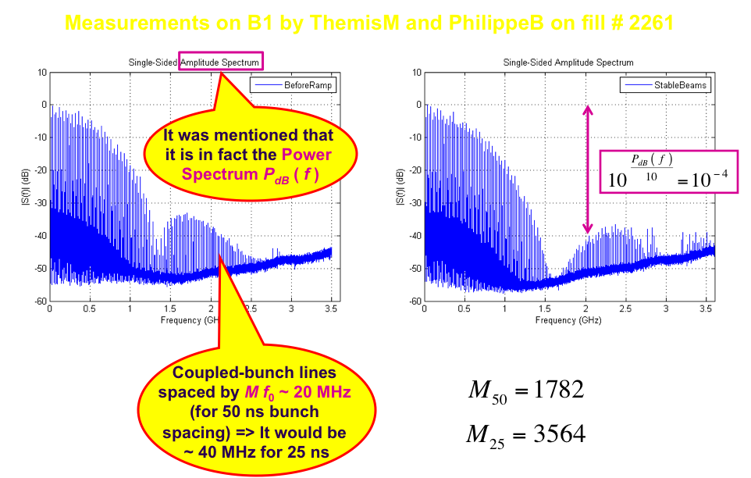
WHY DO WE NEED RF FINGERS AND/OR FERRITE? (5/13)

Slide 12
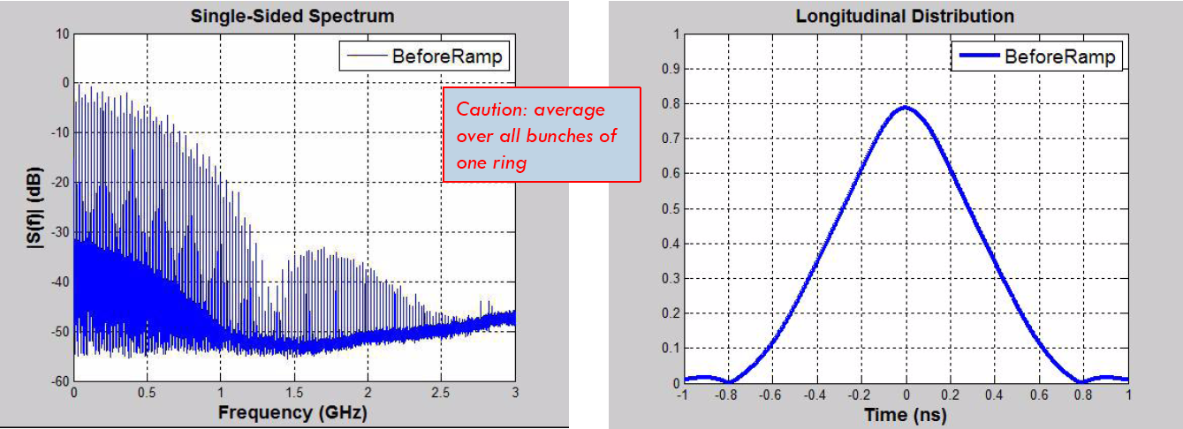
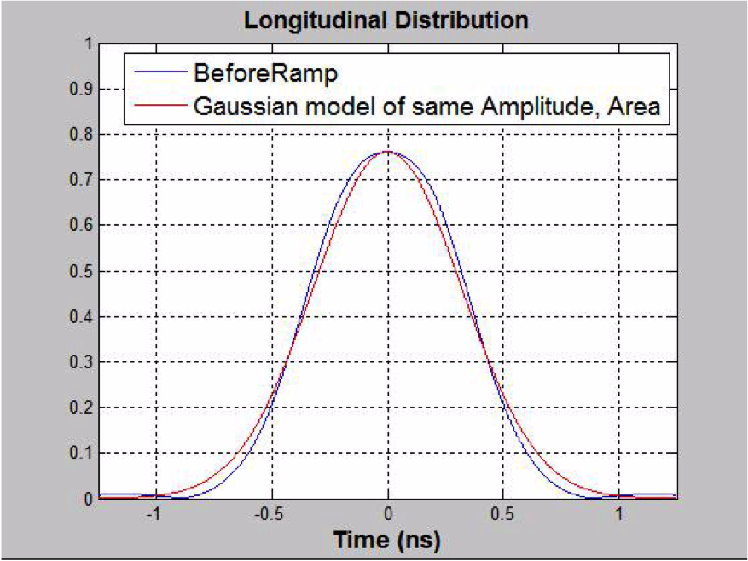
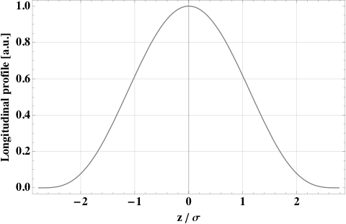
WHY DO WE NEED RF FINGERS AND/OR FERRITE? (6/13)
PhilippeB
Let’s consider the following
(analytical) distribution

Slide 13
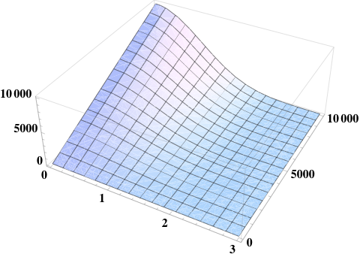
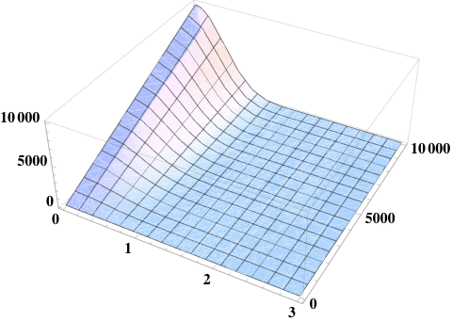
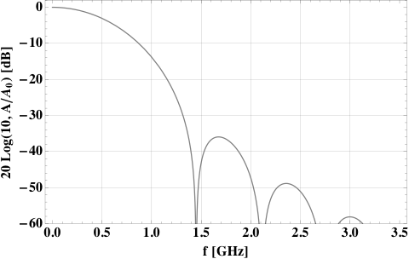
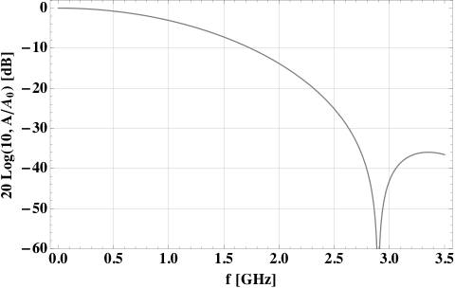
WHY DO WE NEED RF FINGERS AND/OR FERRITE? (7/13)

Slide 14
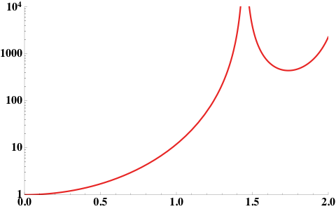
WHY DO WE NEED RF FINGERS AND/OR FERRITE? (8/13)
Assuming the
same shape of the profile

Slide 15
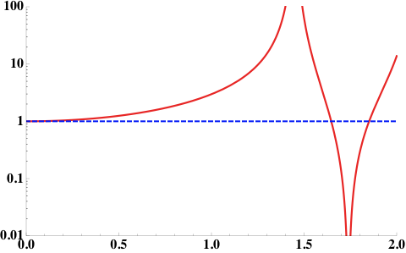
WHY DO WE NEED RF FINGERS AND/OR FERRITE? (9/13)
Assuming the
same shape of the profile

Slide 16
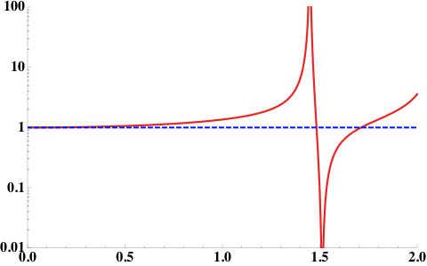
WHY DO WE NEED RF FINGERS AND/OR FERRITE? (10/13)
i.e. – 50 ps compared to the 9 cm case
Assuming the
same shape of the profile

Slide 17
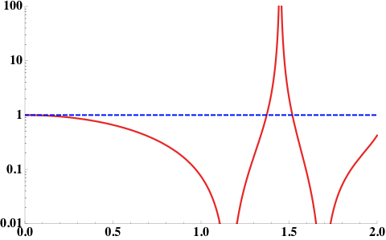
WHY DO WE NEED RF FINGERS AND/OR FERRITE? (11/13)
Assuming the
same shape of the profile

Slide 18
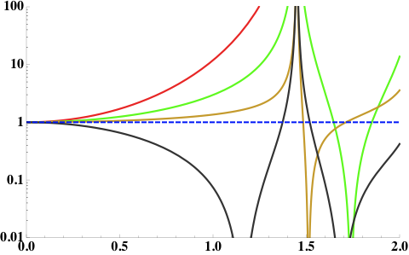
WHY DO WE NEED RF FINGERS AND/OR FERRITE? (12/13)
Assuming the
same shape of the profile

Slide 19
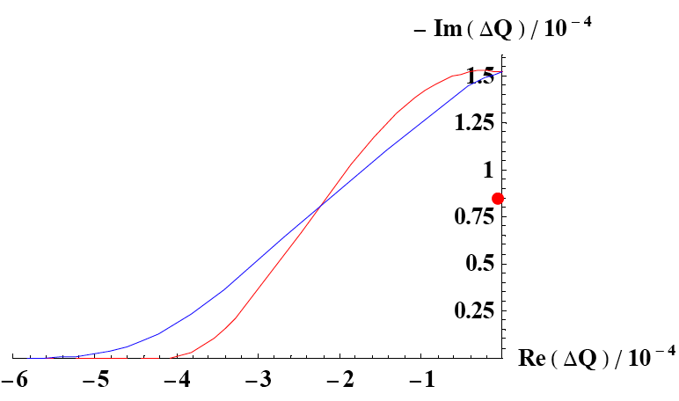
WHY DO WE NEED RF FINGERS AND/OR FERRITE? (13/13)
Example for the transverse instabilities => Case of the TCTVB (2-beam) collimator
  The simulated 2 most critical trapped modes
  Stability (octupoles only)
  at 7 TeV
    Close to the limit for
    nominal parameters and
    these impedances only!
    Ferrite (Ferroxcube 4S60)
    added to standard sliding
    contacts to damp HOMs

Slide 20
WHAT WE PLANNED TO DO
Exhaustive review of all the equipments with RF fingers
Ranking by criticality and action plan
First recommendations of the Task Force
New design and/or mitigation measures
List of endorsed actions presented by the Task Force => To be presented at the LMC

Slide 21
WHAT WAS DONE
1) Follow-up of the VMTSA: EM and heat transfer simulations
2) Review of past work and issue with the PIMs (what was wrong with the Plug-In Modules in the cold part of the LHC?)
3) Review of past development work on RF contacts
4) Review of equipments from TE/VSC, BE/BI, TE/ABT, collimators from EN/STI-MME (and past impedance studies with RF fingers), wake field suppressor in the LHCb VELO
5) New design for RF fingers proposed by TE/VSC and impedance studies
6) Review of nonconformities in warm modules following the X-ray campaign => Typical defects and complete list of all of them
7) Review of recent contacts’ issues in the SPS (after 35 years without any problem) => In power transmission lines (not machine)
8) Guidelines for the use of ferrite: EM and heat transfer simulations

Slide 22
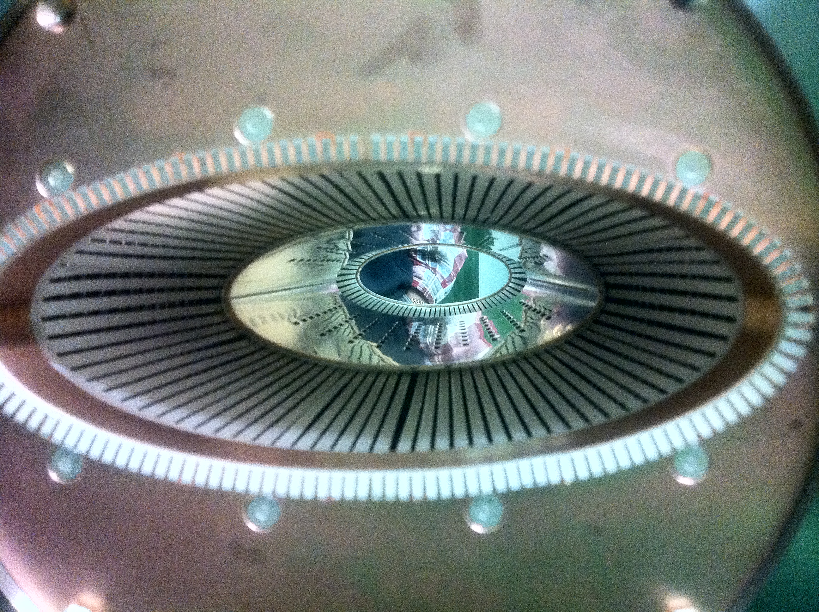
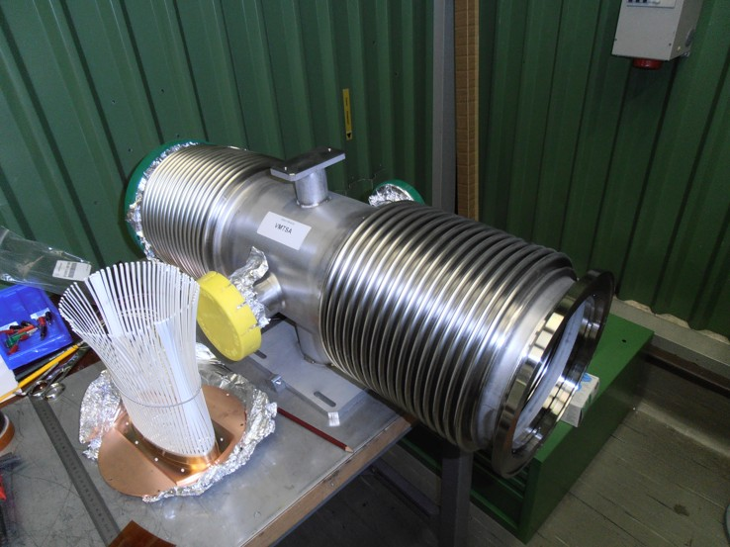
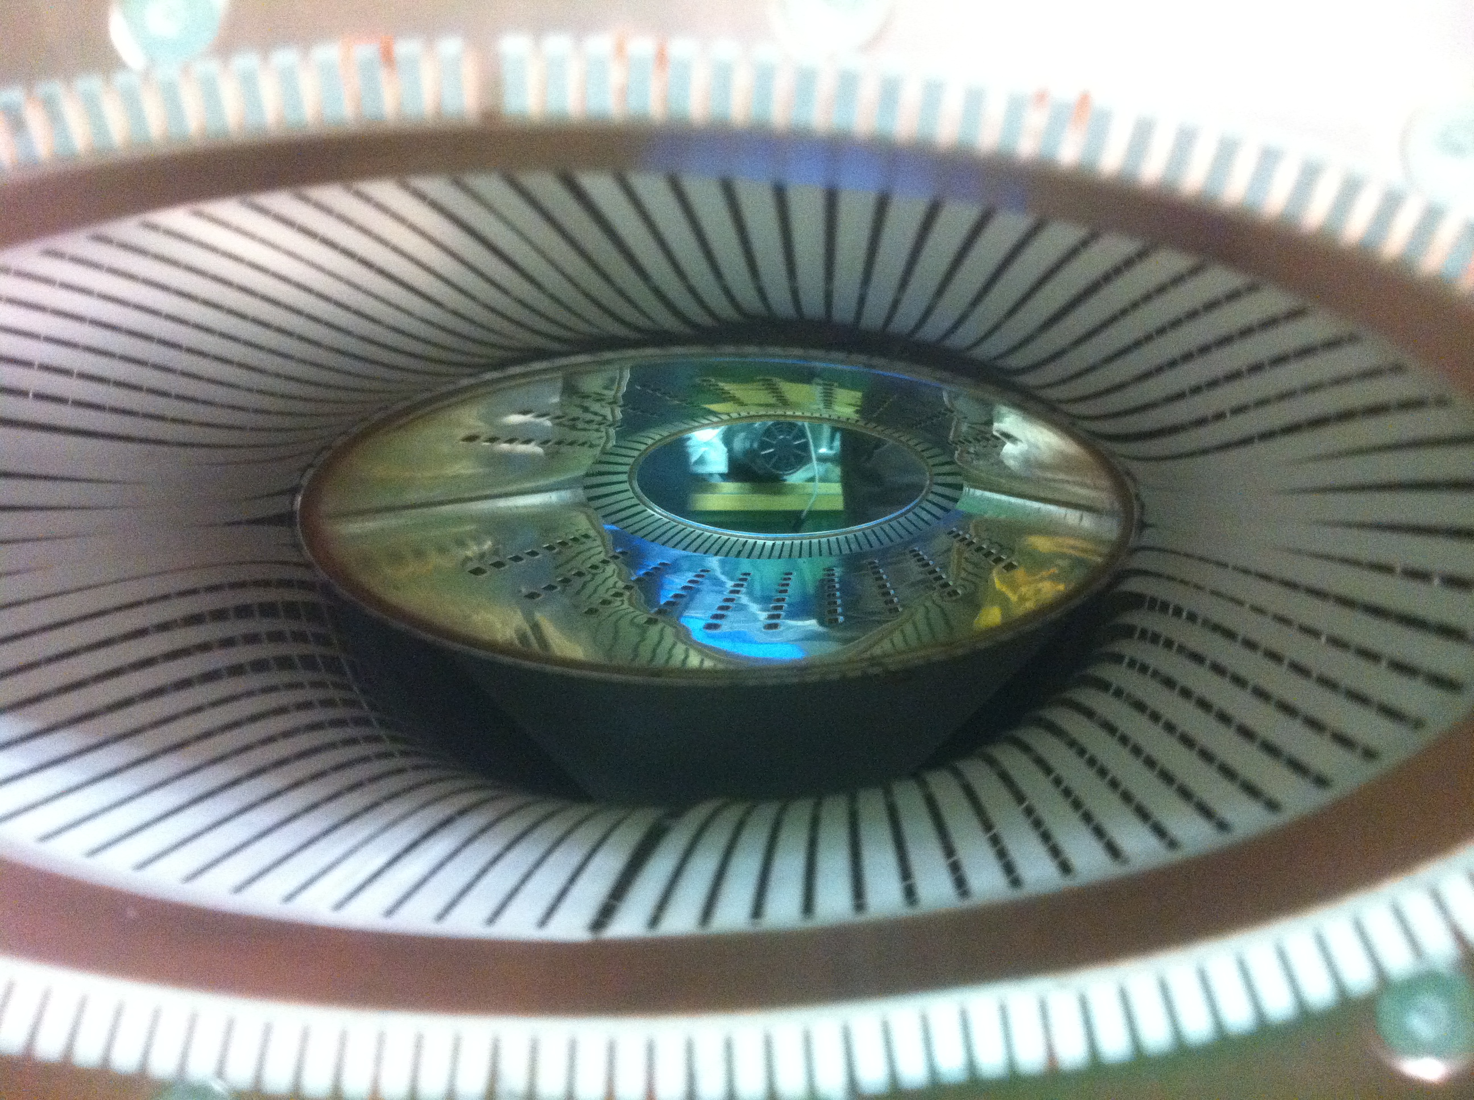
SEVERAL DESIGNS FOR RF FINGERS (1/5)
1) Funnel for the PIMs
  For case of longitudinal movement (only)
  Good for contact / gap
  Possible issue with buckling and aperture restriction
Funnel
RF contact fingers to shield the distorted geometry of the bellows from the beam
Spring (to be put
at the extremity of the RF fingers where there is a groove)
Conforming RF fingers
2) Spring for the VMTSA
  For case of transversal movement
  Possible issue with contact / gap (due to elliptical shape) => RF heating
  Possible issue with aperture restriction
Big gap created in case the spring is NOT in place

Slide 23
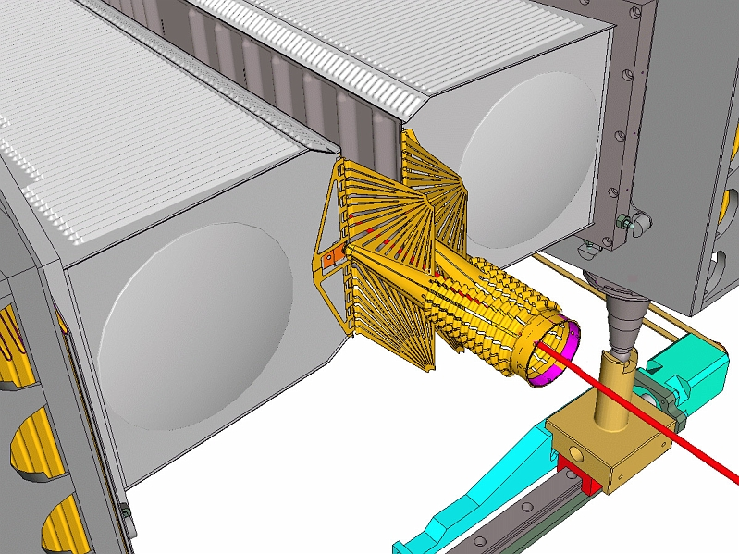
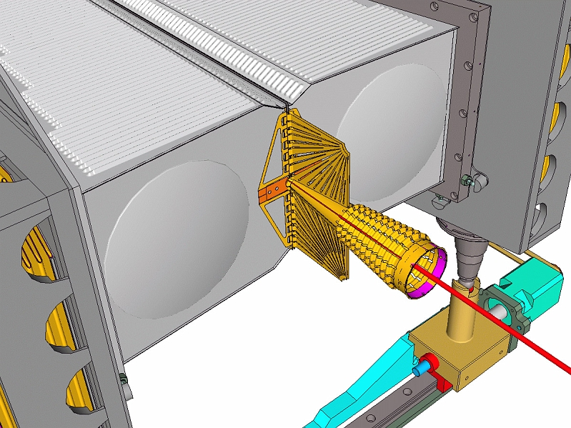
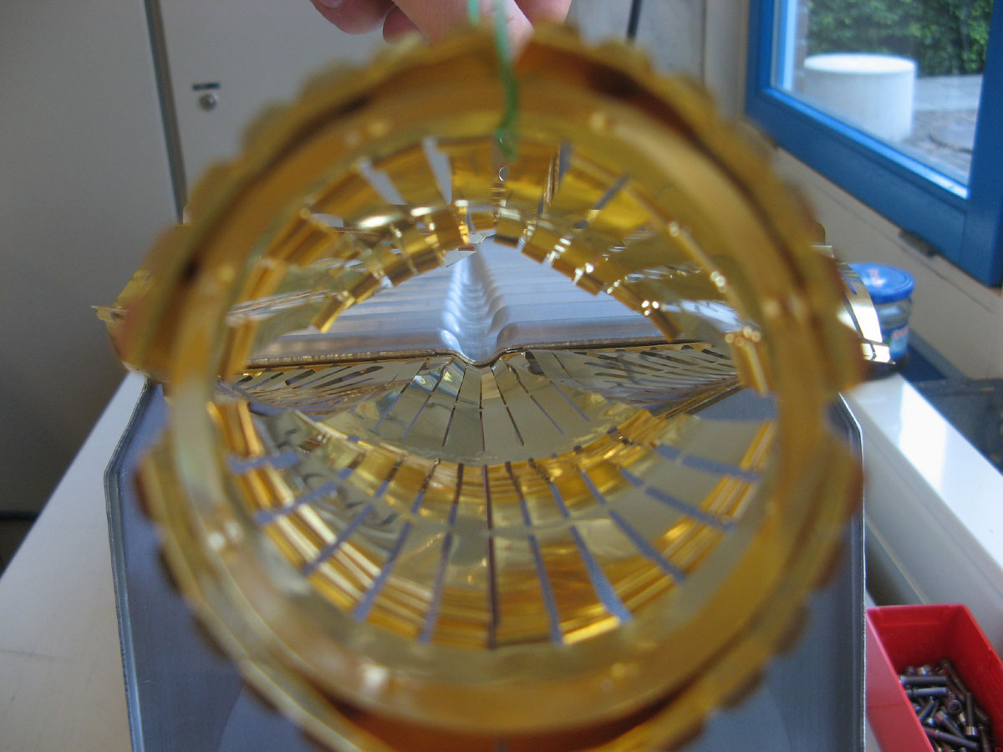
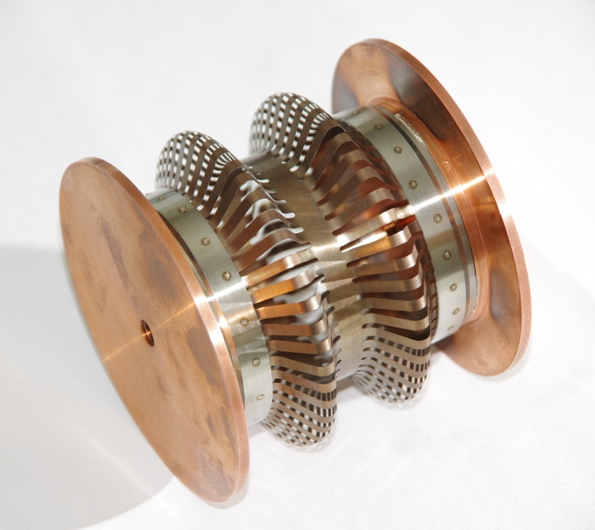
SEVERAL DESIGNS FOR RF FINGERS (2/5)
3) Fixed extremities for the LHCb VELO (VErtex LOcator)
  Seems to work very well!
  Well-studied VELO design in terms of impedance effects paid off => No issue observed
  Future upgrade: Reduction of the inner radius of the foil (from 5.5 to 3 − 4 mm)
4) New RF design from TE/VSC
  1st prototype based on 2 convolutions manufactured this year. Tests ongoing
  Issue: Imaginary part of the longitudinal impedance (if many)
Device EM longer
than mechanically due to induced current having to follow the convolutions

Slide 24
SEVERAL DESIGNS FOR RF FINGERS (3/5)
  The longitudinal impedance depends on how much the RF fingers are stretched
  The impedance is close to zero in either completely compressed state or completely stretched state
  The maximum normalized longitudinal impedance is
        Im [Z_{l} / n] ≈ 1.5 10⁻⁴ Ω
  Should not be used for all the PIMS for instance as the total LHC budget is ~ 0.1 Ω (i.e. only 667 times more) and there are ~ 1700 PIMs / ring

Slide 25
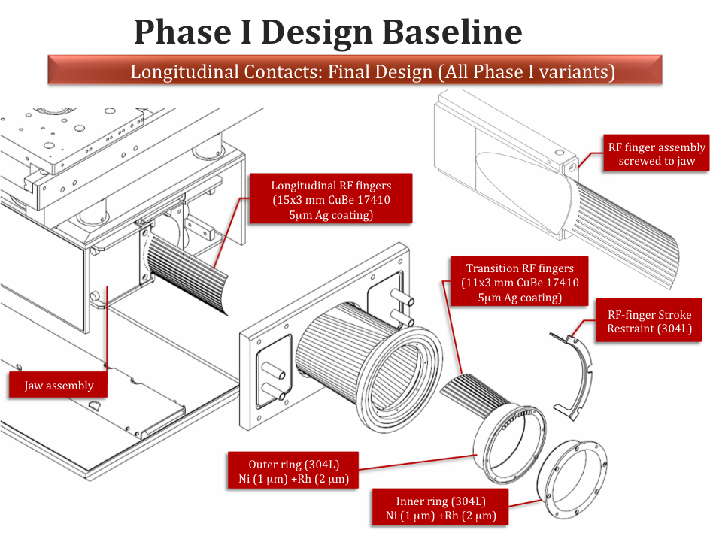
SEVERAL DESIGNS FOR RF FINGERS (4/5)
5) Longitudinal sliding contacts for collimators
  Initial proposal for 1st (SPS) prototype (2003)
  Uncoated CuBe fingers sliding on C/C
  Electrical contact resistance ~ 30 mΩ (specification: 1 mΩ) => Redesign necessary

Slide 26
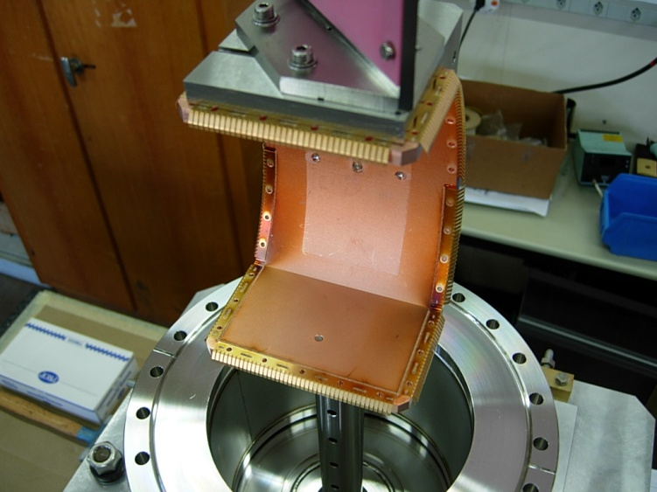
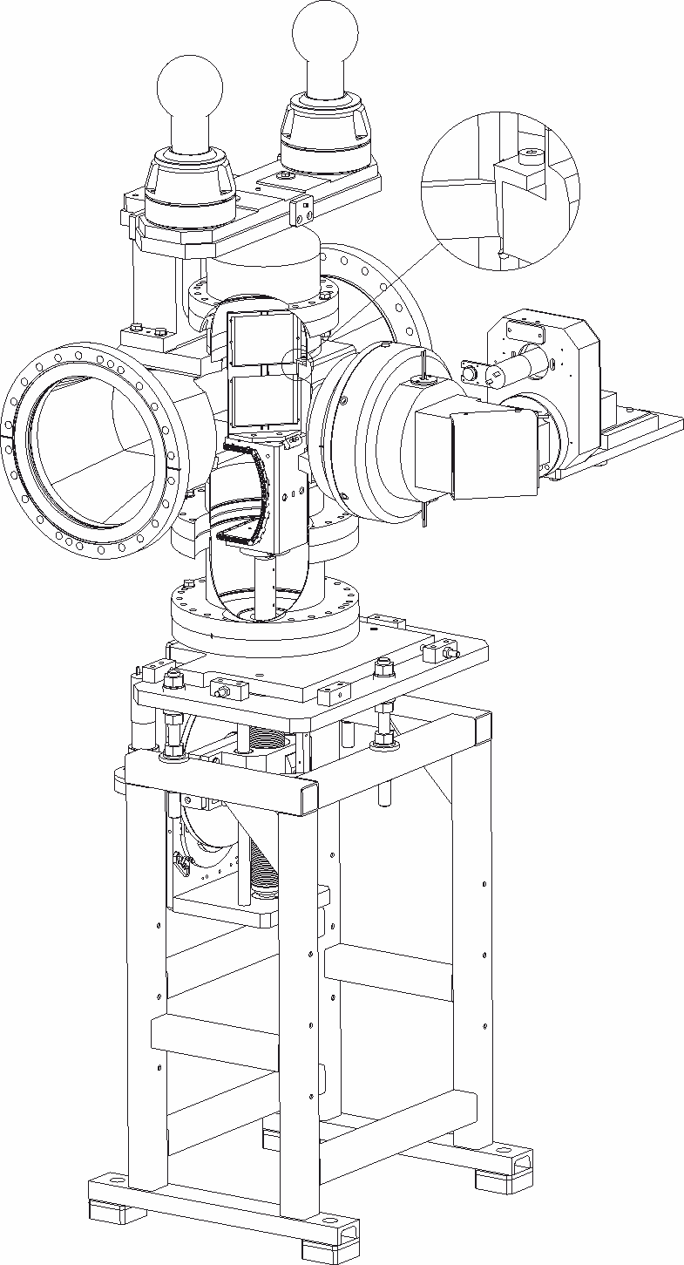
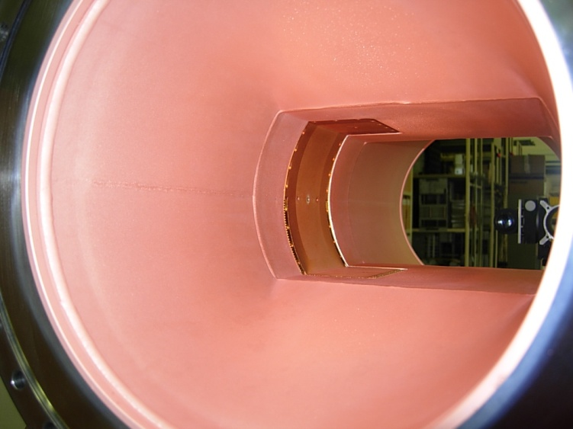
SEVERAL DESIGNS FOR RF FINGERS (5/5)
6) Sliding contacts for BTVs
  Both beams inside the vacuum chamber
  RF contacts all along the moving parts
  Specifications: movement up and down. Very rare (1 or 2 last year). In front of MKI and next to TDI
  They cannot be completely bake out (due to screen etc.) and they are close to equipments very demanding for outgassing => Possibility to remove them?

Slide 27
POSSIBLE ISSUES TO CONSIDER WITH RF FINGERS (1/2)
RF fingers for PIMs
  Low contact resistance < 0.1 mΩ (i.e. 3 mΩ / RF finger as there are 30 RF fingers in //)
  No cold welding
  Low friction
  Good formability properties
RF fingers for collimators
  Same as above with contact resistance < 1 mΩ
  Resistance to bake out: 250°C / 1000 h
  Resistance to heating => Good thermal conductivity
  Wear after many cycles “open-close of the jaws” (1500 cycles ~ 4 years)
Good electric contacts requires
  Low surface roughness
  Soft metals (at least one)
  No oxide layer at the surface

Slide 28
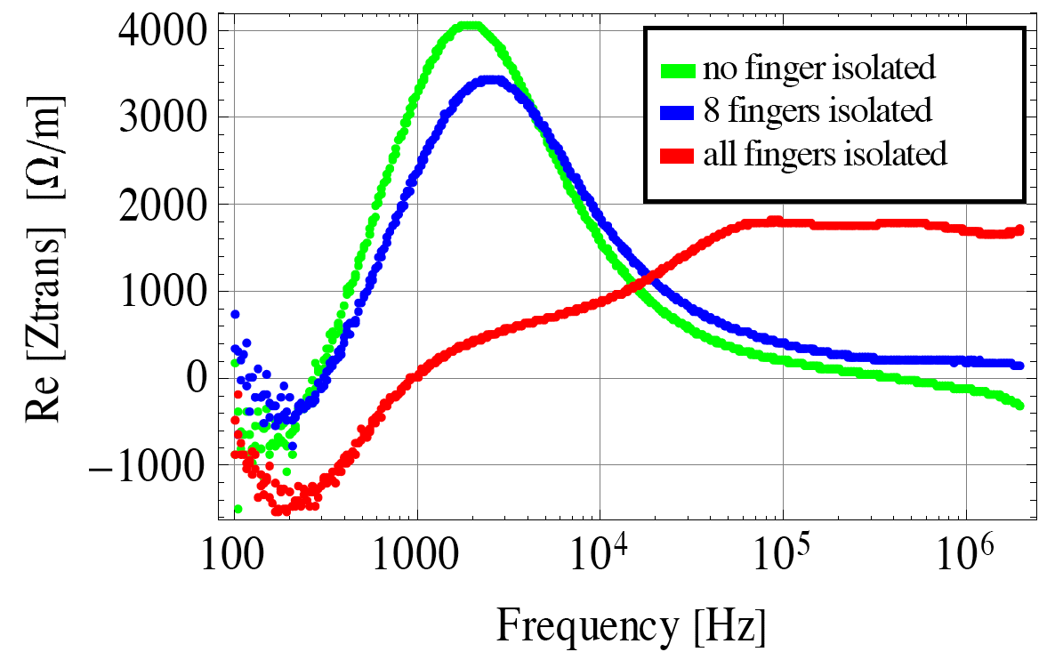
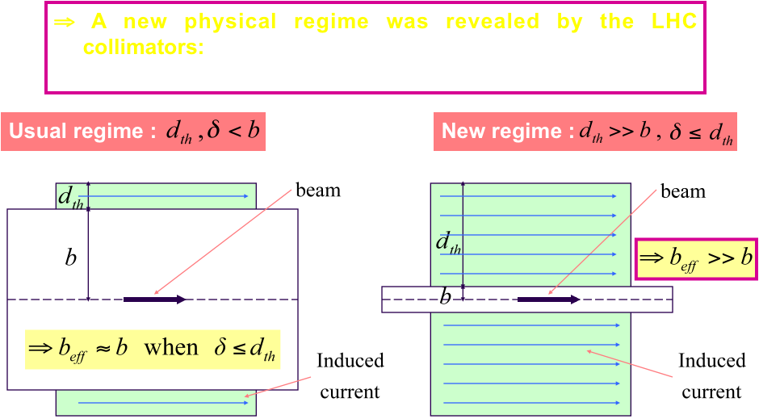
POSSIBLE ISSUES TO CONSIDER WITH RF FINGERS (2/2)
  Resistive-Wall impedance for LHC collimators
New findings have been made over the last few years for the impedance at low frequency => Bad conductor is better! But high frequency also important…
  Contact resistance for the PIMs

Slide 29
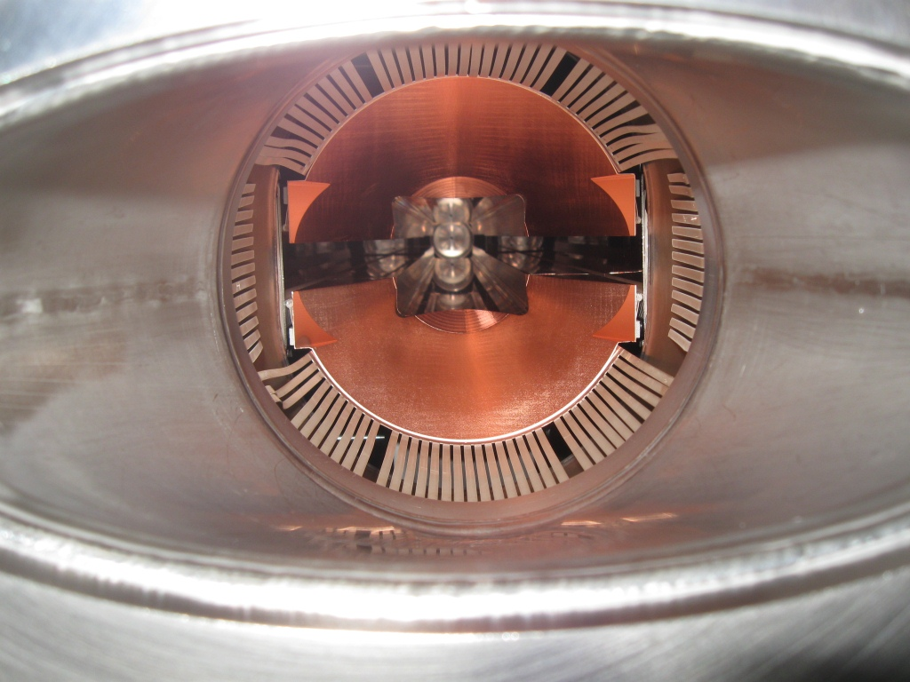
EXAMPLE OF A KNOWN RF FINGER ISSUE WITH A TCDD
Example of the TCDD of sector A4L2 with some RF fingers badly bent
  Known pb which has been solved for the Phase I collimators: the RF-finger stroke restraint piece (304L) was added for that

Slide 30
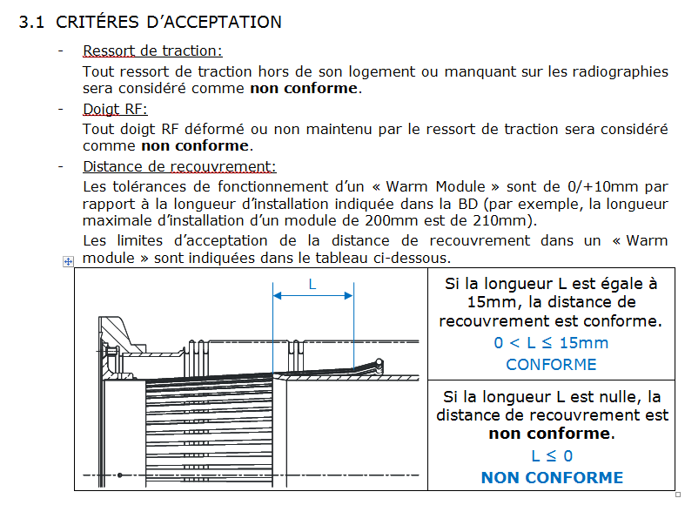
TYPICAL NONCONFORMITIES IN WARM MODULES
FOUND WITH X-RAYS (1/8)
1800 X-rays taken
92 NC (~ 5 %)
58 vacuum sector concerned out of 190 at room temperature (88 sectors at cryogenic temperature)

Slide 31
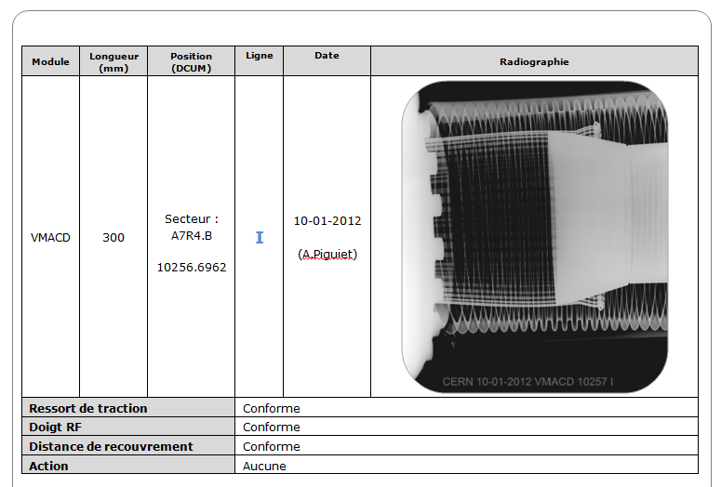
TYPICAL NONCONFORMITIES IN WARM MODULES
FOUND WITH X-RAYS (2/8)

Slide 32
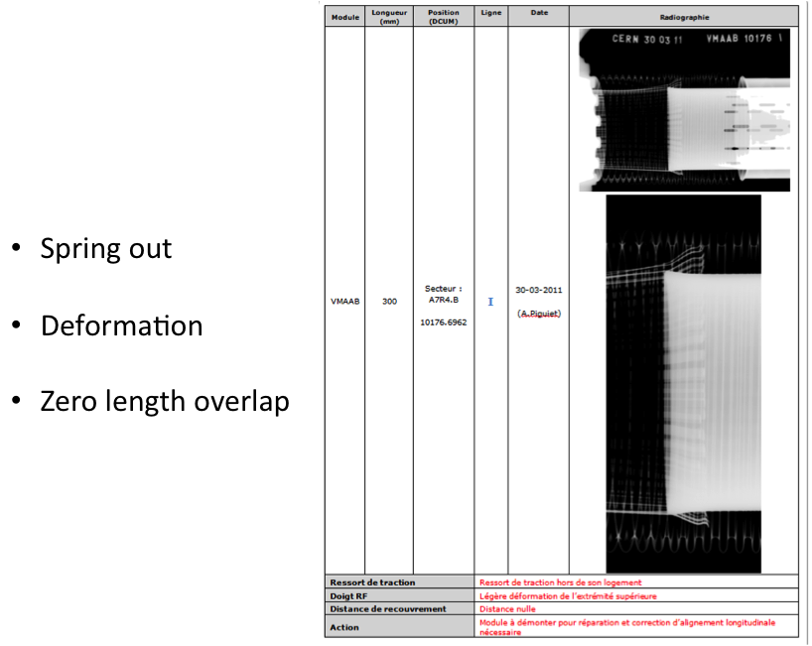
TYPICAL NONCONFORMITIES IN WARM MODULES
FOUND WITH X-RAYS (3/8)
Possible buckling and/or arcing => Very unhealthy

Slide 33
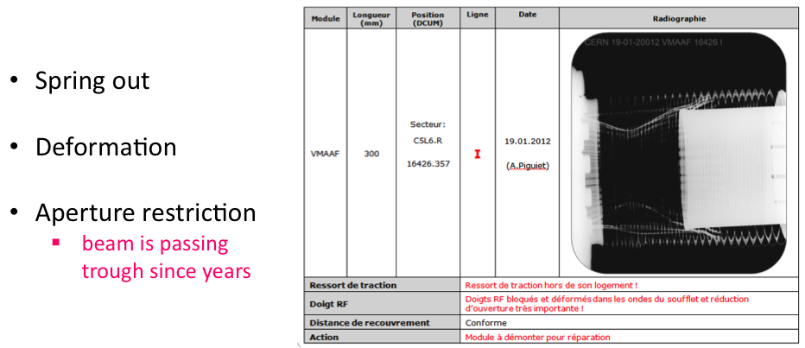
TYPICAL NONCONFORMITIES IN WARM MODULES
FOUND WITH X-RAYS (4/8)

Slide 34
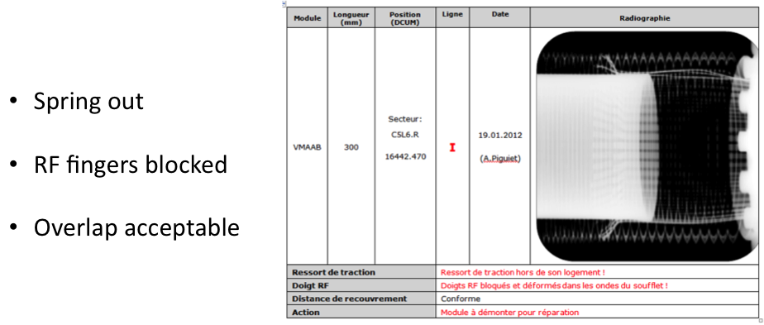
TYPICAL NONCONFORMITIES IN WARM MODULES
FOUND WITH X-RAYS (5/8)

Slide 35
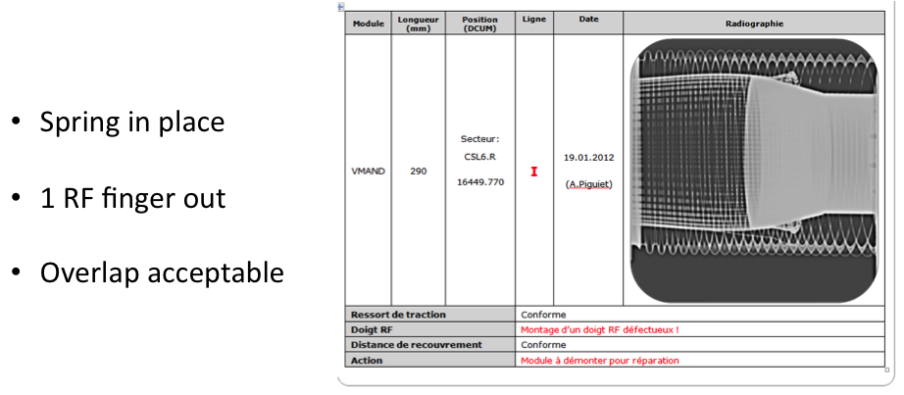
TYPICAL NONCONFORMITIES IN WARM MODULES
FOUND WITH X-RAYS (6/8)
1 RF finger out but not with the
spring attached to it is a better situation than with the spring attached to it (see VMTSA study later)

Slide 36
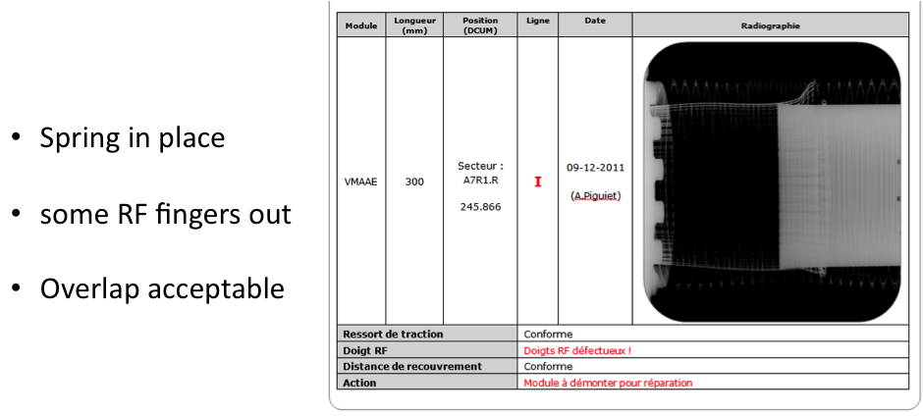
TYPICAL NONCONFORMITIES IN WARM MODULES
FOUND WITH X-RAYS (7/8)

Slide 37
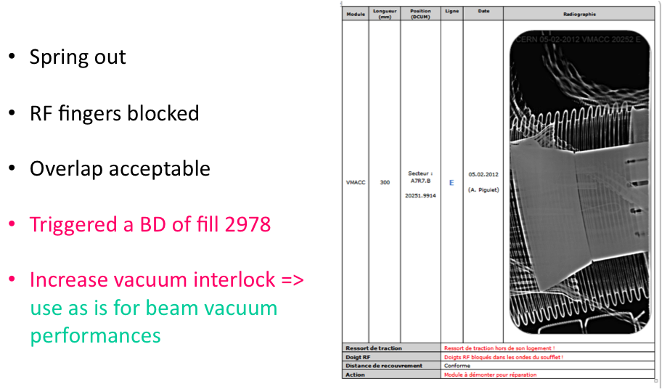
TYPICAL NONCONFORMITIES IN WARM MODULES
FOUND WITH X-RAYS (8/8)

Slide 38
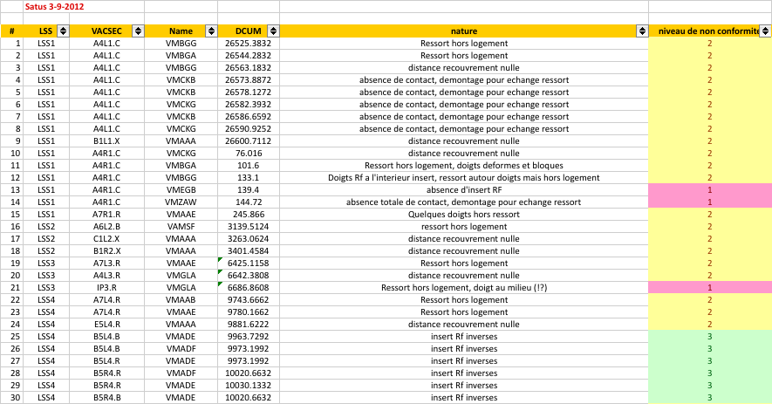
LIST OF ALL NONCONFORMITIES (1/3)

Slide 39

LIST OF ALL NONCONFORMITIES (2/3)

Slide 40

LIST OF ALL NONCONFORMITIES (3/3)

Slide 41




RECENT ISSUES OBSERVED WITH RF CONTACTS IN SPS
Concerns RF power transmission lines in the SPS BA3 Philips plant in 2012
There are 68 RF power amplifiers in total, 200 MHz, 35 kW, CW and 17 output power transmission lines are dismounted / year for maintenance
No problem during 35 years but this year some pbs were encountered for the first time with the innerspring contact clamp which ensures the continuity of the inner line of the RF transmission line
The pb was traced back to a bad procedure, using in some cases springs which were too long. As it was too difficult to insert it in the inner line, the mechanist decided to shorten the RF spring contact. The bad RF contact had then important consequences, as the clamp was then destroyed => This is another example that if everything is mounted normally there is no problem but if the RF contact is too poor, then it can have dramatic effects

Slide 42
GUIDELINES FOR (SLIDING) RF FINGERS (1/4)
Material to be used for the RF fingers => CuBe (grade very important in case of bake-out => C17410): good conductor, good adhesion of coatings, weldability by e- beam, good formability properties, low magnetic permeability (low content of Ni, but contains Co – small enough amount for RP, but more than Be…), higher elasticity than Cu alone, etc.
CuBe is a good conductor but still too high surface impedance => Coating needed to increase surface conductivity + reduce contact resistance + avoid cold welding
No cold welding => 2 solutions
  Put a diffusion barrier between the 2 metals (oxide layer) => Bad for the electrical contact
  Choose metals with lowest solubility => Solution adopted and the best materials’ pair is Au-Rh (best enemies => Almost no solubility). Ag-Rh is quite similar

Slide 43
GUIDELINES FOR (SLIDING) RF FINGERS (2/4)
Contact resistance measurements
  With a plating of the CuBe RF finger in Au and a plating of the base material (Cu) in Rh, the resistance was measured to be ~ 3 mΩ for 1 RF finger (i.e. ~ 0.1 mΩ for 1 PIM) => It was measured to be ~ 35 mΩ for the baseline Ag / SS contacts (i.e. ~ 1.2 mΩ for 1 PIM)
  The use of Ag instead of Au led to ~ 2 mΩ but Au was chosen for the PIMs for the cold welding reason
  Contact surface on the insert => Electro-polished before putting the Rh coating
Bake-out for the collimators (250°C)
  Au cannot be used because of the bake-out at 250°C (due to the diffusion of the Cu into Au and then the Au layer disappears). The same problem happens with Ag but at a higher temperature => Au was replaced by Ag for the collimators

Slide 44
GUIDELINES FOR (SLIDING) RF FINGERS (3/4)
Bake-out for the MKI injection kickers (~ 350°C)
  SS (instead on CuBe, but still Au plated) is used for the MKI RF fingers because of the bake-out at ~ 350°C, which would lead with CuBe to a very small residual elasticity of ~ 20% only (see next slide)
Finally, any gap should be avoided as it can be fatal (depends on real geometry) => Try and design a robust mechanical design to keep all the RF fingers in contact

Slide 45
GUIDELINES FOR (SLIDING) RF FINGERS (4/4)
How to read it?
1) Choose Temp line
=> Ex: 250°C (bake-out)
2) Then choose # hours of bake-out => Ex: 1000 h
3) Go vertically from this point to the curve
=> Gives the residual elasticity in %: 60% here (goal is to keep it as high as possible)
With all sources
of heating
Grade important
when bake-out!
(C17410 for
CuBe)

Slide 46
FERRITE: SEVERAL TYPES, CRITERIA & GUIDELINES (1/4)
Location of the ferrite (assuming known EM properties)
  EM simulations and put the ferrite at (close to) the maximum of the magnetic field of the mode to be damped (at the metallic wall)
  Should not be seen directly by the beam (if possible)…
Penetration depth
with
frequency
speed of light
relative complex permittivity
relative complex permeability

Slide 47

FERRITE: SEVERAL TYPES, CRITERIA & GUIDELINES (2/4)
Case of the 4A4
ferrite
The ε’’ is usually small and can be neglected
vacuum
permittivity

Slide 48

FERRITE: SEVERAL TYPES, CRITERIA & GUIDELINES (3/4)
~ 7 mm
at 1 GHz

Slide 49
FERRITE: SEVERAL TYPES, CRITERIA & GUIDELINES (4/4)
To damp a mode at a frequency f, a ferrite’s thickness equal to the penetration depth at frequency f is an upper limit => It is enough to have less, say (as a 1st guideline, but it should be confirmed by simulation for the particular case under study):
  Ferrite thickness ≈ penetration depth / 2
Example with the previous (fitted) 4A4 ferrite: if one wants to damp a mode at 1 GHz, a thickness of ~ 3-4 mm is OK
Remarks:
  Depending on the frequency, one has to optimize the ferrite to be used
  A lower limit for the ferrite’s thickness is given by mechanical considerations => Should be > few mm for ferrite’s tiles. For plasma sprayed ferrite (under study to improve heat conduction, see later), the thickness is dictated by the technology (maximum of few hundreds μm)

Slide 50


MEASUREMENTS OF THE FERRITE EM PROPERTIES (1/2)
Nominated “ferrite responsible persons” at CERN: Fritz Caspers and Christine Vollinger
EM measurements of the TT2-111R ferrite
  This ferrite is readily available in tiles of 6 cm x 6 cm and 5 mm thickness
  Material samples are “wrapped” around an inner conductor
  This allows a non-destructive (transmission & reflection) meas.
  Without any machining of the ferrite => It is much simpler to machine metal than ceramics with adequate accuracy

Slide 51

MEASUREMENTS OF THE FERRITE EM PROPERTIES (2/2)

Slide 52

FIG. OF MERIT & GUIDELINES FOR FERRITE HEATING (1/6)
Goal: Determine figures of merit for the maximum RF induced power on ferrite before T_{Curie} is reached
Several assumptions
  1) Steady-state regime and uniform ferrite temperature distribution (regardless of actual RF power deposition)
  2) Ferrite tile is of arbitrary cross section
  3) Ferrite radiates from all sides with equal emissivity (0.8)
  4) Completely surrounding heat sink & no intermediate components between ferrite & sink (ferrite view factor equal to 1)
  5) 2D simplification of ferrite tile => Infinitely long geometry (no end effects)
  6) Heat sink with uniform emissivity and temperature

Slide 53

FIG. OF MERIT & GUIDELINES FOR FERRITE HEATING (2/6)
Radiated heat / ferrite surface unit
K_{A} = Surface of the sink / surface of the ferrite

Slide 54

FIG. OF MERIT & GUIDELINES FOR FERRITE HEATING (3/6)

Slide 55

FIG. OF MERIT & GUIDELINES FOR FERRITE HEATING (4/6)

Slide 56
FIG. OF MERIT & GUIDELINES FOR FERRITE HEATING (5/6)
How can we cool the ferrite if it becomes too hot?
  Try and improve the conduction from ferrite as most of the time only radiation is used (given the general brittleness of the ferrite we cannot apply big contact force/pressure)
  Plasma spray (for better conduction) => Collaboration with Aachen university (FritzC)
Ferrite proposed for TCTP collimators
  TT2-111R (Trans-Tech) due to high Curie Temperature of ~ 375˚C
  Best solution for the support material? Several cases studied: pure copper OFE, SS, copper OFE with CrO coating. The latter is the best choice from the thermal point of view, temperature on ferrite decreased by 25-30% with respect to SS (this reduction could be ~ 40% when the upper screen is also coated with CrO). But, is the chrome coating on copper a potential UFO generator (as black chrome presents a dusty surface, i.e. risk of particles detachment)?

Slide 57

FIG. OF MERIT & GUIDELINES FOR FERRITE HEATING (6/6)
Near-field effects
Infra-red tunneling region
Total radiative
transfer between 2 // surfaces spaced by l => Smooth transition between radiation and contact regimes. Applying a mechanical pressure, the gap is reduced

Slide 58

MEAS. OF THE FERRITE VACUUM PROPERTIES (1/4)
The ferrite has to be compatible with UHV => Vacuum approval
Ex. of vacuum (outgassing) measurements of the TT2-111R ferrite

Slide 59

MEAS. OF THE FERRITE VACUUM PROPERTIES (2/4)

Slide 60
MEAS. OF THE FERRITE VACUUM PROPERTIES (3/4)
Scaling this to 1 TCTP collimator, the outgassed flow is close to the LHC vacuum specification limit of 10⁻⁷ mbar l / s
RGA (Residual Gas Analyzer) analysis shows no contamination
The present solution does not present any safety margin in order to remain within the LHC vacuum specification should the ferrite temperature increase
=> VSC proposal: Vacuum test of ferrite with increased thermal treatment temperature (results should not be available before next year)
Very serious finding! Would have thought to be fine due to past experience

Slide 61

MEAS. OF THE FERRITE VACUUM PROPERTIES (4/4)
TT2-111R ferrite interesting due to its high Curie temperature (~ 375°C) but the vacuum outgassing studies still need to be finalized
Another ferrite with a high Curie temperature (> 400°C) was recently found (4E2 from Ferroxcube) => Some samples are being ordered to perform some EM and outgassing measurements

Slide 62
PROS & CONS OF RF FINGERS AND FERRITE (1/2)
RF FINGERS
FERRITE
Avoid the changes of geometry and therefore the creation of (big) impedances
Optimization of the material of the RF fingers and the insert (contact resistance, cold welding, etc.)
Should not restrict the machine aperture (should not fall inside, buckling, etc.)
Should not go far away from the insert and create gaps (funneling, spring, fixed at both ends, etc.)
=> Biggest worry: assembly and mounting issues
Here, there are already big impedances created and one wants to damp them
Ferrite should not be seen directly from the beam (if possible)
Position of the ferrite depends on the maximum of the magnetic field for the mode one wants to damp => Detailed EM simulations needed
Ferrite’s thickness depends on the penetration depth at the frequency of the mode one wants to damp
The ferrite will absorb the remaining (normally much smaller) power => Will heat. How to cool it?

Slide 63
PROS & CONS OF RF FINGERS AND FERRITE (2/2)
Due to some past issues with RF fingers (believed not to be related to impedances) the idea emerged to avoid RF fingers when possible and replace them by ferrite tiles (but there are not doing the same thing!) => For collimators only (transverse RF contacts)
  Phase II collimators RF design was based on this idea
    Potential issue with dust creation due to the movement
    Potential issue with ferrite heating etc. => Studied in detail
    Potential issue with chrome coating on copper (to reduce the ferrite’s temperature) => Potential UFO generator (as black chrome presents a dusty surface)
    Potential issue with vacuum => Ongoing studies
Why not using ferrite for the PIMs?
  Ferrite would not work due to the vicinity of magnets
  The resonance cavity is so high that we don’t need to care

Slide 64


WHAT WAS WRONG WITH THE PIMs IN THE COLD PART OF LHC (1/4)
August 2007 => After warm-up of sector 7-8, a buckled PIM was discovered in interconnect QQBI.26.R7 with the radar (microwave beam pipe reflectometer)
Was rapidly discovered to be due to a nonconformity during the manufacturing: bending angles out of tolerance. The angle should have been 12 deg (see also next slide)

Slide 65

WHAT WAS WRONG WITH THE PIMs IN THE COLD PART OF LHC (2/4)
The specified electrical contact DC resistance of 0.1 mΩ could not be reached (due to large surface roughness from Rhodium layer)
To compensate it was decided to increase the contact force
=> The bending angle was modified, which led to buckling issues

Slide 66
WHAT WAS WRONG WITH THE PIMs IN THE COLD PART OF LHC (3/4)
Corrective actions taken
  A tooling was designed to restore the correct geometry of the fingers => Back to conforming PIM (both angle and finger height at the tip)
  SSS moved by 2 mm to reduce the span of the QQBI => The stroke is smaller (we have gain 2 mm in the stroke)
Summary
  The PIM pb was the too high (out of tolerance) electrical DC contact resistance which led to a mechanical pb (to reach the required contact resistance)
  It has been fully understood
  Nonconforming PIMs can be repaired
  Strategy for replacement has been defined and is applied

Slide 67
WHAT WAS WRONG WITH THE PIMs IN THE COLD PART OF LHC (4/4)
  We still have this “Epee de Damocles” each time we will do a warm up we can have buckling
    Warm-up to room temperature (or even > ~ 150 K) can damage the PIMs => At each Technical Stop the warm-up is done below ~ 150 K to avoid buckling
  Means of detection of damaged PIMS:
    RF transmitter (the “ball”), pushed by a draft (2 m/s through the sector)
    The radar (microwave beam pipe reflectometer)

Slide 68


FOLLOW-UP OF VMTSA ISSUES IN 2011 (1/5)
Reminder: 10 modules (each of 2 bellows) in total in 2011. 8 bellows were found with defects. 2 modules removed for 2012
Remark 1: No issues have been observed in 2012 (with shorter RF fingers + bent to reduce possible gap + ferrite tiles at both extremities => Final situation close to pictures below)!
Remark 2: After LS1 there will be no VMTSA anymore as the 2-in-1 collimator will be removed (VMTSA used only for 2-beam coll.)

Slide 69
FOLLOW-UP OF VMTSA ISSUES IN 2011 (2/5)
Current interpretation of what happened to the VMTSA in 2011
  There must have been a heat source in the spring (as it melted whereas it has a higher melting point than the RF fingers)
  We lost for any reason one or few contacts from RF fingers
  The induced current which did not go to the 1st (main) contact (due to a gap) went to the 2nd contact (done by the spring) and the spring acted as a fuse
  Due to the very small cross section of the spring and the too high current density it melted, broke and then released the bottom RF fingers due to gravity
  A test revealed that ~ 1 W in the spring was sufficient
  What has been simulated is the validation of what happened after (i.e. with a gap)

Slide 70


FOLLOW-UP OF VMTSA ISSUES IN 2011 (3/5)
EM simulations revealed that even a small gap between the RF fingers and the central insert could be fatal for the VMTSA operation => One should avoid “any” gap
Simulated power deposited for the 2011 case
  ~ 650 W for a gap of 40 mm
  ~ 460 W for a gap of 50 mm
Thermal evolution has been studied to try and answer to 2 questions: Is RF power deposition compatible with expected failure temperatures? Limit for power value?
Reminder on melting temperatures
  For 316L spring: ~ 1350°C
  For CuBe RF fingers: 865°C / 1025°C
  (C17200 and C17410 respectively)
Surface loss density for
the first eigenmode @ 279MHz

Slide 71

FOLLOW-UP OF VMTSA ISSUES IN 2011 (4/5)

Slide 72

FOLLOW-UP OF VMTSA ISSUES IN 2011 (5/5)
Temperature of the RF fingers

Slide 73
CONCLUSIONS AND RECOMMENDATIONS (1/4)
A lot of experience has been accumulated at CERN over the past decades for the use of RF fingers and/or ferrite absorbers
This experience needs to be (and will be) summarized in a forthcoming internal report
  Guidelines for the use of RF fingers
  Guidelines for the use of ferrite absorbers
Several designs of RF fingers are used in the LHC depending on the requirements
  Some have been studied in great detail => Takes time but it paid off! Should really be done at the design stage: material, mechanics, beam-induced power, heat transfer etc.
  Some less (due to time constraint, missing manpower etc.) but it can lead to big damages or intensity / bunch lengths limitations
  New design from TE/VSC under checks => Should be carefully evaluated
  Ferrite can be used in some cases as a back-up for RF fingers but it

Slide 74
CONCLUSIONS AND RECOMMENDATIONS (2/4)
  cannot be put like that => Requires detailed EM simulations (knowing the ferrite EM properties) to determine the frequency of the trapped mode(s), the location of maximum of magnetic field (where ideally the relevant ferrite should be put, ideally not seen by the beam) etc.
    Ex: It was found by detailed EM simulations that the ferrite installed during a crash program ~ 1 year ago in the new VMTSA should not be effective as wrongly positioned…
The VMTSA issues observed in 2011 have been reproduced by simulations and traced back to be due to a gap between some RF fingers and the central insert
  Any gap is fatal for this equipment!
  The spring acted as a fuse => Robust mechanical design needed
  No issue at all this year => Our modifications during last year Xmas break’s crash program were sufficient to assure a good contact
Full list of the 92 nonconformities revealed in warm modules after X-rays campaign => Should be repaired during LS1

Slide 75
CONCLUSIONS AND RECOMMENDATIONS (3/4)
For the cases studied, we didn’t see any problem with impedance for conforming RF fingers => No (big) pb expected for HL-LHC bunch populations (i.e. up to 2.2E11 p/b for the 25 ns beam and 3.5E11 p/b for the 50 ns beam)
=> Top priority for the future: Robust mechanical design to keep the contacts of all the RF fingers (e.g. with funnel as for the PIMs) + Very careful installation
The beam-induced RF power loss of a trapped mode scales with the square of the total beam intensity
  Already done in the machine (1380 50 ns bunches, 1.6E11 p/b): 0.4 A
  Nominal case (2808 25 ns bunches, 1.15E11 p/b): 0.58 A => Factor 2.1
  HL-LHC case 1 (2808 25 ns bunches, 2.2E11 p/b): 1.11 A => Factor 7.7
  HL-LHC case 2 (1404 50 ns bunches, 3.5E11 p/b): 0.89 A => Factor 4.9
Assuming the same bunch length

Slide 76

CONCLUSIONS AND RECOMMENDATIONS (4/4)
BUT the big problem is the possible very short bunch of ~ 4 cm
  2012 run made with ~ 10 cm rms bunch length
  Nominal (rms) bunch length = 7.5 cm (for both LHC and HL-LHC) and ~ 4 cm was also considered for HL-LHC => Needs many careful checks!!
Assuming the
same shape of the profile

