Slide 1
Dealing with ferrite heating: Figures OF Merit And design guidelines
LRFF Meeting - 20.11.2012
A. Bertarelli, M. Garlaschè (EN-MME)

Slide 2
Analysis introduction
The goal:
Determine figures of merit for maximum RF induced power on ferrite before T_{CURIE} is reached
The assumptions:
Steady-state regime and uniform ferrite temperature distribution (regardless of actual RF power deposition)
Ferrite tile is of arbitrary cross section
Ferrite radiates from all sides with equal emissivity (0.8)
Completely surrounding heat sink & no intermediate components between ferrite & sink (ferrite view factor equal to 1)
2D simplification of ferrite tile, i.e infinitely long geometry (no end effects)
Heat sink with uniform emissivity and temperature

Slide 3
Analysis introduction
The equation:
Q : [W/m2] radiated heat per ferrite surface unit
σ_{B} : Stefan-Boltzmann constant
T₀ : temperature of surrounding heat sink
K_{G} : geometry and RF power deposition coefficient (K_{G}≡1 thanks to hyp. # I)
K_{ε} : radiation exchange coefficient, function of emissivity and geometry

Slide 4
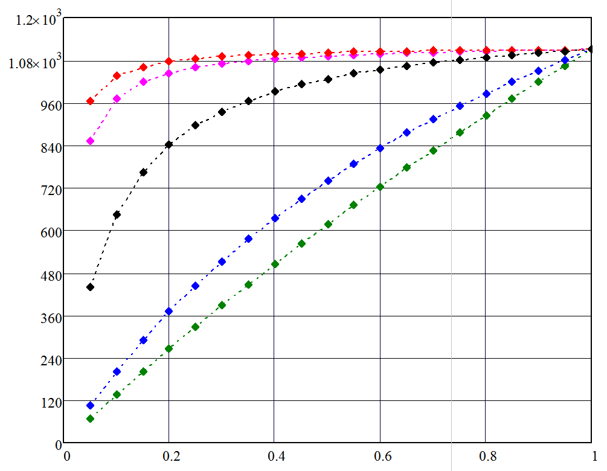
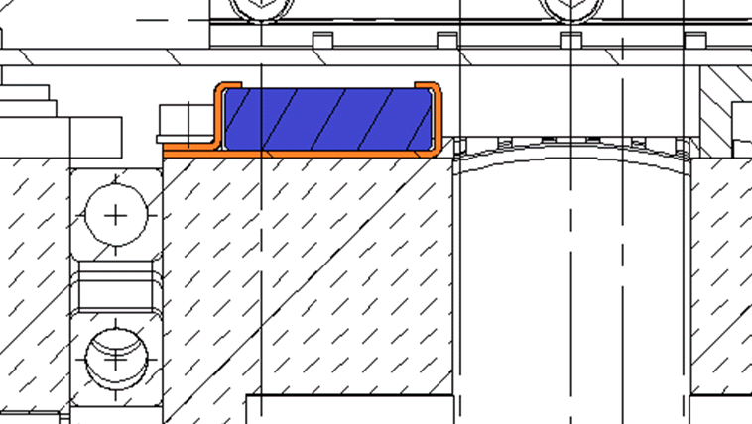
Analysis output
Specific power w.r.t. ε₀ & K_{A}
CASE:
ε_{FERRITE} =0.8
T_{CURIE} = 150°C
T₀=22°C (i.e. cooled heat sink)
If K_{A} is high→ no need for very high ε₀
Q [W/m2]
But ferrite needs to be held, i.e. K_{A} is usually near to one.
E.g. TCTP collimator:
K_{A}
K_{A}=1
K_{A}=1.6
K_{A}=10
K_{A}=50
K_{A}=100
K_{A}~=1.6
ε₀ [-]
Notes:
KA_MKI=2.9

Slide 5
Analysis output
CASE:
ε_{FERRITE} =0.8
T_{CURIE} = 150°C
T₀=22°C (i.e. cooled heat sink)
Legenda:
Q [W/m2]
Heat evacuation can be handled by radiation only (regardless of geometry)
Need for ferrite active cooling
Output is geometry dependent
Critical design zone
High K_{A} point of interest
Low K_{A} point of interest
ε₀ [-]

Slide 6
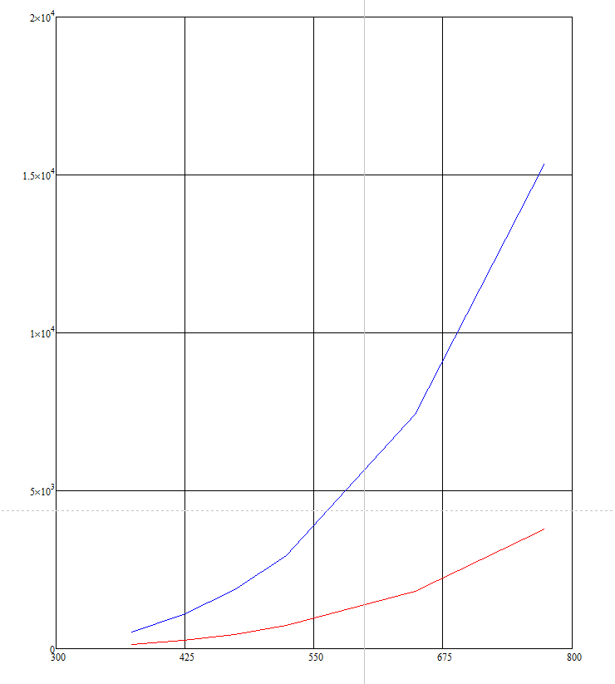
Analysis output
Points of interest obtained for different values of T_{CURIE}
Q [W/m2]
2e4
Legenda:
Heat evacuation can be handled by radiation only (regardless of geometry)
1.5e4
Need for ferrite active cooling
1e4
Output is geometry dependent
5e3
0
T_{CURIE} [°C]
27
150
275
400
530

Slide 7
BACK UP

Slide 8
Analysis output
Power plots obtained for different values of T_{CURIE}
Q [W/m2]
2e4
1.5e4
T_{curie} [°C]
100 | 127 | 519
150 | 264 | 1076
200 | 459 | 1869
250 | 727 | 2959
375 | 1824 | 7423
500 | 3777 | 15372
1e4
5e3
0
T_{CURIE} [°C]
27
150
275
400
530

Slide 9
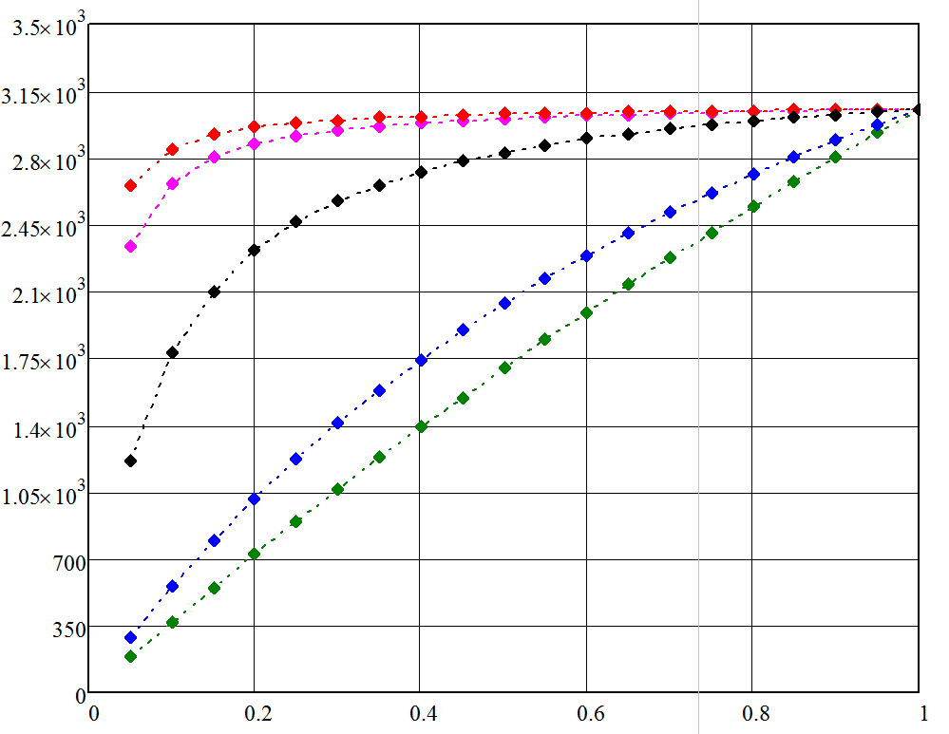
Analysis output
Specific power w.r.t. ε₀ & K_{A}
CASE:
ε_{FERRITE} =0.8
T_{CURIE} = 250°C
T₀=22°C (i.e. cooled heat sink)
Q [W/m2]
K_{A}=1
K_{A}=1.6
K_{A}=10
K_{A}=50
K_{A}=100
ε₀ [-]

Slide 10
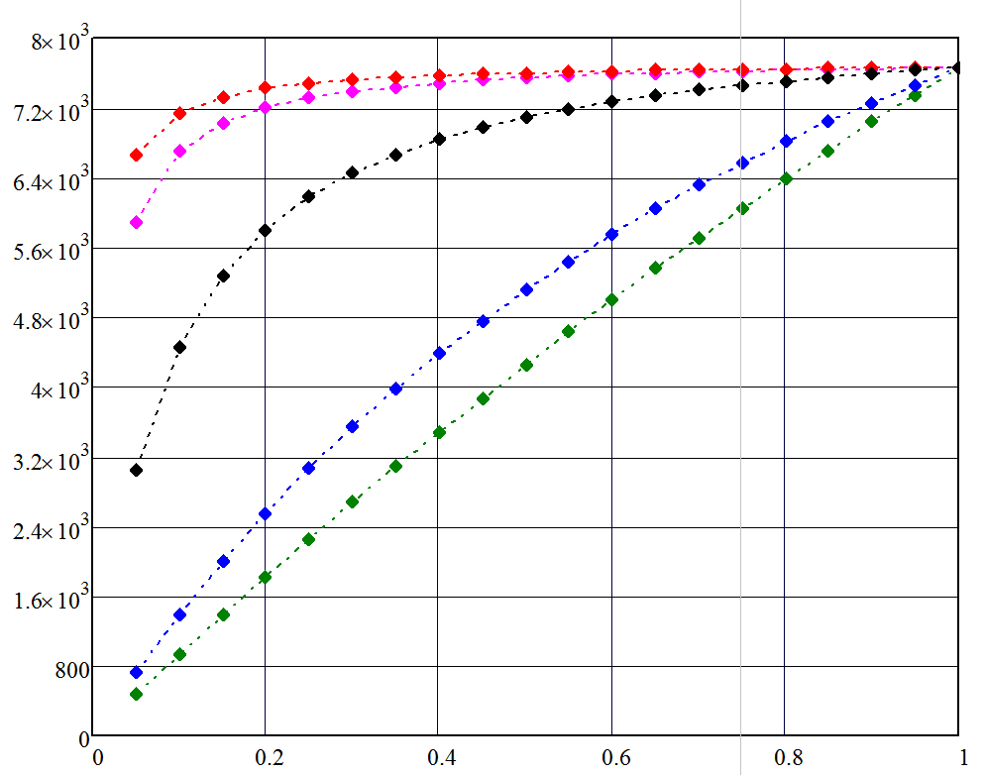
Analysis output
Specific power w.r.t. ε₀ & K_{A}
CASE:
ε_{FERRITE} =0.8
T_{CURIE} = 375°C
T₀=22°C (i.e. cooled heat sink)
Q [W/m2]
K_{A}=1
K_{A}=1.6
K_{A}=10
K_{A}=50
K_{A}=100
ε₀ [-]

