Slide 1
Some RF contacts and power transmission lines

Slide 2
Annual maintenance of RF power transmission lines in BA3 Philips plant
Once per year, we have to dismount 16 RF power amplifiers to make their maintenance
To do so, we need to disconnect their output power transmission lines
With this 35 years old equipment, we recently experienced some difficulties with the innerspring contact clamps

Slide 3
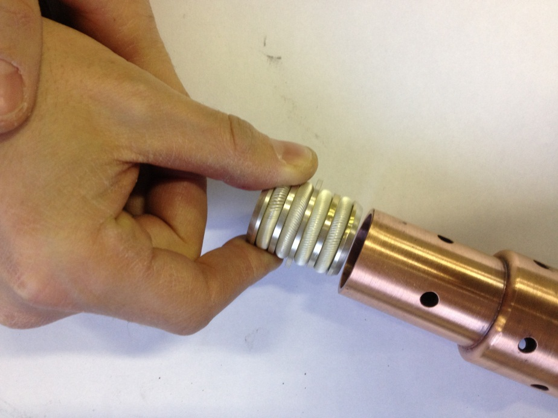
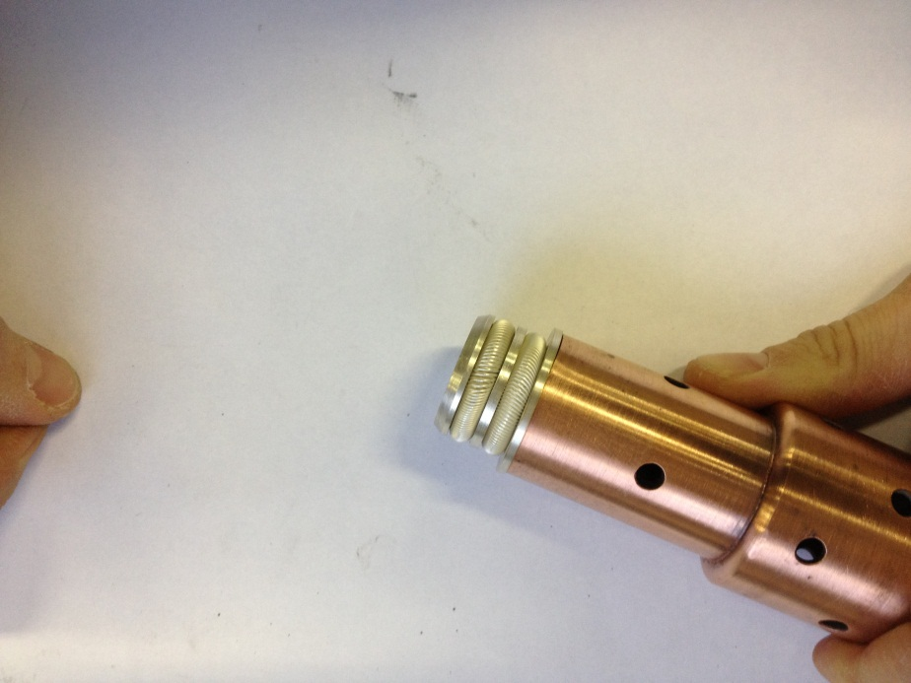
Innerspring contact clamp
Innerspring contact clamp ensures continuity
of the inner line of the 35 kW CW RF transmission line

Slide 4
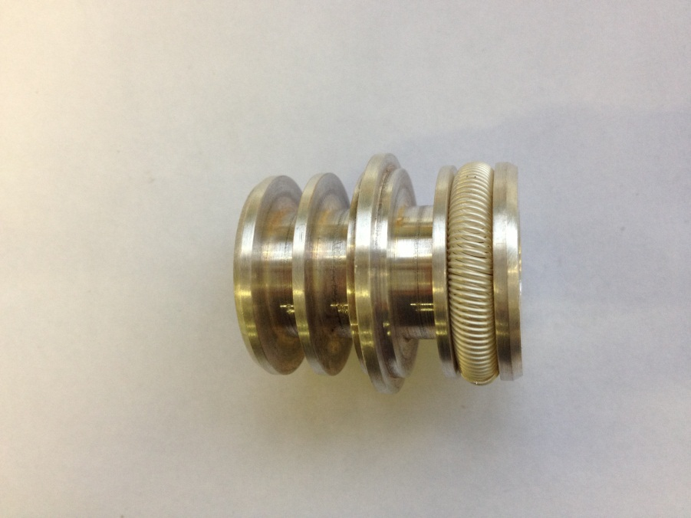
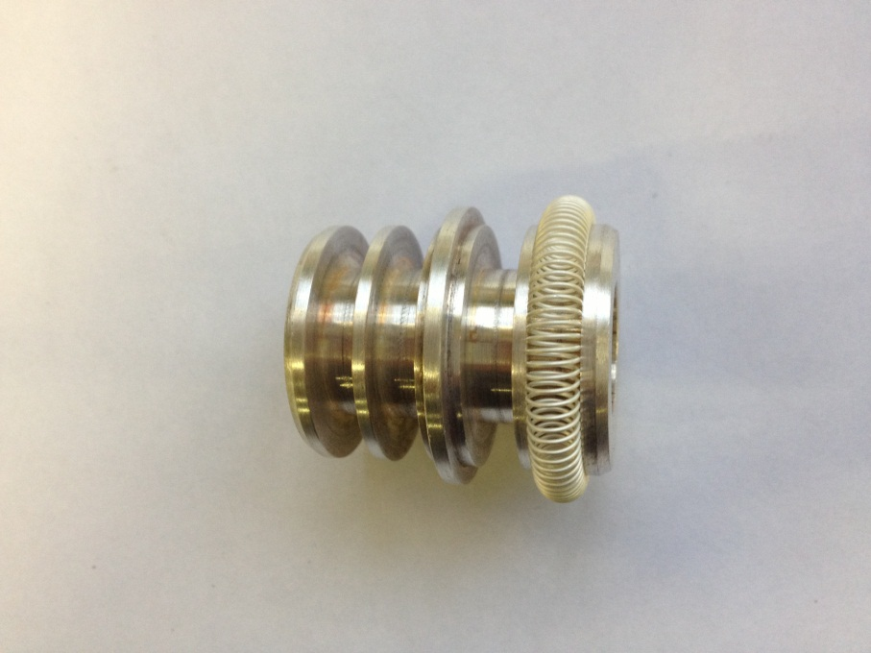
Possible mistakes
Too long spring
Impossible to mount inside
the inner line
As it was too difficult to insert it in the inner line, mechanist decided to shorten the RF spring contact
See next slide for consequences…

Slide 5
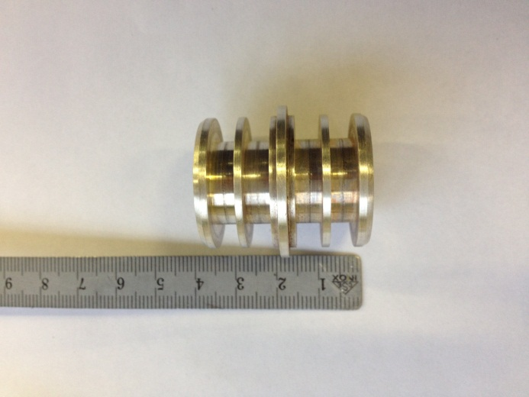
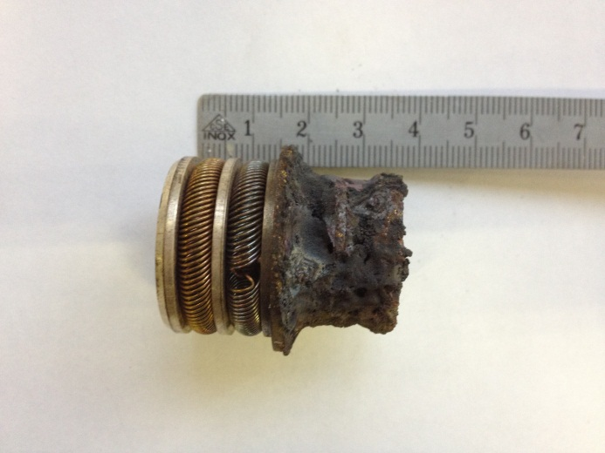
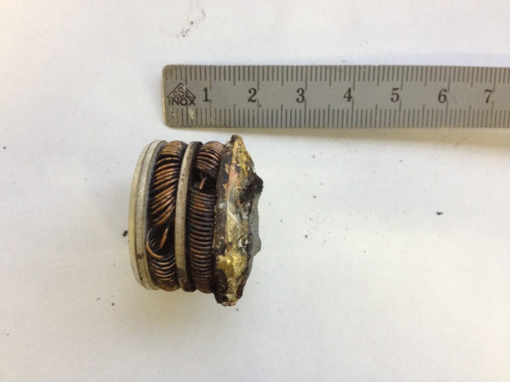
Bad RF contact consequences
Original clamp size
After operation at 35 kW @ 200 MHz with bad contacts
Even worse

Slide 6
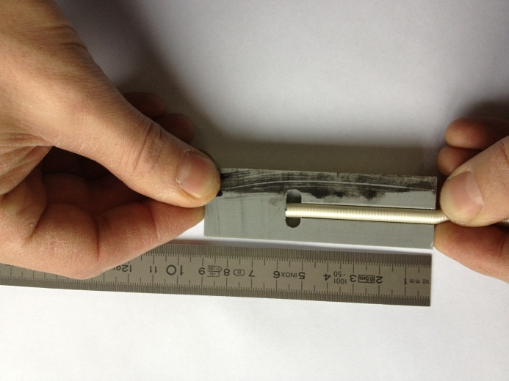
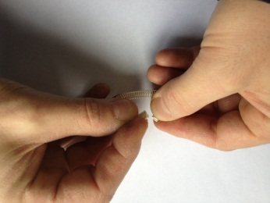
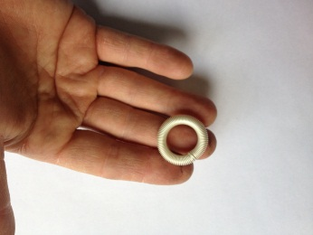
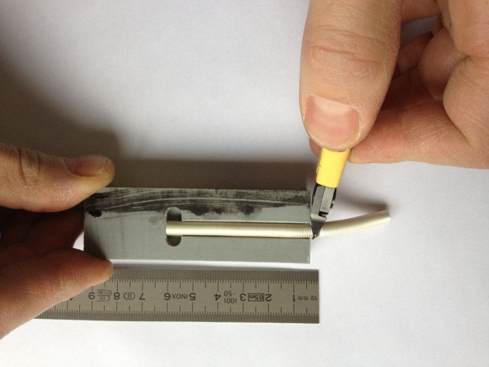
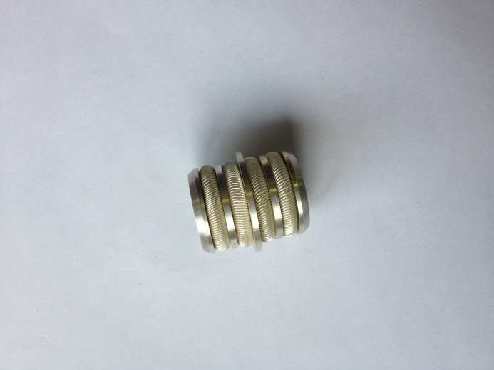
Correct procedure
Compress the spring to the selected length
Roll it up ensuring a good spirals distribution including the connecting point
A very simple process to ensure a correct contact
Once compressed cut it guarantying the correct number of spirals

Slide 7
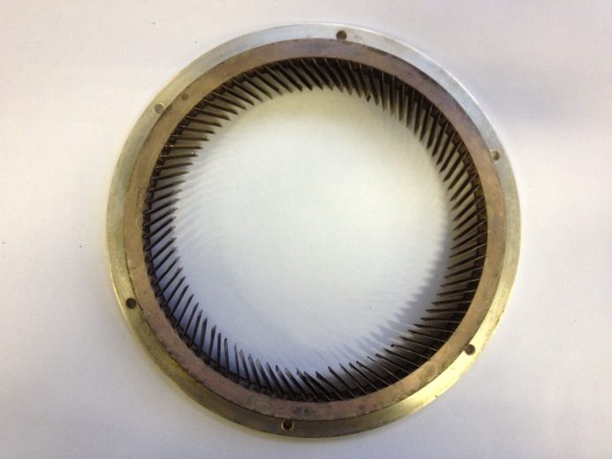
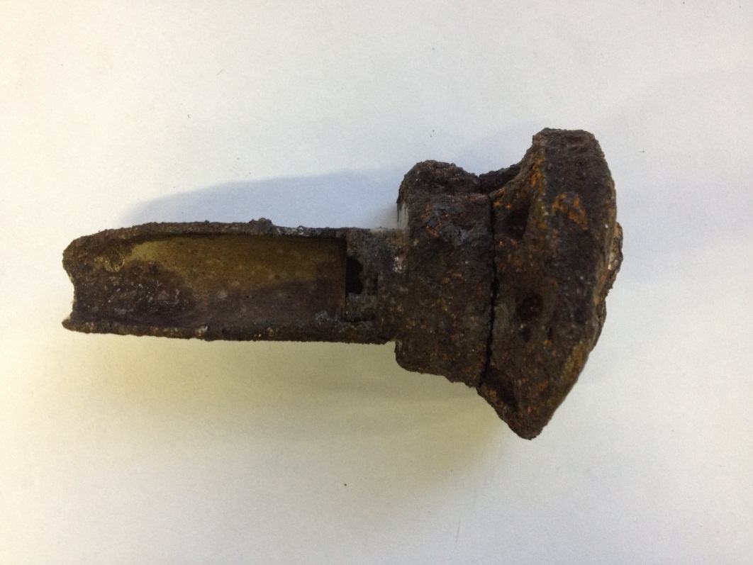
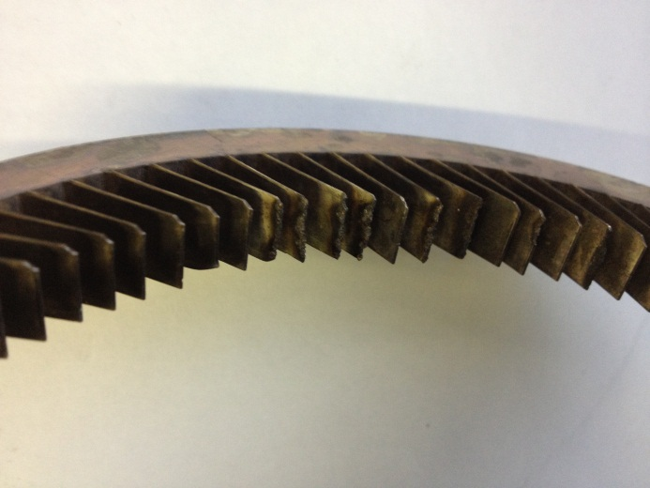
Additional examples…
Wrong lamella angle : burnt contacts
Another clamp burnt because one of the finger contact was mistakenly inserted in the inner side instead of the outer side

