Slide 1
Beam impedance of
63mm VM with unshielded Bellows
Tuesday 6/11 2012
O.Berrig & B. Salvant

Slide 2
CST model of the VM module (diameter = 63 mm)
63 mm

Slide 3
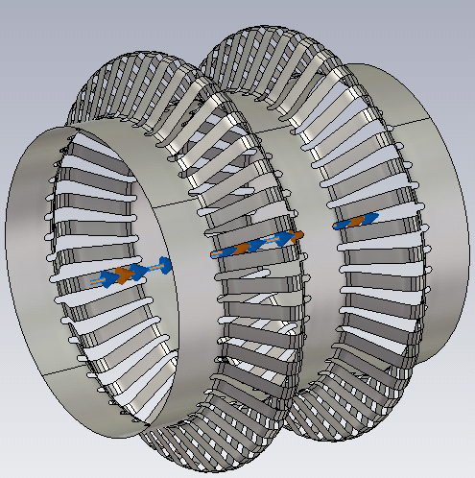
CST model of the RF fingers
The natural state of the RF fingers
( The RF fingers will naturally go
back to this state )
RF fingers in the machine (cold and stretched)

Slide 4
Theory http://cdsweb.cern.ch/record/118026/files/p1.pdf ( page 87 )
This term vanishes at high energy (ɣ large )
Z_{L} = Longitudinal impedance. It is a function of frequency Z_{L}(f)
n = (f/f_{rev})
f_{rev} = Revolution frequency. For the LHC it is 11.2455 kHz
= Relativistic beta ~ 1
= Relativistic gamma
Z₀ = Intrinsic impedance ( )
a = Radius of the beam
b = Radius of the inner of the bellow (= radius of beam pipe)
b’ = Radius of the outer fold of bellow
L = Accumulated length of the bellow, with an outer radius.
It is approximately half of the length of the bellow,
since approximately half the length has an outer radius,
and half of the length has an inner radius
R = Radius of the accelerator. For LHC it is (26659 m / 2π)

Slide 5
Theory
This formula is only valid up to the first cut-off frequency
======
Value of the beam impedance, when the RF fingers are not pressed together
Where: p = 2.405 for the first zero of the TM mode [ J₀(p)=0 for cylindrical geometry ]
c = speed of light
b = radius of beam pipe

Slide 6
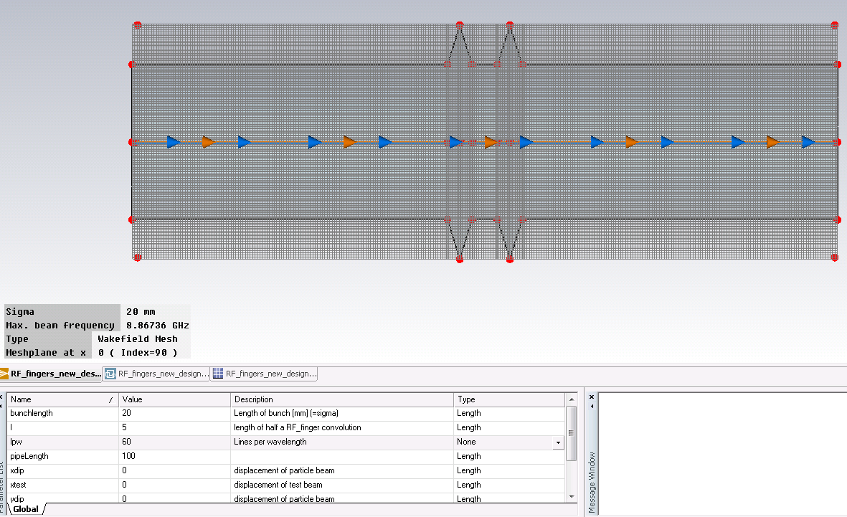
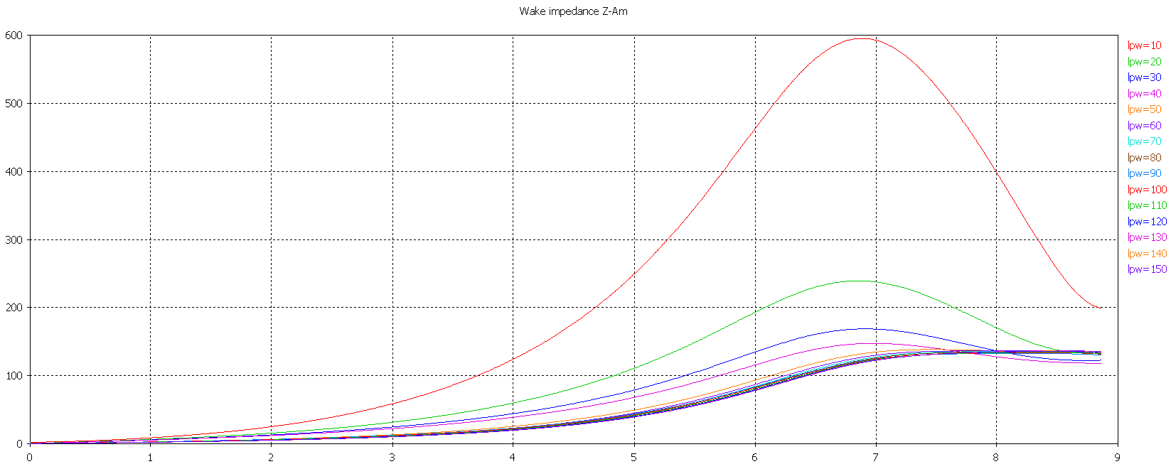
Simulation in CST. First task, find the number of meshcells, where the calculations are precise i.e. converge
When the lpw (lines per wavelength) is greater than 50, then the Wake impedance converge. The mesh on the left is shown for lpw=60. All further calculations were done with lpw=100 and bunch sigma= 20 ns (the bunch sigma also influence the mesh) corresponding to ~ 40M meshcells.

Slide 7

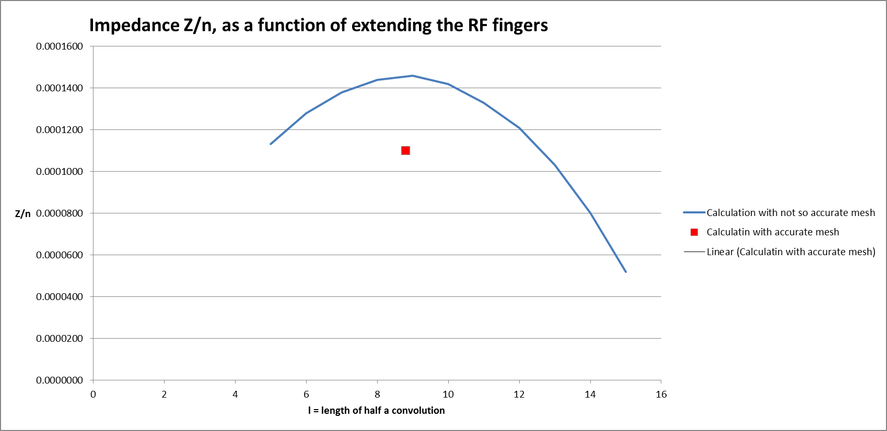
Effect of pressing the RF fingers together

Slide 8
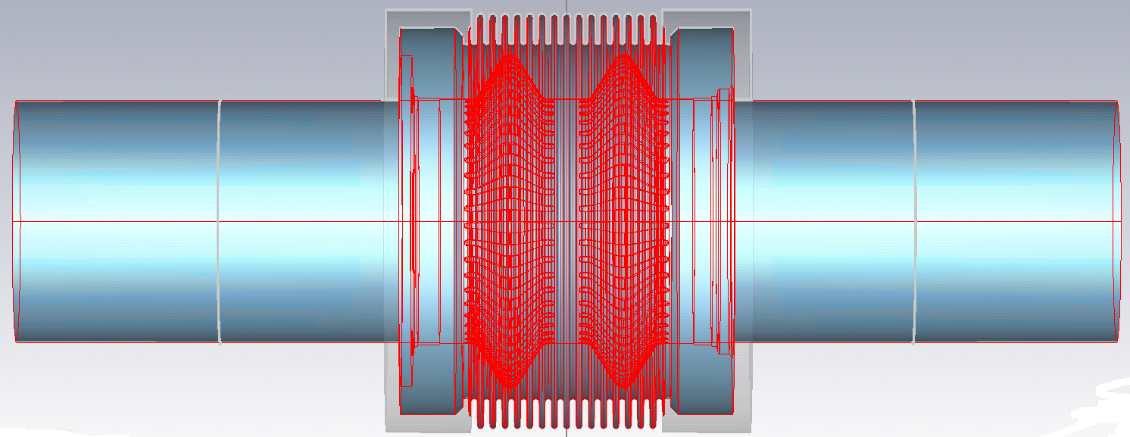
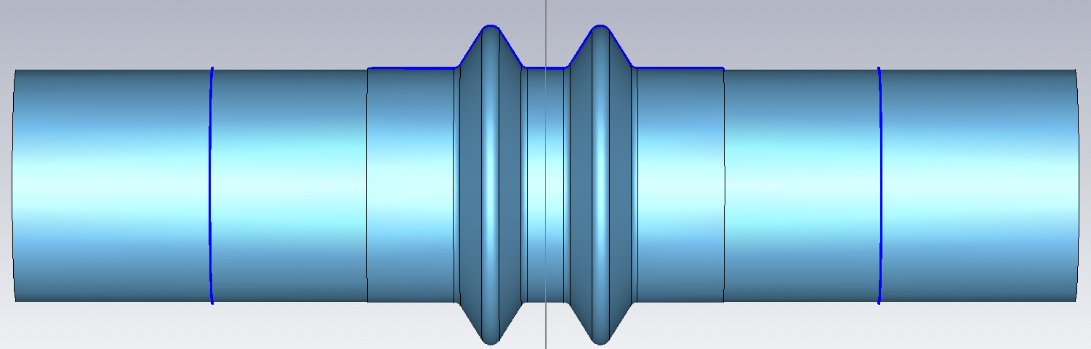
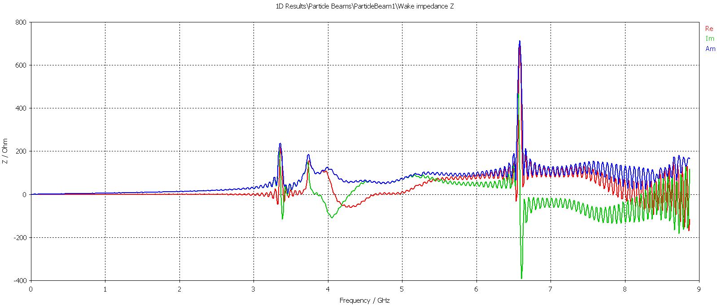
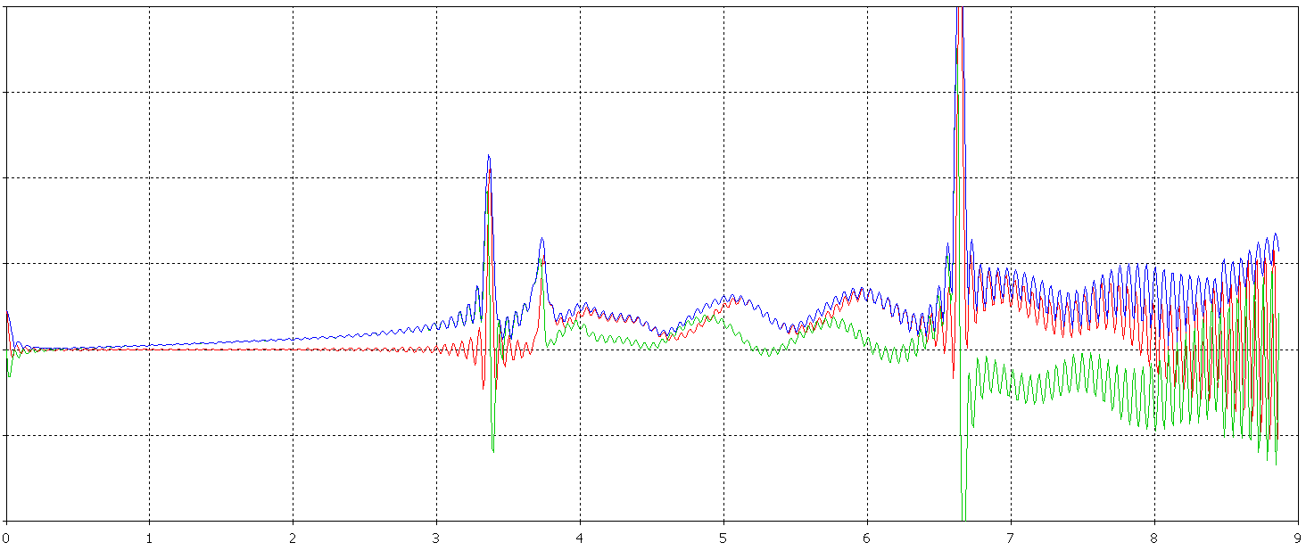

Difference – with or without holes
Z_{longitudinal}/n = 0.7 *10⁻⁴ Ω
Z_{longitudinal}/n = 1.1 *10⁻⁴ Ω

Slide 9
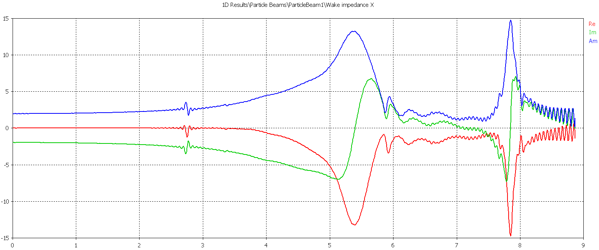
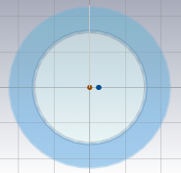
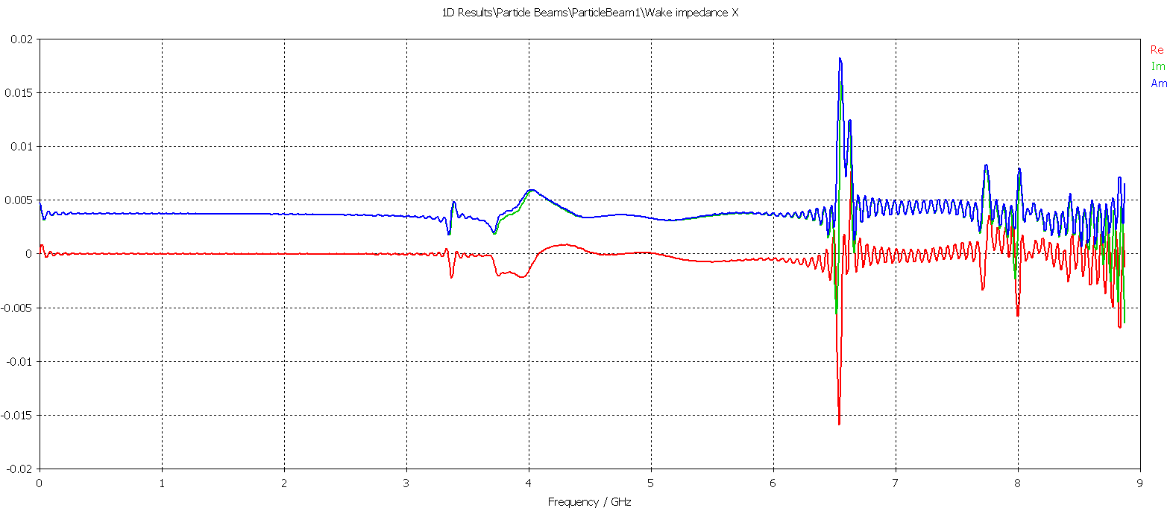
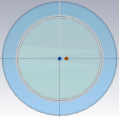
Transverse impedance
Dipolar impedance
The beam is offset by 5 mm
The imaginary dipole impedance = -2.2 Ohm (the real component is zero)
Quadrupolar impedance
The testbeam is offset by 5 mm
The imaginary dipole impedance = 0.003 Ohm (the real component is zero)

Slide 10
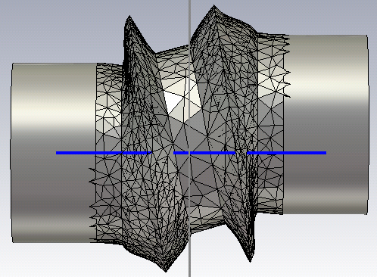
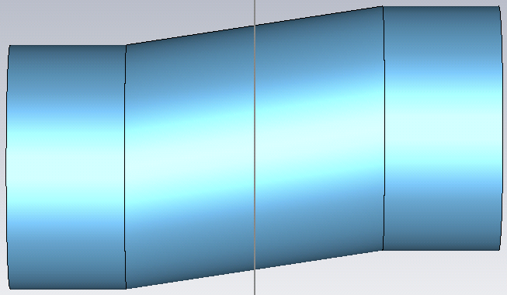
Horizontal offset
Unfortunately, both of the following structures: “the real structure with the RF-fingers” and a “simplified model”, have problems with unphysical fields that introduces constant potentials in the wake-functions. Reported to CST.

Slide 11
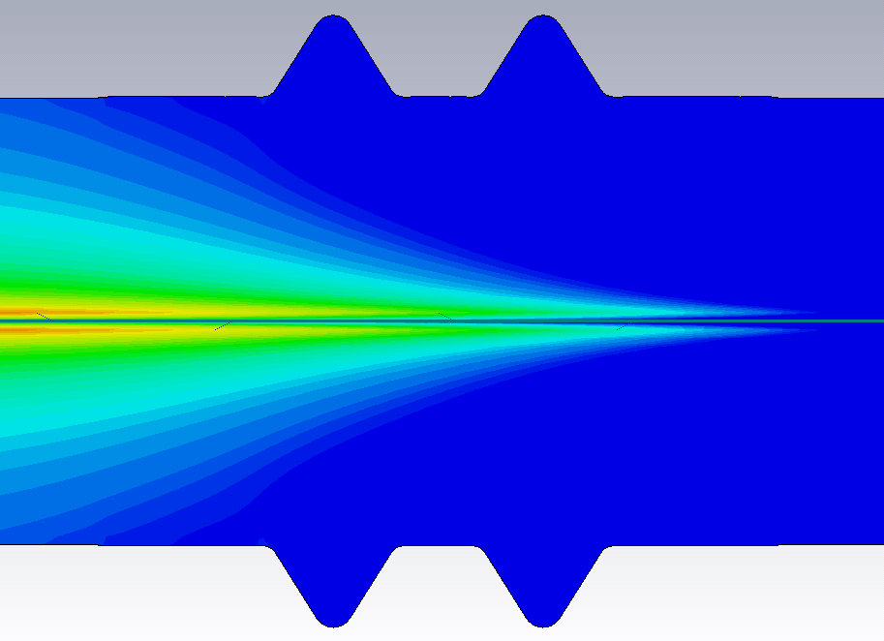
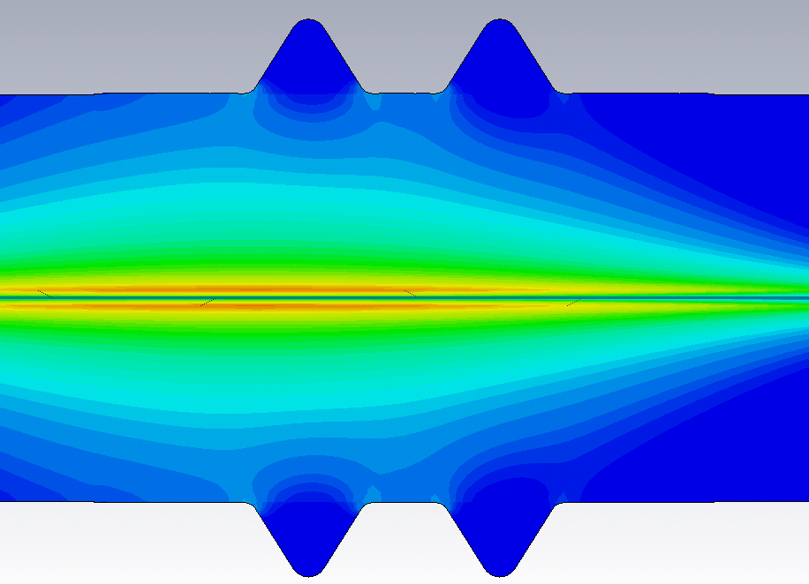
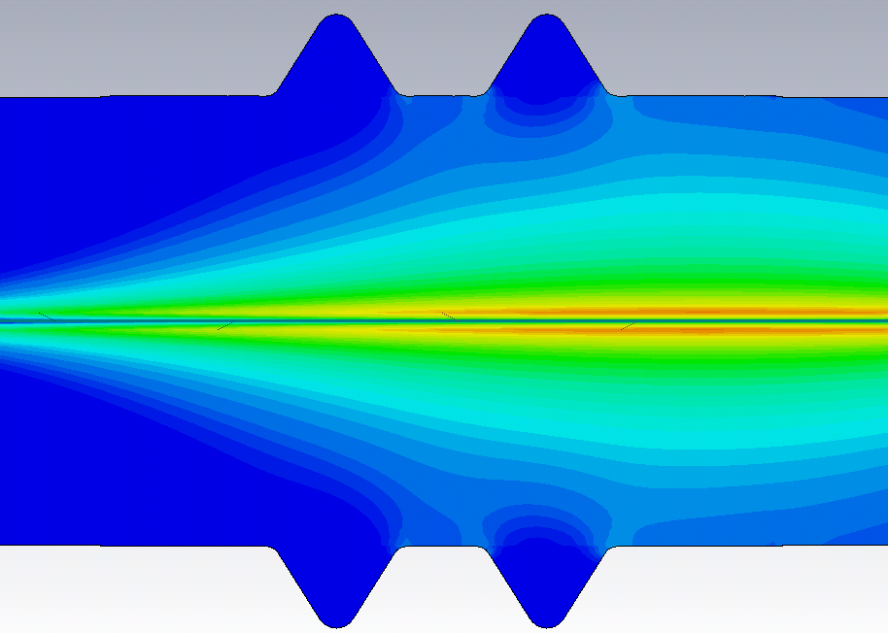
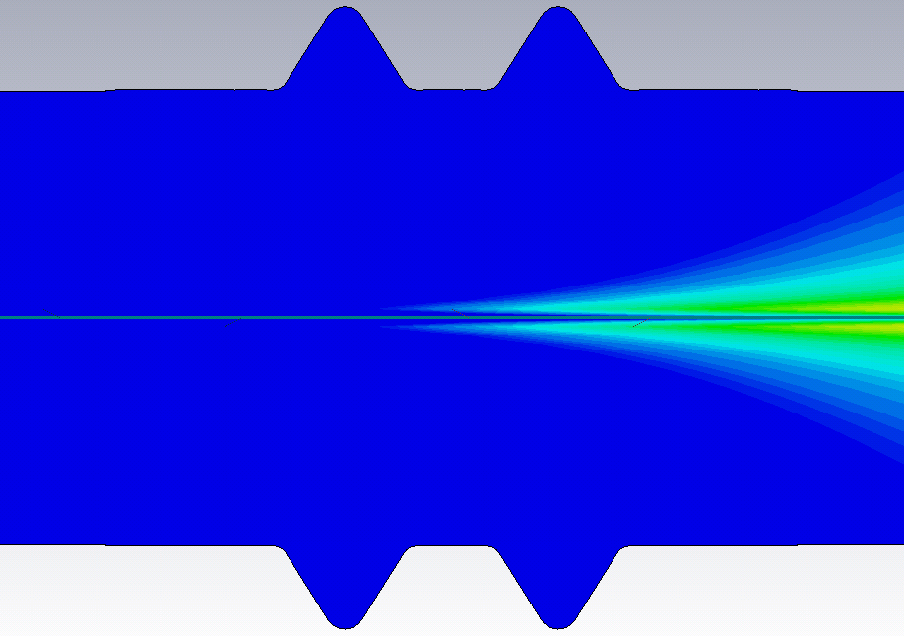
No cavity effect, i.e. fields are not captured

Slide 12
CONCLUSION
The longitudinal impedance depends on how much the RF fingers are stretched. The impedance is close to zero in either completely compressed state or completely stretched state. The maximum normalized longitudinal impedance is about: Z_{longitudinal}/n = 1.5 *10⁻⁴ Ω
A normalized impedance of 1.5 *10⁻⁴ Ω can not be used for all the PIM modules, but only in selected equipment.

Slide 13
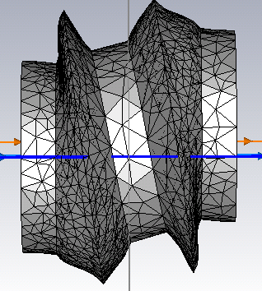
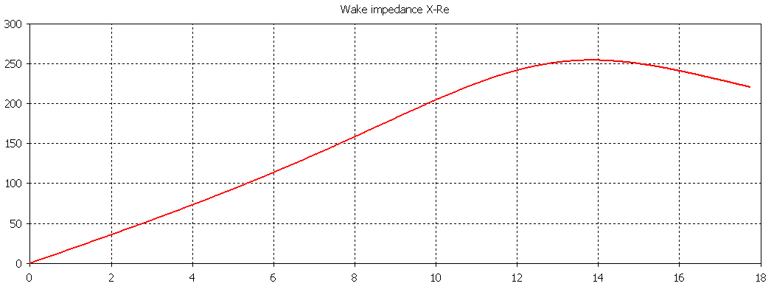
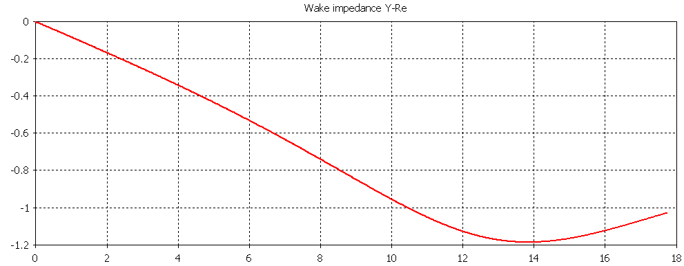
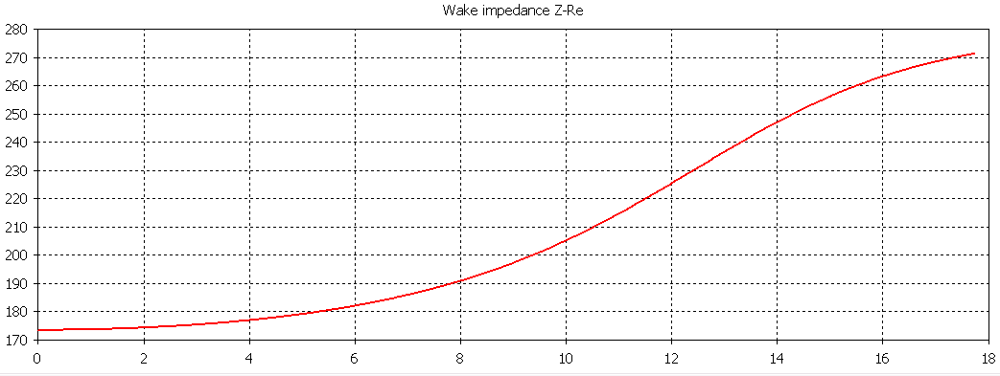
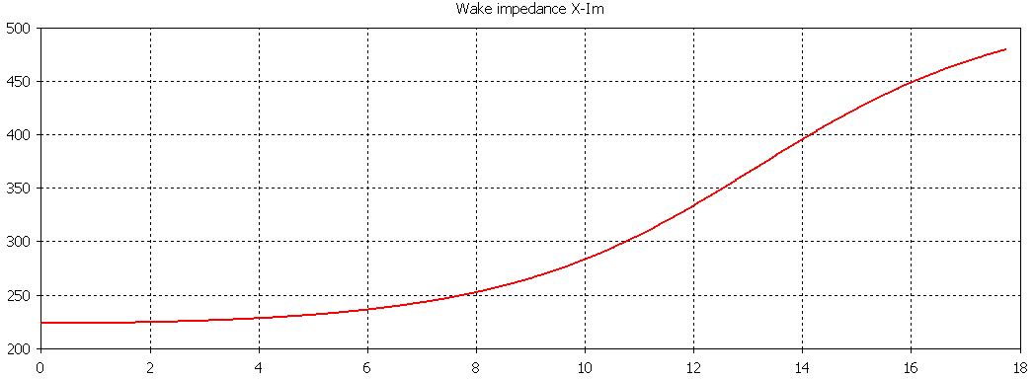
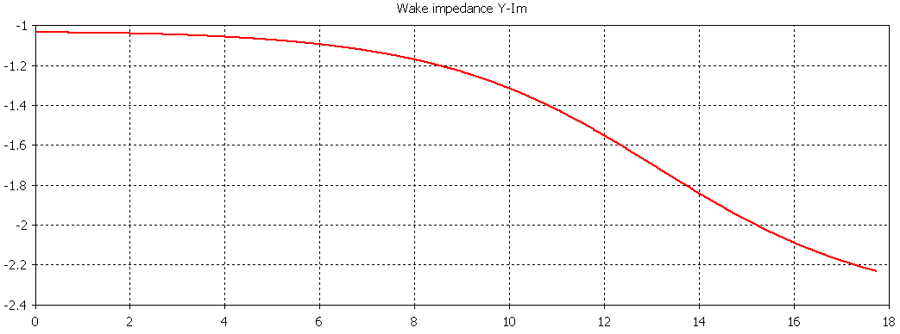
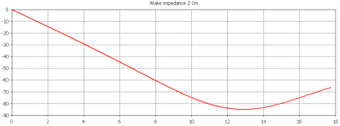
Additional
Impendance of a structure that is 10mm horizontal offset. There are no vacuum chambers on each side. The structure is seen from above.
Horizontal
Vertical
Longitudinal

