Slide 1
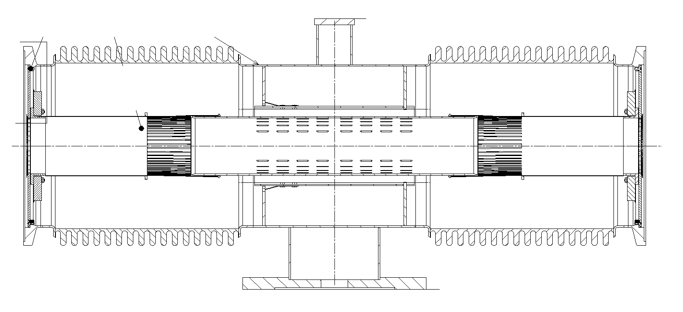
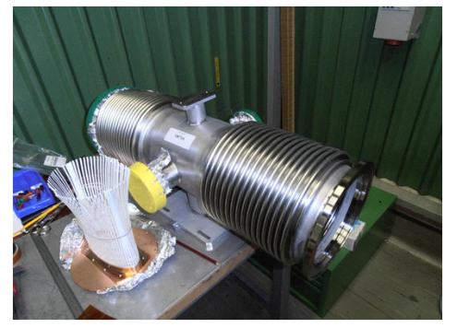
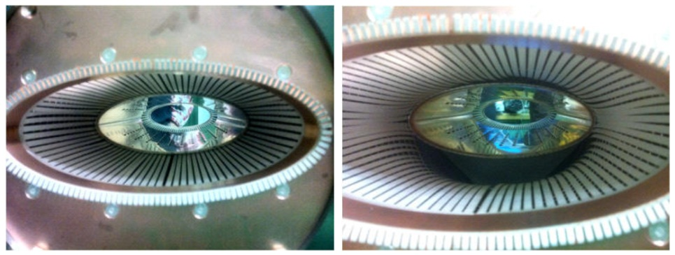
Thermal evaluation on VMTSA heating
M. Garlasché, A. Bertarelli
Acknowledgements: G. Bregliozzi, E. Metral

Slide 2
Summary
Short recap
VMTSA configuration
FEM Model
Results

Slide 3
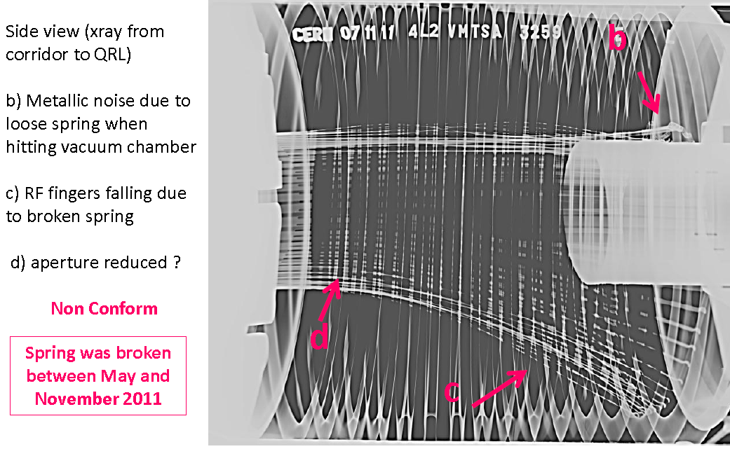
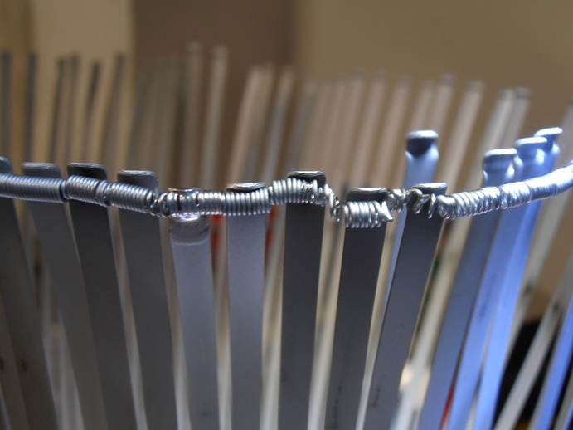
Short recap
[1]
…Opening of the concerned vacuum sectors during Xmas break 2011-2012, have shown that the stainless steel spring is deformed and brazed to the Cu/Be RF fingers and that the RF fingers are permanently deformed. The estimated temperature reached during operation is ~ [800÷]1000 °C…
[2]
[1] LMC 16-11-11, V. Baglin
[2] EDMS LHC-VMTSA-EC-0001, V. Baglin

Slide 4
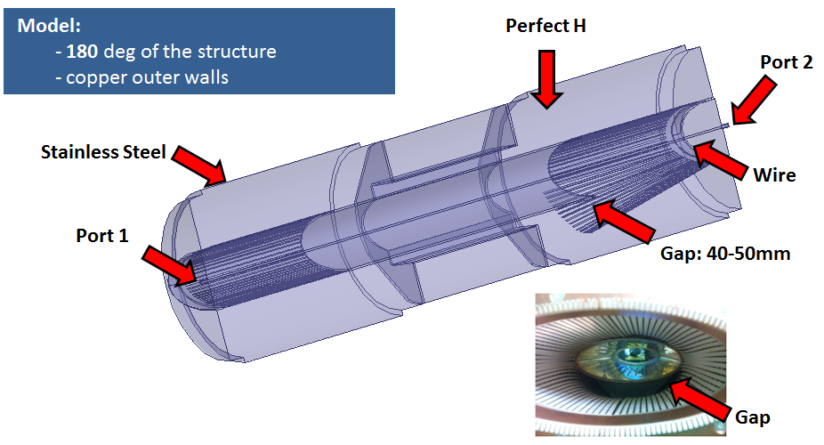
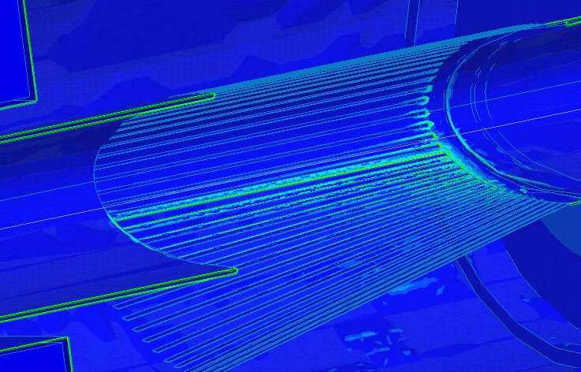
Short recap
Old configuration (long RF fingers)
[3]
P_{RF,fingers}(40mm gap)~650W
P_{RF,fingers}(50mm gap)~460W
Is RF power deposition compatible with expected failure Temperatures?
Limit for power value?
[3] LRFF Meeting 30-10-2012, O. Kononenko

Slide 5
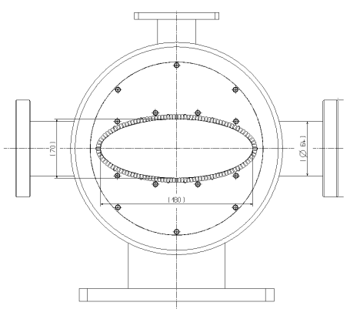
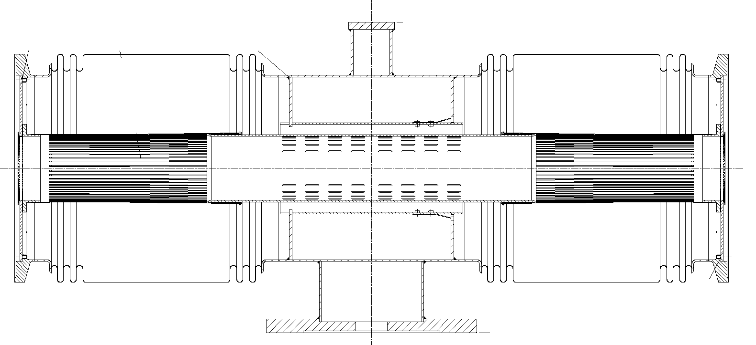
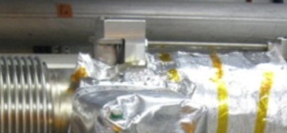
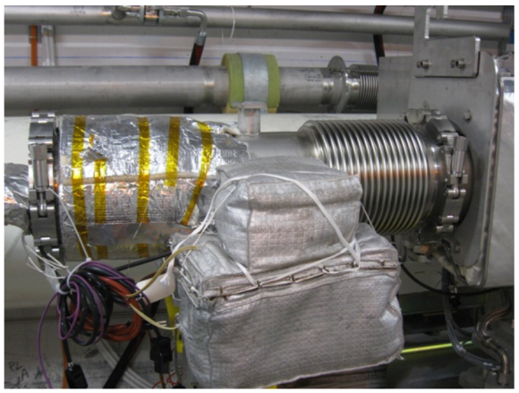
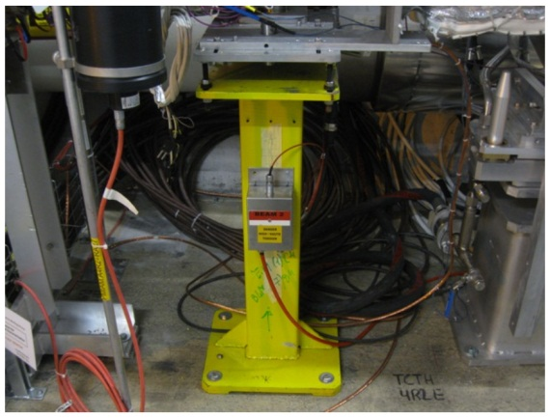
VMTSA Configuration
Rh dep.
Ag dep.
Material:
Stainless Steels (316L/LN,304L)
CuBe
C10100 (OFE Cu)
Eventual cover
..Interesting features for thermal analysis of long fingers configuration..
2x ion pump with jackets
4x screws for support

Slide 6
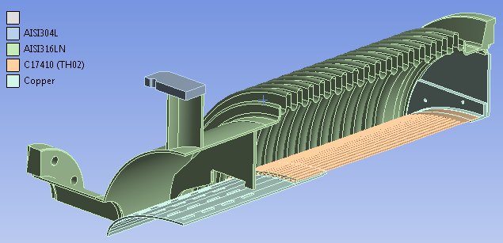
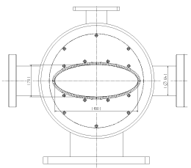
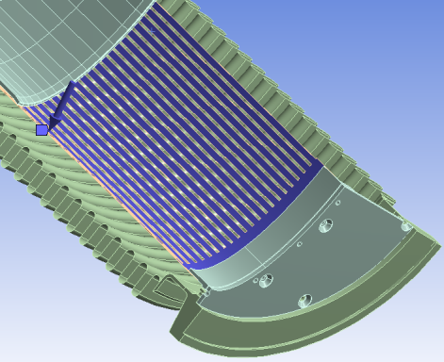
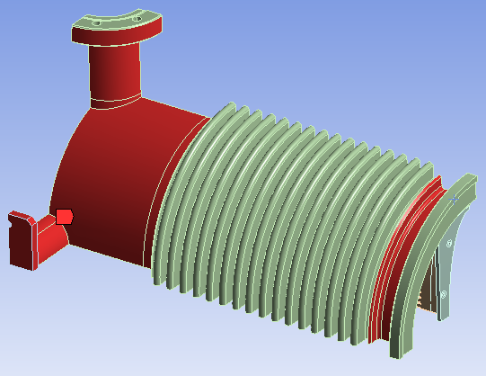
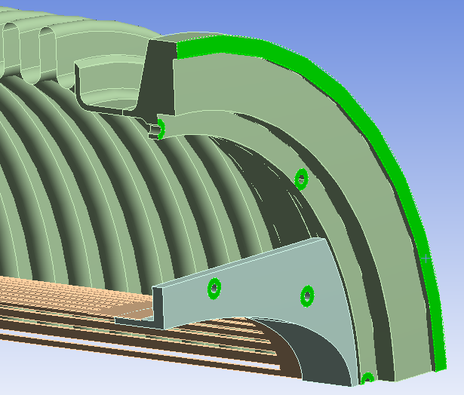
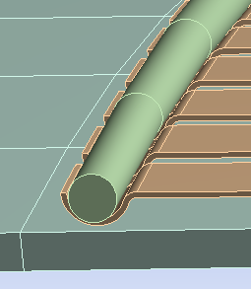
FEM Model
Balanced heat exchange scenario with maximum spring temperature
Components in | Th. Cond [W/m-K] | Emiss. | Emiss. (Lit.)
C17410 | 233 | 0.05
Ag coating | - |  | 0.03
Rh coating | - |  | 0.03-0.1
C10100 | 400 |  | 0.05-0.1
SS. 304L | 15 | 0.3 | 0.3-0.4
SS. 316/LN
2 Fold Symmetry
No central pipe support (LHCVMTSA0008)
No heat evacuation to pumps & ground/top
Function of T
Evenly distributed Power deposition
Free (5 W/m2K @ 22C) external convection on all surfaces
Ideal th. Contact between fingers and spring mockup
Ideal thermal contact

Slide 7
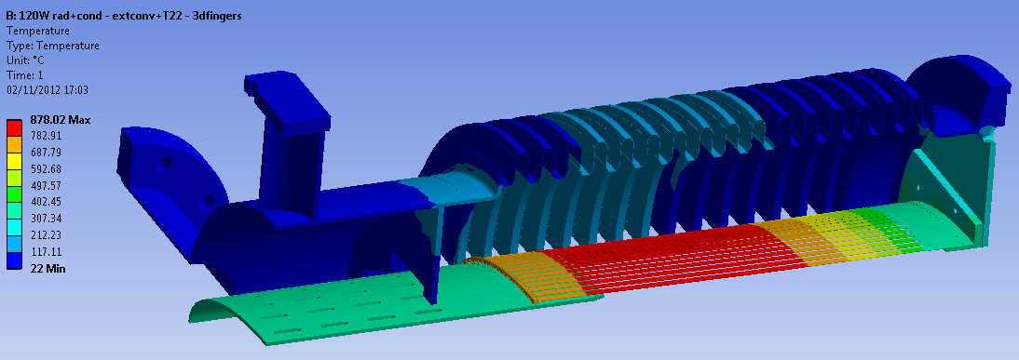
Results
Nonlinear static thermal analysis performed for different RF power cases
Case shown: 480W
P_{RF} [W] | T finger max [°C] | T spring [°C]*
40 | 190 | 188
160 | 498 | 471
400 | 806 | 706
480 | 878 | 752
For higher P_{RF}, convergence is critical w.r.t time effective simulation...
(*) indication, as real geometry is not respected

Slide 8

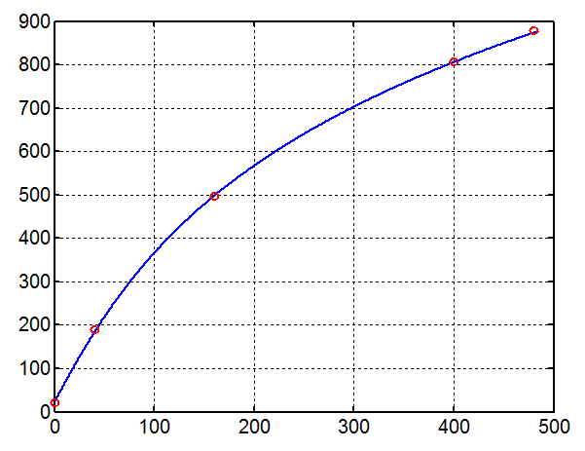
Results
Fingers heat evacuation can be approximated as following:
Geometry
Materials conductivity
Contacts
Geometry (view factors, surfaces)
Materials emissivity
Comp. position
T [°C]
Max interpolation error~ 6°C
P_{RF} [W]

Slide 9
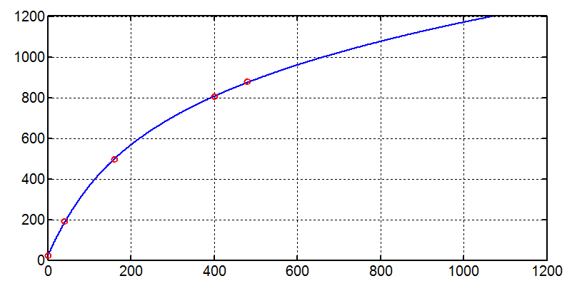
Results
Carefully extrapolating for higher P values..
T [°C]
P_{RF} [W]
Temperatures expected for 650W (40mm gap)? 990°C
Power expected for 1000°C? 670W

Slide 10
Results
Stress relaxation resistance (75% stress)
T [°C]
[4]
P_{RF} [W]
C17410
What could be a reasonable Power limit due to fingers failure? 100°C→ P_{RF}=18W
[4] LRFF Meeting 03-04-2012, S. Calatroni

Slide 11
Conclusions
Simplified model! Watch out especially regarding spring temperature
Failure temperatures estimate are compatible with P_{RF} expected
1000°C reached with P_{RF}=670W
P_{RF}=18W limit for 100°C on fingers

Slide 12
Back Up

Slide 13
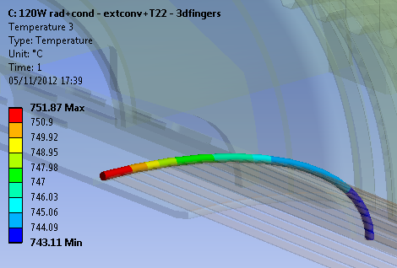
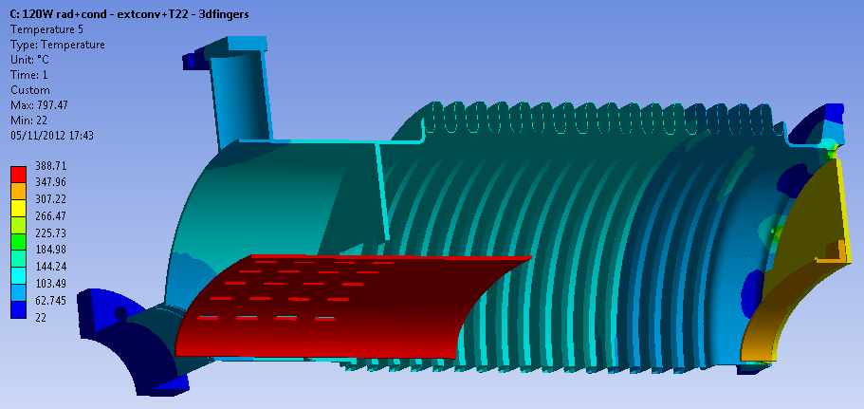
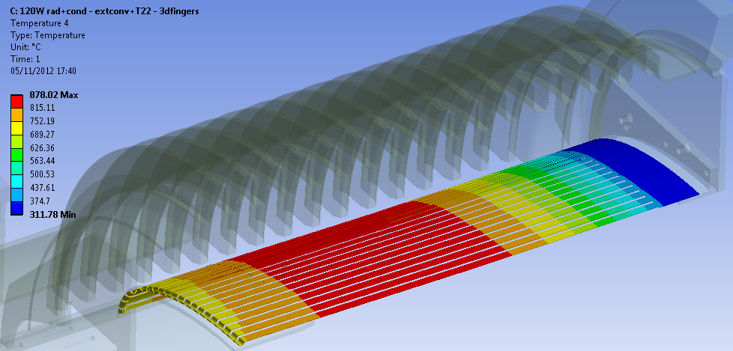
Temp. plots for 480W case

Slide 14
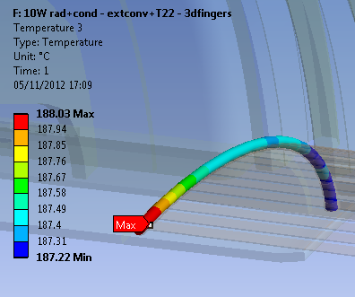
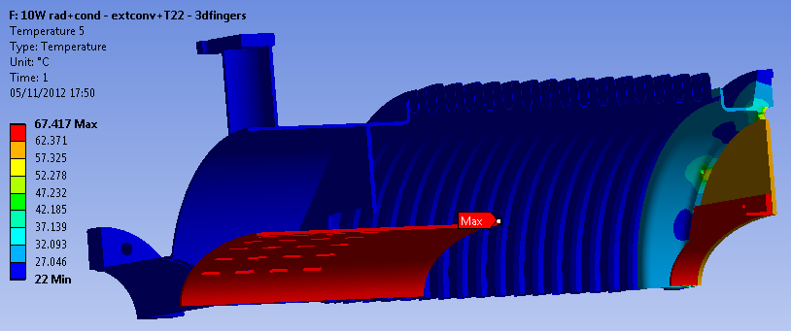
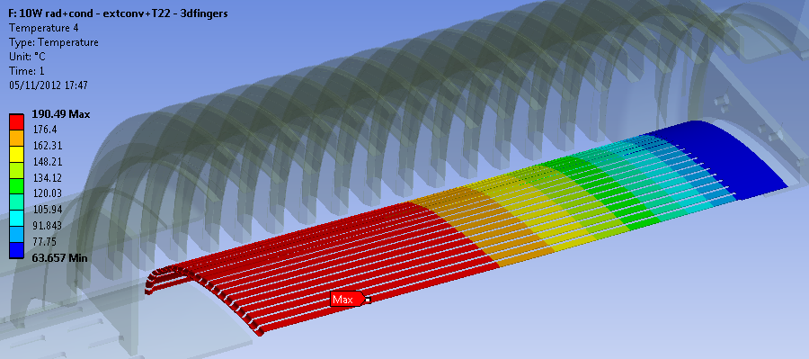
Temp. plots for 40W case

Slide 15
