Slide 1
Electromagnetic Simulations of VMTSA Equipped with the
RF Fingers and Ferrites
O. Kononenko
CERN, BE/RF
JINR
Thanks to Benoit Salvant, Alexej Grudiev, Elias Métral
LRFF Meeting, CERN, October 30, 2012

Slide 2
Outline
Realistic finger deformations for VMTSA equipped with the longer fingers. Time domain, eigen frequency and wire simulations
Simulations of the deformed shorter fingers and effect of Philips 8C11 ferrites

Slide 3
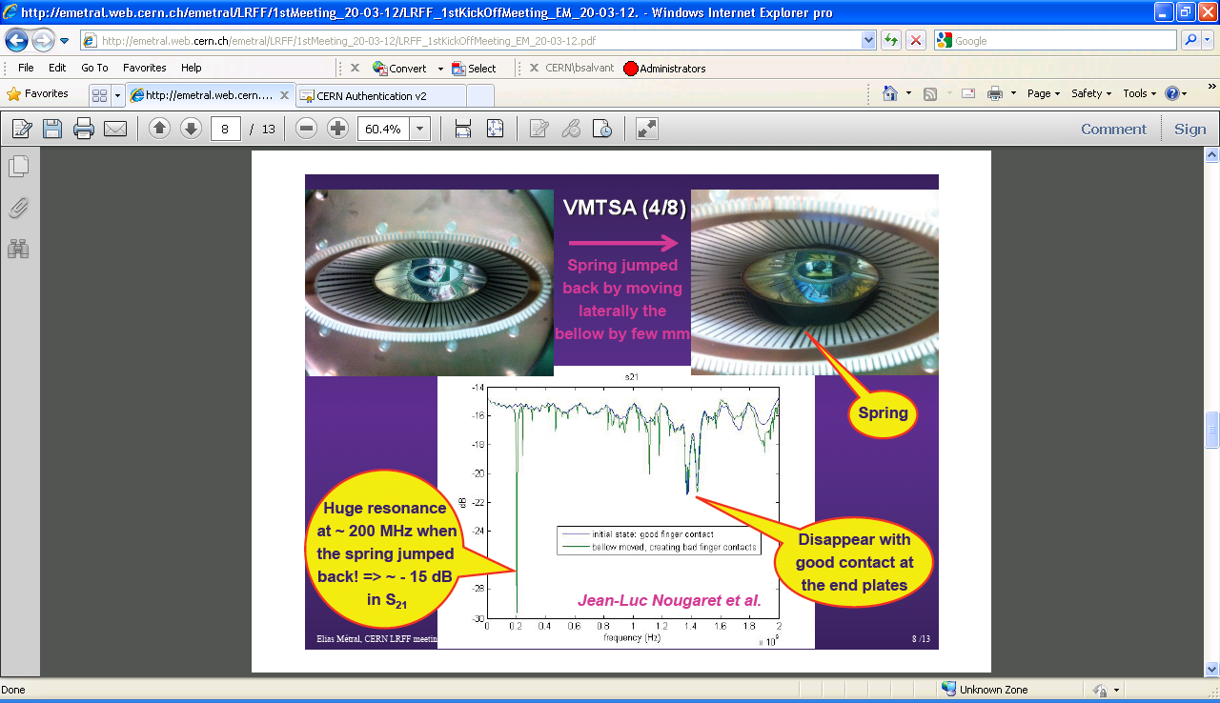
RF Fingers Deformation in VMTSA

Slide 4
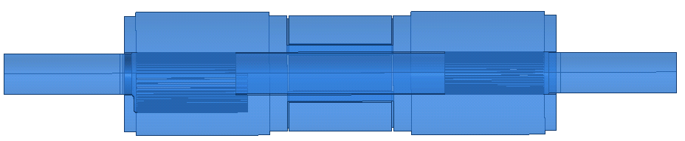
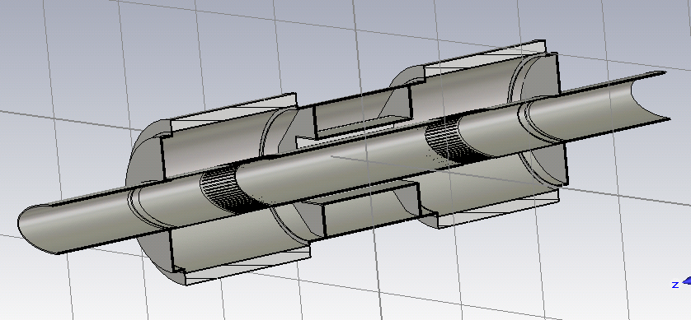
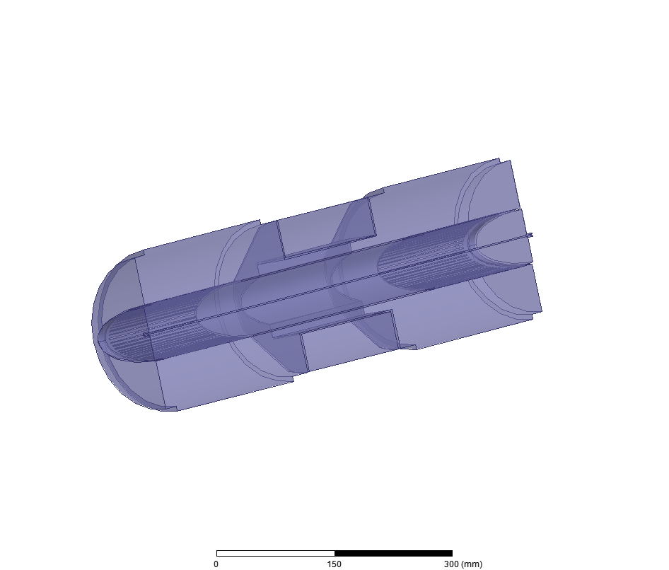
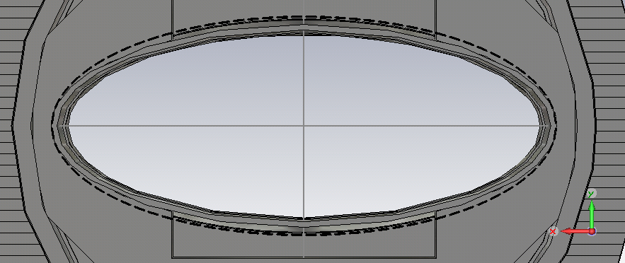
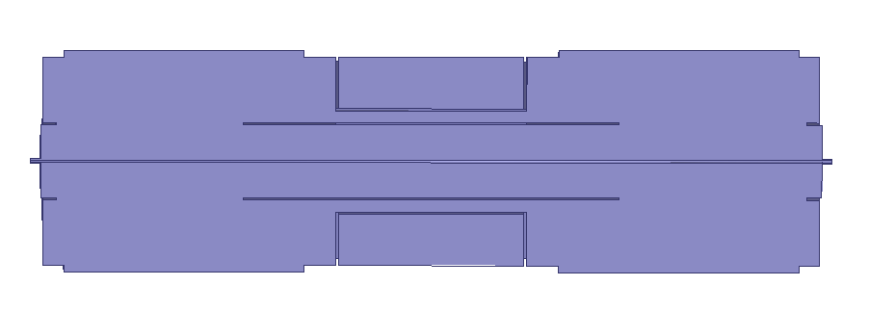
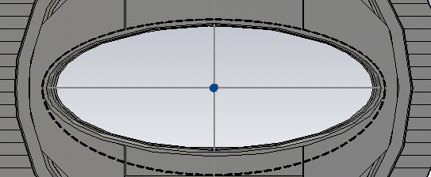
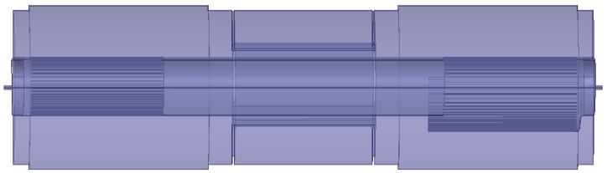
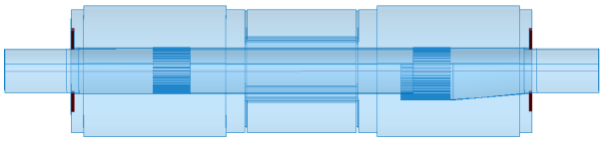
Simulated VMTSA models
Old longer fingers
New shorter fingers
Conforming
and bad contact
fingers
Conforming
fingers
Wire,
conforming
fingers
Bad contact 1st type
Wire,
no fingers
Bad contact 2st type
Wire,
20-50mm gaps
Deformation+Ferrites
Completed
In progress

Slide 5
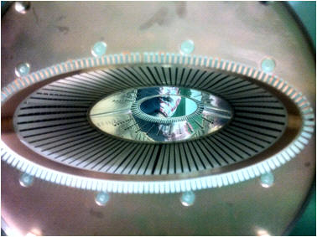
VMTSA with Wire and Comforming Fingers
Model:
  180 deg of the structure
  copper outer walls
Perfect H
Port 2
Copper
Wire
Port 1
Simulation profile:
- second order basis functions
  curvilinear elements enabled
  discrete sweep from 20MHz to 2GHz, 20MHz step
  0.01 s-parameters accuracy => ~220K tet10 mesh
- no matching

Slide 6
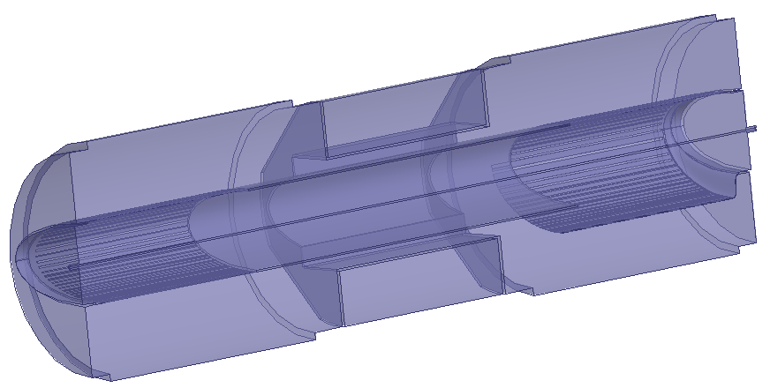
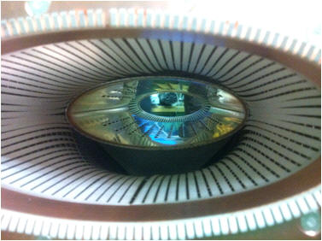
VMTSA with Wire and
Deformed Fingers: 20-40mm gaps
Model:
  180 deg of the structure
  copper outer walls
Perfect H
Port 2
Copper
Wire
Port 1
Gap: 20-40mm
Simulation profile:
- second order basis functions
  curvilinear elements enabled
  discrete sweep from 20MHz to 2GHz, 20MHz step
  0.01 s-parameters accuracy => ~260K tet10 mesh
Gap
- no matching

Slide 7
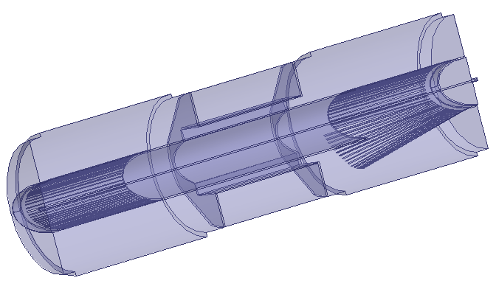
VMTSA with Wire and
More Realistic Deformation
Model:
  180 deg of the structure
  copper outer walls
Perfect H
Port 2
Stainless Steel
Wire
Port 1
Gap: 40-50mm
Simulation profile:
- second order basis functions
  curvilinear elements enabled
  discrete sweep from 10MHz to 2GHz, 10MHz step
  0.01 s-parameters accuracy => ~300K tet10 mesh
Gap
- no matching load

Slide 8
Transmition for Different Gap Sizes
Different level of transmission probably because there is no matching load in the HFSS simulation

Slide 9
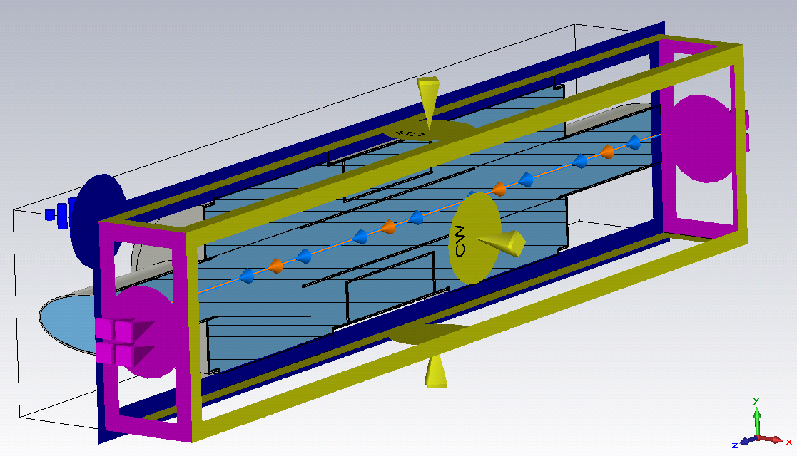
CST TD Simulations of VMTSA
Model:
  full structure
  copper walls
  conforming fingers and 40-50 mm gap
Simulation profile:
- 10 lines per wavelength
- refine at PEC by factor 6
- 70mm bunch sigma
  400K hex mesh

Slide 10
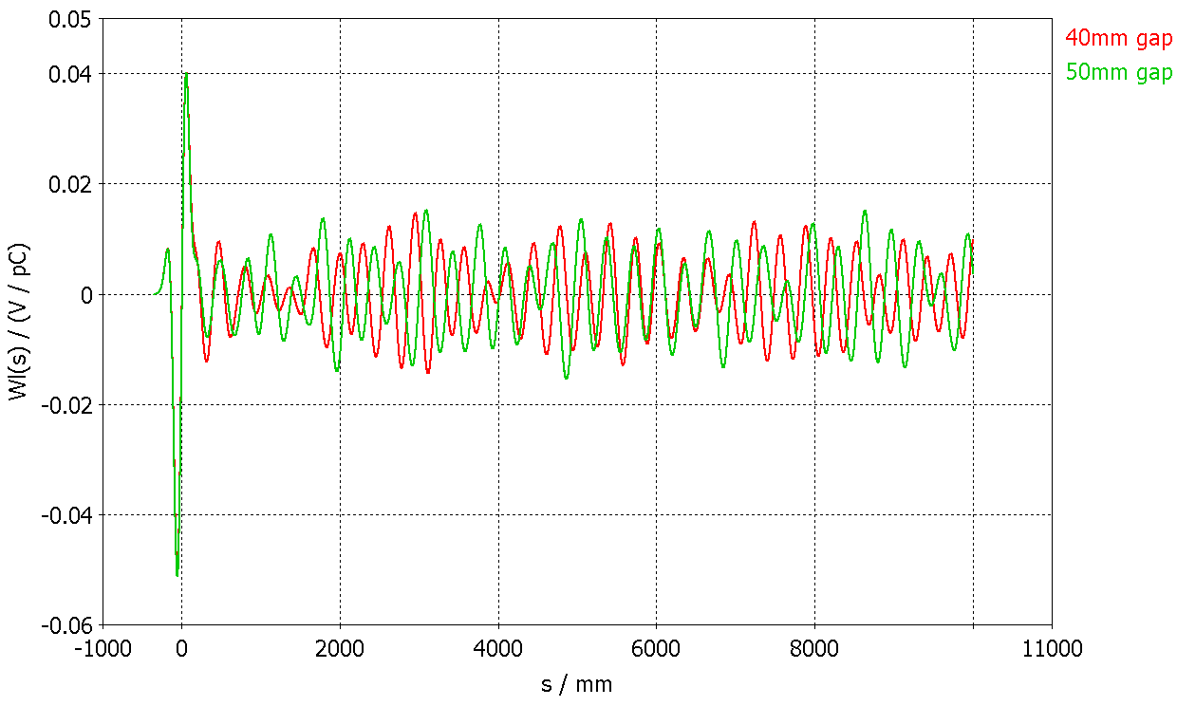
Longitudinal Impedance

Slide 11
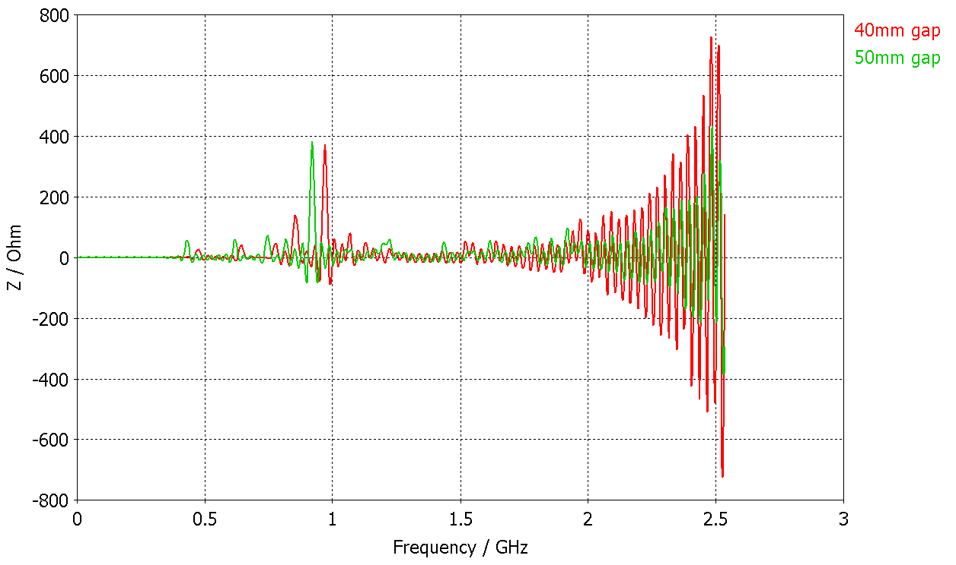
Longitudinal Wake Potential

Slide 12
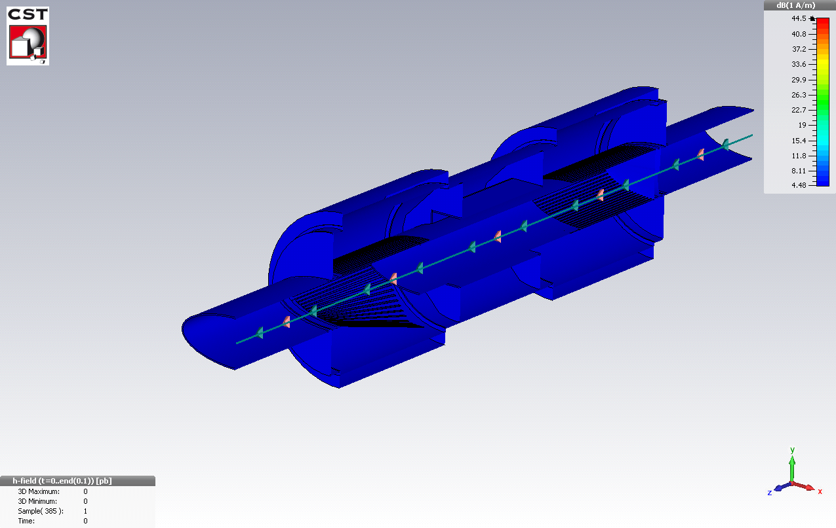
H_{t} for Bunch Passage through VMTSA

Slide 13
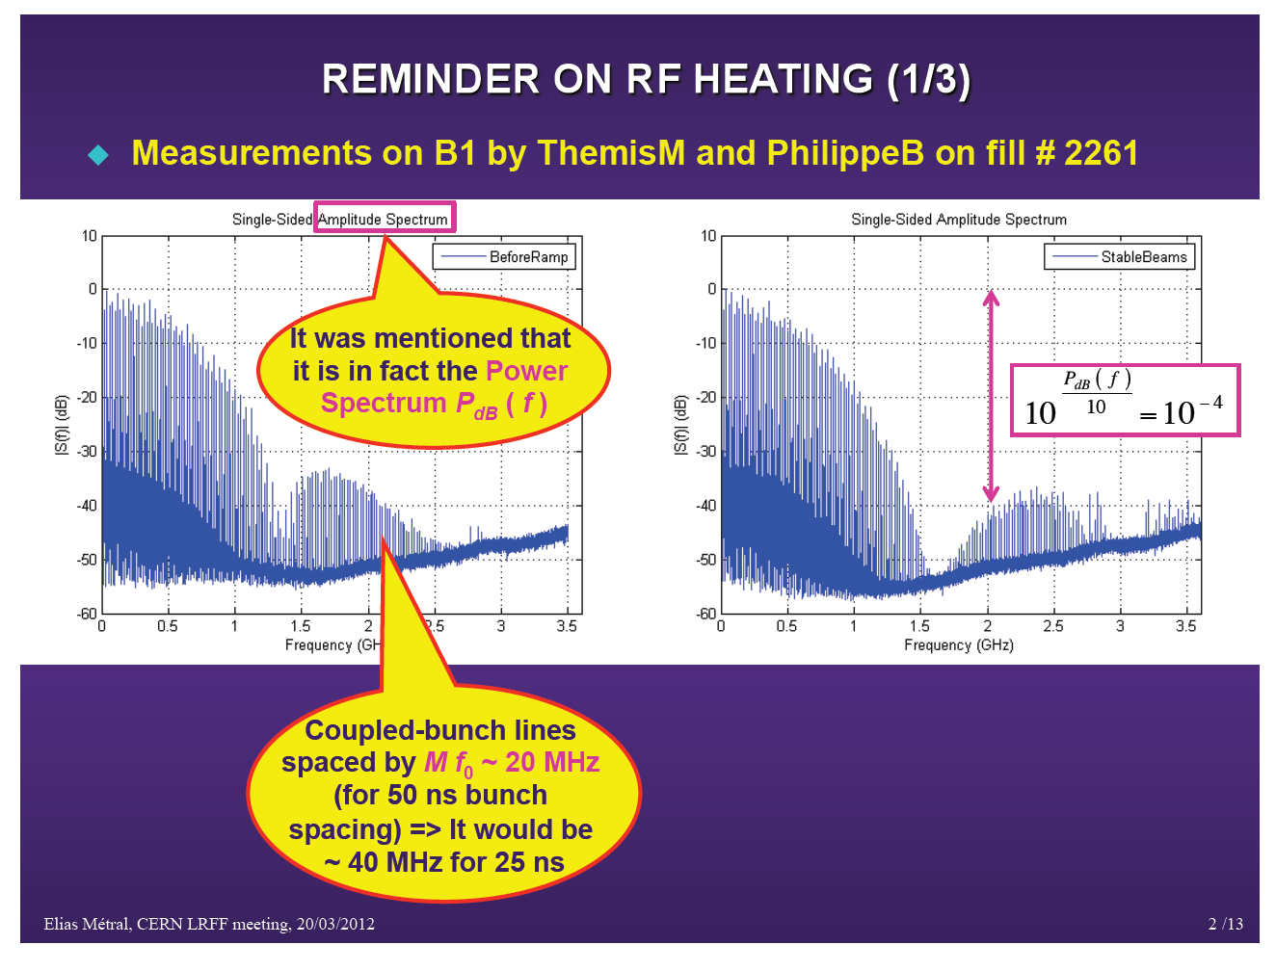
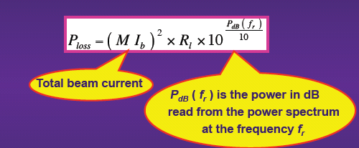
Power Spectrum Measurements

Slide 14
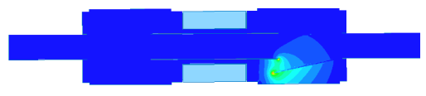
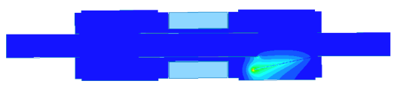
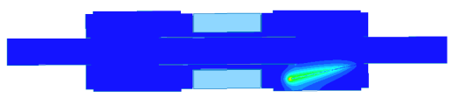
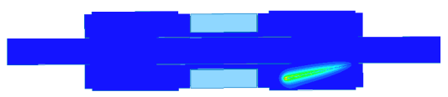

HFSS Eigen Mode Analysis: 40mm
Mode | Complex Magnitude | Eigen Frequency [MHz] | Q-factor | Shunt Impedance, [Ω] | Power Loss [W]
1 |  | 279 | 455 | 10050.5 | 652.8
2 |  | 342 | 211 | 192.6 | 12.5
3 |  | 370 | 163 | 7.5 | 0.6
4 |  | 383 | 134 | 1.7 | 0.1
5 |  | 390 | 114 | 0.6 | 0.04
Longitudinal Shunt Impedance
Voltage along the beam path
Energy stored in the volume

Slide 15
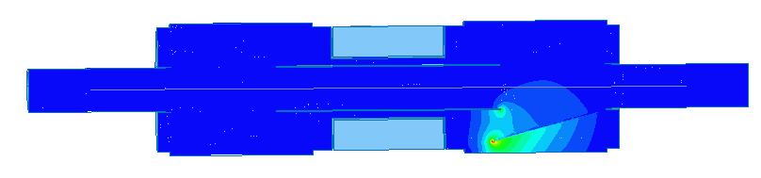
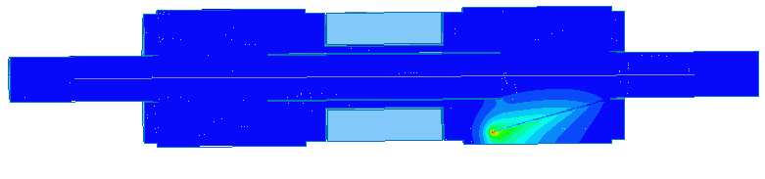

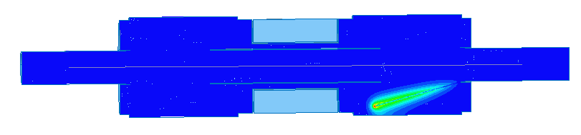
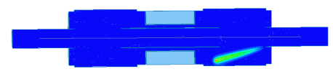
HFSS Eigen Mode Analysis: 50mm
Mode | Complex Magnitude | Eigen Frequency [MHz] | Q-factor | Shunt Impedance [Ω] | Power Loss [W]
1 |  | 270 | 387 | 7121.6 | 462.6
2 |  | 330 | 145 | 50.2 | 3.3
3 |  | 362 | 147 | 7.2 | 0.6
4 |  | 380 | 127 | 8.4 | 0.7
5 |  | 392 | 115 | 3.1 | 0.2

Slide 16
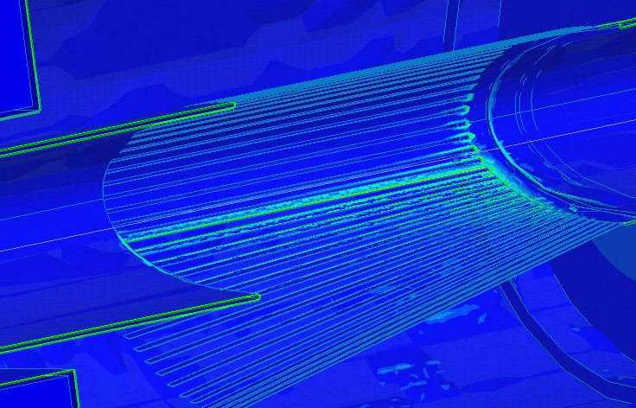
Surface Loss Density for the First Eigen Mode @ 279 MHz
Log scale, 40 mm gap, eigen mode @ 279MHz with 10KΩ longitudinal shunt impedance

Slide 17
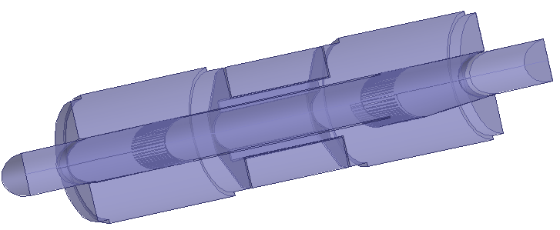
Shorter RF Fingers
HFSS Simulation Setup: Eigensolver
Model:
  180 deg of the structure
  copper outer walls
  10mm gap
Perfect H
Copper
10 mm gap
Simulation profile:
- second order basis functions
  curvilinear elements enabled
  1% frequency accuracy leads to ~300K tet10 mesh

Slide 18
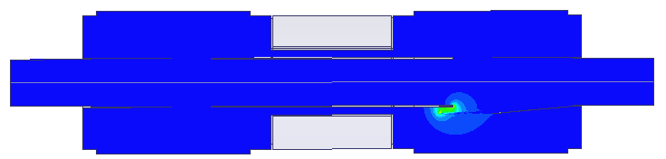
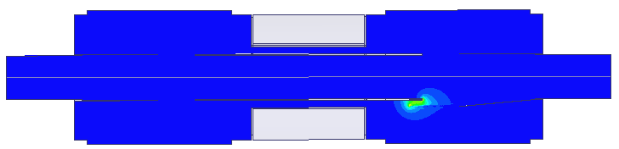
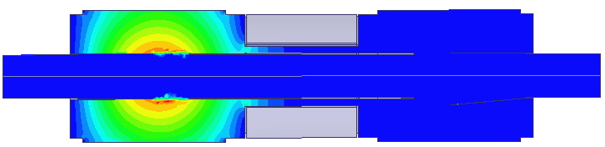
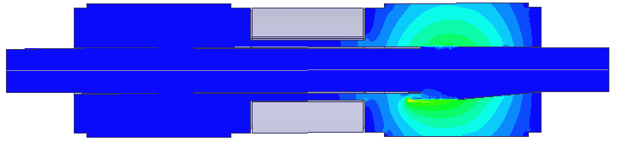

Shorter RF Fingers, CmplxMag(E)
0.113 V/m
0.037 V/m
0.030 V/m
0.005 V/m
0.028 V/m
Mode 1
Mode 2
Mode 3
Mode 4
Mode 5
Eigenmodes
of the Bellows

Slide 19
Eigen Modes, Shorter RF Fingers
 | Eigen Frequency, MHz |  | Q-factor |  | Shunt Impedance, Ω |  | Power Loss,W
 | HFSS | CST | HFSS | CST | HFSS | CST | HFSS | CST
Mode 1 | 339 | 339 | 2409 | 32 | 50709 | 676 | 2616 | 87
Mode 2 | 526 | 531 | 1872 | 322 | 8442 | 1438 | 275 | 186
Mode 3 | 549 | 550 | 6023 | 6837 | 0 | 0.03 | 0 | 0.004
Mode 4 | 586 | 583 | 2462 | 155 | 196 | 7 | 5 | 0.907
Mode 5 | 670 | - | 1217 | - | 389 | - | 5 | -

Slide 20
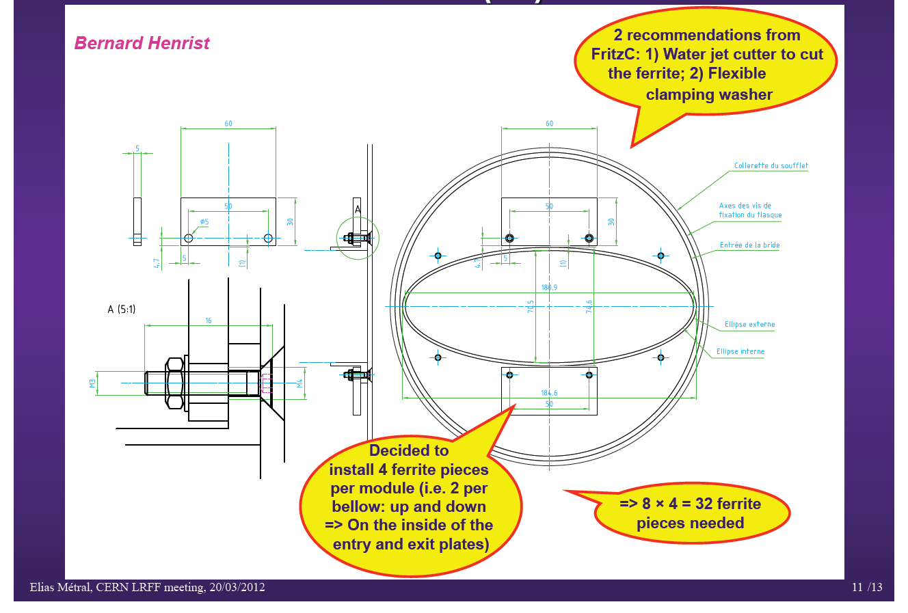
VMTSA equipped with Ferrites
4 pieces of Philips 8C11 (60x30x5 mm) were installed in one VMTSA module
equipped with the shorter fingers

Slide 21
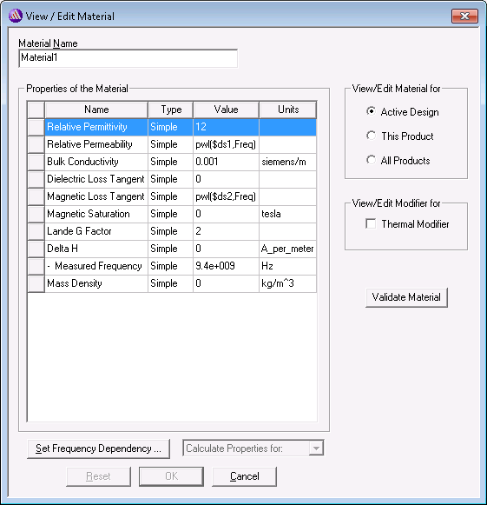
Philips 8C11 Ferrite: Permeability
http://www.ferroxcube.com/appl/info/HB2009.pdf

Slide 22
Philips 8C11 Ferrite:
Resistivity and Permittivity
http://www.ferroxcube.com/appl/info/HB2009.pdf

Slide 23
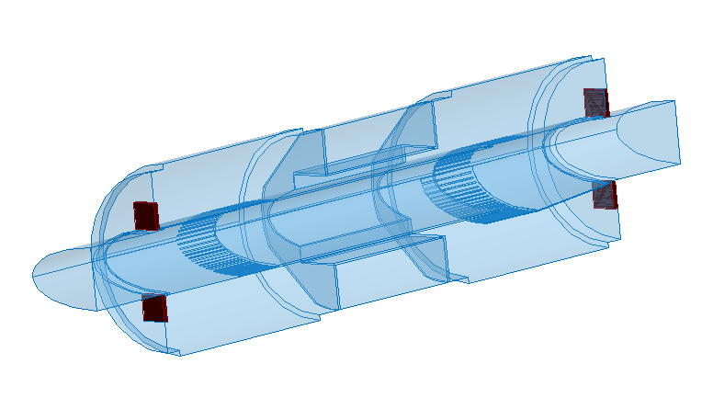
HFSS Setup
Model:
  180 deg of the structure
  copper outer walls
  10mm gap
  4 ferrite pieces
Ferrite 8C11
Perfect H
Copper
10 mm gap
Simulation profile:
- second order basis functions
  curvilinear elements enabled
  1% frequency accuracy

Slide 24
New Fingers Ferrites 10mm
Mode | Eigen Frequency [MHz] | Q-factor | Shunt Impedance [Ω] | Power Loss [W]
1 | 133 | 1 | 0.239 | 0.019544
2 | 133 | 1 | 0.007 | 0.000572
... | ... | ... | ... | ...
3 | 341 | 2479 | 52455 | 2706
... | ... | ... | ... | ...
4 | 528 | 1867 | 8401 | 316
... | ... | ... | ... | ...
Many modes excited in the vicinity of ferrites and in the area outside the
conforming fingers. Some modes excited near to the gap and not affected by ferrites at all

Slide 25
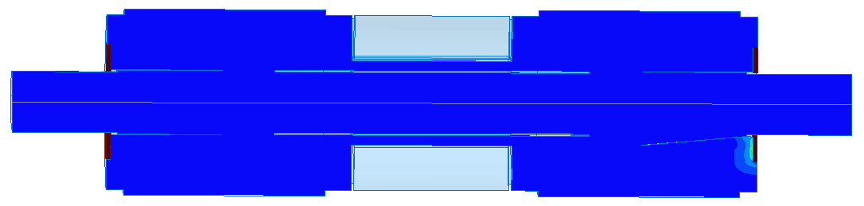
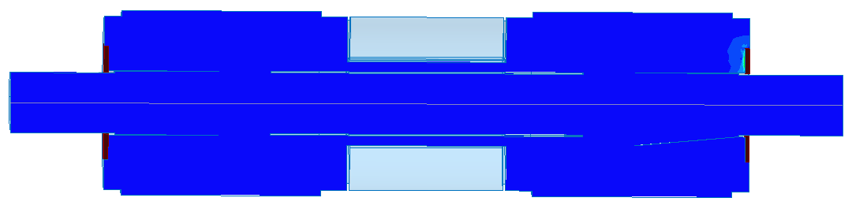
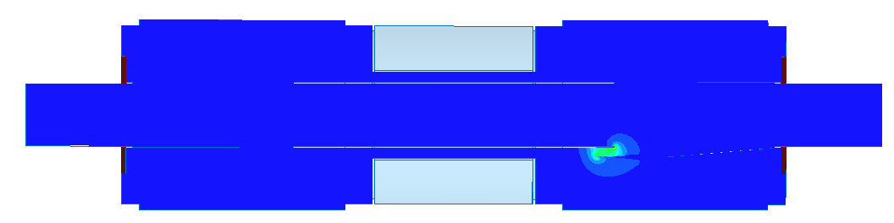
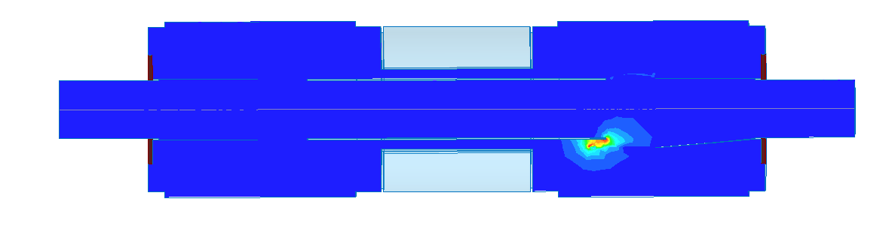
Eigenmodes, CmplxMag(E)
133 MHz
133 MHz
341 MHz 528 MHz
Mode 1
Mode 2
Mode 3
Mode 4

Slide 26
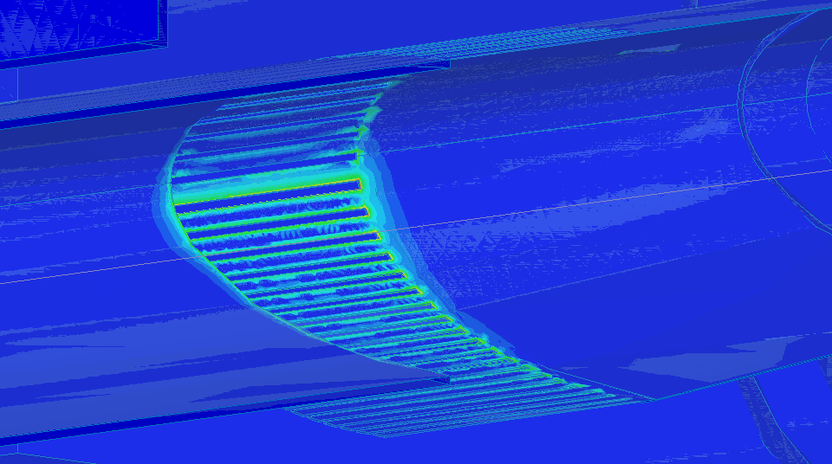
Surface Loss Density for the First Eigen Mode @ 341 MHz
Linear scale, 10 mm gap, eigen mode @ 341MHz with 2700 W power losses

Slide 27
Conclusions
Different shapes of the finger deformations have been studied for longer and shorter fingers. Unconformities could result in ~kW power losses => enough to melt fingers.
Ferrites in the proposed position and amount don’t help. Additional dedicated study is necessary to see if we can damp modes with ferrites.

