Slide 1
Overview of LHC Collimators
RF system
LHC RF Fingers Task Force
30.10.2012
A. Bertarelli
F. Carra, A. Dallocchio, M. Garlaschè, L. Gentini, N. Mariani, R. Perret, …
With invaluable input by S. Calatroni

Slide 2
Outlook
    Specifications
    Phase I
    TCLIA & TCTVB
    Phase II
    TCLD
    TCTP
    Conclusions

Slide 3
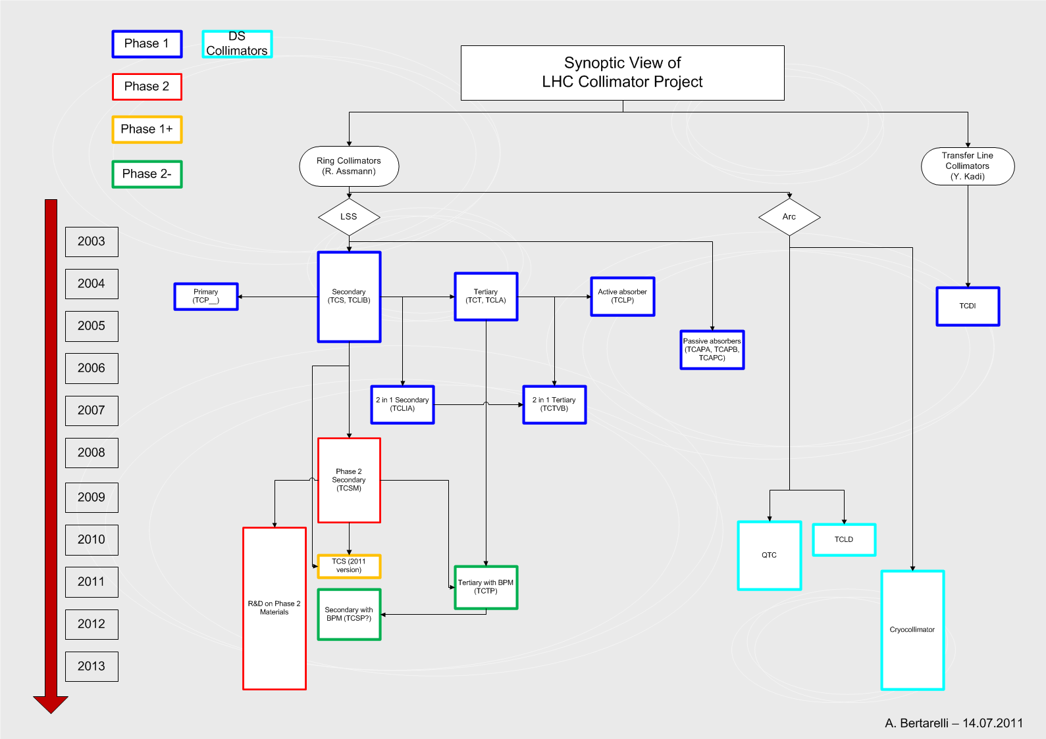
Context
    Focus on RF design of main variants of LHC Collimators:
      Phase I: TCP, TCSG, TCTA, TCLP, TCLIA, TCTVB …
      Phase I Upgrade: TCTP, TCSP …
      DS Collimators: TCLD
      Phase II: TCSM

Slide 4
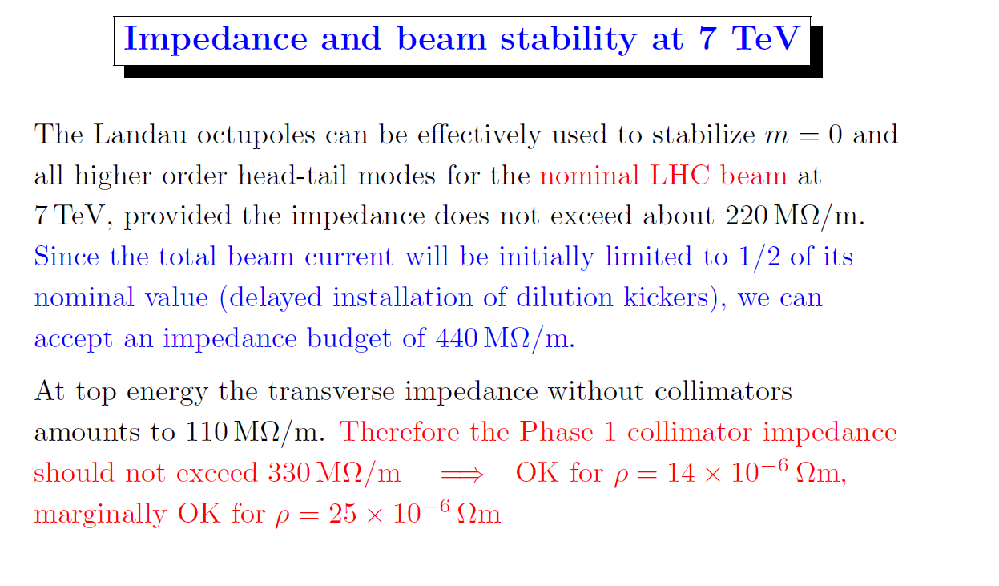
RF Impedance Specifications
    First specification on RF impedance budget for Phase I by F. Ruggiero (25.06.2003) ⇨ Collimator Impedance Budget (Transverse) 330 MΩ/m
    Additional requirement (F. Ruggiero –June 2004) ⇨
    Integral Contact Resistance (on each transition) ≤ 1 mΩ

Slide 5
Phase I Design Baseline
    RF Specifications led (along with other inputs) to following design decisions:
      Carbon-based jaws with lowest possible electrical resistivity for (Phase I) Primary and Secondary Collimators ⇨
        Jaw Material: Across Corp. (Tatsuno) AC150K Carbon/Carbon (ρ ≅ 7 μΩm)
        No thin metallic coating (e.g. Cu) on jaw surface
      Separate (0.15 mm gap) Tungsten (Inermet 180) blocs for Tertiary Collimators.
      RF Contacts:
        Longitudinal Contacts (Jaw-Vacuum Chamber): Ag-coated CuBe (C17410 TH02)
        Transversal Contacts (Jaw1-Vacuum Tank-Jaw2): Ag-coated CuBe (C17200 TH02 off-the-shelf strips by Feuerherdt)
        Transition Contacts (Vacuum Chamber-Vacuum Tank):

Slide 6
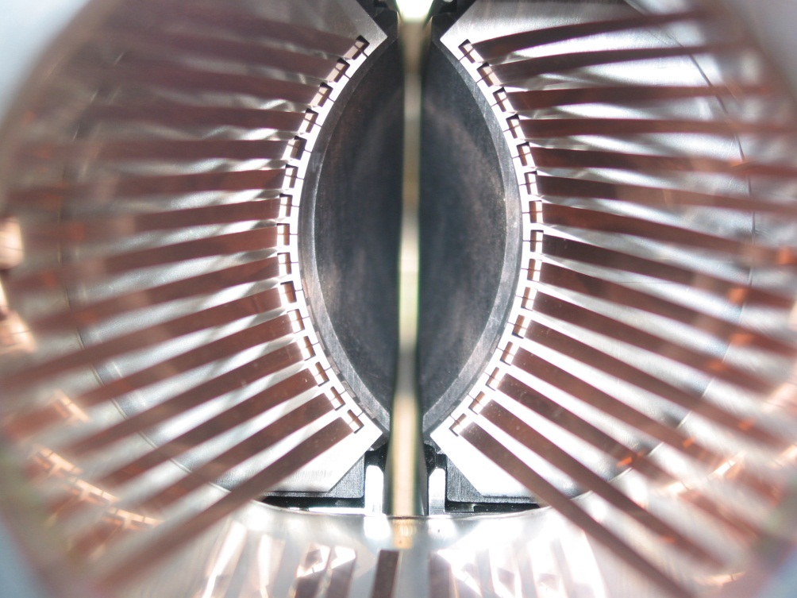
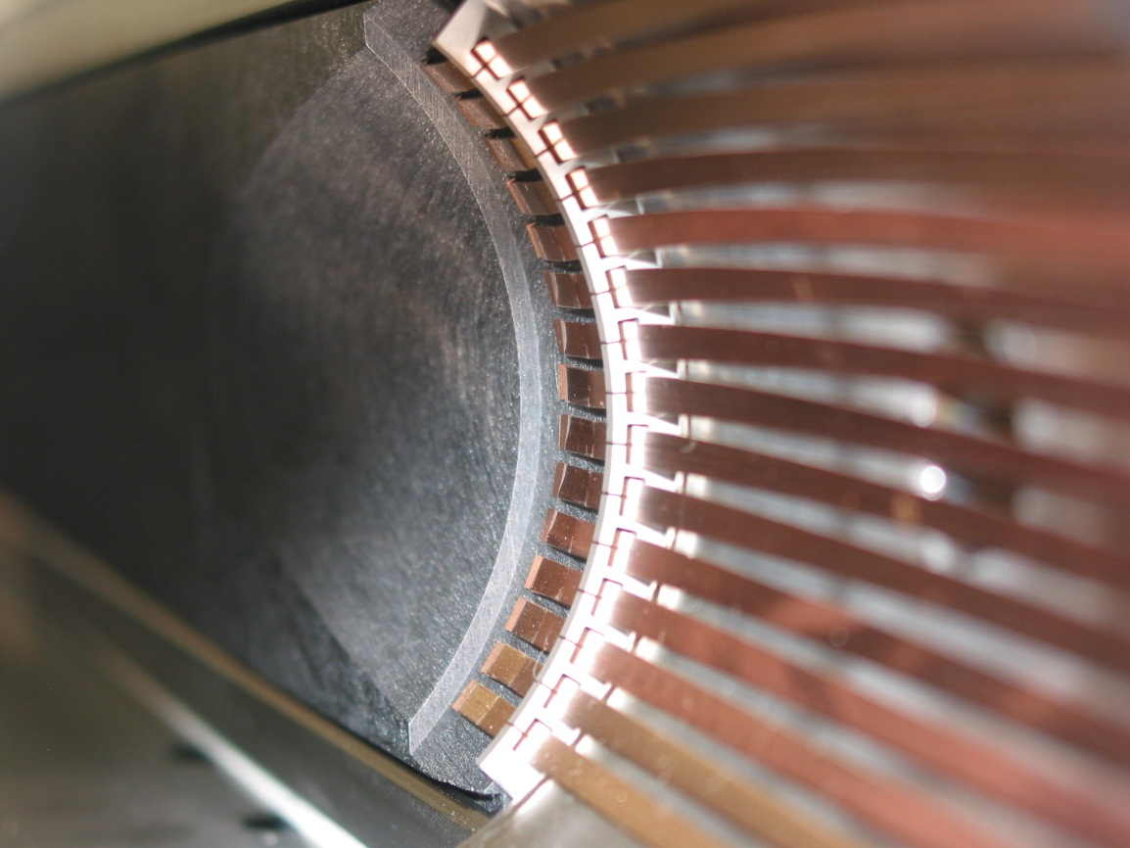
Phase I Design Baseline
  Longitudinal Contacts: Initial Proposal for 1st (SPS) Prototype (2003)
Uncoated CuBe fingers sliding on C/C
Electrical Contact Resistance ~ 30 mΩ (specification: 1 mΩ) ⇨ Redesign necessary.

Slide 7
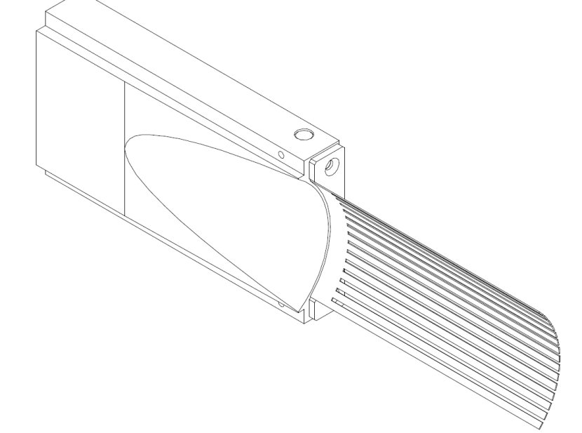
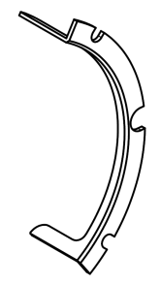
Phase I Design Baseline
  Longitudinal Contacts: Final Design (All Phase I variants)
RF finger assembly screwed to jaw
Longitudinal RF fingers
(15x3 mm CuBe 17410
5μm Ag coating)
Transition RF fingers
(11x3 mm CuBe 17410
5μm Ag coating)
RF-finger Stroke
Restraint (304L)
Jaw assembly
Outer ring (304L)
Ni (1 μm) +Rh (2 μm)
Inner ring (304L)
Ni (1 μm) +Rh (2 μm)

Slide 8
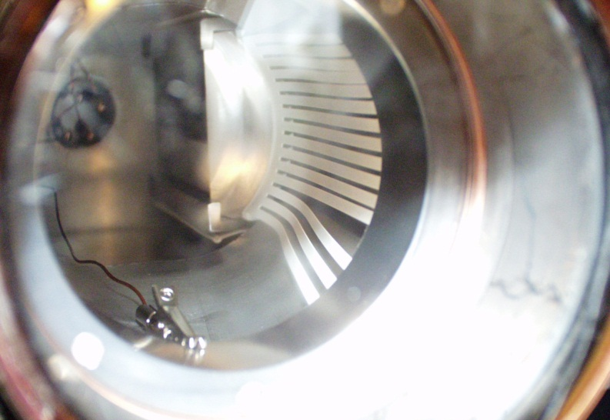
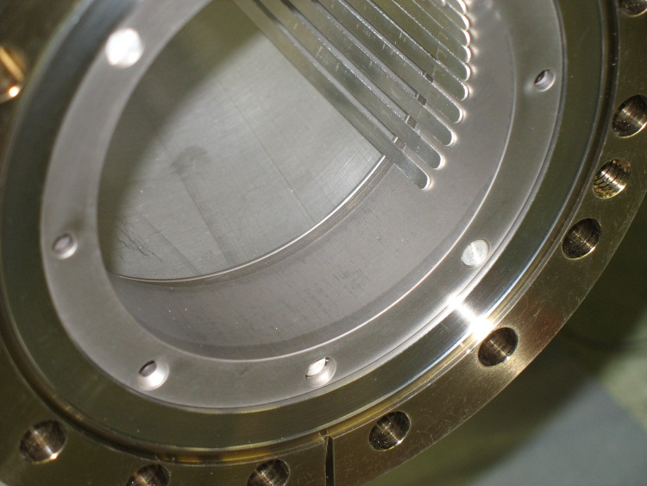
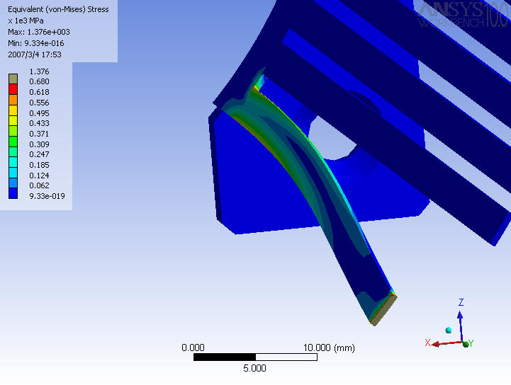
Phase I Design Baseline
Longitudinal Fingers. Lessons learnt:
  Adopt appropriate steps to avoid stick-slipping (tolerance chain, geometry, coatings, de-burr …)
  Use stroke restraint to limit RF finger azimuthal movements.

Slide 9
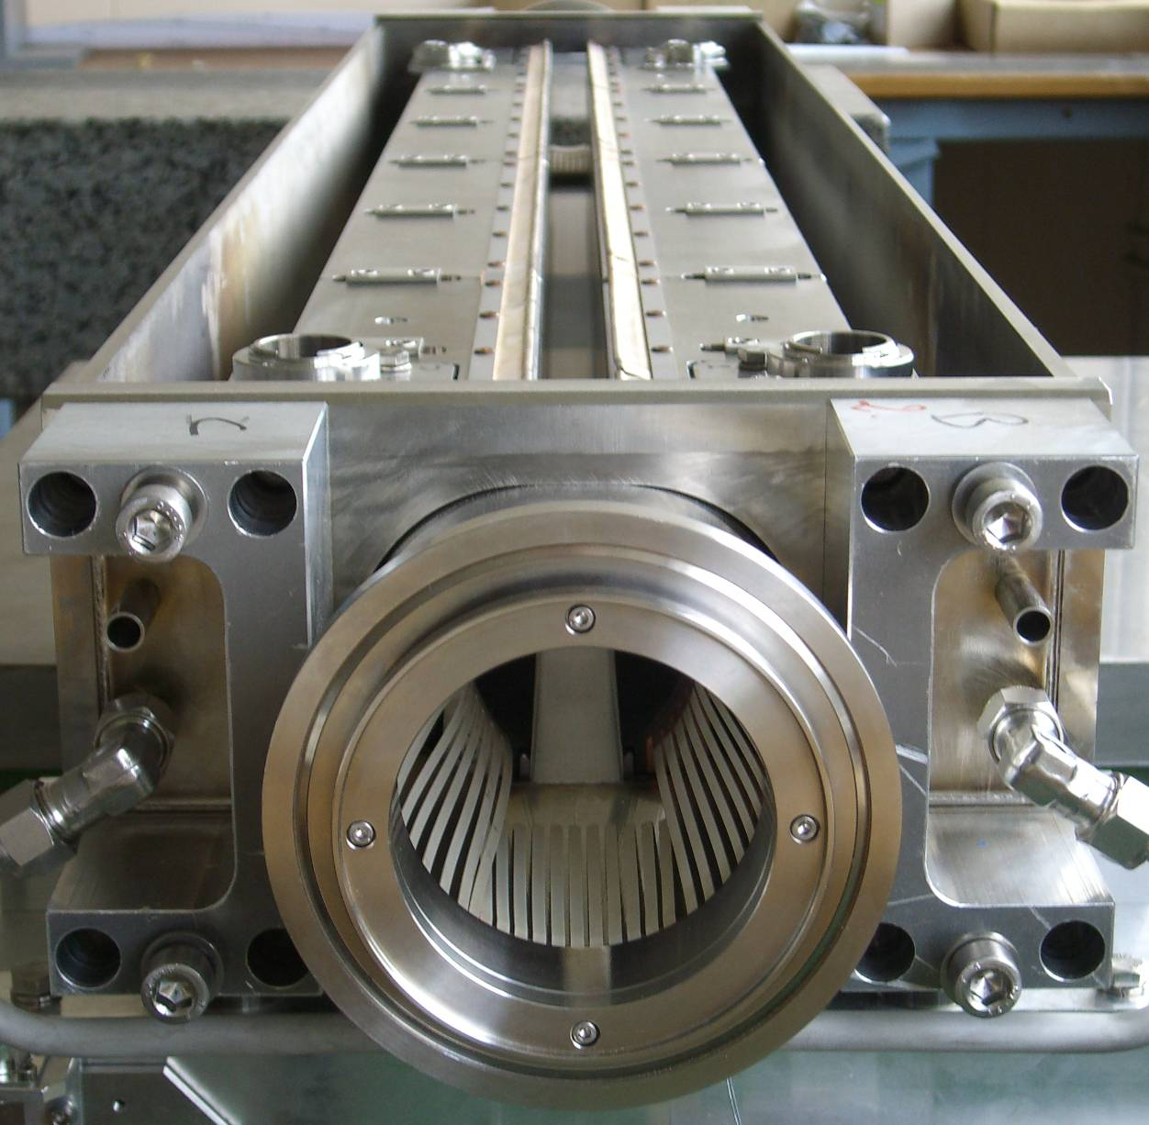
Phase I Design Baseline
  Longitudinal Contacts: Final Design (TCP, TCSG, TCTA, TCTP …)
RF Transverse Strips
(CuBe 17200 5μm Ag coating)

Slide 10
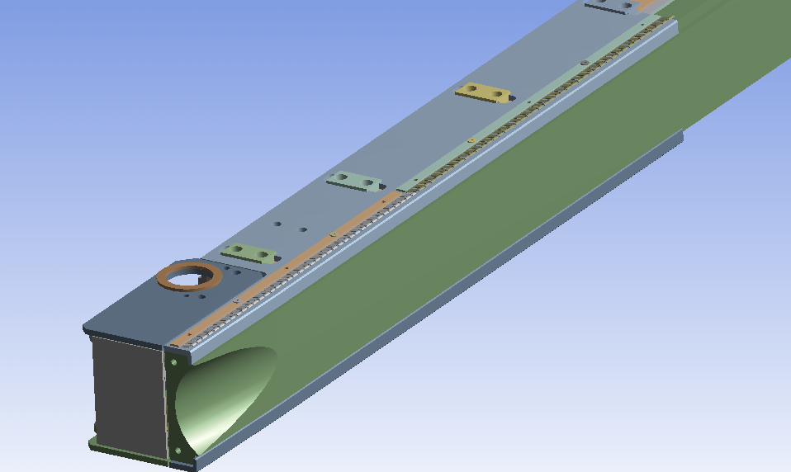
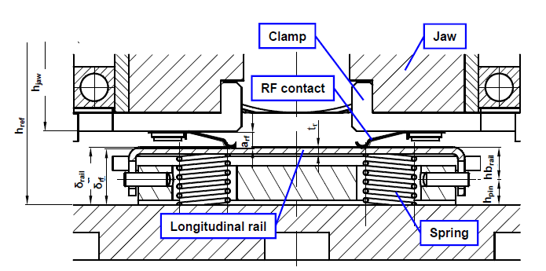
Phase I Design Baseline
  Tranverse Contacts: Final Design (TCP, TCSG, TCTA, TCTP …)
Four clamps, each one equipped with two contact strips (0.15 mm CuBe 17100 5μm Ag-coating) of different length (type 1 – 276 mm and type 2 – 316 mm)
1.5 mm Logitudinal rail (electropolished 304L)
Spring system to keep fingers in contact with rail at moderate force (~18gr/finger)
RF contact strip type 2
RF contact strip type 1
Jaw
Clamp
RF contacts must withstand a wear equivalent to ~20000 cycles (open-close of the jaw) → ~1.4 km !

Slide 11
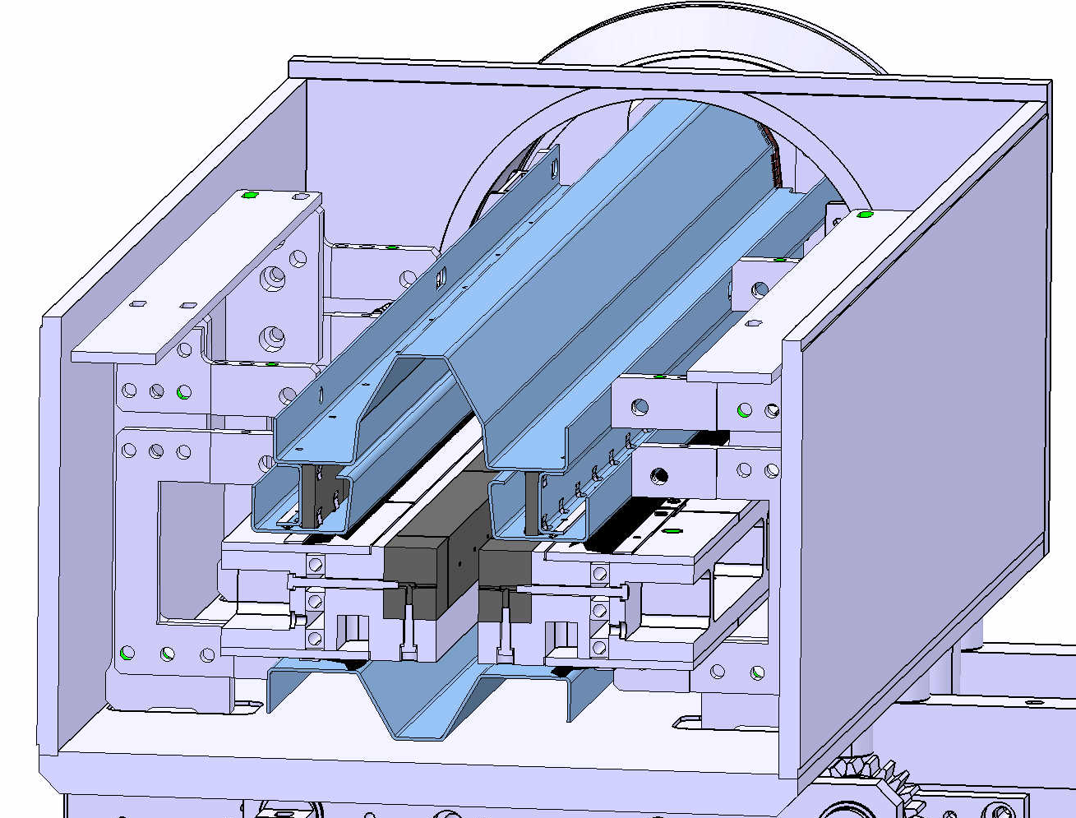
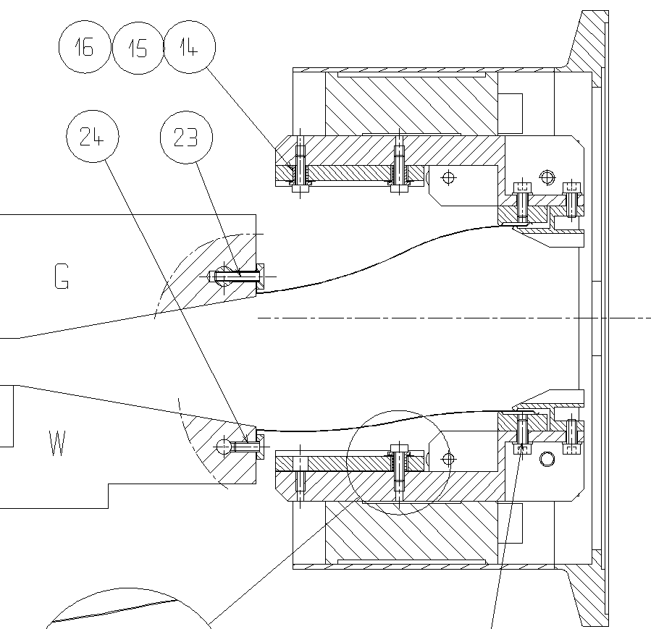
TCLIA/TCTVB Design
As opposed to PhaseI “1 beam per tank” collimators, “2 in 1” designs (TCLIA and TCTVB), ferrite was added to standard sliding contacts to damp HOM in large cavities (A. Grudiev simulations).
Ferrite was also added in transitions.
Ferroxcube 4S60 Ferrite
OF-Cu Shield (1.5 mm)
Transition Ferrite Tiles
(2x2x) 60x60x6 mm3
Longitudinal Ferrite Tiles
(2x13) 30x100x6mm3
316LN Shield (1.5 mm)
0.2mm Cu-coated
RF Transverse Strips
(CuBe 17200 5μm Ag coating)

Slide 12
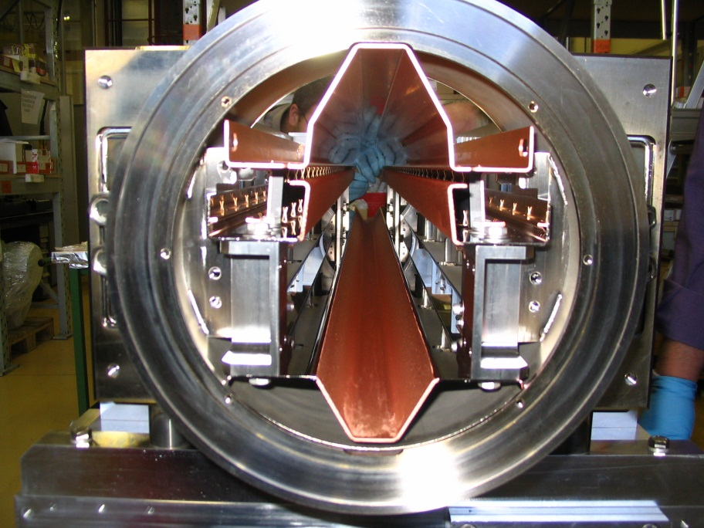
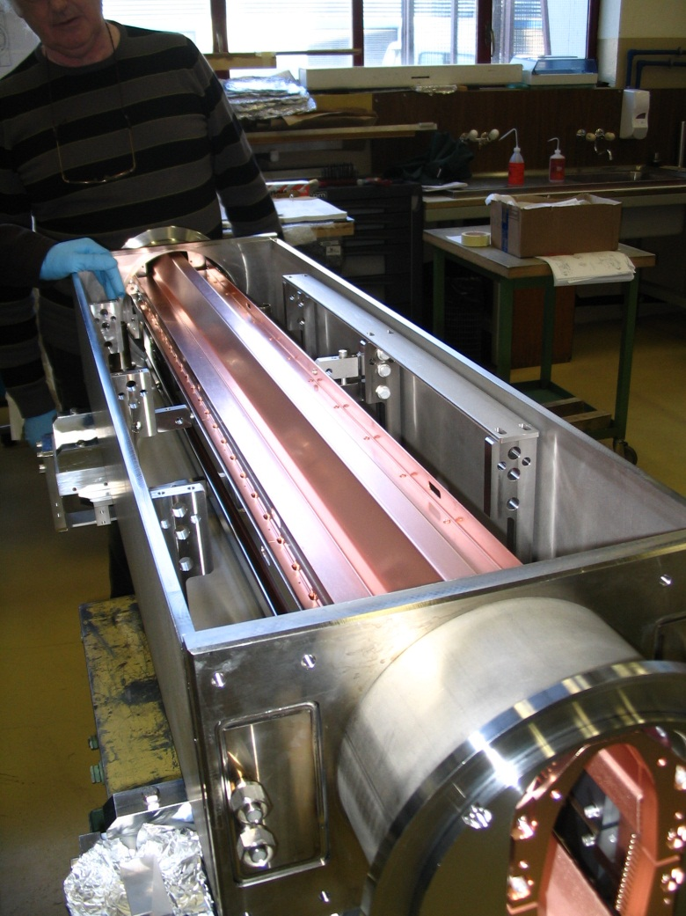
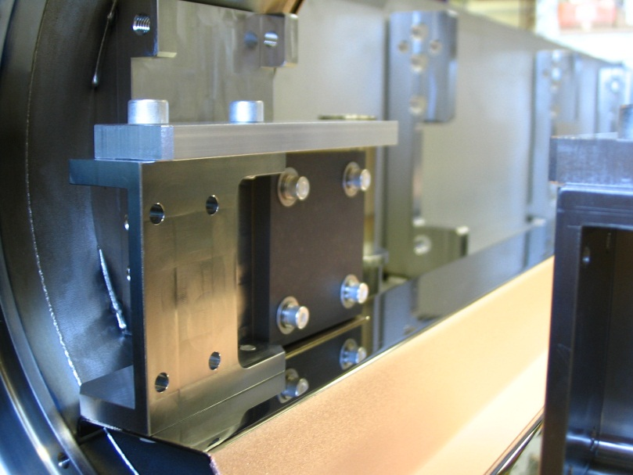
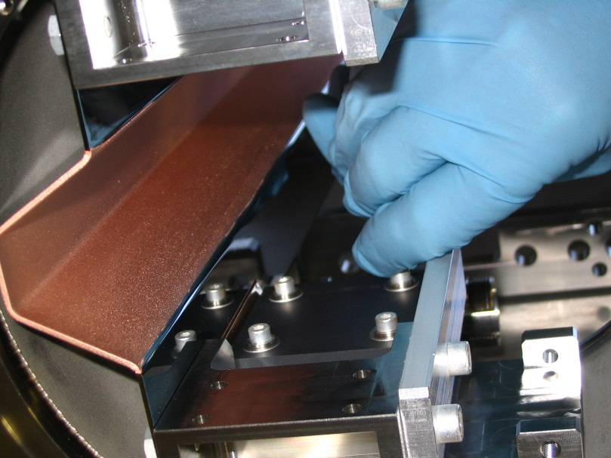
TCLIA/TCTVB Design

Slide 13
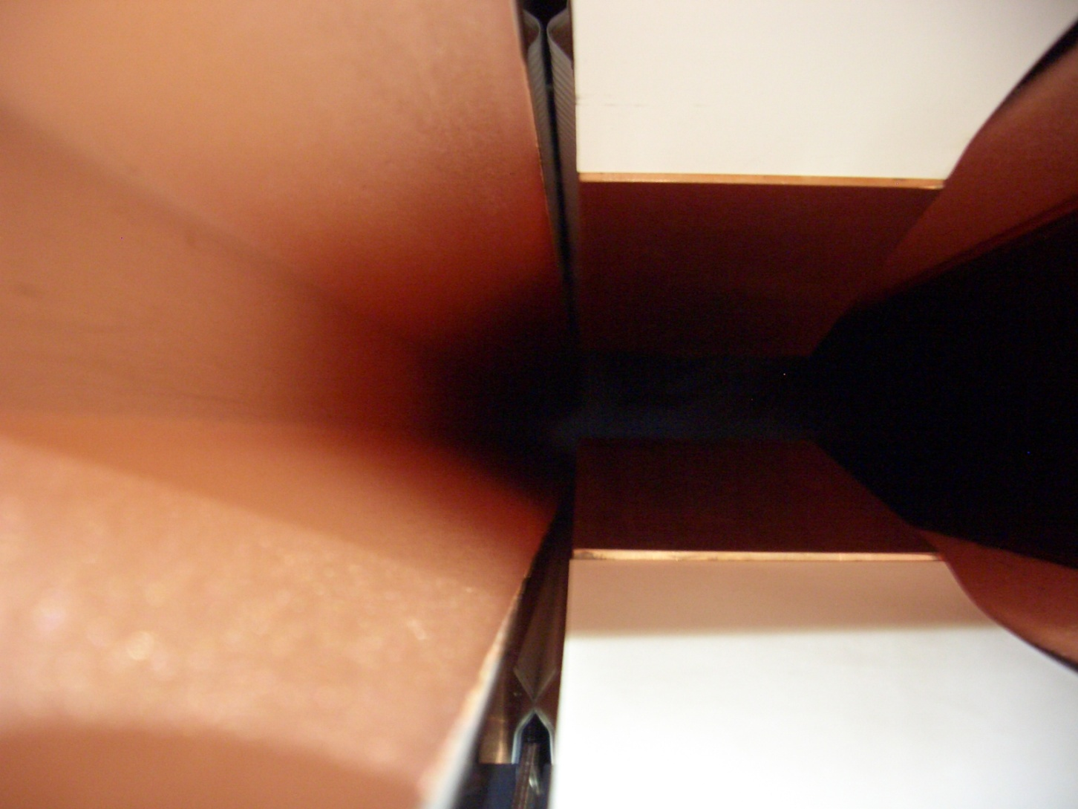
TCLIA/TCTVB Design
RF issue? Visual inspection of TCTVB.4L2 on 03.02.2012 (O. Aberle EN/STI)
RF fingers not in contact
RF Fingers in contact

Slide 14
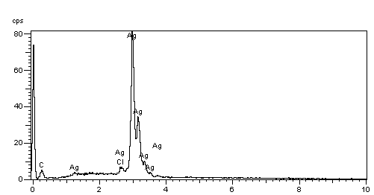
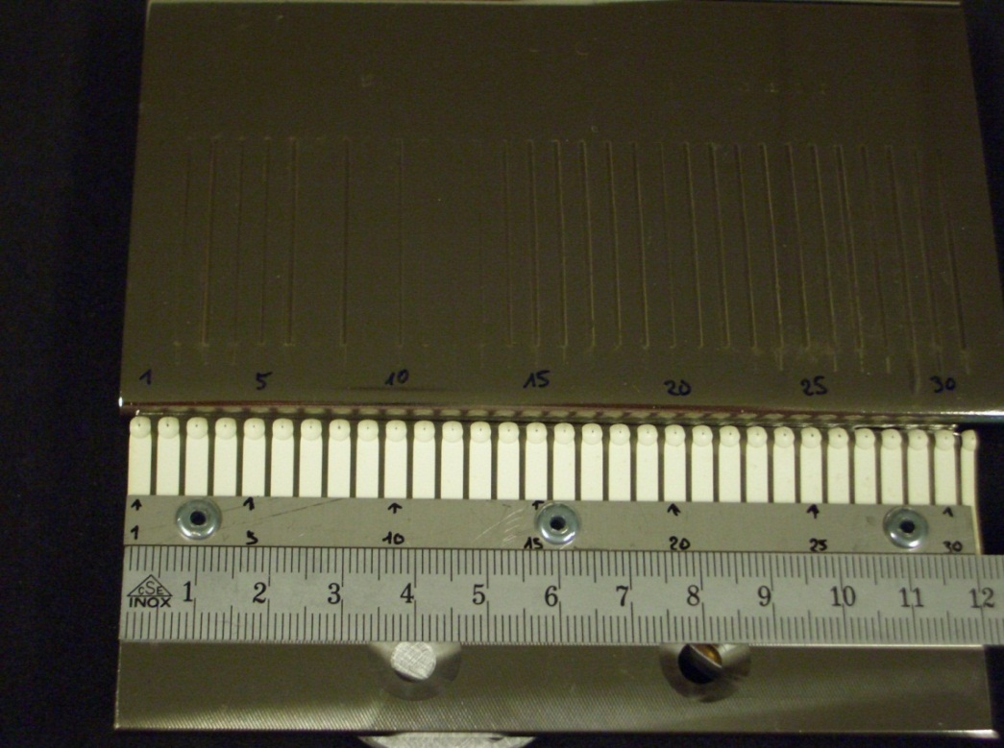
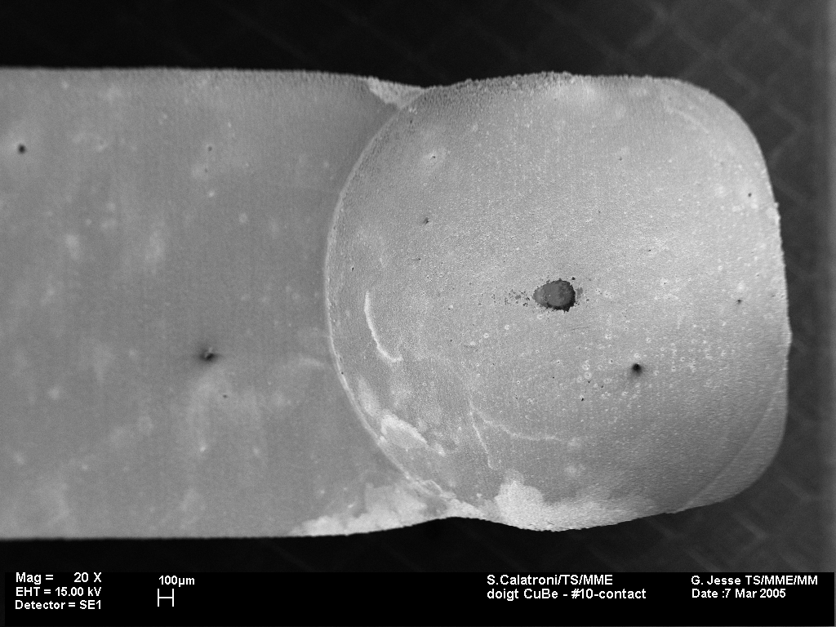
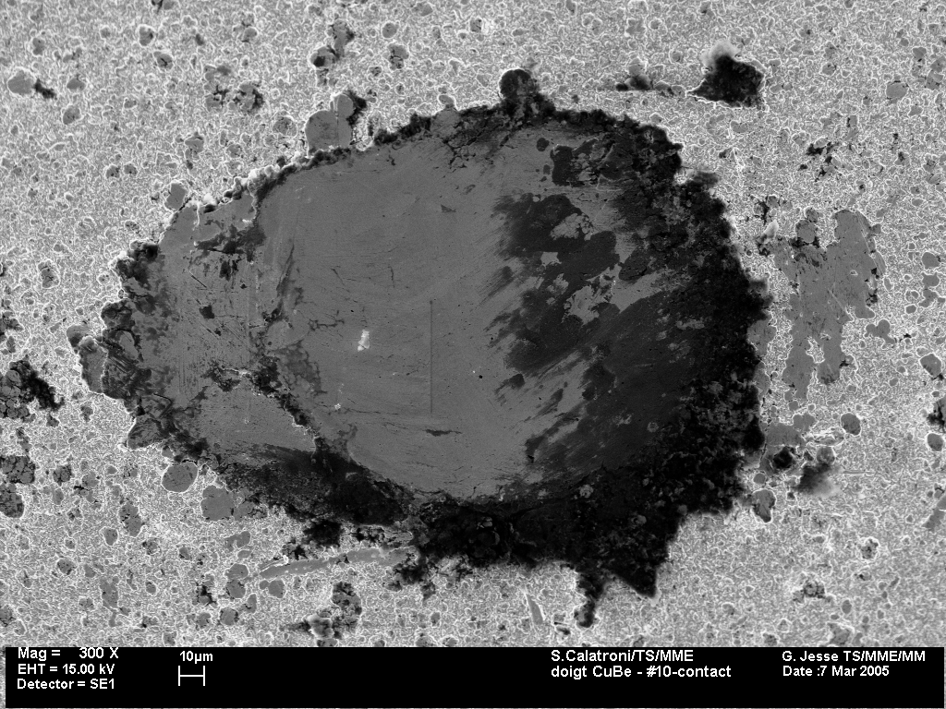
Phase II Design Baseline
Phase II RF design was triggered by the requirement to avoid sliding contacts between RF strips and St. Steel Rail ⇨ In 2008 it was decided to replace RF contacts with Ferrite Tiles
Doigt #10

Slide 15
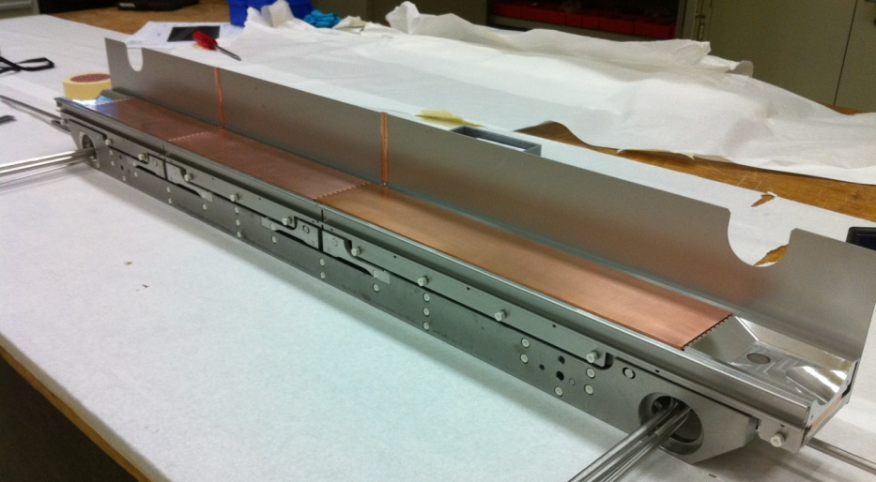
Phase II Design Baseline
3 Jaw sectors independently supported on rigid back stiffener for enhaced geometrical stability.
Modular design allowing flexibility in the active jaw material choice
RF shield
RF contacts (sector-sector and sector-support)
Jaw Sectors
Fine-adjustment system
Mo Back-stiffener

Slide 16
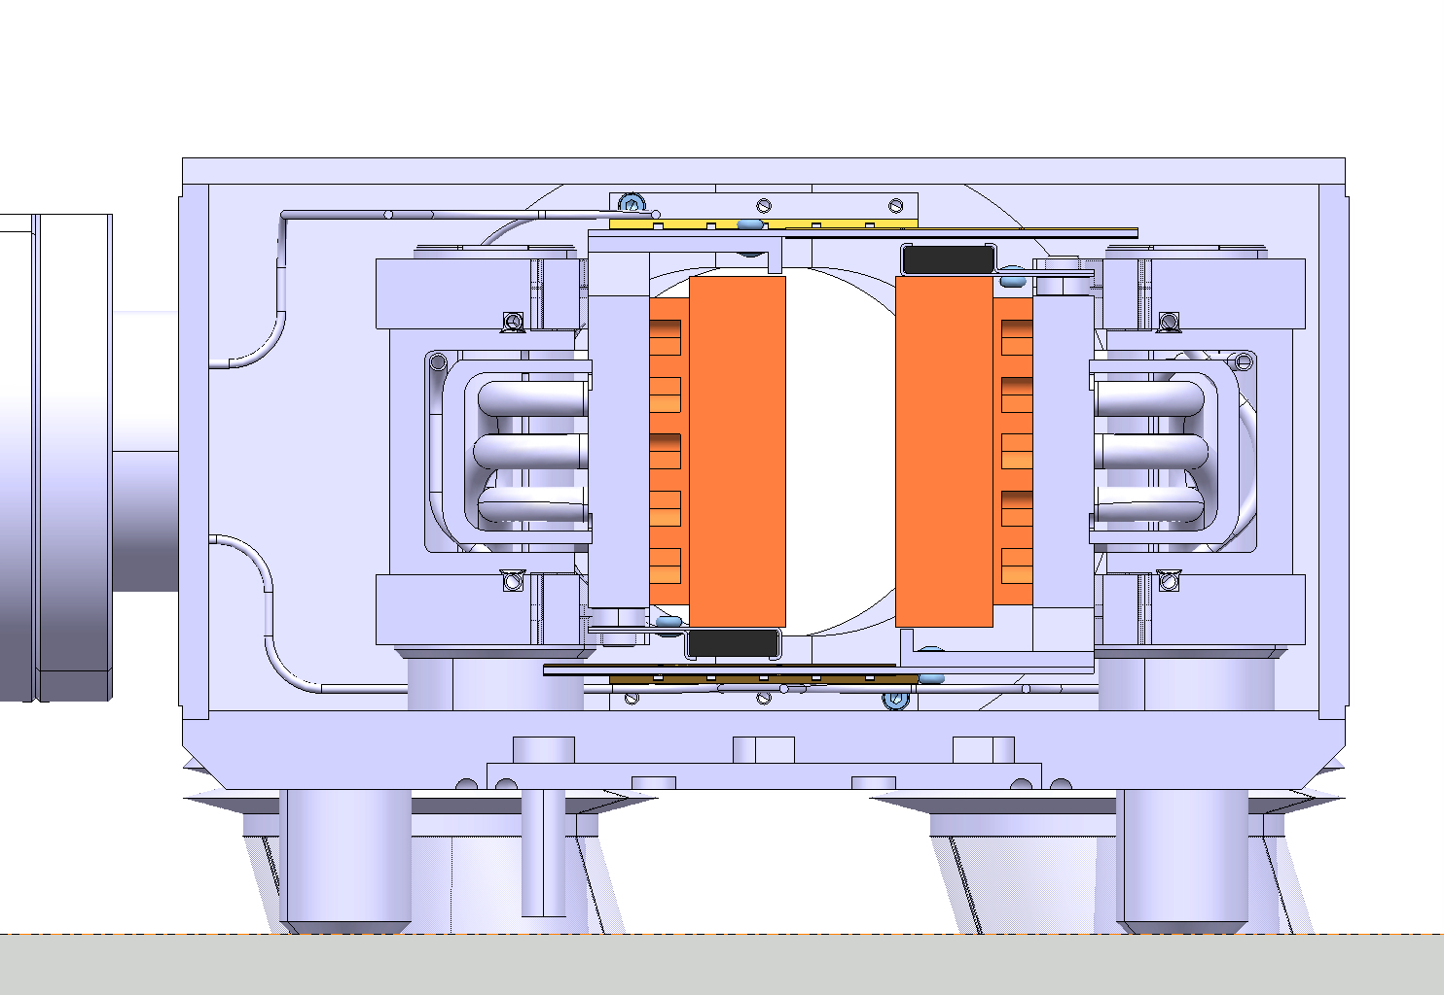
Phase II Design Baseline
Ferrite tiles

Slide 17
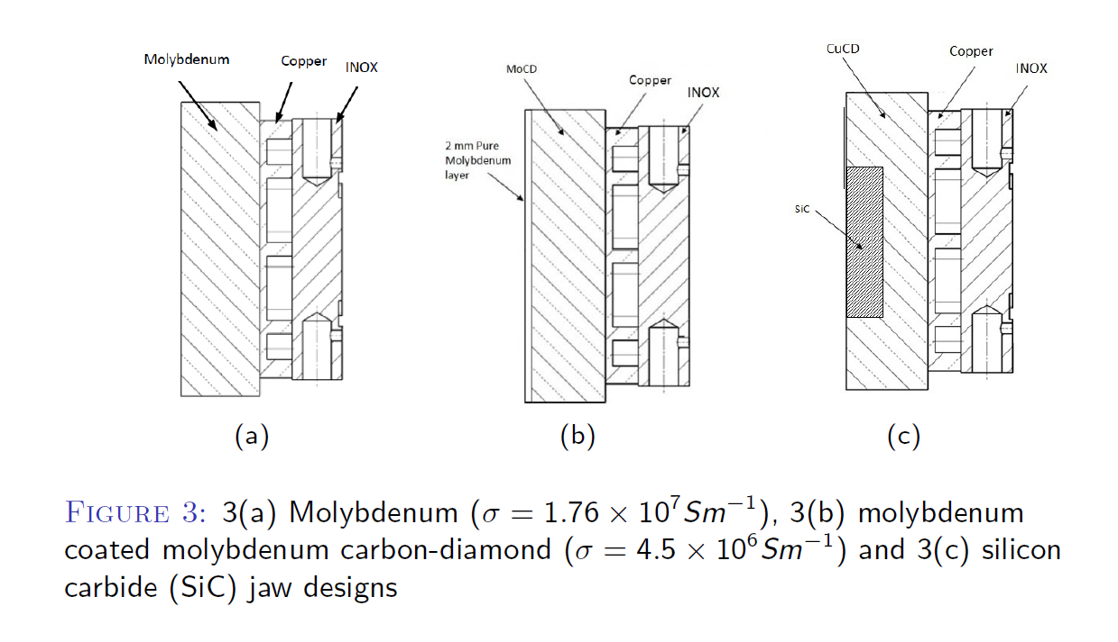
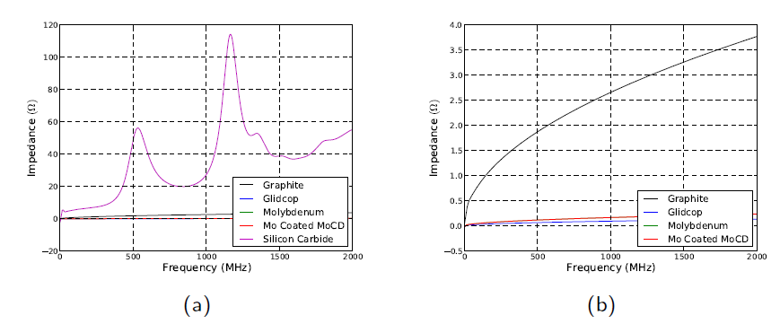
Phase II Impedance Studies
H. Day (BE/ABP)

Slide 18
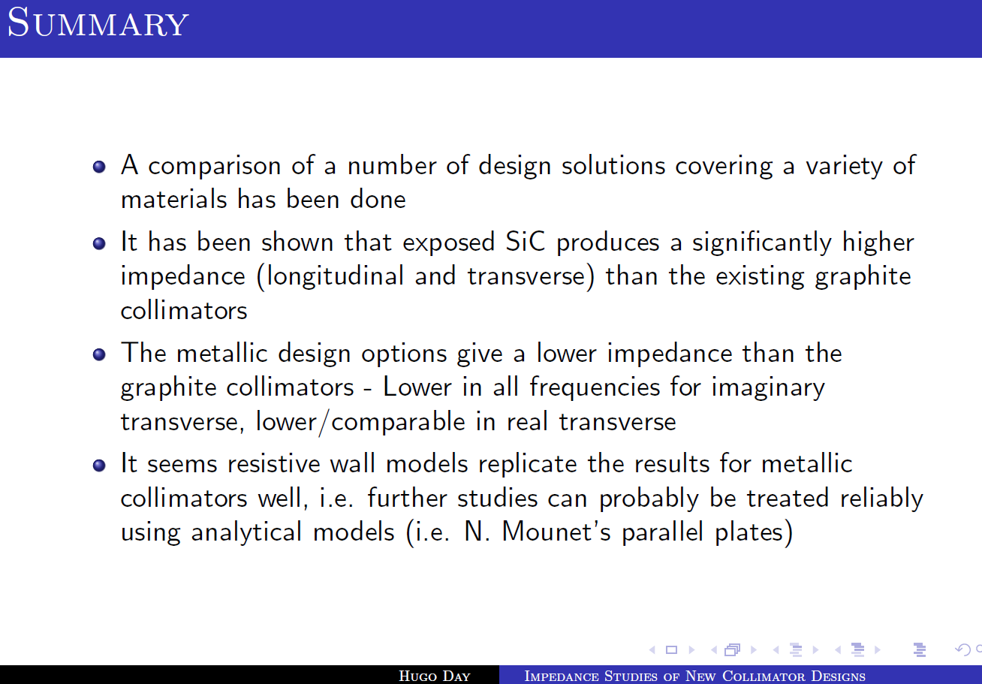
Phase II Impedance Studies

Slide 19
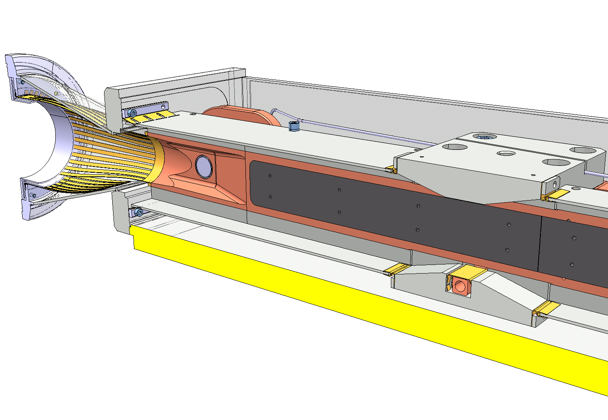
DS (Warm) Collimator (TCLD)
RF screen/tank contact
BEAM
RF extremity fingers
Horizontal fixed contact
Vertical mobile contact
RF Bridge
RF screen contacts

Slide 20
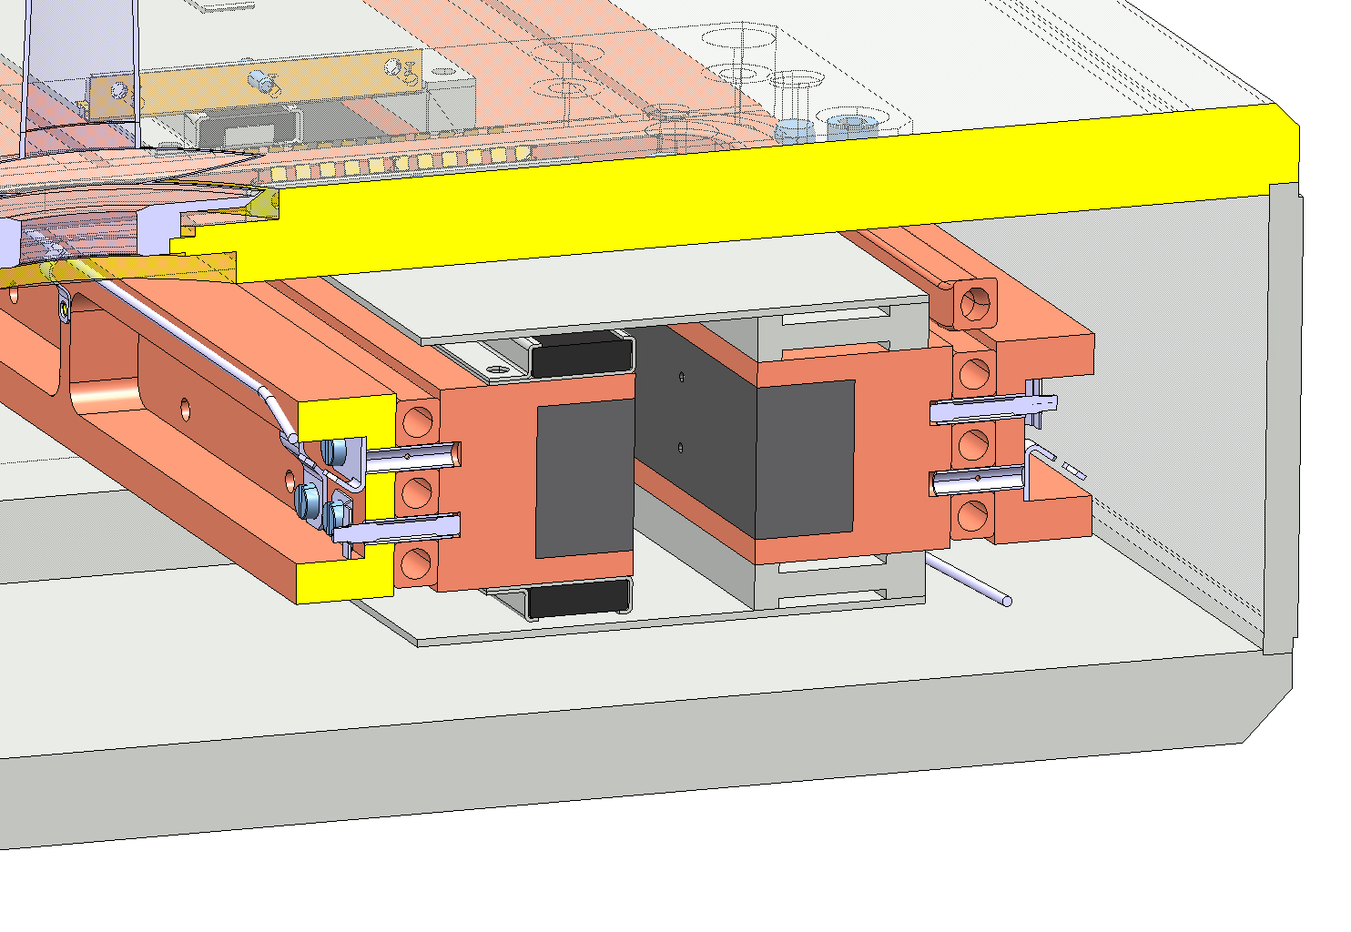
DS (Warm) Collimator (TCLD)
Ferrites

Slide 21
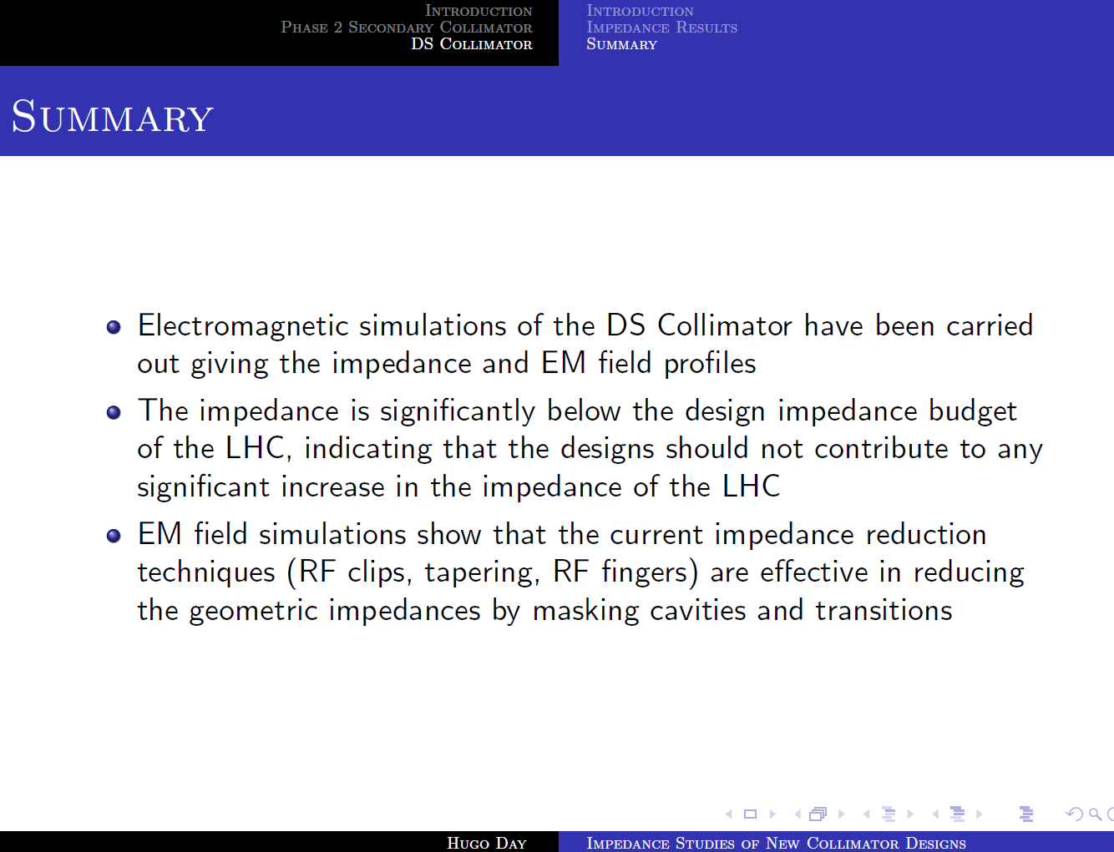
TCLD Impedance Studies

Slide 22
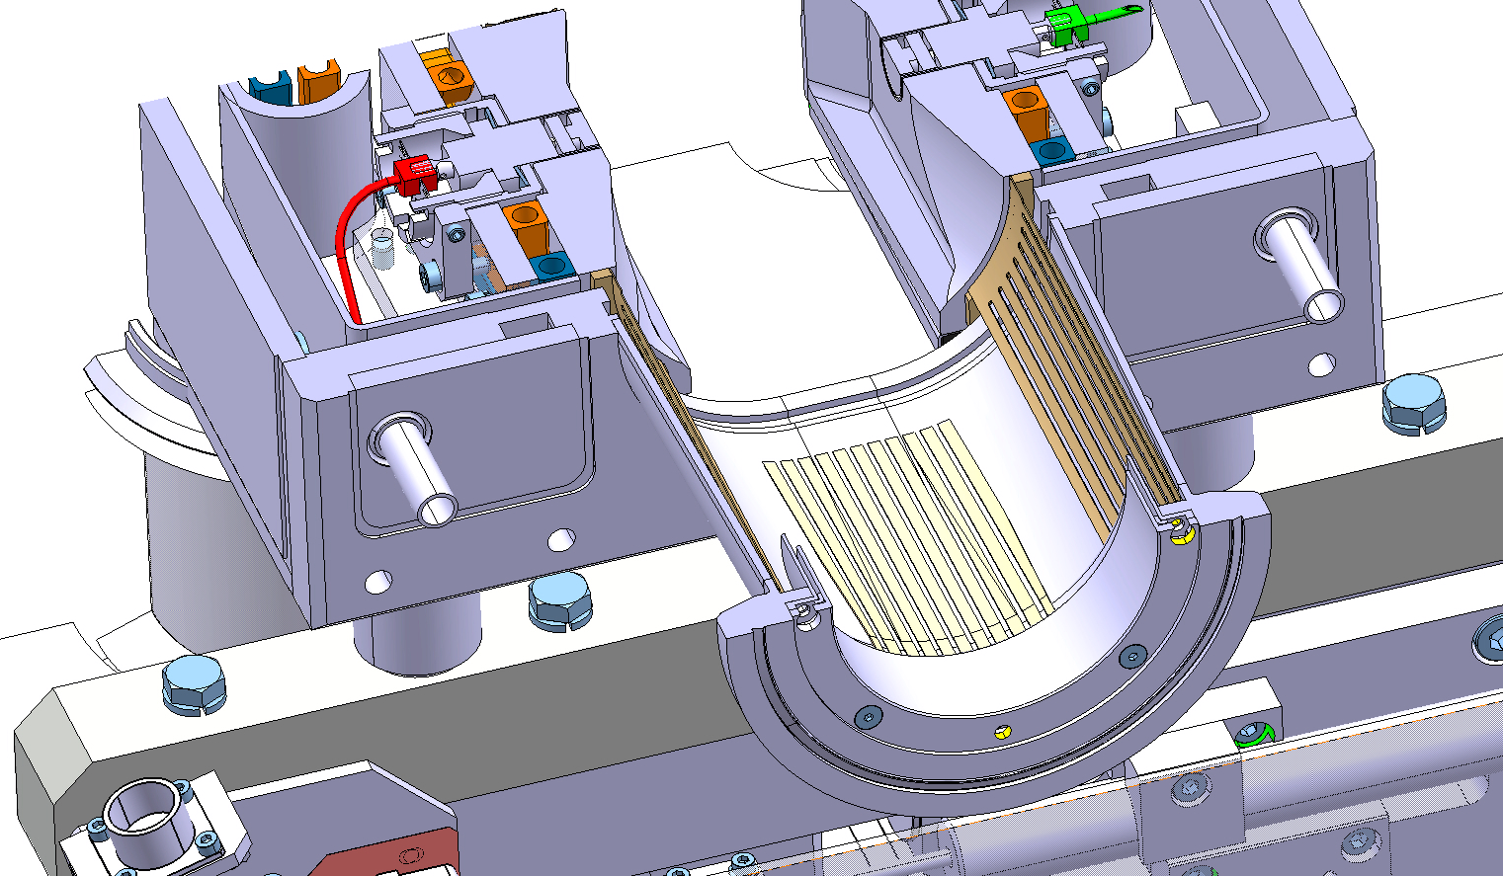
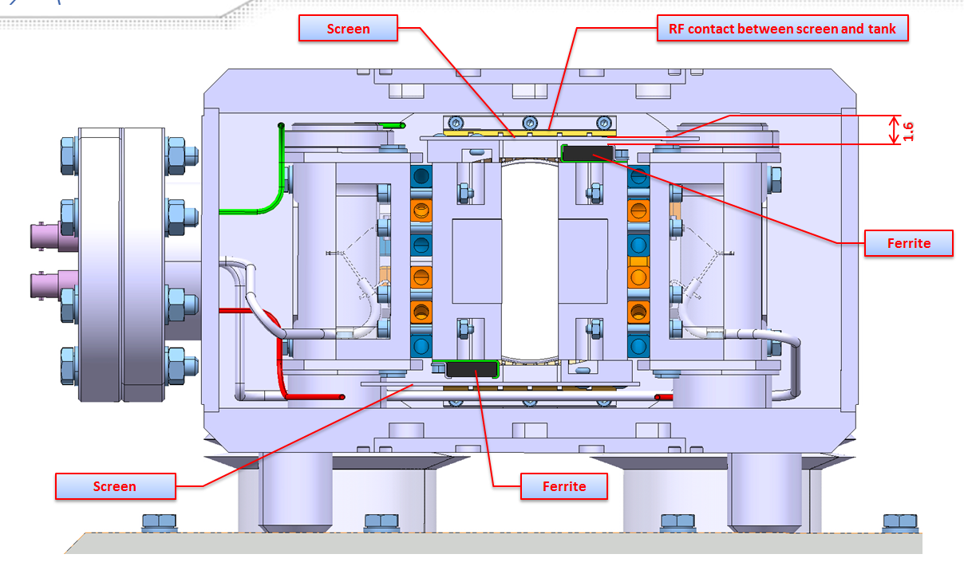
TCTP Design Baseline
Same extremity RF contacts of phase I collimators
Ferrite tiles replacing longitudinal RF strips

Slide 23
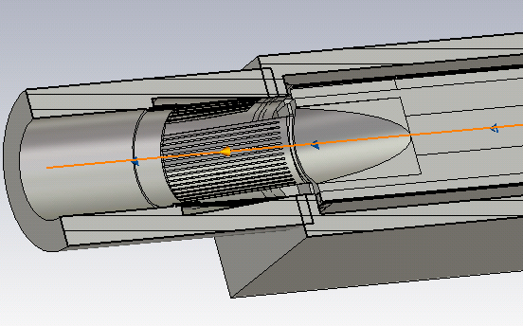
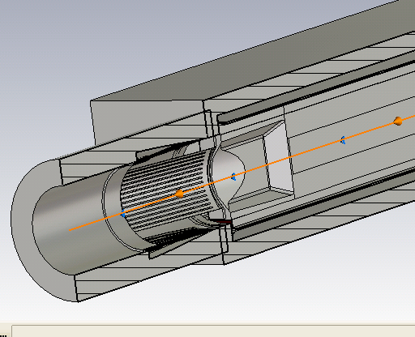
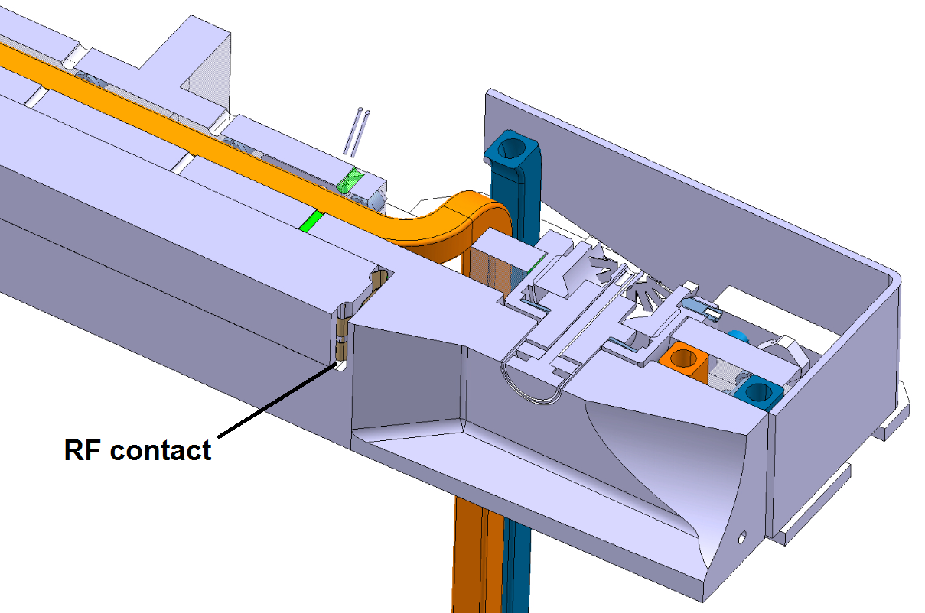
TCTP Design Baseline
Phase I
TCTP
Change of jaw tapering to accommodate BPM buttons
C17200 spring-like contacts added between Glidcop and each W extremity bloc (0.6 mm pre-compression)

Slide 24
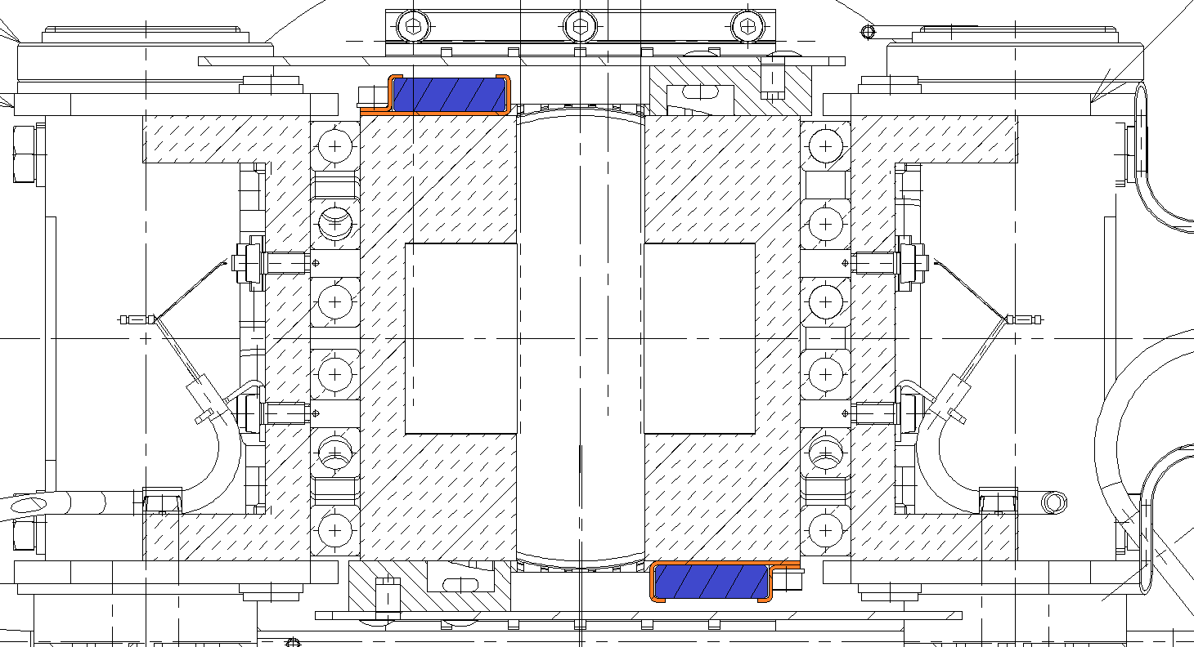
TCTP RF System: materials
Ferrite
Supports
Ferrite proposed for TCTP collimators: TT2-111R Trans-Tech
Higher Curie Temperature: 375 ˚C
What is the best solution for the support material?

Slide 25
TCTP RF System: materials
RF losses on ferrite evaluated by BE/ABP (H. Day, B. Salvant)
Safety factor of 2 considered for the loads reported in the table below
Heat losses (uniformly distributed along the longitudinal coordinate)
 | Total power on collimator [W] | Power loss on 1 ferrite array [W]
Case 1 | 20 | 1
Case 2 | 110 | 6
Case 3 | 375 | 20
Case 1: nominal LHC operation
Case 2: High-Luminosity LHC
Case 3: High-Luminosity LHC, with reduced bunch length (0.5 ns) → Pessimistic case

Slide 26
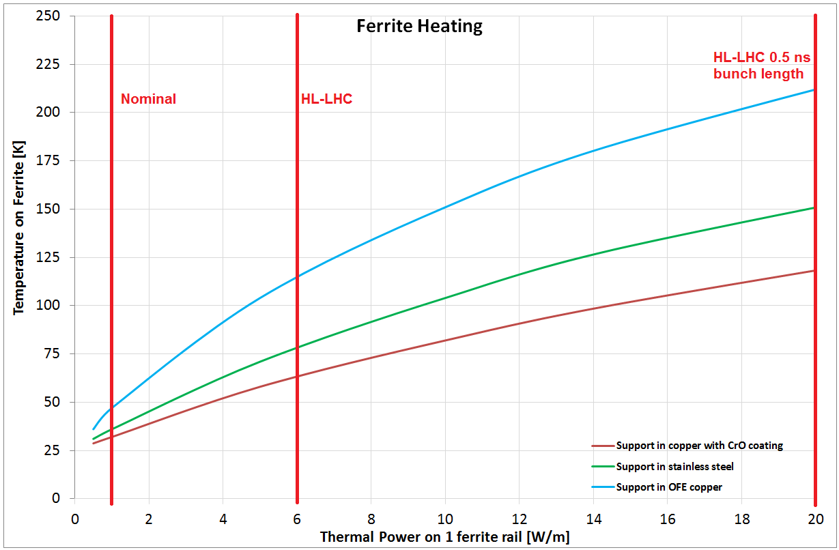
TCTP RF System: materials
Pure copper OFE: worst choice, penalized by copper low emissivity
Stainless steel: temperature up to 150 ˚C in the worst case scenario, with a safety ratio > 2 with respect to the Curie Temperature
Copper OFE with CrO coating: best choice from the thermal point of view, temperature on ferrite decreased by 25-30% with respect to stainless steel (this reduction could be ~ 40% when the upper screen is also coated with CrO)

Slide 27
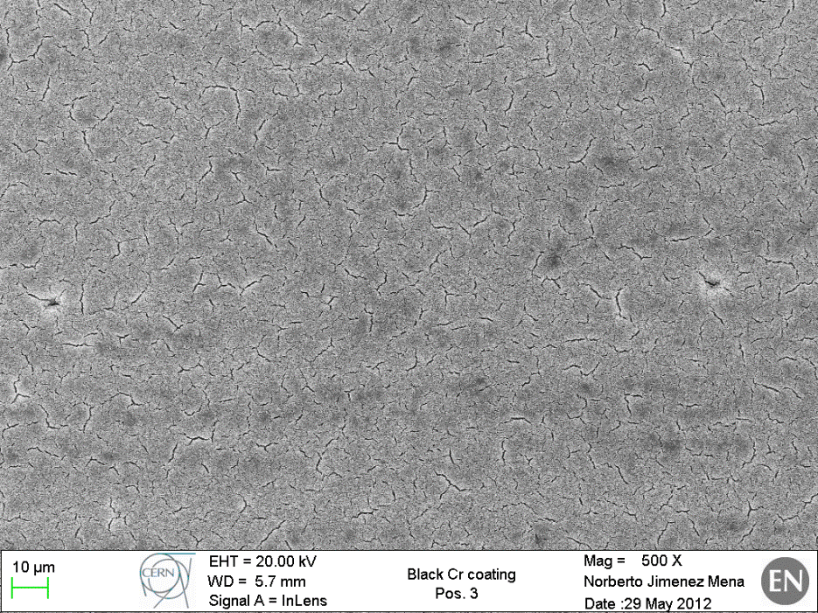
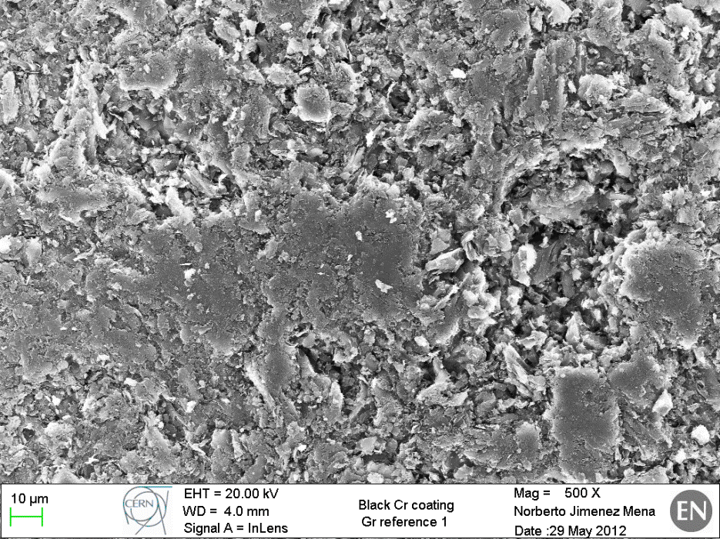
TCTP RF System: materials
Black chrome presents a dusty surface (risk of particles detachment)
SEM observations performed by N. Jimenez Mena compared morphology and porosity of Black Chrome and Graphite (EDMS n. 1220547)
“The Cr coating shows many cracks and some inhomogeneity on the surface. However, the porosity and discontinuities in the graphite reference seem to be higher.”
Black Chrome
Graphite

Slide 28
TCTP RF System: materials
The best thermal treatment on TT2-111R ferrite still has to be defined
First measurements by G. Cattenoz on samples treated 24h in air and 24h in vacuum at 400 ˚C showed high ferrite outgassing rates
A second thermal treatment has been launched (48h in air and 48h in vacuum, T = 1000 ˚C): results expected in the next weeks

Slide 29
  Backup slides

Slide 30
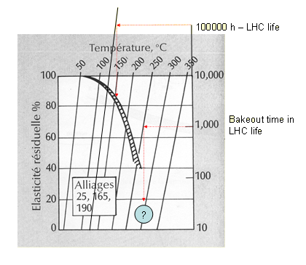
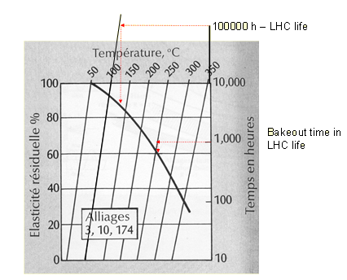
Phase I Design Baseline
C17200: high mechanical properties (σ_{0.2} = 1240 MPa)
C17410: high conductivity, residual elasticity after heat treatment
Silver coating to increase surface contact conductance
C17200 Stress relaxation at σ = 0.75σ_{0.2}
C17410 Stress relaxation at σ = 0.75σ_{0.2}

Slide 32


Phase I Design Baseline

Slide 33
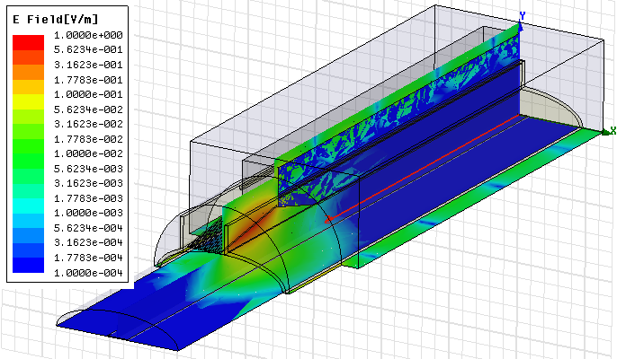
TCLIA/TCTVB Impedance
Calculations by A. Grudiev showed high power losses on the longitudinal RF fingers
f= 0.996 GHz
Q = 2550
Ploss = 170 W
Prf-finger = 1.1W
For nominal LHC intensity

Slide 34
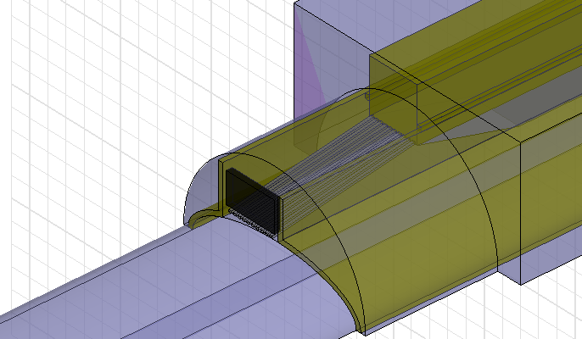
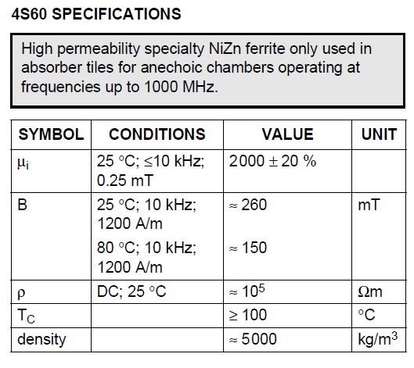
TCLIA/TCTVB Impedance
Q = 26
Ploss ~ 0.5 W
Addition of ferrite reduces RF losses by a factor 3

Slide 35
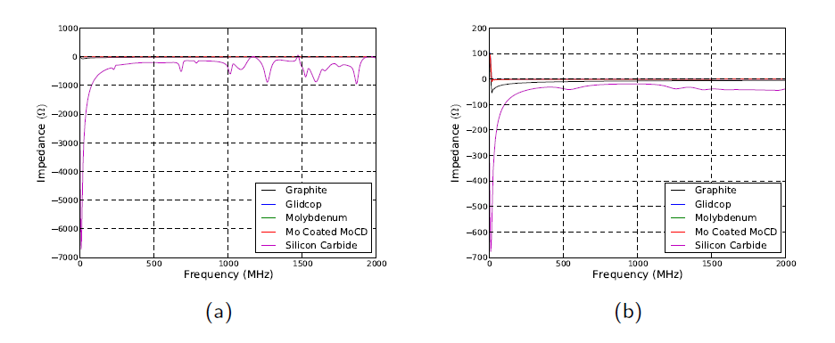
Phase II Impedance
(a) Horizontal driving and (b) vertical driving impedance of all materials
SiC: significantly higher impedance than graphite collimators
Metallic design: lower in all frequencies for imaginary transverse, lower/comparable in real transverse

Slide 36
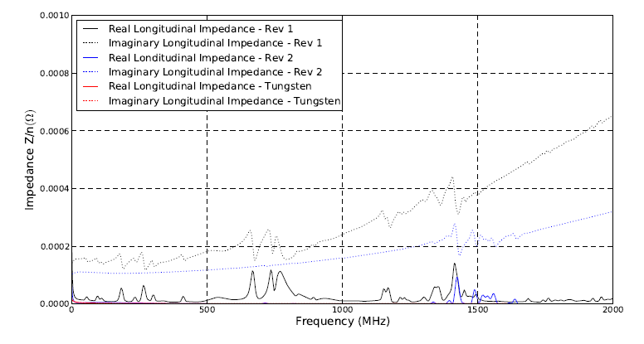
TCLD Impedance Studies
Longitudinal impedance of the DS collimator. Revision 1 indicates a collimator with RF clips, revision 2 is with slightly modified RF finger structure in the transition piece. For comparison the design longitudinal impedance Z/n = 0.1 Ω.

Slide 37
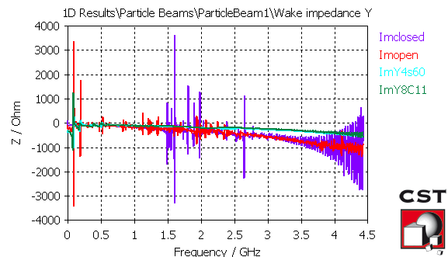
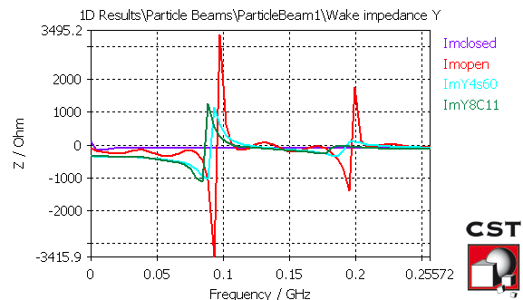
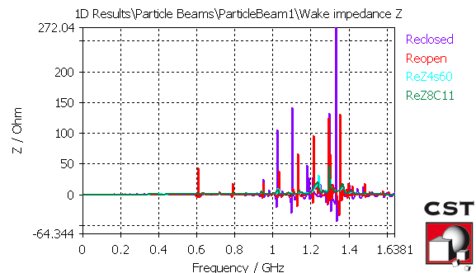
TCTP Impedance Studies
Calculation by B. Salvant → With ferrite, frequency decreases and all transverse modes are damped. However, low frequency (<100 MHz ) impedance increases (factor 2).
Ferrites helps significantly also in the longitudinal plane

