Slide 1
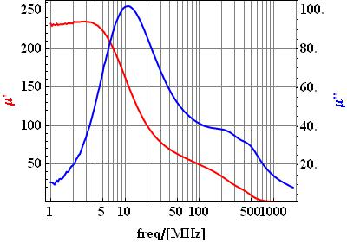
Material Measurement of TT2-111R
Measurements provided by TT

Slide 2
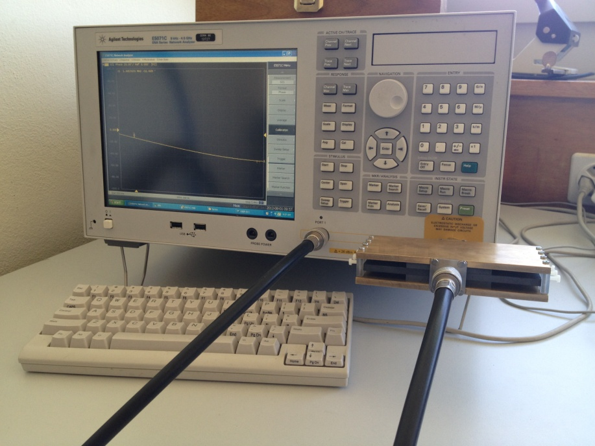
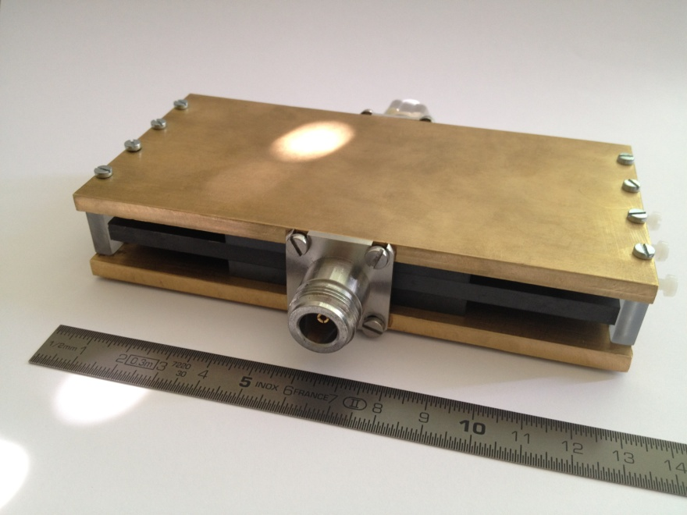
Material Measurement of TT2-111R
This ferrite is readily available in tiles of 6 cm x 6 cm and 5 mm thickness;
Material samples are “wrapped” around an inner conductor;
this allows a non-destructive measurement,
without any machining of the ferrite.

Slide 3
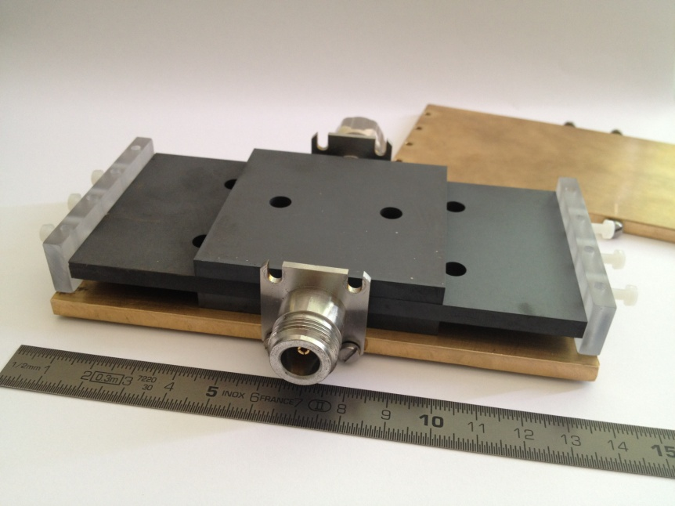
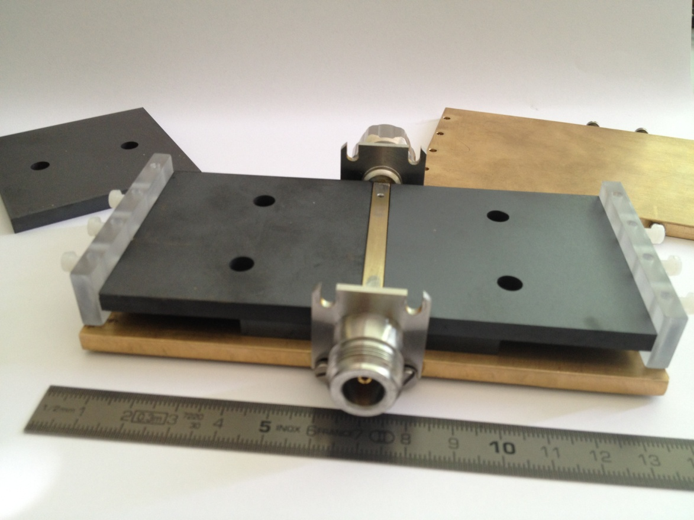
Material Measurement of TT2-111R
SH-sample holder
Side walls made of Plexiglas to allow “wave leakage” (no unwanted HO modes).
It is much simpler to machine metal than ceramics with adequate accuracy…
Embedded conductor (brass)

Slide 4
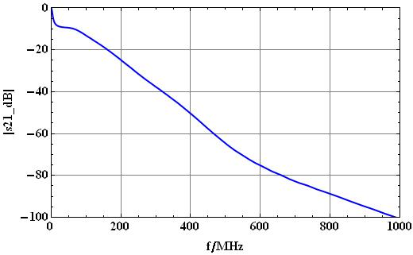
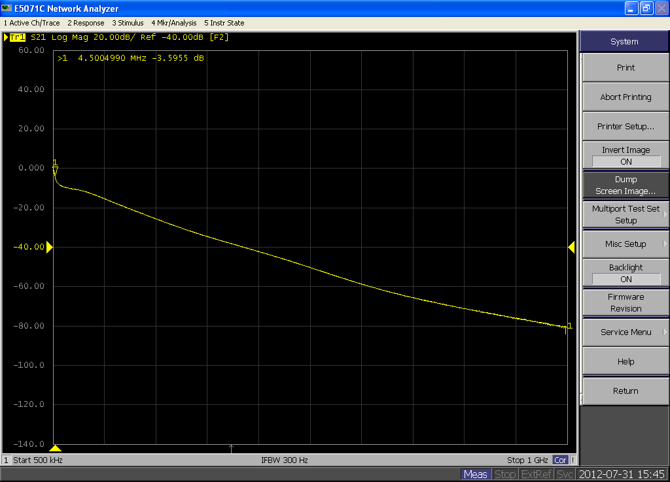
TT2-111R,
Reverse Calculation of S21
TT2-111R,
Measurement of S21

Slide 5
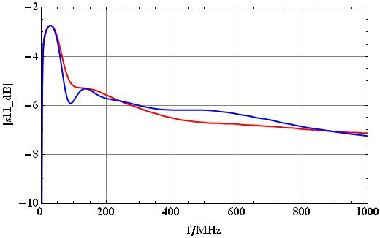
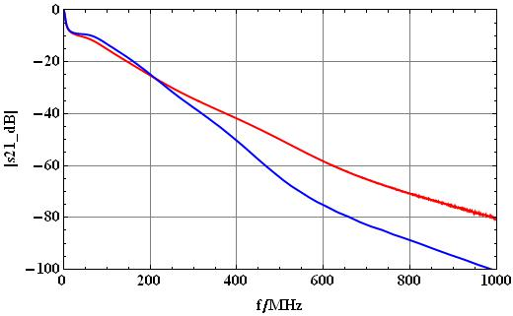
Material Measurement of TT2-111R /S-Params
Red= Measurement in SH-sample holder
Blue= Reverse Calculation from TT-data;
We can’t really say which numbers are
“more correct”…

Slide 6
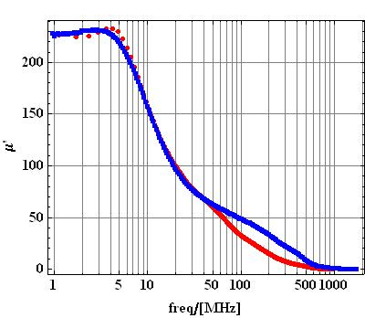
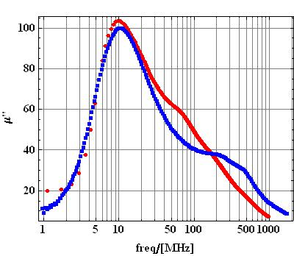
Material Measurement of TT2-111R /Permeability
Red= Measurement in SH-sample holder;
Blue= Measurement provided by TT.

Slide 7
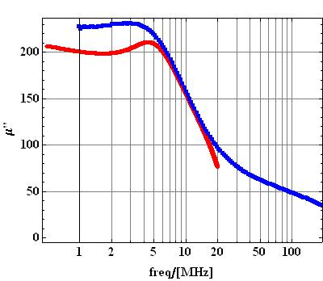
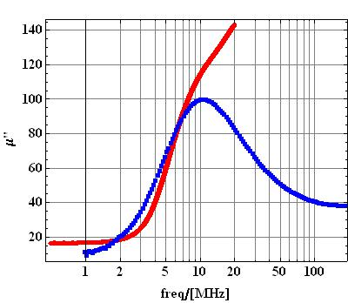
Material Measurement of TT2-111R /Permeability
TT Data
Meas. w.short
TT Data
Meas. w. short
Additional measurement with SH-sample holder terminated with SHORT
Permeability calculated from input impedance: z1=jZ_{L} tan(βl) -> valid for low frequencies, only (up to about λ/4) !
Method with SHORT termination is also limited for absorbing materials due to the material damping.

Slide 8
Material Measurement of TT2-111R
Conclusion
A transmission measurement is used for the measurement of material parameters of ferrite samples;
Material samples are “wrapped” around an inner conductor;
this allows a non-destructive measurement,
without any machining of the ferrite.
Measurement for frequencies < 1 GHz show a limited sensitivity to air gaps in the samples, this is advantageous;
For measuring above approx. 1 GHz, smaller sample lengths would be required (we already reach -80 dB at 1 GHz).
Influence of an air gap can be tested as it is possible to measure with defined air gaps.
This method is used as it is much simpler to machine metal than ceramics with adequate precision.

Slide 9
Material Measurement of TT2-111R /Permeability
Red= Measurement in SH-sample holder;
Blue= Measurement provided by TT.

Slide 10
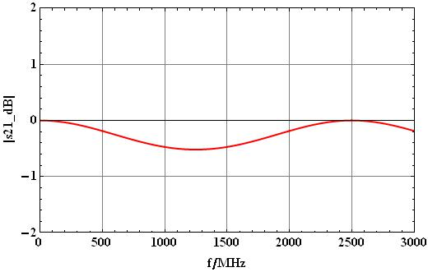
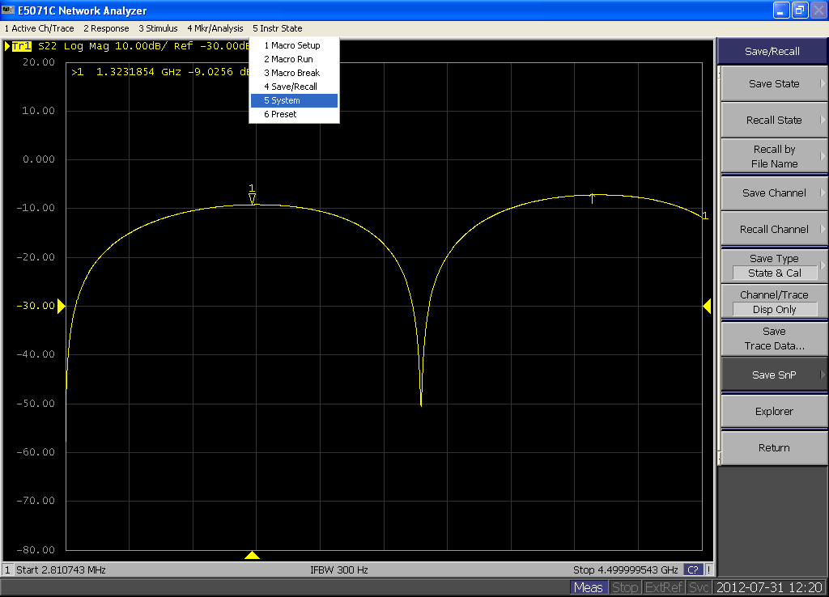
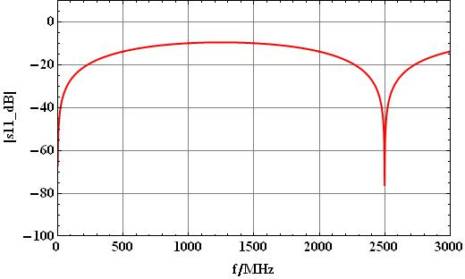
Cross-check: comparison of measurement of empty SH-sample holder with calculated S-parameters

