Slide 1
BSRT: numerical evaluation of RF induced heating

Slide 2
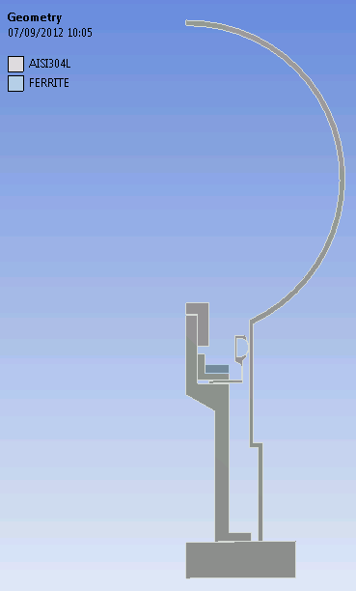
ANALYSIS
General Constraints:
2D axisymmetric analysis
Ferrite ring – R_{e}=30; R_{i}=16; h=6 [mm]
Power on ferrite: 10÷50 W
 | emissivity [-]
steels (304L) | 0.3
Cu coating | 0.05
Ferrite | 0.8
first approximation with all steels→304L
Not axisym. in reality
No mirror
Axis of symmetry
Ferrite
Cu coating

Slide 3
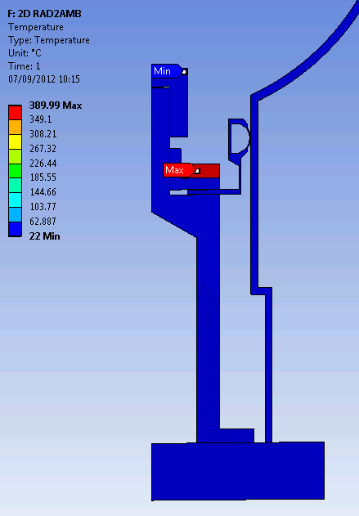
CASE 1:
P=50W
Ferrite radiates to ambient (blackbody of emiss.=1)→ other components are neglected
T_{AMBIENT}=22°C
best case scenario for evacuation only through radiation
T [°C]
Consistent with analytical estimations
T_{ferrite_MAX}=390°C

Slide 4
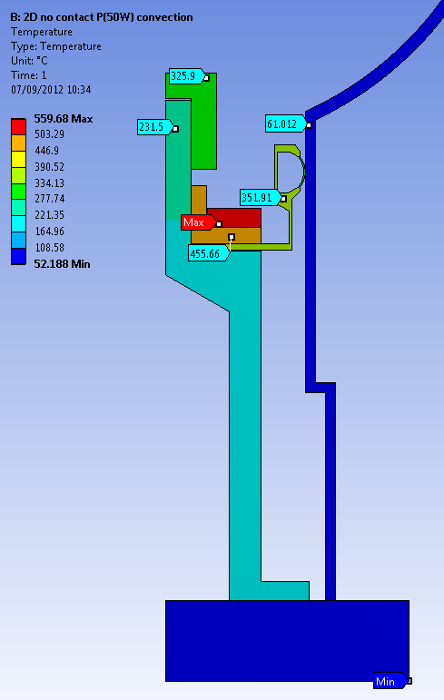
CASE 2:
P=50W
Ferrite radiates to other components
No Contact: all inner components exchange heat only through rad. (also with external vacuum tank)
Vacuum tank cooled by external free convection (α=5W/m2K, T_{AMBIENT}=22°C)
T [°C]
T_{ferrite_MAX}=560°C

Slide 5
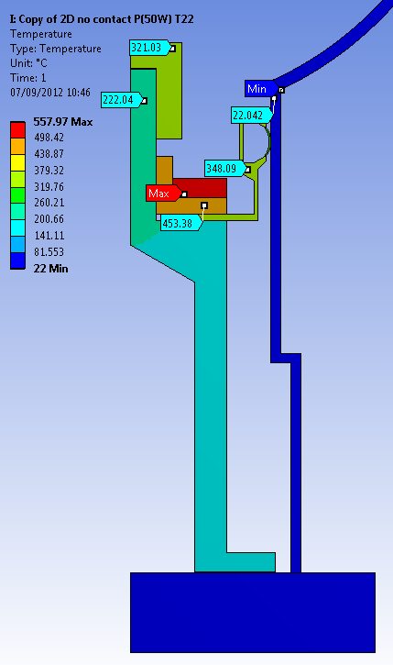
CASE 3a:
Is cooling of external tank interesting in case of evacuation of ferrite heat only through radiation?
P=50W
Ferrite radiates to other components
No Contact: all inner components exchange heat only through rad. (also with external vacuum tank)
Vacuum tank at constant T_{TANK}=22°C
T [°C]
T_{ferrite_MAX}=557°C

Slide 6
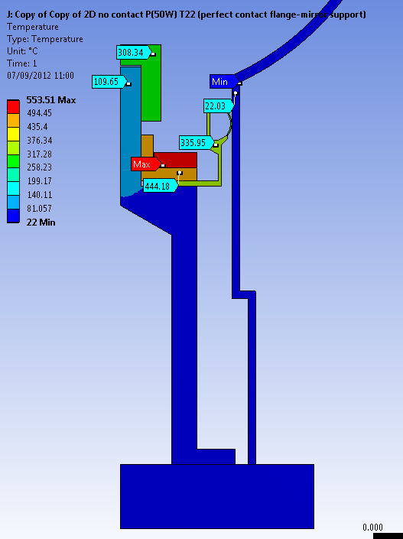
CASE 3b:
P=50W
Ferrite radiates to other components
Contact between mirror support and flange : all other inner components exchange heat only through rad. (also with external vacuum tank)
Vacuum tank at constant T_{TANK}=22°C
T [°C]
T_{ferrite_MAX}=553°C
Ferrite temperature is very slightly affected by cooling methods and T of vacuum tank

Slide 7
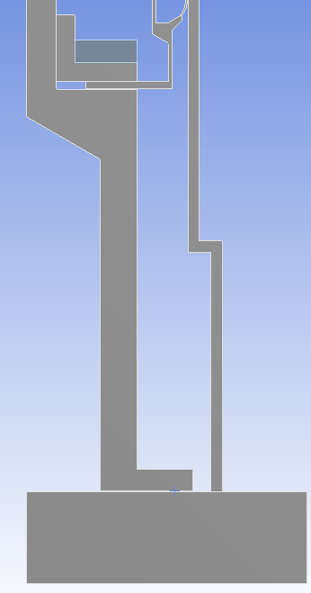
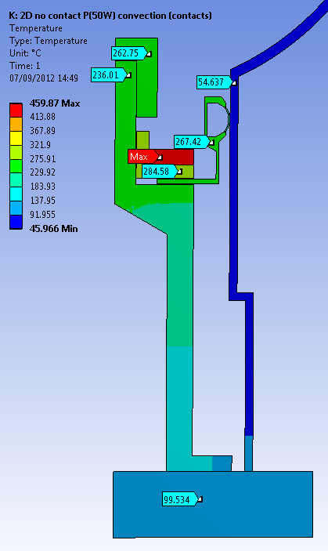
CASE 4:
P=50W
Ferrite radiates to other components
all other inner components exchange heat through rad. (also with external vacuum tank)
CONDUCTION: Thermal contact chain from ferrite to flange
Vacuum tank cooled by external free convection (α=5W/m2K, T_{AMBIENT}=22°C)
pressed by approx. 100kg
INTERFACE | Th.Conductance [W/m2K]
Ferrite-AxialRF | 40
AxialRF-RadialRF | 500
RadialRF-Support | 500
Support-Flange | 1600
T_{ferrite_MAX}=460°C
Temperature drop of 100°C w.r.t case 2
How tank is cooled becomes interesting

Slide 8
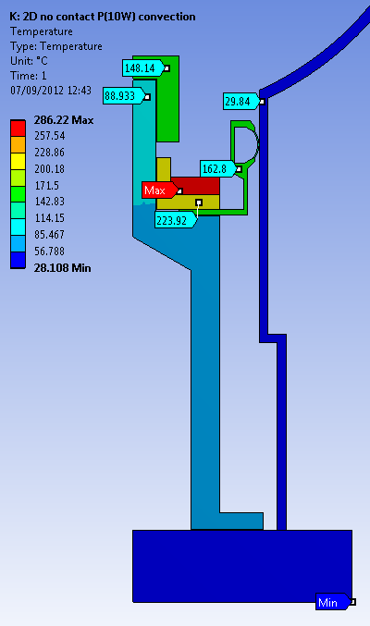
CASE 5:
P=10W
Ferrite radiates to other components
No Contact: all inner components exchange heat only through rad. (also with external vacuum tank)
Vacuum tank cooled by external free convection (α=5W/m2K, T_{AMBIENT}=22°C)
T [°C]
T_{ferrite_MAX}=286°C

Slide 9
Preliminary Conclusions:
For P=50W, if heat is evacuated only through radiation it is impossible to keep ferrite temperature below T_{curie} of the grade (case 2-3)
Cooling also by conduction is highly beneficial (case 4)
Changing ferrite to a grade with higher T_{curie} is effective only if RF induced power is 10W condition (case 5)

