Slide 1
Typical NC in Warm Modules
Following X-ray campaign
V. Baglin (21/8/12)
CERN TE-VSC, Geneva

Slide 2
X-ray campaign
Started in January 2011 – to be finished at next TS
1800 X-rays taken
95NC (~ 5 %)
58 vacuum sector concerned out of 190 at room temperature (88 sectors at cryogenic temperature)

Slide 3
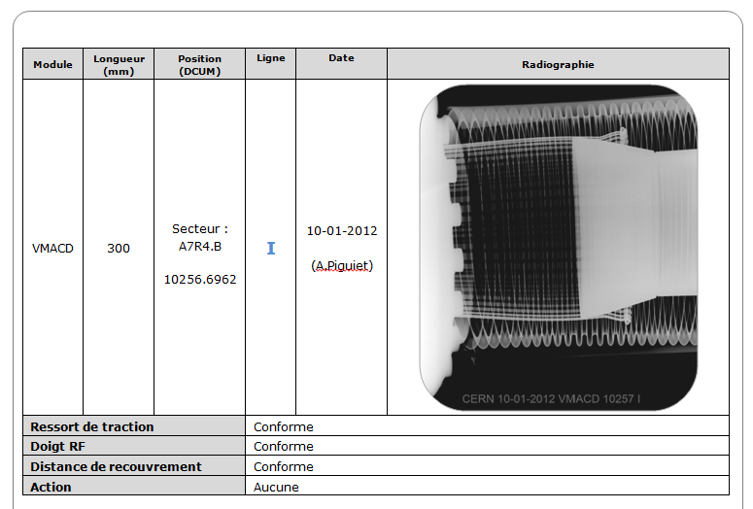
Example of documentation

Slide 4
Reparation campaign
Started during winter technical stop 2011– 2012 :
A5L1.B, A4L2.C, A4R2.C, IP5.X, A4L8.C, A4R8.C repaired
Remains 52 vacuum sector
To be continued during LS1 :
All vacuum sector to be open for activities other than VSC will be repaired
Currently ~ 110 vacuum sectors are foreseen to be opened
Remains 18 vacuum sectors not opened
i.e 29 NC which need to be classified “use as is / repair “
according to X-ray
according to pressure activity in the vicinity
according to impedance simulation
according to impedance measurement

Slide 5
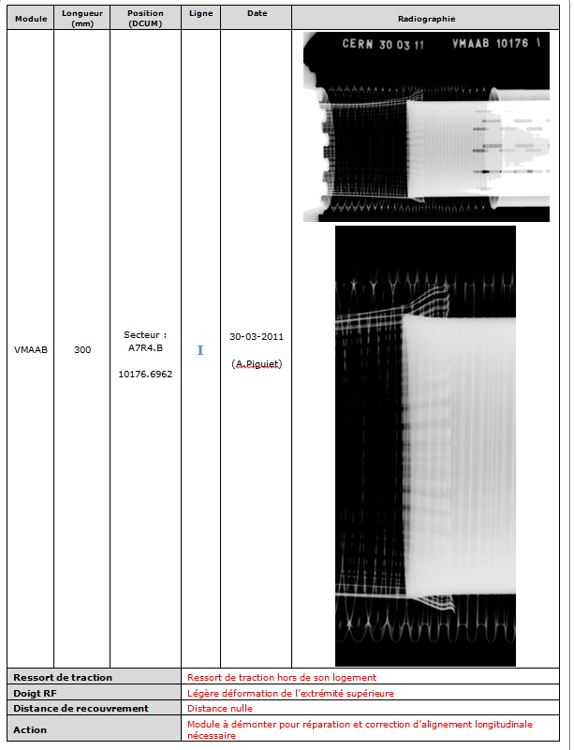
Typical NC
Spring out
Deformation
Zero length overlap
Is this acceptable impedance wise ?

Slide 6
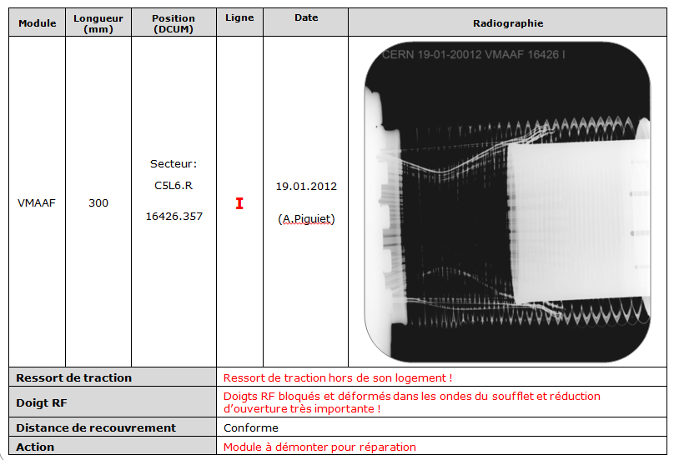
Typical NC
Spring out
Deformation
Aperture restriction
beam is passing trough since years
Is this acceptable impedance wise ?

Slide 7
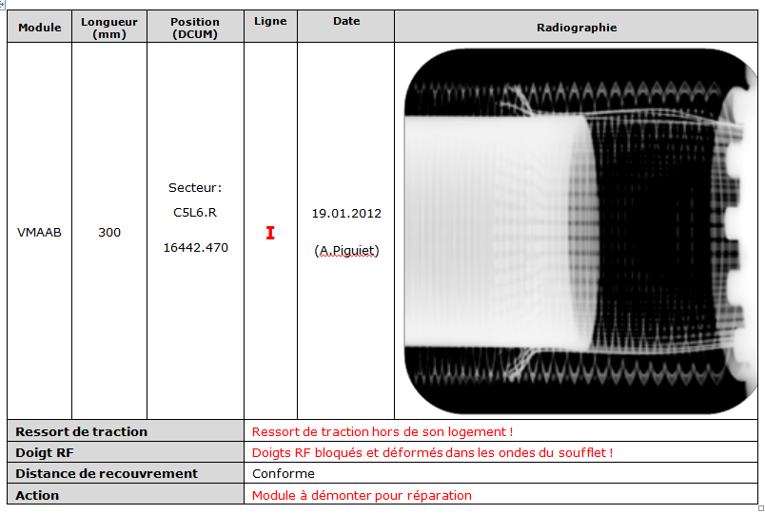
Typical NC
Spring out
RF fingers blocked
Overlap acceptable
Is this acceptable impedance wise ?

Slide 8
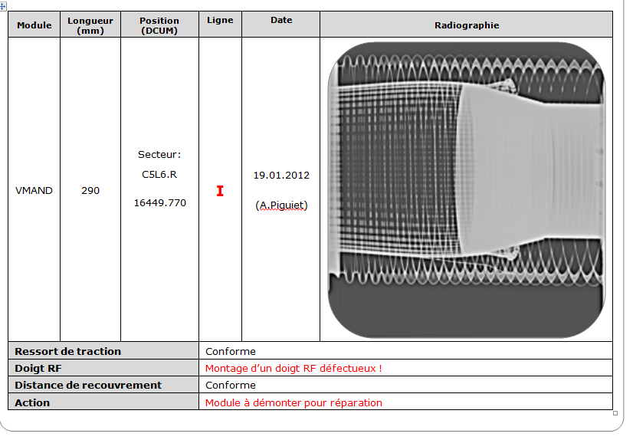
Typical NC
Spring in place
1 RF finger out
Overlap acceptable
Is this acceptable impedance wise ?

Slide 9
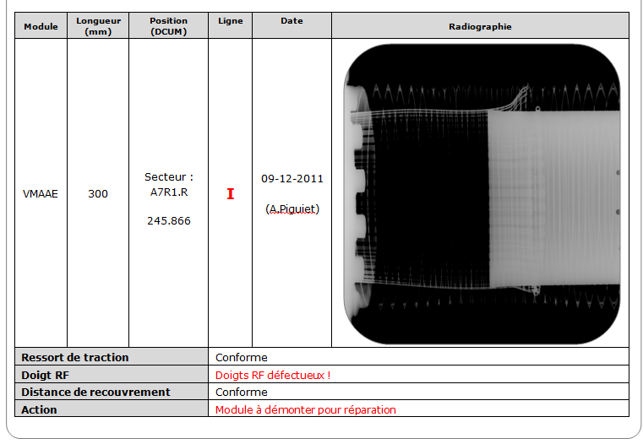
Typical NC
Spring in place
some RF fingers out
Overlap acceptable
Is this acceptable impedance wise ?

Slide 10
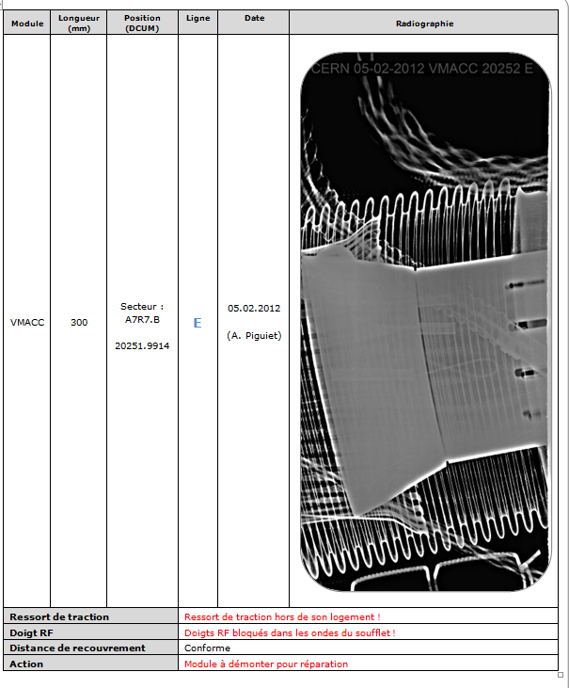
Typical NC
Spring out
RF fingers blocked
Overlap acceptable
Is this acceptable impedance wise ?
Triggered a BD of fill 2978
Increase vacuum interlock => use as is for beam vacuum performances

Slide 11
Conclusions
X ray campaign of warm module is (almost) finished !
95 NC disseminated in 58 vacuum sectors (30 % of total vacsec)
66 NC will be repaired (70 % of total NC)
29 NC are actually foreseen not to be repaired in 18 vacuum sectors
The repair of all NC would imply 15 % more activities in the tunnel => not acceptable
A sorting must be done by LRFF to:
Propose the repair of critical VM
Minimise the number of interventions

