Slide 1
Electromagnetic Simulations of VMTSA Equipped with the
Longer RF Fingers
O. Kononenko
BE/RF
LRFF Meeting, CERN, August 21, 2012

Slide 2
Introduction
Study of the long RF fingers and comparison with the measurements
Many ways to deform the fingers, the gap has been introduced in CST modeller in the simplest way
Different gap sizes have been studied

Slide 3
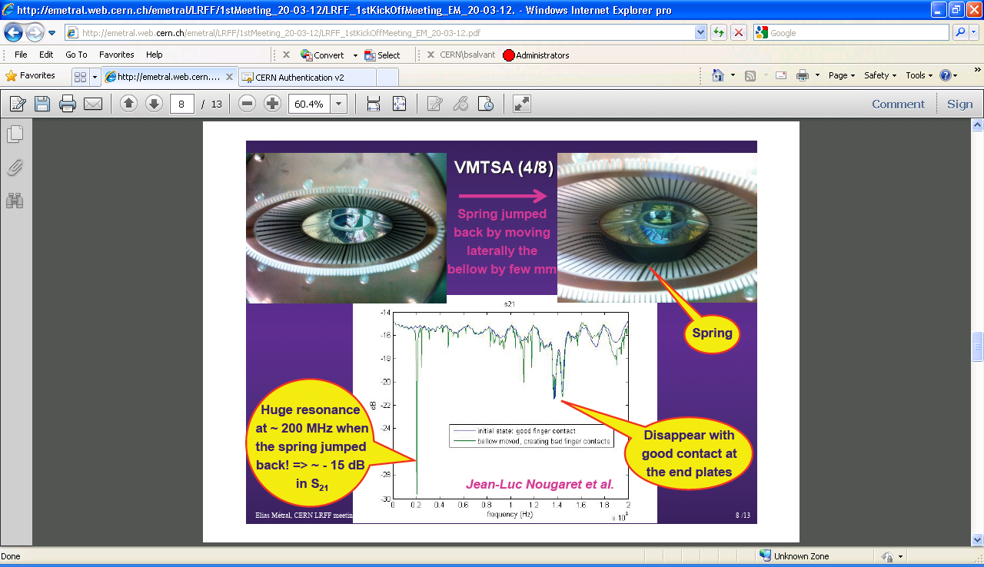
RF Fingers Deformation in VMTSA

Slide 4
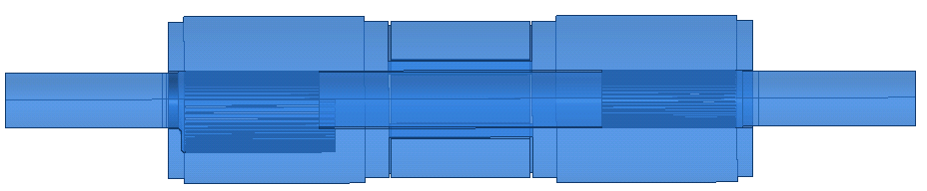
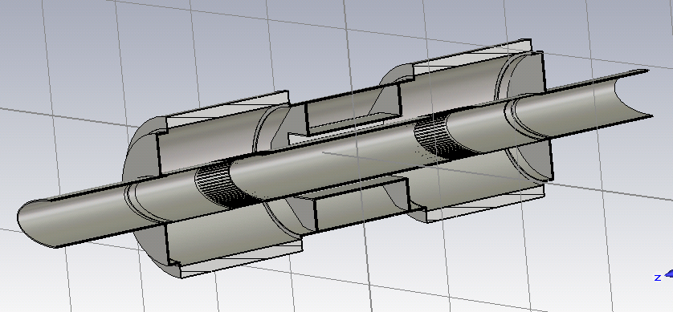
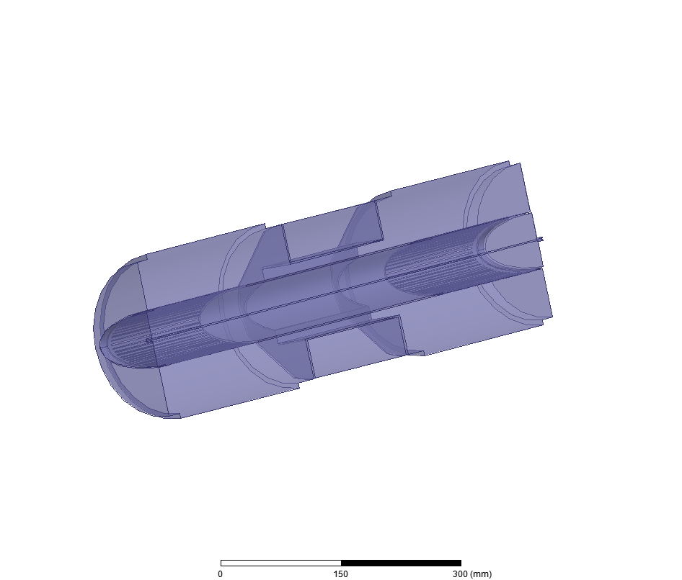
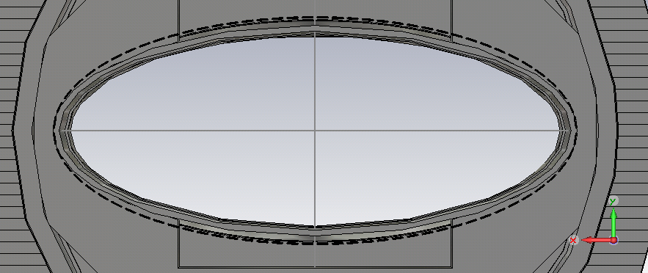
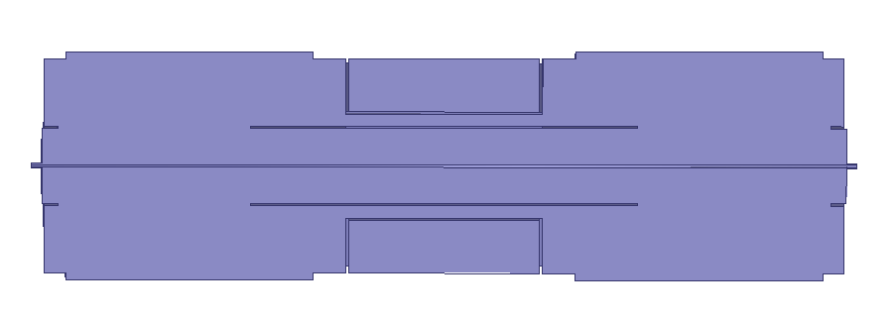
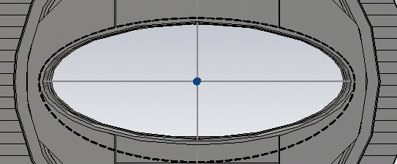
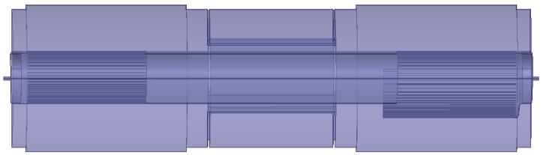
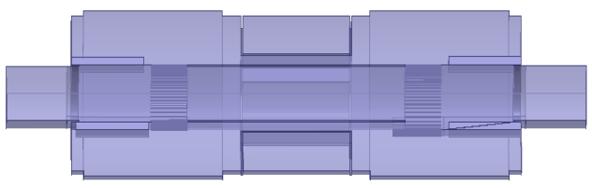
Simulated Models
Old longer fingers
New shorter fingers
Conforming
and bad contact
fingers
Conforming
fingers
Wire,
conforming
fingers
Bad contact 1st type
Wire,
no fingers
Bad contact 2nd type
Wire,
20-40mm gaps
Ferrites in, Philips 8C11
Completed
In progress

Slide 5
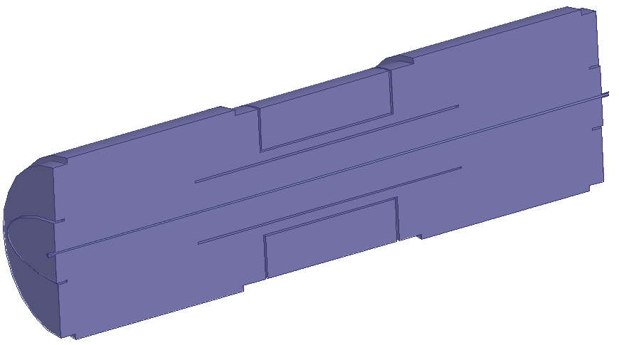
VMTSA with Wire and No Fingers
Model:
  180 deg of the structure
  copper outer walls
Perfect H
Port 2
Copper
Wire
Port 1
Simulation profile:
- second order basis functions
  curvilinear elements enabled
  0.01 s-parameters accuracy => ~170K tet10 mesh
  discrete sweep from 20MHz to 2GHz, 10MHz step

Slide 6
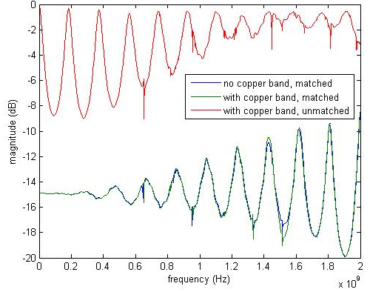
Transmission, no Fingers
Jean-Luc Nougaret, VMTSA measurements,
December 2011-January 2012
Good agreement of the CST/HFSS/Measurements results

Slide 7
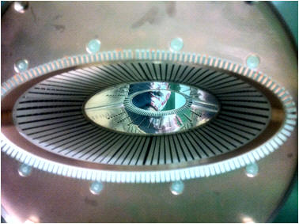
VMTSA with Wire and Comforming Fingers
Model:
  180 deg of the structure
  copper outer walls
Perfect H
Port 2
Copper
Wire
Port 1
Simulation profile:
- second order basis functions
  curvilinear elements enabled
  discrete sweep from 20MHz to 2GHz, 20MHz step
  0.01 s-parameters accuracy => ~220K tet10 mesh
- no matching

Slide 8
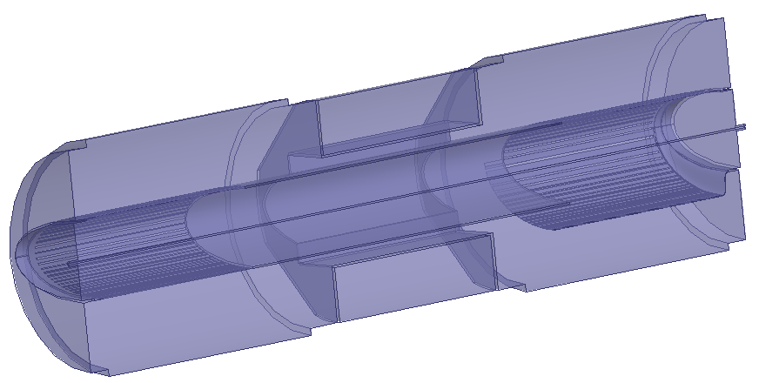
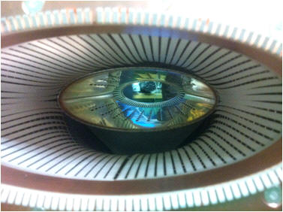
VMTSA with Wire and
Deformed Fingers: 20-40mm gaps
Model:
  180 deg of the structure
  copper outer walls
Perfect H
Port 2
Copper
Wire
Port 1
Gap: 20-40mm
Simulation profile:
- second order basis functions
  curvilinear elements enabled
  discrete sweep from 20MHz to 2GHz, 20MHz step
  0.01 s-parameters accuracy => ~260K tet10 mesh
Gap
- no matching

Slide 9
Transmition for Different Gap Sizes
Transmission level is quite different, may be because there was a matching load in the measurements?
30mm gap simulations give the best agreement for the resonances. Gap shape could be different in the simulation/measurement so it is quite complicated to have full agreement.

Slide 10
Reflection for Different Gap Sizes

Slide 11
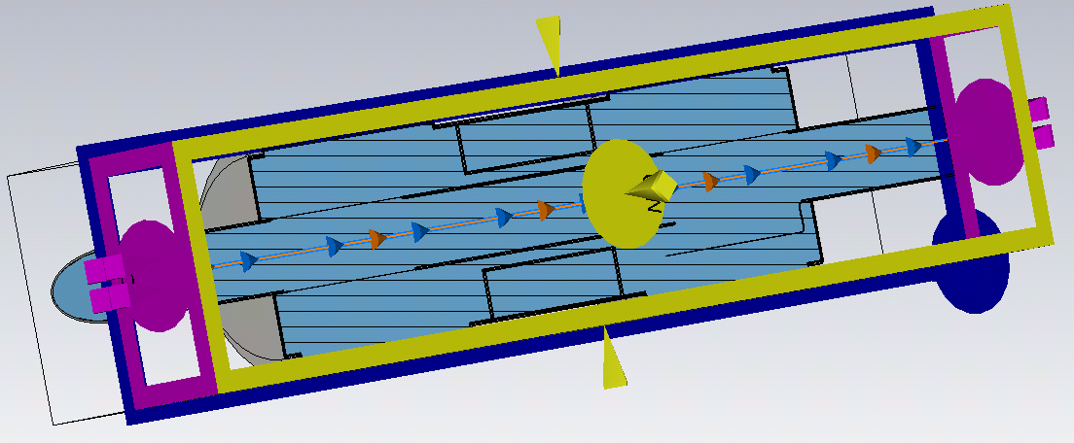
CST TD Simulations of VMTSA
Model:
  full structure
  copper walls
  conforming fingers and 30mm gap
Simulation profile:
- 10 lines per wavelength
- refine at PEC by factor 6
- 70mm bunch sigma
  400K hex mesh

Slide 12
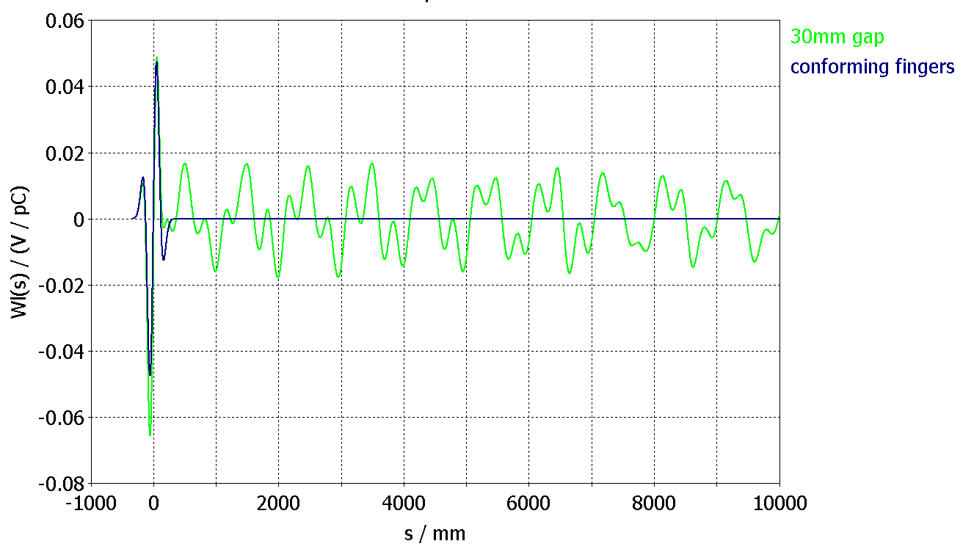
Longitudinal Wake Potential
No surprise: introducing a gap we’re getting unwanted modes with high Q

Slide 13
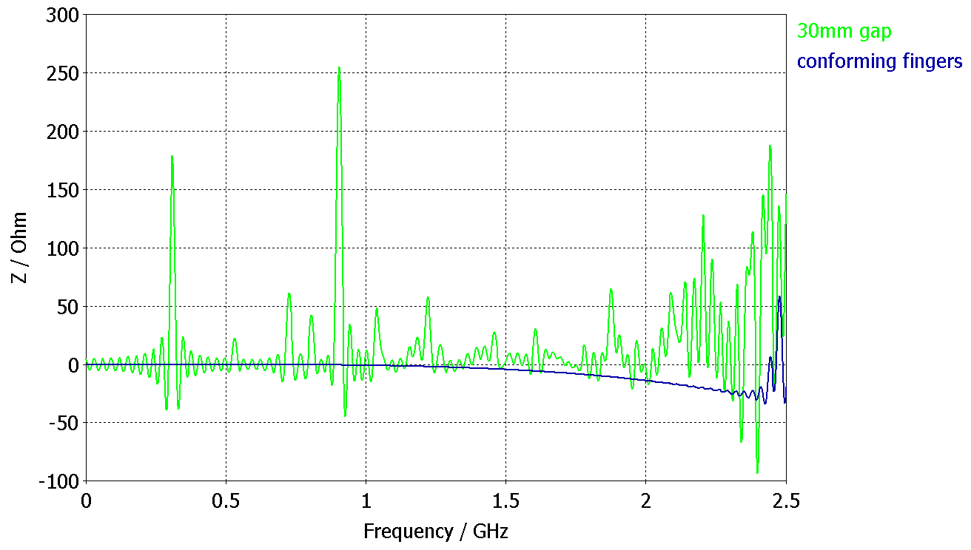
Longitudinal Impedance Re(Z)
Some of the resonances could also be seen in the wire simulations

Slide 14
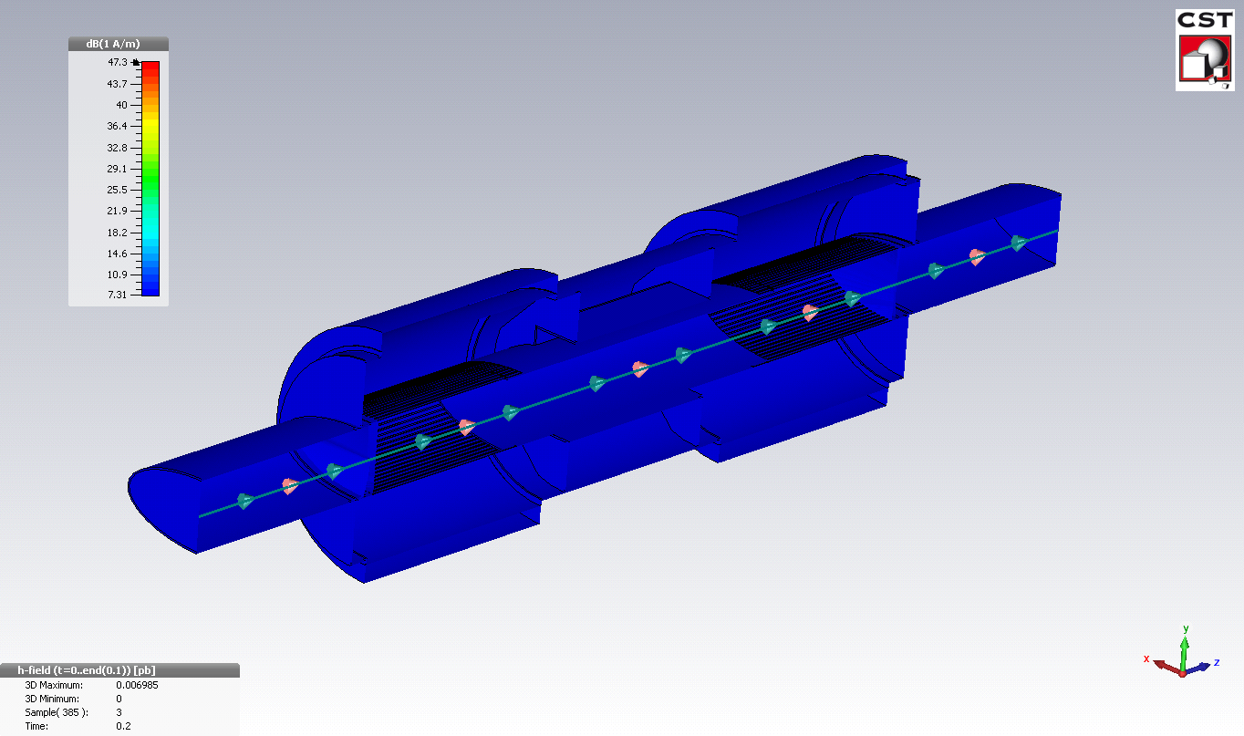
Tangential Component of
Magnetic Field for Conforming Fingers

Slide 15
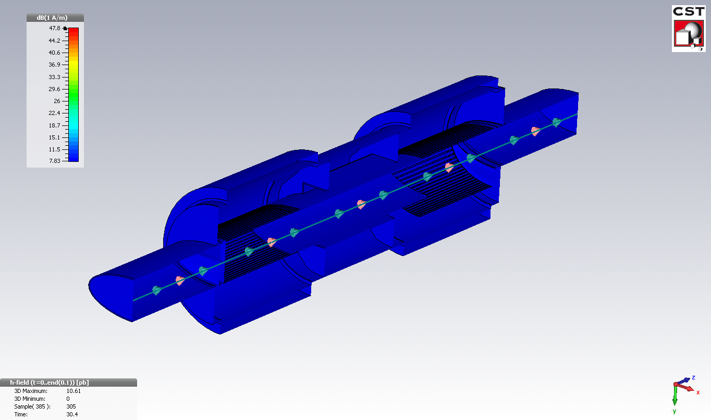
Tangential Component of
Magnetic Field for 30mm gap
Unwanted modes with high Q have been excited near to the deformed fingers

Slide 16
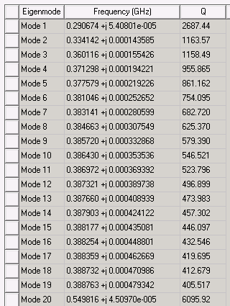
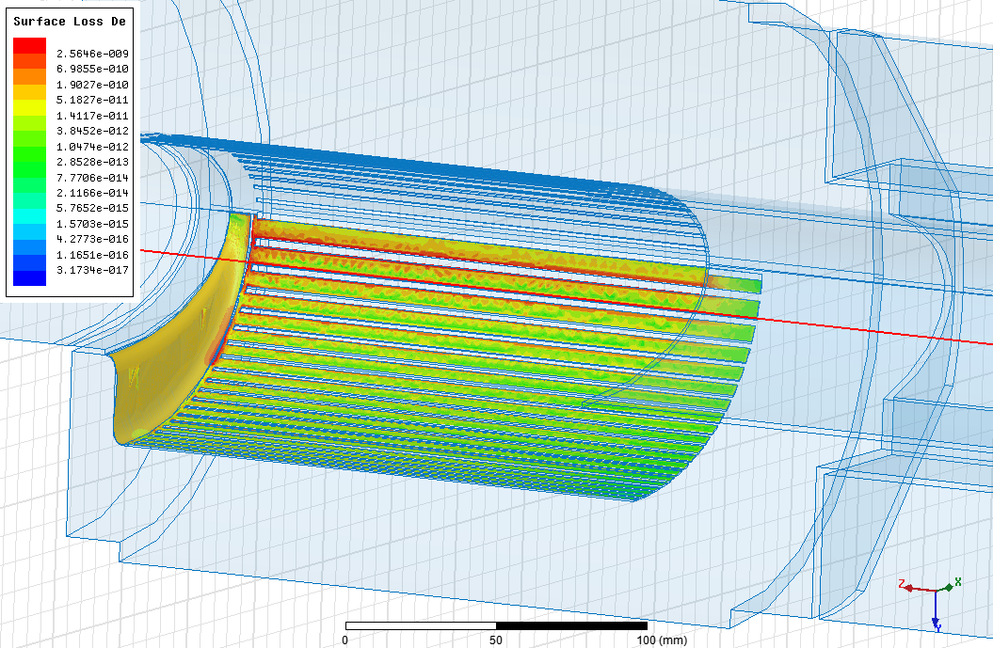
HFSS Eigen Mode Analysis of
30mm Gap
Most of the modes have been excited by 30mm gap, just some of them are eigen modes of the bellows.
Loss Density for the First Eigen Mode at 290MHz
Loss denstity distribution looks similiar to CST.
These frequencies and losses crucially depend on the gap size and shape.

Slide 17
Conclusions
Long fingers with good contact => no impedance problems, no surprise
Bad contact => impedance problems depending on the gap size/shape
Need to measure ferrites properties to accomplish ferrites simulations

