Slide 1
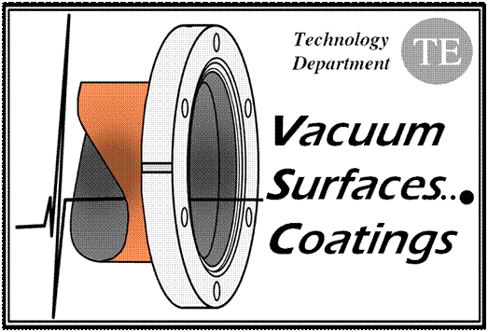
T history TDI-VMTSA
V. Baglin (25.06.12)
CERN TE-VSC, Geneva
No temperature increase observed at VMTSA
Temperature increase observed at TDI 2 & 8

Slide 2
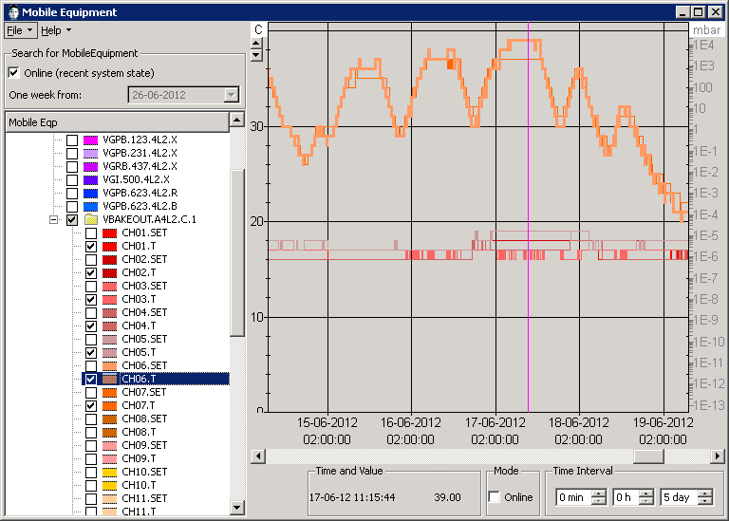
LSS 2

Slide 3
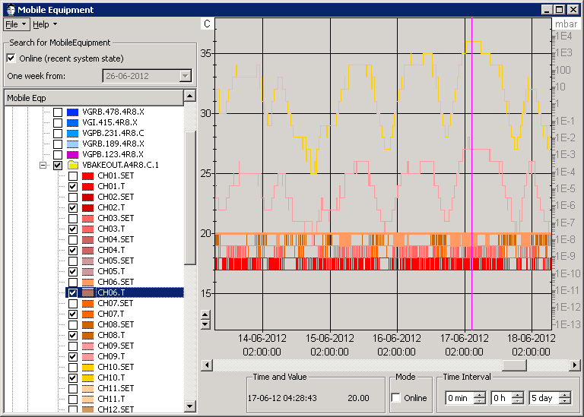
LSS 8

