Slide 1
PyHEADTAIL example
All our thanks to Kevin Li and Michael Schenck BE/ABP-HSC CERN
Reference: http://kli.web.cern.ch/kli/

Slide 2
introduction to PyHEADTAIL
Open source macroparticle tracking code developed at CERN:
Download link: https://github.com/PyCOMPLETE/PyHEADTAIL
Primary use: tracking simulation of collective effects in synchrotron accelerators
Transverse and longitudinal beam dynamics (with feedback)
Electron/ion cloud
Impedances
Space charge
Reference: Introduction to PyHEADTAIL: USPAS course by Kevin Li et al (2015) PyHEADTAIL developer meeting
Not the only code of his kind!
BLOND: longitudinal dynamics simulation code https://blond.web.cern.ch/
HEADTAIL: the father of PyHEADTAIL! G. Rumolo et al (reference)
mbtrack and sbtrack: R. Nagaoka et al “Studies of Collective Effects in SOLEIL and DIAMOND Using the Multiparticle Tracking Codes sbtrack and mbtrack”, PAC09, Vancouver, May 2009.
ORBIT (http://web.ornl.gov/~jzh/JHolmes/ORBIT.html), pyORBIT (http://sourceforge.net/projects/py-orbit/)
And so many others!

Slide 3
introduction to PyHEADTAIL
Courtesy Kevin Li
USPAS 2015

Slide 4
introduction to PyHEADTAIL
Courtesy Kevin Li
USPAS 2015

Slide 5
introduction to PyHEADTAIL
Courtesy Kevin Li
USPAS 2015

Slide 6
introduction to PyHEADTAIL
Courtesy Kevin Li
USPAS 2015

Slide 7
introduction to PyHEADTAIL
Courtesy Kevin Li
USPAS 2015

Slide 8
introduction to PyHEADTAIL
Courtesy Kevin Li
USPAS 2015

Slide 9
introduction to PyHEADTAIL
Courtesy Kevin Li
USPAS 2015

Slide 10
introduction to PyHEADTAIL
Courtesy Kevin Li
USPAS 2015

Slide 11
introduction to PyHEADTAIL
Courtesy Kevin Li
USPAS 2015

Slide 12
introduction to PyHEADTAIL
Courtesy Kevin Li
USPAS 2015

Slide 13
In our case: only RF systems

Slide 14
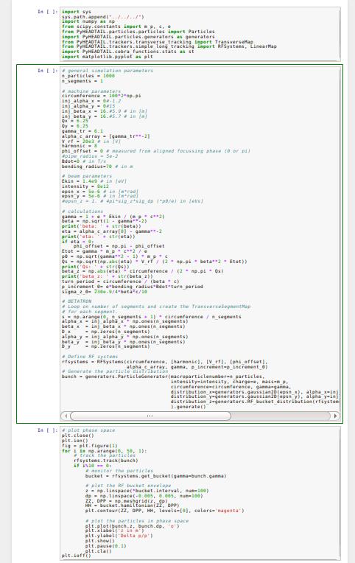
Structure of the ipython file
Import needed libraries
Set beam and machine parameters
Define RF system
Generate a matched distribution corresponding to these parameters
track
Loop over number of turns
monitor
plot

Slide 15
Tracking example: injection energy
0

Slide 16
Tracking example: injection energy
0

Slide 17
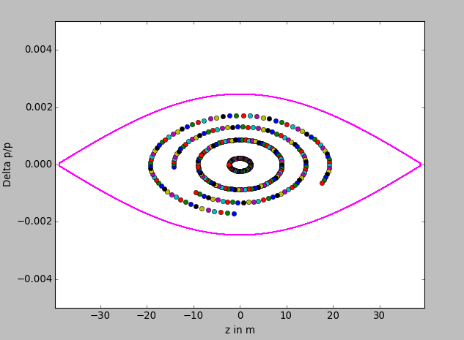
Let’s run that example
Use a small number of particles to observe the synchrotron motion at large and small amplitudes

Slide 18
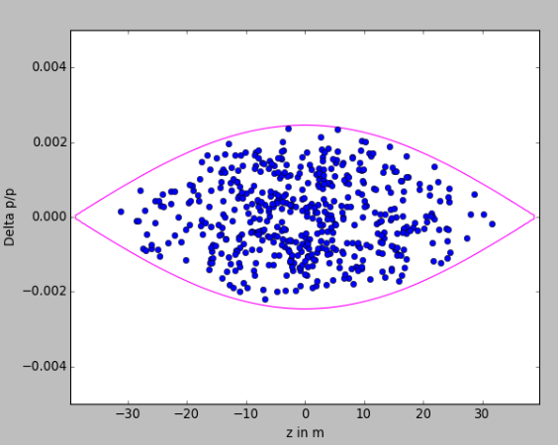
Synchrotron motion
Use a larger number of particles (~500) and reset the graph every time (“plt.cla()” uncommented)
Are the particles rotating in the correct direction?
Plot the phase space as in the course (in φ[degrees], ΔE [MeV])

Slide 19
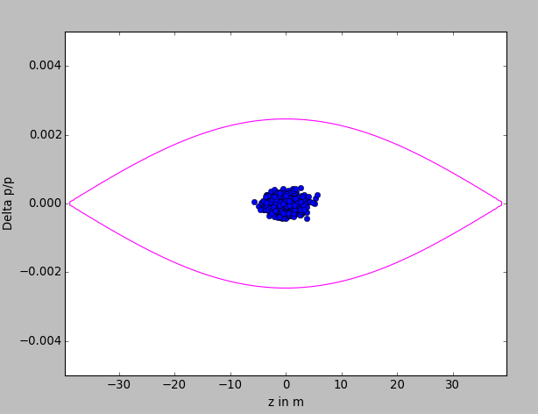
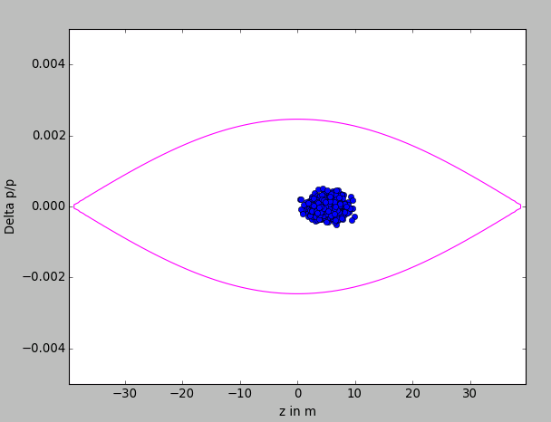
Impact of phase mismatch
Use a smaller bunch length (e.g. divide by 10)
Use more particles (~1000) and more turns
Add e.g. 5m to all particles (“bunch.z =bunch.z+5”)
→ What will happen?

Slide 20
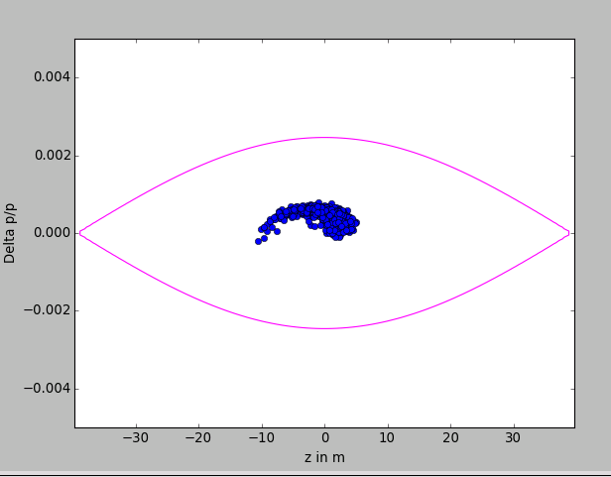
Impact of phase mismatch
Use a smaller bunch length (e.g. divide by 10)
Use more particles (~1000)
Add e.g. 5m to all particles (“bunch.z =bunch.z+5”)
→ filamentation

Slide 21
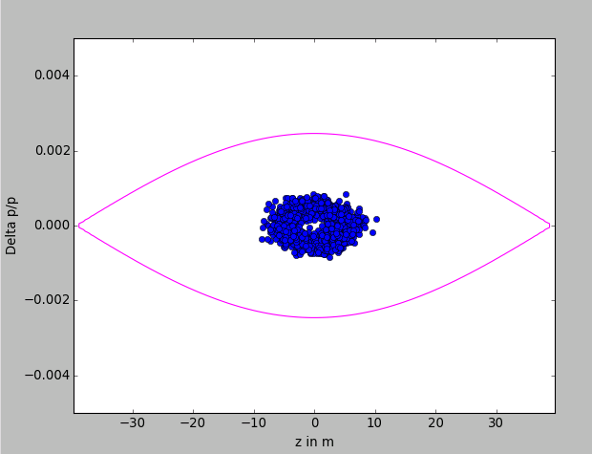
Impact of phase mismatch
Use a smaller bunch length (e.g. divide by 10)
Use more particles (~1000)
Add e.g. 5m to all particles (“bunch.z =bunch.z+5”)
→ Try also with larger mismatch (20 m)

Slide 22
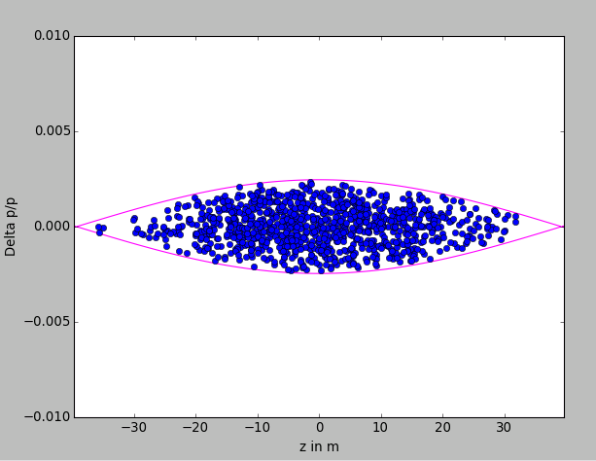
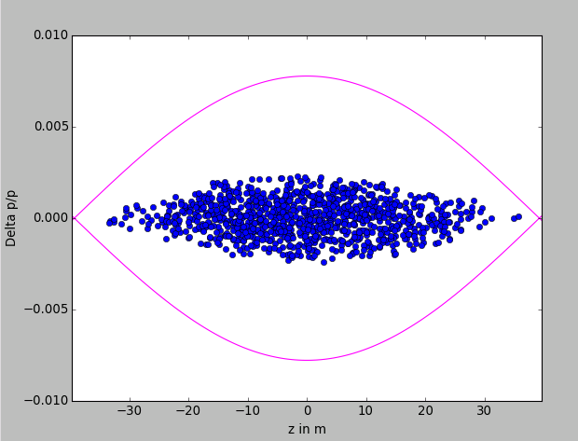
Impact of voltage mismatch (too high)
Use the nominal bunch length
Use more particles (~1000)
Change V_RF to V_RF*10 after the bunch is matched to V_RF
→ What will happen?

Slide 23
Impact of voltage mismatch (too high)
Use the nominal bunch length
Use more particles (~1000)
Change V_RF to V_RF*10 after the bunch is matched to V_RF
→ What will happen?

Slide 24
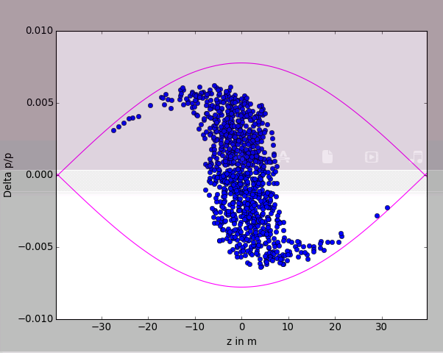
Impact of voltage mismatch (too high)
Use the nominal bunch length
Use more particles (~1000)
Change V_RF to V_RF*10 after the bunch is matched to V_RF
→ Rotation

Slide 25
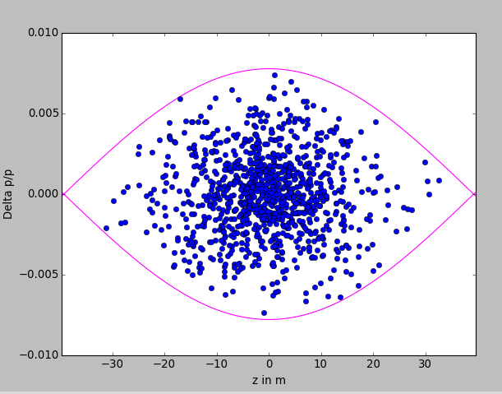
Impact of voltage mismatch (too high)
Use the nominal bunch length
Use more particles (~1000)
Change V_RF to V_RF*10 after the bunch is matched to V_RF
→ But should not wait too long!

Slide 26
Impact of voltage mismatch
Use the nominal bunch length
Use more particles (~1000)
Change V_RF to V_RF*10 after the bunch is matched to V_RF
→ But should not wait too long!

Slide 27
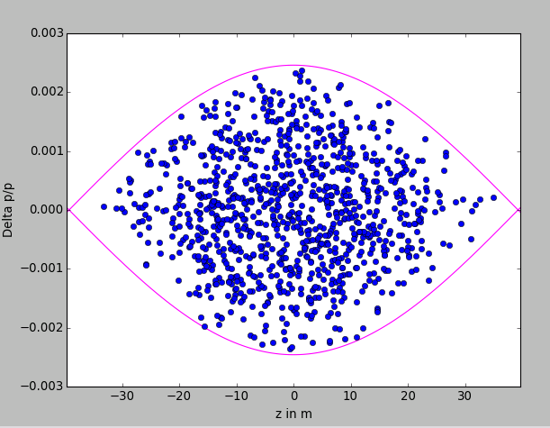
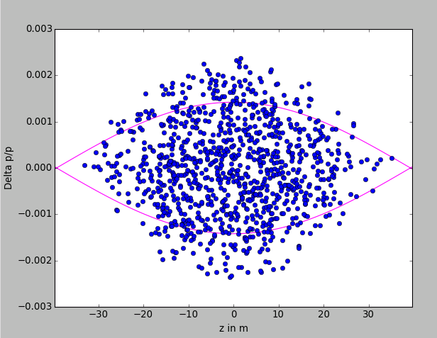
Impact of voltage mismatch (too low)
Use the nominal bunch length
Use more particles (~1000)
Change V_RF to V_RF/3 after the bunch is matched to V_RF
→ But should not wait too long!

Slide 28
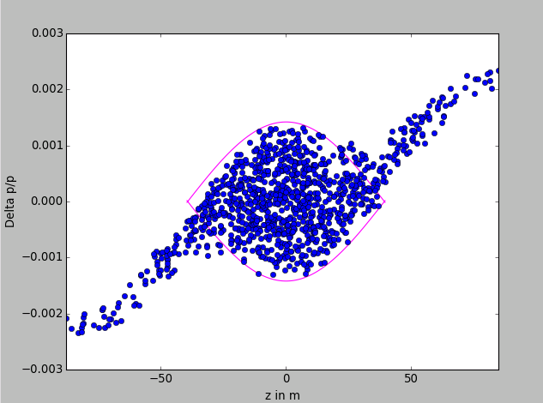
Impact of voltage mismatch (too low)
Use the nominal bunch length
Use more particles (~1000)
Change V_RF to V_RF/3 after the bunch is matched to V_RF

Slide 29
Impact of acceleration
Use the nominal bunch length
Use 200 particles
Use Bdot=2.2 T/s
Does it work? Why?

Slide 30
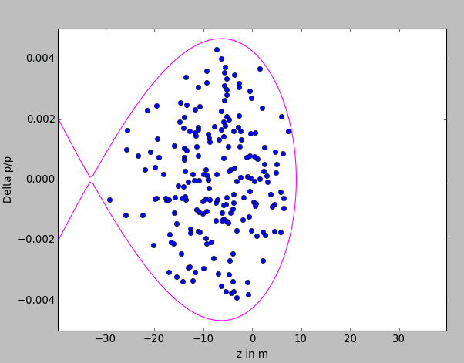
Impact of acceleration
Use the nominal bunch length
Use 1000 particles
Use Bdot=2.2 T/s
Change VRF to 200 kV
Compute the synchronous phase
Plot the phase space in in φ[degrees], ΔE [MeV]

Slide 33
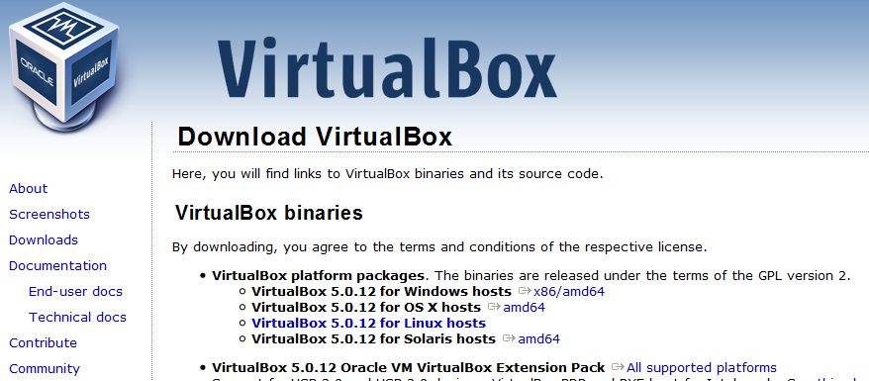
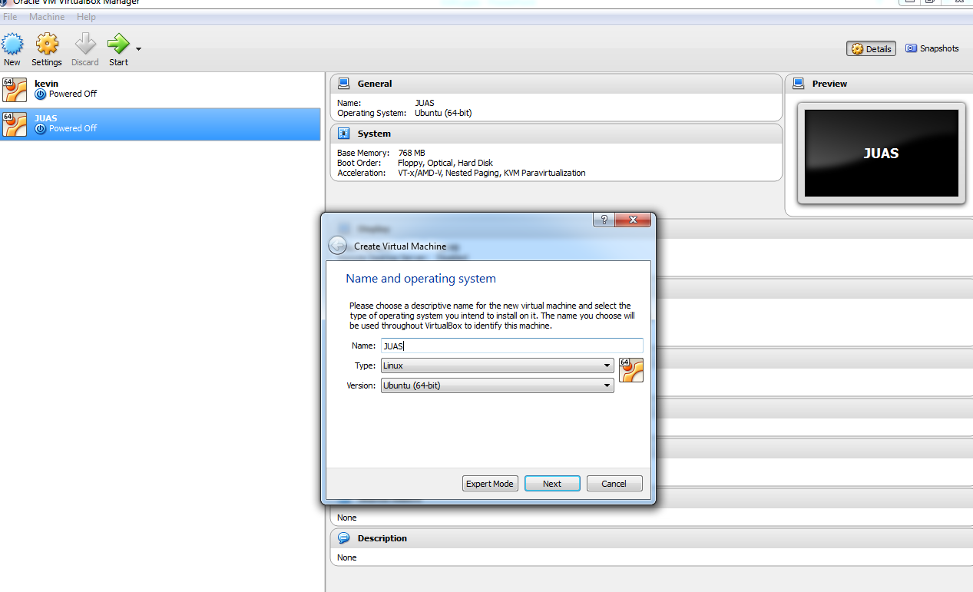
Setting up the operating system
Install a virtual box to get an Ubuntu environment
Ex: https://www.virtualbox.org/wiki/Downloads
Create a new virtual machine with Ubuntu 64-bit

Slide 34
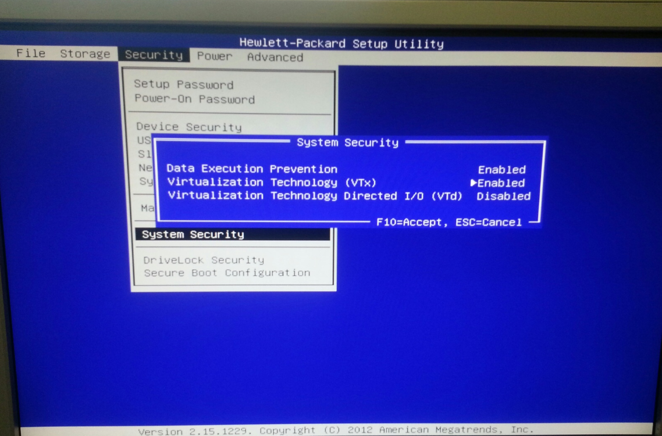
In case of a “VTx” error when launching the virtual machine, one needs to turn Virtualization Technology (VTx) on

