Slide 1
RF quadrupole for Landau damping
Alexej Grudiev
2013/10/23
ICE section meeting

Slide 2
Acknowledgements
Many thanks to Elias Metral and Alexey Burov for listening to me and explaining what actually Landau damping is !

Slide 3
Outline
Introduction
Reminder (many for myself) of what is a stability diagram for Landau damping
Parameters of the LHC octupole scheme for Landau damping
Longitudinal spread of the betatron tune induced by an RF quadrupole
Transverse spread of the synchrotron tune induced by an RF quadrupole
Parameters of Landau damping scheme based on RF quadrupole

Slide 4
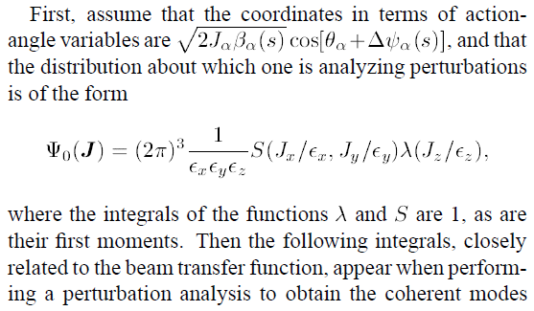
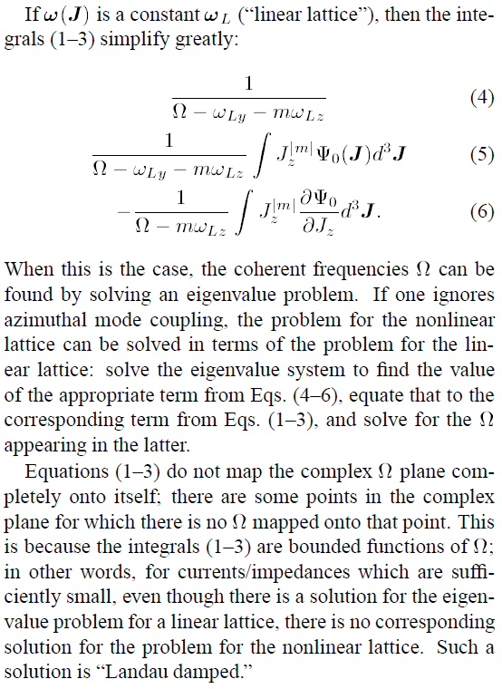
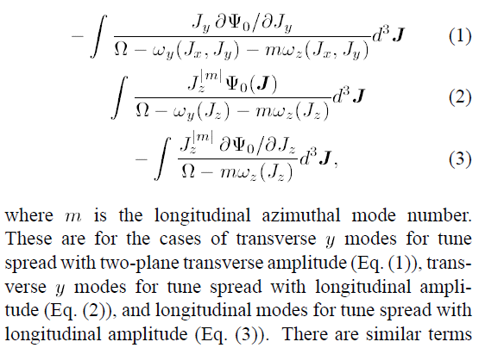
Stability diagrams for Landau damping (1) Berg, J.S.; Ruggiero, F., LHC Project Report 121, 1997

Slide 5
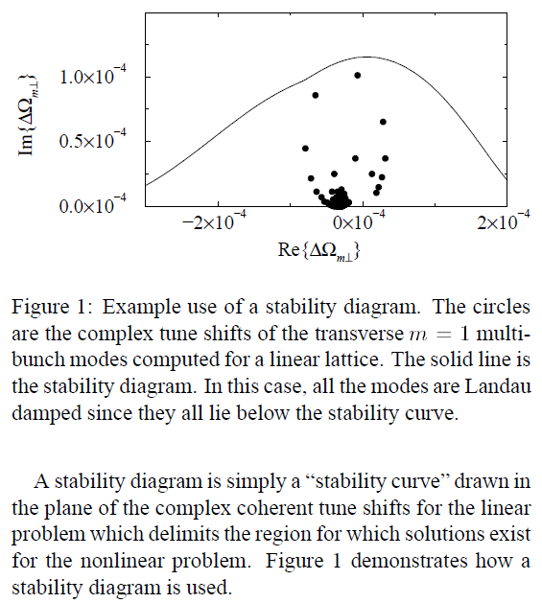
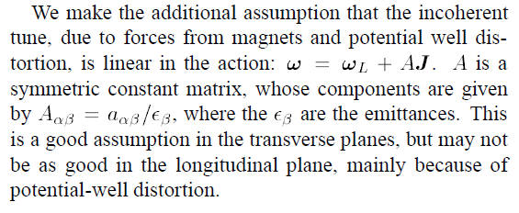
Stability diagrams for Landau damping (2) Berg, J.S.; Ruggiero, F., LHC Project Report 121, 1997
Explicit form for 3D-tune linearized in terms of action:
Octupole tune spread: $Q_{x}=Q_{0}+aJ_{x}+{bJ}_{y}$
$\left(\begin{matrix}ω_{x} \\ ω_{y} \\ ω_{z}\end{matrix}\right)$= $\left(\begin{matrix}ω_{Lx} \\ ω_{Ly} \\ ω_{Lz}\end{matrix}\right) \text{+}\left[\begin{matrix}a_{xx} & a_{xy} & a_{xz} \\ a_{yx} & a_{yy} & a_{yz} \\ a_{zx} & a_{zy} & a_{zz}\end{matrix}\right] \left(\begin{matrix}J_{x}/ε_{x} \\ J_{y}/ε_{y} \\ J_{z}/ε_{z}\end{matrix}\right)$
Potential well distortion,
actually non-linear !

Slide 6
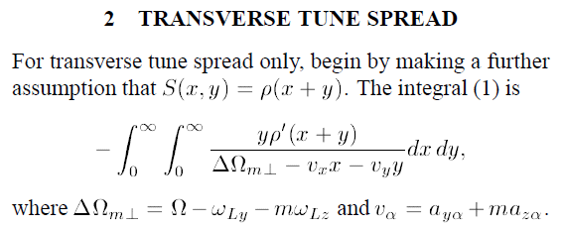
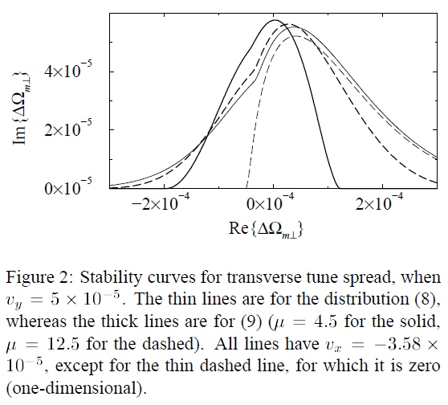
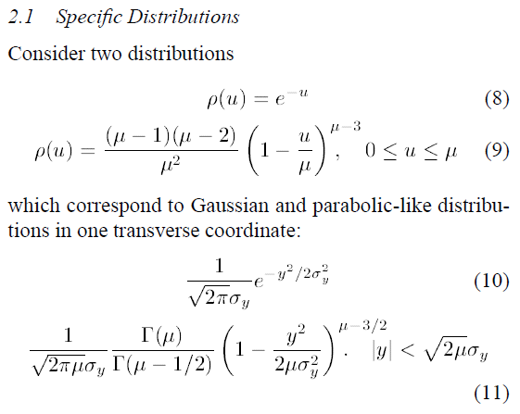
Stability diagrams for Landau damping (3) Berg, J.S.; B Ruggiero, F., LHC Project Report 121, 1997
2D tune spread is more effective if v_{y} and v_{x} have opposite signs
It is done by means of octupoles
Make transverse tune spread larger than the coherent tune shift -> Landau damping

Slide 7
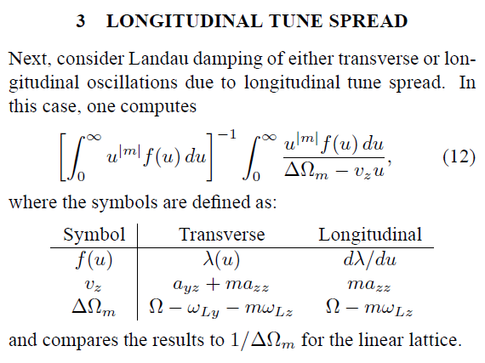
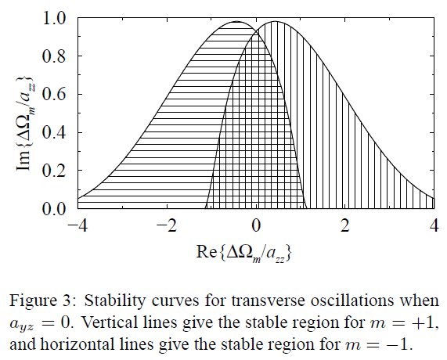
Stability diagrams for Landau damping (4) Berg, J.S.; B Ruggiero, F., LHC Project Report 121, 1997
Transverse oscillation stability curves for longitudinal tune spread are qualitatively similar to the ones for 1D transverse tune spread
Make longitudinal tune spread larger than the coherent tune shift -> Landau damping

Slide 8
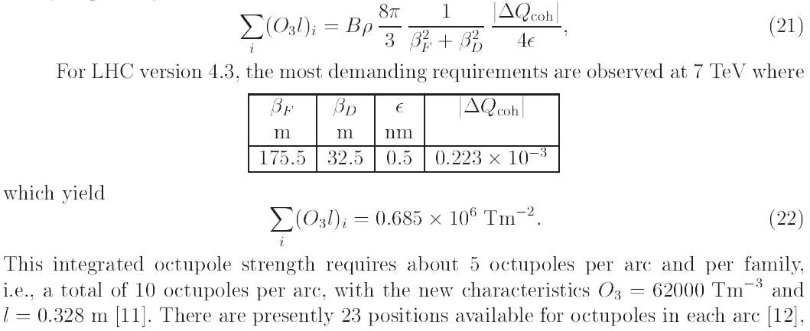
LHC octupoles for Landau damping
Landau damping, dynamic aperture and octupoles in LHC, J. Gareyte, J.P. Koutchouk and F. Ruggiero, LHC project report 91, 1997
80 octupoles of 0.328m each are nesessary to Landau damp the most unstable mode at 7 TeV with ΔQ_{coh}=0.223e-3
In LHC, 144 of these octupoles (total active length: 47 m) are installed in order to have 80% margin and avoid relying completely on 2D damping

Slide 9
What is it, an RF quadrupole ?
For given EM fields
Lorenz Force (LF):
Gives an expression for kick directly from the RF EM fields:
Which can be expanded in terms of multipoles:
And for an RF quadrupole: n=2
For ultra-relativistic particle, equating the RF and magnetic kicks, RF quadrupolar strength can be expressed in magnetic units:
Strength of RF quadruple B’L depends on RF phase:
(for bunch centre: r=ϕ=z=0)

Slide 10
Appling Panofsky-Wenzel theorem to an RF quadrupole
Accelerating Voltage:
Can also be expanded in terms of multipoles:
Panofsky-Wenzel (PW) theorem:
Gives an expression for quadrupolar RF kicks:
For ultra-relativistic particle, equating the RF and magnetic kicks, accelerating voltage quadrupolar strength can be calculated from magnetic quadrupolar strength:
Accelerating voltage of RF quadruple:
(for bunch centre r=ϕ=z=0)

Slide 11
Synhrotron frequency in the presence of an RF quadrupole
Main RF (φ_{s} = 0 at zero crossing):
RF quad voltage, if b⁽⁰⁾ is real.
The centre of the bunch is on crest for quadrupolar focusing but it is on zero crossing for quadrupolar acceleration (φ_{s2} = 0 ):
Synchrotron frequency for
Main RF + RF quad voltage:
Useful relation for stationary bucket:

Slide 12
Longitudinal spread of betatron tune and Transverse spread of synchrotron tune induced by RF quadrupole
Explicit form for 3D-tune linearized in terms of action:
Longitudinal spread of both horizontal and vertical betatron tunes is non-zero for RF quadrupole
$\left(\begin{matrix}ω_{x} \\ ω_{y} \\ ω_{z}\end{matrix}\right)$= $\left(\begin{matrix}ω_{Lx} \\ ω_{Ly} \\ ω_{Lz}\end{matrix}\right) \text{+}\left[\begin{matrix}a_{xx} & a_{xy} & a_{xz} \\ a_{yx} & a_{yy} & a_{yz} \\ a_{zx} & a_{zy} & a_{zz}\end{matrix}\right] \left(\begin{matrix}J_{x}/ε_{x} \\ J_{y}/ε_{y} \\ J_{z}/ε_{z}\end{matrix}\right)$
Both horizontal and vertical transverse spreads of synchrotron tune are non-zero for RF quadrupole
7um >> 0.5nm, for LHC 7TeV => a_{zx} << a_{xz}; a_{zy} << a_{yz} => Longitudinal spread is much more effective ↑TDR longitudinal ε_{z}(4σ) =2.5eVs and transverse normalized ε^{N}_{x,y}(1σ)=3.75um emittances are used

Slide 13
Longitudinal spread of the betatron tune
a_{yz}
a_{yz}
In the case of RF quadrupole a_{yz} is not zero. One can just substitute a_{yz} instead of ma_{zz}
Make longitudinal tune spread a_{yz} larger than the coherent tune shift (ΔΩ_{m}) -> Landau damping.
The same is true for horizontal plane. This gives the RF quadrupole strength:

Slide 14
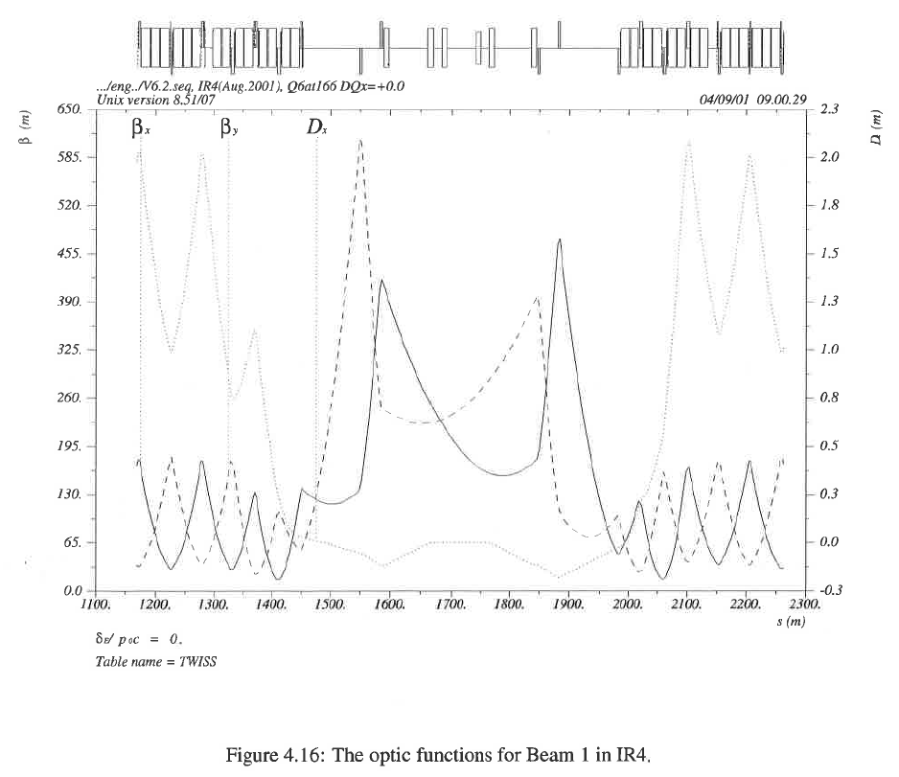
RF quadrupole in IR4
|ΔQ_{coh}|≈2e-4
β≈200m
σ_{z}=0.08m
λ=3/8m
ρ=2804m
B₀=8.33T
-----------------------
b⁽²⁾=0.33Tm/m

Slide 15
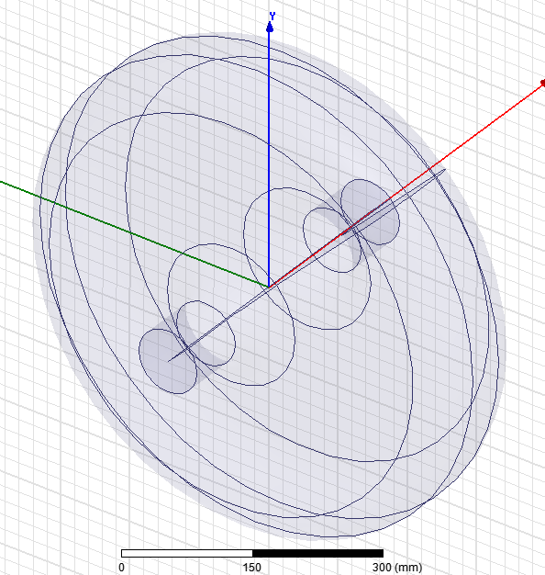
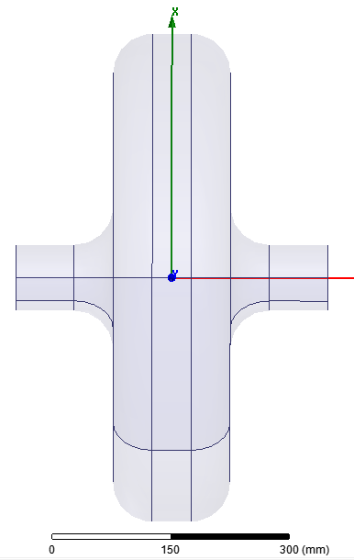
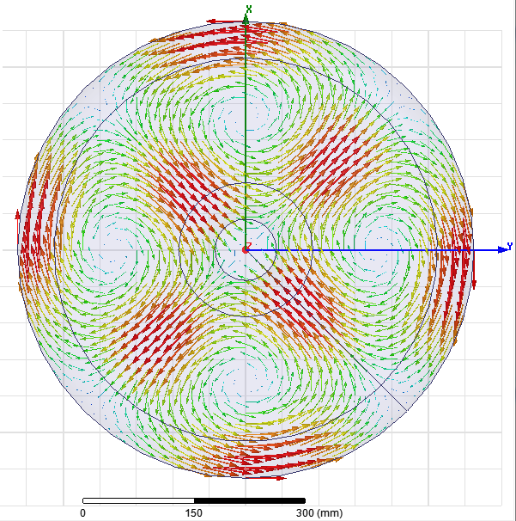
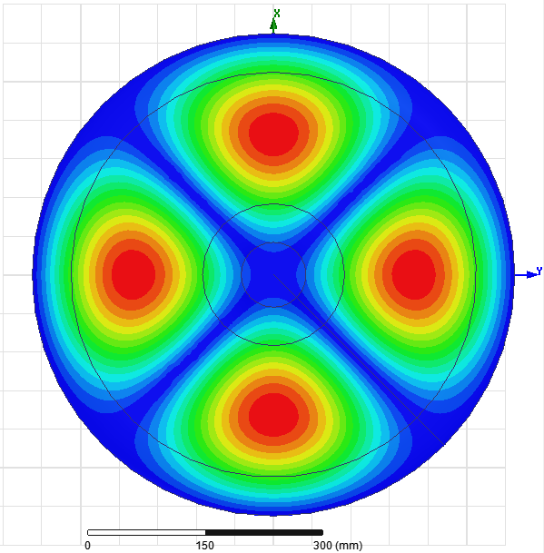
800 MHz Pillbox cavity RF quadrupole
H-field
E-field
For a SC cavity, Max(Bsurf) should nor be larger than ~100mT =>
One cavity can do:
b⁽²⁾ =0.12 [Tm/m]
-----------------------
3 cavity is enough.
1 m long section
Stored energy [J] | 1
b⁽²⁾ [Tm/m] | 0.0143
Max(Bsurf) [mT] | 12
Max(Esurf) [MV/m] | 4.6

Slide 16
Conclusion
RF quadrupole can provide longitudinal spread of betatron tune for Landau damping
A ~1 m long cryomodule with three 800 MHz superconducting pillbox cavities in IR4 can provide enough tune spread for Landau damping of a mode with ΔQ_{coh}~2e-4 at 7TeV
Maybe some tests can be done in SPS with one cavity prototype…
More work needs to be done…

